Slide 1
Bash Script Tutorial (basic)

Slide 2
Introduction:
Bash is a popular shell scripting language used in Unix-based operating systems like linux.

Slide 3
How to Write Bash Script

Slide 4
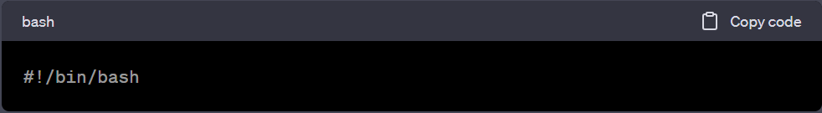
How to write bash script:
Step 1: Open a text editor Open a text editor of your choice. You can use any text editor available on your system, such as Notepad, Atom, Sublime Text, or Visual Studio Code.
Step 2: Start the script Begin your script by adding the following line at the top. This line tells the system to interpret the script using Bash.

Slide 5
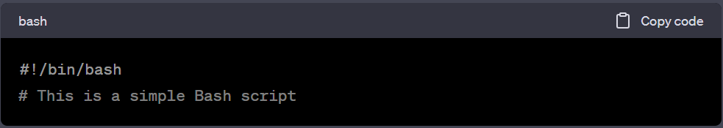
Step 3: Add a comment (optional) You can add comments to your script to provide information about its purpose or any important details. Comments are lines that are ignored by the interpreter. They start with the '#' symbol. Here's an example:

Slide 6
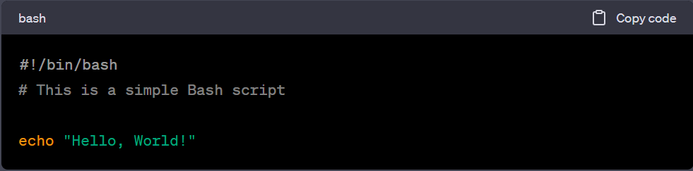
Step 4: Write your script Now you can start adding commands and instructions to your script. Here's an example that prints "Hello, World!" to the terminal:

Slide 7
Step 5 - Save the script:
- Save the file with a .sh extension.
- For example, you could save it as "hello.sh".

Slide 8
How to Execute Bash Script

Slide 9
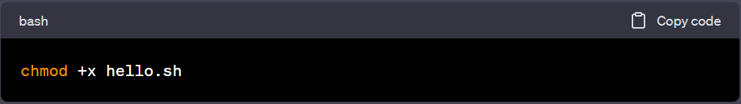
Step 1: Make the script executable In order to run the script, you need to make it executable. Open a terminal and navigate to the directory where you saved the script. Then, run the following command:
This command gives the script executable permissions.

Slide 10
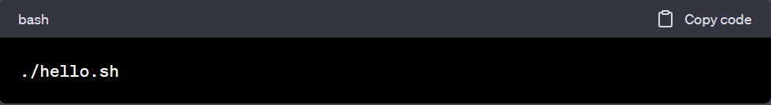
Step 2: Run the script To execute the script, simply run the following command:
You should see the output "Hello, World!" printed in the terminal.
This command gives the script executable permissions.

Slide 11
Congratulations!
You’ve learnt a basic Bash script. From now, you are ready to explore more advanced features of Bash scripting, such as variables, conditionals, loops, and functions, to create more complex scripts.

Slide 12
How to Use Variables in Bash Script

Slide 13
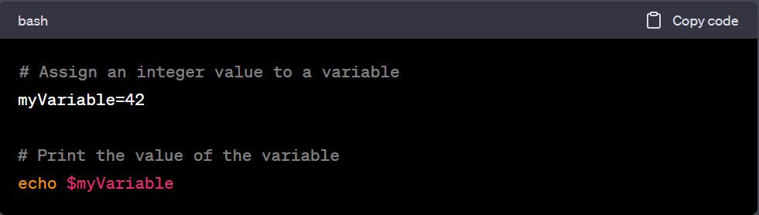
Bash allows you to store values in variables. You can assign values to variables using the '=' symbol. you can assign an integer value to a variable. Here's an example:

Slide 14
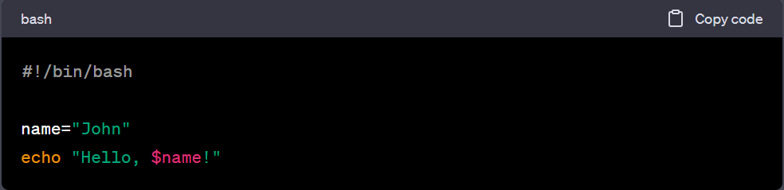
Bash allows you to store values in variables. You can assign string values to variables using the '=' symbol. Here's an example:
This command gives the script executable permissions.

Slide 15
How to Use Command Line Arguments in Bash Script

Slide 16
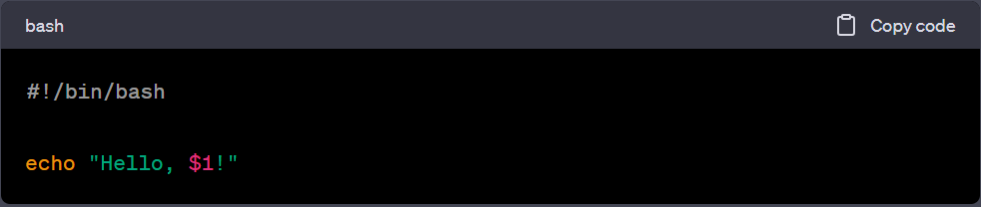
Command-line arguments: You can pass arguments to a Bash script when running it from the command line. The arguments are accessed using special variables like `$1`, `$2`, and so on. Here's an example:
If you run the script like this ./greet.sh Amin, it will output "Hello, Amin!".
This command gives the script executable permissions.

Slide 17
How to Use If Statements in Bash Script

Slide 18
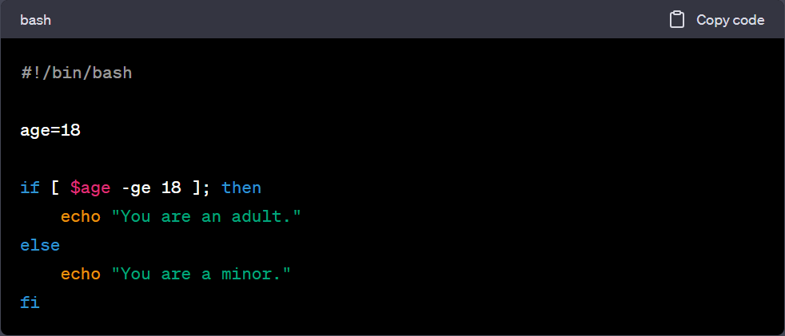
Bash supports conditional statements using the if keyword. You can check conditions and execute different blocks of code based on the result. Here's an example:
Here ge means greater or equal

Slide 19
How to Use arrays in Bash Script

Slide 20
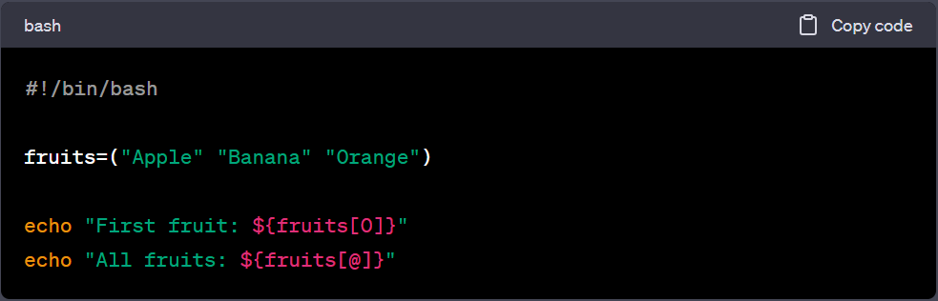
Bash allows you to work with arrays, which can store multiple values in a single variable. Here's an example:
The [@] notation is used to expand all the elements of the array.

Slide 21
How to Use Loops in Bash Script

Slide 22
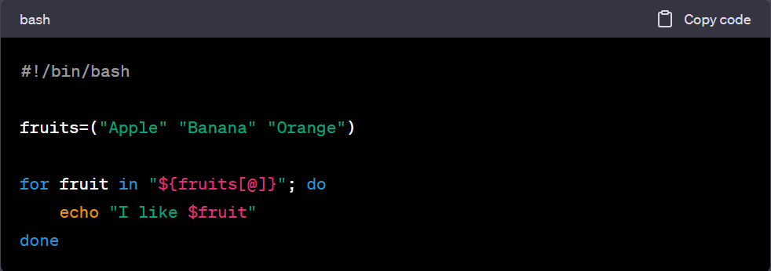
Bash provides different types of loops, such as for and while. These loops allow you to repeat a block of code multiple times. Here's an example using a for loop:
This script will output "I like Apple", "I like Banana", and "I like Orange".

Slide 23
How to write custom functions in Bash Script

Slide 24
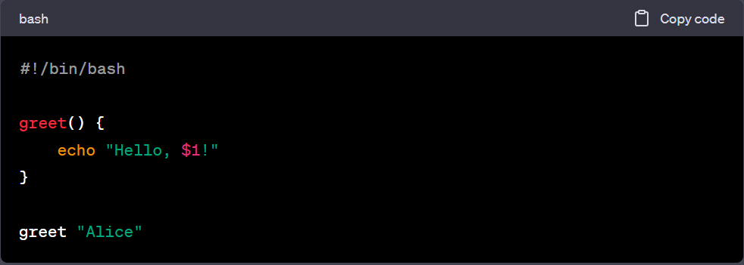
Bash allows you to define functions to organize your code and reuse it. Here's an example:
This script defines a function greet() that takes an argument and outputs a greeting. It then calls the function with the argument "Alice".

