Slide 1
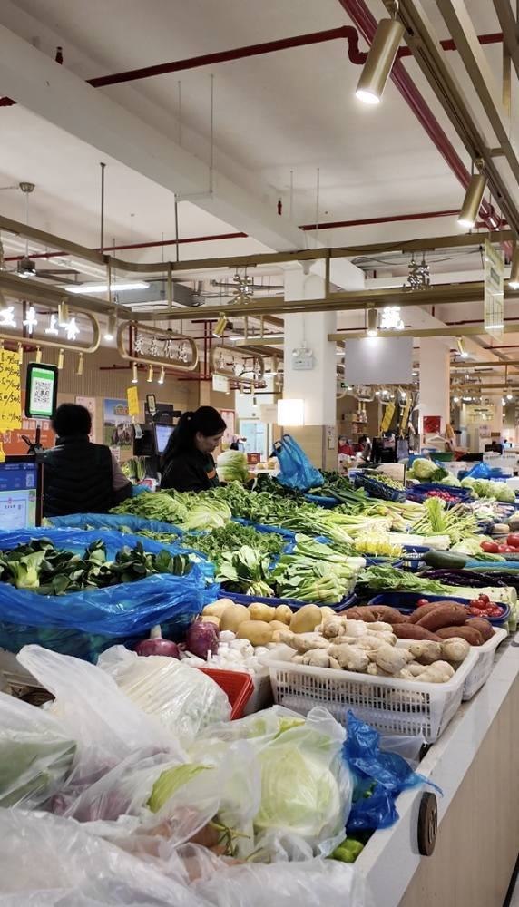
PRIVATE SHANGHAI FOOD CULTURE EXPERIENCE
私人上海美食文化体验
Xiao
Long
Bao
广元菜场
到家庭厨房
From a neighborhood xiaolongbao shop to a real wet market, then into a Shanghainese home kitchen to fold, steam, and taste soup dumplings together.
从街坊小笼馆开始，走进菜场，再到上海本地家庭厨房，亲手完成一笼小笼包。
June 13
3-4 guests
4 hours
2026 afternoon
Italian travelers
No transfer

Slide 2
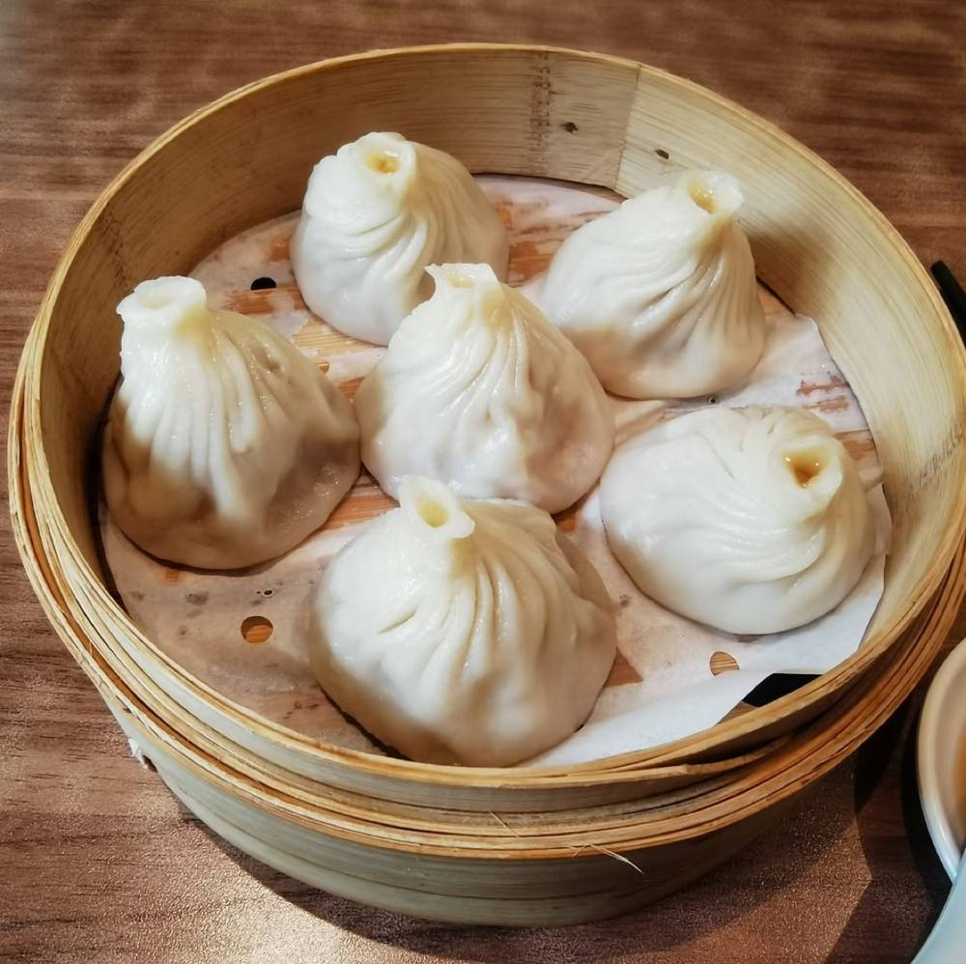
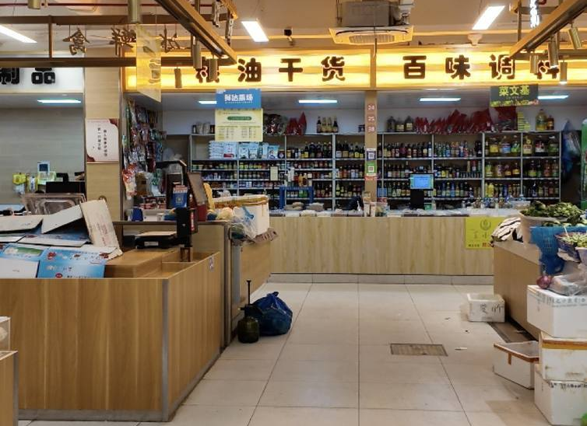
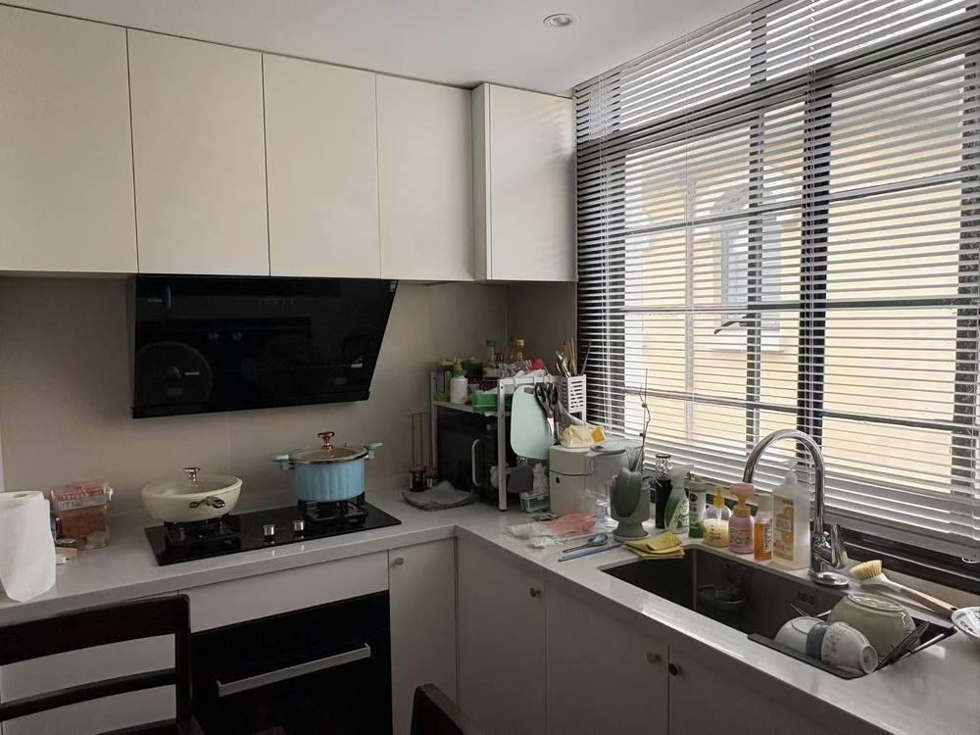
CONCEPT
先看见一只标准小笼包，再去寻找它的来处。
The experience begins with a small tasting at Fuchun Xiaolong. Guests see the finished dumpling first, then walk into Guangyuan Wet Market to decode the ingredients before cooking with a Shanghainese auntie in a private home-style kitchen.
Reference bite: thin skin, neat pleats, hot broth, and the local way to taste it.
标准参照：薄皮、褶子、汤汁和上海本地吃法。
Finished sample → market ingredients → home kitchen practice
成品参照 → 菜场原料 → 家庭厨房动手体验

Slide 3
FUCHUN XIAOLONG
富春小笼馆：先吃懂，再动手做。
14:30 Light tasting and observation
Guests observe the shape, pleats, broth, and eating rhythm of a standard local xiaolongbao before going to the market.
本地吃法 Local way to eat
Make a small opening first, sip the hot soup carefully, then enjoy the dumpling with vinegar and ginger.
先轻轻咬开一个小口，慢慢喝汤，再蘸醋和姜丝吃掉整只小笼包。

Slide 4
4-HOUR MAIN EXPERIENCE
主体验行程
Citywalk is kept separate as an optional neighborhood suggestion before or after the experience. The hosted program focuses on xiaolongbao, market life, and the private kitchen.
14:30
富春小笼馆集合与观察
Light tasting; observe skin, pleats, broth, and local eating method.
15:00
广元菜场采购
Buy pork, scallion, ginger, flour-related ingredients, and seasonal market finds.
15:45
前往私人家庭式厨房
Move to a nearby home-style kitchen opposite the market.
16:00
上海阿姨小笼包教学
Learn filling, wrapping, pleating, and steaming with hands-on guidance.
17:30
品尝与家庭餐桌交流
Taste freshly steamed xiaolongbao and talk about Shanghainese home cooking.
18:30
体验结束
The experience ends on site. Private transfer is not included.

Slide 5
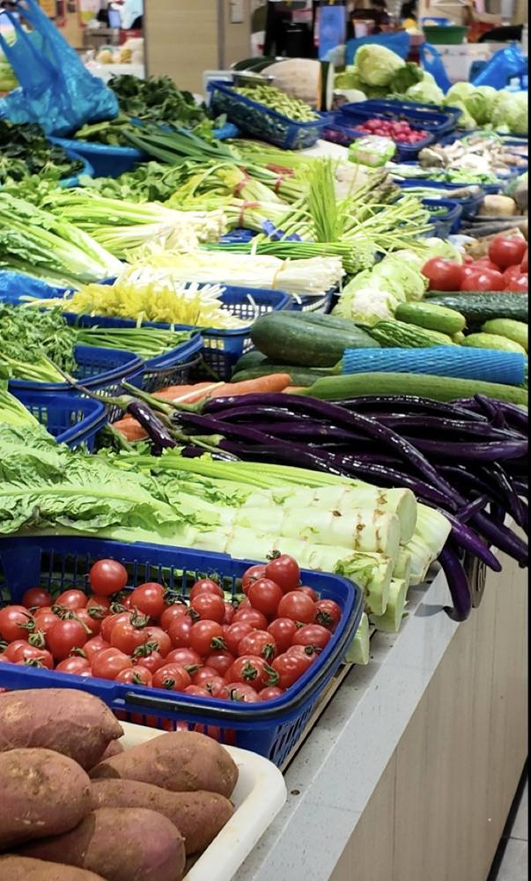
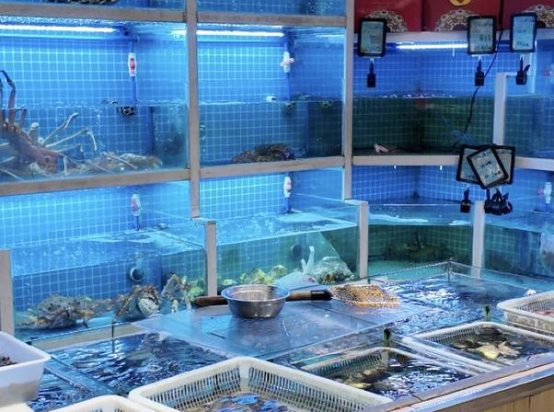
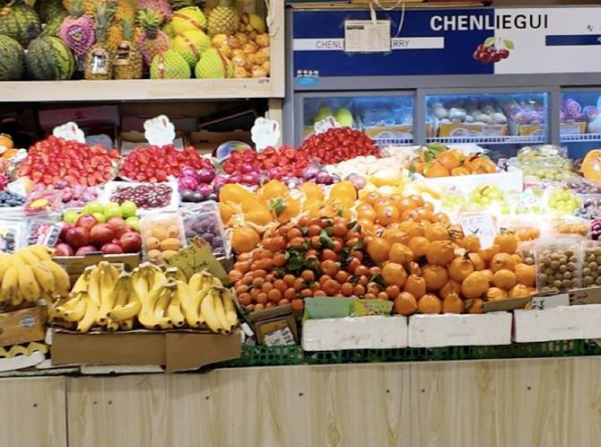
MARKET TEXTURES
菜场不是背景，是这只小笼包的第一间厨房。
The market visit is designed around the logic of the dumpling: meat for texture, aromatics for fragrance, flour for skin, and local stalls for the rhythm of everyday Shanghai.
Shopping is part of the story
It lets guests connect the final bite with texture, aroma, seasonality, and the everyday habits of a Shanghai neighborhood market.

Slide 6
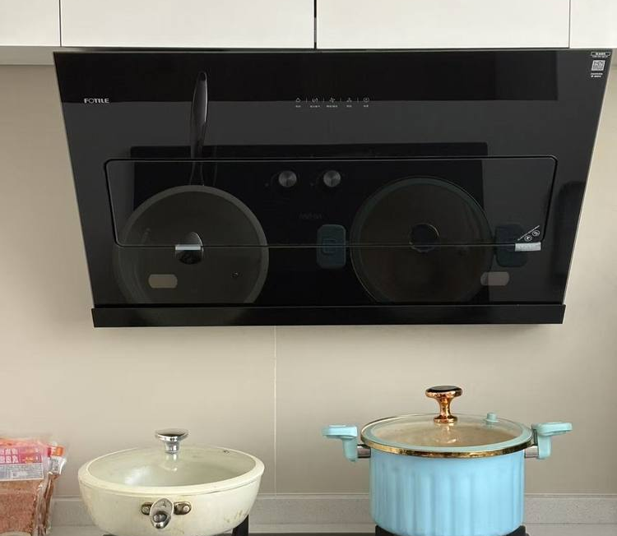
HOME-STYLE KITCHEN
在上海本地家庭厨房里，亲手完成一笼小笼包。
16:00
Auntie demo + hands-on practice
调馅、包褶、蒸制
Filling, pleating, steaming
The private setting keeps the experience warm and personal: guests can ask questions, compare their own folds, and sit down around a family table instead of a classroom counter.

Slide 7
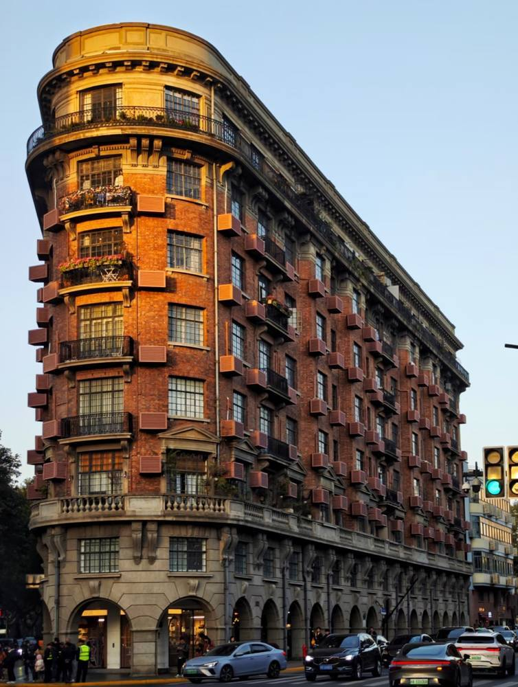


NEARBY MAP GUIDE
体验前后，可以顺路感受这一带的上海。
Optional neighborhood strolls for guests to enjoy on their own before or after the hosted experience. They are not part of the 4-hour guided program.
1.1 km | 30-45 min
武康路 Wukang Road
Less than 1.2 km long, a compact index of Shanghai's modern history with former residences, plane trees, and old villas.
1.2 km | 30-45 min
华山绿地 & 幸福路
A romantic green pocket with the pink Xi Bridge. Nearby Xingfu Road adds the meaning of happiness, vows, and a softer side of Shanghai.
1 km | 45-60 min
徐家汇 Xujiahui
A nearby commercial hub with malls, cafes, and an elevated pedestrian bridge for evening city lights. Xujiahui Park works as a daytime green alternative.

Slide 8
BUDGET
预算与包含项
A compact private experience for 3-4 guests, designed around real local access rather than a standard cooking classroom.
RMB 4,000
Total budget for 3-4 guests | 3-4 位客人总预算
✓
Fuchun xiaolongbao light tasting | 富春小笼少量品尝
✓
Guangyuan Wet Market ingredient purchase | 广元菜场食材采购
✓
Private home-style kitchen access | 私人家庭式厨房空间
✓
Shanghainese auntie cooking guidance | 上海阿姨手把手教学
✓
Bilingual guiding, planning, and on-site hosting | 中英双语陪同、策划与现场执行

Slide 9
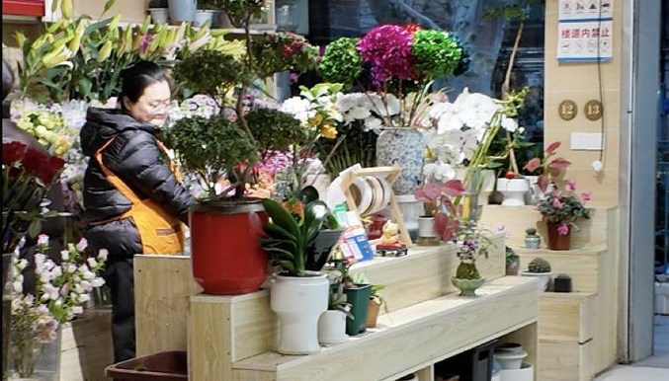
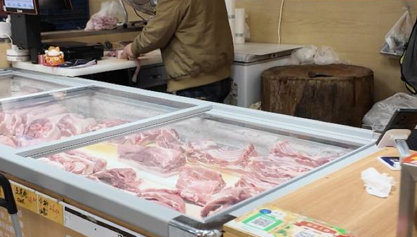
PRACTICAL NOTES
天气、排队与确认事项
Shanghai in mid-June can be warm and rainy. The experience keeps walking short and uses indoor spaces as the anchor.
Fuchun crowd
If Fuchun is crowded, keep the tasting light, use takeaway if needed, and move quickly into the market section.
Rain or heat
If it rains or feels too hot, optional neighborhood walking is reduced. The main experience remains Fuchun, market, kitchen, and tasting.
Before final confirmation
Verify the Fuchun branch, Guangyuan market afternoon ingredient condition, and auntie/kitchen availability for June 13.

Slide 10
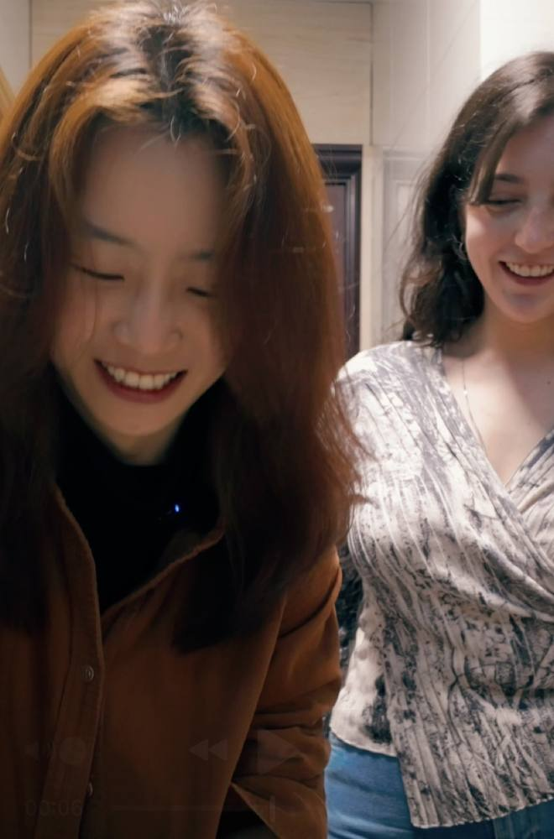
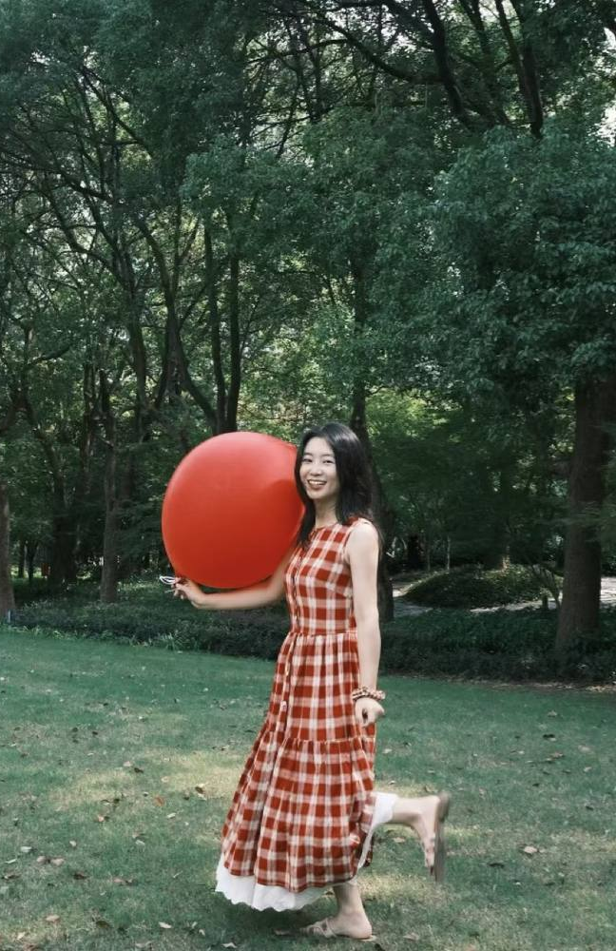
HOSTED BY LU
把上海真正生活着的一面，带给第一次来到中国的客人。
Lu has lived in Shanghai for 10 years. With a background in brand marketing and years of vlogging, she knows the city's main streets, side lanes, markets, riversides, and everyday food scenes.
Many travelers' first idea of Chinese food comes from Chinese restaurants in their own hometowns. Once they arrive in China, Lu hopes to offer something more local and specific: the way people actually shop, cook, eat, and talk around a table.
常驻上海 10 年，Lu 熟悉上海的大街小巷，也擅长把本地美食和文化特色转译给海外游客。相比只去网红景点，她更希望让客人进入真实的本地生活。
Food first, then family kitchens, neighborhood markets, and the small cultural details that make a city feel personal.

Slide 11
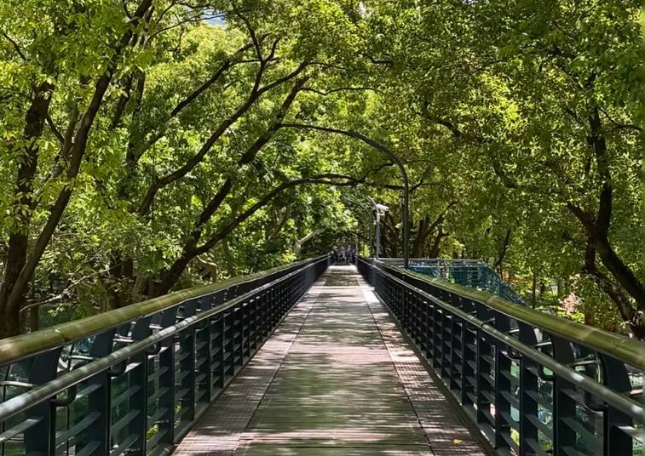
LINKS
视频与地图参考
Clickable references for guests or the travel planner.
Private Shanghai Food Culture Experience Map Guide
Gaode / Amap route collection
苏州河沿岸 citywalk 体验
Watch on Xiaohongshu
和法国朋友一起逛菜市场包馄饨
Watch on Xiaohongshu
Guangyuan Market × Fuchun Xiaolong × Shanghainese Home Kitchen

