Slide 1
AUTOPPT
Renaissance Art
How technique, patronage, and humanism reshaped visual culture
PowerPoint-native output
Layout-aware slide planning
Template and remix ready

Slide 2

Editorial opening slide
A poster-like opening works better than a dense survey slide

Slide 3
“
Perspective became a way of thinking, not just a way of drawing.
— AutoPPT Sample Desk, Renaissance Art Notes

Slide 4
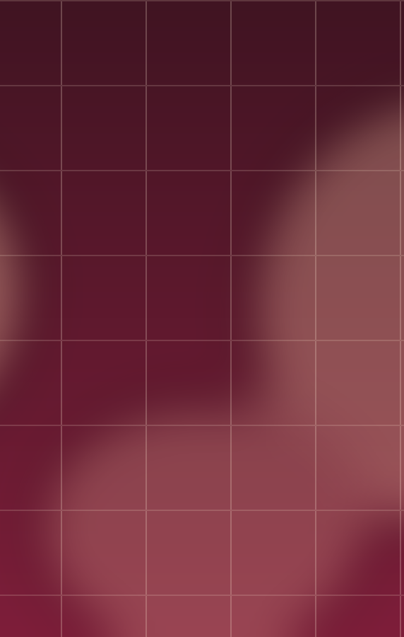
Why it still feels modern
Space became persuasive.
Bodies gained gravity.
Viewers were given a position.

Slide 5

Gallery wall slide
A full-image page keeps pacing and atmosphere intact

Slide 6
Early vs High Renaissance
Early Renaissance
High Renaissance
Spatial experiments
Measured emotion
Technique consolidating
Balanced compositions
Integrated anatomy
Ideal beauty and authority

Slide 7
How to read a painting
Formal clues
Context clues
Perspective and composition
Light and texture
Gesture and proportion
Patron identity
Religious or civic use
Classical references

Slide 8
References
https://www.metmuseum.org/toah/hd/itar/hd_itar.htm
https://www.uffizi.it/en/artworks/birth-of-venus

