Slide 1
Unit 5 LASSO Regularization and Feature Selection
EE-uy 4563/EL-GY 9143: Introduction to machine learning
Prof. Sundeep rangan (With modification by Yao Wang)

Slide 2
Learning Objectives
Describe model selection and identify when it may be needed
Mathematically describe linear regression with regularization
Select regularizers to impose constraints
Compute an L1-regularized estimate (LASSO) using sklearn tools
Compute the optimal regularization level using cross validation
Interpret results from a LASSO path
Set regularizer based on a probabilistic prior
Perform other feature selection methods

Slide 3
Outline
Motivating Example: Feature selection in predicting housing prices
Model selection and regularization
Housing prices prediction in python
Probabilistic interpretation
Other model selection examples
Other model selection methods
In-Class Exercise: Audio Pitch Detection

Slide 4
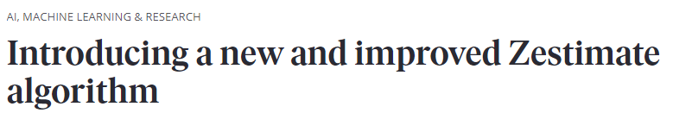
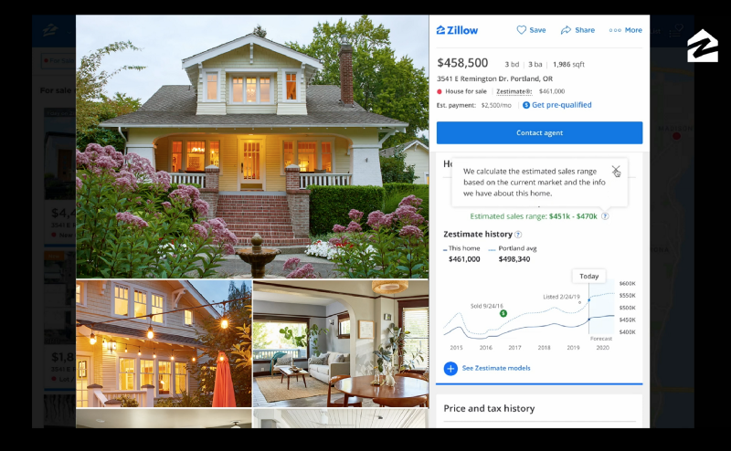



Predicting Housing Prices
Many services now predict house prices
Data science enters real estate!
Many possible variables:
Square meters
Condition
Zip code
Education quality
…
What variables really determine the price?
https://www.zillow.com/tech/introducing-a-new-and-improved-zestimate-algorithm/

Slide 5
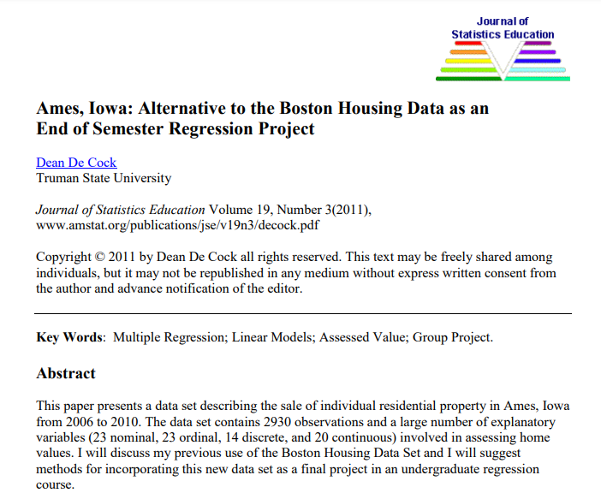
Ames, Iowa Dataset
Ames, Iowa Dataset
Sales from 2006 to 2010
From Dean De Cock
Alternative to Boston Housing dataset
Many more variables to explore
Approximately 81 variables
2930 samples

Slide 6
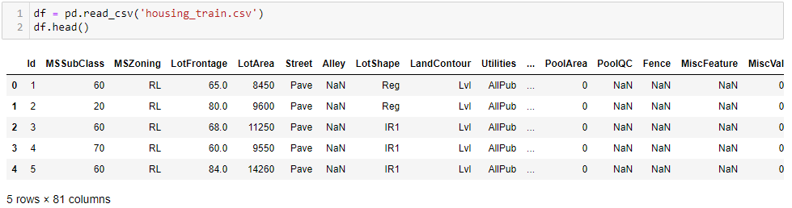
Loading the Dataset
Issues:
Many different types of data: Discrete and continuous
Missing values (NaN)

Slide 7
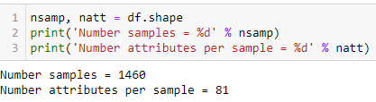
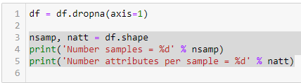
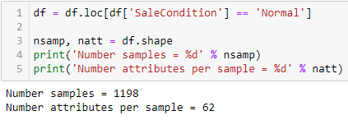
Data Cleaning
Original data
Remove columns with NaN values
Could use more sophisticated methods
Keep only normal sales
Recommended in De Cock paper
Makes fitting much easier

Slide 8
Categorical Variables
Data has many categorical variables
Need to code the categorical variables to numerical values
Real valued
Categorical

Slide 9
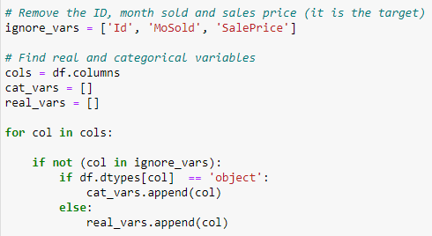
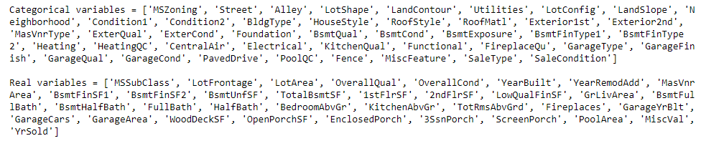
Splitting the Variables
First, split the variables into categorical and real

Slide 10
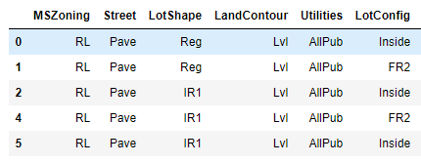
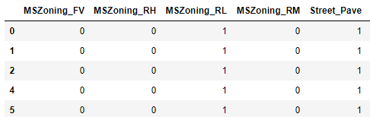
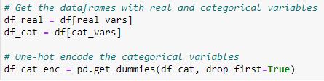
One Hot Coding
Original
One Hot coded
Use pandas get_dummies
Replaces categorical variables with one-hot coded values
Ex: MSZoning
Becomes MSZoning_FV, MSZoning_RH, …

Slide 11

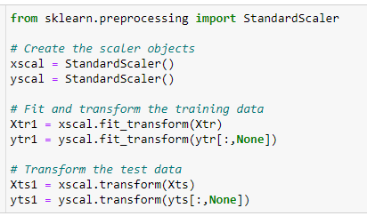
Scaling Data
Split data into training and test
Scale data
Remove mean and variance
Needed to compare coefficients
Ensures that all variables have same range
Note: The scaling transform is
Fit on the training data
Performed on training and test

Slide 12
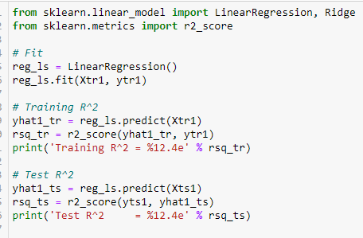

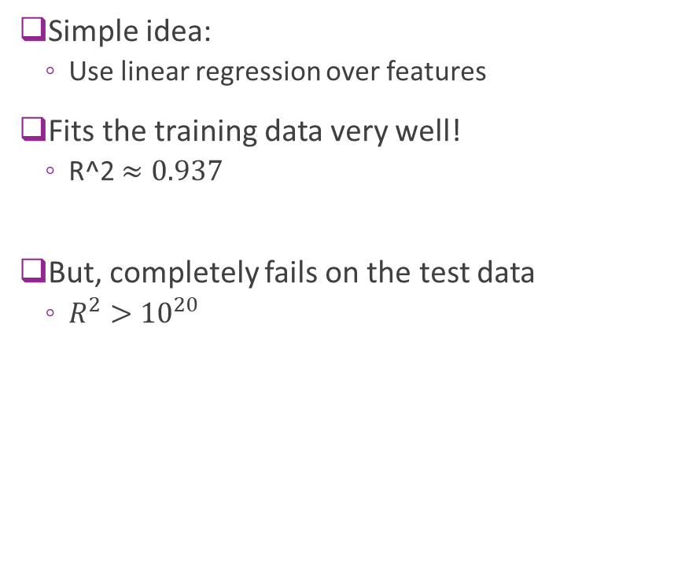
First Try: Linear Regression
Simple idea:
Use linear regression over features
Fits the training data very well!
R^2 $≈0.937$
But, completely fails on the test data
$R^{2}>{10}^{20}$

Slide 13

Conditioning
What went wrong?
Recall LS solution is: $\hat{β}={\left(A^{T}A\right)}^{−1}A^{T}y$
Matrix $A^{T}A$ may be ill-conditioned
Eigenvalues close to zero
Inverse blows up
With ill-conditioned data:
Training error is fine
But the test error blows up
Overfits data

Slide 14


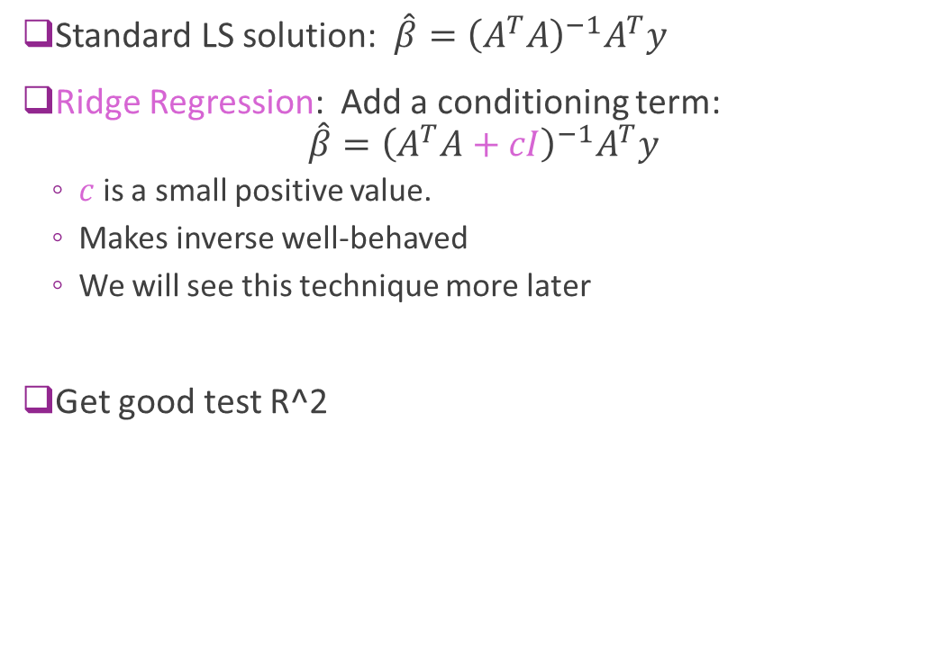
Improving Conditioning via Ridge Regression
Standard LS solution: $\hat{β}={\left(A^{T}A\right)}^{−1}A^{T}y$
Ridge Regression: Add a conditioning term: $\hat{β}={\left(A^{T}A+cI\right)}^{−1}A^{T}y$
$c$ is a small positive value.
Makes inverse well-behaved
We will see this technique more later
Get good test R^2

Slide 15
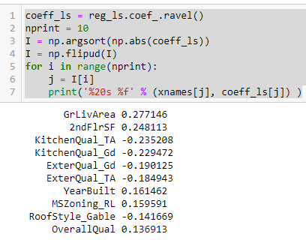
What Components Matter?
Simple idea: Look at large coefficients
We see variables that we may expect:
Square footage
Quality
Zoning
But there are some issues
Some variables seem highly correlated
Ex: GrLivArea and 2ndFlrSF
KitchenQual and OverallQual
Do we need both?

Slide 16
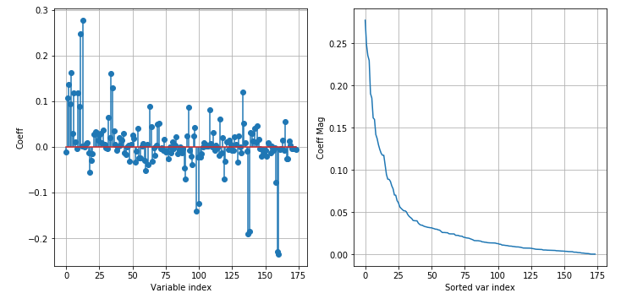
What Components Do Not Matter?
All coefficients are far from zero
Very few coefficients that can be removed
Does this mean all variables matter?
Model or feature selection problem:
How do we find the variables that matter?

Slide 17
Outline
Motivating Example: Feature selection in predicting housing prices
Model selection and regularization
Housing prices prediction in python
Probabilistic interpretation
Other model selection examples
Other model selection methods
In-Class Exercise: Audio Pitch Detection

Slide 18
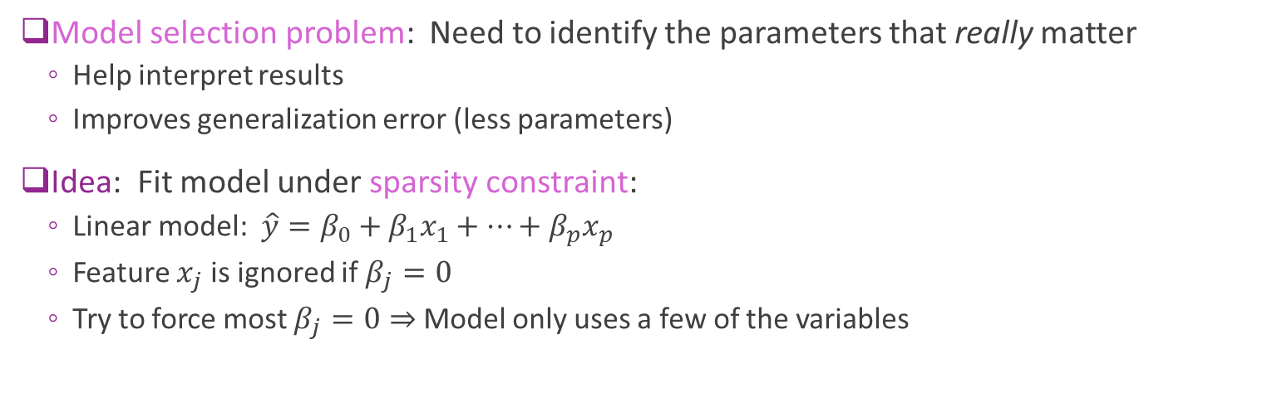
Model Selection via Sparsity
174 variables after one-hot coding
Model selection problem: Need to identify the parameters that really matter
Help interpret results
Improves generalization error (less parameters)
Idea: Fit model under sparsity constraint:
Linear model: $\hat{y}=β_{0}+β_{1}x_{1}+⋯+β_{p}x_{p}$
Feature $x_{j}$ is ignored if $β_{j}=0$
Try to force most $β_{j}=0⇒$ Model only uses a few of the variables

Slide 19
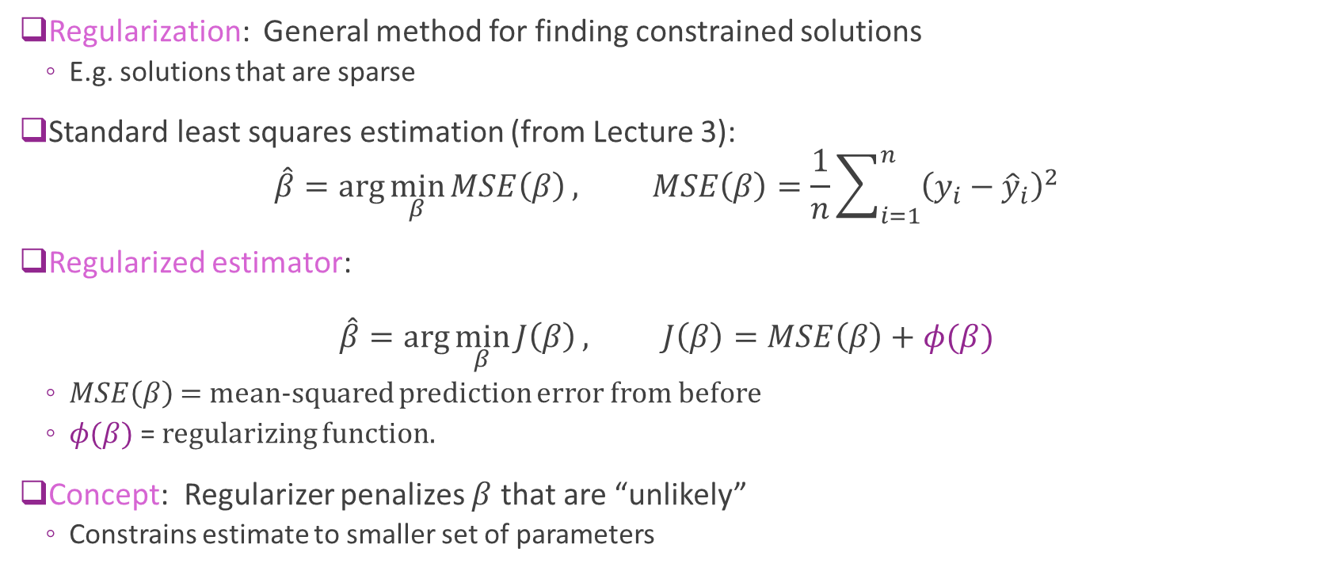
Regularized LS Estimation
Regularization: General method for finding constrained solutions
E.g. solutions that are sparse
Standard least squares estimation (from Lecture 3): $\hat{β}=\arg{\min_{β}{MSE\left(β\right)}}, MSE\left(β\right)=\frac{1}{n}\sum_{i=1}^{n}{{\left(y_{i}−{\hat{y}}_{i}\right)}^{2}}$
Regularized estimator: $\hat{β}=\arg{\min_{β}{J\left(β\right)}}, J\left(β\right)=MSE\left(β\right)+φ(β)$
$MSE\left(β\right)$ = mean-squared prediction error from before
$φ(β)$ = regularizing function.
Concept: Regularizer penalizes $β$ that are “unlikely”
Constrains estimate to smaller set of parameters

Slide 20
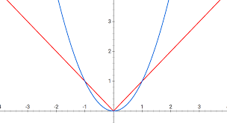
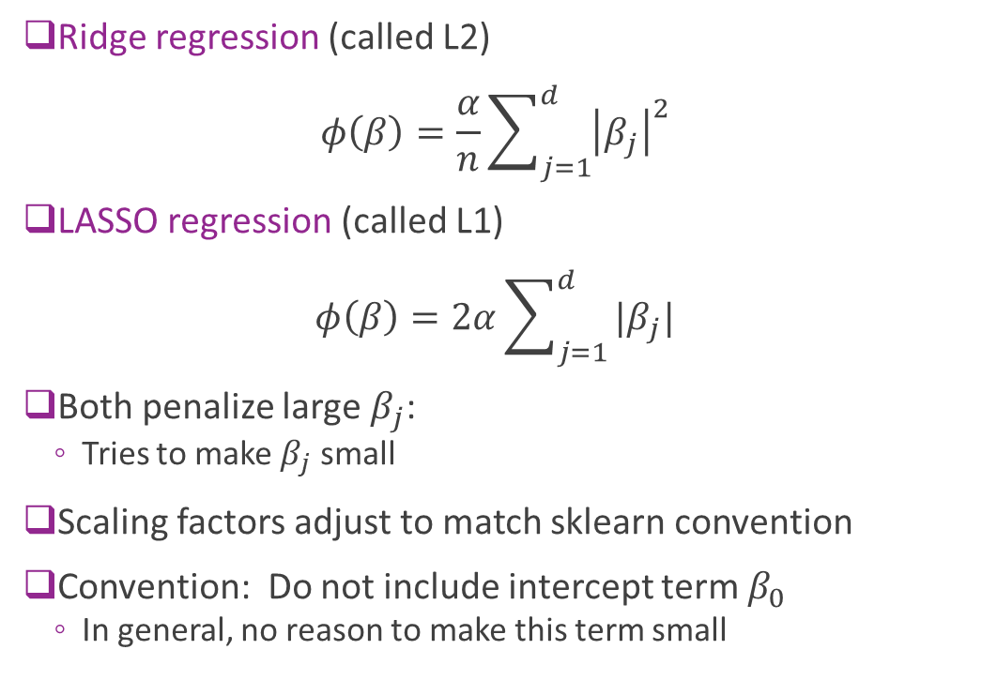



Two Common Regularizers
Ridge regression (called L2) $φ\left(β\right)=\frac{α}{n}\sum_{j=1}^{d}{{\left|β_{j}\right|}^{2}}$
LASSO regression (called L1) $φ\left(β\right)=2α\sum_{j=1}^{d}{|β_{j}|}$
Both penalize large $β_{j}$:
Tries to make $β_{j}$ small
Scaling factors adjust to match sklearn convention
Convention: Do not include intercept term $β_{0}$
In general, no reason to make this term small
$$\left|β_{j}\right|$$
$${\left|β_{j}\right|}^{2}$$
$$β_{j}$$

Slide 21
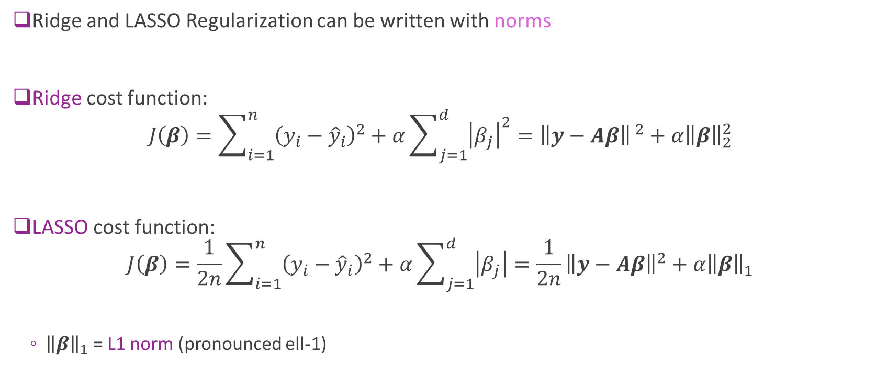
L1 and L2 Norm
Ridge and LASSO Regularization can be written with norms
Ridge cost function: $J\left(β\right)=\sum_{i=1}^{n}{{\left(y_{i}−{\hat{y}}_{i}\right)}^{2}}+α\sum_{j=1}^{d}{{\left|β_{j}\right|}^{2}}={\left\|y−Aβ\right\|}^{ 2}+α{\left\|β\right\|}_{2}^{2}$
LASSO cost function: $J\left(β\right)=\frac{1}{2n}\sum_{i=1}^{n}{{\left(y_{i}−{\hat{y}}_{i}\right)}^{2}}+α\sum_{j=1}^{d}{\left|β_{j}\right|}=\frac{1}{2n}{\left\|y−Aβ\right\|}^{2}+α{\left\|β\right\|}_{1}$
${\left\|β\right\|}_{1}$ = L1 norm (pronounced ell-1)

Slide 22
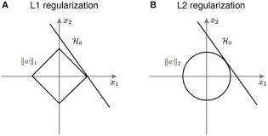
Ridge vs LASSO
L2 tends to lead to many “small” coefficients
But solutions are not exactly zero
Not ideal for feature selection
L1 tends to lead to more sparse solutions
Several coefficients are zero

Slide 23
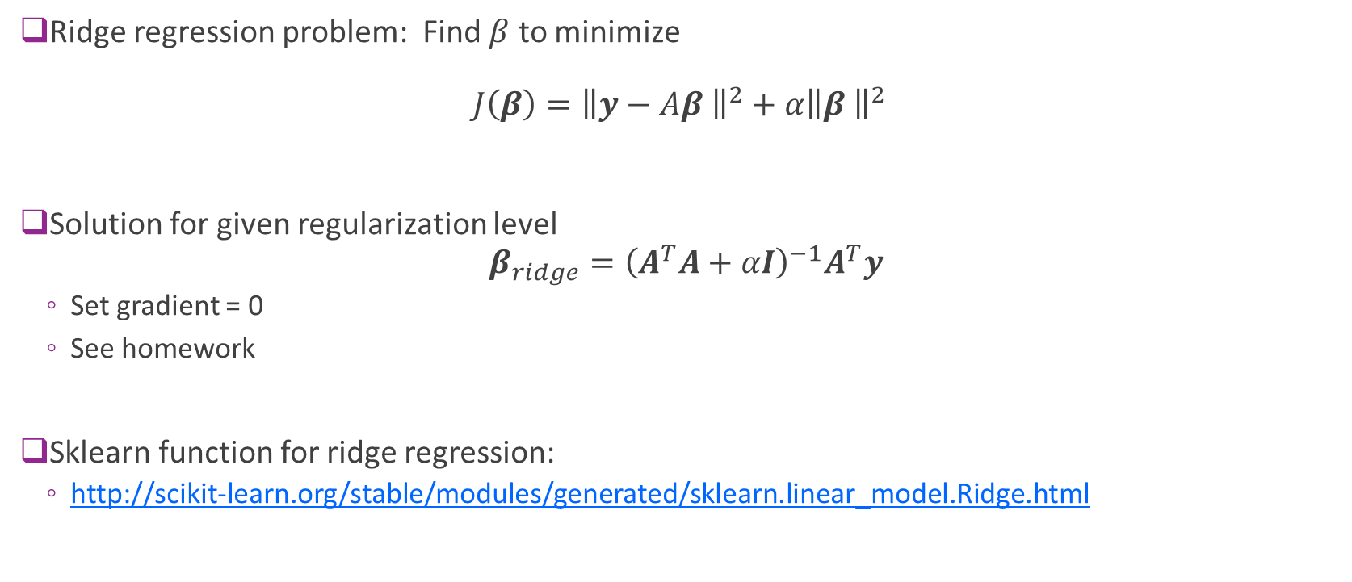
Solving Ridge Regression
Ridge regression problem: Find $β$ to minimize $J\left(β\right)={\left\|y−Aβ \right\|}^{2}+α{\left\|β \right\|}^{2}$
Solution for given regularization level $β_{ridge}={\left(A^{T}A+αI\right)}^{−1}A^{T}y$
Set gradient = 0
See homework
Sklearn function for ridge regression:
http://scikit-learn.org/stable/modules/generated/sklearn.linear_model.Ridge.html

Slide 24
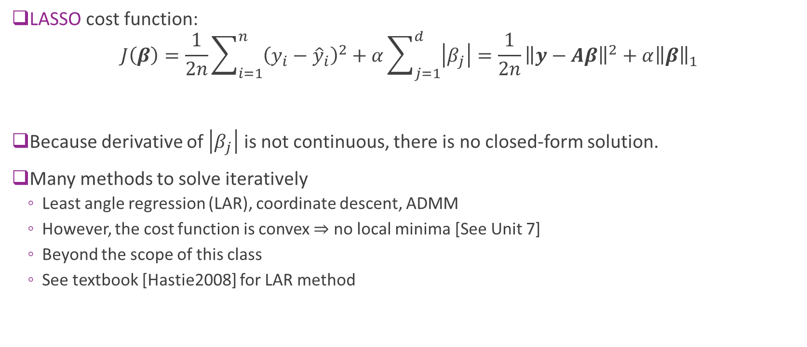
Solving LASSO Regression
LASSO cost function:
$$J\left(β\right)=\frac{1}{2n}\sum_{i=1}^{n}{{\left(y_{i}−{\hat{y}}_{i}\right)}^{2}}+α\sum_{j=1}^{d}{\left|β_{j}\right|}=\frac{1}{2n}{\left\|y−Aβ\right\|}^{2}+α{\left\|β\right\|}_{1}$$
Because derivative of $\left|β_{j}\right|$ is not continuous, there is no closed-form solution.
Many methods to solve iteratively
Least angle regression (LAR), coordinate descent, ADMM
However, the cost function is convex $⇒$ no local minima [See Unit 7]
Beyond the scope of this class
See textbook [Hastie2008] for LAR method

Slide 25
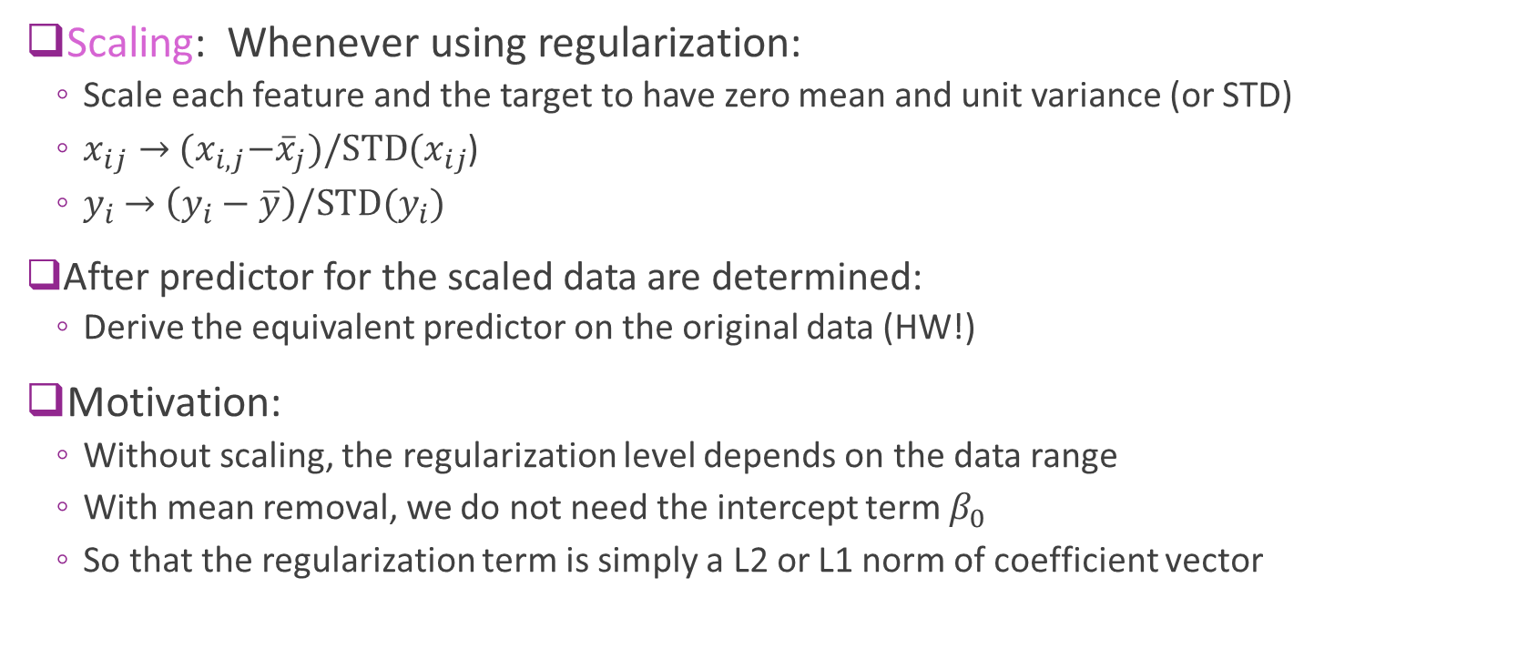
Data Scaling
Scaling: Whenever using regularization:
Scale each feature and the target to have zero mean and unit variance (or STD)
$x_{ij}→$ ${(x}_{i,j}−{\overline{x}}_{j})/STD(x_{ij}$)
$y_{i}$ $→$ ${\left(y_{i}−\overline{y}\right)/STD(y}_{i})$
After predictor for the scaled data are determined:
Derive the equivalent predictor on the original data (HW!)
Motivation:
Without scaling, the regularization level depends on the data range
With mean removal, we do not need the intercept term $β_{0}$
So that the regularization term is simply a L2 or L1 norm of coefficient vector

Slide 26
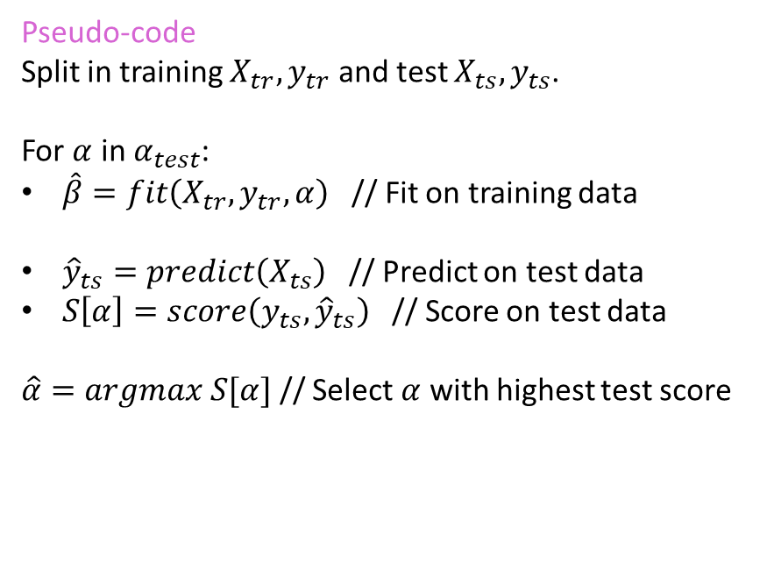
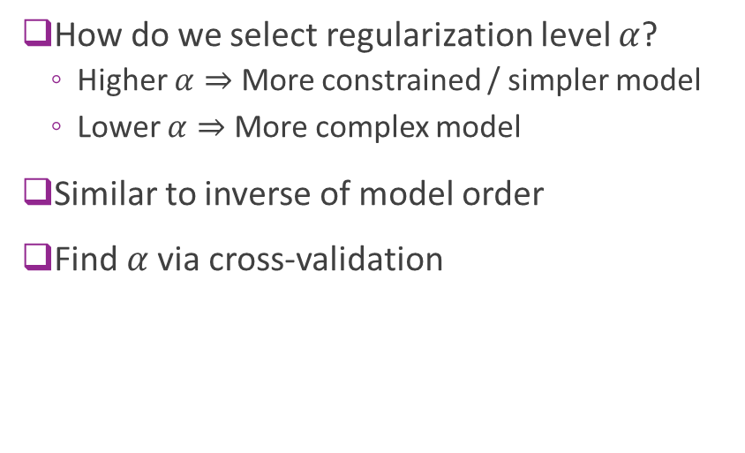
Selecting the Regularization Level
How do we select regularization level $α$?
Higher $α⇒$ More constrained / simpler model
Lower $α⇒$ More complex model
Similar to inverse of model order
Find $α$via cross-validation
Pseudo-code
Split in training $X_{tr},y_{tr}$ and test $X_{ts},y_{ts}$.
For $α$ in $α_{test}$:
$\hat{β}=fit\left(X_{tr},y_{tr},α\right)$ // Fit on training data
${\hat{y}}_{ts}=predict\left(X_{ts}\right)$ // Predict on test data
$S\left[α\right]=score\left(y_{ts},{\hat{y}}_{ts}\right)$ // Score on test data
$\hat{α}=argmax S[α]$ // Select $α$ with highest test score

Slide 27
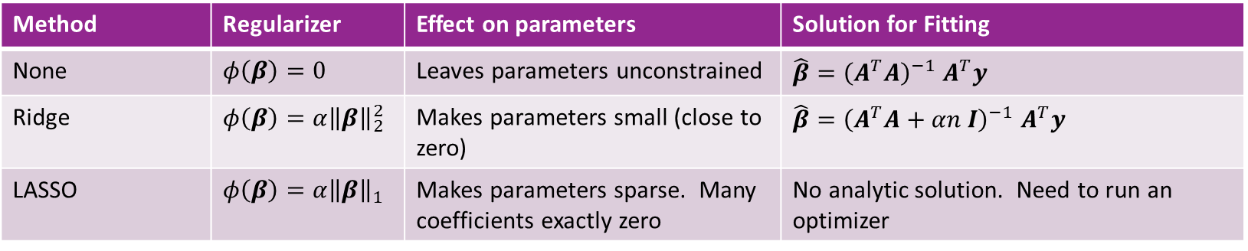
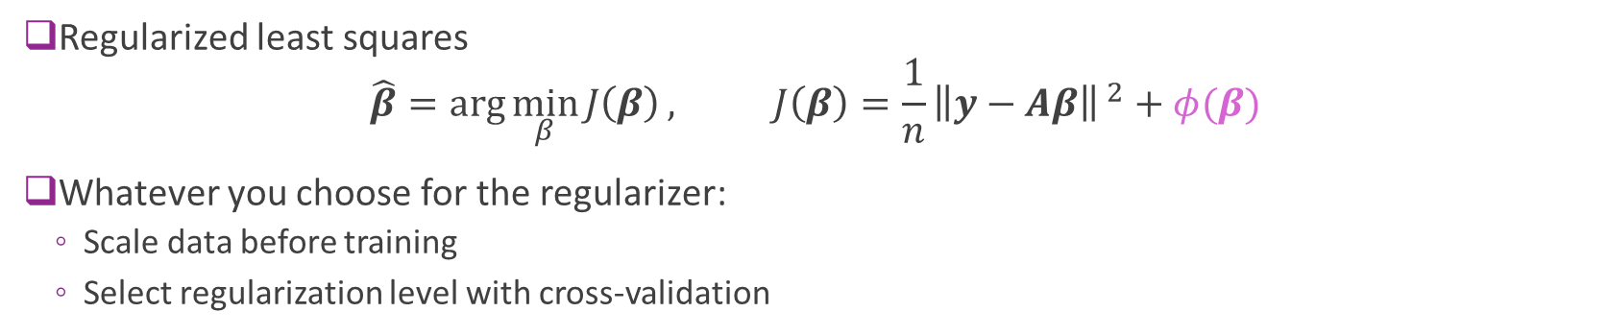
Summary
Method | Regularizer | Effect on parameters | Solution for Fitting
None | $φ\left(β\right)=0$ | Leaves parameters unconstrained | $\hat{β}={\left(A^{T}A\right)}^{−1}$ $A^{T}y$
Ridge | $φ\left(β\right)=α{\left\|β\right\|}_{2}^{2}$ | Makes parameters small (close to zero) | $\hat{β}={\left(A^{T}A+αn I\right)}^{−1}$ $A^{T}y$
LASSO | $φ\left(β\right)=α{\left\|β\right\|}_{1}$ | Makes parameters sparse. Many coefficients exactly zero | No analytic solution. Need to run an optimizer
Regularized least squares $\hat{β}=\arg{\min_{β}{J\left(β\right)}}, J\left(β\right)=\frac{1}{n}{\left\|y−Aβ\right\|}^{ 2}+φ(β)$
Whatever you choose for the regularizer:
Scale data before training
Select regularization level with cross-validation

Slide 28
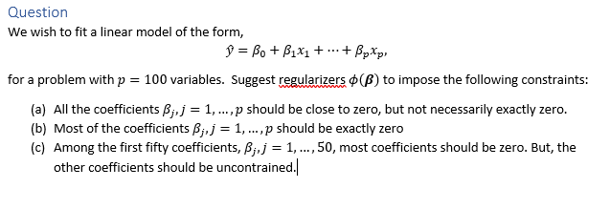
In-Class Exercise

Slide 29
Outline
Motivating Example: Feature selection in predicting housing prices
Model selection and regularization
Housing prices prediction in python
Probabilistic interpretation
Other model selection examples
Other model selection methods
In-Class Exercise: Audio Pitch Detection

Slide 30
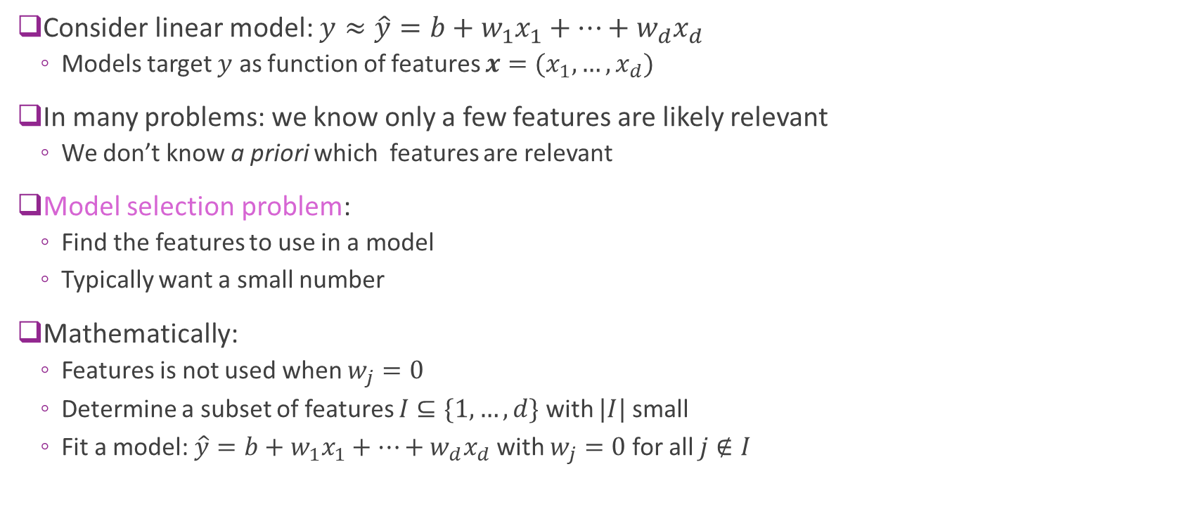
Model Selection
Consider linear model: $y≈\hat{y}=b+w_{1}x_{1}+⋯+w_{d}x_{d}$
Models target $y$ as function of features $x=(x_{1},…,x_{d})$
In many problems: we know only a few features are likely relevant
We don’t know a priori which features are relevant
Model selection problem:
Find the features to use in a model
Typically want a small number
Mathematically:
Features is not used when $w_{j}=0$
Determine a subset of features $I⊆\{1,…,d\}$ with $|I|$ small
Fit a model: $\hat{y}=b+w_{1}x_{1}+⋯+w_{d}x_{d}$ with $w_{j}=0$ for all $j∉I$

Slide 31
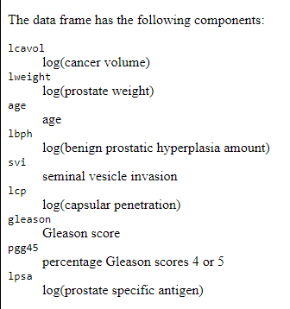

Example 1: Medical Modeling
Ex: Prostate specific antigen (PSA) test
Many years ago, PSA level was being consider for cancer screening
Question: Is a PSA test good for cancer?
Obtain features of prostate and correlate with PSA level
Determine if cancer volume is a relevant feature
See demo 1 on github site
Also in text

Slide 32

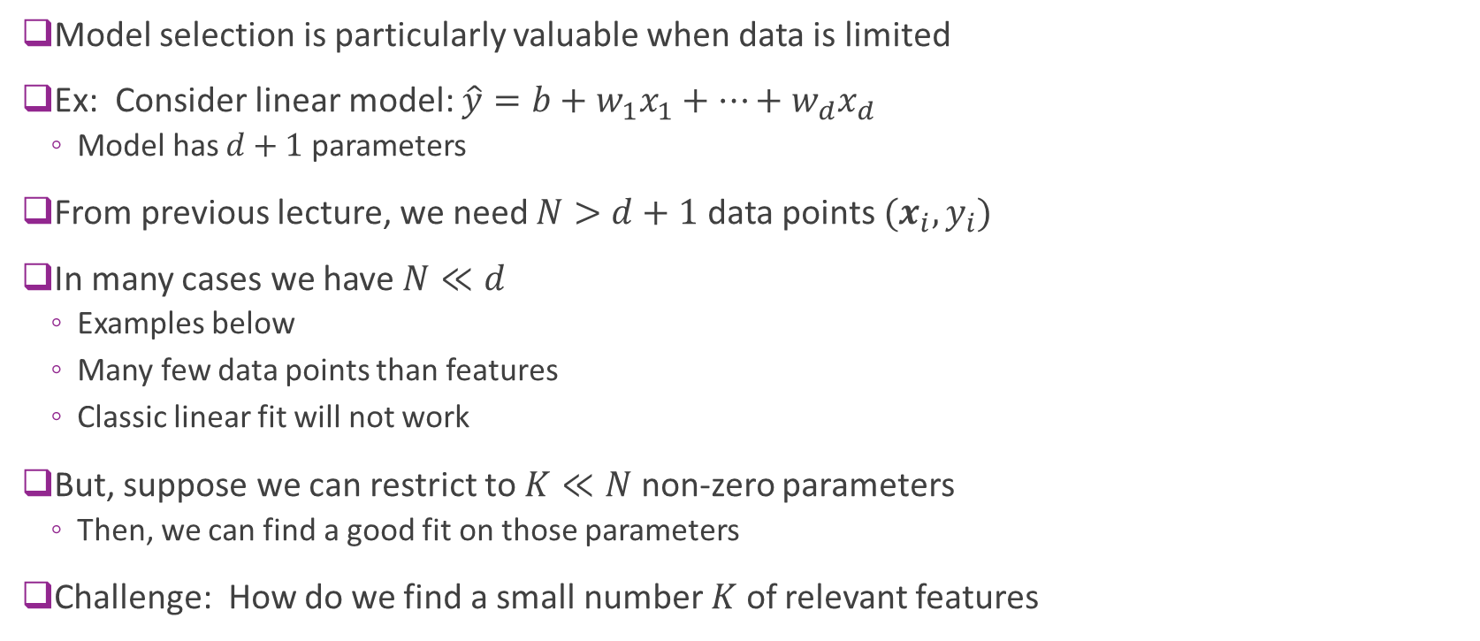



Ex 2: Model Selection with Limited Data
Model selection is particularly valuable when data is limited
Ex: Consider linear model: $\hat{y}=b+w_{1}x_{1}+⋯+w_{d}x_{d}$
Model has $d+1$ parameters
From previous lecture, we need $N>d+1$ data points $(x_{i},y_{i})$
In many cases we have $N≪d$
Examples below
Many few data points than features
Classic linear fit will not work
But, suppose we can restrict to $K≪N$ non-zero parameters
Then, we can find a good fit on those parameters
Challenge: How do we find a small number $K$ of relevant features
$d$ Features
$N$Samples
$$X$$
$$N≪d$$

Slide 33
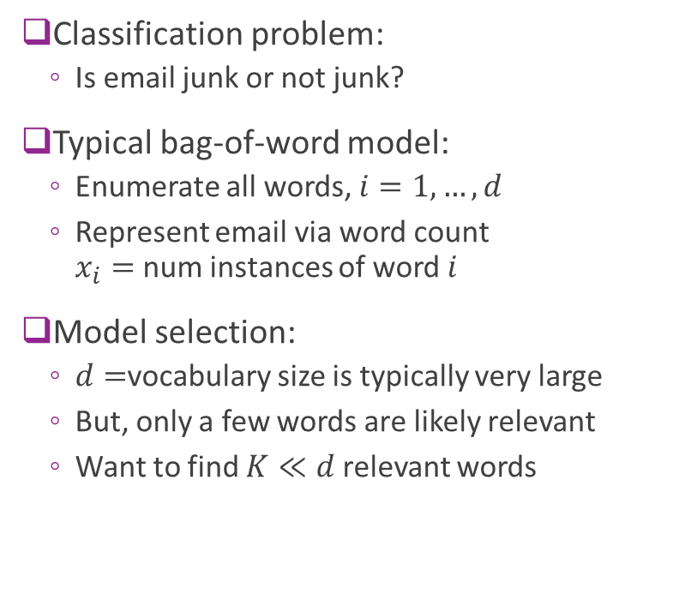
Example 3: Spam Detection
Classification problem:
Is email junk or not junk?
Typical bag-of-word model:
Enumerate all words, $i=1,…,d$
Represent email via word count $x_{i}=$ num instances of word $i$
Model selection:
$d=$vocabulary size is typically very large
But, only a few words are likely relevant
Want to find $K≪d$ relevant words

Slide 34

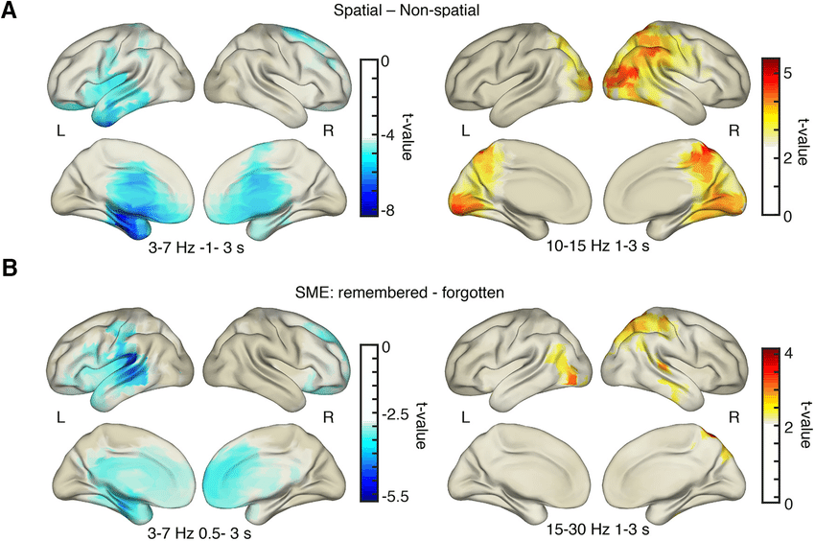
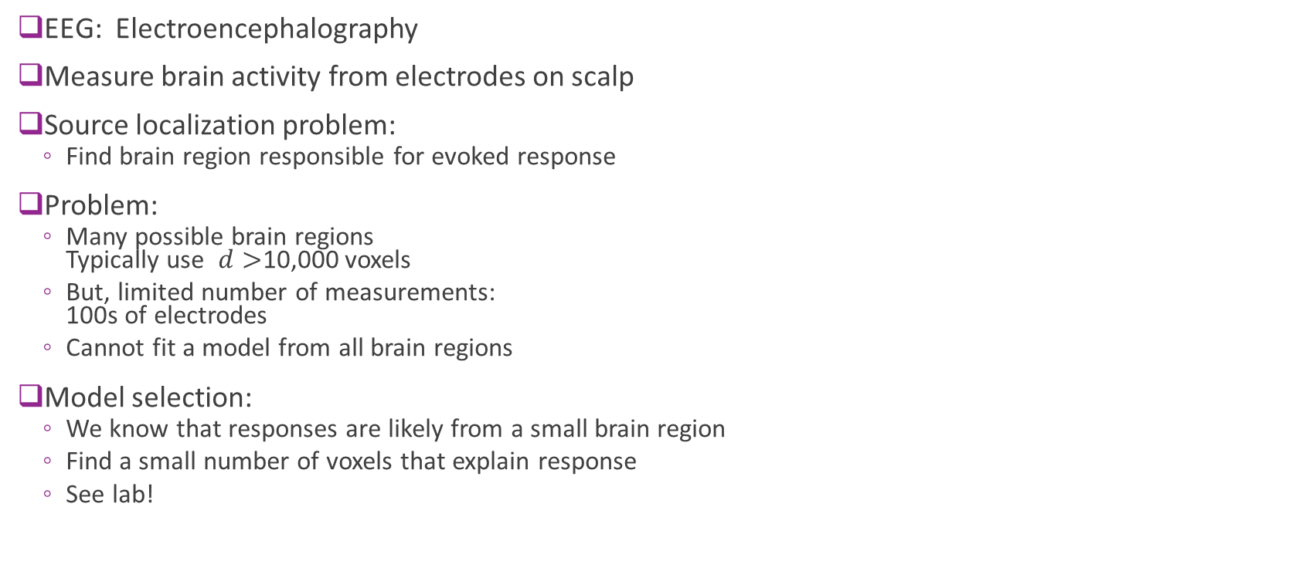
Example 4: EEG
Image: mayoclinic.org
EEG: Electroencephalography
Measure brain activity from electrodes on scalp
Source localization problem:
Find brain region responsible for evoked response
Problem:
Many possible brain regions Typically use $d>$10,000 voxels
But, limited number of measurements: 100s of electrodes
Cannot fit a model from all brain regions
Model selection:
We know that responses are likely from a small brain region
Find a small number of voxels that explain response
See lab!

Slide 35
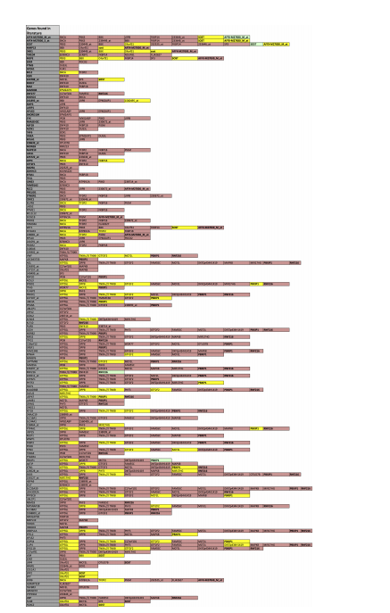
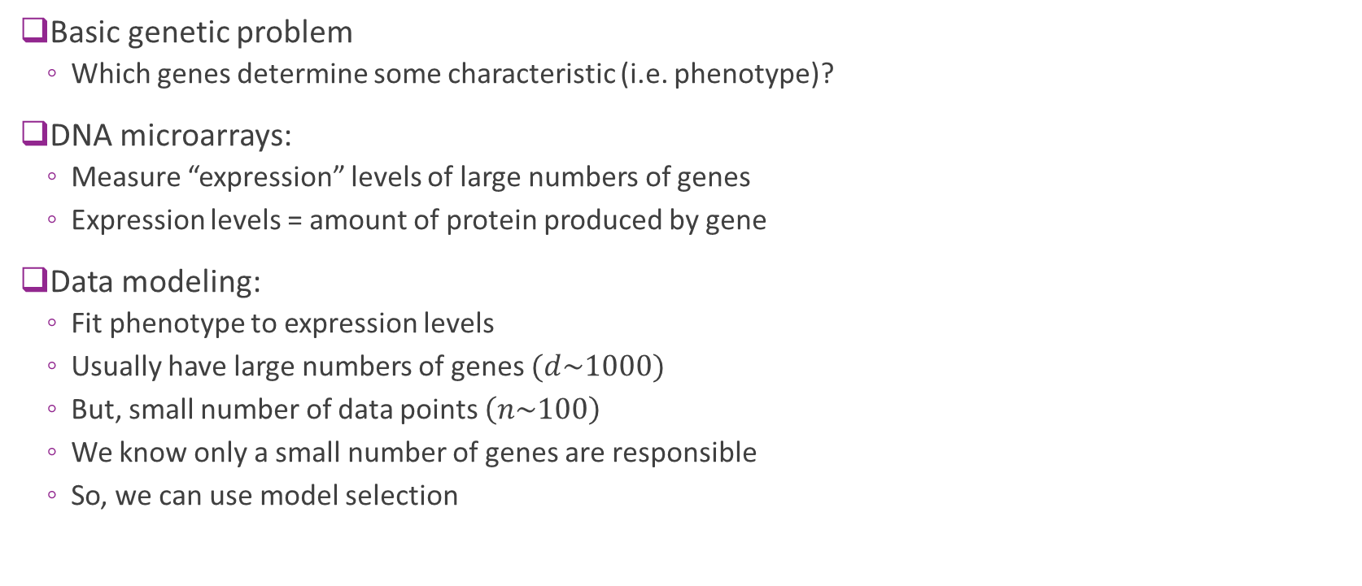
Example 5: DNA MicroArray Data
Basic genetic problem
Which genes determine some characteristic (i.e. phenotype)?
DNA microarrays:
Measure “expression” levels of large numbers of genes
Expression levels = amount of protein produced by gene
Data modeling:
Fit phenotype to expression levels
Usually have large numbers of genes $(d\sim 1000)$
But, small number of data points $\left(n\sim 100\right)$
We know only a small number of genes are responsible
So, we can use model selection

Slide 36
Outline
Motivating Example: Feature selection in predicting housing prices
Model Selection Problem
Model Selection via Regularization
Return to the housing price demo
Probabilistic interpretation
Other Model Selection Methods
In-Class Exercise: Audio Pitch Detection

Slide 37
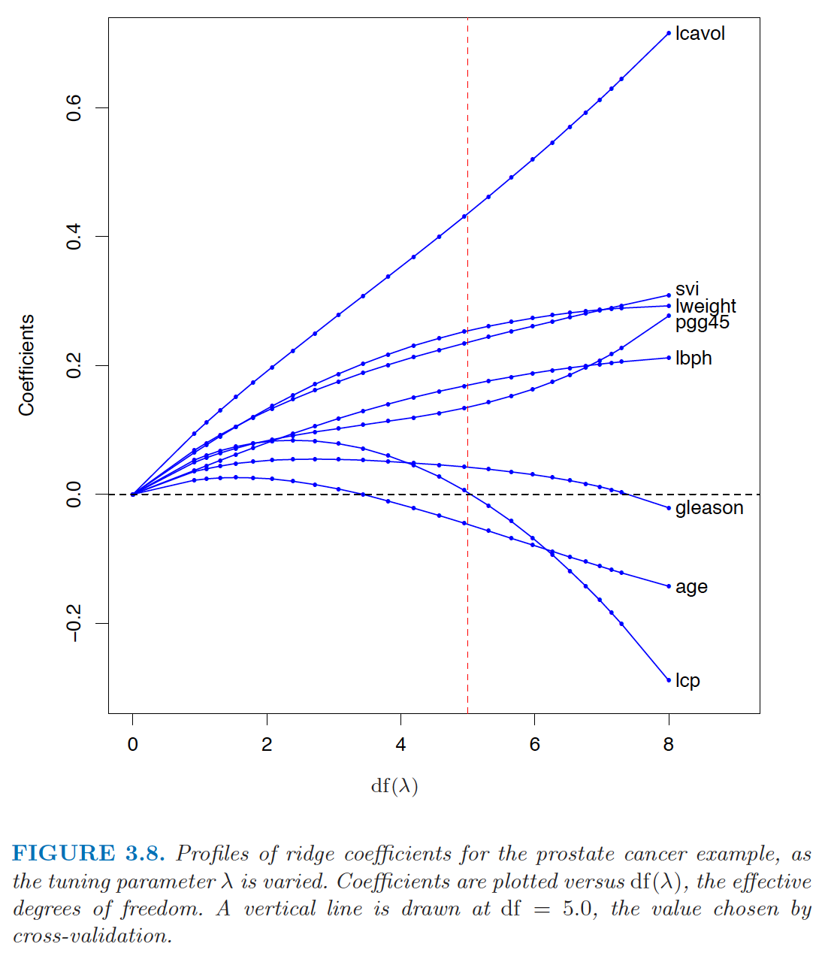

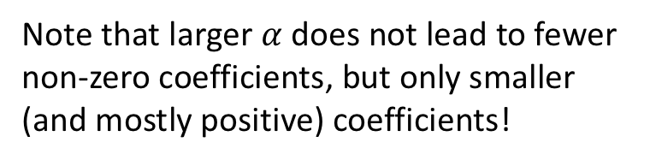

Coefficient path with ridge regression
Note that larger $α$ does not lead to fewer non-zero coefficients, but only smaller (and mostly positive) coefficients!
Figure from [Hastie2008]: Hastie, Tibshirani, Friedman, The elements of statistical learning.
For more on this subject, see Sec. 3.4.1.
Larger $α$
Smaller $α$

Slide 38
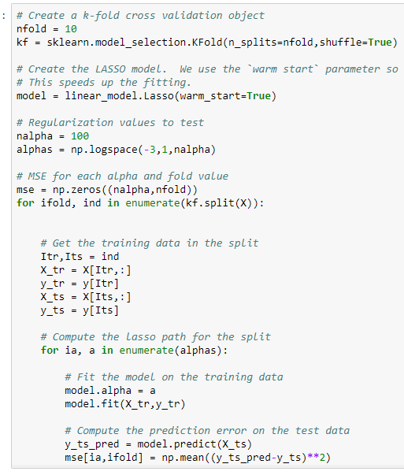
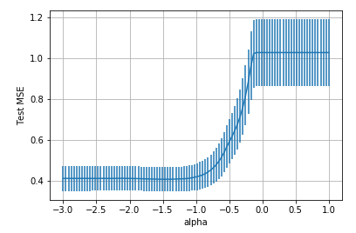

Computing LASSO in python
Use sklearn Lasso method
Solve using coordinate descent
Cross validation loop
Outer loop: Loop over folds
Inner loop: Loop over $α$
Measure mean and std deviation of MSE

Slide 39
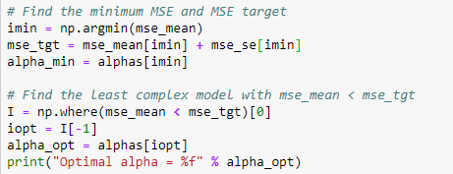
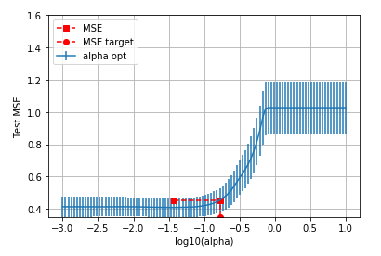

Using One Standard Deviation Rule
Use one standard deviation rule from before
Find $α_{0}$ with minimum mean MSE, mean_mean
Set $\text{mse}\text{_}\text{tgt} = \text{mse}\text{_}\text{mean}[α_{0}] + \text{mse}\text{_}\text{s}e[α_{0}]$
Find largest $α$ where mse_mean[$α$] < mse_tgt

Slide 40
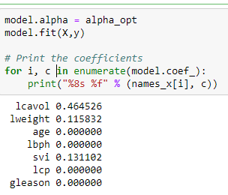

Coefficients
Select $α$ via cross-validation
Then, find coefficients using all training data.
Final coefficients are sparse:
Only three factors are non-zeros
Lcavol: log cancer volume
Lweight: Log weight
Svi: seminal vesicle invasion
Use only features corresponding to non-zero coefficients for linear regression

Slide 41


LASSO path
Useful to plot coefficients as a function of $α$.
Called the LASSO path
Indicates relative importance of different factors
For this data set:
lcavol most important
Don’t draw medical conclusions
Need more detailed significance testing
Complex subject for another class…

Slide 42

Finding the Final Regressor
Select features from cross-validation
Re-run ordinary (un-regularized) regression on reduced features
Use $K−$fold validation
K-folds yield $K$ weights and biases
Take mean of the weights and biases for the final parameter estimate
Take mean of the test MSE for the estimate of the test MSE

Slide 43
Outline
Motivating Example: Predicting prostate cancer from a PSA test
Model Selection
Model Selection from LASSO regularization
Probabilistic interpretation
Other Model Selection Methods
In-Class Exercise: Audio Pitch Detection

Slide 44

Maximum Likelihood Estimate
Suppose that true data generated from probabilistic model with Gaussian noise: $y=Aβ+w, w_{i}\sim N(0,σ^{2})$
Maximum likelihood estimator:
$$\hat{β}=\arg{\max_{β}{p\left(y | A,β \right)}}=\arg{\min_{β}\left[−\ln{p\left(y | A,β \right)}\right]}$$
Gaussian density for noise in y: $\ln{p\left(y | A,β \right)}=−\frac{1}{2σ^{2}}{\left\|y−Aβ \right\|}^{2}$
Hence
$\hat{β}=\arg{\max_{β}{p\left(y | A,β \right)}}=\arg{\min_{β}\left[{\left\|y−Aβ \right\|}^{2}\right]}=$Least Squares Solution

Slide 45

Bayes Estimation (MAP Estimate)
Maximum a posterior (MAP) estimator of $β$: $\hat{β}=\arg{max_{β}{p(β|y,A)}}$
$\hat{β}=$Most likely parameter value given evidence $y,A$
Bayes Rule: $p\left(β | y,A\right)={p\left(y | A,β \right)p(β)}/{p(y|A)}$
Hence: $\hat{β}=\arg{\max_{β}{p\left(y | A,β \right)p(β)}}$ (because $y$ and A are fixed)
Likelihood: $p\left(y | A,β \right)$ How well $β$ matches data
Prior: $p\left(β \right)$ : How well $β$ agrees with prior knowledge about its distribution (constraints)
More in probability class…

Slide 46

Bayes Estimation with Logarithms
Often easier to use logarithms: $\hat{β}=\arg{\max_{β}{p\left(y | A,β \right)p(β)}}=\arg{\min_{β}\left[−\ln{p\left(y | A,β \right)p(β )}\right]}$ $=\arg{\min_{β}\left[−\ln{p\left(y | A,β\right)}−\ln{p(β)}\right]}$
Gaussian density for noise in y: $\ln{p\left(y | A,β \right)}=−\frac{1}{2σ^{2}}{\left\|y−Aβ \right\|}^{2}$
Hence $\hat{β}=\arg{\min_{β}\left[\frac{1}{2σ^{2}}{\left\|y−Aβ \right\| }^{2}−\ln{p(β )}\right]=\arg{\min_{β}\left[{\left\|y−Aβ \right\|}^{2}+φ(β)\right]}}$
Conclusion: MAP estimate = regularized LS with $φ\left(β \right)=−2σ^{2}\ln{p(β)}$
Penalize $β$ proportional to $−\ln{p(β)}$: Less likely $β$ penalized more

Slide 47

Ridge and Lasso as Bayesian Estimators
Bayesian Estimator:
$$\hat{β}=\arg{\min_{β}\left[\frac{1}{2σ^{2}}{\left\|y−A β\right\|}^{2}−\ln{p(β)}\right]}$$
Assuming $β_{j}$ are i.i.d. Gaussian with zero mean:
$p\left(β_{j}\right)=\frac{1}{2πσ}exp\left(−{{β_{j}}^{2}}/{2γ^{2}}\right),−log{p\left(β_{j}\right)=}$ ${{β_{j}}^{2}}/{2γ^{2}+constants}$
$\hat{β}=\arg{\min_{β}\left[{\left\|y−Aβ\right\|}^{2}+\frac{σ^{2}}{γ^{2}}{\left\| β\right\|}^{2}\right]} =$Ridge Regression!
Assuming $β_{j}$ are i.i.d. Laplacian with zero mean:
$$p\left(β_{j}\right)=\frac{1}{2σ}exp\left(−{\left|β_{j}\right|}/{γ }\right),−log{p\left(β_{j}\right)=}{\left|β_{j}\right|}/{γ }+constant$$
$\hat{β}=\arg{\min_{β}\left[{\left\|y−Aβ \right\|}^{2}+\frac{{2σ}^{2}}{γ}{\left\|β\right\|}_{1}\right]} =$Lasso Regression!

Slide 48
Outline
Motivating Example: Predicting prostate cancer from a PSA test
Model Selection
Model Selection from LASSO regularization
Probabilistic interpretation
Other Model Selection Methods
In-Class Exercise: Audio Pitch Detection

Slide 49
Other feature selection methods
Filtering method:
Rank the features based on their correlation or mutual information with the target and possibly the redundancy among the features
Simple but not very good
Wrapper method:
For each candidate feature subset, apply a chosen classifier/regressor, evaluate the cross validation accuracy. Go through all possible feature subsets, or test the subsets in some greedy way
Computationally expensive
Embedded method:
Some regression/classification method naturally lead to feature ranking and selection
What is available in Python:
http://scikit-learn.org/stable/modules/feature_selection.html

Slide 50
Filtering method
Rank the features based on their correlation with the target
Can use other metrics: Correlation, F-test, mutual information, …
Also should consider the redundancy (correlation) among chosen features
Minimal Redundancy Maximum Relevance (mRMR)
Peng, H.C., Long, F., and Ding, C., "Feature selection based on mutual information: criteria of max-dependency, max-relevance, and min-redundancy," IEEE Transactions on Pattern Analysis and Machine Intelligence, Vol. 27, No. 8, pp. 1226–1238, 2005.
http://home.penglab.com/proj/mRMR/
https://www.mathworks.com/matlabcentral/fileexchange/14916-minimum-redundancy-maximum-relevance-feature-selection

Slide 51

Ranking metrics
Correlation coefficient between a feature and the target
F-test: test the significance of using one feature vs. not using any (use the mean of y only. Essentially measure the difference in the MSE when using only the mean value of y vs. using a single feature.
$ftest=\frac{r^{2}}{1−r^{2}}$(nsample-2)
Mutual information between a feature and the target
$$I\left(X,Y\right)=\iint{p\left(x,y\right)log\frac{p(x,y)}{p\left(x\right)p(y)}dxdy}$$

Slide 52
Embedded Method
Results from some regression/classification methods allow feature selection
Linear regression: based on coefficient magnitude
Neural net: based on weight magnitude
Decision tree: based on tree level
Can add regularization terms on the coefficients/weights to encourage sparsity
LASSO regression
Recursive feature elimination
Starting with all features, remove one feature that has the lowest importance (e.g. smallest coefficient magnitude)
Recursive feature elimination in sklearn
http://scikit-learn.org/stable/auto_examples/feature_selection/plot_rfe_digits.html#sphx-glr-auto-examples-feature-selection-plot-rfe-digits-py
http://scikit-learn.org/stable/auto_examples/feature_selection/plot_rfe_with_cross_validation.html#sphx-glr-auto-examples-feature-selection-plot-rfe-with-cross-validation-py

Slide 53
Wrapper method
For each candidate feature subset, apply a chosen classifier/regressor, evaluate the cross validation accuracy. Go through all possible feature subsets, or test the subsets in some greedy way
Exhaustive search
Genetic algorithm
Forward stepwise
Backward stepwise

Slide 54

Exhaustive search for feature selection
Suppose you want to consider feature subset of size up to $p$
For all possible feature subsets of size 1 to $p$:
use cross validation to find mean RSS mean and standard deviation
Choose the subset with the minimal RSS mean,
Or use the one standard error rule.
When the number of features is large, may not be computationally feasible
Fast search algorithms:
Genetic algorithm

Slide 55
Greedy feature selection
Forward-Stepwise Selection
Select one feature from all features that provides the lowest RSS with cross validation
Select one new feature from all remaining features, so that previously chosen features plus the new feature provides the lowest RSS
Repeat until the maximum feature number is reached, or when the RSS starts to increase
Backward-Stepwise
First use all features and find the RSS (using cross validation)
Remove one feature and find the new RSS. Go through all possible features to remove.
Find the one that leads to the least RSS increase. Remove this feature.
Repeat the above, remove one from the remaining features, to find the next most important feature.
Except exhaustive search, can all lead to suboptimal solution

Slide 56

Comparison of feature selection methods
Figure from [Hastie2008]: Hastie, Tibshirani, Friedman, The elements of statistical learning.
For more on this subject, see Sec. 3.3

Slide 57
Going through demo comparing different feature selection methods

Slide 58
More about cross validation
Why do we use cross validation?
To estimate the test error when there are insufficient training data so that we can partition the total data to a large training set and a large test set.
Whether a dataset is large depends on the number of parameters of the model to be trained.
Ideally the number of samples should be >100x of the number of parameters, but at least 10x.
When you have sufficient training data, you can just use a certain percentage (e.g. 50%) for training and remaining for testing. The error on the testing set would be a reliable estimate of the test error.
Two ways of using cross validation
When the “best” model class, model order, and feature set are known:
Use CV to estimate the test error
Use CV to determine the appropriate model class, model order and feature subset
For each candidate model class, model order, and feature subset, evaluate CV error
Determine which candidate yields the least CV error.

Slide 59
More about cross validation
How to use the multiple estimated models from multiple trials?
Apply each on a test sample and take the average (for regression) or majority (for classification) of results
For linear regression, equivalent to average the model coefficients
When your data is limited, you may want to go beyond K-folds
Ex: 5-fold means that you partition the data to 5 parts in some way, each part has 20% of data, and only do 5 fold training and testing
When your data is small, the average CV error is still very sensitive to how the data is partitioned to 5 parts. If you use random shuffling, you will get different result each time.
Instead, you could do L trials (L>>5) of random sampling, each time using 80% for training and 20% for testing
How to handle limited data in machine learning is still a challenging topic!

Slide 60
Outline
Motivating Example: Predicting prostate cancer from a PSA test
Model Selection
Model Selection from LASSO regularization
Probabilistic interpretation
Other Model Selection Methods
In-Class Exercise: Audio Pitch Detection

Slide 61

In Class Exercise
https://github.com/sdrangan/introml/blob/master/unit05_lasso/lasso_in_class.ipynb

Slide 62
What You Should Know to Do
Formulate a linear estimation problem with a regularization
Compute an L1-regularized estimate (LASSO) using sklearn tools
Compute the optimal regularization level using cross validation
Interpret results from a LASSO path
Determine final regression function from cross validation
Set regularizer based on a probabilistic prior
Perform other feature selection methods

