Slide 1

Introduction to Python Programming
Making Decisions and Repeating Fun!
Practice

Slide 2
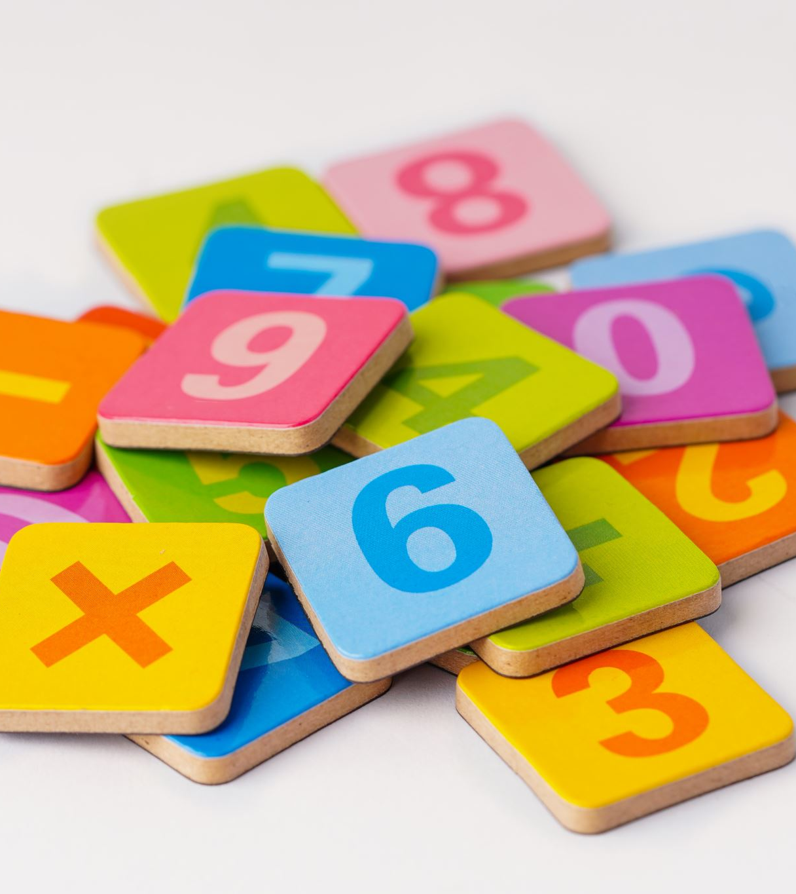
Assignment 1: Age Categories
Instruction: Create a program that categorizes people by age:
  0-5: "Toddler"
  6-12: "Kid"
  13-17: "Teen"
  18+: "Adult"
Hint: Ask the user for their age and then have the program tell them their category using conditions

Slide 3
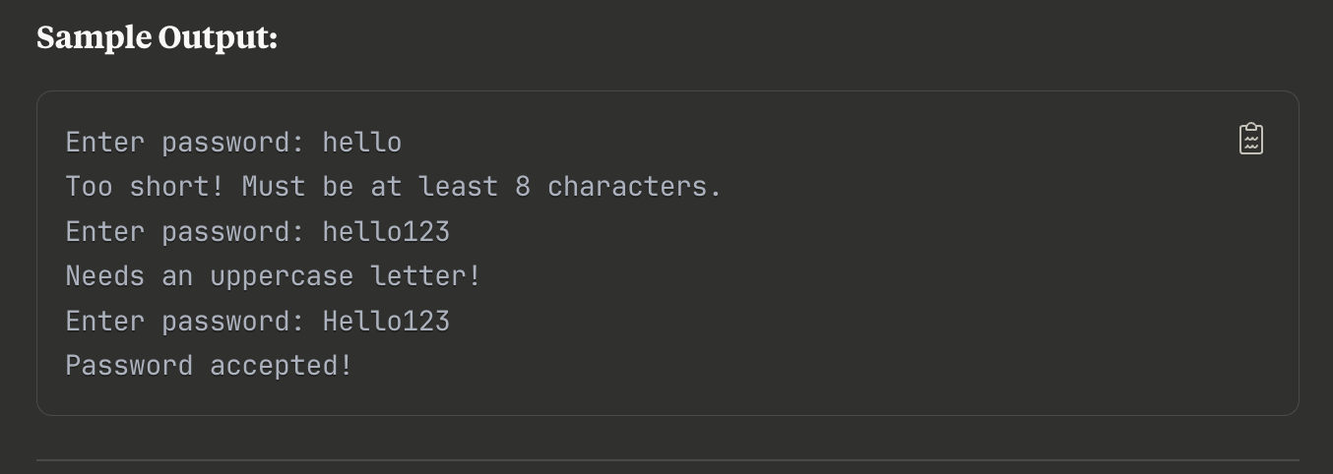
Assignment 2: Password Validator
Instruction: Create a password checker that keeps asking until password meets requirements:
  At least 8 characters long
  Contains at least one number
  Contains at least one uppercase letter
  Hint: look up string manipulation in Python on Google to help solve this
Notes:
For this exercise they are allowed to look up string manipulation in Python on google to help them complete this assignment,

Slide 4
Hangman – Project Analysis
Think about the game Hangman.
You are given 6 tries to solve a word by guessing the letters in the word. Now that you know about loops and conditions, think about how you would create a Hangman program. Write down the steps you will take in English.

Slide 5
Assignment 3
Instruction: Create a pizza ordering system:
  Keep asking for pizza sizes until user says "done"
  Small ($8), Medium ($12), Large ($16)
  Add toppings ($1.50 each)
  Apply 10% discount for orders over $50
  Calculate tax and final total
Hint: use loops, conditions, input, and math operations

