Slide 1
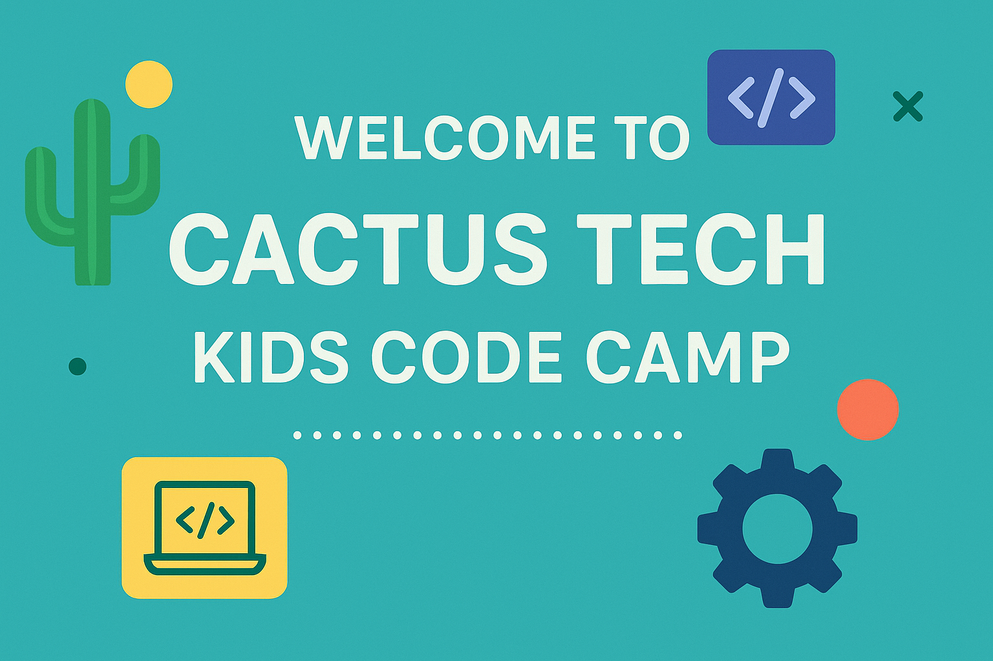

Slide 2


Four in a Row Game
Introduction to Python

Slide 3

What Are We Building?
Just like Connect Four at the arcade
Two players take turns dropping pieces
First to get 4 pieces in a row wins!
We'll build this step by step using Python

Slide 4
What You'll Learn
How to store game data (lists)
How to repeat actions (loops)
How to organize code (functions)
How to get user input
How to check if someone won

Slide 5
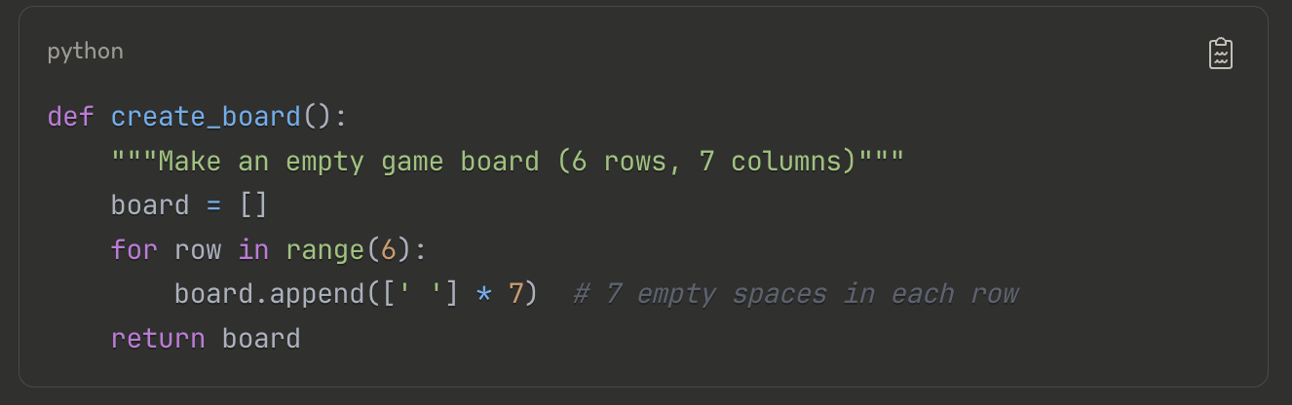
Setting Up the Game Board
Concept: Using Lists to Store Data

Slide 6

What’s Happening
board = [] creates an empty list
range(6) counts from 0 to 5 (6 rows total)
[' '] * 7 creates a list with 7 empty spaces
board.append() adds each row to our board

Slide 7
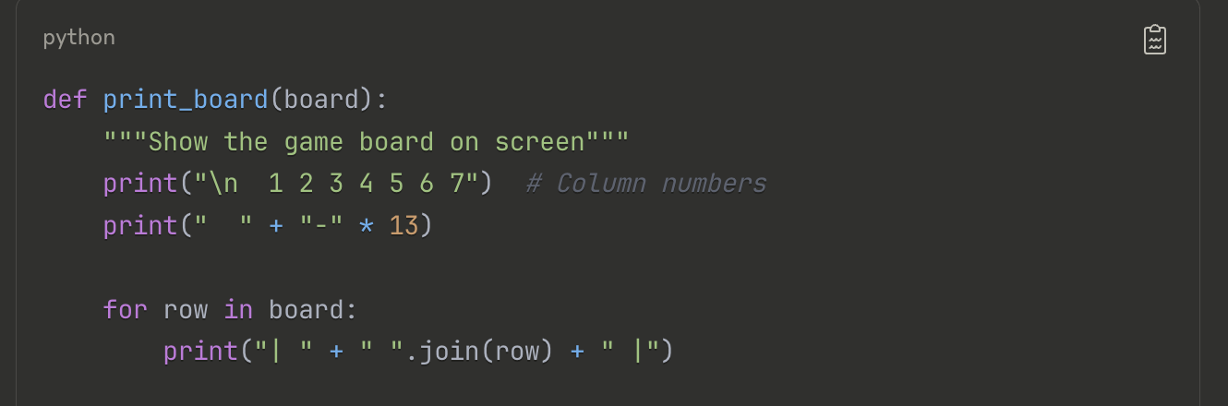
Showing the Board to Players

Slide 8

Cool Tricks
"-" * 13 repeats the dash 13 times
" ".join(row) puts spaces between each piece
\n makes a new line
Activity: Run just this part and see what it prints!

Slide 9
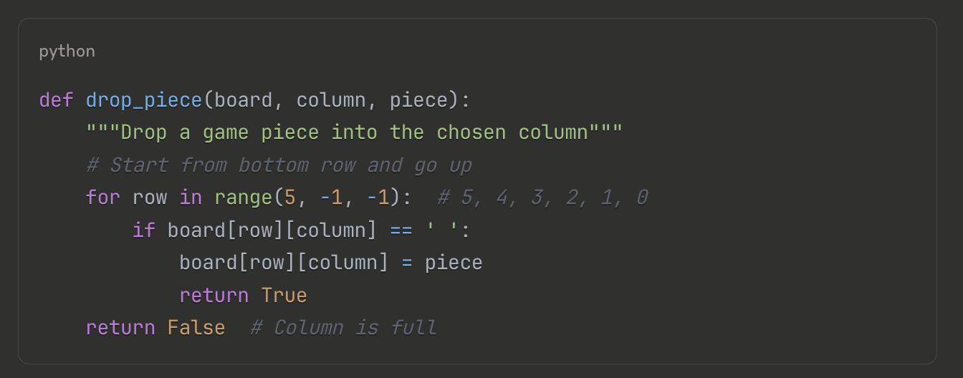
Dropping Game Pieces
Concept: Changing Data Based on Rules

Slide 10
Why Start at the Bottom?
Gravity! Pieces fall down in real life
range(5, -1, -1) counts backwards: 5, 4, 3, 2, 1, 0
We find the first empty space from the bottom
Question: What happens if the column is already full?

Slide 11
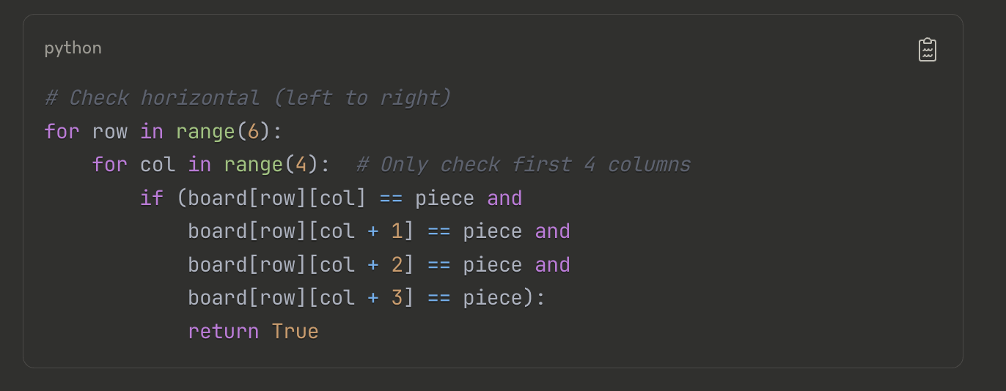
Checking for a Winner - Horizontal
Concept: Looking for Patterns

Slide 12
Smart Thinking
We only check the first 4 columns (0, 1, 2, 3)
Why? Because we look 3 spaces ahead (col + 3)
If we started at column 4, we'd go past the board!
Visual: Draw a row and see why we stop at column 4

Slide 13
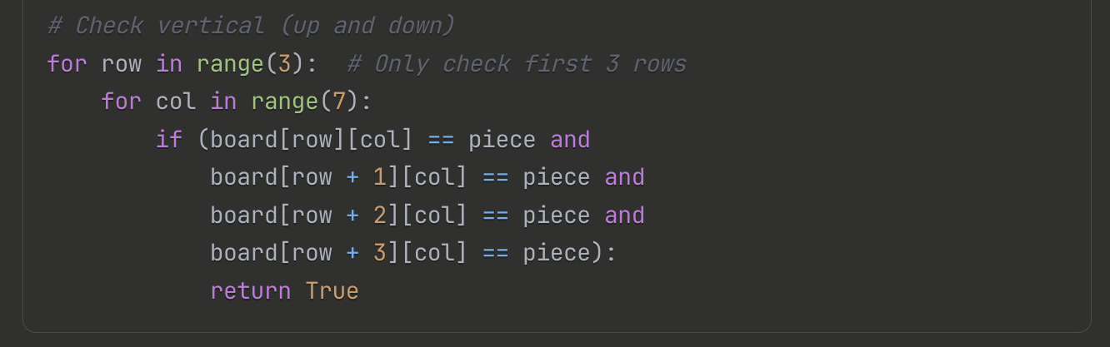
Checking for a Winner - Vertical
Concept: Looking Up and Down

Slide 14
Pattern Recognition
Same idea as horizontal, but we go down instead of right
Only check first 3 rows (why?)
Look 3 rows down (row + 3)
Challenge: Can you guess how diagonal checking works?

Slide 15
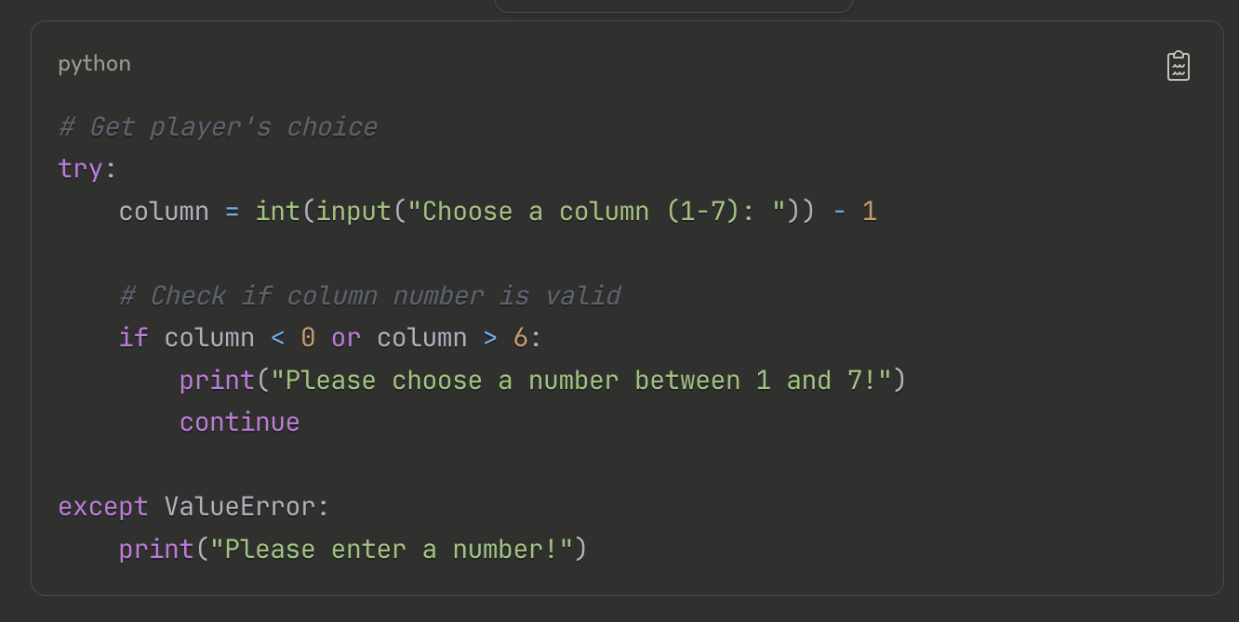
Getting Player Input
Concept: Talking to Your Users

Slide 16
Error Handling
try/except catches mistakes (like typing "abc" instead of "3")
We subtract 1 because humans count 1-7, but computers count 0-6
Always check if input makes sense!

Slide 17
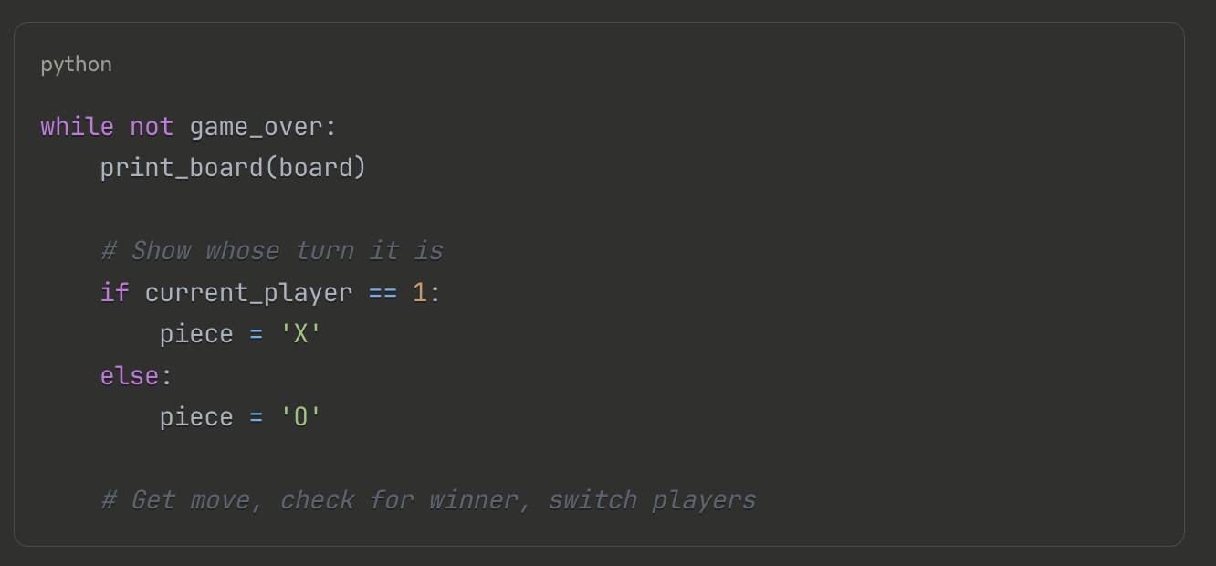
The Main Game Loop
Concept: Keeping the Game Running

Slide 18
The Game Loop
Show
Show the board
Get
Get the player's move
Check
Check if they won
Switch
Switch to the other player
Repeat
Repeat until someone wins!

Slide 19
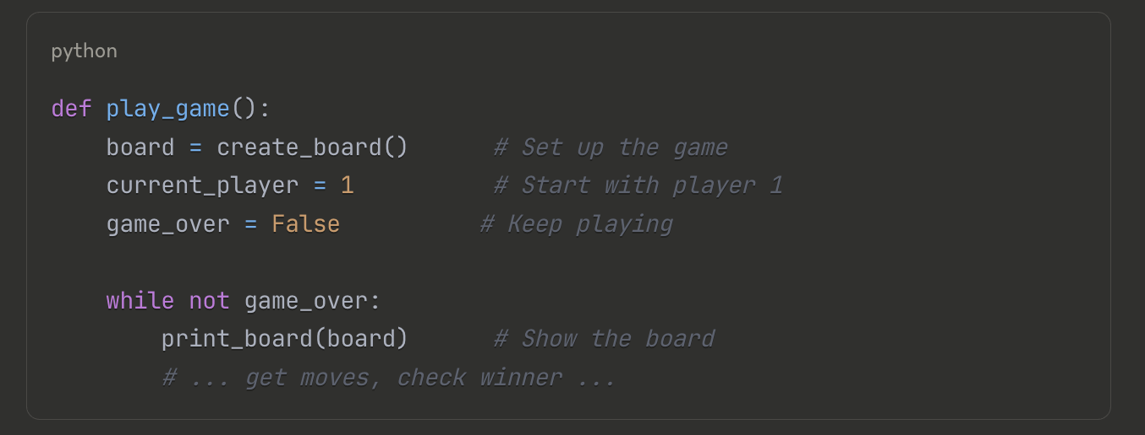
Putting It All Together
Concept: Functions Work as a Team

Slide 20
Big Picture:
Each function has one job
Functions call other functions
This makes code easier to understand and fix

Slide 21
Coding Challenges
Change the symbols from 'X' and 'O' to '🔴' and '🔵'
Make the board bigger (8x8 instead of 6x7)
Add player names instead of "Player 1" and "Player 2"

Slide 22

Concepts Learned
Data Structures:
Lists - Store multiple pieces of information
2D Lists - Lists inside lists (like our game board)
Control Flow:
Loops - Repeat actions (for, while)
Conditions - Make decisions (if, else)
Functions:
Organization - Break big problems into small pieces
Reuse - Write once, use many times
Input/Output:
Getting data from users
Showing results in a nice way

