Slide 1

Group 12: Settlers of Catan
Barrett Arbour, Brandon Ye, Jimmy Lu, Cameron Beaulieu

Slide 2
(D5) - Documentation
Summary, Propositions & Constraints, Model Exploration, Jape Proofs, Project Formulation

Slide 3
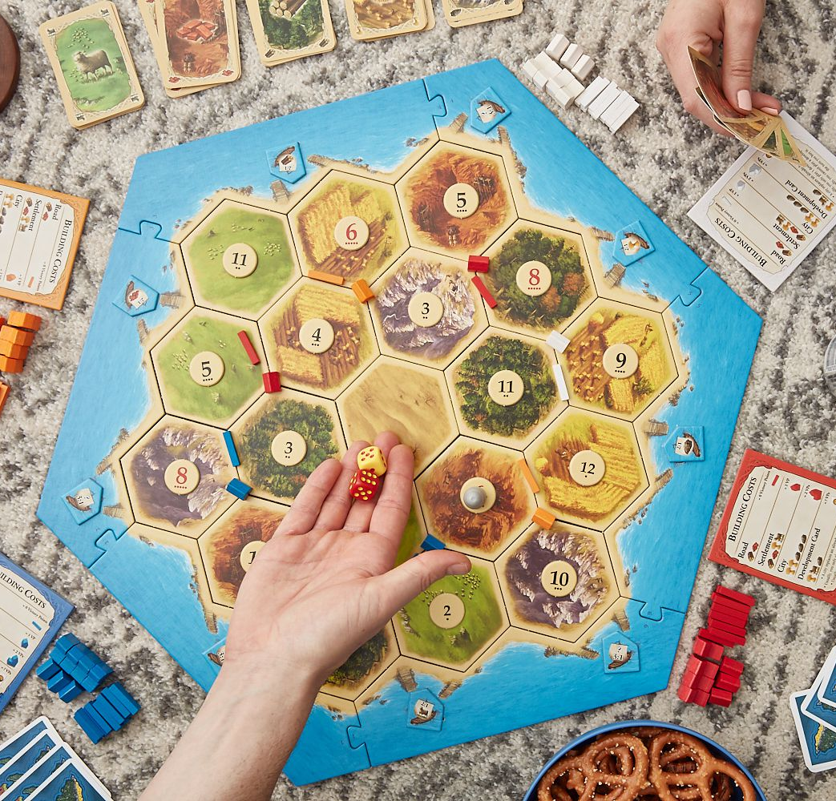
PROJECT FORMULATION
The logical model takes some board configuration in Settlers of Catan, and converts said board into a tree in which adjoining resources, or resources that imply one another, are organized in a series of nodes. This model is additionally provided with a value k and a set S of required resources. The model is satisfied when a branch is found in the tree that contains all the resources in S in no more than k steps, or rows of the tree. There can be more than one branch that satisfies S in a given tree, however, there is only one winning branch.

Slide 4
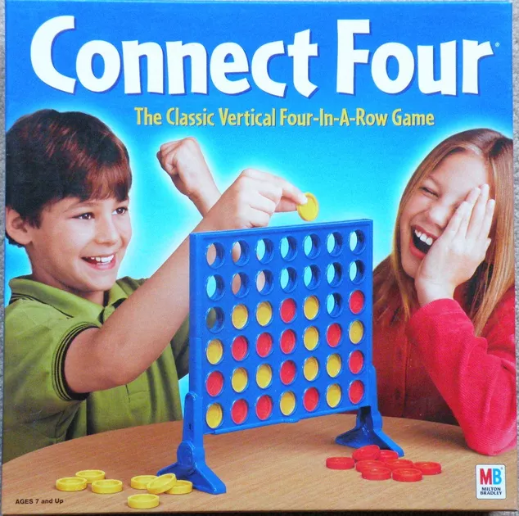
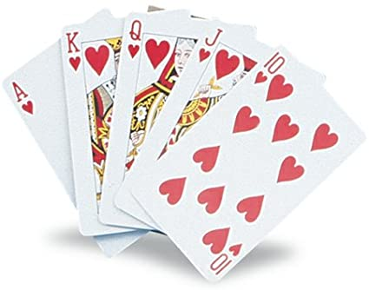
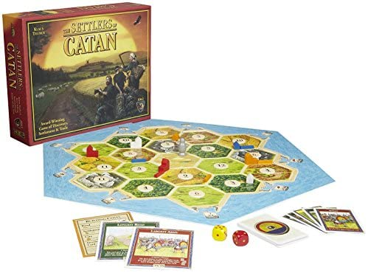
INITIAL IDEATION
When first coming out with the idea for our project, our group was interested in creating a model based off of some sort of game after looking at the example at tic tac toe. We considered exploring other card and board games such as Connect Four and various games based using a standard deck of playing cards until we eventually decided on Settlers of Catan.
We then began thinking of what kind of problems within the game could be explored in a modelling project. We considered the different mechanics within Settlers of Catan such as traversing the entire board, trading, and building different structures until we arrived at our core problem.
We established that the central idea of our model would be that the player would need to collect four different types of resources, and we used this problem for our initial submission for (D1) Problem Formulation

Slide 5
INITIAL FEEDBACK
After receiving feedback on our initial proposal submission from Prof. Muise, we started to flesh out more of our project and iterated based on the proposed changes.
Our initial project proposal was attempting to consider the game state of Settlers of Catan as unfolding over a period of time by assuming the player had no resources to begin with, but we had to shift this structure to capture a model in an instant of time that would be appropriate for the modelling project.
In order to increase the complexity of our model to better fit the scope of the modelling project, we introduced parameters into our model as a way to build the board configuration, such as the resources required to win the game and what the initial board state looked like.
Finally, we shifted our core question from “what path does the player need to take to win” to “does a path exist with k steps”, so it could be better represented with a logical model.

Slide 6
SUMMARY
Given a certain board state in Settlers of Catan, where we know which tiles of a certain resource type (wood, sheep, wheat, and brick) are connected to which other tiles, as well as the set of resources S needed to be gathered in order to win the game, we would like to determine if there exists a winning branch with k or lower steps (that is, a size of k-1 or lower). We will take as input a series of implications defining the board state, the set of required resources, as well as the maximum possible value of k we would like to consider.

Slide 7
RULES AND VOCABULARY
In Settlers of Catan, players take turns traversing through the game board to gather resources, build structures, and conquer territory. The full ruleset of the game is quite extensive, so we have altered the rules and introduce some key vocabulary to suit our model. Our model considers the following:
The "(game) board" is a tree of connected nodes with one root node
There are four possible types of nodes, each representing a different resource: brick, sheep, wheat, and wood
The "board state" is a configuration that defines how many nodes are in the board, what the type of each node is, and which nodes are connected to which other nodes.
A "branch" of the board is a sequence of connected nodes that starts at the root node and ends at a “leaf node”, that is, a terminal node or a node with no children
A "satisfiable branch" is a branch that contains at least one node for each “required resource”
A “winning branch” is a satisfiable branch that is true for the solution
k is the maximum number of steps in the winning branch we would like to consider
S is the set of required resources needed to win the game
The board state, S, and k, are defined by the user as part of the logical problem setting

Slide 8
PROPOSITIONS
N_{rc} : This is true when a node of any type is part of the winning branch at row r and column c
Wh_{rc}: This is true when a node of type wheat is part of the winning branch at row r and column c
Sh_{rc}, Br_{rc}, Wo_{rc}: These follow a similar structure to Wh_{rc} for nodes of type sheep, brick, and wood
W: This is true if the winning branch has k or fewer steps
N_{rc} → (Wh_{(r-1)(c-1 or c+1)} ∨ Wo_{(r-1)(c-1 or c+1)} ∨ Sh_{(r-1)(c-1 or c+1)} ∨ Br_{(r-1)(c-1 or c+1)})
Where N is a node of type Wh or Wo or Sh or Br
These implications are based on being on node N and implies True for nodes in which there is a connection from node N and False given there is no connection to node N
Noting that in order to determine a board configuration all implications of the board must be taken into account

Slide 9
CONSTRAINTS
The winning condition W is true if a branch is found that contains all resources defined in S.
S is a set of resources required to win the game, provided by the user.
W↔ s₁ ∧ s₂ ∧ … ∧ s_{y} for all s∃S
Similar to the branch constraint, there can only be one node N chosen per row:
N_{rn}→ ¬N_{r1} ∧ ¬N_{r2} ∧ … ∧ ¬N_{r(n-1)}
The satisfiable branch does not contain any nodes with a row number r greater than k
¬N_{(r>k)c}

Slide 10
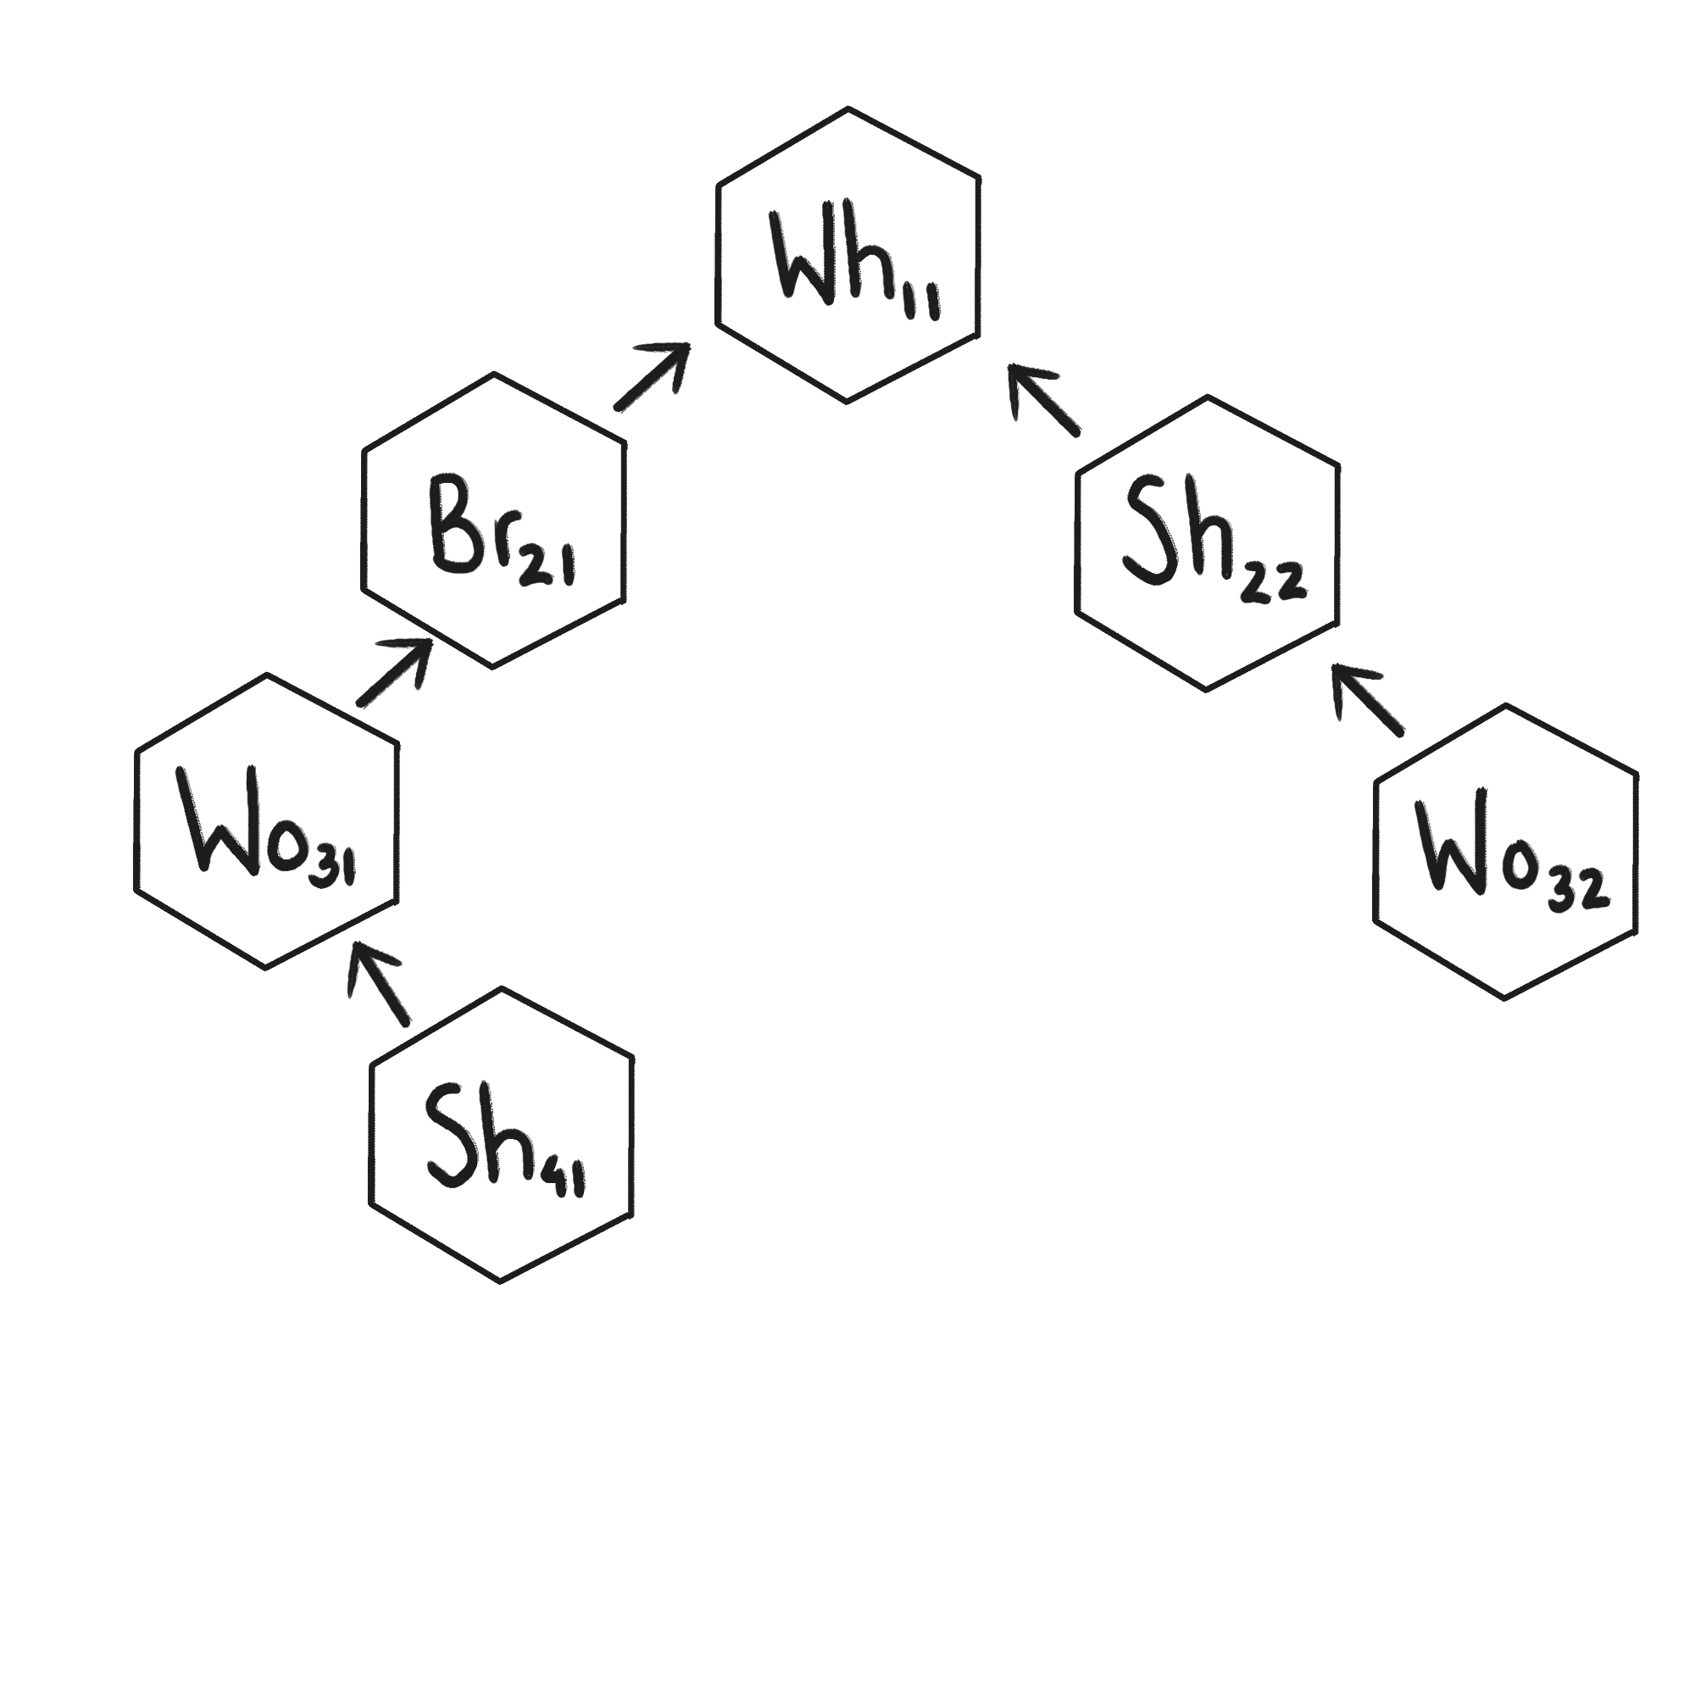
Example Board State
We can model the node graph depicted on the right as a series of implications as follows:
Sh_41→Wo_31
Wo_31→ Br_21
Br_21 → Wh_11
Wo_32 → Sh_22
Sh_22 → Wh_11
Given S = [Wh, Sh, Wo] and k = 2
The winning condition W is true as the following branch in the tree satisfies the set S:
[Wh_11, Sh_41, Wo_31]

Slide 11
JAPE PROOFS EXPLANATION
Jape key mapped to original constraints: H represents Wh (Wheat), D represents Wo (Wood), S represents Sh (sheep), B represents Bi or the Winning Branch, all other predicates used such as N and P for some generic Node, and Br for Brick are the same.
If some N does not imply another resource, then N does not have a connection to another node. As N is defined in our propositions as some generic node it must contain one of the resources or Wh, Wo, S, or Br must be true. Thus the above can be modelled logically as follows:
¬((H∨D∨S∨Br)→(H∨D∨S∨Br))⊢ (H∨D∨S∨Br)→¬(H∨D∨S∨Br)
In a similar vein as the first proof, if a node N implies another node P, then P cannot imply none of the resources. Again, N and P can both be defined as (H∨D∨S∨Br) per our propositions, thus the following can be modelled as follows:
(H∨D∨S∨Br)→(H∨D∨S∨Br) ⊢ (H∨D∨S∨Br)→¬(¬H∧¬D∧¬S∧¬Br)
If a winning branch B has been found and the winning branch implies the Wheat and Wood resources, for example, then in the tree structure the Wheat node must imply the Wood node (or vice versa). Resources can be changed based on appropriate winning conditions for a game:
B, B→H∧D ⊢ H→D

Slide 12
MODEL EXPLORATION - Initial Version
To start we assumed that the starting board condition would be given in the form of [(W_11 >> (Wh_21 || Sh_22)), (Wh_21 >> Br_31)]
The given board condition was broken down into a dictionary containing variables for each node where the key is the variable name “W_11” and the value paired is the variable of matching the key ‘Var(“W_11”)’
The given board condition was broken down into constraints of implications for each section of the list ie. “W_11 >> (Wh_21 || Sh_22)”
Current thoughts is to create a function which creates a branch variables where each branch variable is a list of which nodes are within the branch
To implement k we intend to remove all variables with a r value greater than k since that node will not be able to be reached in k moves

Slide 13
MODEL EXPLORATION - Explanation
How To Set Up The Board
Originally we attempted to turn the idea of the board/tree into a set of constraints in which the parent constraint implied one of the child nodes (ie. Parent → (Child or Child or Child….)
The issue with this became the idea of only one Child being True and the others being False
To combat this, we reversed the way we thought about the implications, now having a Child imply a Parent, since for a Child to be true, the parent must be true. This would look like (Child → Parent) and would go from the leaves up until the root
How To Restrict “Choosing” Multiple Branches
We had set up the implications, thus giving us a board state in the form of our implications, however, the SAT solver could still set multiple leaf nodes to True, thus making the whole tree True
To solve this, we created constraints in which one leaf node would imply the rest of the leaf nodes were false
In implementing this, we had to create another version of the board in the form of a binary search tree as to identify the leaf nodes
How To Restrict “Choosing” Inner Nodes
With our implications and the solver properly selecting only one leaf, we had thought we had solved it, however, we had not realized that the solver could set a Inner node to true even though a corresponding leaf node was False.
This was because there was no constraint specifying that only one node per row could be true
As such, to fix this we created constraint on each row in which a node, N, implied all other nodes, T_{n}, were False
N → (¬T₁ ∧ ¬T₂ ∧ … ∧ ¬T_{n})

Slide 14
MODEL EXPLORATION - Results
We began by taking the initial board configuration and parsing it into individual variables which were stored in a dictionary
Using this dictionary of variables and initial board configuration, we created implications in which every child node implied its corresponding parent node
A constraint was added in which the winning condition, W, implied that all variables representing having found a variable of the corresponding type (Wh, Wo, Br, Sh) were true
A constraint was added which made W always true, thus implying that Wh, Wo, Br, and Sh were always true
Constraints were created so that every node would imply that the overall node of the same type (ie. Wh₁₁ → Wh)
We created a binary search tree using the given board constraint, used this to identify the leaf nodes in our board, and then created constraints in which having one leaf node be true implied all other leaf nodes were false
Based on S, the nodes that we needed to “find”, we added constraints that set the ones we did not need to “find” to be true as to make sure they would not be a factor in finding a satisfiable model
Finally, we found what variables shared a common row using r and created constraints in which every variable in row r would imply all other variables in row r were false

Slide 15
FIRST-ORDER EXTENSION
Up until now, we have mostly been dealing with propositional logic to build a model for our problem scenario in Settlers of Catan. We can extend our model to include predicate logic and introduce a variety of new tools that could be used to reflect the problem setting in a different way.
In our first-order extension setting, we will use functions, predicates, and constraints to explore our model.

Slide 16
FIRST-ORDER EXTENSION
Functions
P(r, c) maps to the set of nodes
Receives a row number r and a column number c and returns a node object, the node found at that position in the game board, or null if it does not exist

Slide 17
FIRST-ORDER EXTENSION
Predicates (replacing propositions)
C(N₁, N₂) maps to the set of connections
Receives a node object a and another node object b, returning true if there is a connection between those two nodes, and returning false otherwise
Wh(N) maps to the set of wheat nodes
Receives a node object p, returning true if that node is of type wheat, and returning false otherwise
Predicates for the rest of the node types follow a similar structure
Sh(N) maps to the set of sheep nodes
Br(N) maps to the set of brick nodes
Wo(N) maps to the set of wood nodes

Slide 18
FIRST-ORDER EXTENSION
Constraints
∀N(Wh(N) ∨ Sh(N) ∨ Br(N) ∨ Wo(N))
For all nodes, the node is either a wheat node, a sheep node, a brick node, or a wood node
R(N) maps to the set of nodes contain required resources
Receives a node N, returning true if N is in the set S and false otherwise
W(N₁, N₂, N₃… N_{n}) maps to the set of winning branches
Receives a sequence of nodes and returns
Returns true if the branch N₁, N₂, N₃… N_{n} contains at least one of each node in the set S
∀s∈S((Br(s) → ∃N(Br(N)) ^ (Wh(s) → ∃N(Wh(N)) ^ (Sh(s) → ∃N(Sh(N)) ^ (Wo(s) → ∃N(Wo(N))
For every resource in the set of required resources, the resource bring a brick node implies that there exists a node of type brick, and so on for wheat, sheep, and wood

Slide 19
END

