Slide 1
IBM University Engagement Project Submission
“Exploring the Power of Agentic AI with IBM Granite and IBM Bob”

Slide 2

Project Tile – Interview Trainer Agent
Domain of Project – Education
Student Name | Recent Passport Photo | Email ID | Mobile number [WhatsApp]
Yeddula pavan kumar reddy |  | ypkr2006@gmail.com | 9392869237

Slide 3
Problem Statement
Problem Statement – Interview Trainer Agent
The Challenge – An Interview Trainer Agent, powered by RAG (Retrieval-Augmented Generation), prepares users for job interviews by generating tailored question sets and preparation strategies based on their profile name, experience level, and job role. It retrieves role-specific interview questions, industry expectations, behavioral scenarios, and HR guidelines from recruitment portals, professional networks, and company interview databases. Users can input their resume or job title, and the agent provides targeted questions, model answers, and improvement tips. It supports both technical and soft skill assessment, ensuring a comprehensive interview prep experience. This AI-driven assistant builds user confidence, sharpens responses, and increases success rates in competitive hiring environments.

Slide 4
objectives
Personalized Interview Preparation – Tailor interview questions according to the candidate’s resume, skills, experience, and target job role.
RAG-Based Knowledge Retrieval – Retrieve relevant role-specific questions, concepts, and interview guidelines from a knowledge base.
AI-Powered Mock Interviews – Use IBM Granite to conduct technical, HR, and behavioral interview sessions.
Intelligent Evaluation & Feedback – Evaluate candidate answers, identify strengths and weaknesses, provide scores, and generate improvement suggestions.
Personalized Career Improvement – Analyze interview performance and provide analytics, weak-area identification, and a customized preparation plan.

Slide 5
Proposed Solution
Personalized Interview Preparation – Collects the candidate’s profile, resume, skills, experience, and target job role.
RAG-Based Knowledge Retrieval – Retrieves relevant interview questions, technical concepts, HR guidelines, and role-specific information from the knowledge base.
IBM Granite-Powered Interview Agent – Generates tailored technical, HR, and behavioral questions and conducts the mock interview.
Adaptive Evaluation & Feedback – Evaluates candidate answers, provides scores, identifies strengths and weaknesses, and generates relevant follow-up questions.
Personalized Improvement Plan – Analyzes overall performance and creates analytics, weak-skill identification, and a targeted preparation plan.

Slide 6
Technologies Used
Frontend: React.js, Vite, Tailwind CSS
Backend: Python, FastAPI, REST API
AI/LLM: IBM Granite, IBM watsonx.ai
RAG: TF-IDF-based Retrieval-Augmented Generation
Database: SQLite, SQLAlchemy
Document Processing: PDF, DOCX & TXT Resume Extraction
AI/Agent Logic: Agentic AI, adaptive question generation & answer evaluation
Testing: Pytest
Version Control: Git & GitHub

Slide 7
Required Files created using IBM bob
Frontend Files – React/Vite UI pages, components, routing, and API integration.
Backend Files – FastAPI application, REST API routes, database models, and schemas.
AI & RAG Files – IBM Granite/watsonx.ai integration, RAG retrieval service, and interview generation/evaluation logic.
Knowledge Base Files – Technical, HR, behavioral, and interview guideline documents used for RAG.
Testing & Configuration Files – Pytest test suite, .env.example, configuration files, README, and startup scripts.

Slide 8
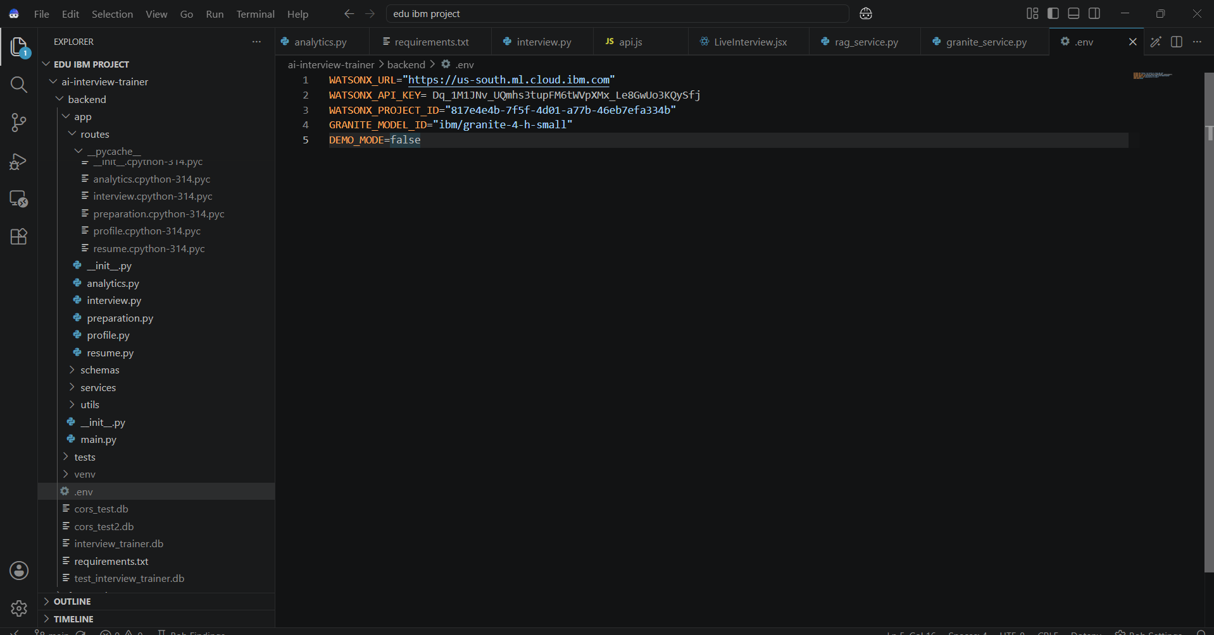
IBM Bob Screenshots

Slide 9
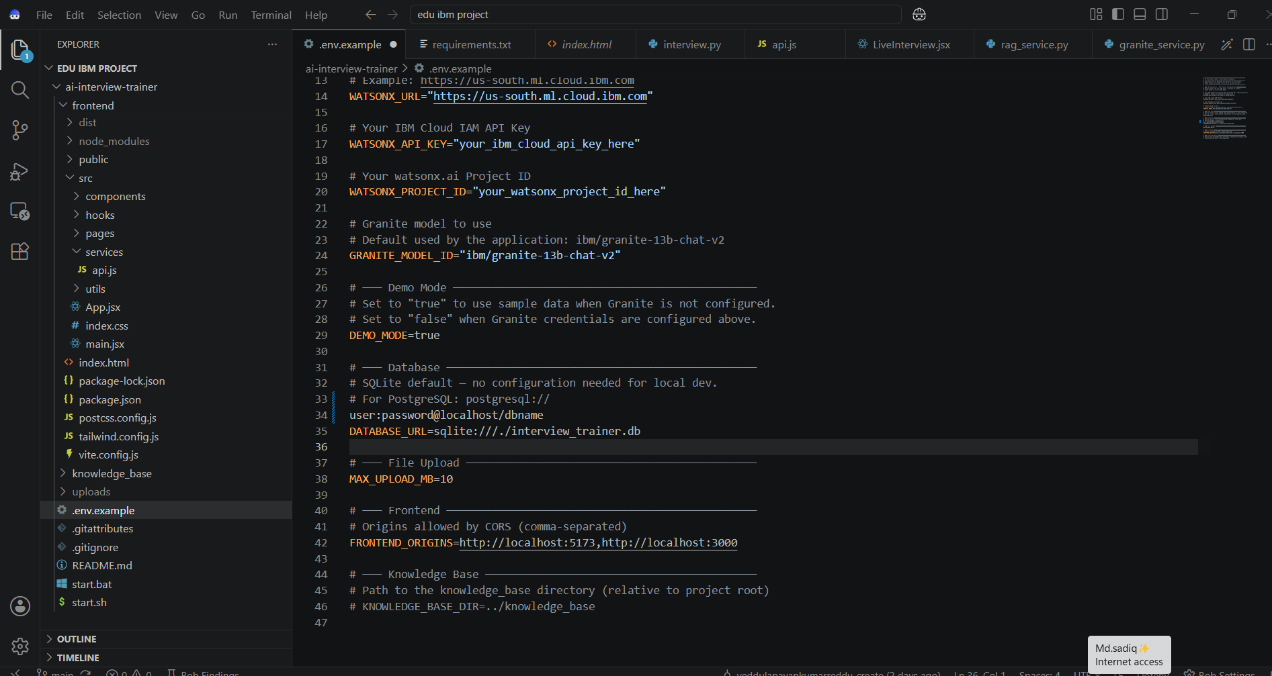

Slide 10
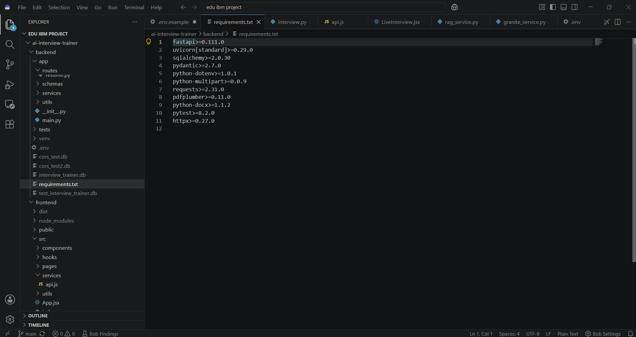

Slide 11
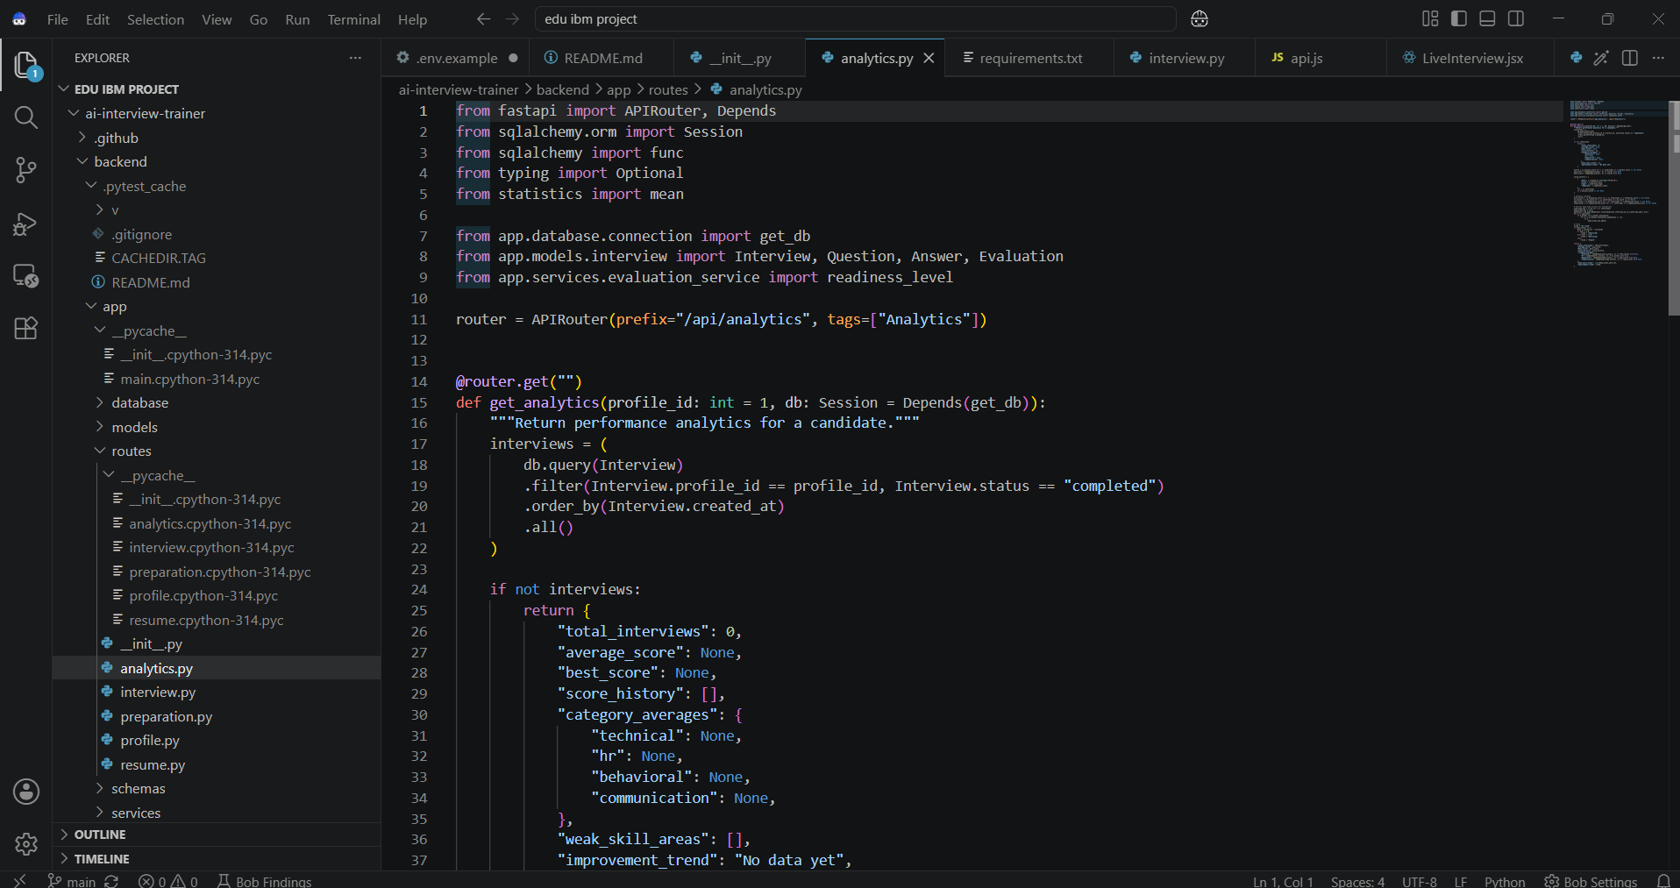

Slide 12
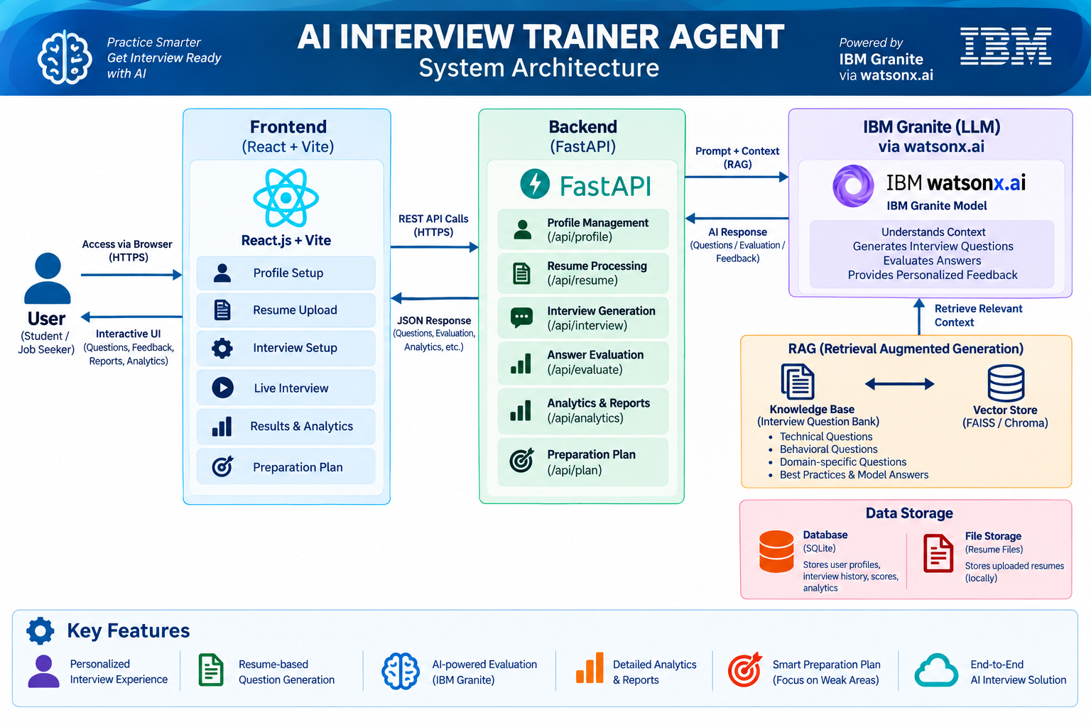
Architecture blueprint for IBM bob

Slide 13
Role of Agentic AI in the solution
Understand Candidate – Analyzes the user’s profile, resume, skills, experience, and target job role.
Retrieve Relevant Knowledge – Uses the RAG agent to retrieve role-specific questions, concepts, and interview guidelines from the knowledge base.
Generate Personalized Questions – The Interview Agent, powered by IBM Granite, generates relevant technical, HR, and behavioral questions.
Evaluate & Adapt – The Evaluation Agent analyzes answers, provides scores and feedback, while the system adapts follow-up questions based on performance.
Create Preparation Plan – The Planner Agent identifies weak areas and generates a personalized preparation strategy to improve future interview performance.

Slide 14
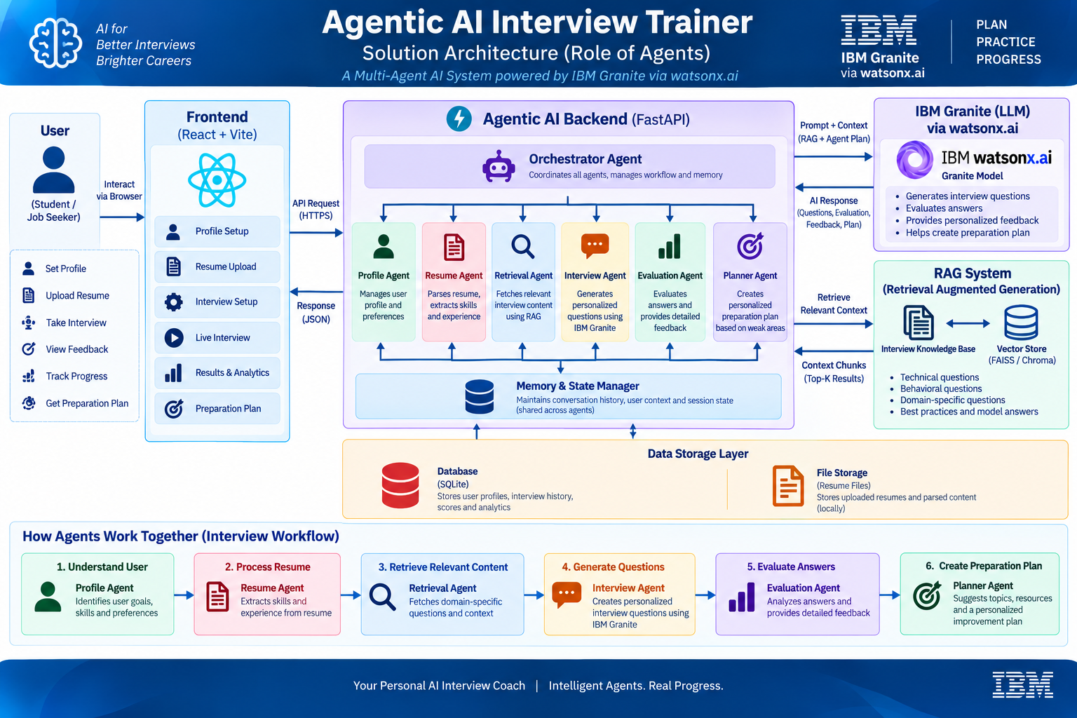

Slide 15
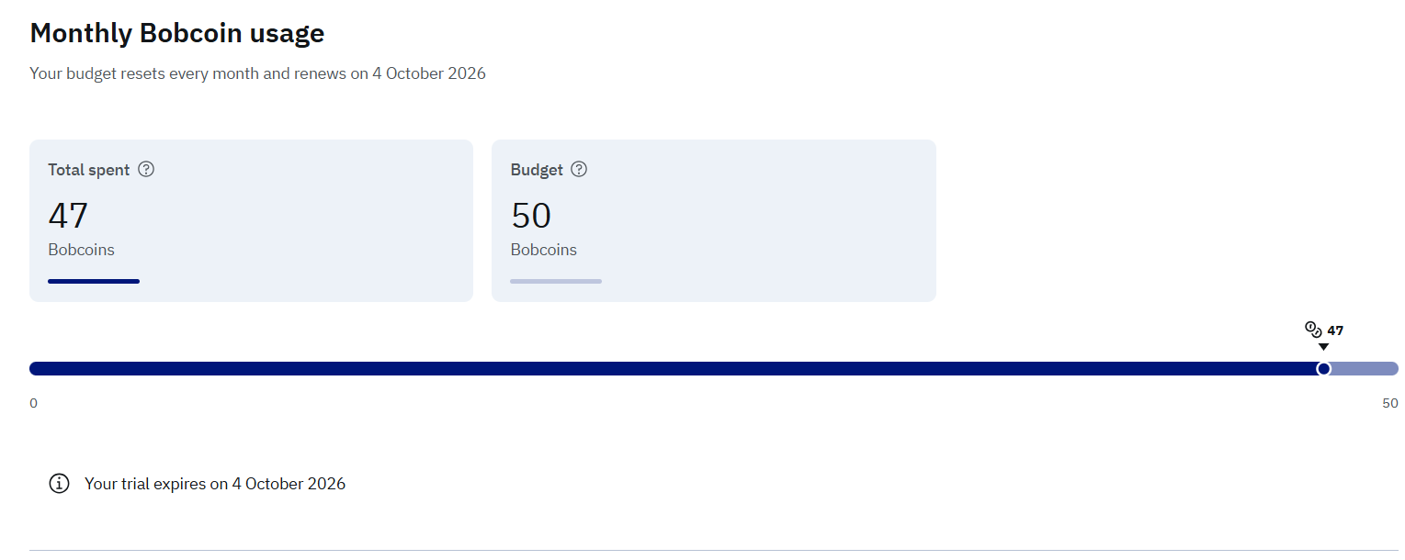
Token Usage

Slide 16
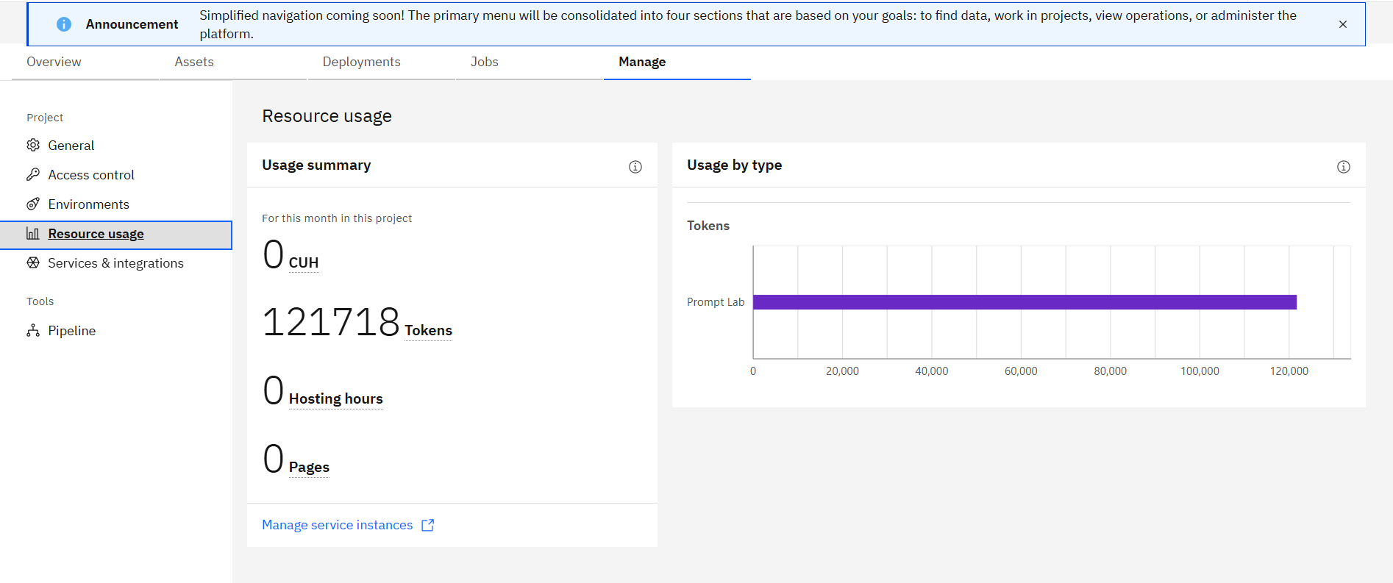

Slide 17
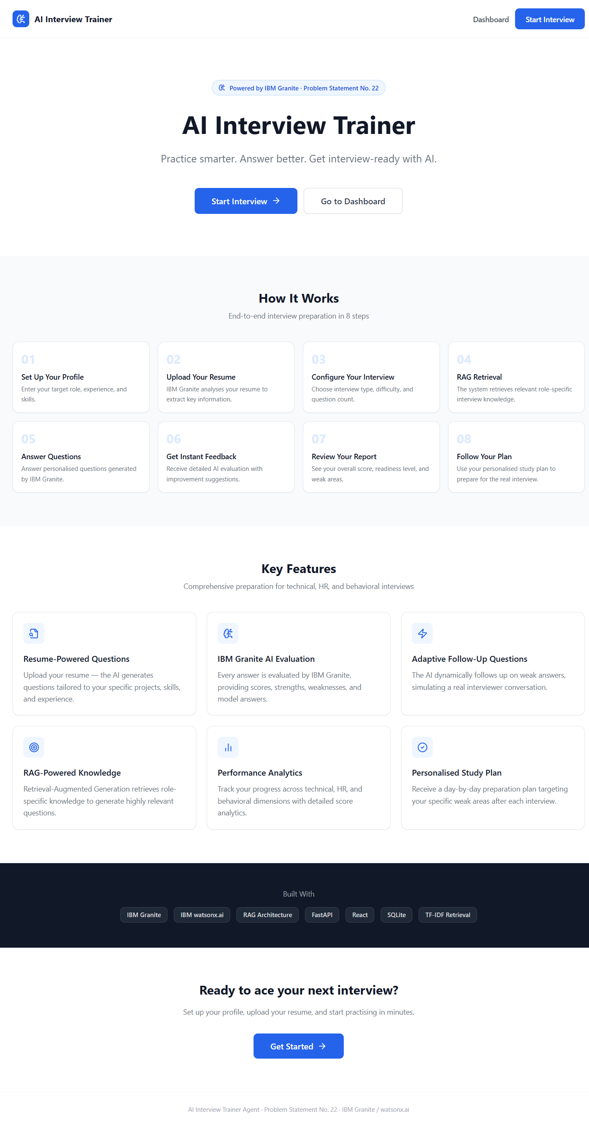
Project Output Screenshots

Slide 18
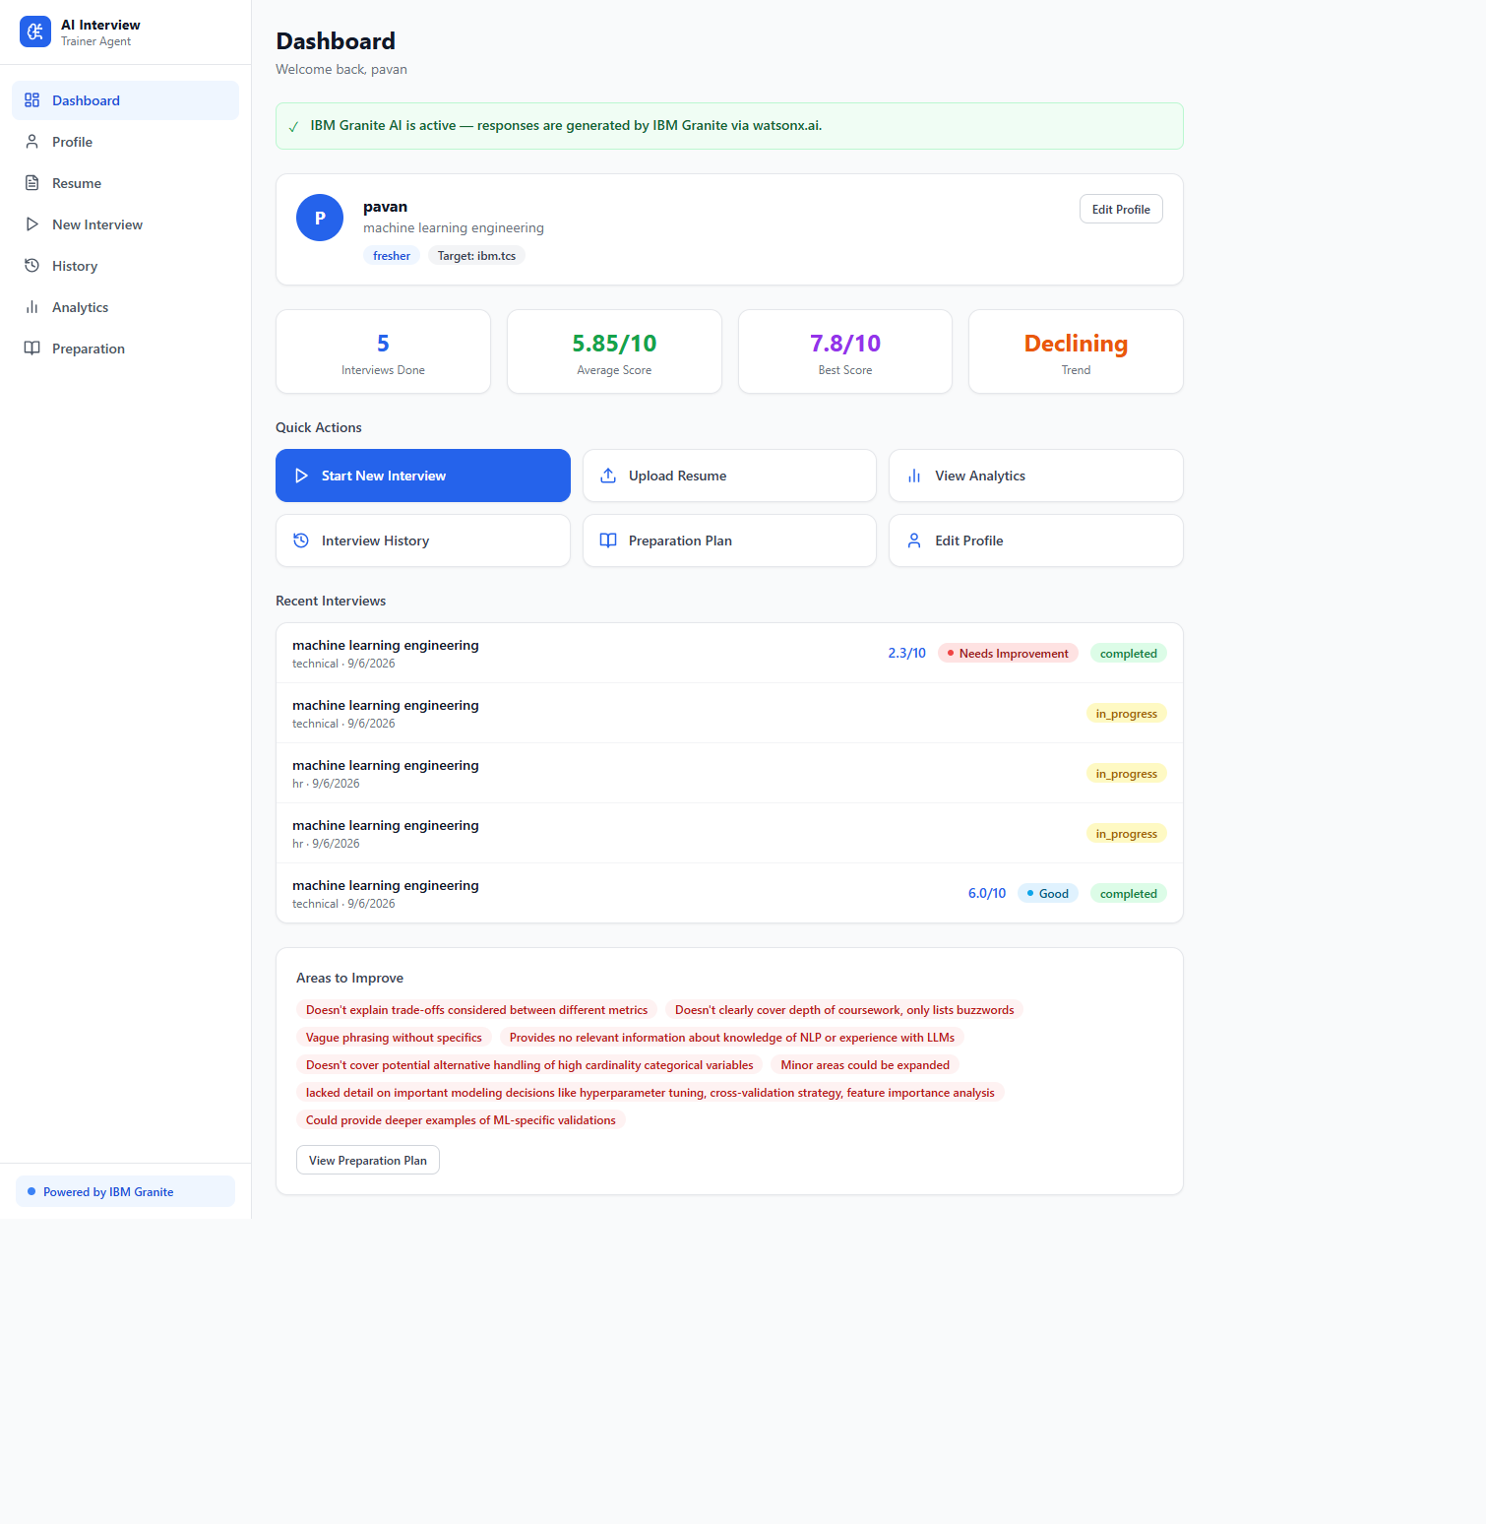

Slide 19
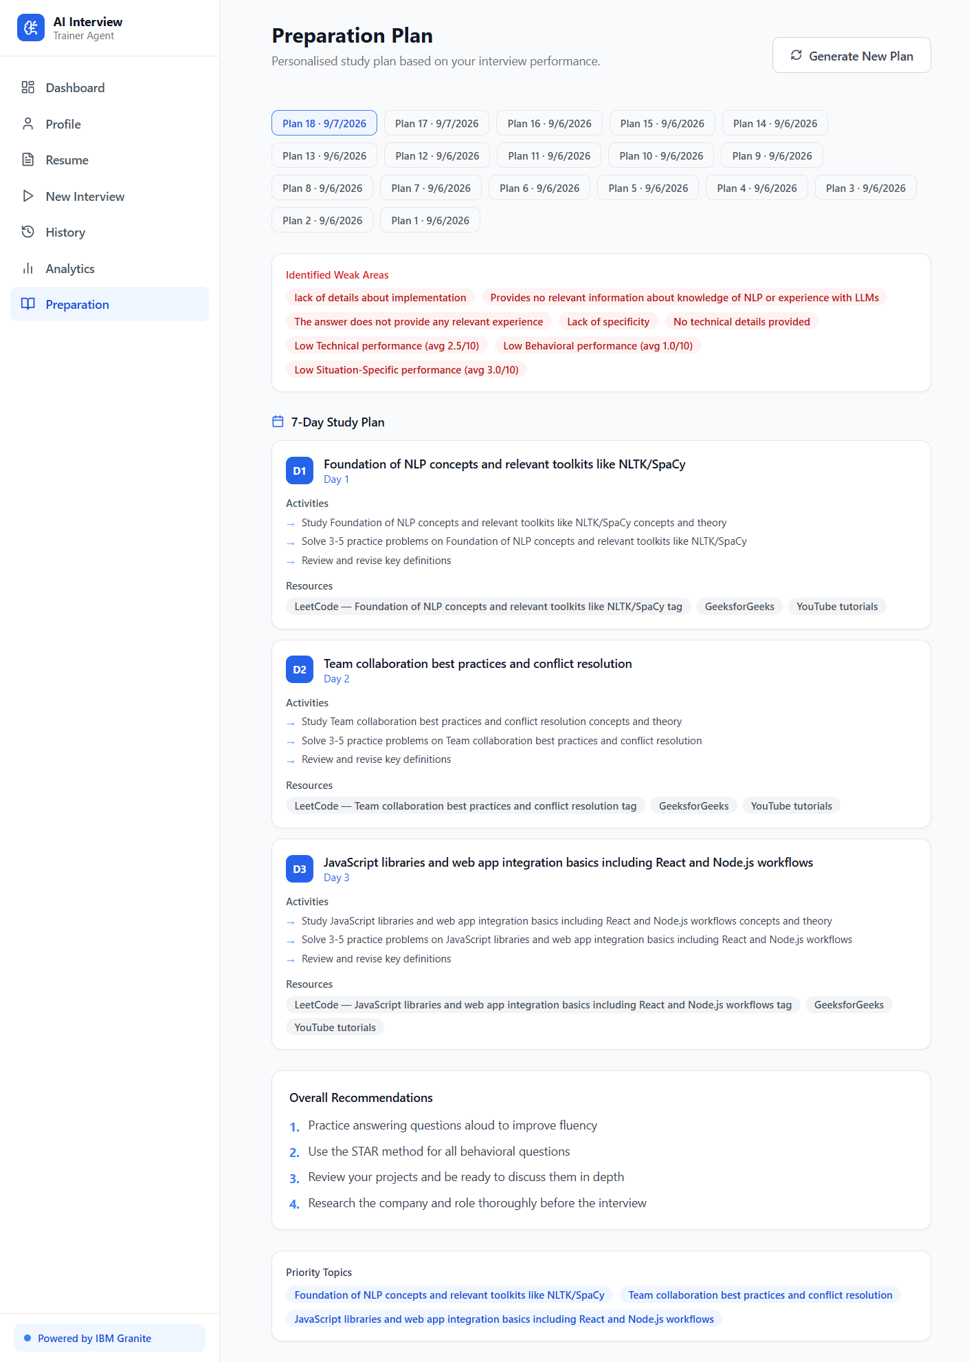

Slide 20
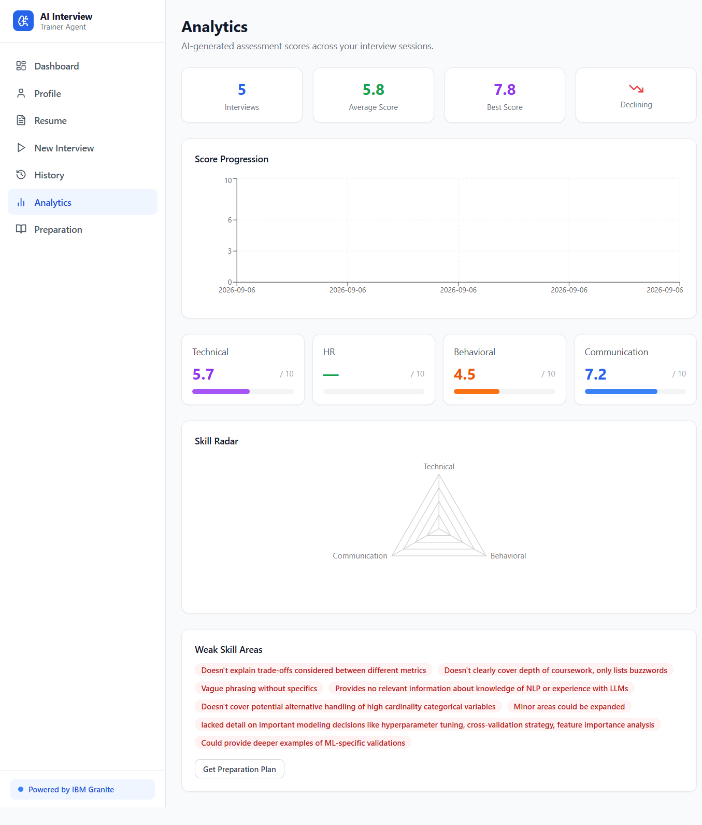

Slide 21
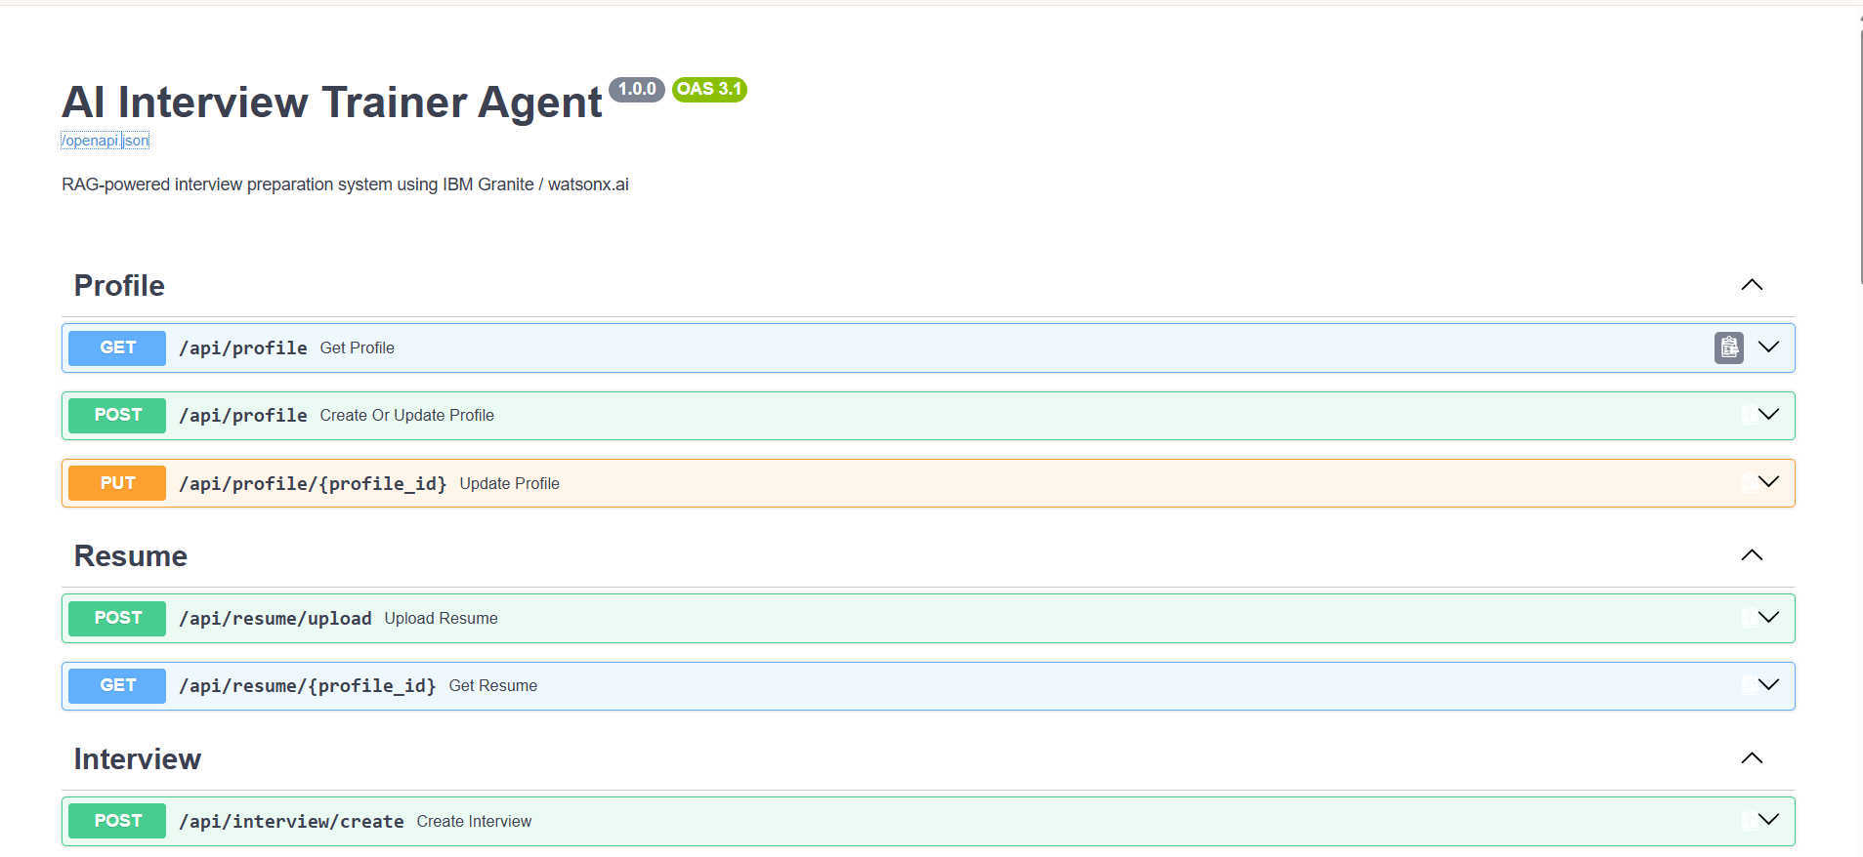

Slide 22
Novelty and Uniqueness
Agentic Interview Workflow – Multiple specialized AI agents work together to plan, conduct, evaluate, and improve the interview.
RAG-Based Personalization – Retrieves relevant technical, behavioral, and role-specific knowledge to generate context-aware questions.
Resume + Job Role Intelligence – Uses the candidate’s resume, skills, experience, and target role to create a personalized interview experience.
Adaptive Interviewing – Dynamically generates follow-up questions based on the candidate’s answers and performance.
End-to-End AI Career Coach – Goes beyond question generation by providing AI evaluation, detailed feedback, performance analytics, and a personalized preparation plan in one platform.

Slide 23
Git Hub Link
https://github.com/yeddulapavankumarreddy-create/ai-interview-trainer

Slide 24
Future Scope
Voice-Based Interview – Conduct realistic interviews using speech recognition and voice interaction.
Advanced Multi-Agent AI – Add specialized agents for technical, HR, coding, behavioral, and communication assessment.
Company-Specific Preparation – Generate interview questions based on a target company, job role, and job description.
Real-Time Performance Analysis – Analyze answers, communication, confidence, and identify weaknesses instantly.
Coding & Multilingual Support – Add live coding assessment and support for interviews in multiple languages.

Slide 25
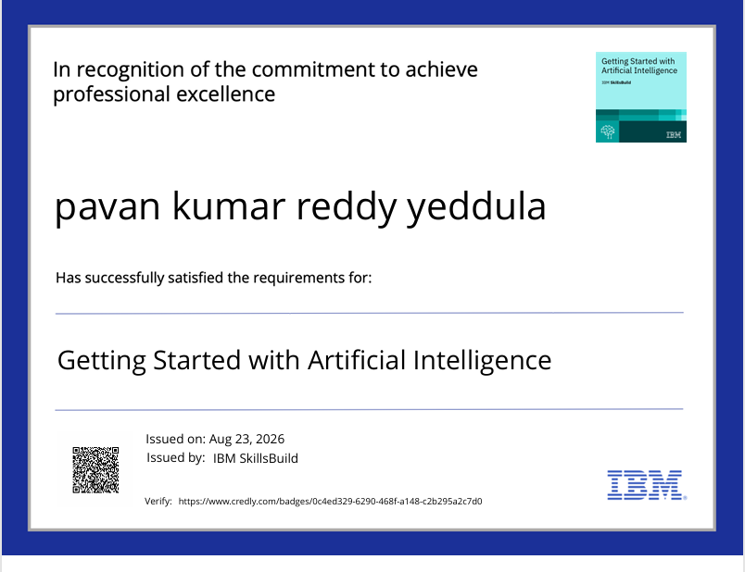
Certificates Earned

Slide 26
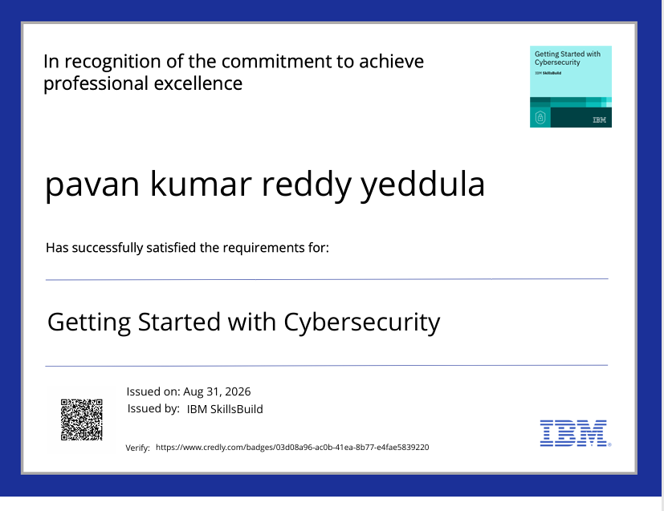
Certificates Earned

Slide 27
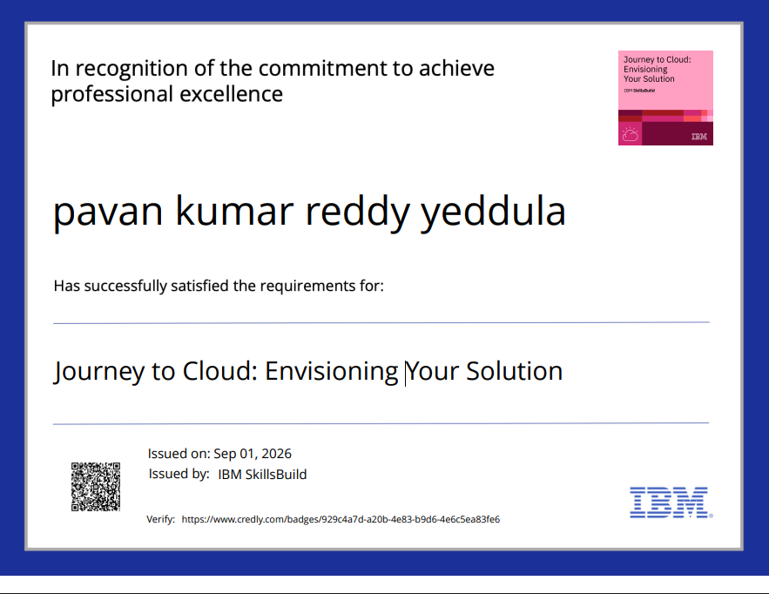
Certificates Earned

Slide 28
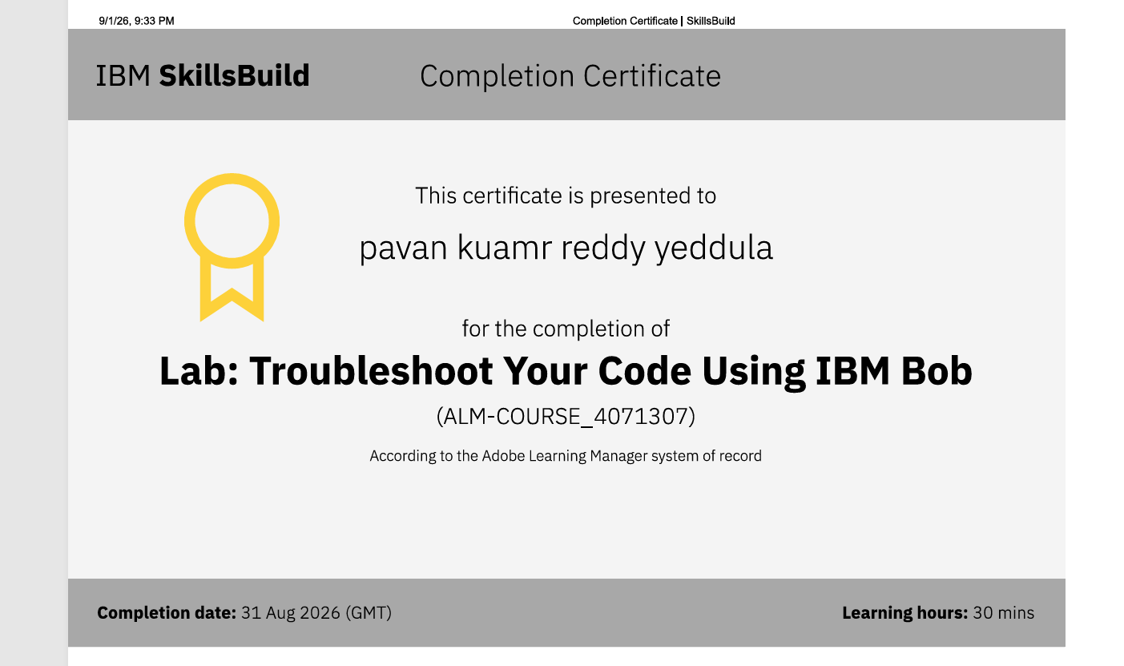
Certificates Earned

Slide 29
Thank You!
Thank you for your time and interest.

