Slide 1

Twitter Sentiment Analysis
Vijay Yedidi

Slide 2
Problem description, objective, evaluation criteria.
Over 330 million people use Twitter worldwide
Tweets going viral can sway public opinion
Create a Model to predict the sentiment behind tweets
Positive, Negative, and Neutral Tweets
Capture the word/phrase that leads to the sentiment

Slide 3

Evaluation Criteria
Jaccard Score
Numerical Comparison of similarity between two sets
Shows percent difference between two sets
Union divided by intersection
Selected Text vs Predicted Text

Slide 4
Data Cleaning
Tweets were cleaned using RegEx (Regular Expression)
Removed punctuation, urls, unnecessary spaces, converted to lowercase
Stopwords Removed
Commonly used words that wouldn’t have any impact on sentiment
”The”, “A”, “An”, “In”, etc.
NLTK Package (Natural Language Toolkit)
Problems with Run Time
For Loop comparing words in tweets to stop words
Output to csv file

Slide 5
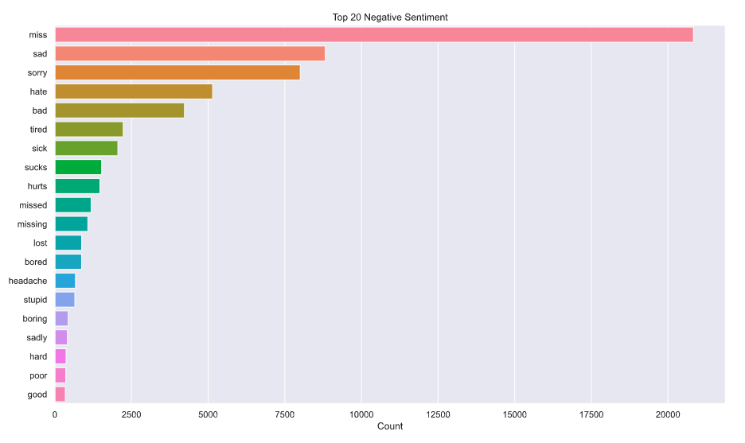
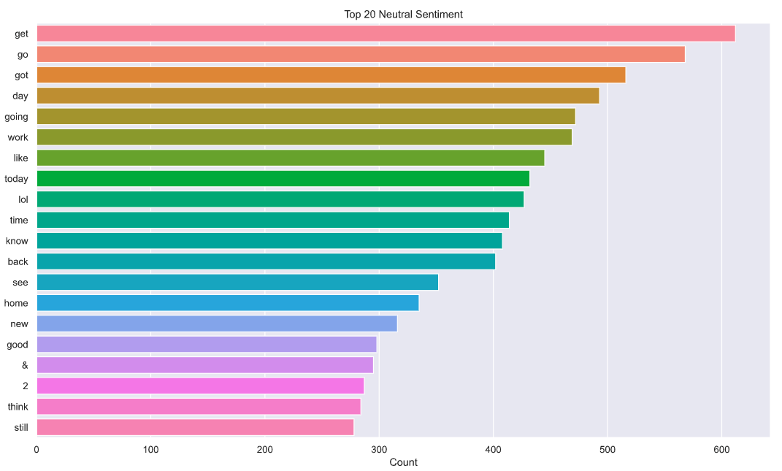
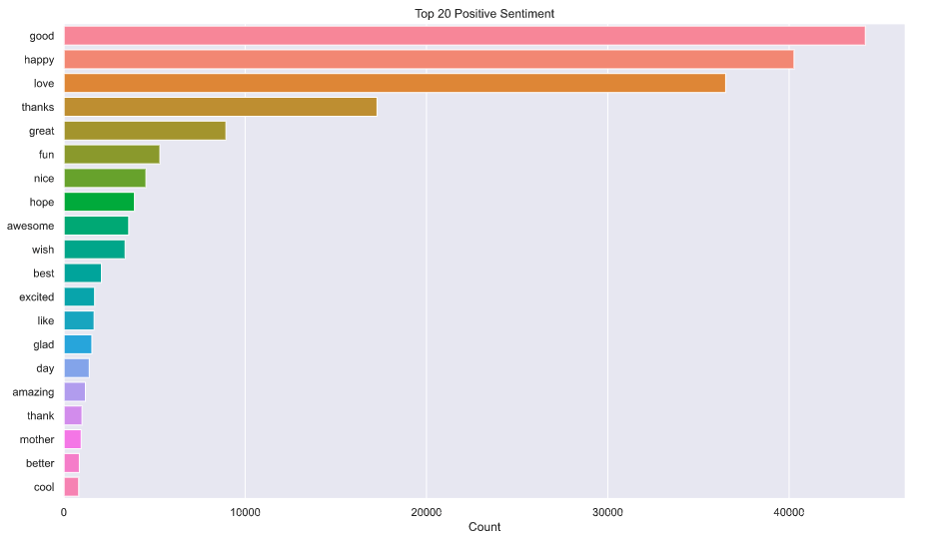

Slide 6
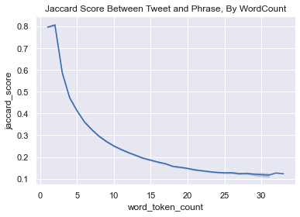
Key Insights
Unclean data used for model
May cause overfitting, but cleaning tweets may impact the sentiment
Phrases for smaller tweets are more similar to the actual tweet
Tweets less than 3 words are 100% similar

Slide 7
Simple Solution- Weighting the Words
Groups words by sentiment
Find how many tweets each word appears in
Divide this by the number of tweets in the sentiment
Proportion of tweets that contain the word
Weight = Proportion of tweets with the word – Proportion of tweets without the word

Slide 8
Simple Solution- Finding Selected Phrase
For every tweet
Find the sentiment of the tweet. If Neutral, return the entire text
Otherwise find the sum of weights for each subset of the tweet (all lengths)
Return subset of words with the largest sum of weights
Final score of 0.65825

Slide 9
SpaCy NER Solution (Name Entity Recognition)
Spots groups (people, places, organizations)
Classifies based on convolution neural network
TextCategorizer
Blank model that can be trained
Trained in batches
Order is randomized to prevent overfitting

Slide 10
Results
Feed in text, start and end locations for the entity, name of entity
Tweet String, start and stop location of given phrase, entity = ”Selected_Text”
('my boss is bullying me...', {'entities': [[11, 22, 'bullying me']]})
Jaccard Score of 0.779098

Slide 11

Questions?

