Slide 1
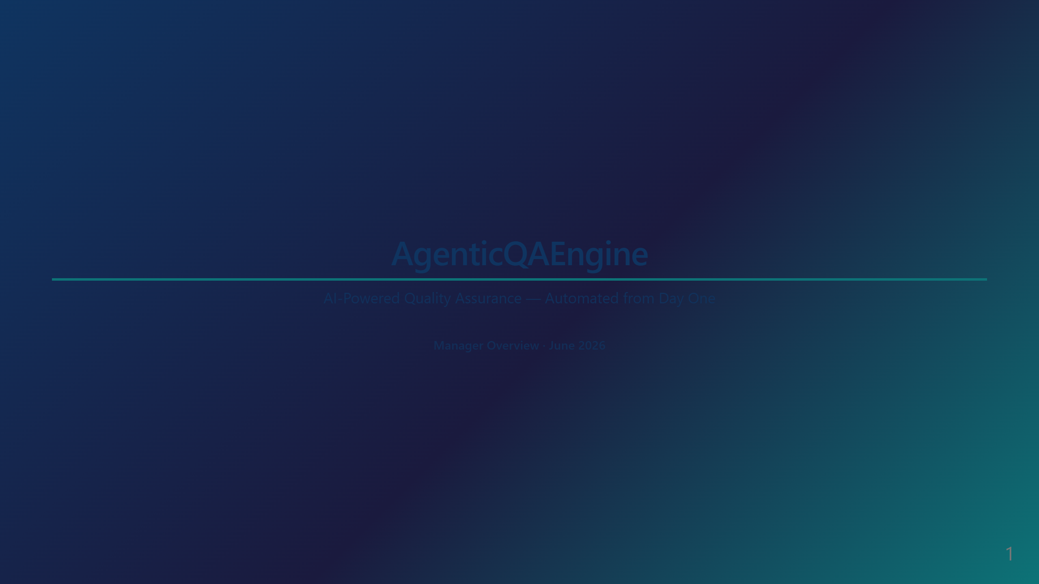

Slide 2
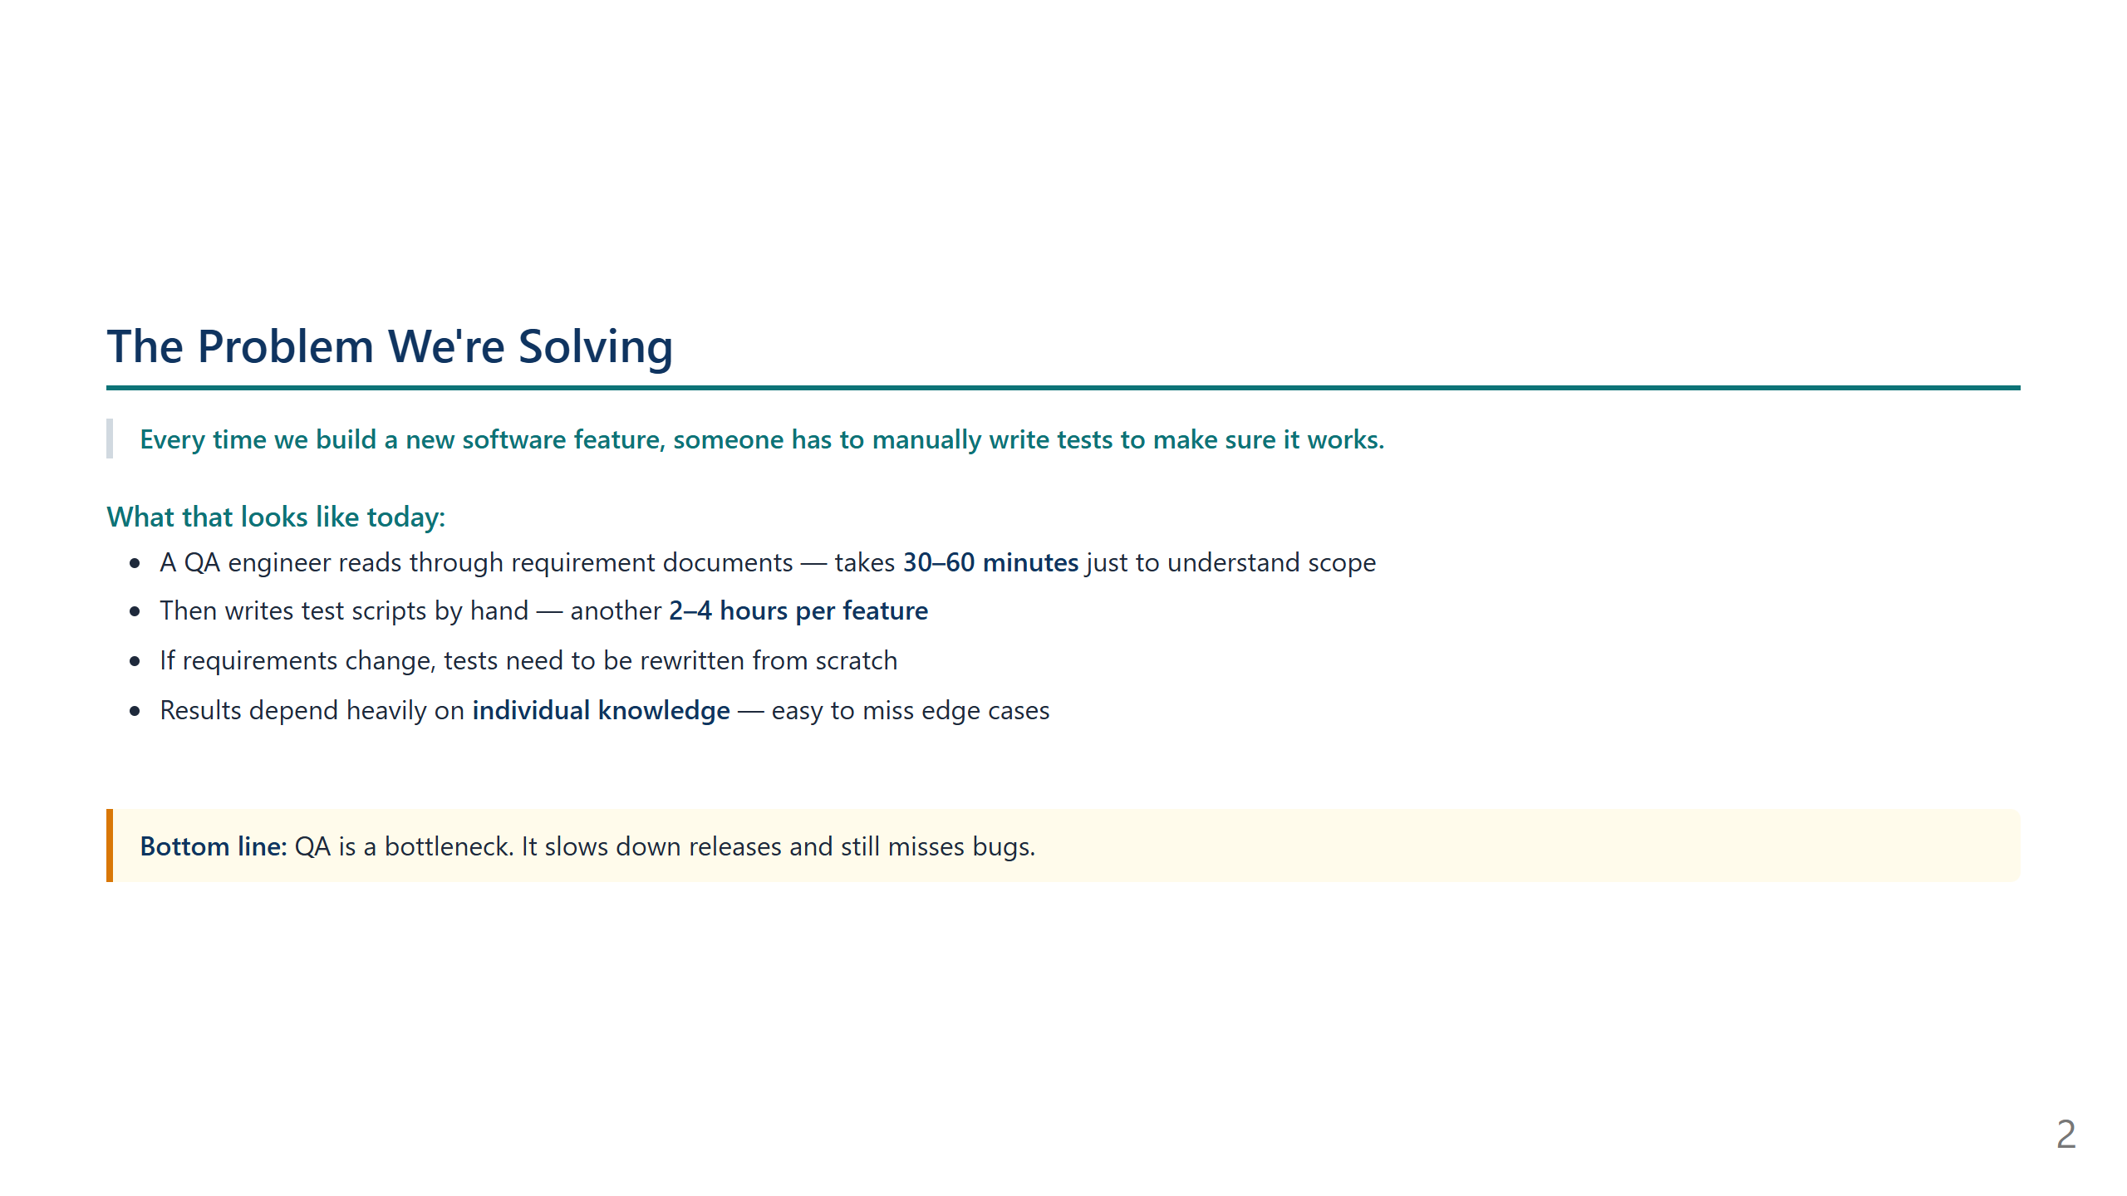
Notes:
SCRIPT — Slide 1 (Title) "Good [morning/afternoon]. Today I want to walk you through something we've built that changes how we approach software quality testing — completely. It's called AgenticQAEngine, and by the end of this demo I think you'll see why it matters for the team's speed and confidence when we ship new features."

Slide 3
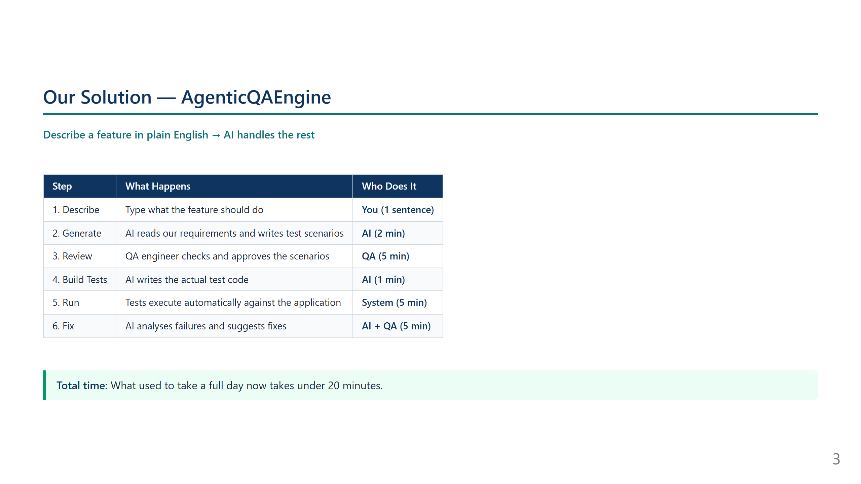
Notes:
SCRIPT — Slide 2 (The Problem) "Before I show you the solution, let me set the context. Every time the team builds a new feature — say, a new user login flow or a new employee onboarding screen — a QA engineer has to manually figure out all the ways to test it. That means reading documents, understanding business rules, and then writing dozens of test cases by hand. It takes hours, it's repetitive, and it still depends on one person's knowledge. If they miss an edge case, it becomes a bug in production. This is the bottleneck we set out to fix."

Slide 4
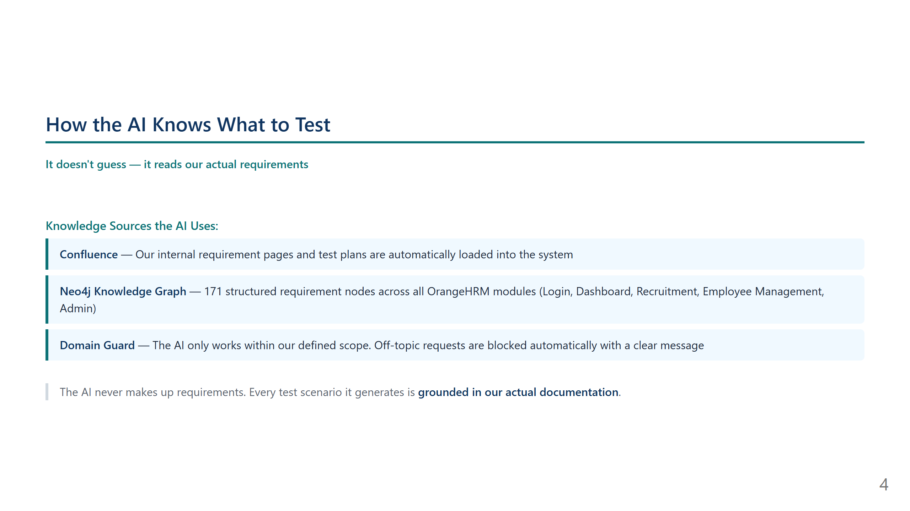
Notes:
SCRIPT — Slide 3 (Our Solution) "Here's what AgenticQAEngine does. Instead of a QA engineer spending hours writing tests manually, they simply type what a feature does in one sentence. The AI takes over from there. It reads our existing requirement documents, generates a comprehensive set of test scenarios, and writes the actual test code — all automatically. The QA engineer is still in the loop at every step. They review what the AI produced, make changes if needed, and give the green light before anything runs. What used to take a full day now takes under 20 minutes — end to end."

Slide 5
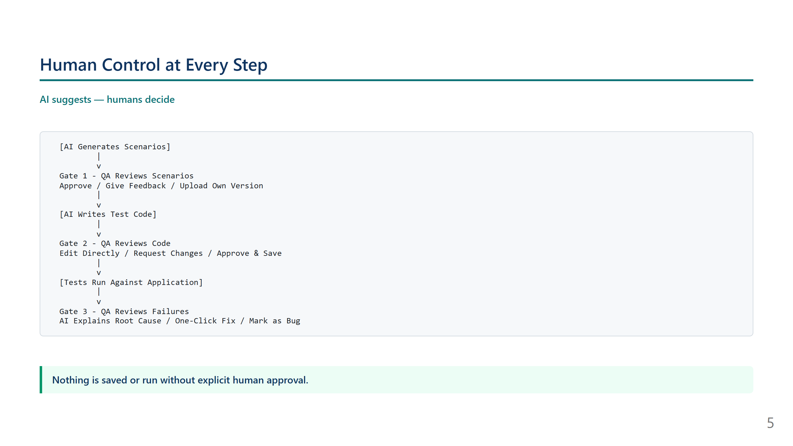
Notes:
SCRIPT — Slide 4 (How the AI Knows) "One thing managers often ask is — how does the AI know what's correct? Is it just guessing? The answer is no. We've connected it to our actual Confluence requirement pages and built a structured knowledge database with 171 requirement nodes. The AI reads these sources before generating anything. We also built a guardrail: if someone asks it to generate tests for something outside our defined scope — for example, a trading system — it refuses with a clear message. It only works with what we've told it about."

Slide 6
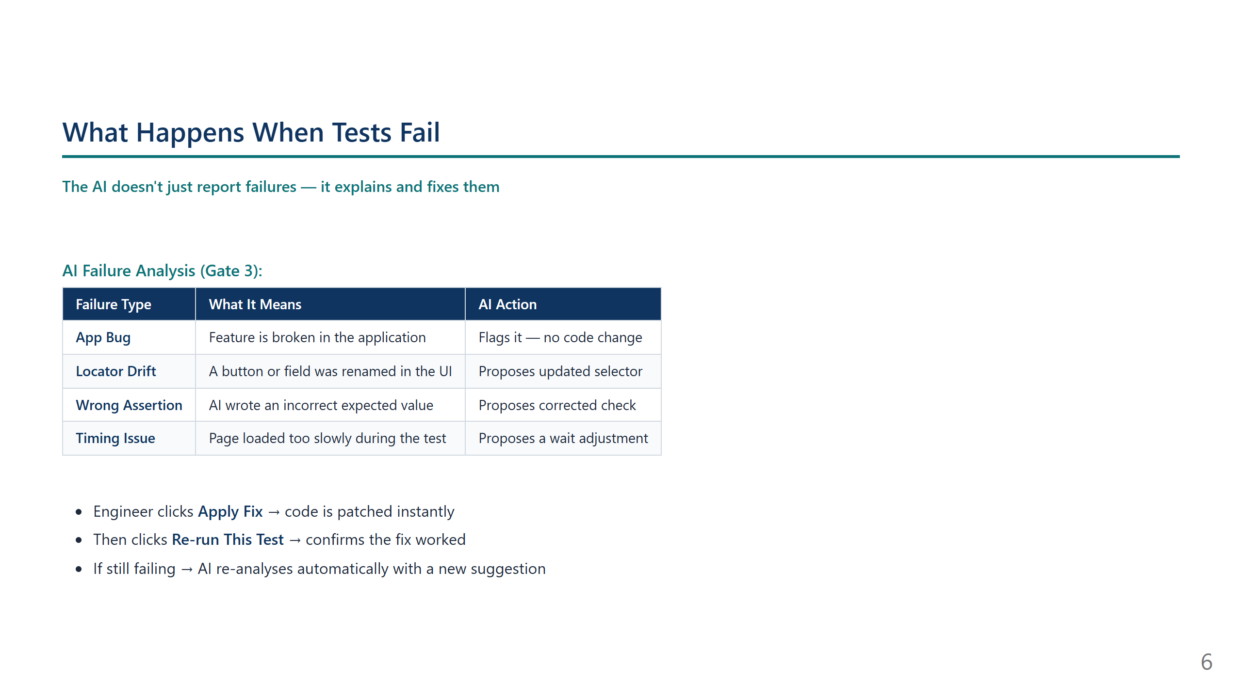
Notes:
SCRIPT — Slide 5 (Human Control) "I want to address something that often comes up: does this mean the AI just runs loose and generates whatever it wants? Absolutely not. There are three human approval gates built into the workflow. First, the QA engineer reviews every scenario the AI generates before any code is written. They can approve, reject, or give feedback — and the AI re-generates. Second, once the AI writes the test code, the engineer reviews and edits it directly before it's saved. Third, after tests run, if anything fails, the AI analyses the failure and suggests a fix — but the engineer decides whether to apply it. Nothing is saved, nothing runs, nothing is changed without a human saying yes."

Slide 7
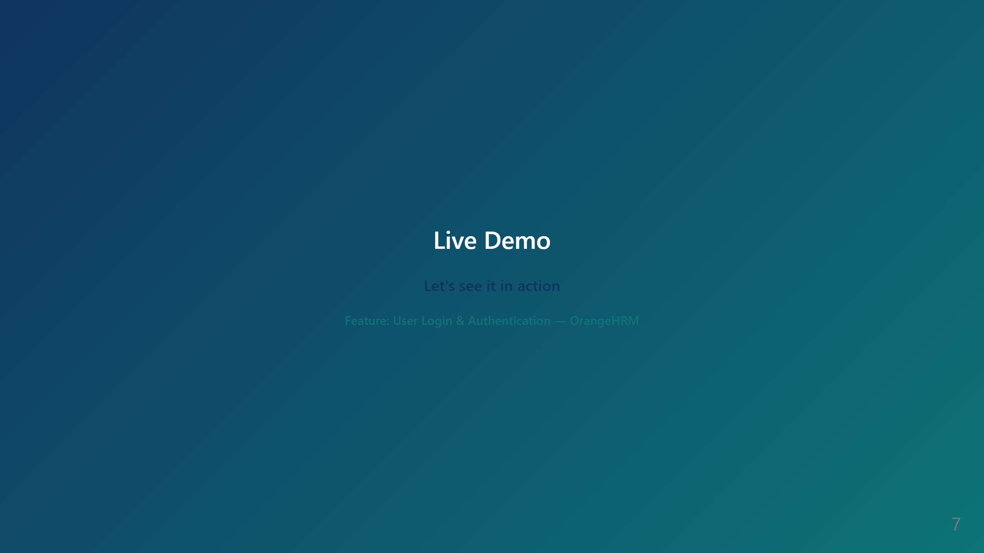
Notes:
SCRIPT — Slide 6 (What Happens When Tests Fail) "Here's where it gets really powerful. When tests fail — and in any real application, some will fail — the AI doesn't just say 'test failed, good luck.' It reads the actual error, looks at a screenshot of what the browser showed during the test, and classifies the root cause. Is it a real bug in the application? Is it a UI element that got renamed? Is it a timing issue? For anything fixable in the test code, it proposes an exact code change — old line vs new line. The engineer reviews it, clicks Apply Fix, and then re-runs just that one test to confirm it's resolved. This alone saves hours of debugging time."

Slide 8
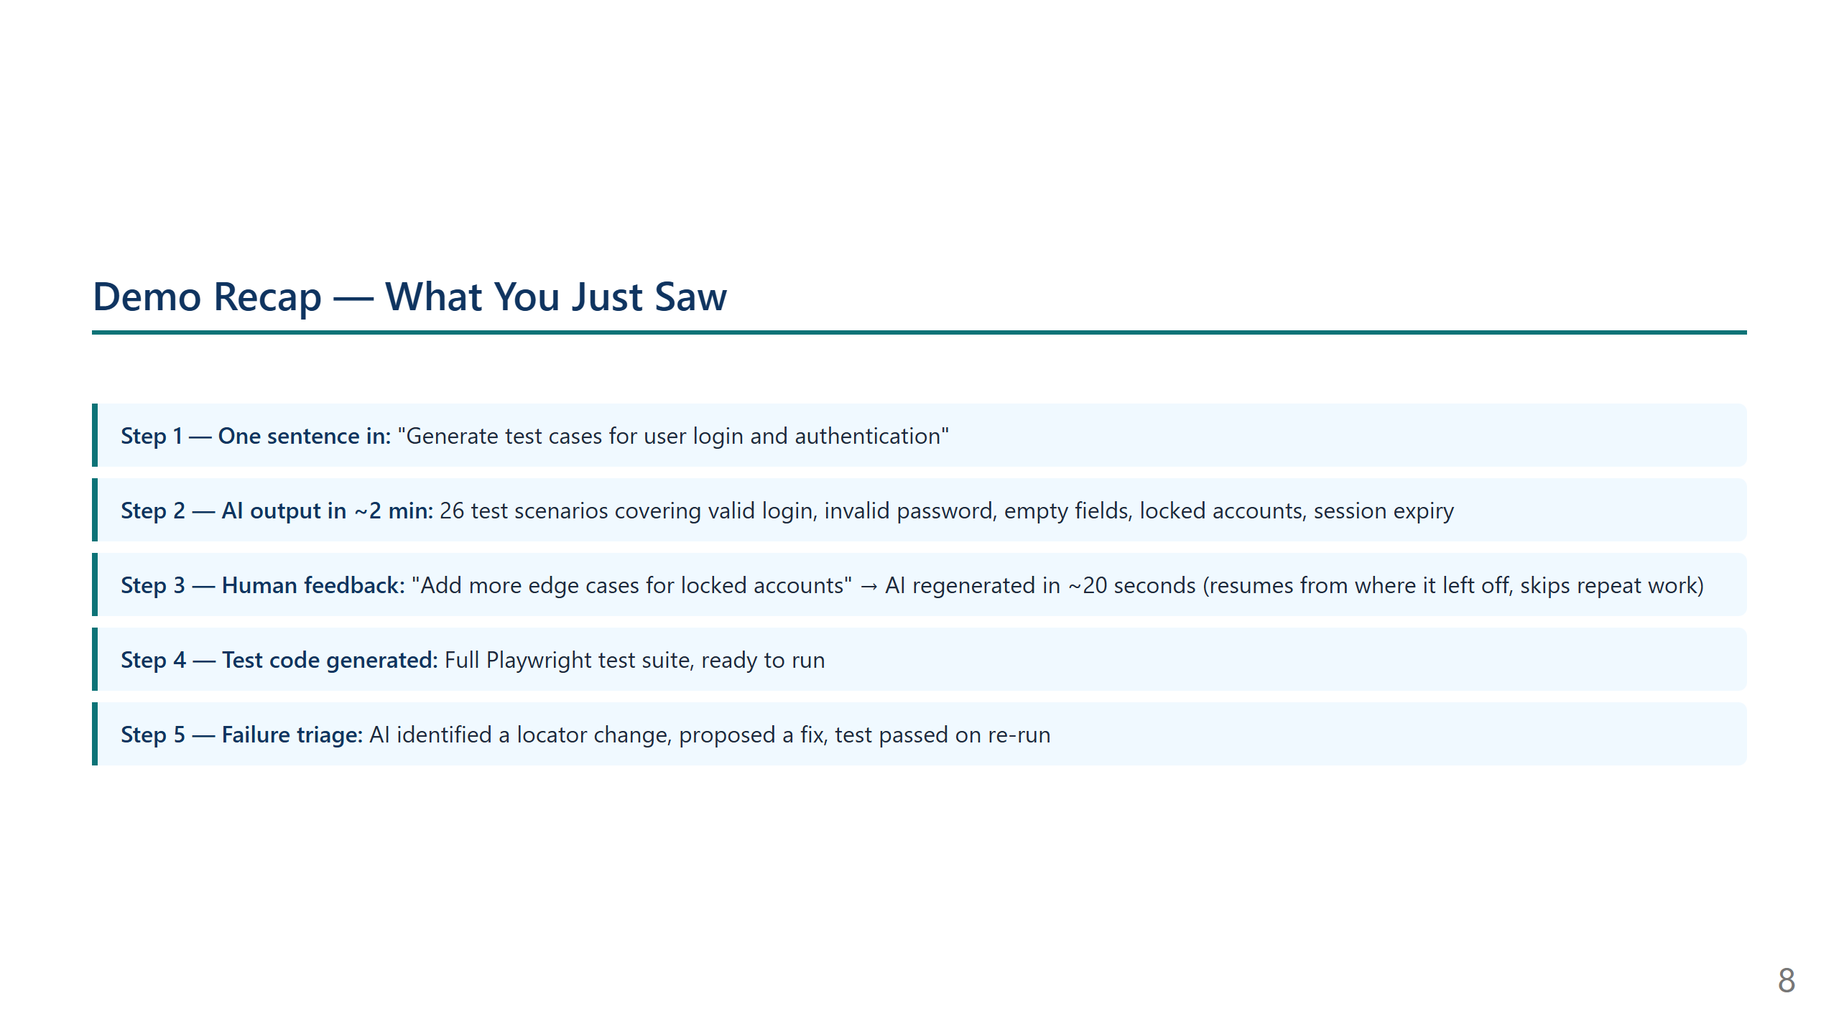
Notes:
SCRIPT — Slide 7 (Demo Divider) "Let me show you exactly how this works with a real example. We'll generate test cases for the user login and authentication feature in OrangeHRM. I'll type one sentence, and you'll see the AI produce a full test suite in under two minutes." [SWITCH TO LIVE DEMO — steps below] Demo flow: 1. Open http://localhost:3000 2. Type: "Generate test cases for user login and authentication" 3. Watch the 6-step pipeline animate 4. Show the generated Gherkin scenarios — point out variety: valid login, wrong password, empty fields, session expiry 5. Click "Re-generate" with feedback: "add more edge cases for locked accounts" 6. Show the faster HITL re-generation (~20s) 7. Approve scenarios → show test code generation 8. Open Saved Test Suites → show a pre-run suite with results 9. Click Triage Failures → show AI root cause + Apply Fix

Slide 9
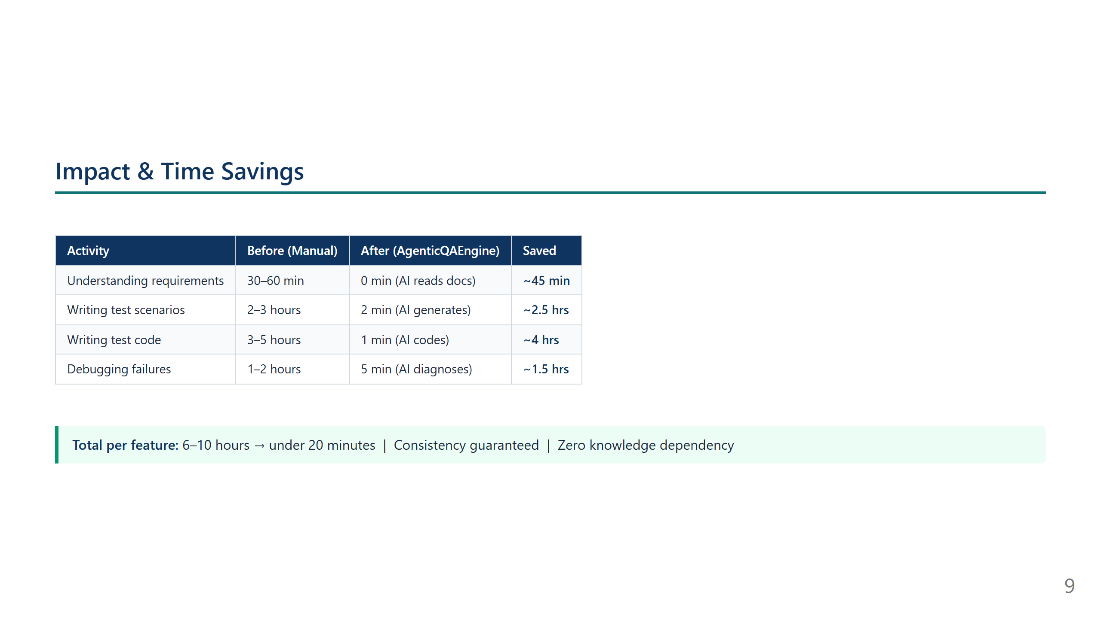
Notes:
SCRIPT — Slide 8 (Demo Recap) "So to summarise what we just saw: With one sentence, the system produced 26 test scenarios — all grounded in our actual requirements. When I gave feedback asking for more edge cases, it didn't start over — it resumed from where it had paused and came back with updated scenarios in about 20 seconds. The generated test code ran against the application, one test failed due to a UI change, the AI diagnosed it, proposed a one-line fix, and after applying it the test passed. That entire workflow — from typing the feature description to a passing test suite — took under 15 minutes."

Slide 10
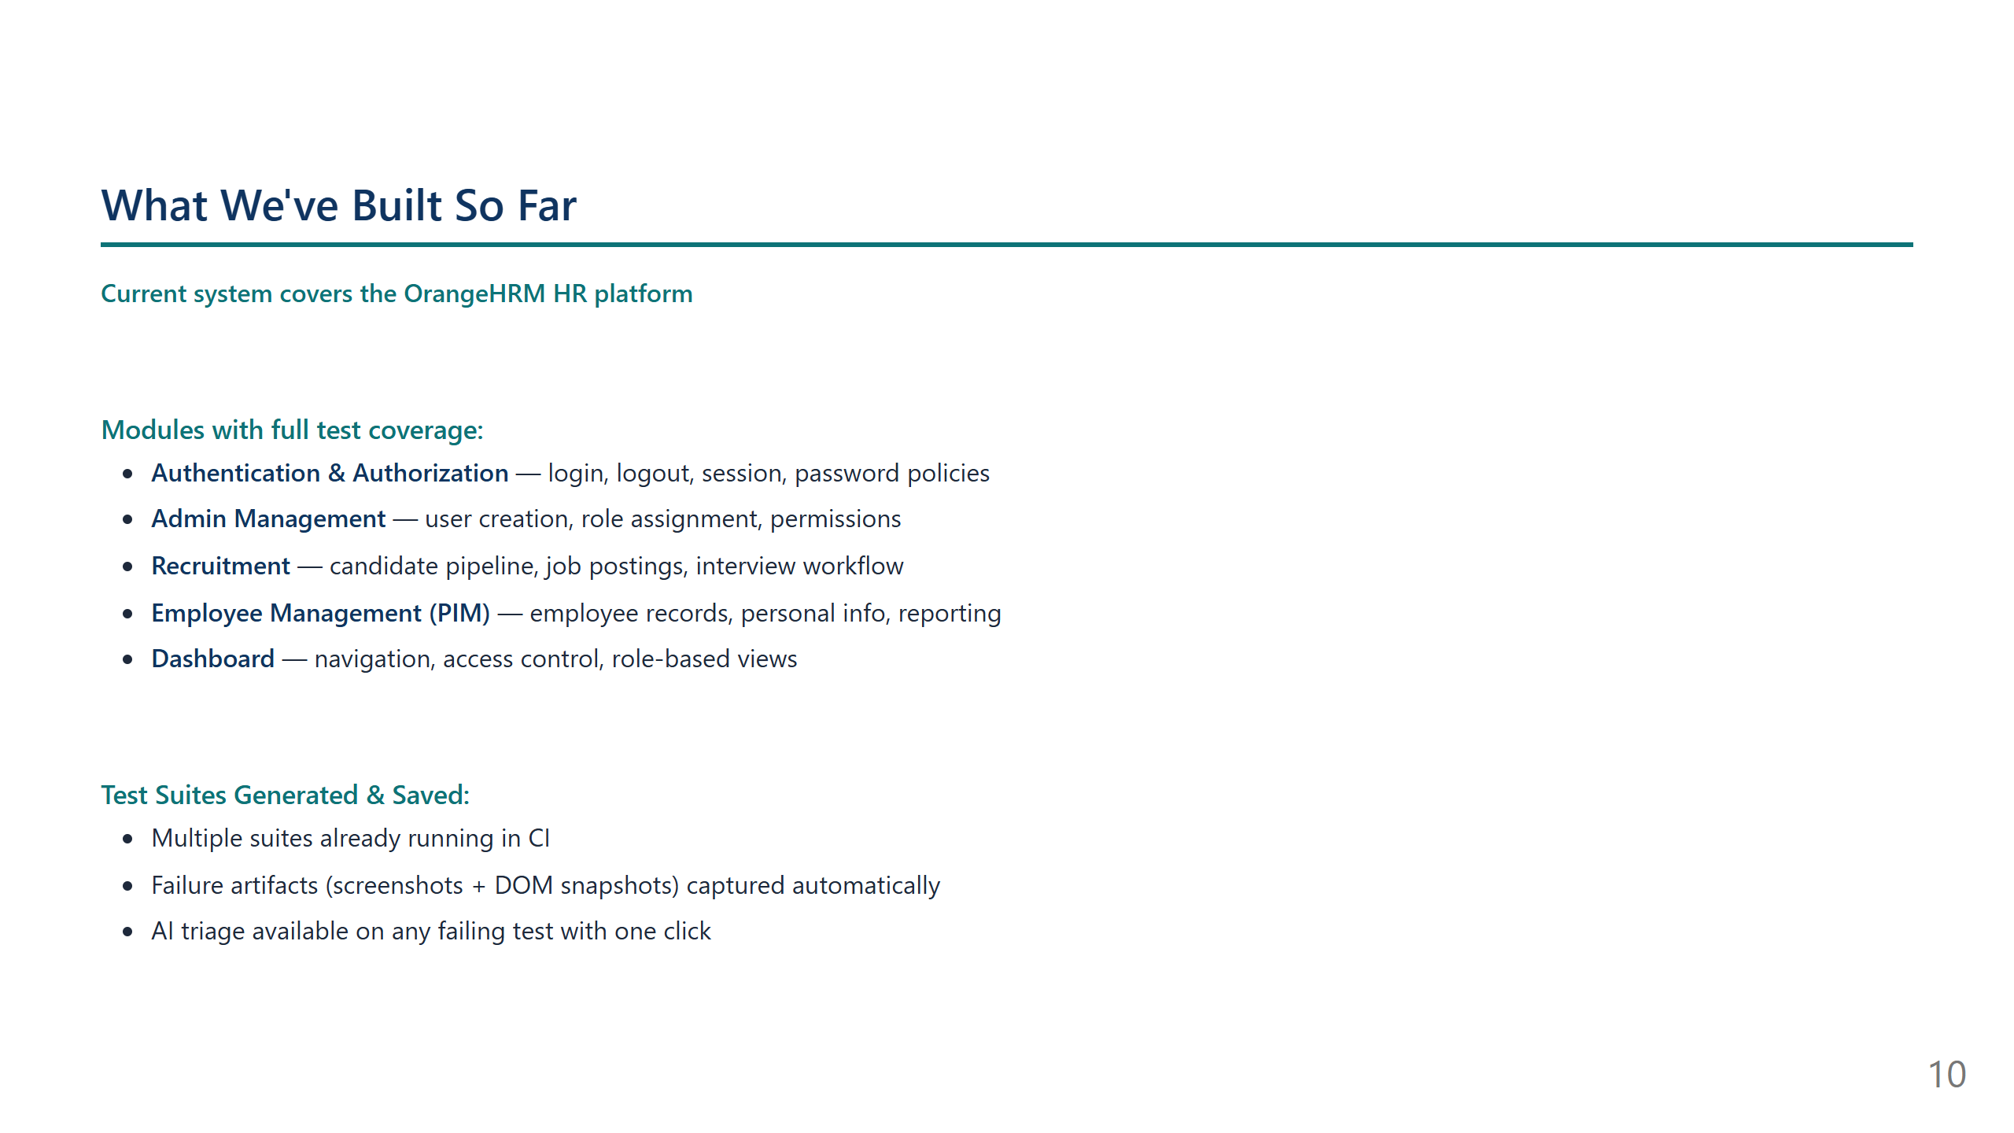
Notes:
SCRIPT — Slide 9 (Impact) "Here's what this means in numbers. For every feature we test, we save roughly 6 to 10 hours of manual QA work. That's not an estimate — that's based on our current team's actual time spent. Beyond speed, there's a consistency benefit. A manual QA engineer might miss edge cases on a Friday afternoon. The AI doesn't. It always checks the same categories — valid paths, error handling, edge cases, permissions. And there's no longer a single point of failure where only one person knows how to test a specific module."

Slide 11
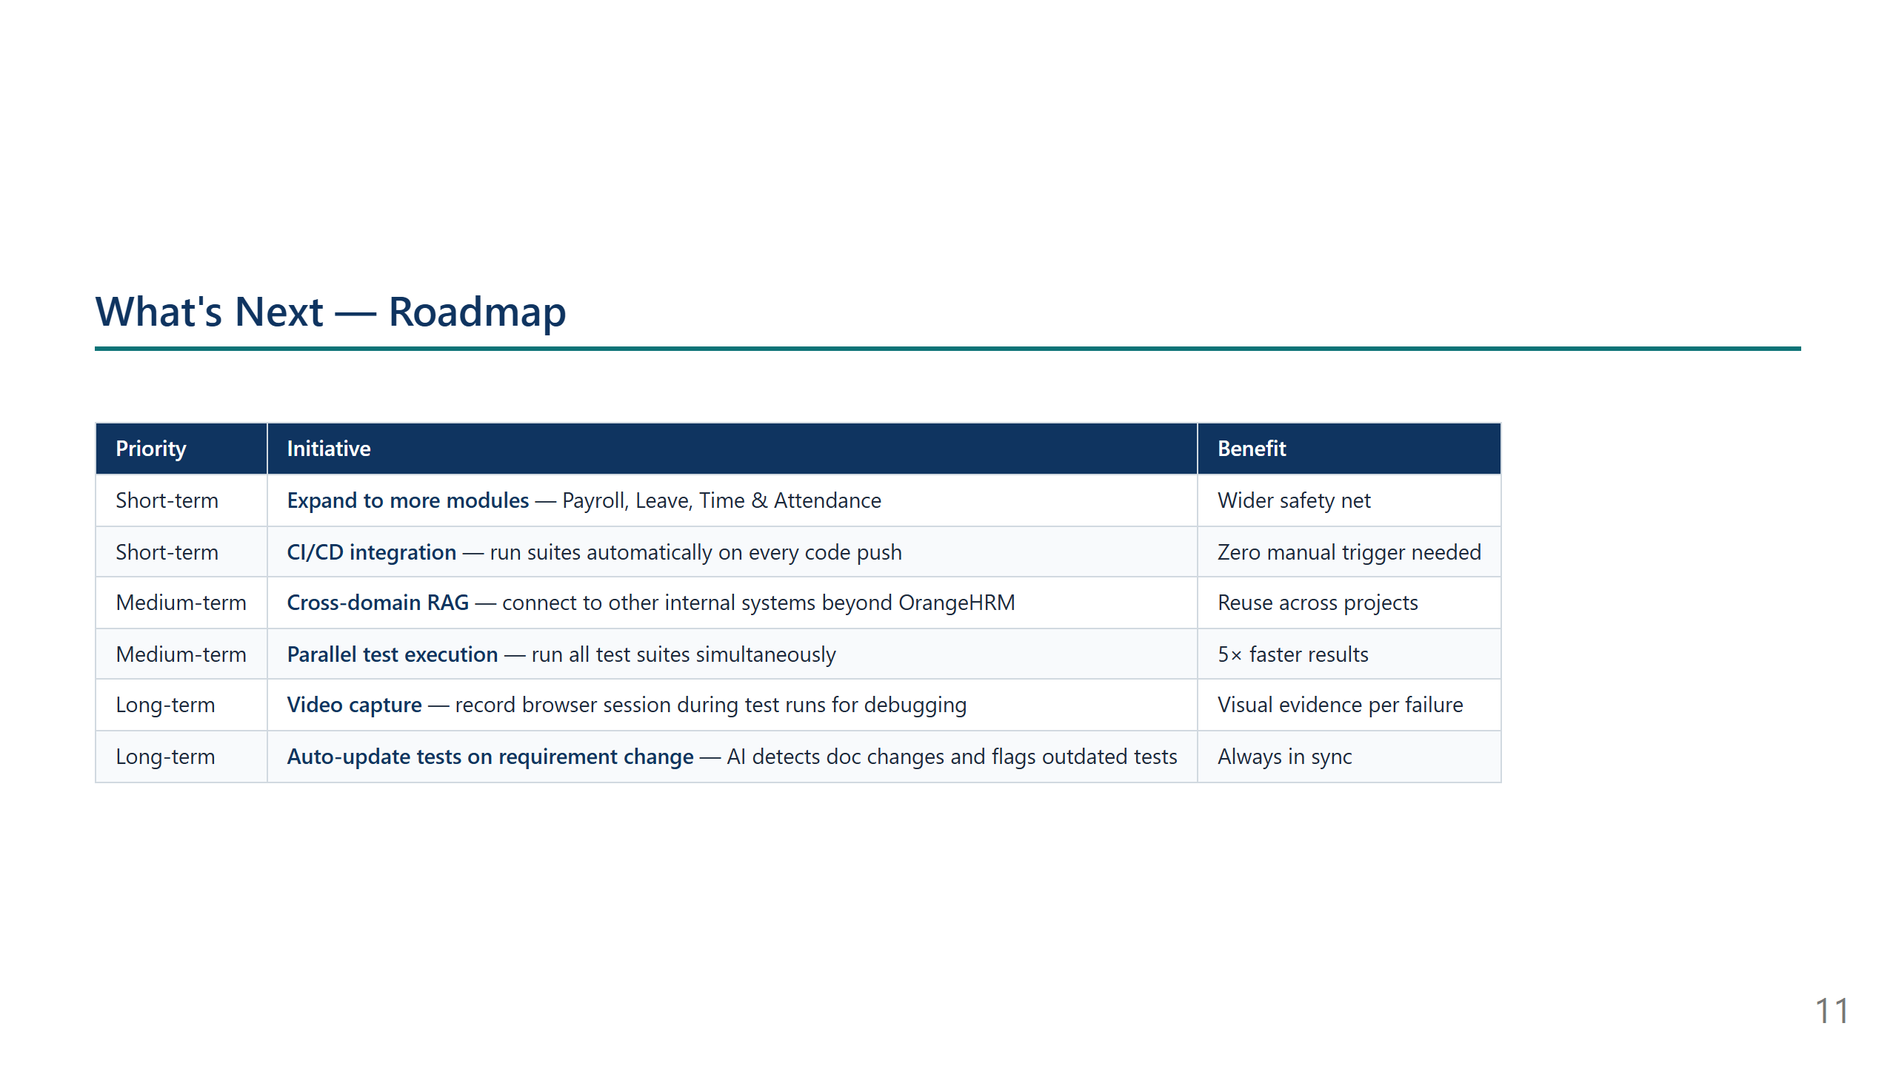
Notes:
SCRIPT — Slide 10 (What We've Built) "In terms of where we are today — we've built out full test coverage for five modules of our OrangeHRM HR system. Each module has scenarios, test code, and the ability to run and triage failures. We have multiple saved test suites that can be re-run at any time — before a release, after a configuration change, or whenever the team wants confidence that the system is working correctly."

Slide 12
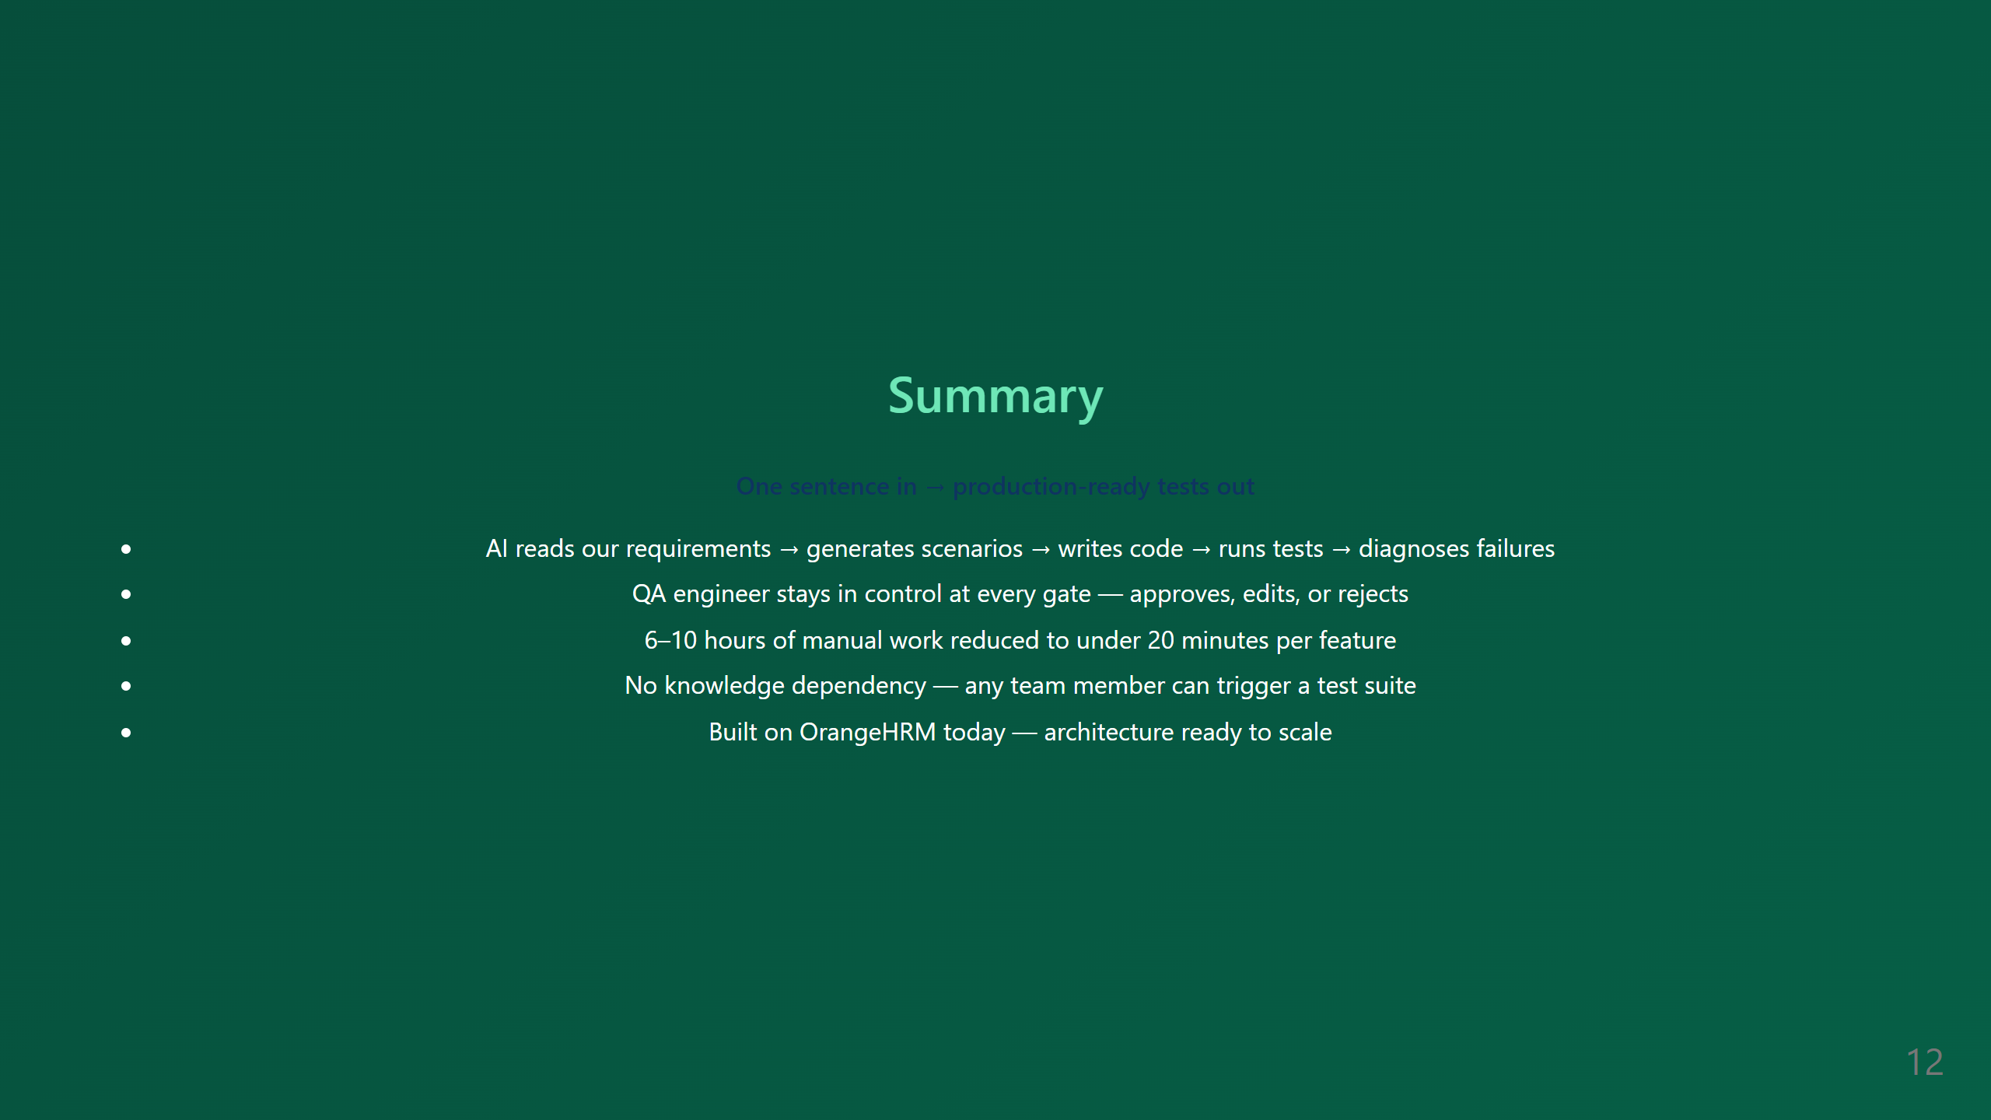
Notes:
SCRIPT — Slide 11 (Roadmap) "Looking ahead, the immediate next step is expanding coverage to the remaining OrangeHRM modules — Payroll, Leave, Time & Attendance. The bigger opportunity is CI/CD integration — connecting the system so tests run automatically every time a developer pushes code. That turns this from a QA tool into a continuous safety net. Longer term, the same architecture can be reused for any other system we bring in — not just OrangeHRM. The AI pipeline, the human-in-the-loop gates, the test execution engine — all of that carries over."

Slide 13
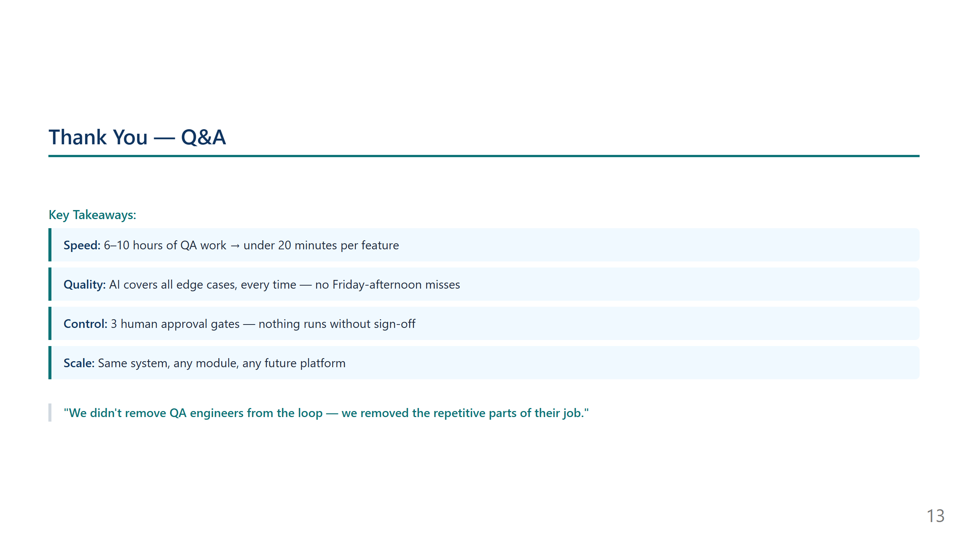
Notes:
SCRIPT — Slide 12 (Summary) "To wrap up: AgenticQAEngine takes what used to be one of the most time-consuming and knowledge-dependent parts of software delivery — writing and maintaining QA tests — and automates it end to end. The AI does the heavy lifting. The human stays in control at every step. And the result is faster releases, better coverage, and a team that spends its time on decisions rather than on writing boilerplate test code. I'm happy to answer any questions, or we can do a deeper dive into any specific part of the system."

Slide 14

Notes:
SCRIPT — Slide 13 (Q&A) [Wait for questions. Common ones and suggested answers:] Q: "What if the AI generates wrong tests?" A: "That's exactly why the human review gate exists. The QA engineer sees every scenario before any code is written. They can reject it, give feedback, or upload their own version." Q: "Does this replace the QA team?" A: "No. It removes the repetitive, time-consuming parts — reading docs, writing boilerplate code, debugging obvious failures. The QA engineer focuses on edge cases the AI might miss, business logic decisions, and interpreting what failures mean for the product." Q: "What systems can this work with?" A: "Right now it's connected to OrangeHRM through our Confluence and Neo4j knowledge base. The architecture is built to be extended — connecting a new system means loading its requirements into the knowledge graph." Q: "How accurate is the AI?" A: "The AI has a built-in review step — it grades its own output and re-runs if quality isn't met. In our testing, the human reviewer typically approves with minor feedback on the first or second generation."

