Slide 1
PPT No. 6 | COMMUNITY SERVICE PROJECT
Burglar / Intruder / Theft
Door Alarm with Buzzer
!
DEPARTMENT
SECTION
GROUP NO.
GUIDE
CSE (AI & ML)
B
6
Mr. B. Venkateswara Reddy
TEAM MEMBERS
24BQ1A4288 D. Venkata Siva Prasad
24BQ1A42B9 G. Mahesh Reddy
24BQ1A42B7 G. Yedukondalu
Burglar / Intruder / Theft Door Alarm with Buzzer
1

Slide 2
Problem Statement & Introduction
PROBLEM STATEMENT
INTRODUCTION
Burglary and unauthorized entry are common security concerns. Traditional locks alone give no immediate warning. A low-cost electronic alarm can alert people the moment an intruder attempts to enter.
The project uses sensors to detect unauthorized door entry
An Arduino Nano processes the sensor signal
A buzzer produces a loud audible alarm when intrusion is detected
The result is a simple, low-cost security system anyone can build
•
Risk of burglary in homes & rural areas
•
Lack of affordable security systems
•
Need for immediate, audible alerts
A door sensor and motion sensor work together with Arduino to instantly flag unauthorized access.
•
Need for easy installation & maintenance
Burglar / Intruder / Theft Door Alarm with Buzzer
2

Slide 3
Objectives & Components
OBJECTIVES
MAIN COMPONENTS
1
Detect unauthorized door opening
Arduino Nano
Magnetic Reed Switch
2
Detect intruder movement
Processes sensor signals
Detects door opening
3
Activate an alarm immediately
PIR Motion Sensor
Relay Module
4
Provide a low-cost security solution
Detects intruder movement
Switches the buzzer circuit
5
Keep the system simple & easy to maintain
Buzzer
Battery / Power Supply
Sounds the audible alarm
Powers the whole circuit
Burglar / Intruder / Theft Door Alarm with Buzzer
3

Slide 4
Circuit Diagram
Door Sensor + PIR Sensor → Arduino Nano → Relay Module → Buzzer
Door Sensor
(Magnetic Reed Switch)
D2
ARDUINO NANO
D3
USB
D8
Relay Module
Buzzer
PIR Motion Sensor
(Detects movement)
GND
VIN/5V
Battery /
Power Supply
Common GND Rail
Signal wire
Power (+)
Ground (GND)
Reed switch (D2) & PIR sensor (D3) send signals to Arduino → Arduino drives relay (D8) → relay switches buzzer ON.
Burglar / Intruder / Theft Door Alarm with Buzzer
4

Slide 5
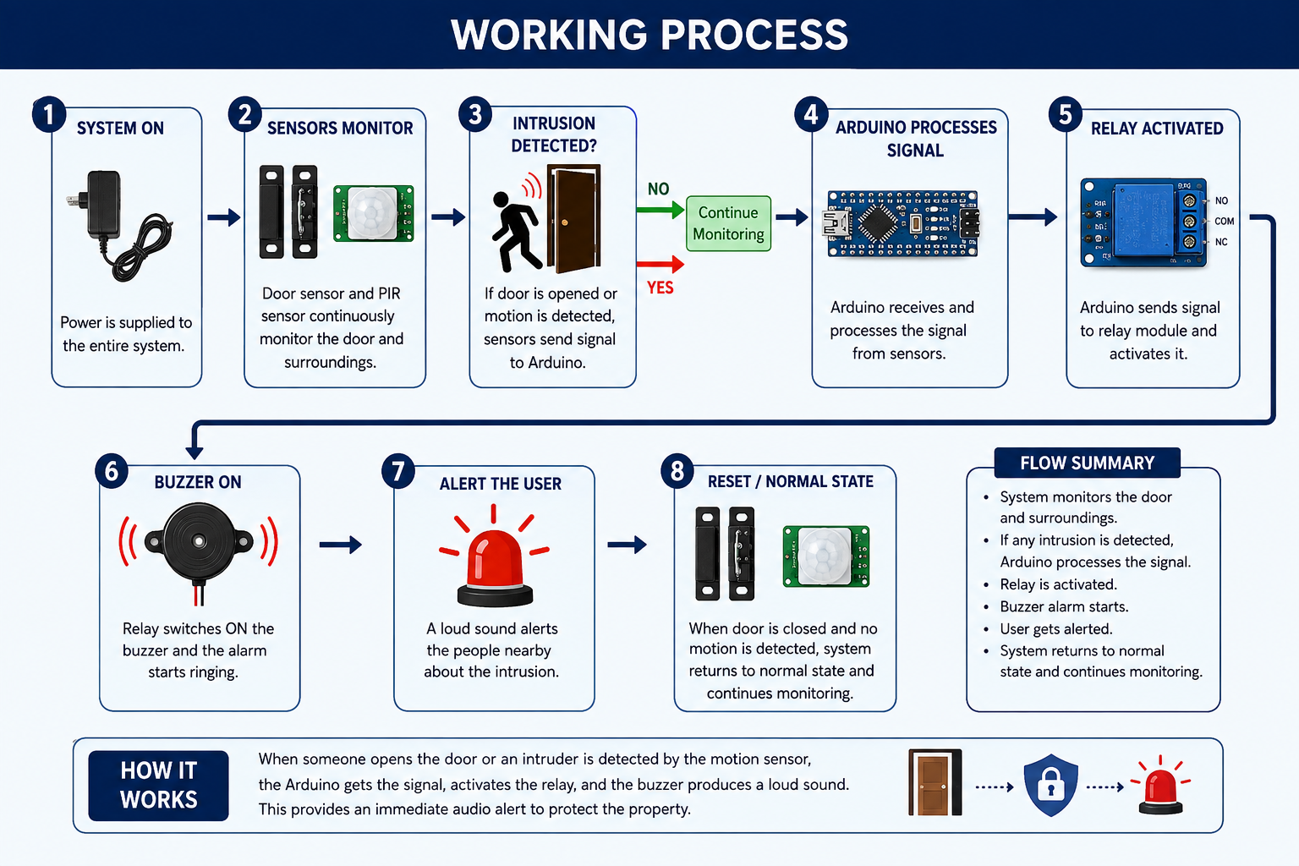
Burglar / Intruder / Theft Door Alarm with Buzzer
5

Slide 6
Advantages, Applications & Future Scope
ADVANTAGES
APPLICATIONS
FUTURE SCOPE
✓
Low cost
Houses
→ GSM/SMS alerts
✓
Easy to install
Shops
→ Wi-Fi / IoT connectivity
✓
Simple operation
Offices
✓
Immediate audible alert
Classrooms
→ Mobile application
✓
Low power consumption
Small warehouses
→ Camera integration
✓
Easy maintenance
Storage rooms
→ Cloud monitoring
→ Solar power
Burglar / Intruder / Theft Door Alarm with Buzzer
6

Slide 7
Expected Outcomes & Conclusion
EXPECTED OUTCOMES
✓
Detect unauthorized entry
THANK YOU
✓
Generate an immediate buzzer alert
✓
Improve awareness of intrusion
GUIDE
✓
Provide an affordable security system
Mr. B. Venkateswara Reddy
CSE (AI & ML) | Sec B | Group 6
CONCLUSION
TEAM MEMBERS
The Burglar / Intruder / Theft Door Alarm with Buzzer provides a simple, affordable and effective first level of protection against unauthorized entry, easy to implement for homes and small establishments.
24BQ1A4288
D. Venkata Siva Prasad
24BQ1A42B9
G. Mahesh Reddy
24BQ1A42B7
G. Yedukondalu
Burglar / Intruder / Theft Door Alarm with Buzzer
7

