Slide 1
My Portfolio Website
Shao Yee Ng (yee)
September 2020
Notes:
Hi guys, I’m Yee. Welcome to my portfolio website presentation. In this presentation, I’m going to show you my progress on creating my portfolio website from scratch using HTML and CSS.

Slide 2

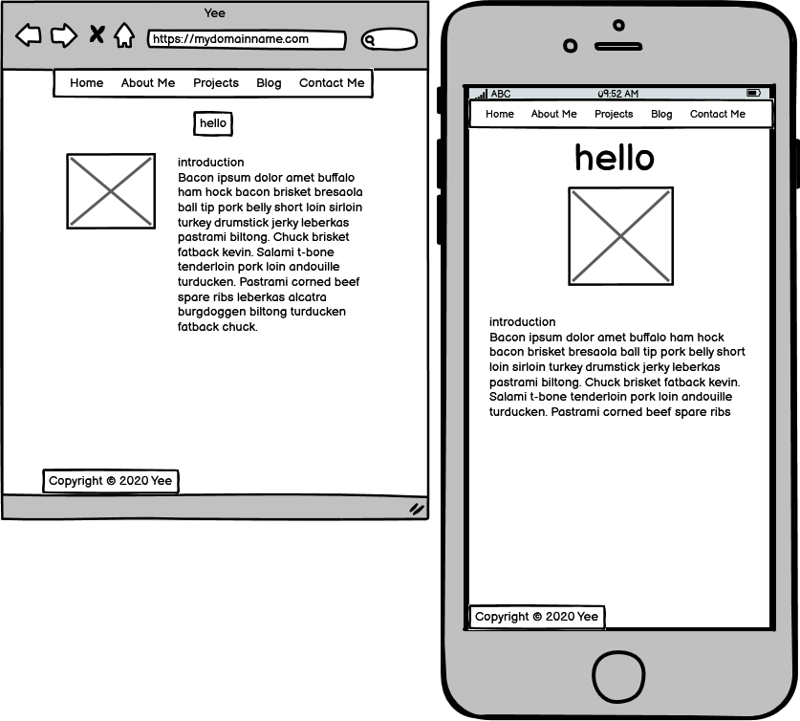

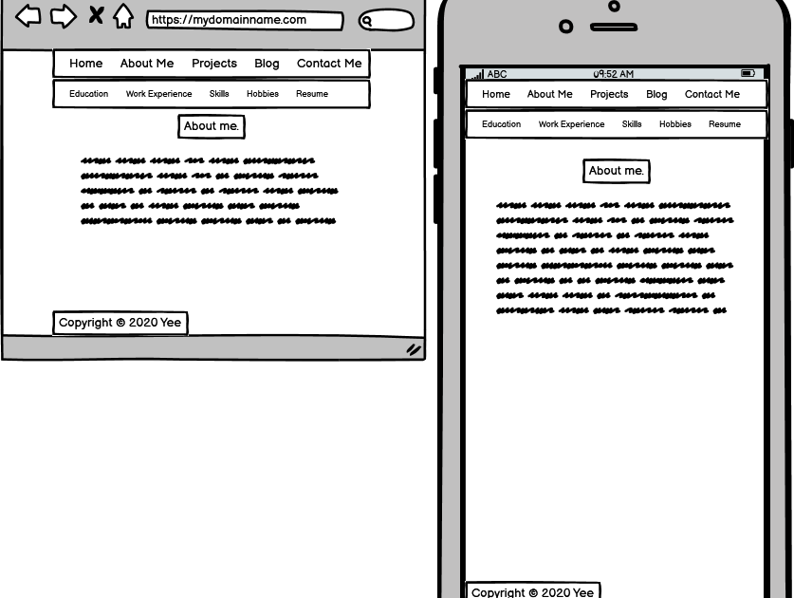



Balsamiq Wireframes
Notes:
The first thing I did was design the structure and layout of the website using Balsamiq Wireframes. In the next few slides, I’ll show you the different wireframes I created for the site. The wireframe you see on the left here is the homepage and it’s the parent of all the other pages on the site. It has a greeting, a photo and a short bio. I would like to take your attention to the navigation menu on top of the page. It’s a main component of the site as it helps users navigate to where they want to go on the site. This navigation menu or navigation bar is on all pages of the site. On the right hand side is the “About Me” page, originally, I planned to have another navigation bar for different HTML pages such as a separate page for education, a separate page for work experience and so on. But then when I was developing the website, I thought it would be a better idea to combine all these into one page so the page is cleaner with only one navigation bar. And that’s what I did with the actual website.

Slide 3
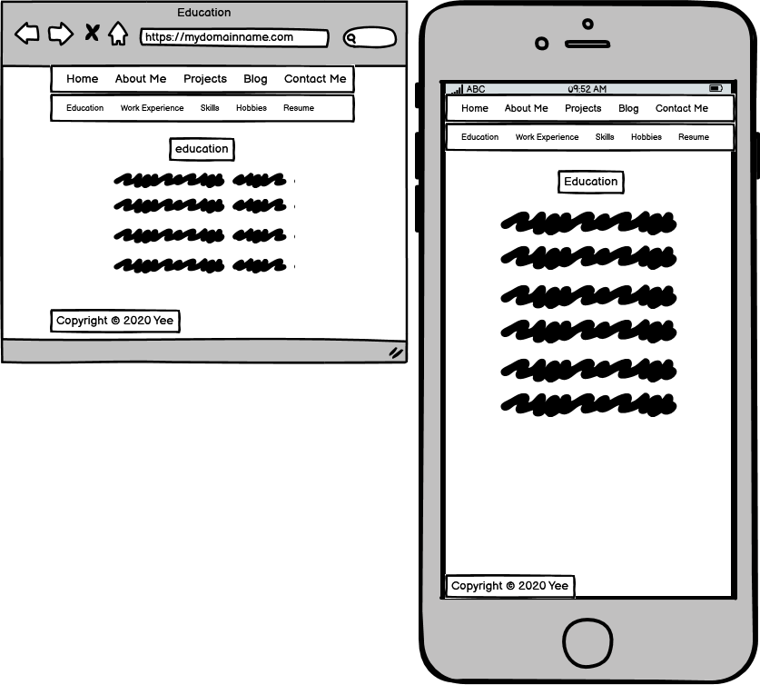
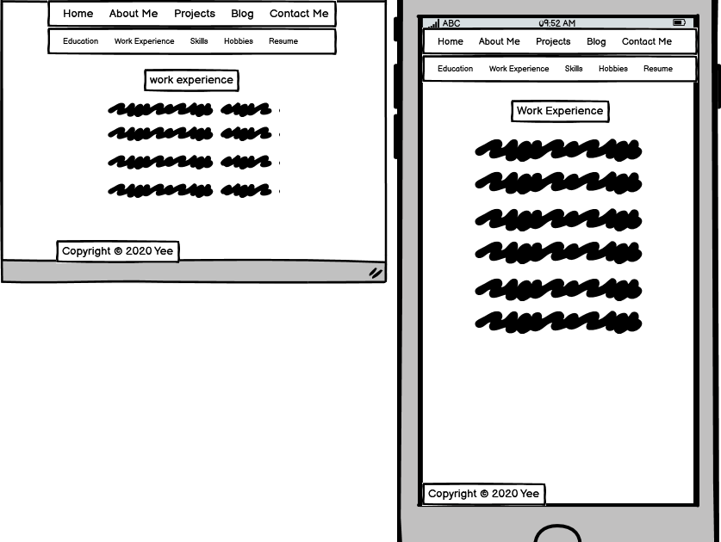
Balsamiq Wireframes
Notes:
Here’s what the pages were going to look like if they were separate pages but I have combined them into one page.

Slide 4
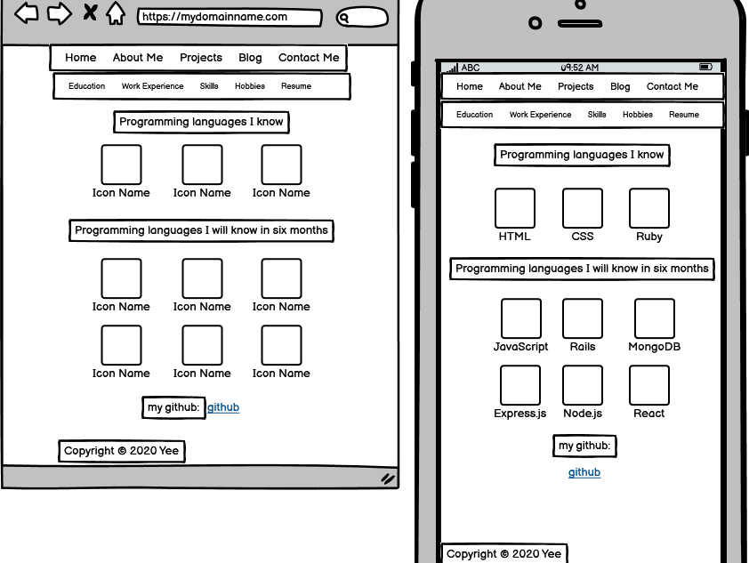
Balsamiq Wireframes
Notes:
This is the design for my “Skills” page. These blank boxes are icons for respective programming languages.

Slide 5
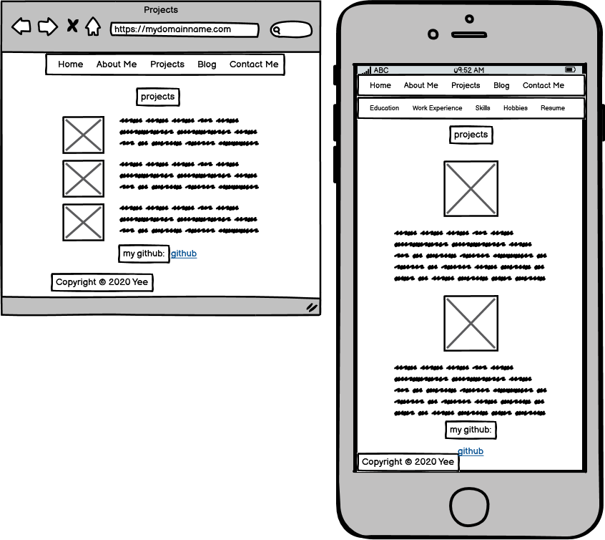
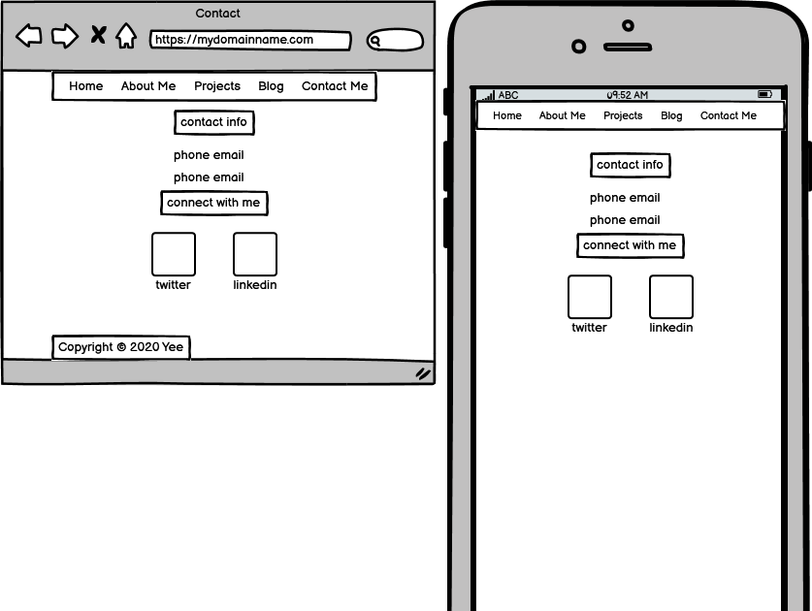
Balsamiq Wireframes
Notes:
These are the “Projects” and “Contact Me” HTML. With the social media icons, clicking or tapping the icon with bring the user to my social media account.

Slide 6
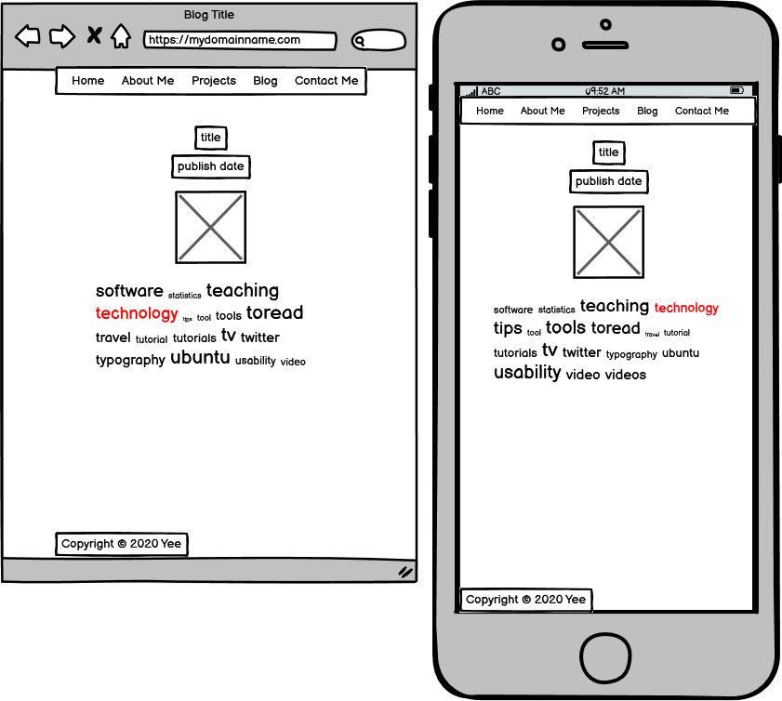
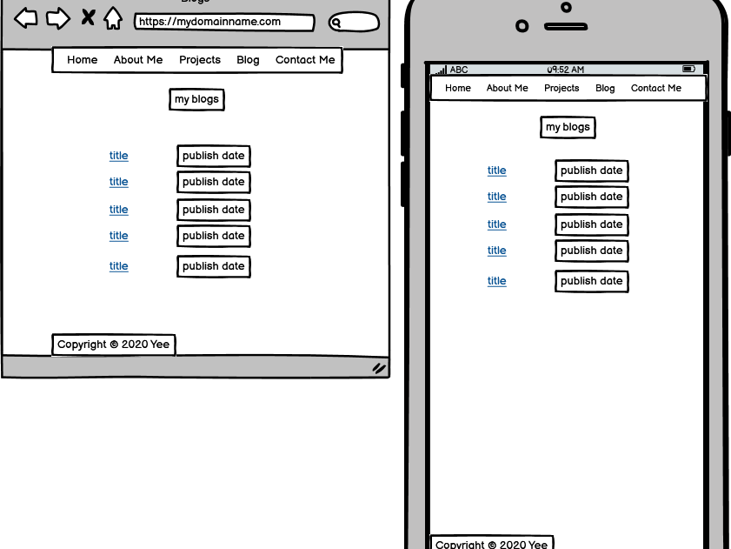
Balsamiq Wireframes
Notes:
And these are pages for my blog, the right wireframe has a list of links to my blog post with publish date. Clicking the link will bring the user to the blog post they want to read. And this is my blog post page.

Slide 7
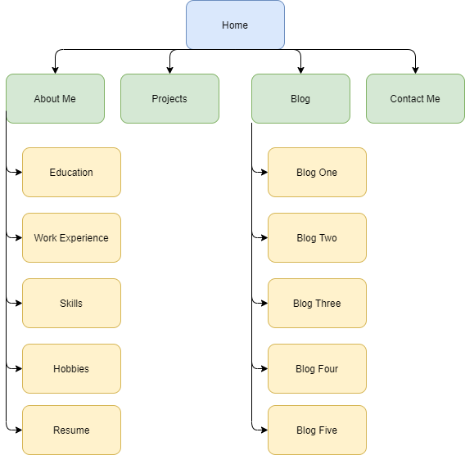
Sitemap
Notes:
This is the sitemap of the website showing the overall structure of the website. The home page is the parent page or grandparent page to all the other pages. A user can find information about me in the about me page and the blog link is the parent to all the blog posts. I forgot to mention that I have also decided to add another link to the navigation menu named “Technical Skills”. The reason I did this was because I think technical skills is very important consideration for prospective employers and having a separate page just for this would be quite handy.

Slide 8
Website Components
Navigation menu
Headings
Typography
Images
Links to internal pages and external websites
Responsive design
Semantic HTML
Notes:
When I was developing the website, these are the components I spent the most time on to make the website user friendly and easy to navigate. The main component being the navigation menu with all the links to their respective page. I have also use big headings throughout the pages to highlight what each page is about to capture the users’ attention. Instead of using the browser default font type and font size, I have chosen a font that I think is quite easy to read and make the fonts bigger. To make the website prettier, I used images instead of plain text to showcase my skills. To ensure that the website displayed properly on different screen sizes, I also applied the responsive design concepts I learned such as using percentages to size image and flexbox to display the images. Last but not least, I have used semantic HTML to give meaning to the content of an element such as header, section, article, figure, figcaption and so on. Now let me give you guys a live demo of the website that I deployed using Netlify.

Slide 9
Live Demo

