Slide 1
My Portfolio Website
by shao yee ng (yee)
August 2020

Slide 2
My Portfolio Website
The design process.
The website and its features.
Project review.

Slide 3
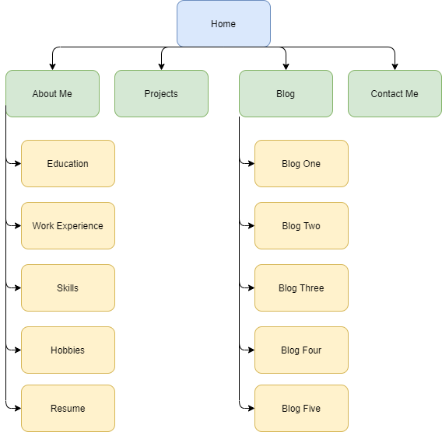

Slide 4


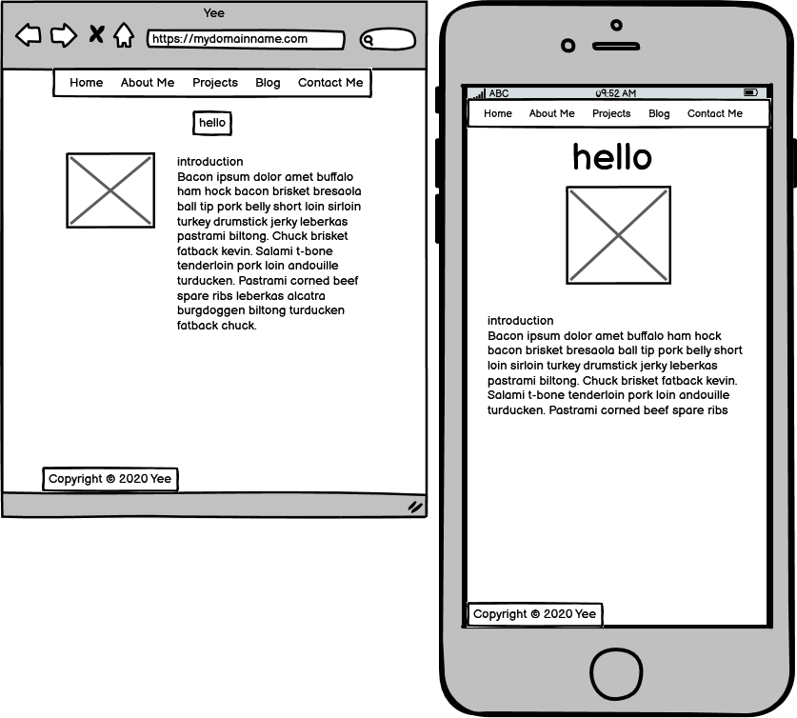



Wireframes (Balsamiq)

Slide 5
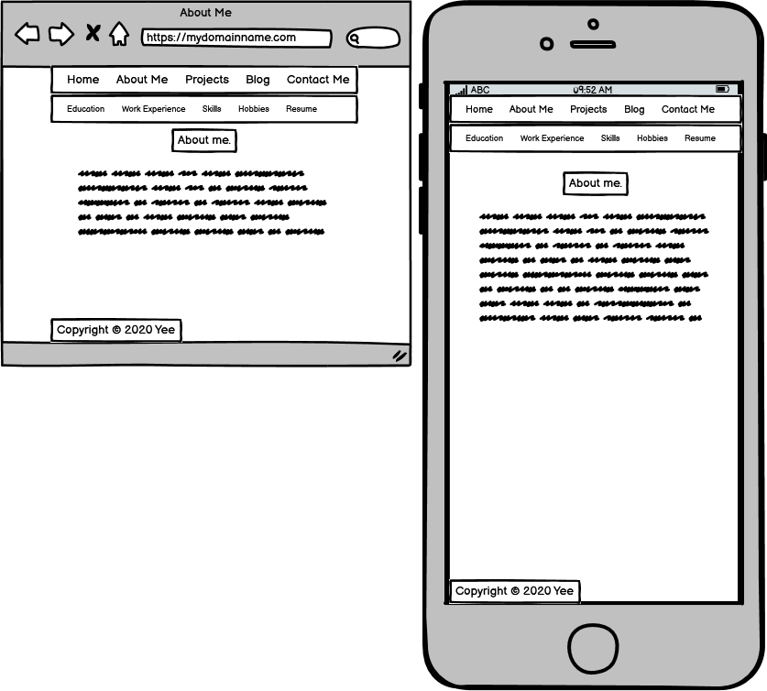
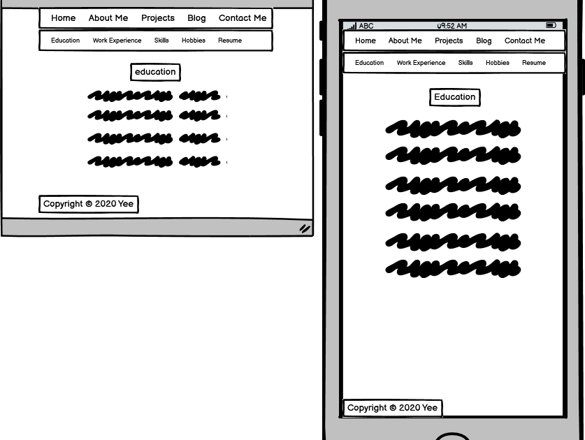

Slide 6
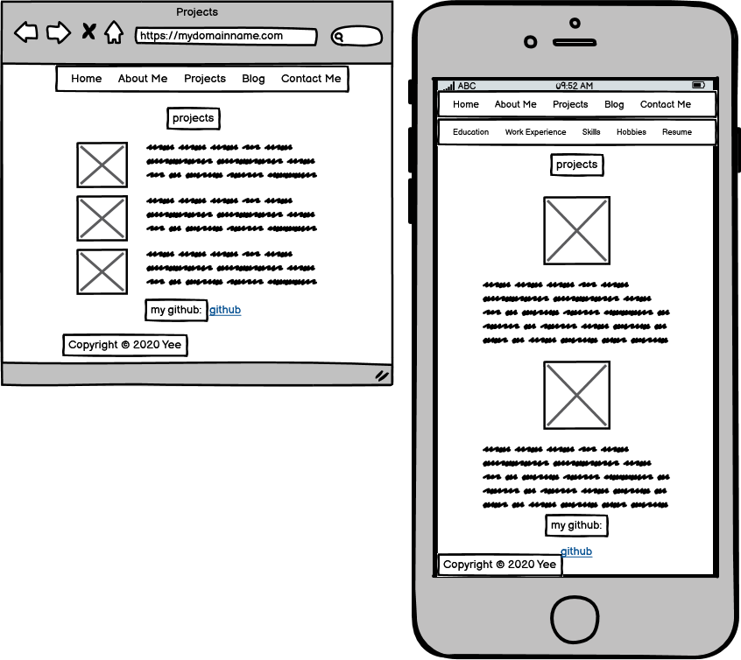
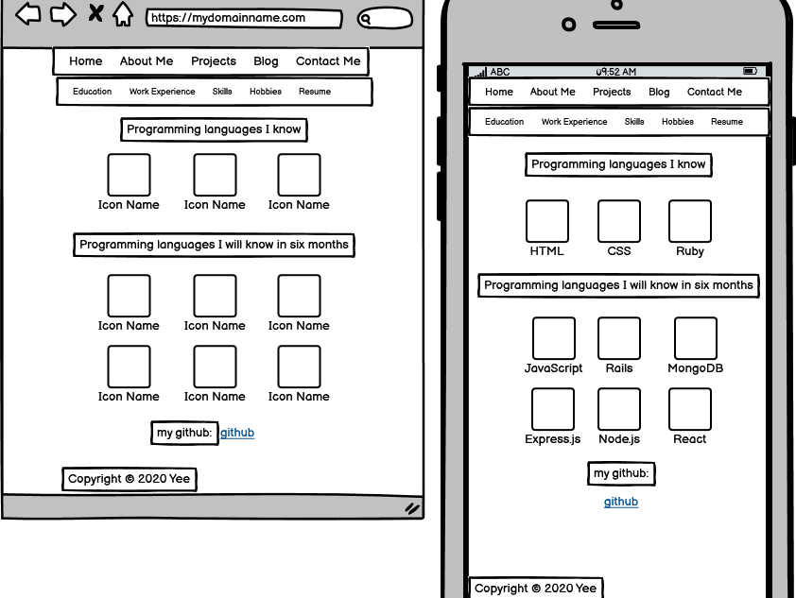

Slide 7
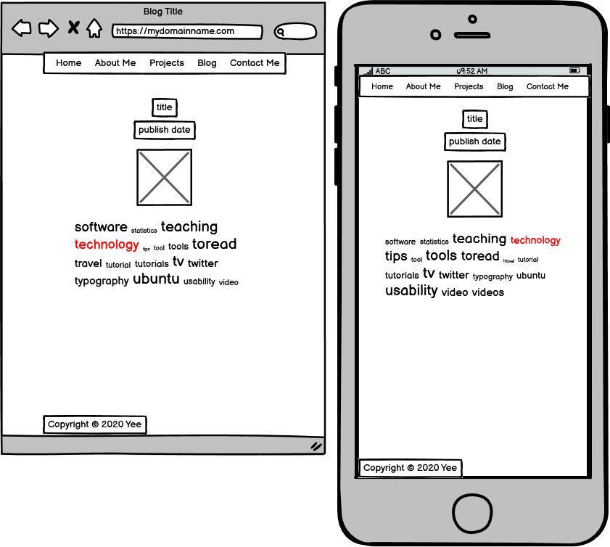
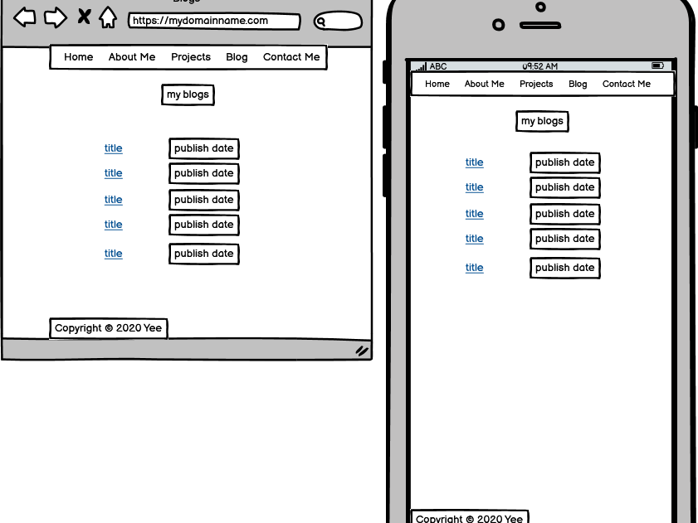

Slide 8
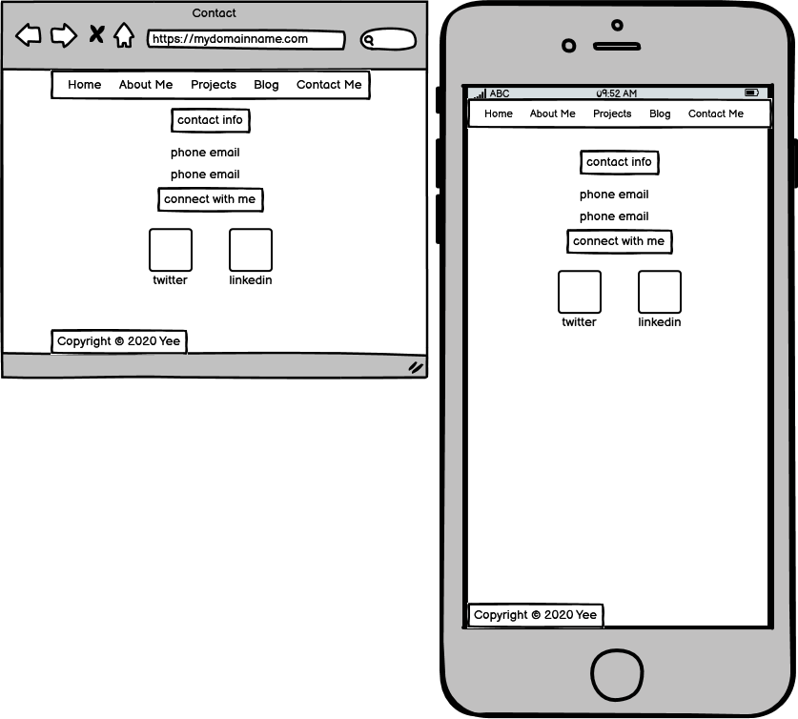

Slide 9
Website Components
Navigation menu
Headings
Legible font type
Images/icons
Links
Responsive design

