Slide 1
My Portfolio Website
Shao Yee Ng (yee)
September 2020

Slide 2

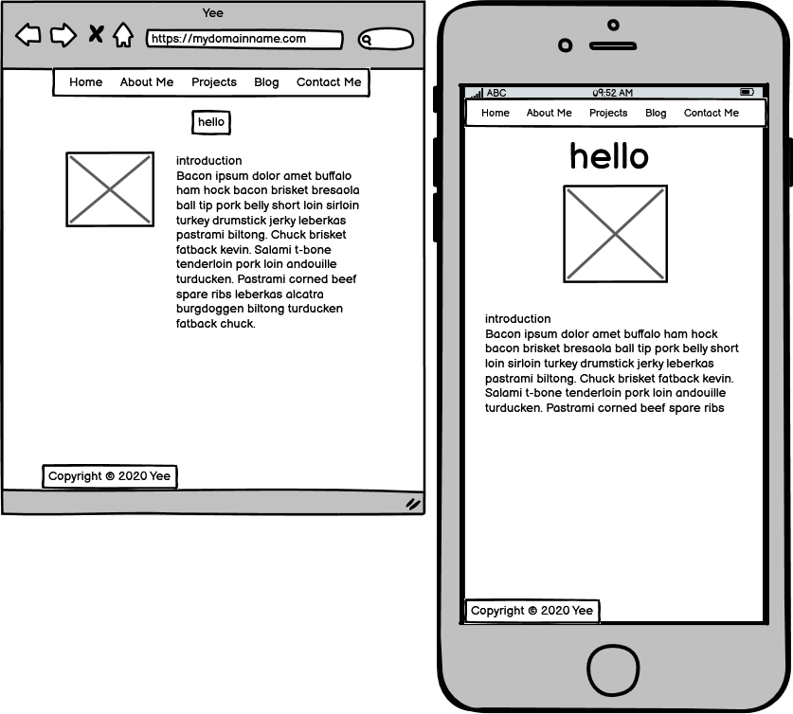

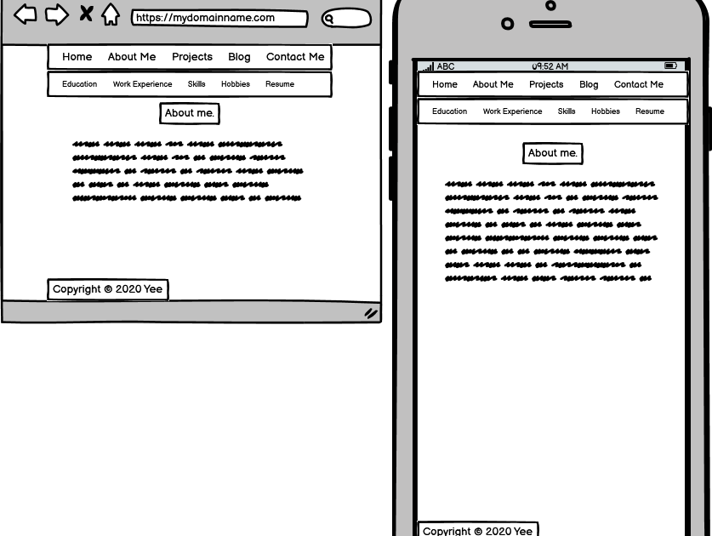



Balsamiq Wireframes

Slide 3
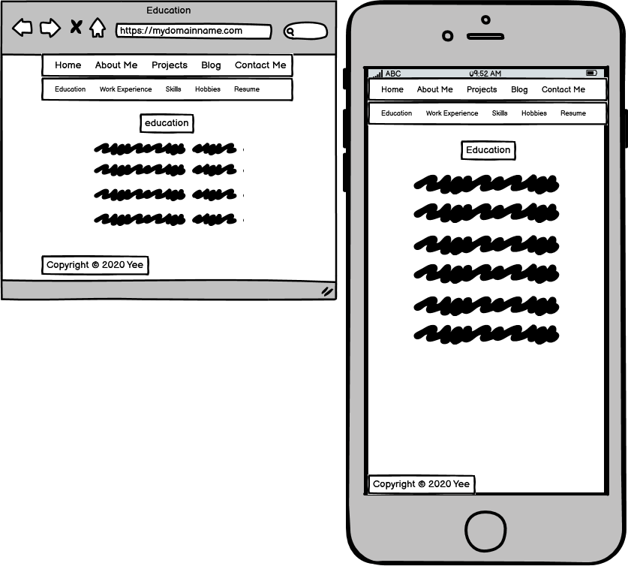
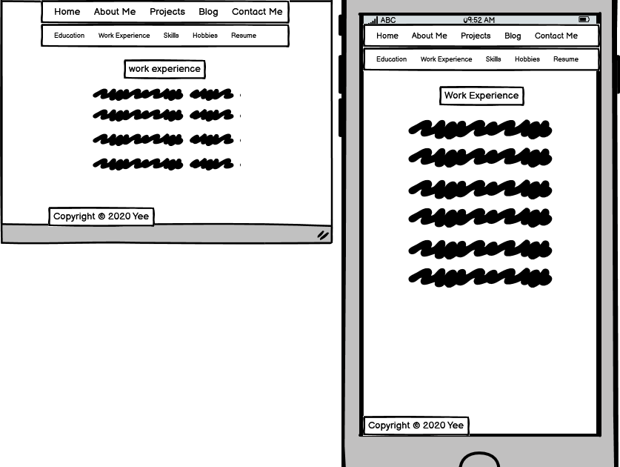
Balsamiq Wireframes

Slide 4
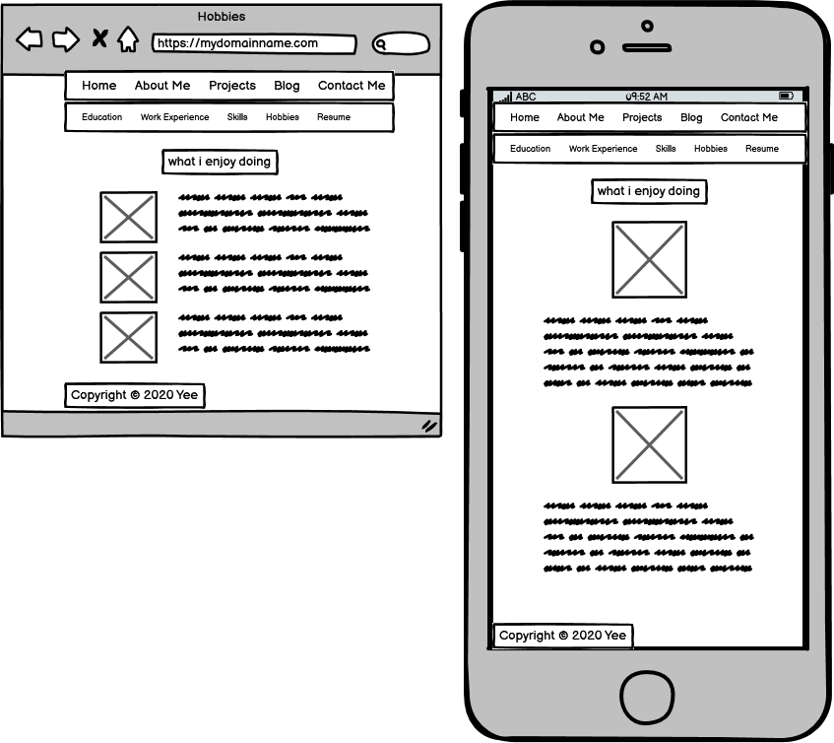
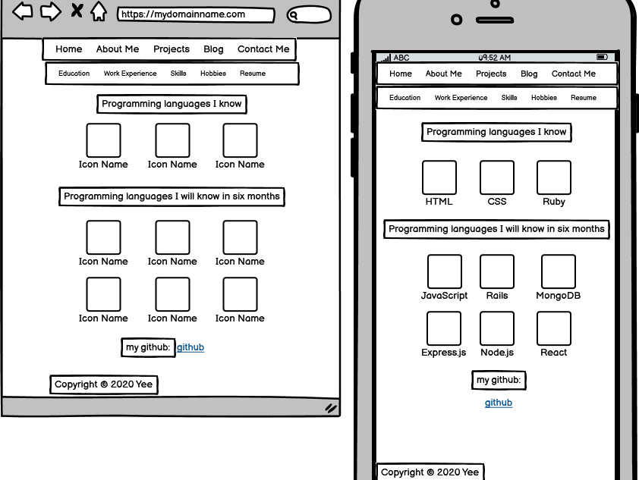
Balsamiq Wireframes

Slide 5
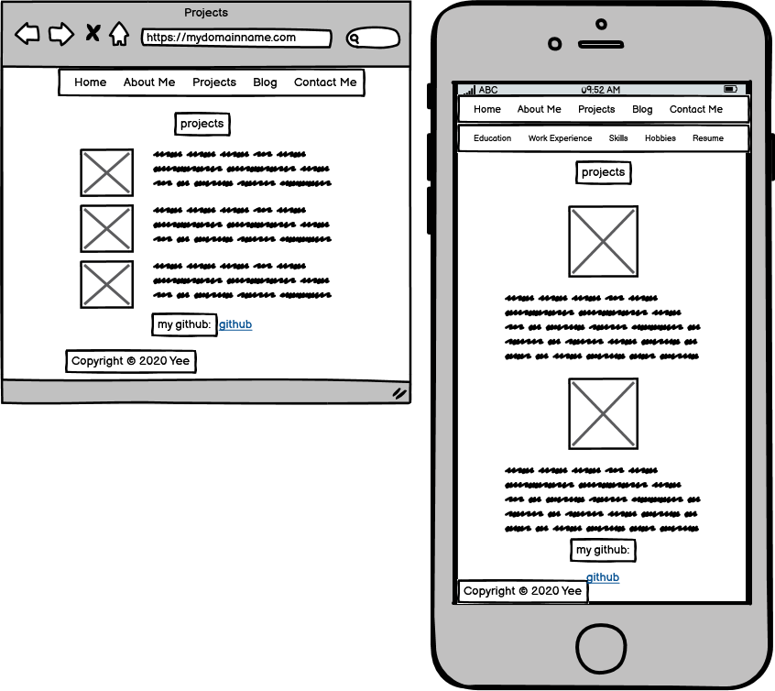
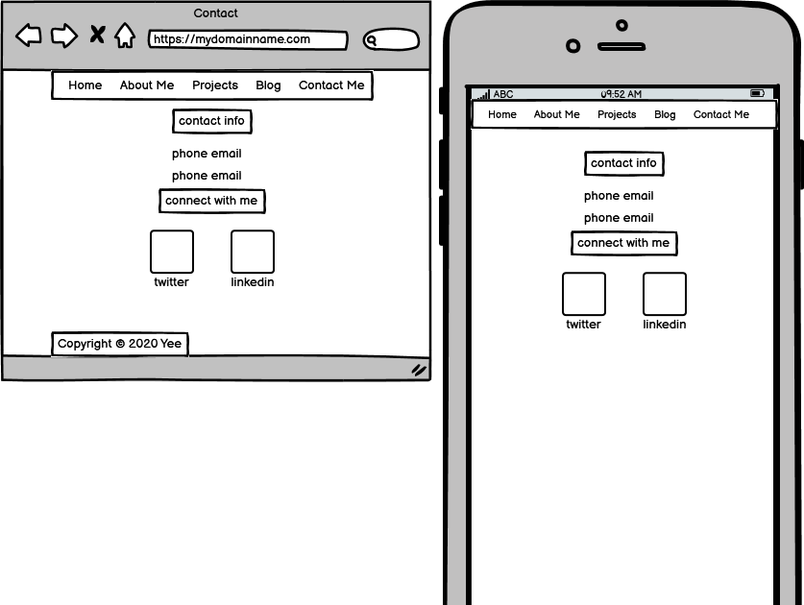
Balsamiq Wireframes

Slide 6
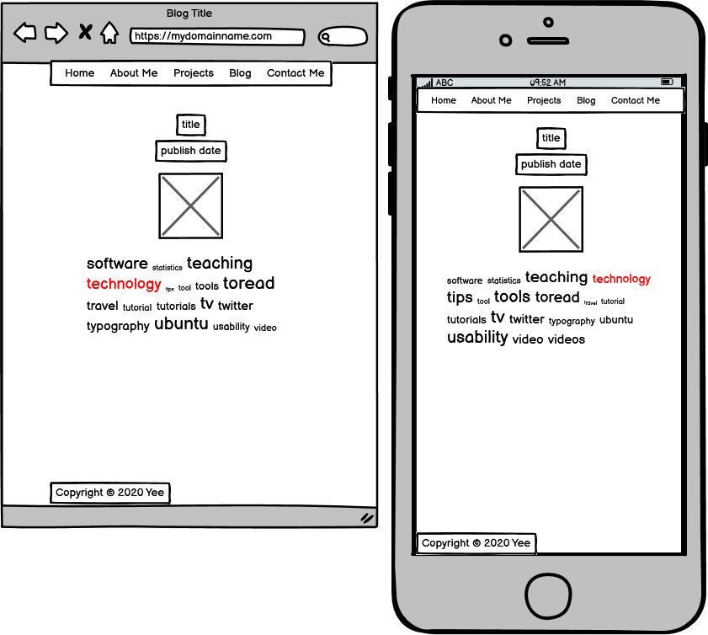
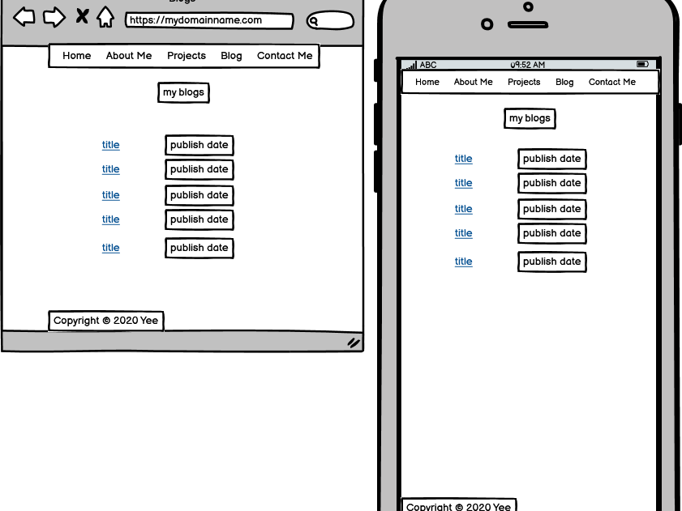
Balsamiq Wireframes

Slide 7
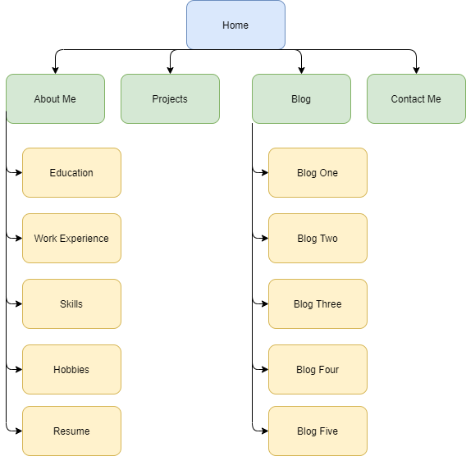
Sitemap

Slide 8
Website Components
Navigation menu
Headings
Typography
Images
Links to internal pages and external websites
Responsive design
Semantic HTML

Slide 9
Live Demo

