Slide 1

Terminal App – Blackjack
Shao Yee Ng
September 2020

Slide 2
App Features
Navigation menu (Start Game, Tutorial, Quit)
Built-in prompts to help you use the app (e.g. hit or stand)
Tutorial page for first time blackjack player
Pre-defined drawing rules for the dealer
It’s a fair game (cards are generated randomly)
For those who are bad at math, total points of a hand are calculated for you

Slide 3
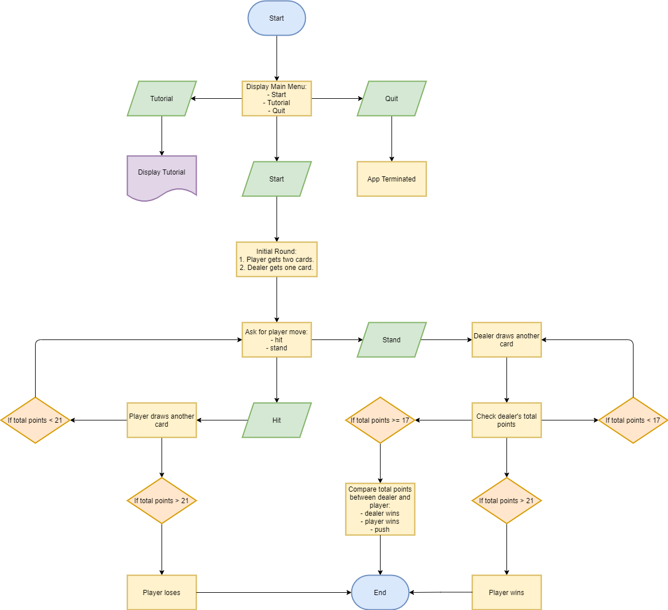
App/Game Structure

Slide 4
Demo Time
Let’s play some Blackjack!

