Slide 1
.1.3.6.1.2.1.1.3
GRADUATION PROJECT DEFENSE
Smart Network
Monitoring System
SNMP-based Network Surveillance with Python & Telegram Alerts
From reactive firefighting to proactive monitoring
PRESENTED BY
SUPERVISOR
[Student Name]
[Supervisor Name]
UNIVERSITY
ACADEMIC YEAR
[University — Faculty]
2025/2026
UDP 161 · 162
Cisco Packet Tracer 8.2 • Python 3 • SNMPv2c • Telegram Bot API
Notes:
- Greet the committee, introduce yourself, and state the project title: Smart Network Monitoring System.
- One-line framing: SNMP-based surveillance of a multi-site lab, automated with Python and Telegram alerts.
- Point to the technology footer: Packet Tracer 8.2, Python 3, SNMPv2c, Telegram Bot API.
- Fill in the student, supervisor and university placeholders before the actual defense.
- Bridge to the next slide: "let me start with why networks need this."

Slide 2
AGENDA
What we will cover
01
The Problem
why networks need proactive monitoring
6
monitored devices
◌
02
SNMP fundamentals
how network devices speak
03
The lab
designing a multi-site network in Packet Tracer
2
alert planes — polling + traps
⚡
04
The engine
Python polling, thresholds, traps
05
Telegram
alerts and control in your pocket
22/22
automated checks passing
✓
06
Verification
measured results & live demo
Notes:
- Walk the six agenda items in order — roughly one minute each.
- Emphasize the arc: fundamentals first, then the build (lab, engine, Telegram), then verification.
- Point at the right-hand stats as the promises: 6 monitored devices, 2 alert planes, 22/22 automated checks.
- Signpost that the talk closes with measured results and a live demo.

Slide 3
MOTIVATION
Networks fail before anyone notices
◔
Reactive (today)
✓
Proactive (this project)
✦
users are the first outage sensor (helpdesk calls)
◆
poll CPU / memory / interface status every 15 s
↗
MTTR grows with device count
✦
thresholds catch degradation BEFORE outage
✦
operators hop CLI-to-CLI across 6+ devices
⚡
link failures reported by traps in under a second
✦
no history — incidents vanish with the console
✦
every alert timestamped and archived
FCAPS management model
Fault
Configuration
Accounting
Performance
Security
✓
✓
This project owns the Fault + Performance planes end-to-end.
Notes:
- Contrast the two columns: today the helpdesk is the outage sensor; MTTR grows with every added device.
- Operators waste time hopping CLI-to-CLI across 6+ devices, and incidents leave no history.
- This project is proactive: 15-second polling of CPU / memory / interfaces, thresholds before outage, sub-second traps.
- Close with FCAPS: we own the Fault and Performance planes end-to-end, the rest is out of scope.

Slide 4
OBJECTIVES
Five measurable goals
O1
Build a documented multi-site lab in Packet Tracer 8.2
O2
Implement SNMPv2c at protocol level
O3
Threshold engine as a state machine
✓
OSPF triangle, VLAN segmentation, SNMP on all 6 routers/switches
✓
BER/ASN.1 codec, GET, GETNEXT and trap PDUs with zero external libraries
✓
CPU 70/85%, memory 75/90%, alerts on transitions only, recovery notices
O4
Telegram alarm channel
O5
Prove it works
✓
push alerts + interactive commands /status, /cpu, /ifaces, /alerts, /mute
✓
22 automated end-to-end checks + measured detection latencies
Notes:
- Stress that every objective carries a measurable acceptance criterion — nothing is hand-waved.
- O1 the lab, O2 protocol-level SNMPv2c with zero dependencies, O3 the threshold state machine.
- O4 the Telegram channel with live commands; O5 the 22 automated end-to-end checks.
- Each objective maps to a later slide — this grid is the contract for the rest of the talk.

Slide 5
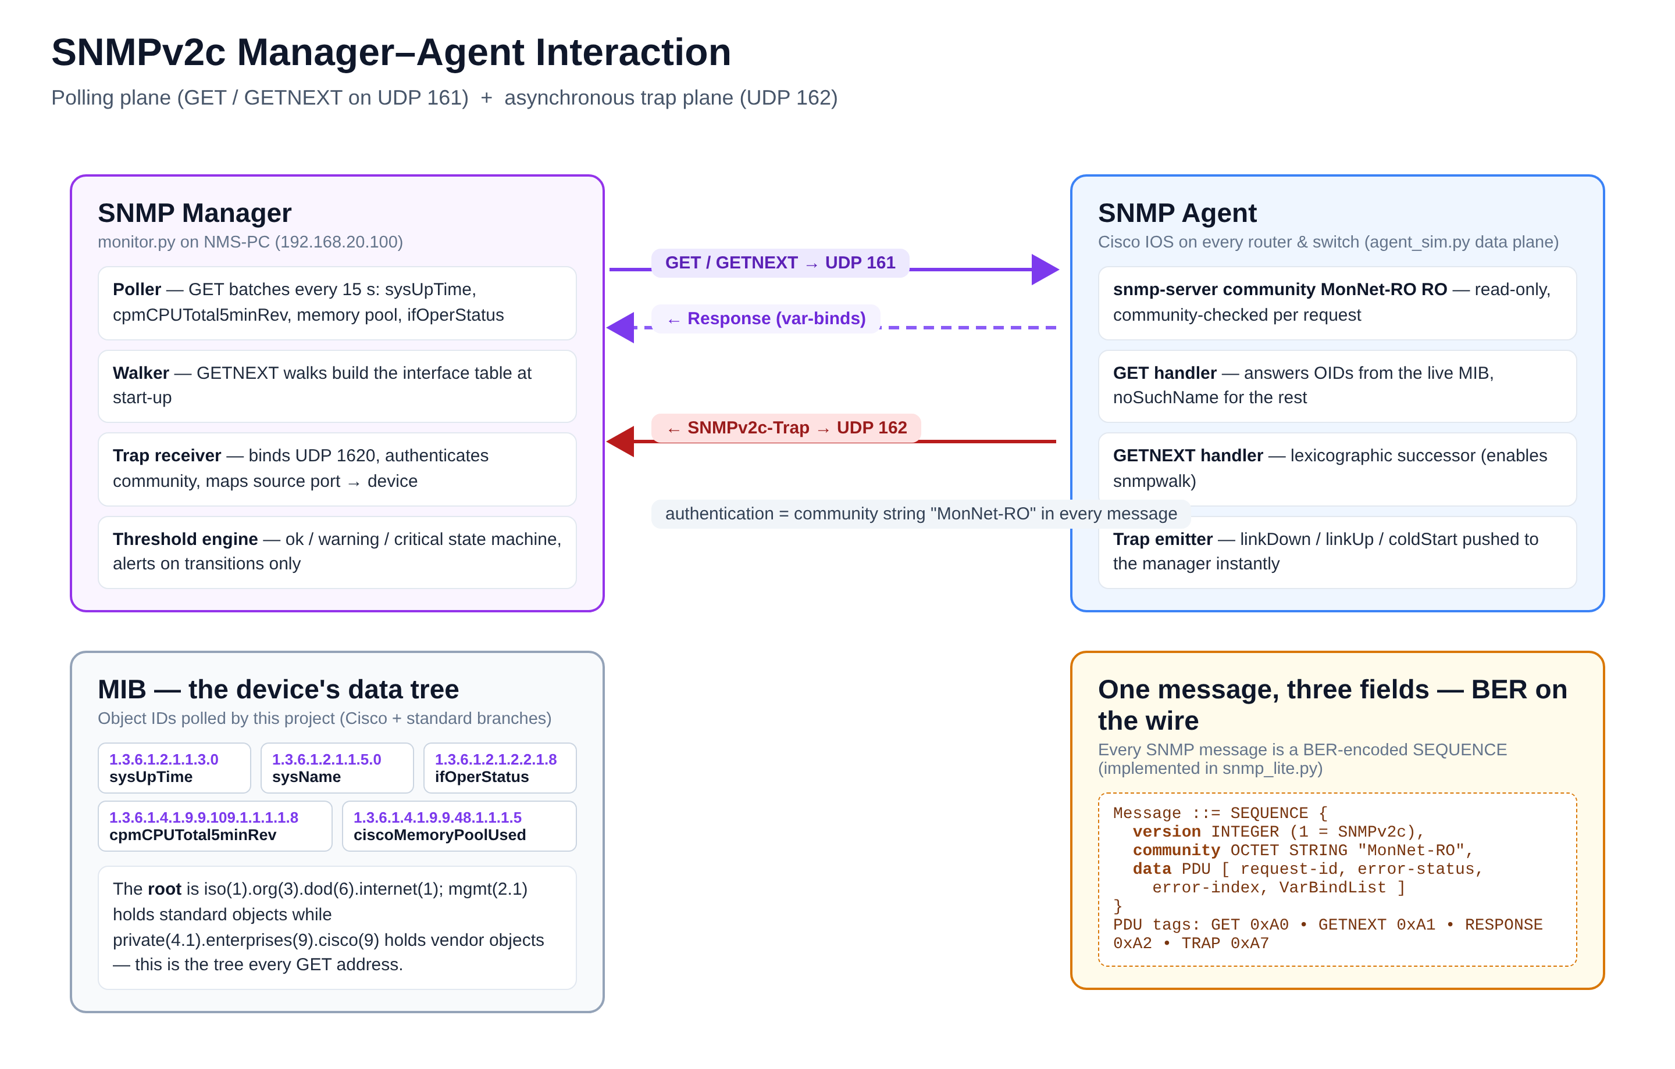
FUNDAMENTALS 1/2
SNMP — a manager, an agent, two UDP ports
↻
GET / GETNEXT → UDP 161 — the polling plane
⚡
Trap → UDP 162 — the asynchronous plane
⚿
Community string — the v2c authentication
Every message is version + community + PDU, BER-encoded per RFC 3416 — we implement this format ourselves in snmp_lite.py.
Notes:
- Walk the figure left to right: the NMS (manager) polls, the agents answer, and traps flow back asynchronously.
- GET / GETNEXT ride UDP 161 — the polling plane; traps ride UDP 162 — the asynchronous plane.
- The community string is the only "authentication" v2c offers — treat it as a password, keep it read-only.
- Punchline: we implement the BER encoding ourselves in snmp_lite.py per RFC 3416 — no external libraries.

Slide 6
FUNDAMENTALS 2/2
Everything is a number in a tree
✿
The MIB — managed information base
⇄
Polling vs traps
iso(1)
→
org(3)
→
dod(6)
→
internet(1)
Plane | Direction | Latency | Best for
↻Polling GET every 15 s | manager→agent | ≤ interval + 1.4 s (measured) | trends & thresholds
⚡Traps UDP push on event | agent→manager | 0.4 s (measured) | link down, cold start
├─
mgmt(2.1)
│ ├─
sysUpTime
.1.3.6.1.2.1.1.3
│ ├─
ifOperStatus
.1.3.6.1.2.1.2.2.1.8
│ └─
ifInOctets
.1.3.6.1.2.1.2.2.1.10
└─
private(4.1)
→
enterprises(9)
→
cisco(9)
├─
cpmCPUTotal5minRev
.1.3.6.1.4.1.9.9.109.1.1.1.1.8
└─
ciscoMemoryPoolUsed
.1.3.6.1.4.1.9.9.48.1.1.1.5
“
A metric is just a numbered leaf — the poller only needs the number.
Notes:
- Walk the tree from iso(1) down: org, dod, internet — then the two branches we actually use.
- Under mgmt(2.1): sysUpTime, ifOperStatus, ifInOctets — the standard health objects.
- Under private → enterprises → cisco: CPU and memory pools — the Cisco-specific OIDs we poll.
- Table: polling gives trends at ≤ interval + 1.4 s; traps give 0.4 s push for link down and cold start.
- Punchline: a metric is just a numbered leaf — the poller only needs the number.

Slide 7
SIMULATION ENVIRONMENT
Why Packet Tracer — and where its boundary is
Criterion | GNS3 | Packet Tracer 8.2
Technology | Emulation of real IOS images | Behavior-level simulation
Licensing | Requires Cisco IOS images | Free via Networking Academy
Footprint | RAM-heavy for multi-router labs | Lightweight, student-friendly
SNMP from an external Python process | ✓Natively reachable | ⊗Simulated stack, NOT externally reachable
✓
Decision: PT for the network design plane + protocol-faithful SNMP agents as the live data plane (same Cisco OIDs, same community, same trap host). The monitoring code is production-shaped — only the endpoints in config.yaml change for real hardware.
ⓘ
The .pkt lab is the design twin of the agents: identical devices, addressing and SNMP policy.
Notes:
- Frame the trade-off: GNS3 emulates real IOS but needs licensed images and is RAM-heavy; Packet Tracer is free via Networking Academy and student-friendly.
- Be honest about the boundary — PT's SNMP stack is simulated and NOT reachable from an external Python process, while GNS3 would be.
- Explain the hybrid decision: PT for the network design plane, our protocol-faithful SNMP agents as the live data plane with identical Cisco OIDs, community and trap host.
- Stress portability: only the endpoints in config.yaml change to move to real hardware.
- Close with the footnote — the .pkt lab is the design twin of the agents: same devices, addressing and SNMP policy.

Slide 8
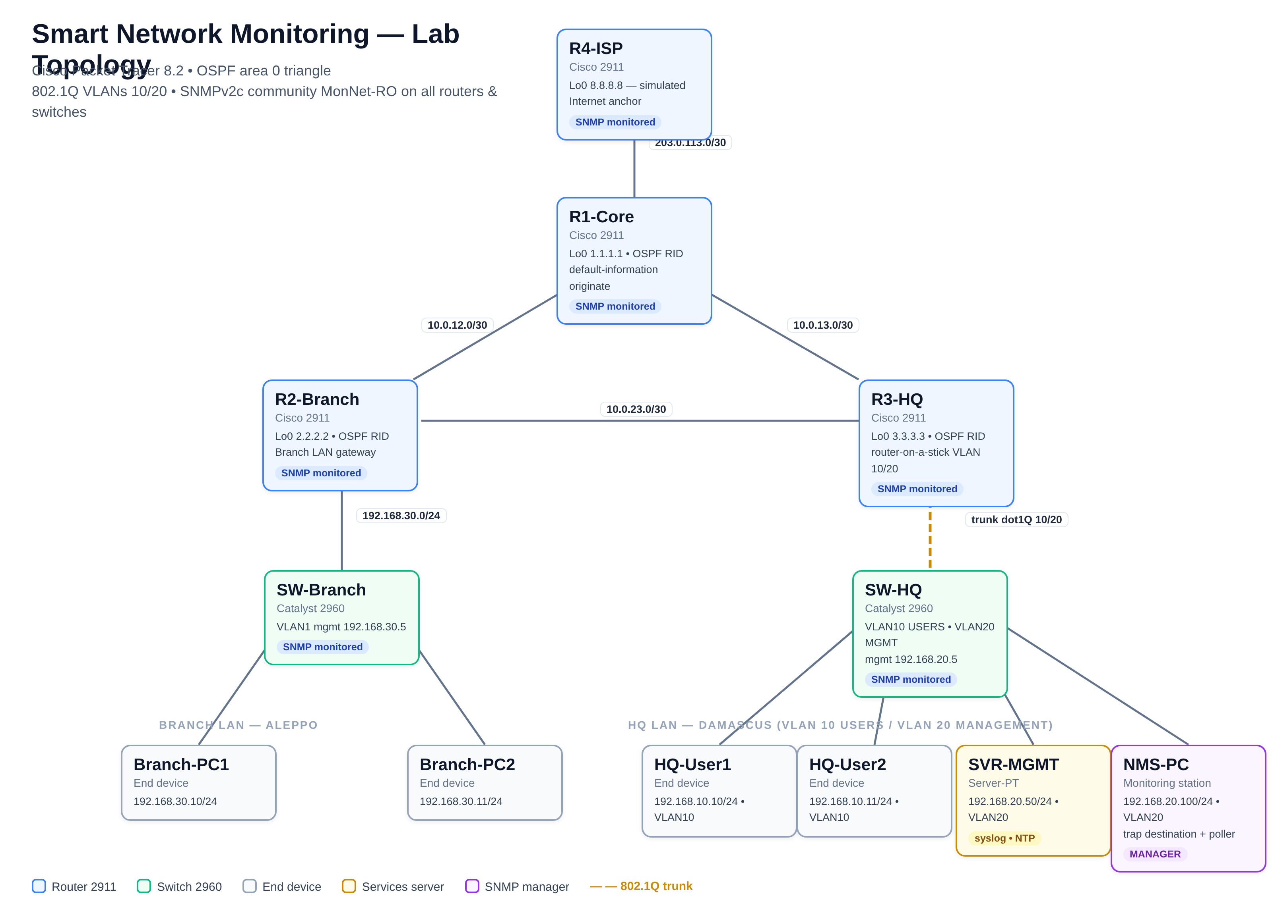
THE NETWORK
One file, twelve devices, full redundancy
OSPF area 0 triangle R1–R2–R3
✦
No single link failure isolates a site (2 paths survive any one cut).
Router-on-a-stick on R3-HQ
⚙
VLAN 10 users / VLAN 20 management segmentation on one physical trunk.
Services plane
▦
SVR-MGMT: syslog + NTP (192.168.20.50); NMS-PC: trap destination + poller (192.168.20.100).
Smart_Network_Monitoring_Lab.pkt — opens directly in Packet Tracer 8.2, all devices pre-configured.
Notes:
- Walk the figure left to right: three sites, twelve devices, all pre-configured in one .pkt file that opens directly in Packet Tracer 8.2.
- Redundancy story: the OSPF area 0 triangle R1–R2–R3 means no single link failure isolates a site — two paths survive any one cut.
- Point at R3-HQ: router-on-a-stick separates VLAN 10 users from VLAN 20 management on a single physical trunk.
- Services plane: SVR-MGMT provides syslog + NTP at 192.168.20.50, and NMS-PC at 192.168.20.100 is both trap destination and poller.

Slide 9
THE NETWORK
Addressing plan — documented, hierarchical, testable
Segment | VLAN | Subnet | Gateway | Members
WAN R1↔R4-ISP | — | 203.0.113.0/30 | — | R1 .1, R4 .2
Core R1↔R2 | — | 10.0.12.0/30 | — | R1 .1, R2 .2
Core R1↔R3 | — | 10.0.13.0/30 | — | R1 .1, R3 .2
Core R2↔R3 | — | 10.0.23.0/30 | — | R2 .1, R3 .2
Branch LAN | 1 | 192.168.30.0/24 | R2 .1 | PC1 .10, PC2 .11, SW-Branch .5
HQ users | 10 | 192.168.10.0/24 | R3 Gi0/0.10 .1 | User1 .10, User2 .11
HQ management | 20 | 192.168.20.0/24 | R3 Gi0/0.20 .1 | SVR-MGMT .50, NMS-PC .100, SW-HQ .5
Loopbacks (OSPF router-ids):R1 1.1.1.1·R2 2.2.2.2·R3 3.3.3.3·R4 8.8.8.8
✦
/30 on point-to-point links — 50% address efficiency per link
✦
Loopbacks give OSPF stable router-ids independent of physical interfaces
Notes:
- Point out the hierarchy: /30 point-to-point subnets between routers, /24 LANs per site — documented, hierarchical, testable.
- Note the /30 efficiency argument — 50% address efficiency per link on point-to-point segments.
- Walk the HQ side: VLAN 10 users and VLAN 20 management share the R3 trunk via sub-interfaces Gi0/0.10 and Gi0/0.20.
- Highlight NMS-PC at 192.168.20.100 — the trap destination and poller the next slides depend on.
- Finish with loopbacks: R1 1.1.1.1 through R4 8.8.8.8 give OSPF stable router-ids independent of physical interfaces.

Slide 10
IMPLEMENTATION 1/3
Five lines that turn a router into a data source
Cisco IOS · global configuration mode
L1
community MonNet-RO RO
Read-only access; a RW community would expose SET (config change) — deliberately avoided.
1
snmp-server community MonNet-RO RO
L2
location / contact
Appear as sysLocation / sysContact OIDs, proving the agent identity.
2
snmp-server location CORE-POP Damascus
snmp-server contact netmon@monnet.lab
L3
host 192.168.20.100 version 2c
3
The NMS receives traps with the same community.
4
snmp-server host 192.168.20.100 version 2c MonNet-RO
enable traps snmp link…
L4
Link state + config events generate notifications.
5
snmp-server enable traps snmp link linkdown linkup config
✓
Applied on all 4 routers + 2 switches
Visible in IOS via show snmp.
Notes:
- Read the five lines slowly — this is the entire device-side configuration; everything else is our Python engine.
- Line 1: read-only community on purpose — a RW community would expose SET, i.e. remote config changes.
- Lines 2–3: location and contact surface as sysLocation / sysContact OIDs, proving agent identity to the poller.
- Line 4: traps are sent to NMS-PC 192.168.20.100 with the same community; line 5 enables link up/down and config notifications.
- Wrap up: applied identically on all 4 routers + 2 switches — verify live with 'show snmp'.

Slide 11
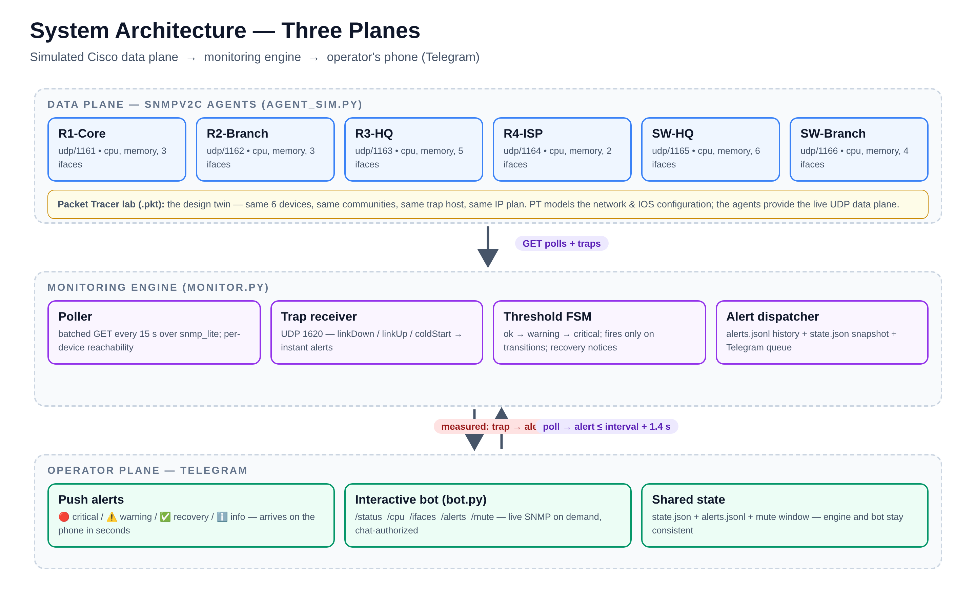
IMPLEMENTATION 2/3
Three planes, one Python codebase
✦
snmp_lite.py
SNMPv2c implemented from the RFC: BER codec, GET / GETNEXT, trap PDUs — stdlib only.
❄
agent_sim.py
Six Cisco-compatible agents: live cpu / memory / ifTable, trap emitter, scripted incidents.
✦
monitor.py
Poller, threshold state machine, trap receiver, alert dispatcher + Telegram queue.
We implemented the protocol, not just a library call — every byte on the wire is ours and explainable.
Notes:
- Orient the audience on the figure: three planes — simulated agents at the bottom, the monitoring engine in the middle, Telegram at the top.
- snmp_lite.py: SNMPv2c written from the RFC — BER codec, GET / GETNEXT and trap PDUs, stdlib only, zero dependencies.
- agent_sim.py: six Cisco-compatible agents with live cpu / memory / ifTable values, a trap emitter and scripted incidents for the demo.
- monitor.py ties it together: poller, threshold state machine, trap receiver, alert dispatcher and the Telegram queue.
- Land the closing line: we implemented the protocol, not just a library call — every byte on the wire is ours and explainable.

Slide 12
IMPLEMENTATION 3/3
Alert on transitions, not on values
R1
No duplicates while a state persists
Verified: exactly 1 critical alert during a 105-second sustained CPU incident.
CPU ≥ 70%
MEM ≥ 75%
CPU ≥ 85%
MEM ≥ 90%
Unreachability is its own alert
✓
OK
⚠
WARNING
⊗
CRITICAL
R2
SNMP timeout flags the device DOWN, recovery when it answers again.
recovery notice
A state per (device, metric) — alerts fire ONLY when the state changes.
R3
Recovery notifications close the loop
The operator knows when the incident is over, not just when it started.
R4
Every alert is auditable
Appended to alerts.jsonl with event + detection timestamps.
Notes:
- Core principle: a state per (device, metric) — alerts fire only on transitions, never on repeated values.
- Walk the machine: OK → WARNING at CPU ≥ 70% / MEM ≥ 75%, then CRITICAL at CPU ≥ 85% / MEM ≥ 90%; the dashed return path emits the recovery notice.
- R1 evidence: exactly one critical alert during a 105-second sustained CPU incident — no duplicates.
- R2: an SNMP timeout is its own alert — device DOWN until it answers again.
- R3/R4: recovery notices close the loop, and every alert lands in alerts.jsonl with event + detection timestamps.

Slide 13
NOTIFICATION PLANE
➤
The operator’s phone is the new NMS screen
➤
Bot in 5 minutes
✦
Commands
1
Talk to @BotFather, /newbot, receive token
/status
→
health table of all 6 devices
2
Press START on your bot (any message)
/cpu R2-Branch
→
LIVE SNMP poll, cpu + memory
3
Read your chat id from api.telegram.org/bot<TOKEN>/getUpdates
/ifaces R3-HQ
→
live interface table
4
Export TELEGRAM_BOT_TOKEN and TELEGRAM_CHAT_ID
/alerts
→
timestamped history
5
python3 bot.py
/mute 30
→
maintenance silence
▯
LIVE ALERT FEED
🔴 CRITICAL — R2-Branch: CPU = 93% (threshold 85%)
10:02:11
Delivered to the operator’s chat in real time — no NMS console required.
✅ RESOLVED — R2-Branch: CPU back to 26%
10:02:47
⚿
Chat-authorized only — the bot refuses other chats; the community string never leaves the lab host.
Notes:
- Frame the shift: the operator’s phone becomes the NMS screen — alerts and control travel in one chat.
- Walk the 5-minute setup: BotFather issues the token, press START, read the chat id from getUpdates, export the two env vars, run bot.py.
- Highlight that commands do LIVE SNMP polls on demand — /cpu R2-Branch and /ifaces R3-HQ query the agents in real time.
- Point at the bubble pair: a CRITICAL at 10:02:11 and its RESOLVED notice 36 seconds later — the alert loop closes on the phone.
- Close on security: the bot serves the authorized chat only, and the community string never leaves the lab host.

Slide 14
VERIFICATION
Measured, not claimed
✓
◔
⚡
◔
22/22
12
0.4 s
1.4–3.9 s
automated checks passing
alerts in one incident drill
trap-to-alert latency
poll-to-alert at 5 s interval
◔
Measured latency
poll interval 5 s · incident drill
INCIDENT
EVENT
DETECTED
LATENCY
R2 CPU 78% (warning)
22.5 s
23.8 s
1.4 s
R2 CPU 93% (critical)
30.0 s
33.9 s
3.9 s
R3 Gi0/0 link down (trap)
40.0 s
40.4 s
0.4 s
R1 memory 81% (warning)
57.5 s
58.9 s
1.4 s
R2 CPU recovery
82.5 s
83.9 s
1.4 s
✦
test_system.py — one command, 2.5 minutes, rerunnable evidence: protocol self-test, agent bring-up, incident drill, bot handlers.
Notes:
- Lead with the headline: 22 of 22 automated checks pass — every number on this slide is measured, not claimed.
- Contrast the two alert planes: traps reach the operator in 0.4 s, while polling is bounded by the 5 s interval at 1.4–3.9 s.
- Walk one row end-to-end: R2 CPU hits 93% at t=30.0 s, the engine detects it at 33.9 s — a 3.9 s latency.
- Note that recovery is instrumented too: the R2 CPU recovery row shows the loop closing 1.4 s after the event.
- Finish on reproducibility: test_system.py runs the whole evidence chain in 2.5 minutes and can be re-run by the committee.

Slide 15
DEMO
Three minutes from healthy to hero
Agents boot
R1 memory pressure 81%
6 coldStart traps arrive
R2 CPU 93%
R2 CPU cools
🔴 CRITICAL alert
memory warning
RESOLVED
0:45
1:20
2:20
0:00
1:00
1:55
2:45
R2 CPU climbs to 78%
R3 Gi0/0 goes down
R3 link recovers
✅ LINK UP
⚠️ WARNING alert
trap alert in 0.4 s
✦
Run it yourself: ./run_demo.sh — agents + engine + bot, alerts arrive on your phone in real time.
Notes:
- Set the scene: a scripted 3-minute run that takes the lab from a healthy network to a fully resolved incident.
- Narrate each marker as it fires: six coldStart traps at boot, then CPU escalation 78% → 93% on R2-Branch.
- Emphasize the contrast at 1:20 — the R3 Gi0/0 link-down trap reaches the phone in 0.4 s, faster than any poll cycle.
- Show the loop closing: LINK UP at 2:20 and the RESOLVED notice at 2:45 land on the phone in real time.
- Invite the committee to reproduce it themselves with ./run_demo.sh.

Slide 16
CONCLUSION
What was built — and where it goes next
✓
Delivered
➤
Future work
✓
Full lab in Packet Tracer 8.2 — 12 devices, SNMP on all 6 routers/switches, opens with zero manual config
SNMPv3 — authentication & privacy, engine is already modular
⚿
✓
SNMPv2c implemented at protocol level — BER codec, PDUs, traps, zero dependencies
⌇
Time-series + Grafana — from alerts to dashboards (RRD / InfluxDB)
✓
Production-shaped engine — switching to real hardware means editing endpoints in one YAML file
◌
Hardware migration — GNS3 or real routers, path documented
✓
Sub-second trap alerting verified end-to-end (0.4 s)
◆
Anomaly detection — auto-learned baselines instead of static thresholds
✓
Interactive Telegram control plane with live SNMP commands
Notes:
- Recap the five deliverables, stressing that SNMPv2c was implemented at protocol level with zero external dependencies.
- Underline the production shape: moving to real hardware only means editing endpoints in one YAML file.
- Cite the key verified result — sub-second trap alerting end-to-end at 0.4 s — plus the interactive Telegram control plane.
- Frame future work as a natural extension: SNMPv3 security, time-series dashboards, hardware migration, and auto-learned anomaly baselines.
- Bridge to the closing slide: the system is finished as a graduation project but architected to keep growing.

Slide 17
?
THANK YOU
Questions & Discussion
Six devices, two alert planes, one phone.
[student@example.edu] • [University]
▣
Full technical report (PDF), the Packet Tracer lab file and the complete source code are in the project package.
Notes:
- Thank the committee and open the floor for questions and discussion.
- Repeat the one-line summary if needed: six devices, two alert planes, one phone.
- Point to the project package: full technical report (PDF), the Packet Tracer lab file, and the complete source code.
- Offer a live re-run of the demo or a look at specific code modules if the committee is interested.

