Slide 1
Predictive Standby Dispatch:
Machine Learning-based Smart Elevator Idle Positioning
Student Name | : | TEN YEE CHERN
Student ID | : | 0381084
Supervisor | : | Prof. Afizan Azman
Notes:
Morning Professor, this is my project title
let start the content

Slide 2
INTRODUCTION
Notes:
First introduction, let’s see what im trying to solve

Slide 3
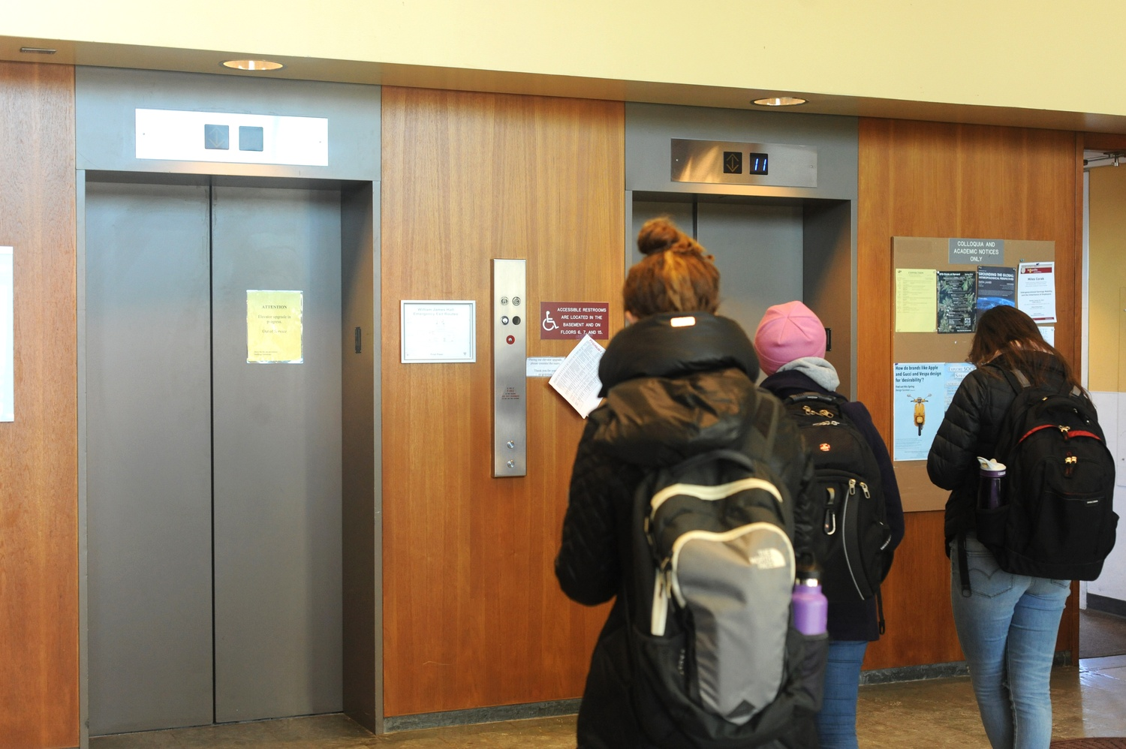
Notes:
U can see here is some people waiting the lift

Slide 4
INTRODUCTION
Traditional elevator control strategy: Send the nearest and heading elevator to the calling floor, and stay at where they lastly unload passengers (closet car algorithm, CCA)
This makes idle elevators often stay at low-demand frequency floors
When high-demand frequency floors are making calls, the elevator needs to take time to arrive at calling floors, increasing waiting time
When buildings become taller, this situation becomes worse
Notes:
In the traditional elevator control strategy, the lift just stays at where the last passenger is unloaded
This makes the idle elevators often stay at low-demand frequency floors, usually the upper floor
When a high-demand frequency floor, for example, the ground floor making calls, the elevator needs to take time to reach the calling floor, therefore causing waiting time increased
When the buildings become taller, this situation becomes worse

Slide 5
Solution:
Elevator’s Predictive Standby Dispatch
A system that allows the elevator to predict future calls
Reposition the idle elevator according to the predicted calls
Therefore, reducing users’ waiting time
Notes:
My solution is a predictive standby dispatch strategy
Using a predictor to allow the elevator to predict future calls and reposition the idle elevator according to the predicted calls
Send the lift before passenger makes call, therefore reducing users’ waiting time

Slide 6
Problem Statement, Research Questions & Objectives
Notes:
And the following is the problem statement, research questions and objectives

Slide 7
PROBLEM STATEMENT
Waiting Time Gap: A reactive dispatch control system only sends the elevator once a call is received, even though there are several optimising strategies, but the time the elevator takes to reach the calling floors cannot be eliminated.
System’s Effectiveness in different scenarios: The developed predictive system might not improve much in demand-saturated scenarios, as it only repositions the elevator when it is idle.
Cost-Benefit balance: It can be expected that waiting time can be reduced significantly if we send the elevator to stand by at every possible floor, but the cost also increases.
Notes:
First is the Waiting Time Gap, a traditional elevator control system is reactive, which means it only sends the lift when a call is received, the time gap for the elevator reaching the calling floors cannot be eliminated
Second is the System’s Effectiveness in different scenarios, because the system only repositions the lift when it is idle, hence in a demand-saturated scenarios, which mean the lifts are barely empty, the system might not help
Last is the cost-benefit balance, because we are going to reposition the idle elevator, it can be expected that waiting time can be reduced significantly if we send the elevator to stand by at every possible floor, even the possibility is very low, but this might cause increase of cost, hence we need to find a way to balance between cost and waiting time reduction

Slide 8
RESEARCH QUESTION
Can machine learning algorithms reliably predict future hall calls (floor and direction) before they occur?
Does using prediction to reposition idle elevators (standby dispatch) reduce waiting time compared to baseline in different scenarios (high and low demand)?
How should the system trade off between decreasing waiting time and minimising repositioning movement/energy cost?

Slide 9
RESEARCH OBJECTIVE
How should the system trade off between decreasing waiting time and minimising repositioning movement/energy cost?
Implement and simulate the predictive standby dispatching strategy, and compare its average waiting time (AWT) versus a baseline reactive dispatch strategy in different scenarios (high and low demand).
Design a framework or strategy to balance between AWT reduction and movement cost.

Slide 10
LITERTURE REVIEW

Slide 11
Domain Research ( Elevator Dispatch Optimisation)
Reactive: CV occupancy-aware (Wang et al., 2021); Dispatch control RL Opti (Crites & Barto, 1995);
Proactive: Standby floor scoring system(-AWT:~24%) (Tsai et al., 2025); Arrival time prediction based on users’ trajectory (Zhang et al., 2022)
Dataset
All previous similar work using a simulator
Poisson process (Crites & Barto, 1995) and Gaussian-based (Tsai et al., 2025) arrival rate
Predictor
Statistical Models: (ARIMA, SARIMA)
  Easy to implement
  Computationally efficient and low-cost
  Design for regression, not suitable for classification task (Fatima & Rahimi, 2024)
RNNs: (RNN, LSTM, GRU)
  Able to capture long-term dependencies
  Gradient explosion/vanishing problem limit dependencies range (Sherstinsky, 2020)
TCN:
  Able to capture longer-range dependencies compared to RNNs
  High training efficiency (D. Kim, 2023)
Notes:
Because I cannot find a work that completely fits with my project, therefore, I search for some previous research that trying to optimise elevator dispatch strategy
I also look for the dataset they have used, to see if there is a dataset that I can use on my work
I also compare different predictor to see which is the best fit for my work
First is the previous optimisation strategies, I categorise them into reactive and proactive, reactive only respond after call while proactive take action before call.
In reactive, one uses computer vision for elevator occupancy-awareness, which makes the elevator not only rely on weight to detect occupancy.
There is also using reinforcement learning to optimise the dispatch strategy, replacing the traditional rule-based dispatch strategy
In proactive, the first research is quite close to my project, but they using a scoring system by by themselves to calculate the probability of future call
Another is using a transformer to predict when the passenger arrives at the lift, but it is predicted based on the trajectory of the passenger, which means it requires an extra sensor to detect the passenger’s position
Come to the dataset
All the previous studies that used elevator call data are using simulated datasets, but their simulator strategies are slightly different. In the RL research, they simulate arrival with Poisson process, while the standby floor scoring system use a Gaussian-based formula. Because im going to use the Gaussian-based formula too, so, I will show it later
About the predictor, I have looked for statistical models, RNNs, tcn and transformer. Statistical model for sequential task, basically the ARIMA and SARIMA. They are useful but are designed for the regression task, while my project is a multi-label classification task. RNNs, also useful but they tend to struggle with the gradient explosion and vanishing problem, GRU is better, but also struggles with this problem. Also RNNs are not quite fit to multi-label task, for multi-label task it is better to use a hybrid RNN model.
TCN can capture longer range of dependencies compared to RNN and they also have a high training efficiency. Which make it a idea model for my task.

Slide 12
Transformers:
  Able to process extremely long-range dependencies
  Able to capture global temporal dependencies
  Outperform RNNs and TCN in a longer range of dependencies (Hall & Rasheed, 2025)
  Require higher computation and memory (Kong et al., 2025)
Interesting study:
Encoder-decoder separated LSTM (W. Zhang et al., 2019)
Hybrid model GRU-TCN (Nanni et al., 2021)
Notes:
Transformers are very good but it require a lot of computation and memory.
I also found some interesting studies, first is a encoder-decoder separated LSTM structure. They used two separated LSTM, one as encoder, one as decoder, so when they need to fit the model to different length of output window, they can use transfer learning, freeze the encoder and train the decoder only. If I want to try different length of output window, I can try this strategy also.
Another one is hybrid model, GRU-TCN, because GRU is not well fit for multi-label task, they combine GRU-TCN together, and found that it outperform both GRU and TCN.

Slide 13
METHODOLOGY

Slide 14
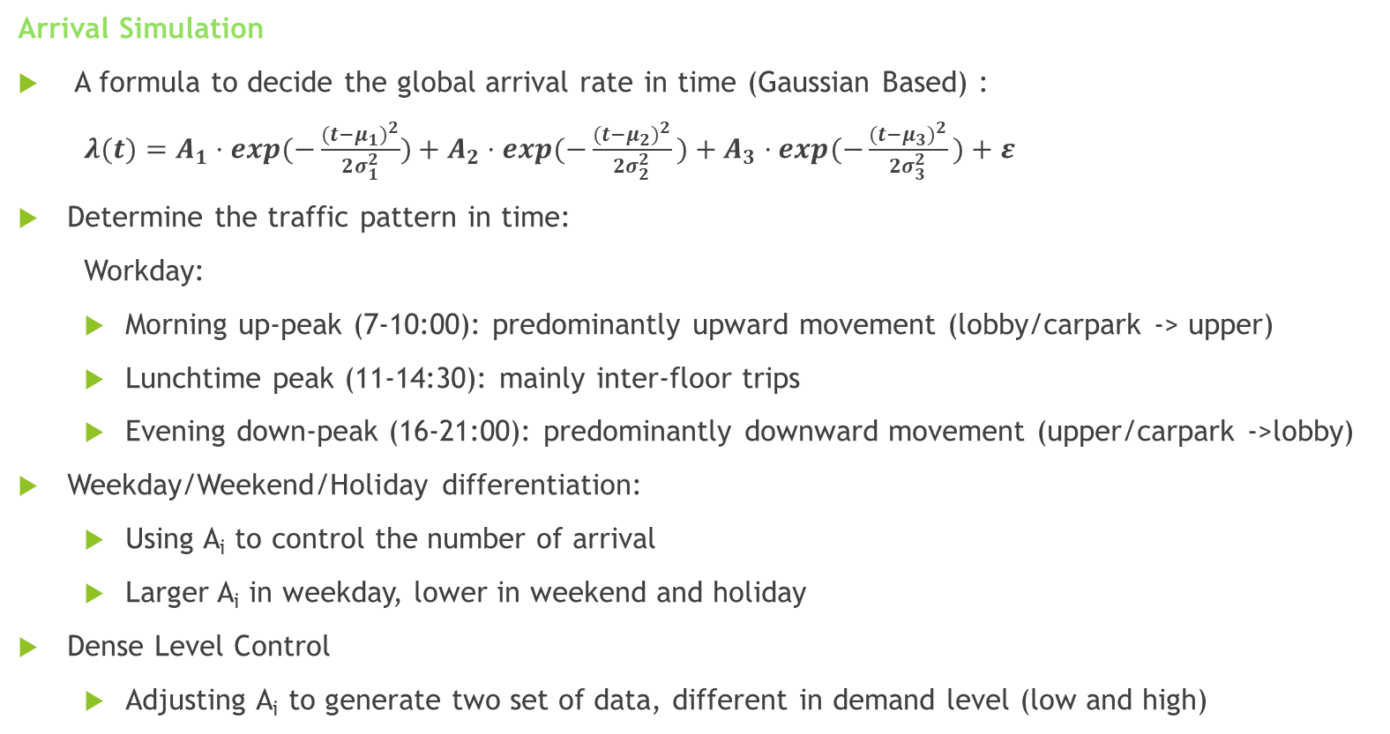
DATA & ENVIRONMENT SIMULATIONS
Arrival Simulation
A formula to decide the global arrival rate in time (Gaussian Based) :
$λ(t)=A_{1}​⋅exp(−\frac{{(t−μ_{1}​)}^{2}}{2σ_{1}^{2}})+A_{2}​⋅exp(−\frac{{(t−μ_{2})}^{2}}{2σ_{2}^{2}}​)+A_{3}​⋅exp(−\frac{{(t−μ_{3})}^{2}}{{2σ}_{3}^{2}}​)+ε$
Determine the traffic pattern in time:
Workday:
  Morning up-peak (7-10:00): predominantly upward movement (lobby/carpark -> upper)
  Lunchtime peak (11-14:30): mainly inter-floor trips
  Evening down-peak (16-21:00): predominantly downward movement (upper/carpark ->lobby)
Weekday/Weekend/Holiday differentiation:
  Using A_{i} to control the number of arrival
  Larger A_{i} in weekday, lower in weekend and holiday
Dense Level Control
  Adjusting A_{i} to generate two set of data, different in demand level (low and high)
Notes:
To train the predictor , first I need to simulate the passenger arrivals.
First, I will use a Gaussian Based formula to decide the arrival rate for each time.
The formula is consist of three blocks, each is a Gaussion distribution.
After the arrival rate is decide, the passenger traffic pattern, where the arrive and where they heading, will be determine by time period.
In the morning up-peak period, mainly moves upward. In the lunchtime period, mainly inter-floor travels. While in evening period, mainly downward movement.
I will generate two set of data with different demand level, by changing the A , amplitude in the formula. To train and test the system in different scenarios.

Slide 15
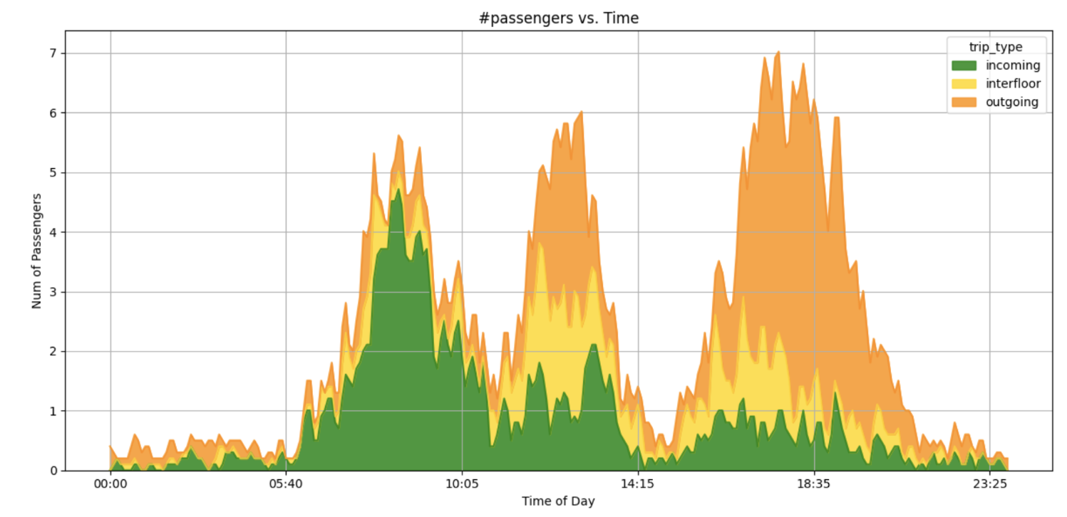
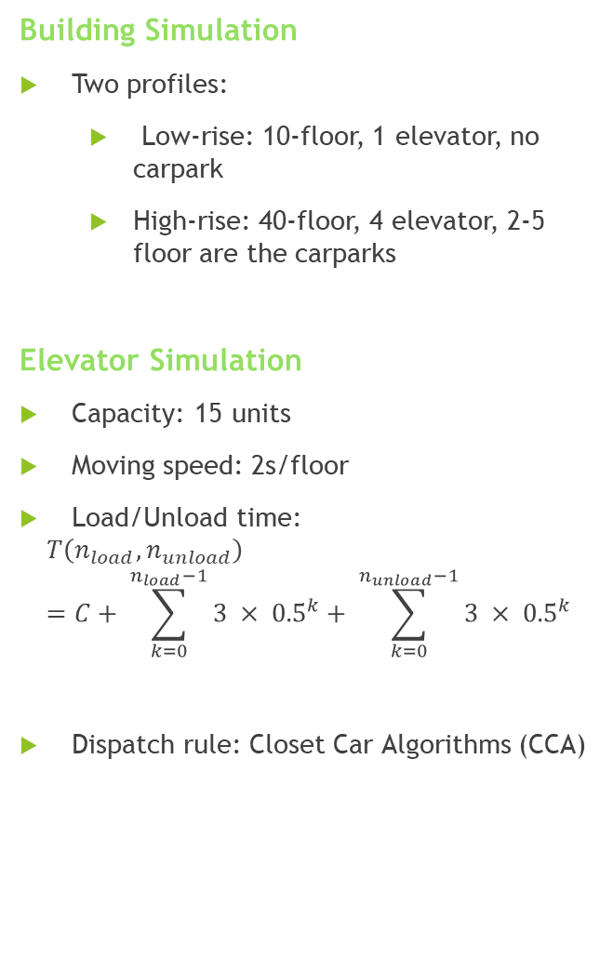
Building Simulation
Two profiles:
  Low-rise: 10-floor, 1 elevator, no carpark
  High-rise: 40-floor, 4 elevator, 2-5 floor are the carparks
Elevator Simulation
Capacity: 15 units
Moving speed: 2s/floor
Load/Unload time:
$$T\left(n_{load},n_{unload}\right)=C+ \sum_{k=0}^{n_{load}−1}{3 × {0.5}^{k}}+ \sum_{k=0}^{n_{unload}−1}{3 × {0.5}^{k}}$$
Dispatch rule: Closet Car Algorithms (CCA)
Daily traffic profile from Tsai et al. (2025)

Slide 16
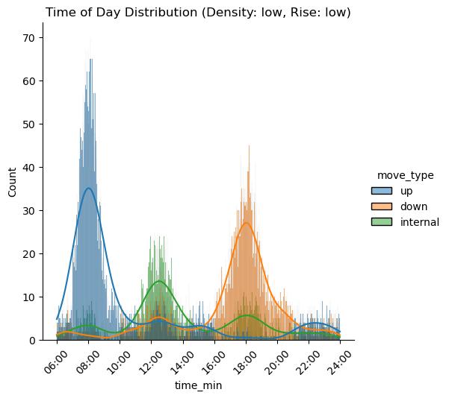
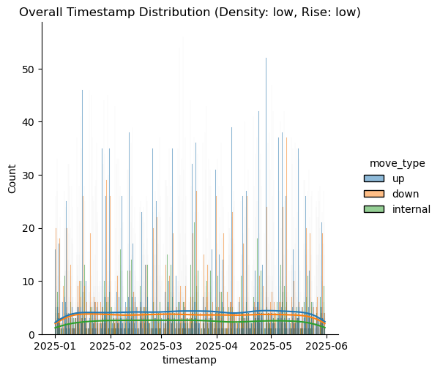
Data Simulation

Slide 17
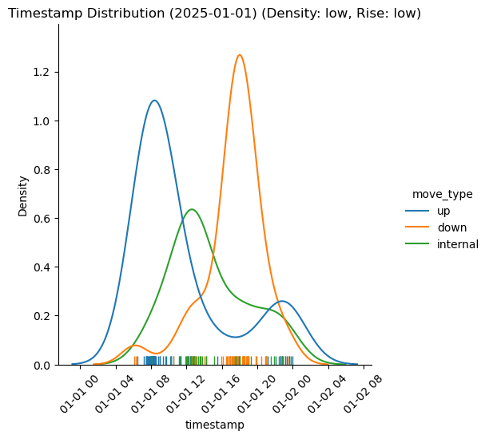
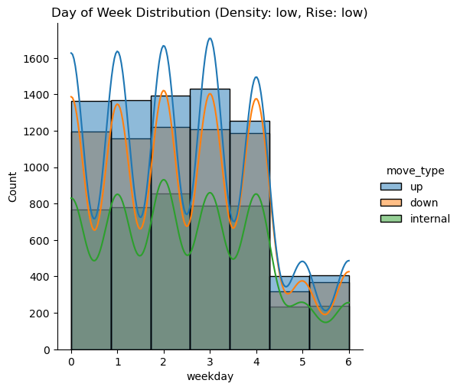

Slide 18
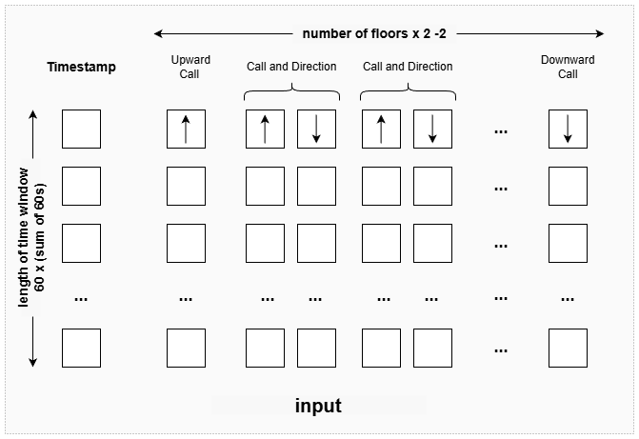
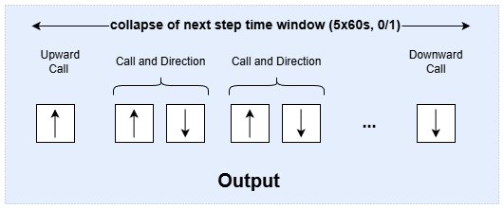
Machine Learning
Task type: Multi-label Classification
Model: TCN
Criterion:
  Binary Cross-Entropy (BCE) with positive weight
  Focal Loss
Optimiser: Adam
Input:
A matrix of features within a time window that consists of Timestamp & sum of 60 time steps’(seconds) one-hot encode call and direction record of each floor in 1 hour
Output:
Collapsed one-hot encode call and direction record of floors (0/1) in the future time window (5 minutes)
Evaluation: Accuracy, Precision, Recall

Slide 19
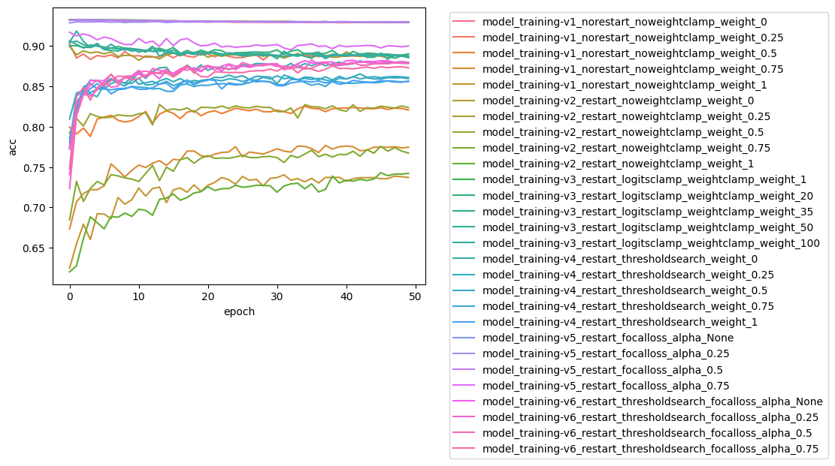
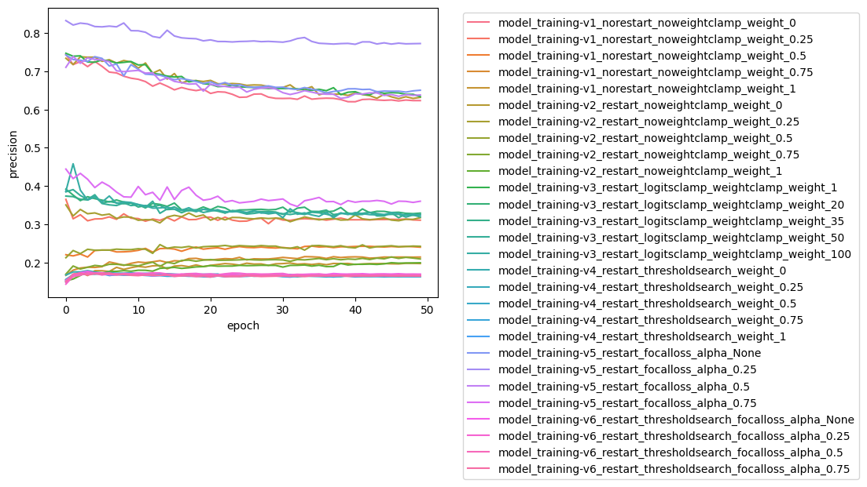
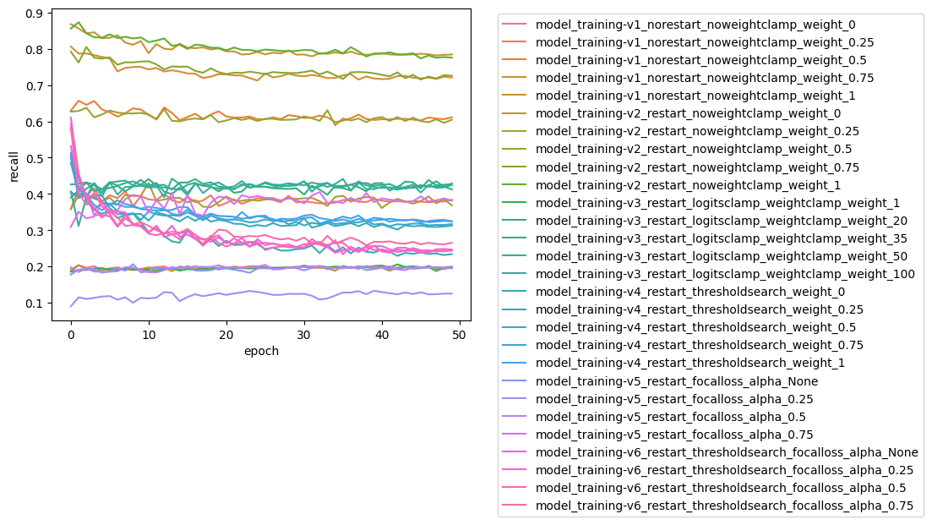
Model Training Details
Train in different hyperparameter:
  Learning rate scheduler Cosine Annealing & Cosine Annealing Warm Restart
  BCE with pos_weight (scale into 0/0.25/0.5/0.75/1 or clamp within 1/20/35/50/100)
  Focal loss (alpha = None/0.25/0.5/0.75)

Slide 20
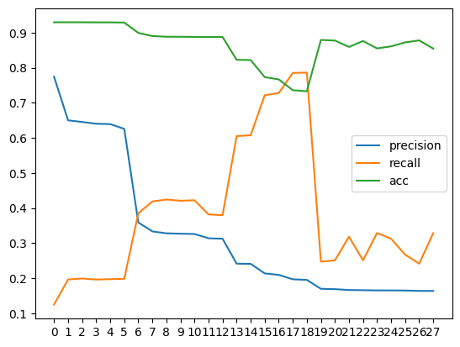
Model Summary
Models sort by precision:
Models sort by recall:
model_with_parameter | acc | precision | recall
model_training-v5_restart_focalloss_alpha_0.25 | 0.9297 | 0.7746 | 0.1245
model_training-v5_restart_focalloss_alpha_None | 0.9299 | 0.6500 | 0.1961
model_training-v3_restart_logitsclamp_weightclamp_weight_1 | 0.9298 | 0.6454 | 0.1988
model_training-v2_restart_noweightclamp_weight_0 | 0.9295 | 0.6403 | 0.1959
model_training-v5_restart_focalloss_alpha_0.5 | 0.9295 | 0.6393 | 0.1969
model_with_parameter | acc | precision | recall
model_training-v2_restart_noweightclamp_weight_1 | 0.7329 | 0.1948 | 0.7862
model_training-v1_norestart_noweightclamp_weight_1 | 0.7360 | 0.1966 | 0.7853
model_training-v2_restart_noweightclamp_weight_0.75 | 0.7668 | 0.2092 | 0.7281
model_training-v1_norestart_noweightclamp_weight_0.75 | 0.7734 | 0.2134 | 0.7216
model_training-v1_norestart_noweightclamp_weight_0.5 | 0.8220 | 0.2406 | 0.6075
Models plot sort by precision

Slide 21
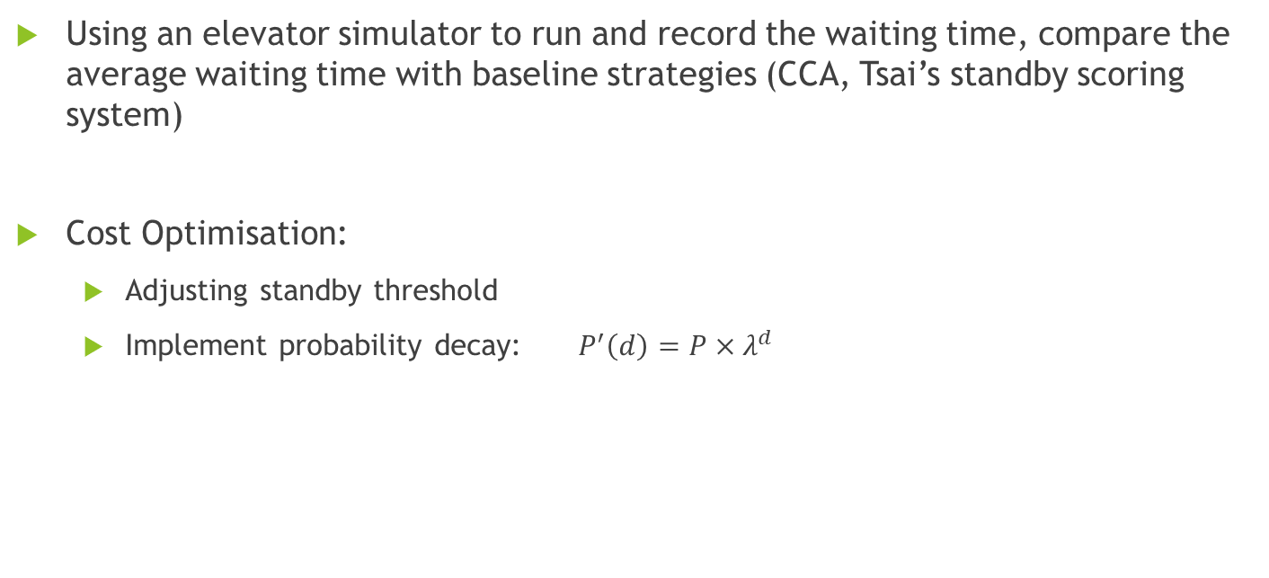
Improvement evaluation &
Cost-benefit balancing
Using an elevator simulator to run and record the waiting time, compare the average waiting time with baseline strategies (CCA, Tsai’s standby scoring system)
Cost Optimisation:
  Adjusting standby threshold
  Implement probability decay: $P^{′}\left(d\right)=P×λ^{d}$

Slide 23
PROJECT MANAGEMENT AND TIMELINE

Slide 24
Gantt Chart

Slide 25
Refference
Wang, S., Gong, X., Song, M., Fei, C. Y., Quaadgras, S., Peng, J., ... & Jiao, R. J. (2021). Smart dispatching and optimal elevator group control through real-time occupancy-aware deep learning of usage patterns. Advanced Engineering Informatics, 48, 101286. https://doi.org/10.1016/j.aei.2021.101286
Crites, R., & Barto, A. (1995). Improving elevator performance using reinforcement learning. Advances in neural information processing systems, 8. http://papers.nips.cc/paper/1073-improving-elevator-performance-using-reinforcement-learning.pdf
Tsai, I. N., Wu, Y. X., Huang, Y. H., Chen, Y. C., & Ding, J. J. (2025). Optimization of Elevator Standby Scheduling Strategy in Smart Buildings. Applied System Innovation, 8(5), 132. https://doi.org/10.3390/asi8050132
Zhang, J., Tsiligkaridis, A., Taguchi, H., Raghunathan, A., & Nikovski, D. (2022). Transformer networks for predictive group elevator control. 2022 European Control Conference (ECC), 1429–1435. https://doi.org/10.23919/ecc55457.2022.9838059
Sherstinsky, A. (2020). Fundamentals of Recurrent Neural Network (RNN) and Long Short-Term Memory (LSTM) network. Physica D Nonlinear Phenomena, 404, 132306. https://doi.org/10.1016/j.physd.2019.132306
Fatima, S. S. W., & Rahimi, A. (2024). A review of Time-Series Forecasting Algorithms for Industrial Manufacturing Systems. Machines, 12(6), 380. https://doi.org/10.3390/machines12060380
Kim, D. (2023, July 23). Temporal Convolutional Networks - Architectures and Applications: Investigating temporal convolutional networks (TCNs) and their applications in modeling sequential data with long-range dependencies. https://aimlstudies.co.uk/index.php/jaira/article/view/70/
Kong, X., Chen, Z., Liu, W., Ning, K., Zhang, L., Marier, S. M., Liu, Y., Chen, Y., & Xia, F. (2025). Deep learning for time series forecasting: a survey. International Journal of Machine Learning and Cybernetics. https://doi.org/10.1007/s13042-025-02560-w
Zhang, W., Jha, D. K., Laftchiev, E., & Nikovski, D. (2019). Multi-label Prediction in Time Series Data using Deep Neural Networks. International Journal of Prognostics and Health Management, 10(4). https://doi.org/10.36001/ijphm.2019.v10i4.2611
Nanni, L., Lumini, A., Manfe, A., Rampon, R., Brahnam, S., & Venturin, G. (2021). Gated recurrent units and temporal convolutional network for multilabel classification. arXiv (Cornell University). https://doi.org/10.48550/arxiv.2110.04414

