Slide 1
SOS Project
Final Status Report

Slide 2
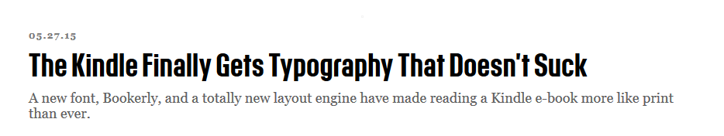
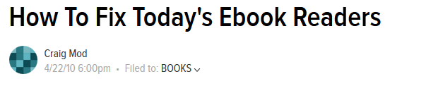
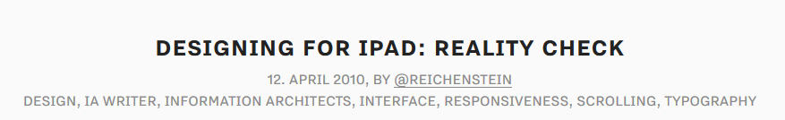
Project Overview:
Build a simple eBook reader
Special attention to readability and typography
Built with Python

Slide 3
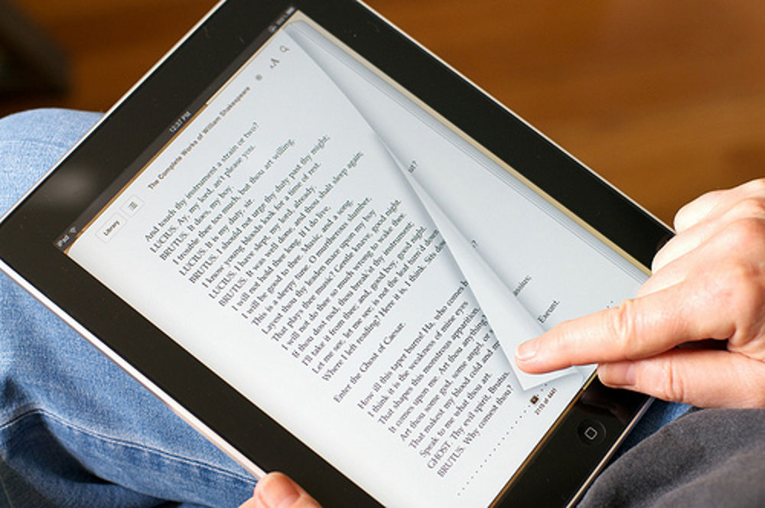
Why I am interested in this
I really enjoy using my iPad to read .ePub books
But I dislike the standard formats
I want to make my own eBook reader that is customizable to my own preferences
Eventually, I would like to implement advanced features like bookmarks the way I want

Slide 4
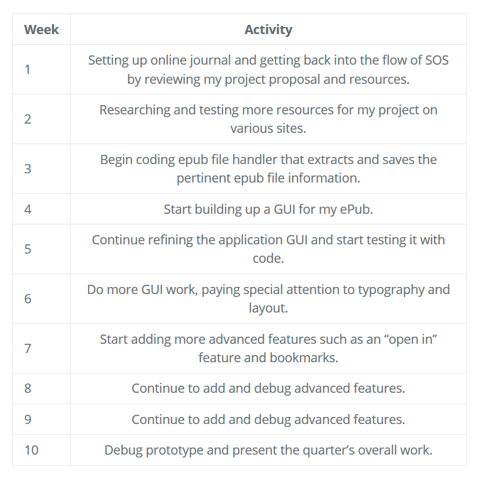
“3-Step” Original Timeline
Researching .ePub format and parsing the files
Create a GUI to display the html files (the core book content)
Start adding advanced features such as bookmarks

Slide 5
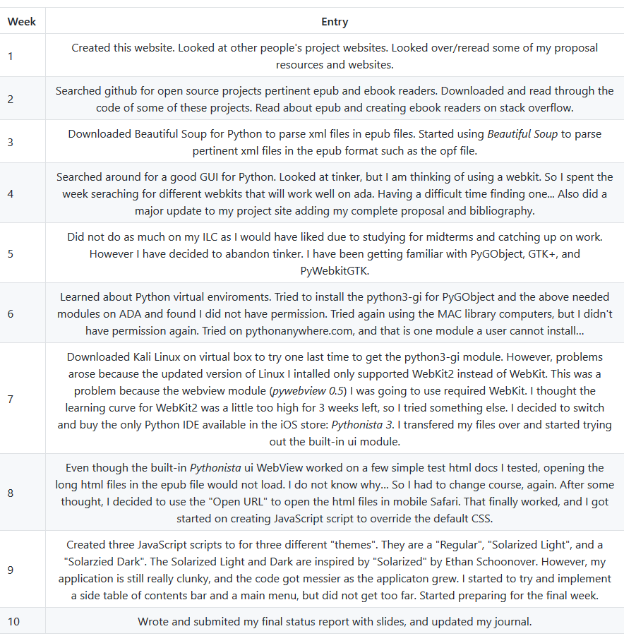
Accomplishments: Actual time line–2 steps
In reality, I only accomplished the first 2 steps of my original timeline.
I learned about the .ePub format, parsing the files with Beautiful Soup
I am using mobile Safari as my GUI to open the html, using JavaScript to change the CSS

Slide 6
Why the change?
Step 1: Learning about the .ePub format was simple, and parsing with Beautiful Soup was fun and quick
Step 2: The frustration arrives! I only have an iPad, so I need the school computers to do heavy programming. Unfortunately, all the GUI’s I wanted to use, I did not have permission:
ADA – You do not have permission to install, the administrator has been notified
Windows – You cannot install, please enter admin password
Library MAC – Your username is not in the root directory. The admin has been notified.
Pythonanywhere.com – Individual users cannot install this module
Kali Linux on Virtual Box – Downloaded WebKit2 instead of WebKit, steep learning curve

Slide 7
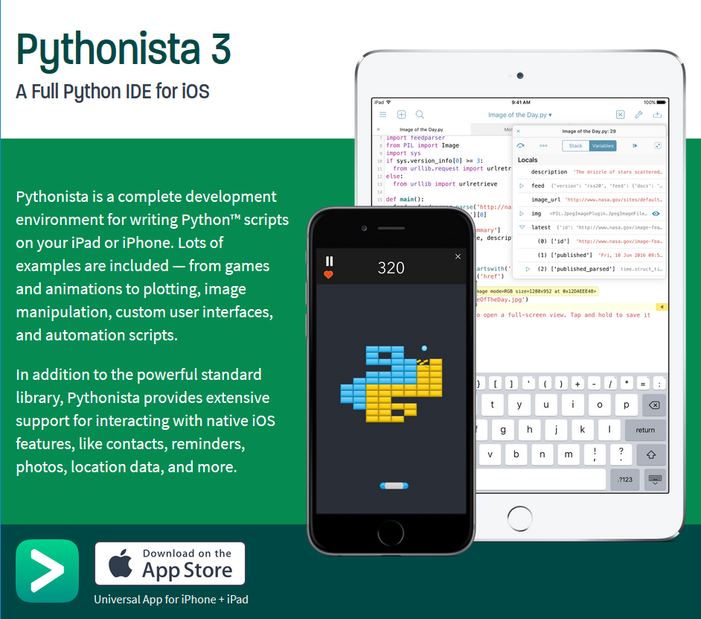
Solution
Downloaded Pythonista 3 from the iOS store
The built-in WebView could not open the long html files
Decided to open the files in mobile Safari
Created JavaScript scripts to edit the htmls’ CSS

Slide 8
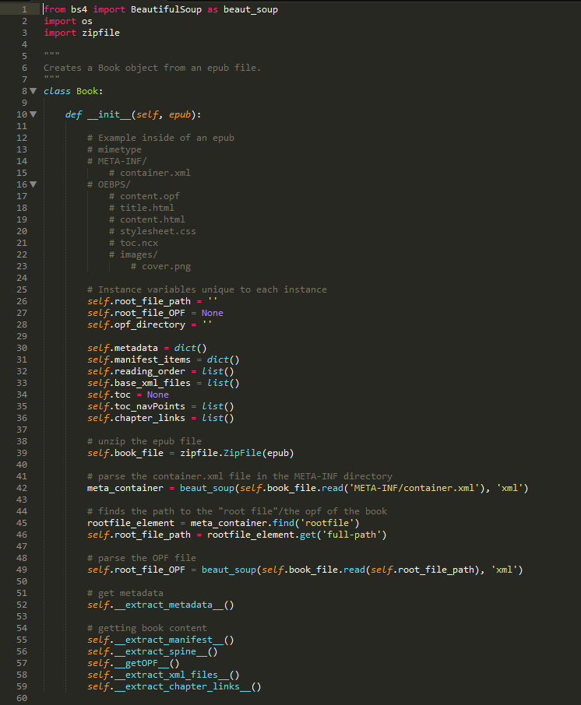
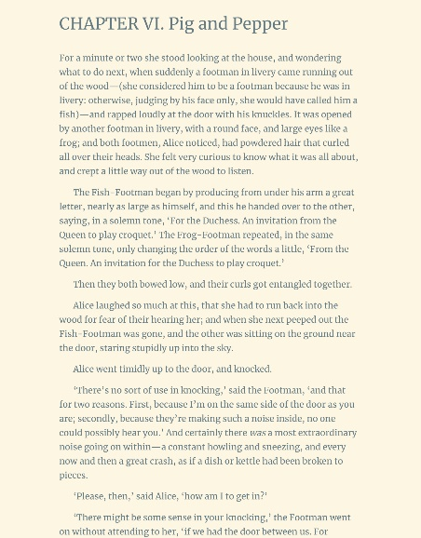
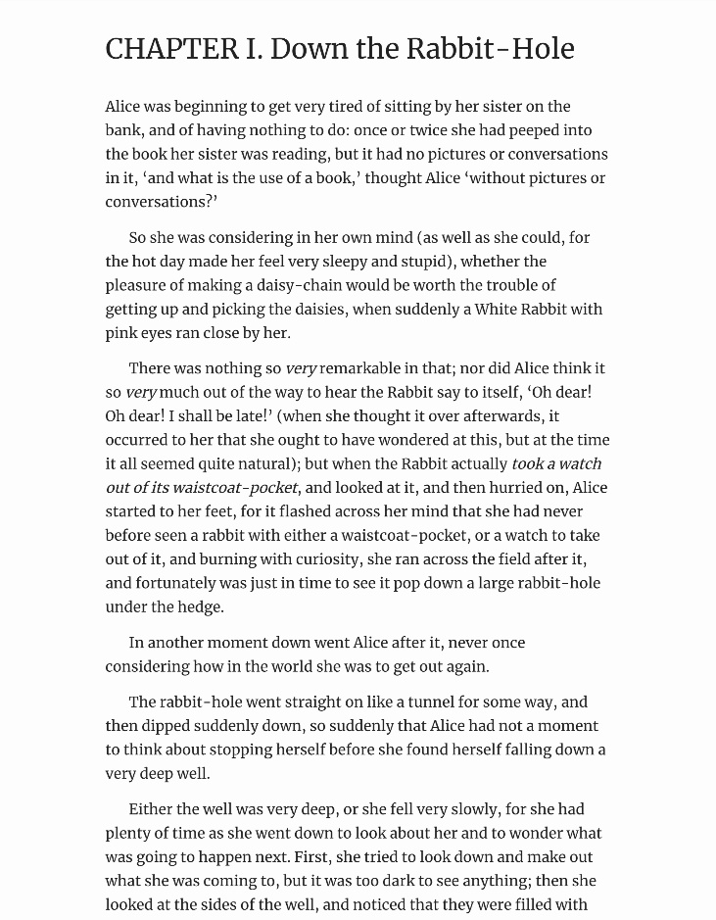
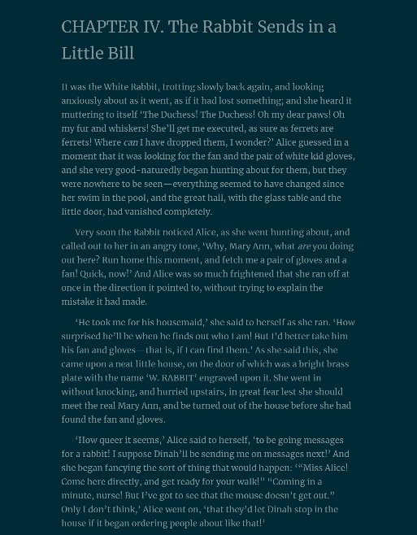
Samples

Slide 9

What I Learned
GUIs in Python are frustrating without a computer
.ePub is a wonderful format
Beautiful Soup makes parsing html/xml easy and fun
Evergreen’s computers/ADA are not good for installing
iPads are not good for deep coding
As the project grows, the style of my code goes down
It is difficult to stay on a timeline if I have never done a project before

Slide 10
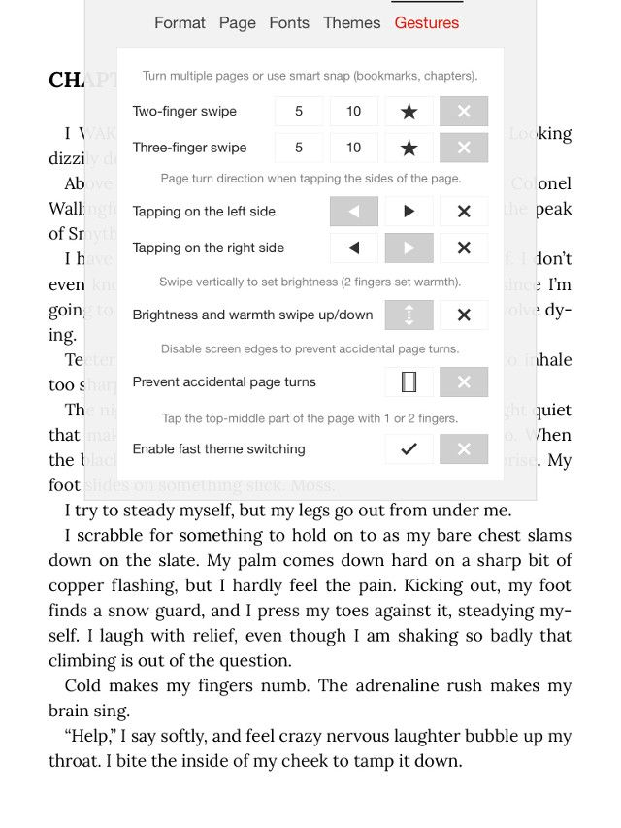
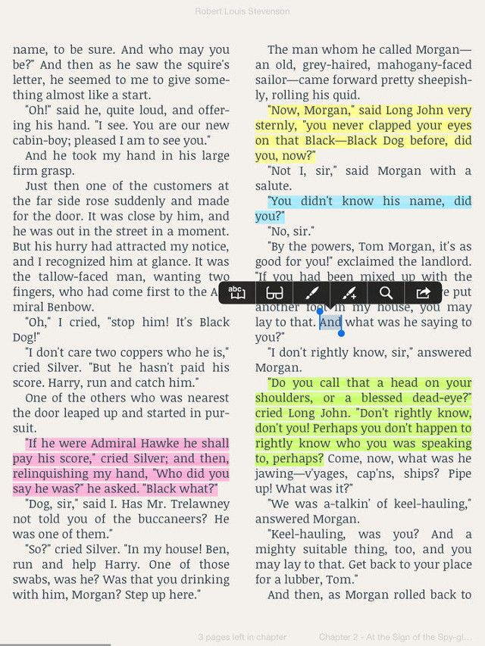
What to add next
Create a main menu
Implement an “open in” feature
Save the last reading spot
Create multiple bookmarks for each book

