Slide 1
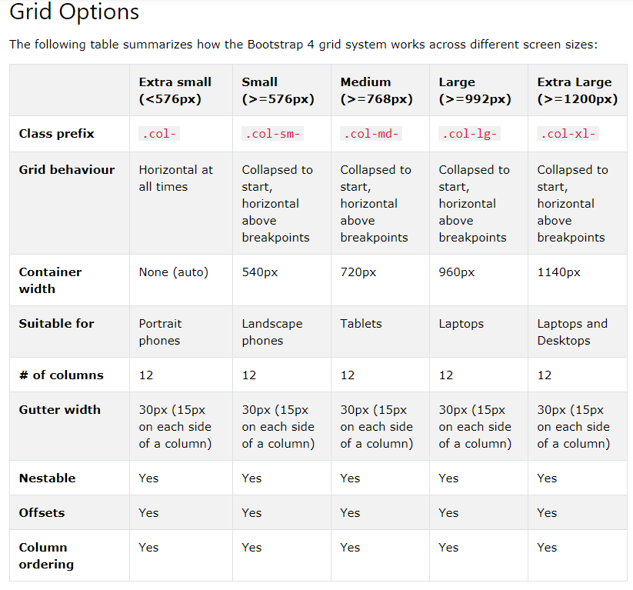
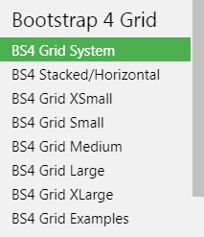
https://www.w3schools.com/bootstrap4/bootstrap_grid_system.asp

