Slide 1

Chapter 6 Normalization of Database Tables

Slide 2
Learning Objectives
In this chapter, students will learn:
What normalization is and what role it plays in the database design process
About the normal forms 1NF, 2NF, 3NF, BCNF, and 4NF
How normal forms can be transformed from lower normal forms to higher normal forms
That normalization and ER modeling are used concurrently to produce a good database design
That some situations require denormalization to generate information efficiently

Slide 3
Normalization
Evaluating and correcting table structures to minimize data redundancies
Reduces data anomalies
Assigns attributes to tables based on determination
Normal forms
First normal form (1NF)
Second normal form (2NF)
Third normal form (3NF)

Slide 4
Normalization
Higher normal forms are better than lower normal forms
2NF is better than 1NF; 3NF is better than 2NF
For most business database design purposes, 3NF is as high as needed in normalization
Highest level of normalization is not always most desirable
Denormalization: Produces a lower normal form
Results in increased performance and greater data redundancy

Slide 5
Need for Normalization
Used while designing a new database structure
Analyzes the relationship among the attributes within each entity
Determines if the structure can be improved
Improves the existing data structure and creates an appropriate database design

Slide 6
Normalization Process
Objective is to ensure that each table conforms to the concept of well-formed relations
Each table represents a single subject
No data item will be unnecessarily stored in more than one table
All nonprime attributes in a table are dependent on the primary key
Each table is void of insertion, update, and deletion anomalies

Slide 7
Normalization Process
Ensures that all tables are in at least 3NF
Higher forms are not likely to be encountered in business environment
Works one relation at a time
Starts by:
Identifying the dependencies of a relation (table)
Progressively breaking the relation into new set of relations

Slide 8
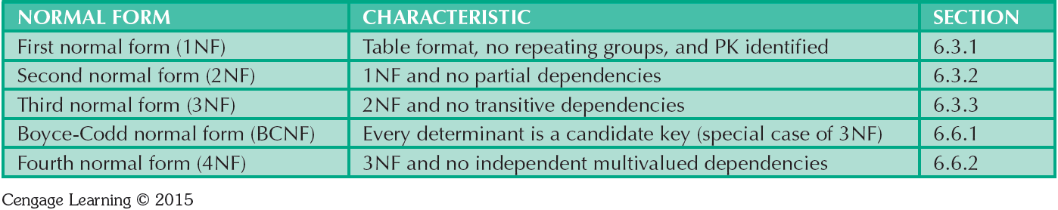
Table 6.2 - Normal Forms

Slide 9
Functional Dependence Concepts
Concept | Definition
Functional dependence | The attribute B is fully functionally dependent on the attribute A if each value of A determines one and only one value of B.
Functional dependence (Generalized definition) | Attribute A determines attribute B if all of the rows in the table that agree in value for attribute A also agree in value for attribute B.
Fully functional dependence (composite key) | If attribute B is functionally dependent on a composite key A but not on any Subset of that composite key, the attribute B is fully functionally dependent on A.

Slide 10
Types of Functional Dependencies
Partial dependency: Functional dependence in which the determinant is only part of the primary key
Assumption - One candidate key
Straight forward
Easy to identify
Transitive dependency: An attribute functionally depends on another nonkey attribute

Slide 11
Conversion to First Normal Form
Repeating group: Group of multiple entries of same type can exist for any single key attribute occurrence
Existence proves the presence of data redundancies
Enable reducing data redundancies
Steps
Eliminate the repeating groups
Identify the primary key
Identify all dependencies

Slide 12
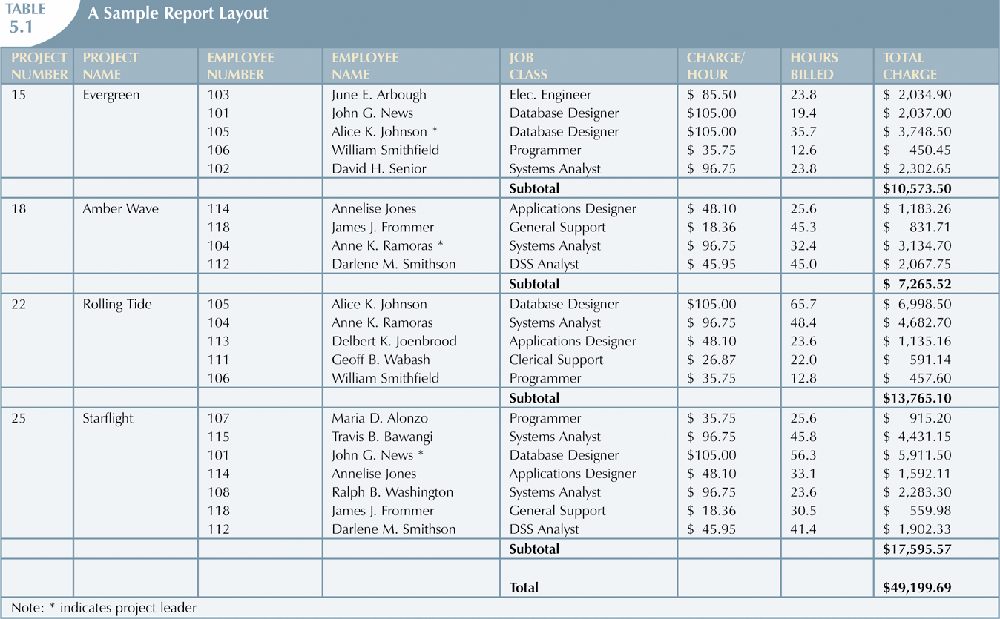

Slide 13
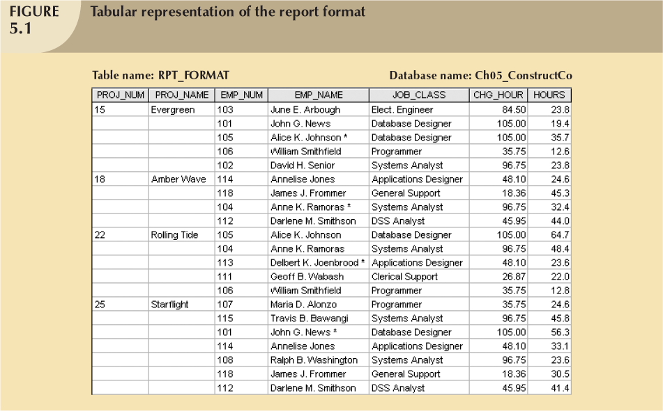

Slide 14
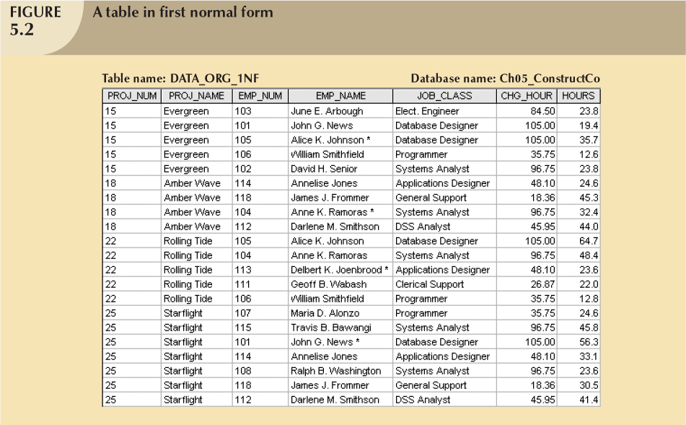

Slide 15
Conversion to First Normal Form
Dependency diagram:
Depicts all dependencies found within given table structure
Helps to get an overview of all relationships among table’s attributes
Makes it less likely that an important dependency will be overlooked

Slide 16
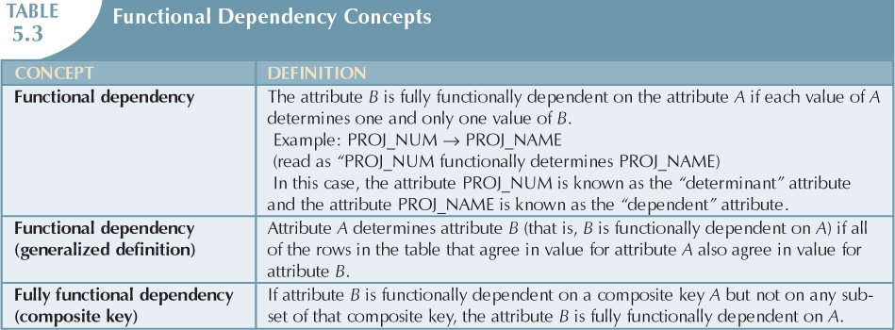

Slide 17
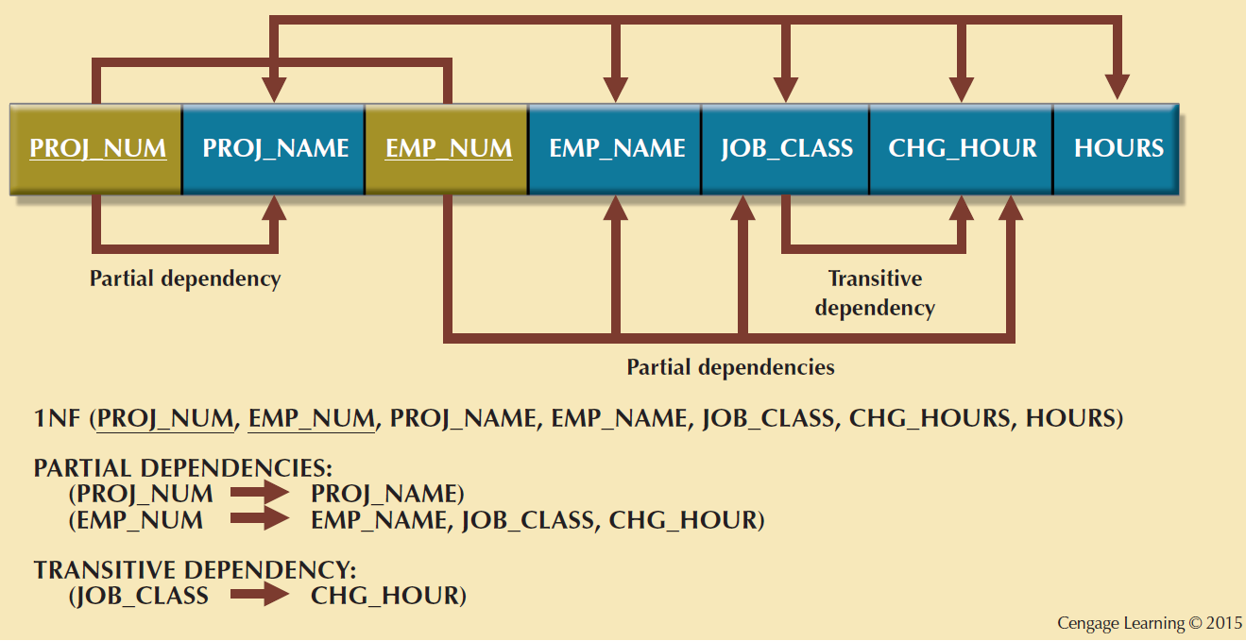
Figure 6.3 - First Normal Form (1NF) Dependency Diagram

Slide 18
Conversion to First Normal Form
1NF describes tabular format in which:
All key attributes are defined
There are no repeating groups in the table
All attributes are dependent on the primary key
All relational tables satisfy 1NF requirements
Some tables contain partial dependencies
Subject to data redundancies and various anomalies

Slide 19
Conversion to Second Normal Form
Make new tables to eliminate partial dependencies
Write Each Key Component on a Separate Line
Write each key component on separate line, then write original (composite) key on last line
Each component will become key in new table
Determine those attributes that are dependent on other attributes

Slide 20
Conversion to Second Normal Form
Table is in 2NF when it is in 1NF and has no partial dependencies
No attribute is dependent on only portion of primary key

Slide 21
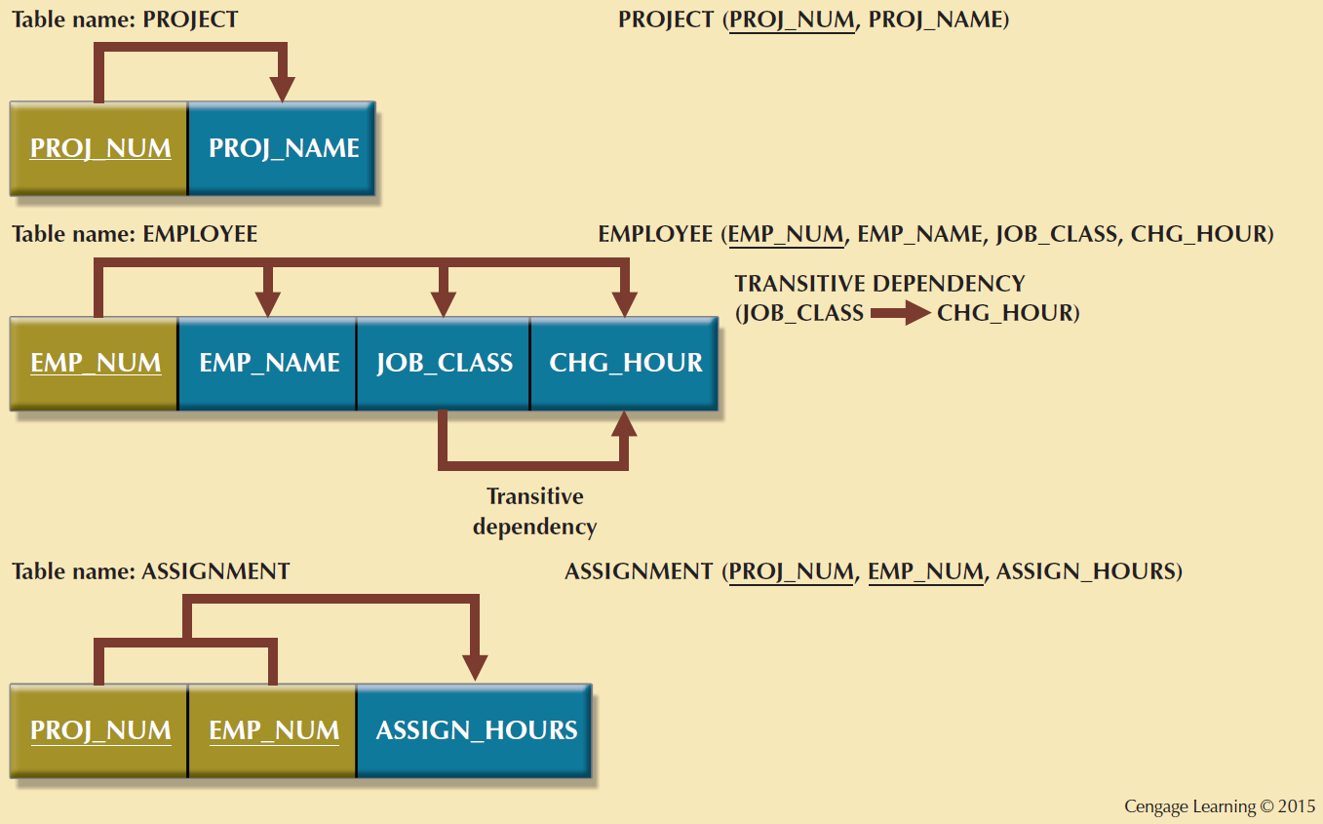
Figure 6.4 - Second Normal Form (2NF) Conversion Results

Slide 22
Conversion to Third Normal Form
Steps
Make new tables to eliminate transitive dependencies
Identify Each New Determinant.For every transitive dependency, write its determinant as PK for new table
Determinant: Any attribute whose value determines other values within a row
Reassign corresponding dependent attributes
Table is in 3NF when it:
Is in 2NF
Contains no transitive dependencies

Slide 23
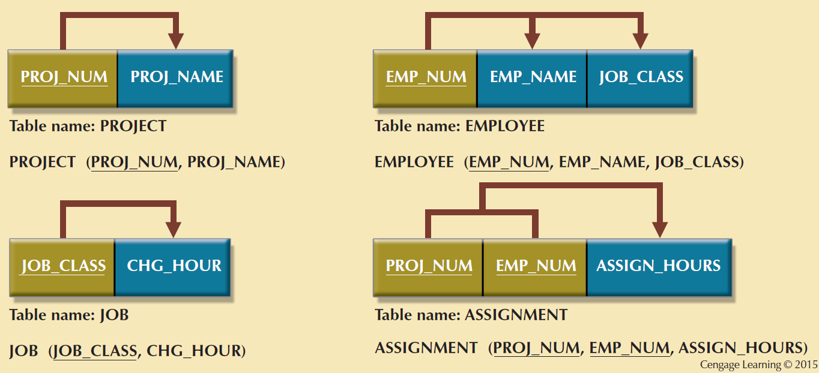
Figure 6.5 - Third Normal Form (3NF) Conversion Results

Slide 24
Requirements for Good Normalized Set of Tables
Evaluate PK assignments and naming conventions
Refine attribute atomicity
Atomic attribute: Cannot be further subdivided
Atomicity: Characteristic of an atomic attribute
Identify new attributes and new relationships
Refine primary keys as required for data granularity
Granularity: Level of detail represented by the values stored in a table’s row
Maintain historical accuracy and evaluate using derived attributes

Slide 25
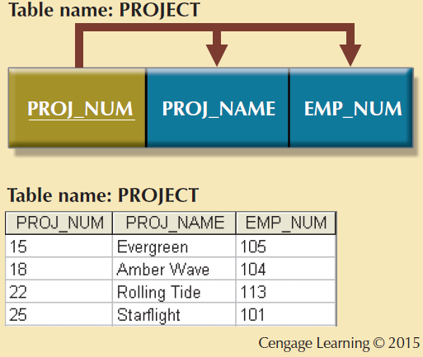
Figure 6.6 - The Completed Database

Slide 26
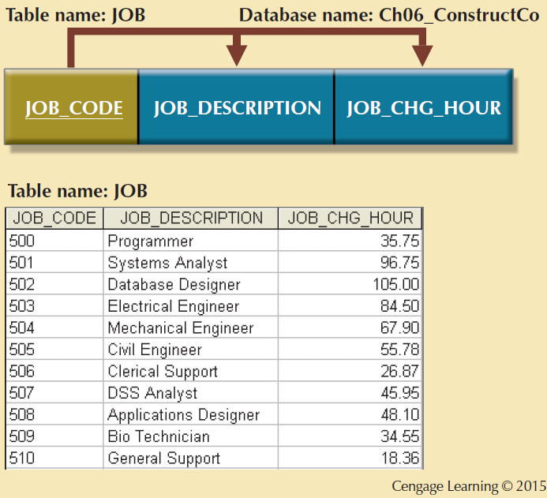
Figure 6.6 - The Completed Database

Slide 27
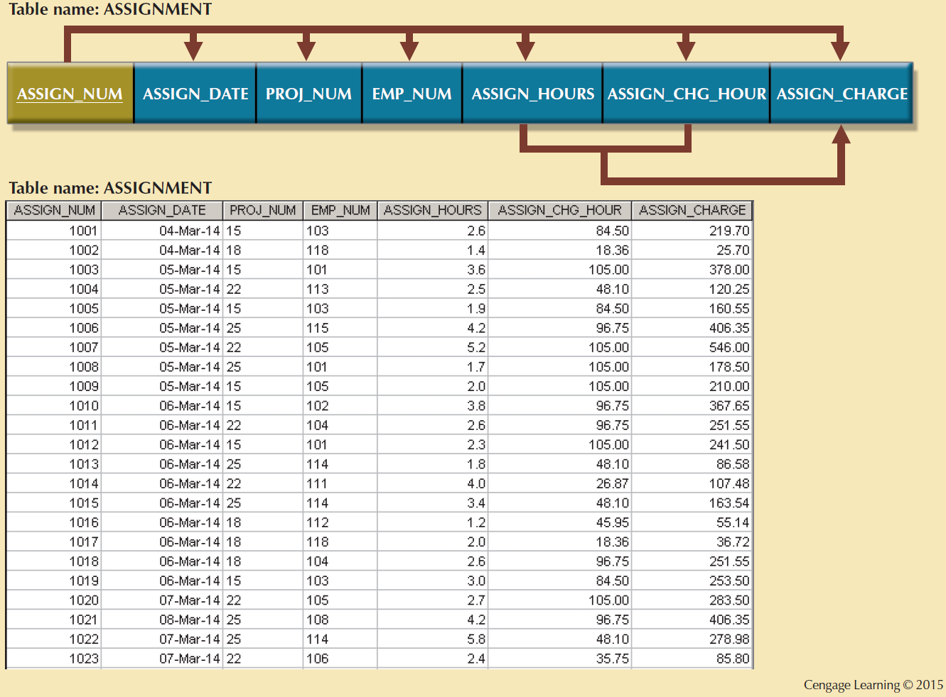
Figure 6.6 - The Completed Database

Slide 28
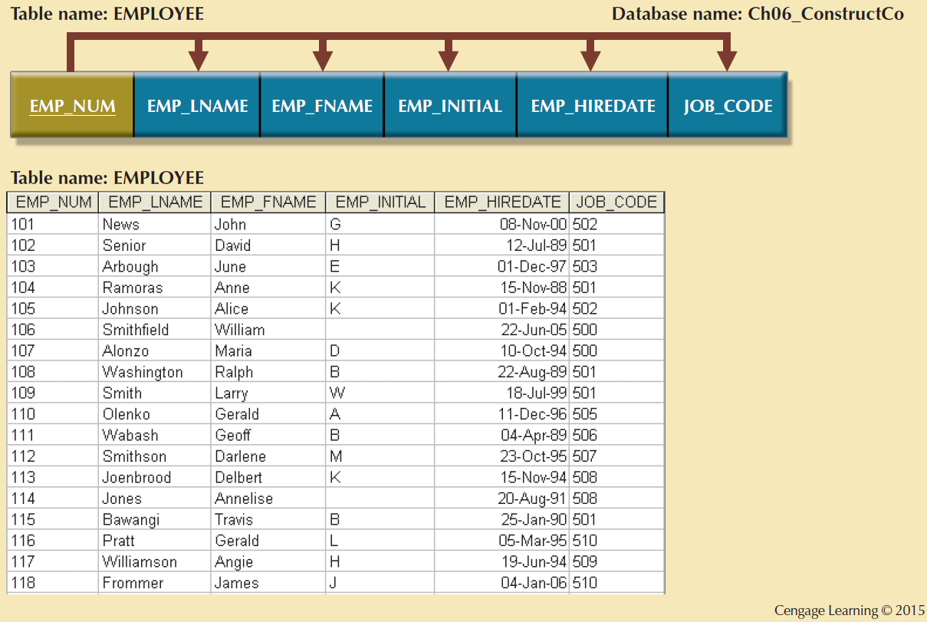
Figure 6.6 - The Completed Database

Slide 29
Surrogate Keys
Used by designers when the primary key is considered to be unsuitable
System-defined attribute
Created and managed via the DBMS
Have a numeric value which is automatically incremented for each new row

Slide 30
Normalization and Database Design
Normalization should be part of the design process
Proposed entities must meet required the normal form before table structures are created
Principles and normalization procedures to be understood to redesign and modify databases
ERD is created through an iterative process
Normalization focuses on the characteristics of specific entities

Slide 31
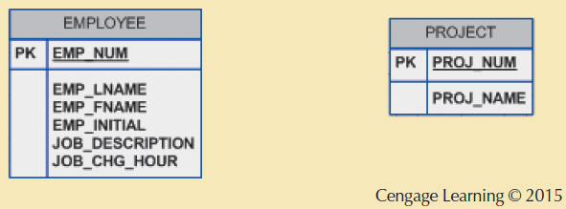
Figure 6.12 - Initial Contracting Company ERD

Slide 32
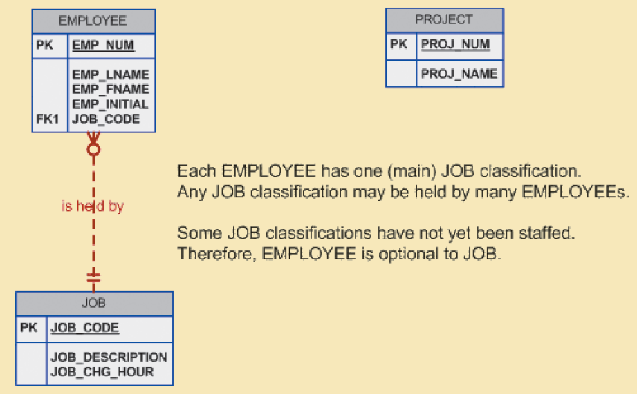
Figure 6.13 - Modified Contracting Company ERD
Cengage Learning © 2015

Slide 33
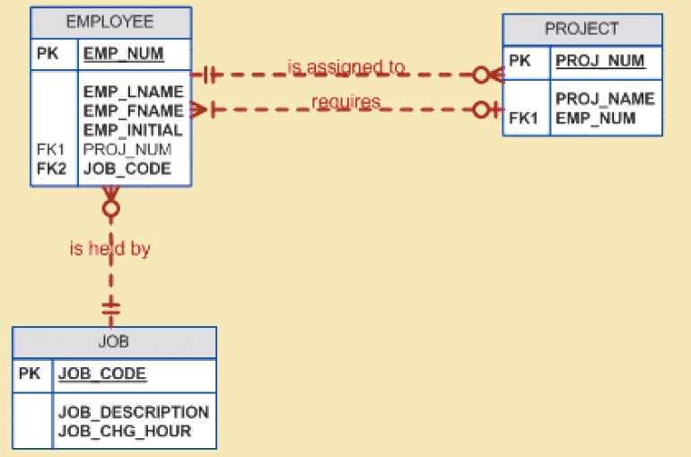
Figure 6.14 - Incorrect M:N Relationship Representation
Cengage Learning © 2015

Slide 34
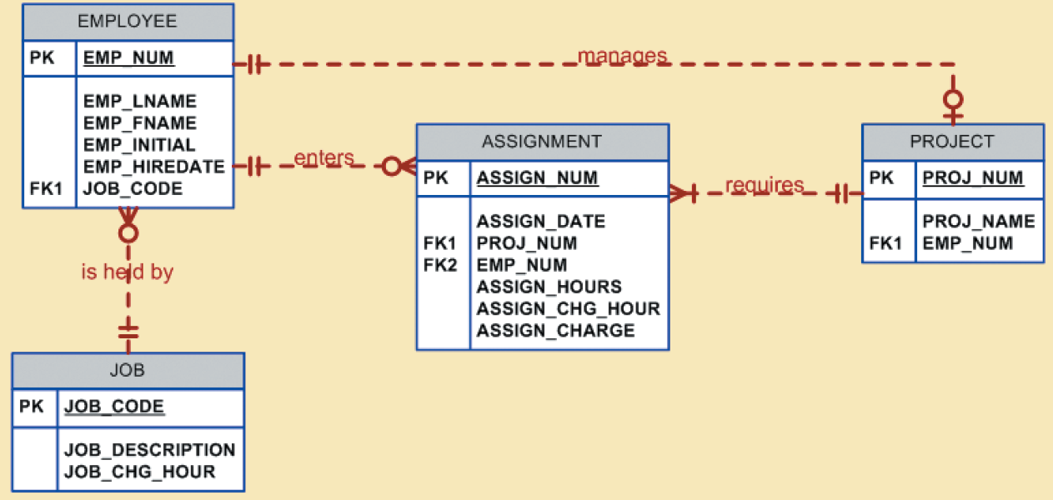
Figure 6.15 - Final Contracting Company ERD
Cengage Learning © 2015

Slide 35
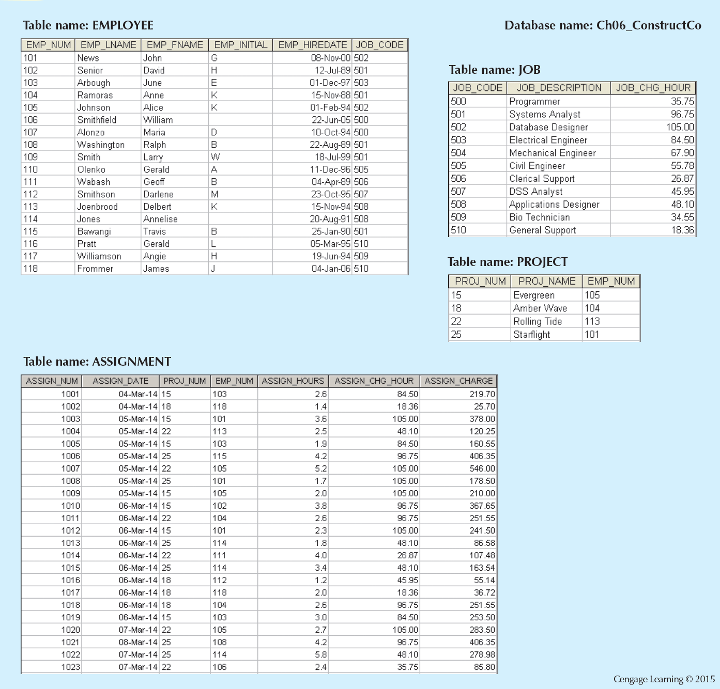
Figure 6.16 - The Implemented Database

Slide 36
Denormalization
Design goals
Creation of normalized relations
Processing requirements and speed
Number of database tables expands when tables are decomposed to conform to normalization requirements
Joining a larger number of tables:
Takes additional input/output (I/O) operations and processing logic
Reduces system speed

Slide 37
Denormalization
Defects in unnormalized tables
Data updates are less efficient because tables are larger
Indexing is more cumbersome
No simple strategies for creating virtual tables known as views

Slide 38
What do you think ? Verify this table.
APPOINTMENT
PatientID | Patient Name | Doctor Name | RoomNo | Department
8023 | Anderson | Smith | 324 | Cardiology
9167 | Bancroft | Hicks | 135 | Neurology
7924 | Hobbs | Smith | 324 | Cardiology
6837 | Tucker | Hernandez | 134 | Neurology
8596 | Eckersley | Hicks | 135 | Neurology
7018 | Arnold | Faulb | 256 | Optometry

