Slide 1
IT Infrastructure Automation –ansible - jenkins
BY YEE TONG

Slide 2
Background of company
Never Connect Systems (NCS) Ptd Ltd Company is a leading system integrator company in the Tech industry, with many teams of engineers implementing and maintaining project.
Current Process:
Manually spin VMs in local machine
Manually download Jenkins agent(CI/CD pipieline flow) into machine
Opportunity for Improvement:
Reduce repetitive tasks through Automation and CloudFormation
Saves time and reduces human error
Increase productivity and project efficiency

Slide 3


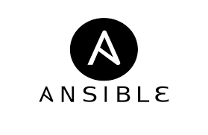

SOLUTION
Cloud Formation
CLOSE THE GAP
EASE OF SETUP
CloudFormation stacks to provision EC2 instances
Using Ansible to automate the process for Jenkins download
Have AWS CF templates ready and playbook ready
Does not require additional software or tool other than opening firewall ports
EFFORT & EFFICIENCY
Output
Reduce engineer effort and eliminate repetitive tasks with lesser error
Fully managed Jenkins servers available for team to test

Slide 4
Proposed Solution in detail
AWS CloudFormation
Ansible
- Cloud formation to launch stack and specify resources and values
- Nested stack to provision test environment (Security Group having port 20 and 8080 opne, Ubuntu EC2)
- Ansible playbook to install necessary packages in the EC2 (apt update, java, etc...)
- Set up key/repo
- Install Jenkins
- Send token through email

Slide 5
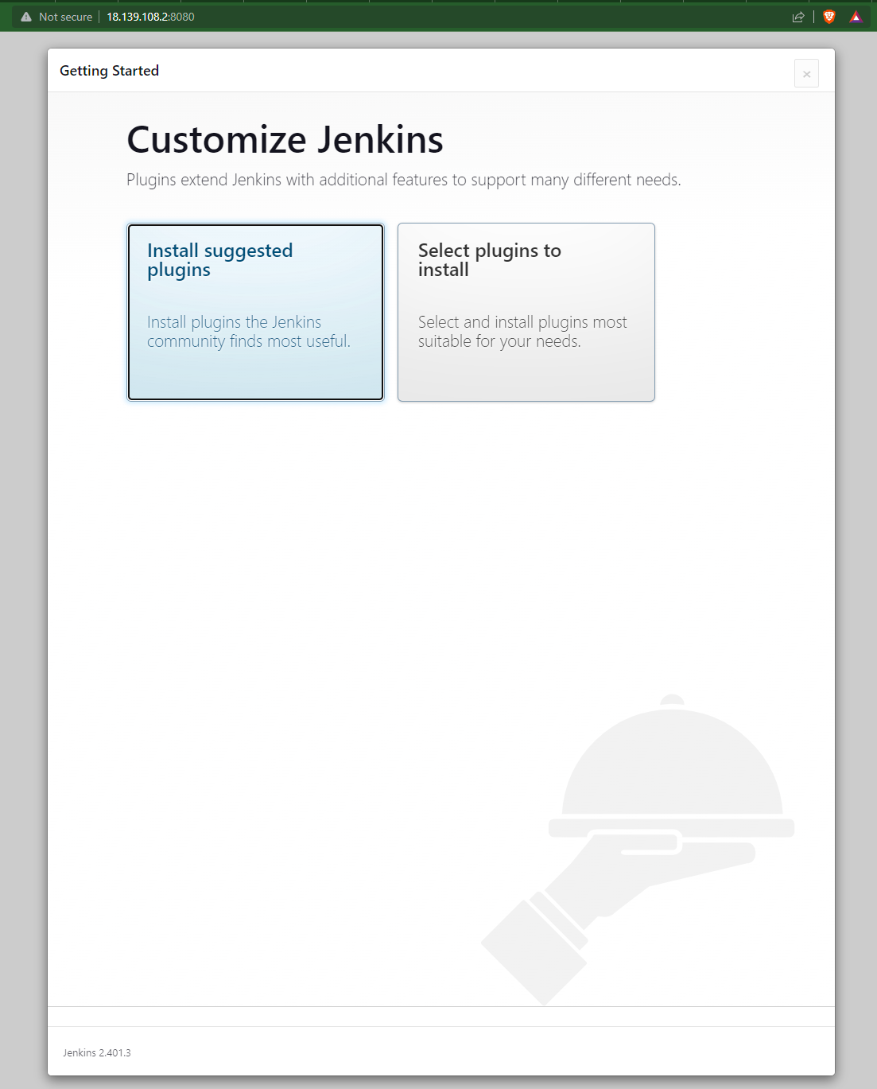
Demonstration
Outcome ->
5

Slide 6
Future Improvement
Set up IAM, VPC, Ansible server with CloudFormation
Set up SonarSource, GIT, Nexus in Ansible

Slide 7
SUMMARY
With the help of AWS CloudFormation and Ansible, the Jenkins servers can be quickly deployed in different projects that require them.
Mundane tasks such as downloading agents all can be automated through Ansible which will save tons of time and effort.

Slide 8
THANK YOU
Mr. Anggrasastriawan for his teaching and guidance

