Slide 1
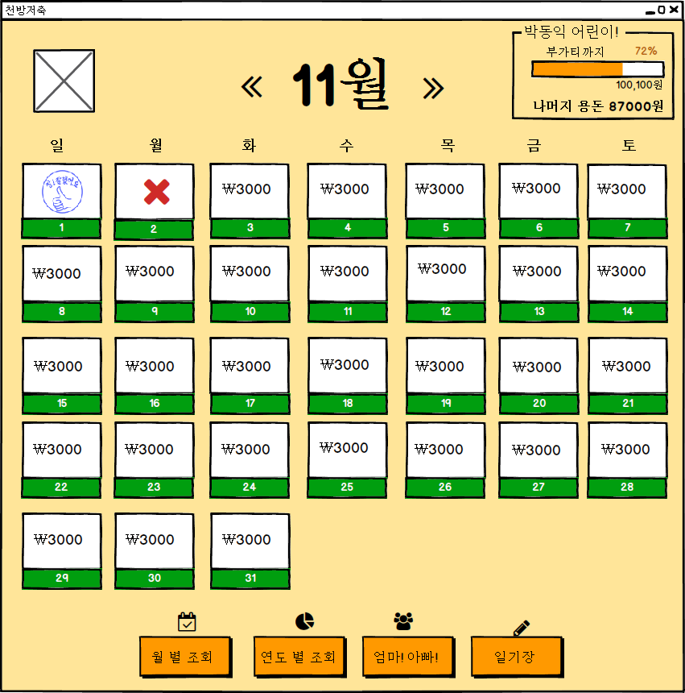
UIDiagram001
PreviousCalendarListener
actionPerformed(ActionEvenet:e)
EventSource : ImageIcon
NextCalendarListener
actionPerformed(ActionEvenet:e)
EventSource : ImageIcon
DayAccountLabelListener
actionPerformed(ActionEvenet:e)
EventSource : JLabel

Slide 2
UIDiagram001
MonthAccountBtnListener
actionPerformed(ActionEvenet:e)
EventSource : JButton
YearAccountBtnListener
actionPerformed(ActionEvenet:e)
EventSource : JButton

Slide 3
UIDiagram001
CommunicationBtnListener
actionPerformed(ActionEvenet:e)
EventSource : JButton
DiaryBtnListener
actionPerformed(ActionEvenet:e)
EventSource : JButton

Slide 4
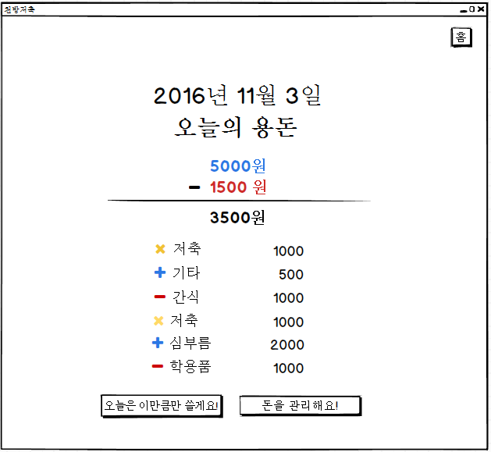
UIDiagram001
HomeBtnListener
+mouseClicked(MouseEvent:e)
EventSource : JButton
OneHistoryMouseListener
+mouseClicked(MouseEvent:e)
EventSource : JLabel
TodayLimitListener
+mouseClicked(MouseEvent:e)
EventSource : JButton
MoneyEditListener
+actionPerformed(ActionEvenet:e)
EventSource : JButton

Slide 5
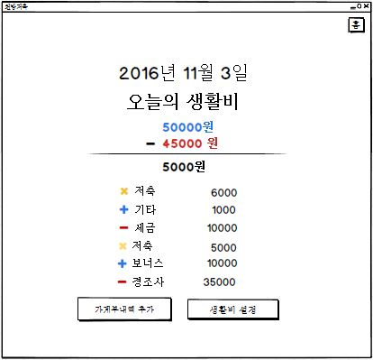
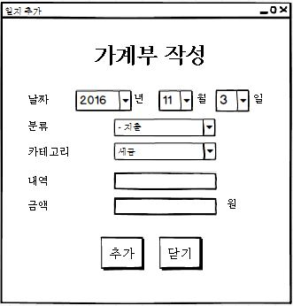
UIDiagram001
CategoryChangeListener
+itemStataChanged(ItemEvent:event)
EditBtnListener
+actionPerformed(ActionEvenet:e)
EventSource : JButton
ㅕ
EditCloseBtnListener
+actionPerformed(ActionEvenet:e)
EventSource : JButton

Slide 6
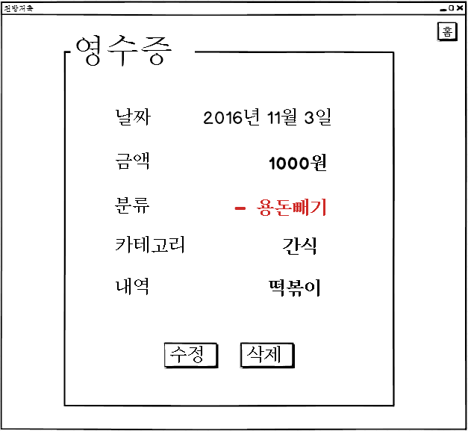
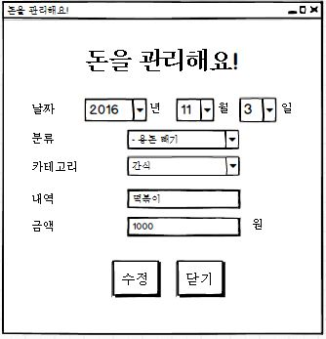
UIDiagram001
ModifyCategoryChangeListener
+itemStataChanged(ItemEvent:event)
ModifyBtnButton
+actionPerformed(ActionEvenet:e)
EventSource : JButton
CloseBtnListener
+actionPerformed(ActionEvenet:e)
EventSource : JButton

Slide 7
UIDiagram001
HomeBtnListener
+mouseClicked(MouseEvent:e)
EventSource : JButton
OneHistoryMouseListener
+mouseClicked(MouseEvent:e)
EventSource : JLabel
TodayLimitListener
+mouseClicked(MouseEvent:e)
EventSource : JButton
MoneyEditListener
+actionPerformed(ActionEvenet:e)
EventSource : JButton

Slide 8
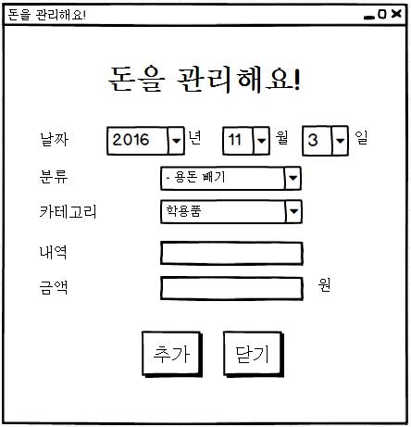
UIDiagram001
CategoryChangeListener
+itemStataChanged(ItemEvent:event)
EditBtnListener
+actionPerformed(ActionEvenet:e)
EventSource : JButton
EditCloseBtnListener
+actionPerformed(ActionEvenet:e)
EventSource : JButton

Slide 9
UIDiagram001
HistoryViewCloseBtnListener
+actionPerformed(ActionEvenet:e)
EventSource : JButton
닫기
HistoryViewModifyBtnListener
+actionPerformed(ActionEvenet:e)
EventSource : JButton
HistroyViewDelBtnListener
+actionPerformed(ActionEvenet:e)
EventSource : JButton

Slide 10
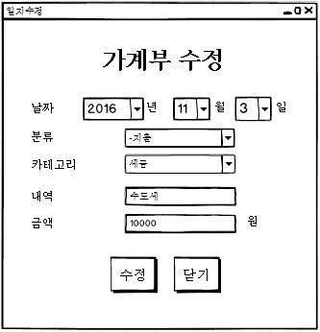
UIDiagram001
ModifyCategoryChangeListener
+itemStataChanged(ItemEvent:event)
ModifyBtnButton
+actionPerformed(ActionEvenet:e)
EventSource : JButton
CloseBtnListener
+actionPerformed(ActionEvenet:e)
EventSource : JButton

Slide 11
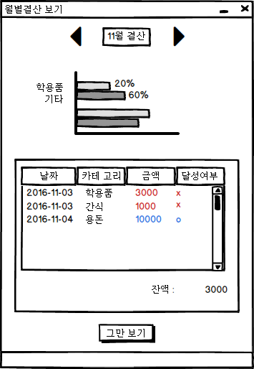
UIDiagram001
PreviousMonthListener
actionPerformed(ActionEvenet:e)
EventSource : ImageIcon
NextMonthListener
actionPerformed(ActionEvenet:e)
EventSource : ImageIcon
StopShowingListener
actionPerformed(ActionEvenet:e)
EventSource : JButton

Slide 12
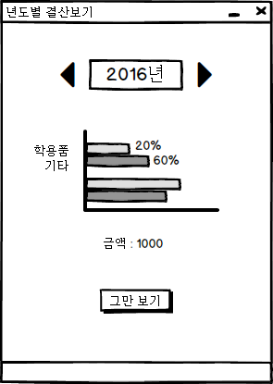
UIDiagram001
PreviousYearListener
actionPerformed(ActionEvenet:e)
EventSource : ImageIcon
NextYearListener
actionPerformed(ActionEvenet:e)
EventSource : ImageIcon
StopShowingListener
actionPerformed(ActionEvenet:e)
EventSource : JButton

Slide 13
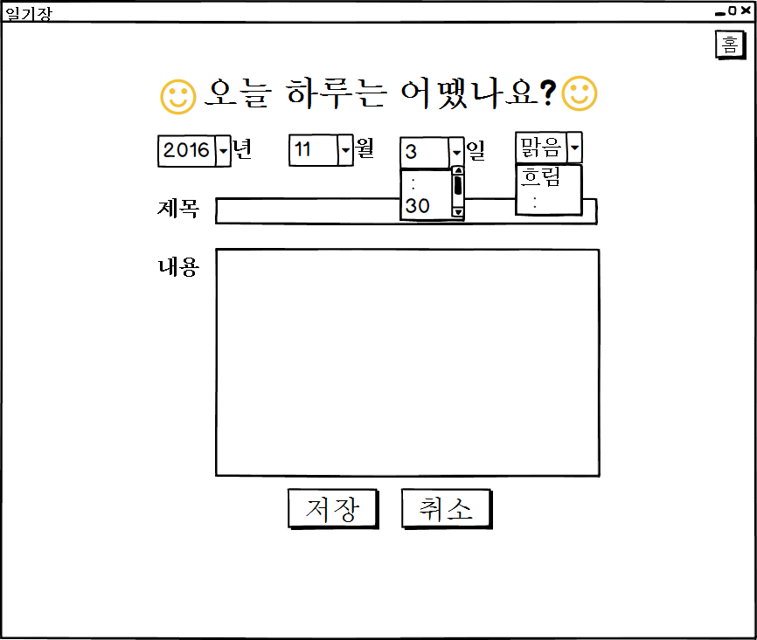
UIDiagram001
DiaryDayListener
+actionPerformed(ActionEvenet:e)
EventSource : JComboBox
SaveDiaryBtnListener
+actionPerformed(ActionEvenet:e)
EventSource : JButton
StopShowingDiaryBtn Listener
+actionPerformed(ActionEvenet:e)
EventSource : JButton

Slide 14
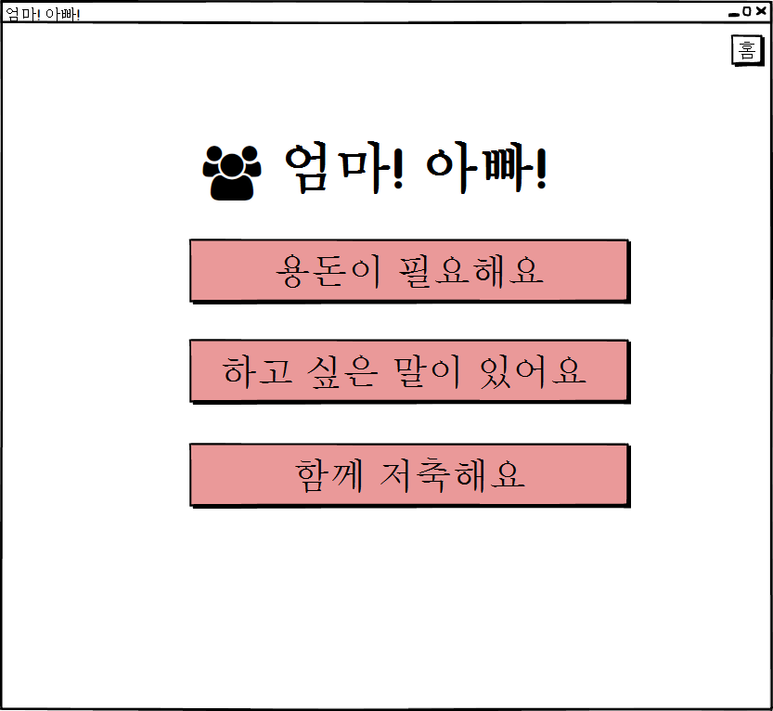
UIDiagram001
NeedAllowanceBtnListener
+actionPerformed(ActionEvenet:e)
EventSource : JButton
TalkToParentBtnListener
+actionPerformed(ActionEvenet:e)
EventSource : JButton
SavingWithParentBtnListener
+actionPerformed(ActionEvenet:e)
EventSource : JButton

Slide 15
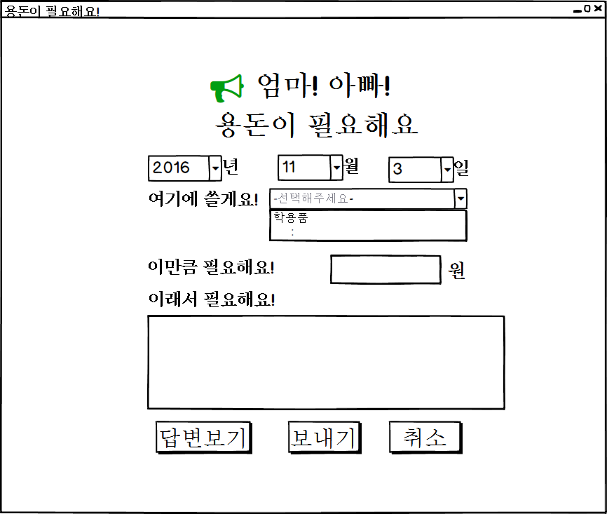
UIDiagram001
ShowResponseBtnListener
+actionPerformed(ActionEvenet:e)
EventSource : JButton
AskAllowanceBtnListener
+actionPerformed(ActionEvenet:e)
EventSource : JButton
CancelAllowanceBtnListener
+actionPerformed(ActionEvenet:e)
EventSource : JButton

Slide 16
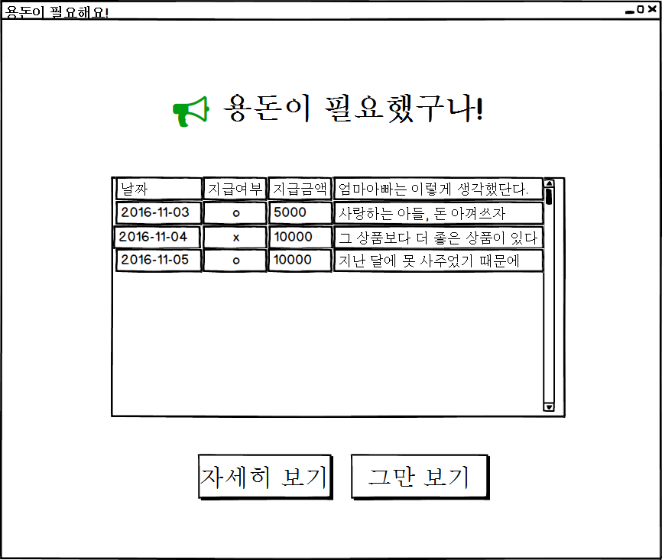
UIDiagram001
ShowDetailAllowanceBtn Listener
+actionPerformed(ActionEvenet:e)
EventSource : JButton
CancelDetailAllowanceBtn Listener
+actionPerformed(ActionEvenet:e)
EventSource : JButton

Slide 17
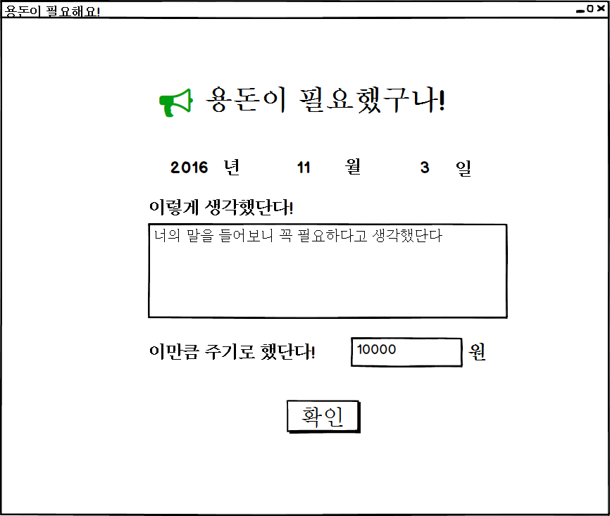
UIDiagram001
ConfirmDetailAllowanceBtnListener
+actionPerformed(ActionEvenet:e)
EventSource : JButton

Slide 18
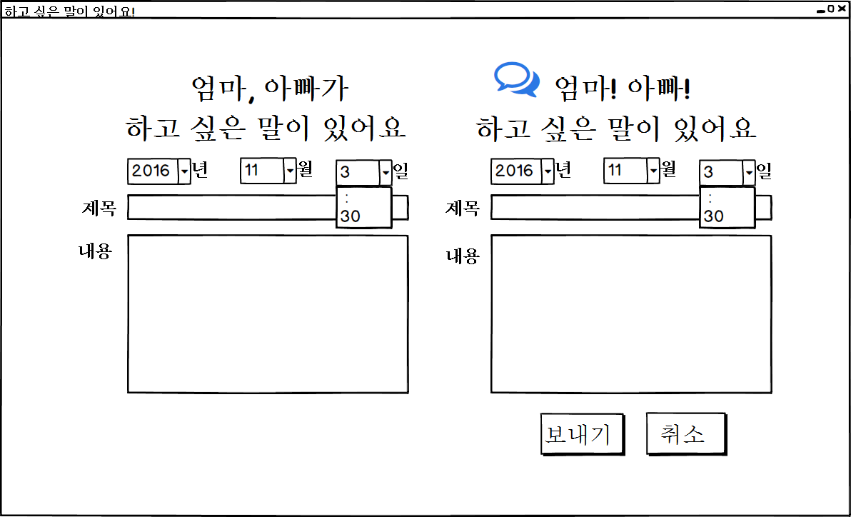
UIDiagram001
MemoDayListener
+actionPerformed(ActionEvenet:e)
EventSource : JComboBox

Slide 19
UIDiagram001
SaveMemoBtnListener
+actionPerformed(ActionEvenet:e)
SaveMemoBtnListener
+actionPerformed(ActionEvenet:e)
EventSource : JButton
EventSource : JButton

Slide 20
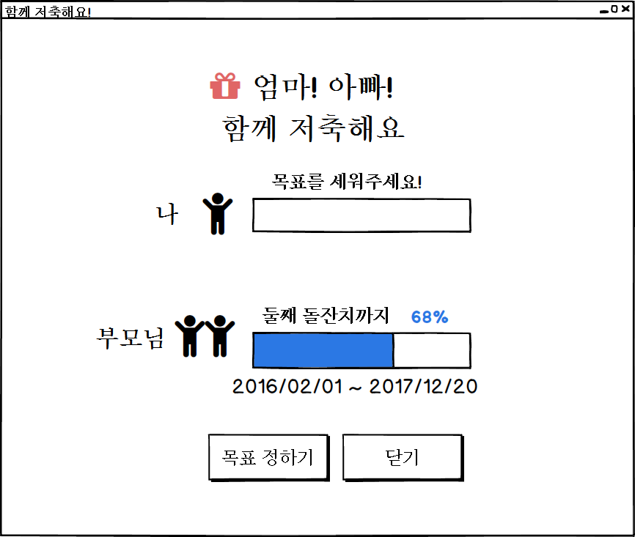
UIDiagram001
SetGoalStartBtnListener
+actionPerformed(ActionEvenet:e)
EventSource : JButton
CancelGoalBtnListener
+actionPerformed(ActionEvenet:e)
EventSource : JButton

Slide 21
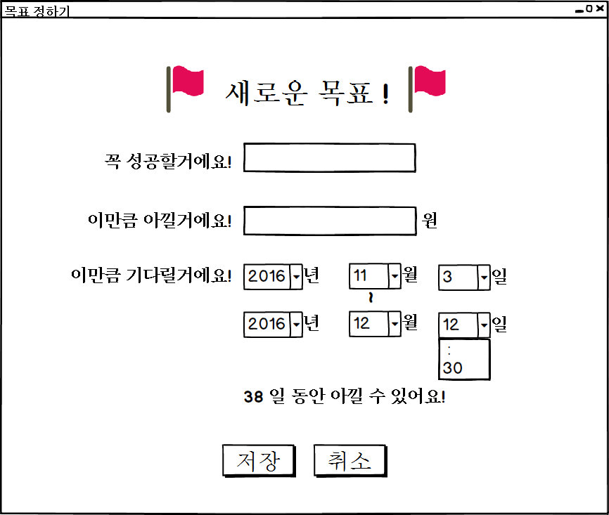
UIDiagram001
SetGoalBtnListener
+actionPerformed(ActionEvenet:e)
EventSource : JButton
CancelSetGoalBtnListener
+actionPerformed(ActionEvenet:e)
EventSource : JButton

Slide 22
UIDiagram001
DiaryDayListener
+actionPerformed(ActionEvenet:e)
EventSource : JComboBox
SaveDiaryBtnListener
+actionPerformed(ActionEvenet:e)
EventSource : JButton
StopShowingDiaryBtn Listener
+actionPerformed(ActionEvenet:e)
EventSource : JButton

Slide 23
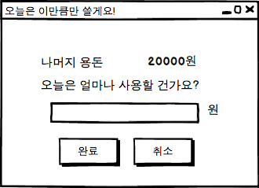
RegisterLimitListener
+actionPerformed(e:ActionEvent)
CancelLimitListener
+actionPerformed(e:ActionEvent)
EventSource : JButton
EventSource : JButton

Slide 24
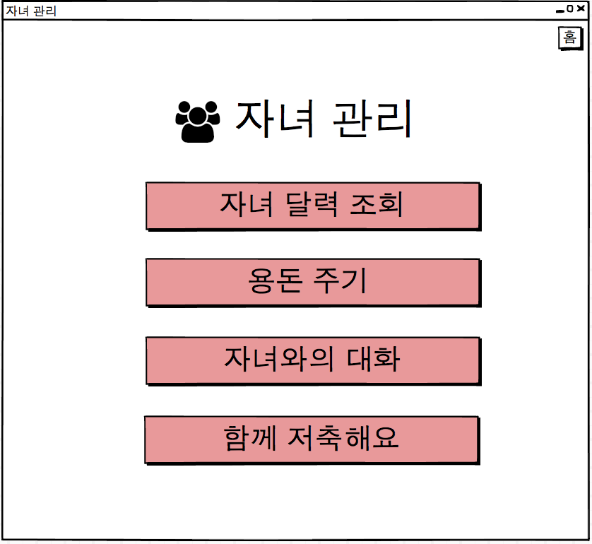
CheckChildMainListener
+actionPerformed(e:ActionEvent)
EventSource : JButton
GiveMoneyListener
+actionPerformed(e:ActionEvent)
EventSource : JButton
SavingWithChildListener
+actionPerformed(e:ActionEvent)
TalkToChildListener
+actionPerformed(e:ActionEvent)
EventSource : JButton
EventSource : JButton

Slide 25
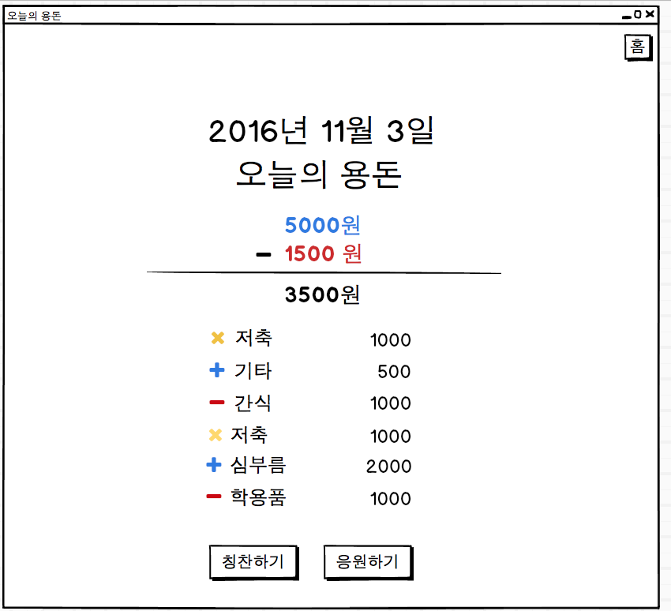
ComplimentListener
+actionPerformed(e:ActionEvent)
SupportListener
+actionPerformed(e:ActionEvent)
EventSource : JButton
EventSource : JButton

Slide 26
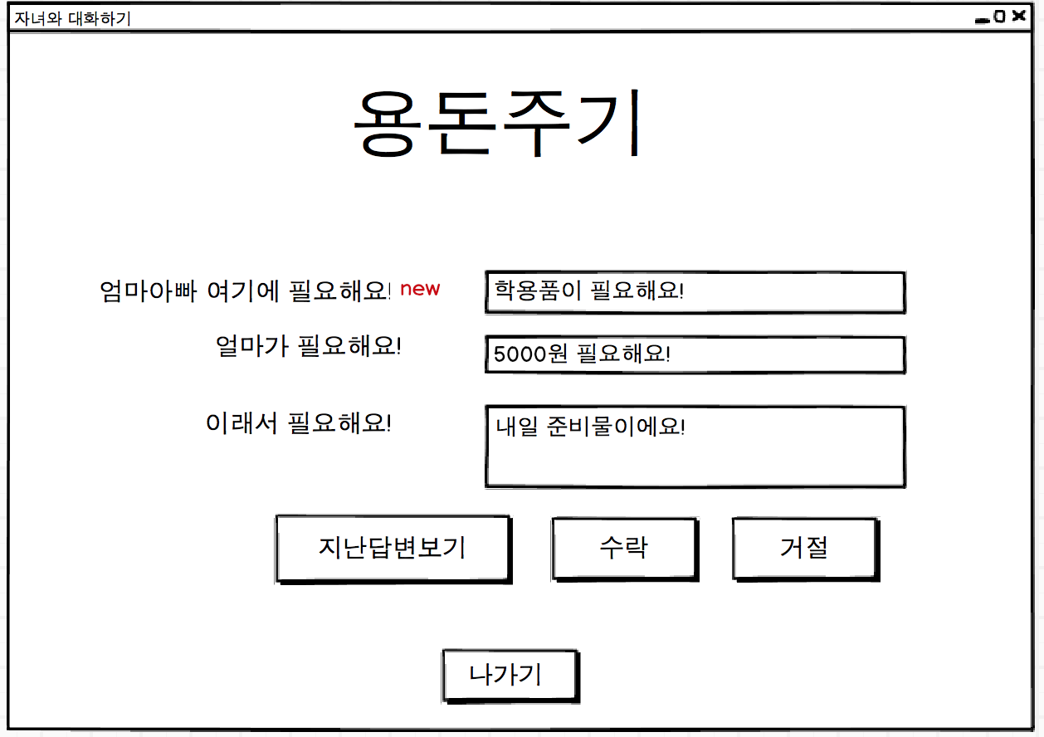
AcceptListener
+actionPerformed(e:ActionEvent)
EventSource : JButton
RefuseListener
+actionPerformed(e:ActionEvent)
EventSource : JButton
CloseGiveMoneyListener
+actionPerformed(e:ActionEvent)
?
+actionPerformed(e:ActionEvent)
EventSource : JButton
EventSource : JButton

Slide 27
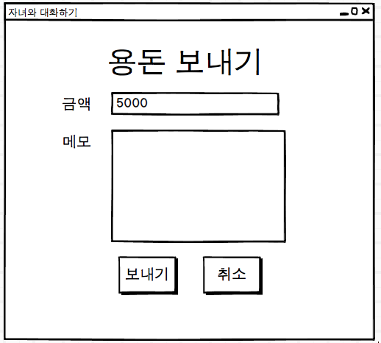
SendMoneyListener
+actionPerformed(e:ActionEvent)
CancelSendMoneyListener
+actionPerformed(e:ActionEvent)
EventSource : JButton
EventSource : JButton

Slide 28
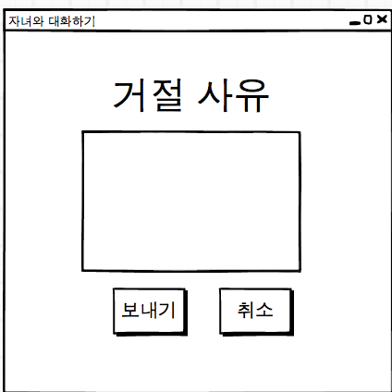
SendRefuseMsgListener
+actionPerformed(e:ActionEvent)
CancelSendRefuseMsgListener
+actionPerformed(e:ActionEvent)
EventSource : JButton
EventSource : JButton

Slide 29
UIDiagram001
ShowDetailAllowanceBtn Listener
+actionPerformed(ActionEvenet:e)
EventSource : JButton
CancelDetailAllowanceBtn Listener
+actionPerformed(ActionEvenet:e)
EventSource : JButton

Slide 30
UIDiagram001
ConfirmDetailAllowanceBtnListener
+actionPerformed(ActionEvenet:e)
EventSource : JButton

Slide 31
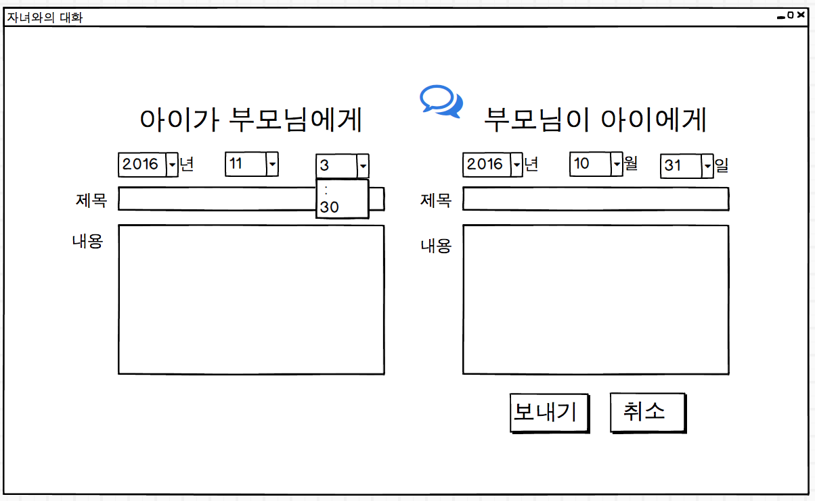
UIDiagram001
SaveMemoBtnListener
+actionPerformed(ActionEvenet:e)
SaveMemoBtnListener
+actionPerformed(ActionEvenet:e)
EventSource : JButton
EventSource : JButton

Slide 32
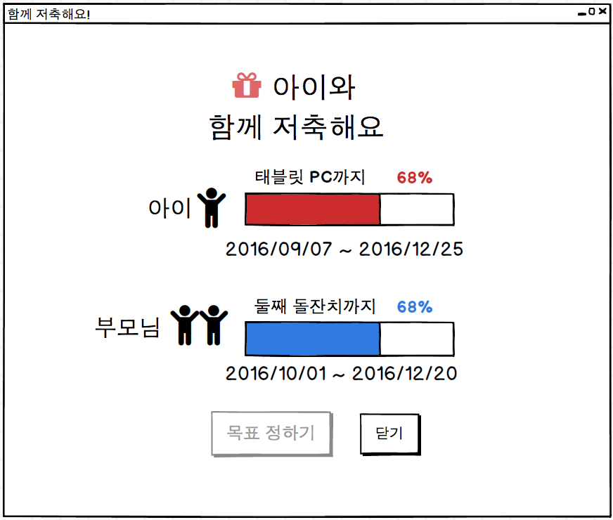
UIDiagram001
SetGoalStartBtnListener
+actionPerformed(ActionEvenet:e)
EventSource : JButton
CancelGoalBtnListener
+actionPerformed(ActionEvenet:e)
EventSource : JButton

Slide 33
UIDiagram001
SetGoalBtnListener
+actionPerformed(ActionEvenet:e)
EventSource : JButton
CancelSetGoalBtnListener
+actionPerformed(ActionEvenet:e)
EventSource : JButton

Slide 34
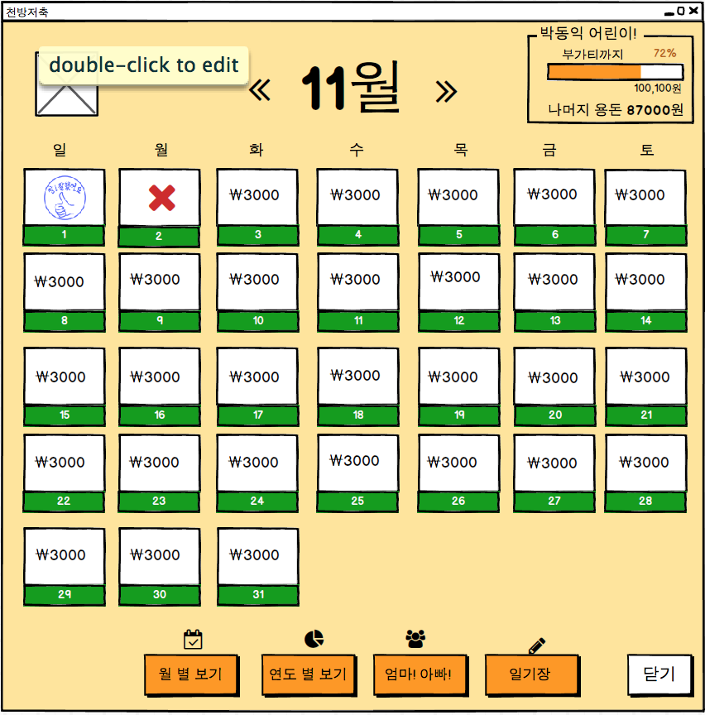
ChildManagementListener
+actionPerformed(e:ActionEvent)
EventSource : JButton
CloseChildManagementListener
+actionPerformed(e:ActionEvent)
EventSource : JButton

Slide 35
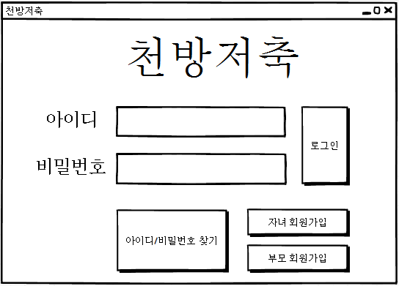
UIDiagram001
LogInBtnListener
actionPerformed(ActionEvenet:e)
EventSource : ImageIcon
ChildSignUpBtnListener
actionPerformed(ActionEvenet:e)
EventSource : ImageIcon
ParentSignUpBtnListener
actionPerformed(ActionEvenet:e)
InfoFindBtnListener
actionPerformed(ActionEvenet:e)
EventSource : JButton

Slide 36
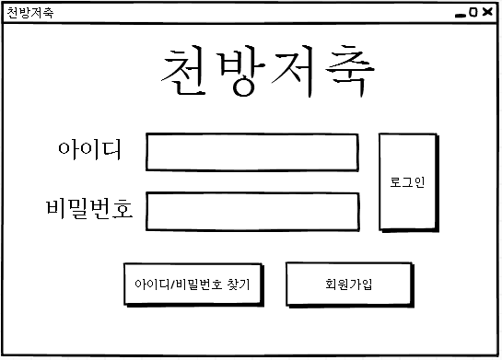
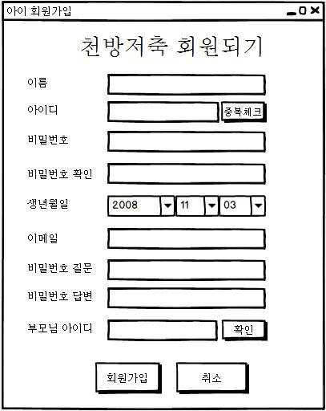
ChildMemberCheckBtnListener
+actionPerformed(ActionEvenet:e)
UIDiagram001
EventSource : JButton
ChildJoinBtnListener
+actionPerformed(ActionEvenet:e)
EventSource : JButton
ParentAcceptBtnListener
+actionPerformed(ActionEvenet:e)
EventSource : JButton
ChildJoinCancelBtnListener
+actionPerformed(ActionEvenet:e)
EventSource : JButton

Slide 37
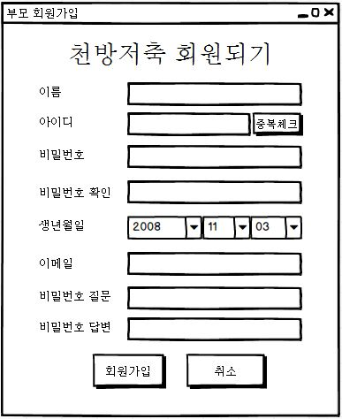
UIDiagram001
ParentMemberCheckBtnListener
+actionPerformed(ActionEvenet:e)
EventSource : JButton
ParentJoinBtnListener
+actionPerformed(ActionEvenet:e)
EventSource : JButton
ParentJoinCancelBtnListener
+actionPerformed(ActionEvenet:e)
EventSource : JButton

Slide 38
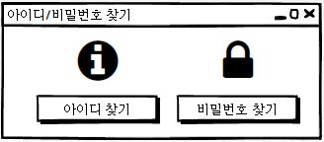
UIDiagram001
PasswordFindBtnListener
actionPerformed(ActionEvenet:e)
EventSource : JButton
IDFindBtnListener
actionPerformed(ActionEvenet:e)
EventSource : JButton

Slide 39
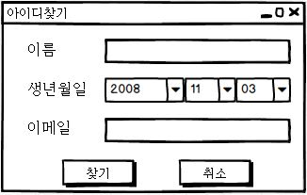
UIDiagram001
IDFindBtnListener
+actionPerformed(ActionEvenet:e)
EventSource : JButton
IDCancelBtnListener
+actionPerformed(ActionEvenet:e)
EventSource : JButton

Slide 40
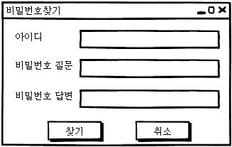
UIDiagram001
PasswordFindBtnListener
+actionPerformed(ActionEvenet:e)
EventSource : JButton
PasswordCancelBtnListener
+actionPerformed(ActionEvenet:e)
EventSource : JButton

