Slide 1
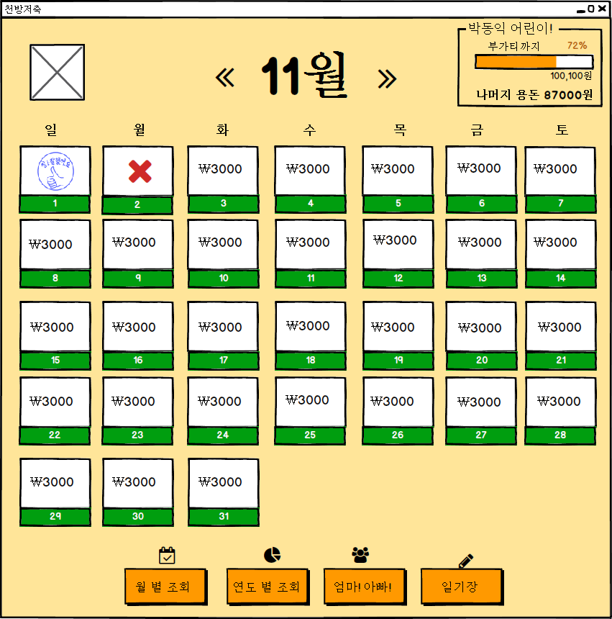
UIDiagram001
PreviousCalendarListener
+actionPerformed(ActionEvenet:e)
EventSource : ImageIcon
NextCalendarListener
+actionPerformed(ActionEvenet:e)
EventSource : ImageIcon
DayAccountLabelListener
+mouseClicked(MouseEvent:e)
EventSource : JLabel

Slide 2
UIDiagram002
MonthAccountBtnListener
+actionPerformed(ActionEvenet:e)
EventSource : JButton
YearAccountBtnListener
+actionPerformed(ActionEvenet:e)
EventSource : JButton

Slide 3
UIDiagram003
CommunicationBtnListener
+actionPerformed(ActionEvenet:e)
EventSource : JButton
DiaryBtnListener
+actionPerformed(ActionEvenet:e)
EventSource : JButton

Slide 4
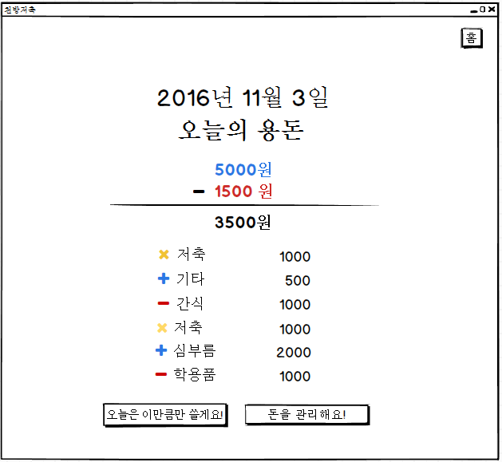
UIDiagram004
HomeBtnListener
+actionPerformed(ActionEvenet:e)
EventSource : JButton
OneHistoryMouseListener
+mouseClicked(MouseEvent:e)
EventSource : JLabel
TodayLimitListener
+actionPerformed(ActionEvenet:e)
EventSource : JButton
MoneyEditListener
+actionPerformed(ActionEvenet:e)
EventSource : JButton

Slide 5
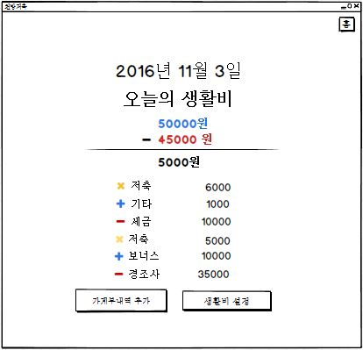
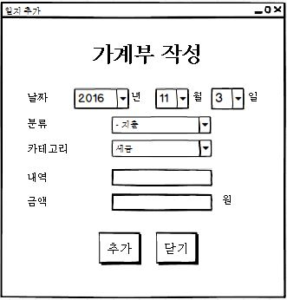
UIDiagram005
CategoryChangeListener
+actionPerformed(ActionEvenet:e)
EditBtnListener
+actionPerformed(ActionEvenet:e)
EventSource : JButton
ㅕ
EditCloseBtnListener
+actionPerformed(ActionEvenet:e)
EventSource : JButton

Slide 6
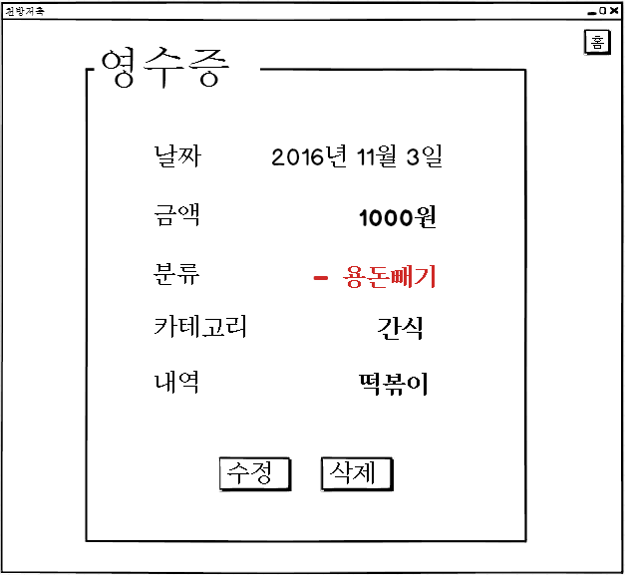
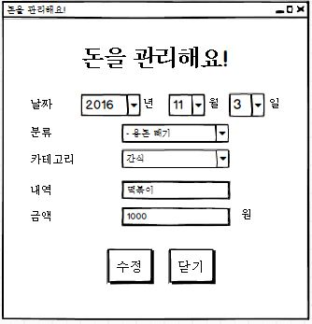
UIDiagram006
ModifyCategoryChangeListener
+actionPerformed(ActionEvenet:e)
ModifyBtnButton
+actionPerformed(ActionEvenet:e)
EventSource : JButton
CloseBtnListener
+actionPerformed(ActionEvenet:e)
EventSource : JButton

Slide 7
UIDiagram007
HomeBtnListener
+actionPerformed(ActionEvenet:e)
EventSource : JButton
OneHistoryMouseListener
+mouseClicked(MouseEvent:e)
EventSource : JLabel
TodayLimitListener
+actionPerformed(ActionEvenet:e)
EventSource : JButton
MoneyEditListener
+actionPerformed(ActionEvenet:e)
EventSource : JButton

Slide 8
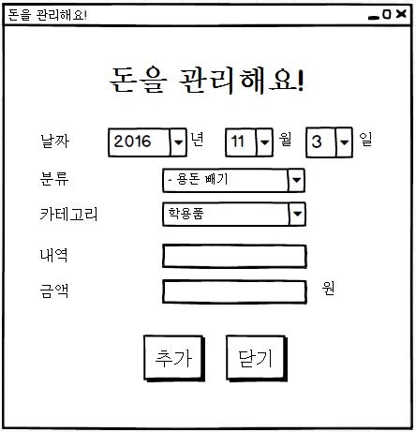
UIDiagram008
CategoryChangeListener
+actionPerformed(ActionEvenet:e)
EditBtnListener
+actionPerformed(ActionEvenet:e)
EventSource : JButton
EditCloseBtnListener
+actionPerformed(ActionEvenet:e)
EventSource : JButton

Slide 9
UIDiagram009
HistoryViewCloseBtnListener
+actionPerformed(ActionEvenet:e)
EventSource : JButton
닫기
HistoryViewModifyBtnListener
+actionPerformed(ActionEvenet:e)
EventSource : JButton
HistroyViewDelBtnListener
+actionPerformed(ActionEvenet:e)
EventSource : JButton

Slide 10
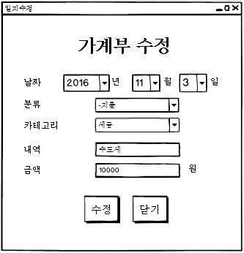
UIDiagram010
ModifyCategoryChangeListener
+actionPerformed(ActionEvenet:e)
ModifyBtnButton
+actionPerformed(ActionEvenet:e)
EventSource : JButton
CloseBtnListener
+actionPerformed(ActionEvenet:e)
EventSource : JButton

Slide 11
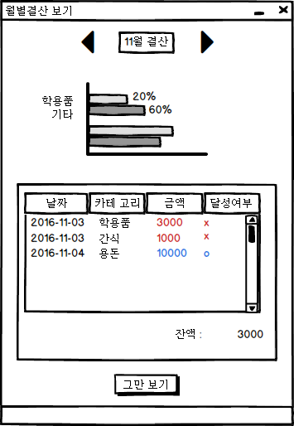
UIDiagram011
PreviousMonthListener
+actionPerformed(ActionEvenet:e)
EventSource : ImageIcon
NextMonthListener
+actionPerformed(ActionEvenet:e)
EventSource : ImageIcon
StopShowingListener
+actionPerformed(ActionEvenet:e)
EventSource : JButton

Slide 12
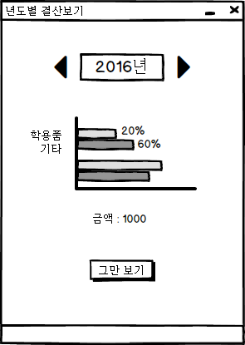
UIDiagram012
PreviousYearListener
+actionPerformed(ActionEvenet:e)
EventSource : ImageIcon
NextYearListener
+actionPerformed(ActionEvenet:e)
EventSource : ImageIcon
StopShowingListener
+actionPerformed(ActionEvenet:e)
EventSource : JButton

Slide 13
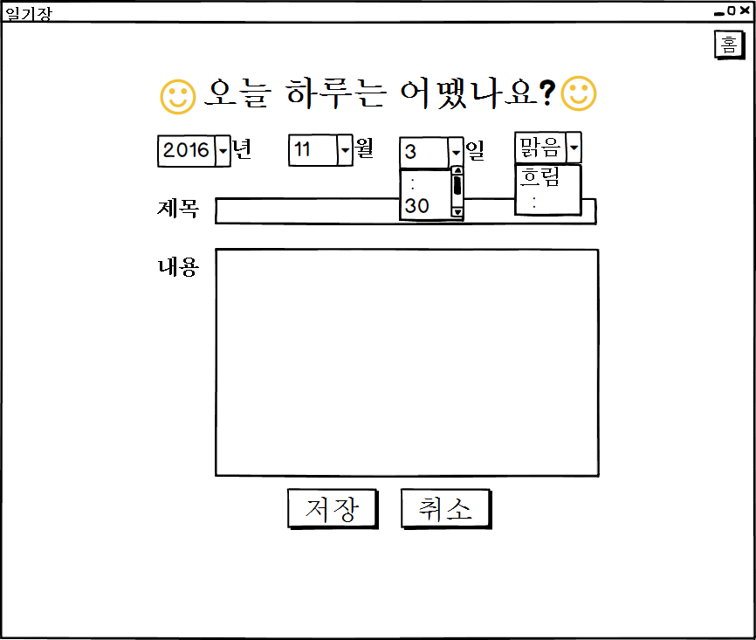
UIDiagram013
DiaryDayListener
+actionPerformed(ActionEvenet:e)
EventSource : JComboBox
SaveDiaryBtnListener
+actionPerformed(ActionEvenet:e)
EventSource : JButton
StopShowingDiaryBtn Listener
+actionPerformed(ActionEvenet:e)
EventSource : JButton

Slide 14
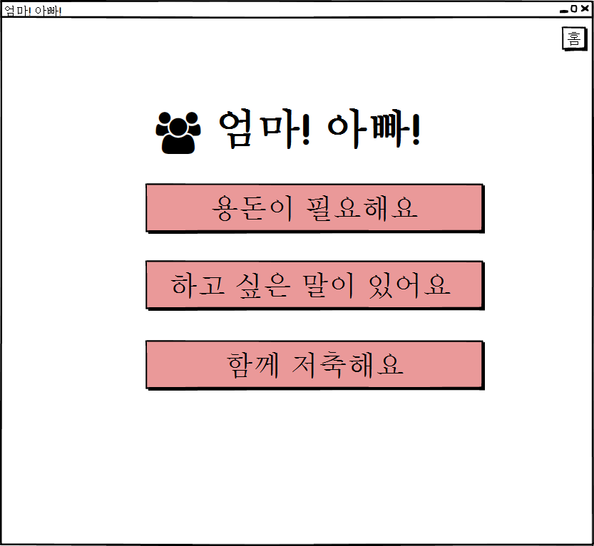
UIDiagram014
NeedAllowanceBtnListener
+actionPerformed(ActionEvenet:e)
EventSource : JButton
TalkToParentBtnListener
+actionPerformed(ActionEvenet:e)
EventSource : JButton
SavingWithParentBtnListener
+actionPerformed(ActionEvenet:e)
EventSource : JButton

Slide 15
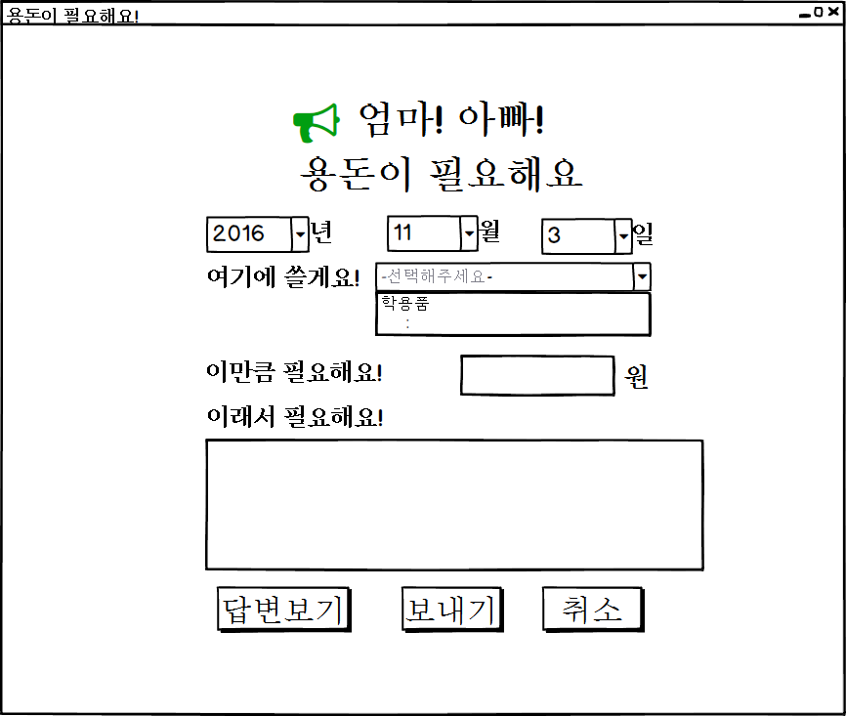
UIDiagram015
ShowResponseBtnListener
+actionPerformed(ActionEvenet:e)
EventSource : JButton
AskAllowanceBtnListener
+actionPerformed(ActionEvenet:e)
EventSource : JButton
CancelAllowanceBtnListener
+actionPerformed(ActionEvenet:e)
EventSource : JButton

Slide 16
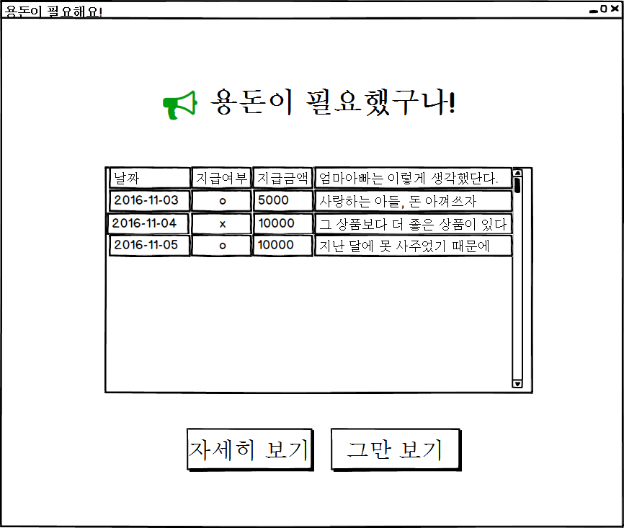
UIDiagram016
ShowDetailAllowanceBtn Listener
+actionPerformed(ActionEvenet:e)
EventSource : JButton
CancelDetailAllowanceBtn Listener
+actionPerformed(ActionEvenet:e)
EventSource : JButton

Slide 17
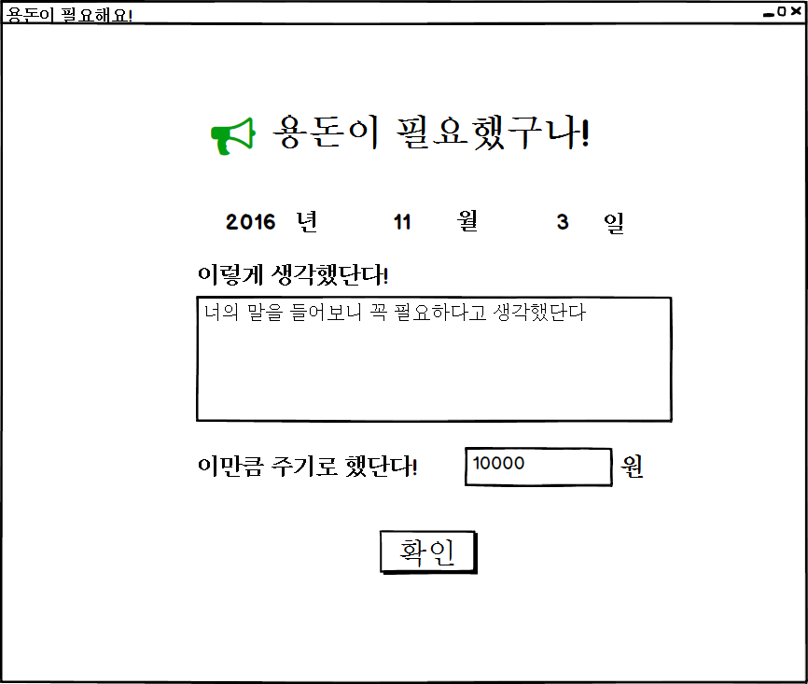
UIDiagram017
ConfirmDetailAllowanceBtnListener
+actionPerformed(ActionEvenet:e)
EventSource : JButton

Slide 18
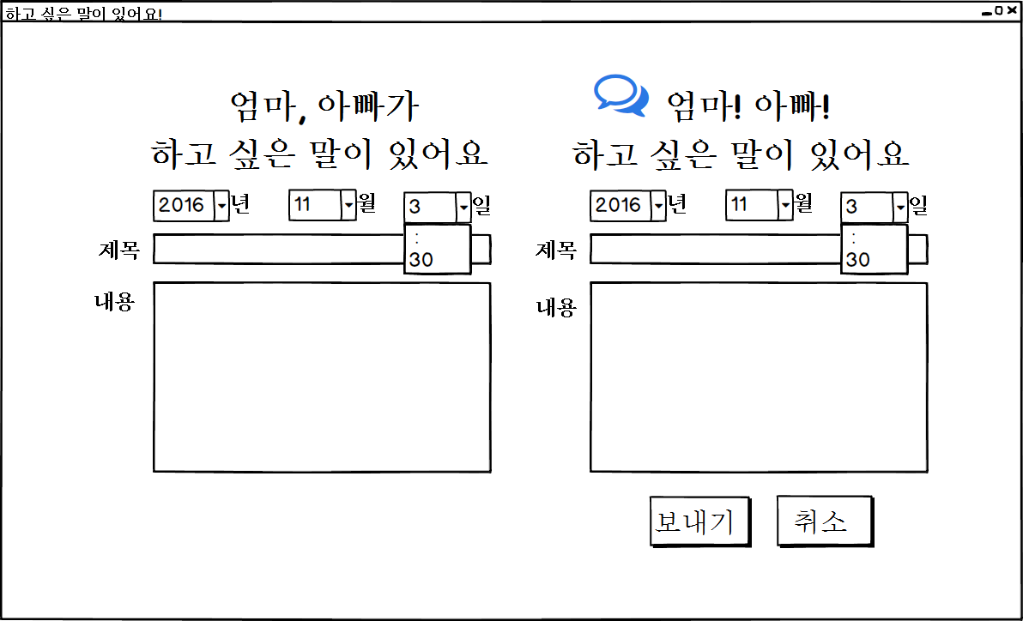
UIDiagram018
MemoDayListener
+actionPerformed(ActionEvenet:e)
EventSource : JComboBox

Slide 19
UIDiagram019
SaveMemoBtnListener
+actionPerformed(ActionEvenet:e)
SaveMemoBtnListener
+actionPerformed(ActionEvenet:e)
EventSource : JButton
EventSource : JButton

Slide 20
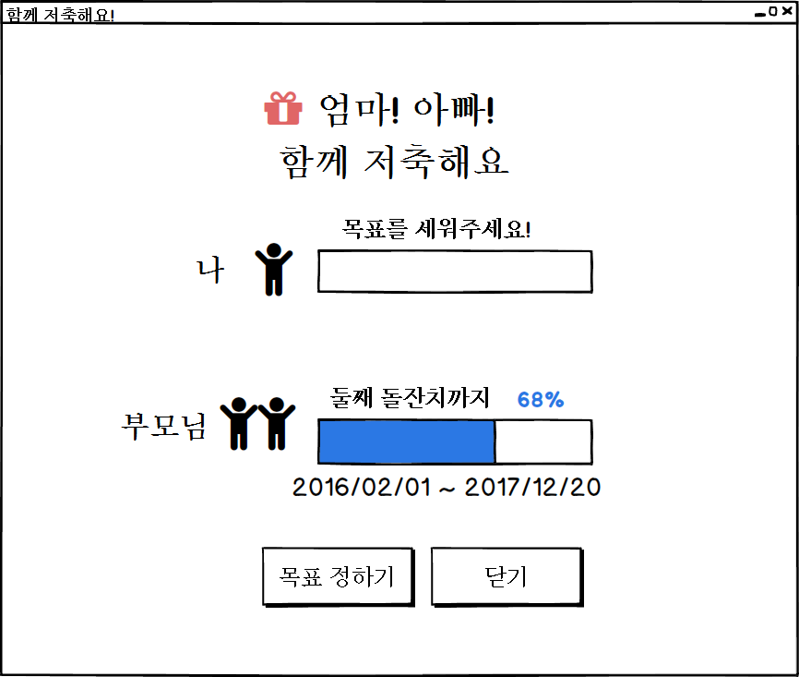
UIDiagram020
SetGoalStartBtnListener
+actionPerformed(ActionEvenet:e)
EventSource : JButton
CancelGoalBtnListener
+actionPerformed(ActionEvenet:e)
EventSource : JButton

Slide 21
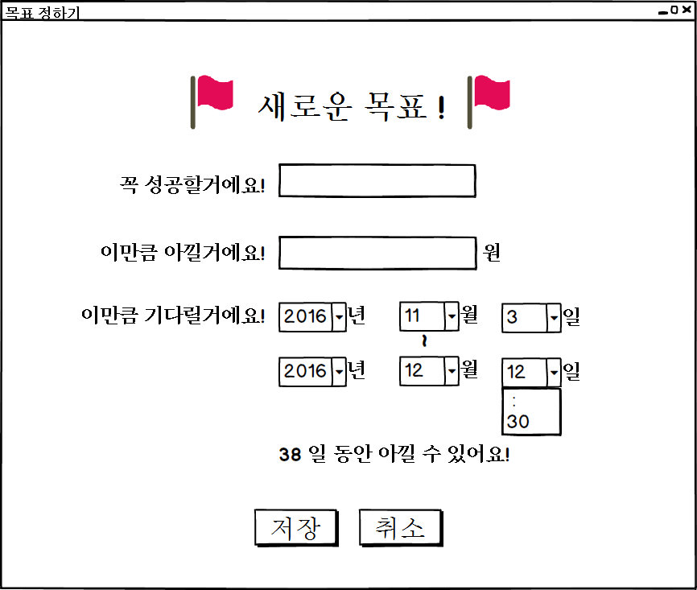
UIDiagram021
SetGoalBtnListener
+actionPerformed(ActionEvenet:e)
EventSource : JButton
CancelSetGoalBtnListener
+actionPerformed(ActionEvenet:e)
EventSource : JButton

Slide 22
UIDiagram022
DiaryDayListener
+actionPerformed(ActionEvenet:e)
EventSource : JComboBox
SaveDiaryBtnListener
+actionPerformed(ActionEvenet:e)
EventSource : JButton
StopShowingDiaryBtn Listener
+actionPerformed(ActionEvenet:e)
EventSource : JButton

Slide 23
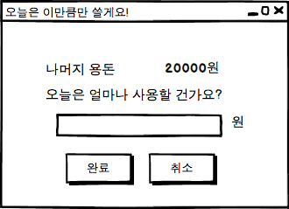
UIDiagram023
RegisterLimitListener
+actionPerformed(e:ActionEvent)
CancelLimitListener
+actionPerformed(e:ActionEvent)
EventSource : JButton
EventSource : JButton

Slide 24
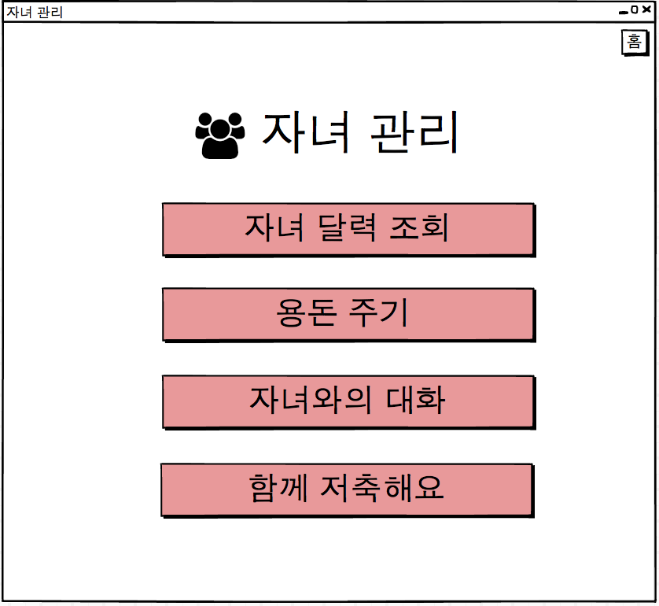
UIDiagram024
CheckChildMainListener
+actionPerformed(e:ActionEvent)
EventSource : JButton
GiveMoneyListener
+actionPerformed(e:ActionEvent)
EventSource : JButton
SavingWithChildListener
+actionPerformed(e:ActionEvent)
TalkToChildListener
+actionPerformed(e:ActionEvent)
EventSource : JButton
EventSource : JButton

Slide 25
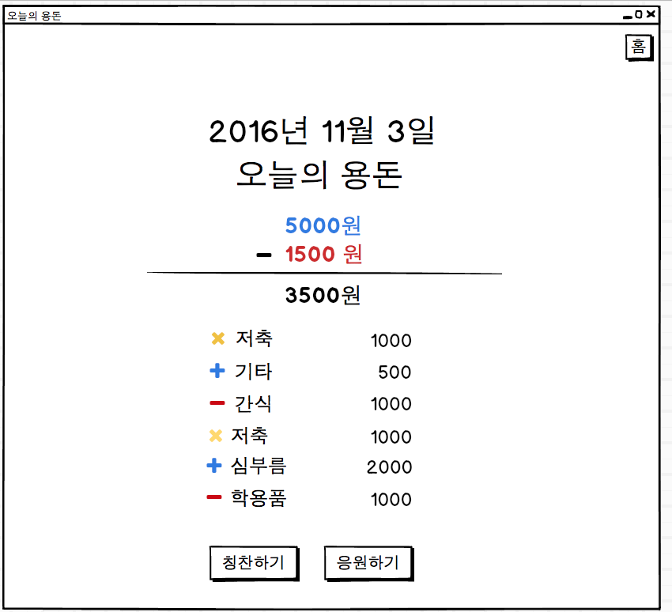
UIDiagram025
ComplimentListener
+actionPerformed(e:ActionEvent)
SupportListener
+actionPerformed(e:ActionEvent)
EventSource : JButton
EventSource : JButton

Slide 26
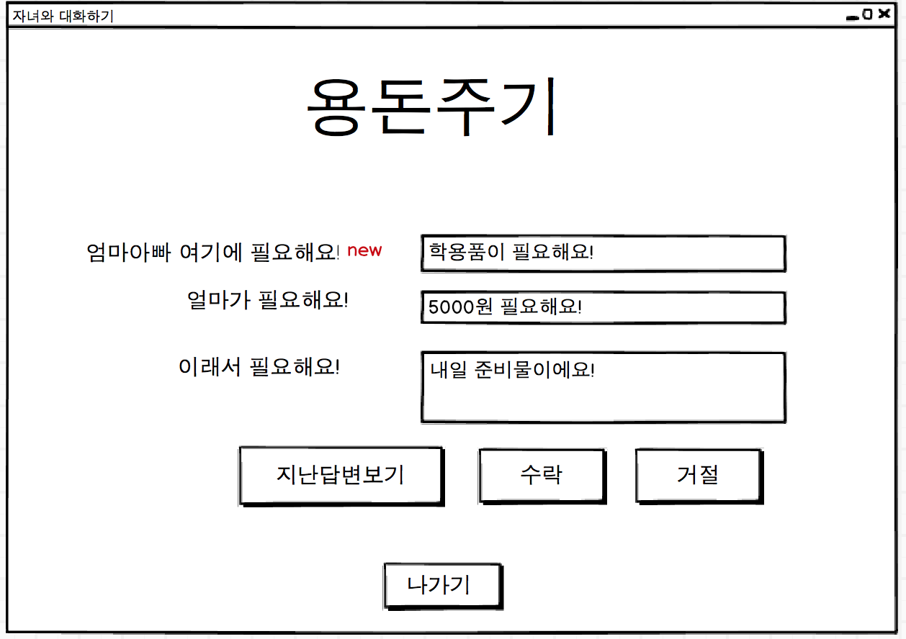
UIDiagram026
AcceptListener
+actionPerformed(e:ActionEvent)
EventSource : JButton
RefuseListener
+actionPerformed(e:ActionEvent)
EventSource : JButton
CloseGiveMoneyListener
+actionPerformed(e:ActionEvent)
?
+actionPerformed(e:ActionEvent)
EventSource : JButton
EventSource : JButton

Slide 27
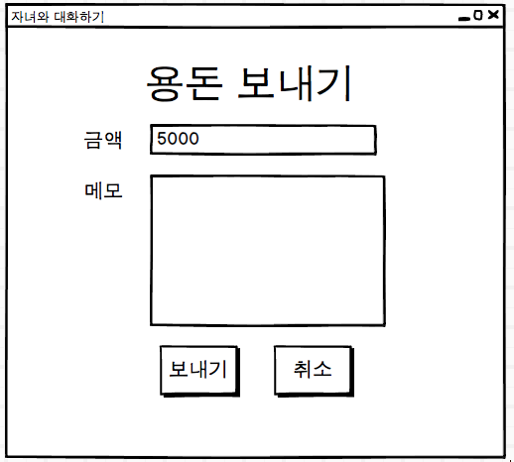
UIDiagram027
SendMoneyListener
+actionPerformed(e:ActionEvent)
CancelSendMoneyListener
+actionPerformed(e:ActionEvent)
EventSource : JButton
EventSource : JButton

Slide 28
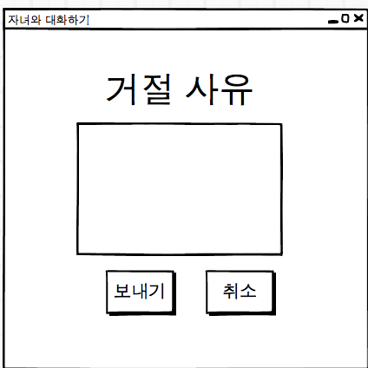
UIDiagram028
SendRefuseMsgListener
+actionPerformed(e:ActionEvent)
CancelSendRefuseMsgListener
+actionPerformed(e:ActionEvent)
EventSource : JButton
EventSource : JButton

Slide 29
UIDiagram029
ShowDetailAllowanceBtn Listener
+actionPerformed(ActionEvenet:e)
EventSource : JButton
CancelDetailAllowanceBtn Listener
+actionPerformed(ActionEvenet:e)
EventSource : JButton

Slide 30
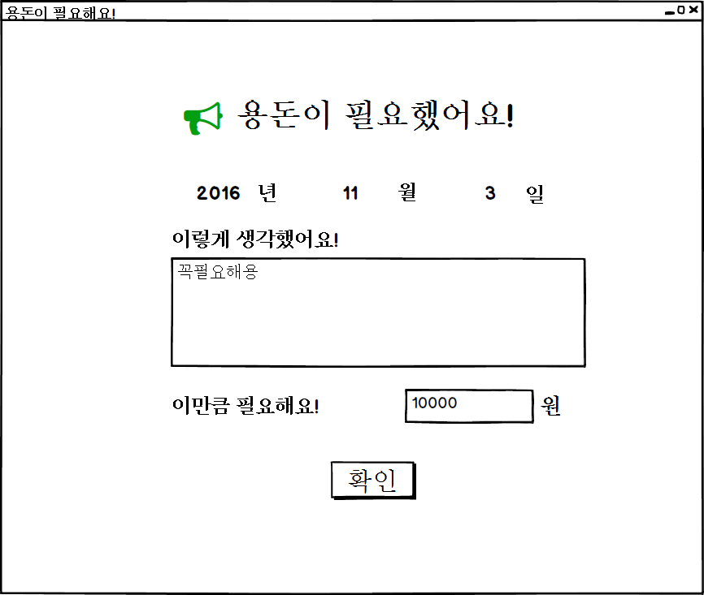
UIDiagram030
ConfirmDetailAllowanceBtnListener
+actionPerformed(ActionEvenet:e)
EventSource : JButton

Slide 31
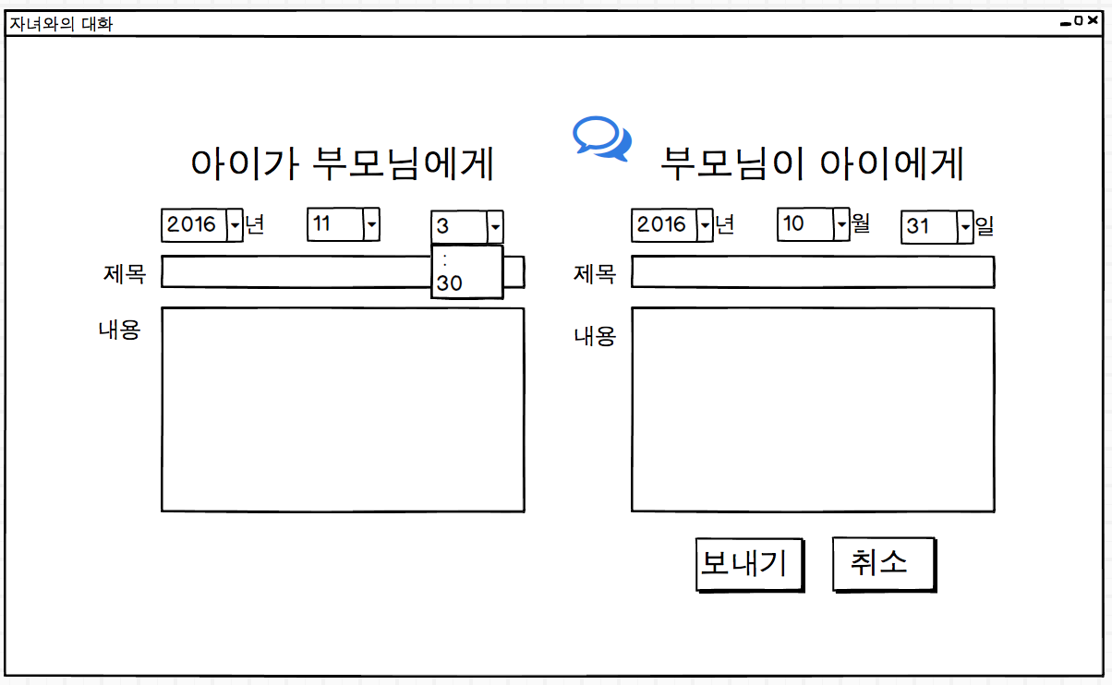
UIDiagram031
SaveMemoBtnListener
+actionPerformed(ActionEvenet:e)
SaveMemoBtnListener
+actionPerformed(ActionEvenet:e)
EventSource : JButton
EventSource : JButton

Slide 32
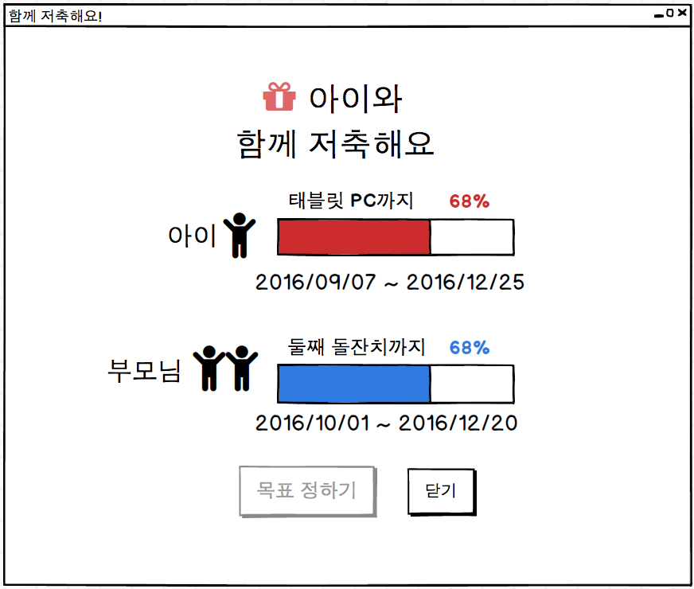
UIDiagram032
SetGoalStartBtnListener
+actionPerformed(ActionEvenet:e)
EventSource : JButton
CancelGoalBtnListener
+actionPerformed(ActionEvenet:e)
EventSource : JButton

Slide 33
UIDiagram033
SetGoalBtnListener
+actionPerformed(ActionEvenet:e)
EventSource : JButton
CancelSetGoalBtnListener
+actionPerformed(ActionEvenet:e)
EventSource : JButton

Slide 34
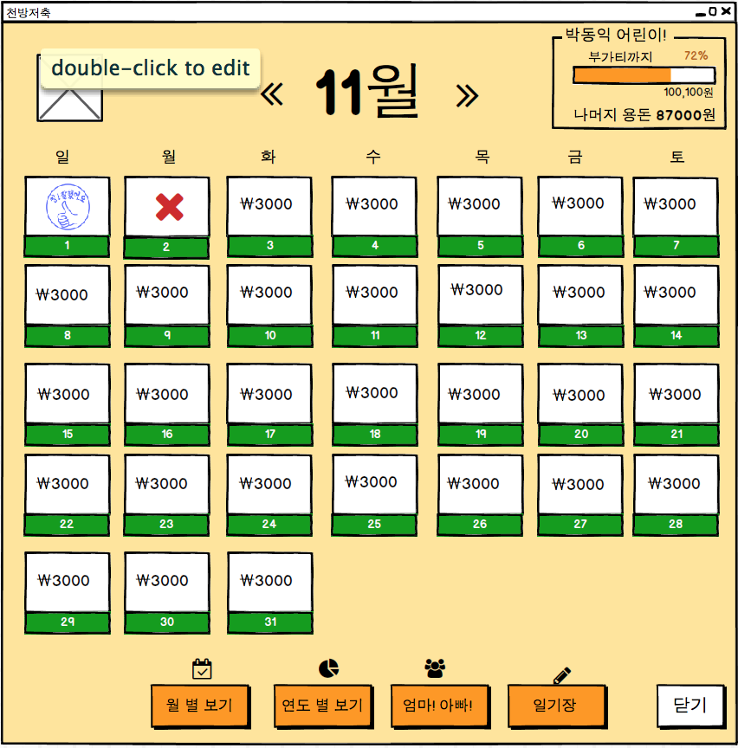
UIDiagram034
ChildManagementListener
+actionPerformed(e:ActionEvent)
EventSource : JButton
CloseChildManagementListener
+actionPerformed(e:ActionEvent)
EventSource : JButton

Slide 35
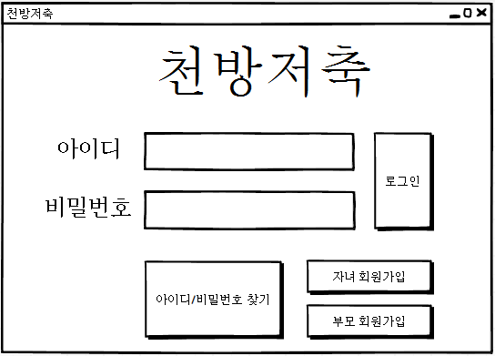
UIDiagram035
LogInBtnListener
+actionPerformed(ActionEvenet:e)
EventSource : ImageIcon
ChildSignUpBtnListener
+actionPerformed(ActionEvenet:e)
EventSource : ImageIcon
ParentSignUpBtnListener
+actionPerformed(ActionEvenet:e)
InfoFindBtnListener
+actionPerformed(ActionEvenet:e)
EventSource : JButton

Slide 36
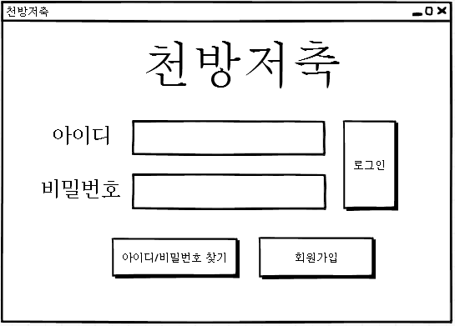
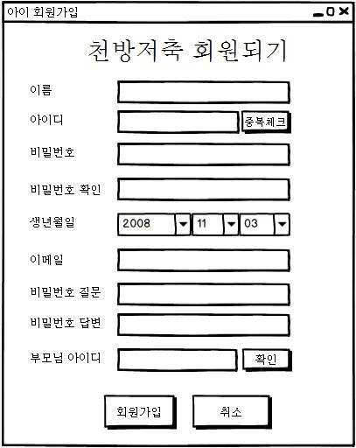
ChildMemberCheckBtnListener
+actionPerformed(ActionEvenet:e)
UIDiagram036
EventSource : JButton
ChildJoinBtnListener
+actionPerformed(ActionEvenet:e)
EventSource : JButton
ParentAcceptBtnListener
+actionPerformed(ActionEvenet:e)
EventSource : JButton
ChildJoinCancelBtnListener
+actionPerformed(ActionEvenet:e)
EventSource : JButton

Slide 37
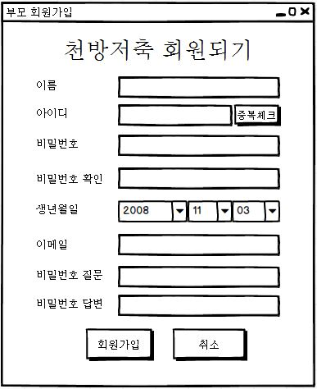
UIDiagram037
ParentMemberCheckBtnListener
+actionPerformed(ActionEvenet:e)
EventSource : JButton
ParentJoinBtnListener
+actionPerformed(ActionEvenet:e)
EventSource : JButton
ParentJoinCancelBtnListener
+actionPerformed(ActionEvenet:e)
EventSource : JButton

Slide 38
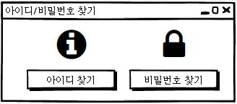
UIDiagram038
PasswordFindBtnListener
+actionPerformed(ActionEvenet:e)
EventSource : JButton
IDFindBtnListener
+actionPerformed(ActionEvenet:e)
EventSource : JButton

Slide 39
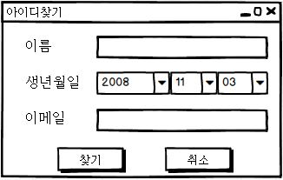
UIDiagram039
StartFindBtnListener
+actionPerformed(ActionEvenet:e)
EventSource : JButton
IDCancelBtnListener
+actionPerformed(ActionEvenet:e)
EventSource : JButton

Slide 40
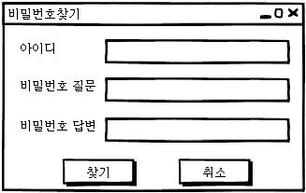
UIDiagram040
StartFindPasswordBtnListener
+actionPerformed(ActionEvenet:e)
EventSource : JButton
PasswordCancelBtnListener
+actionPerformed(ActionEvenet:e)
EventSource : JButton

