Slide 1
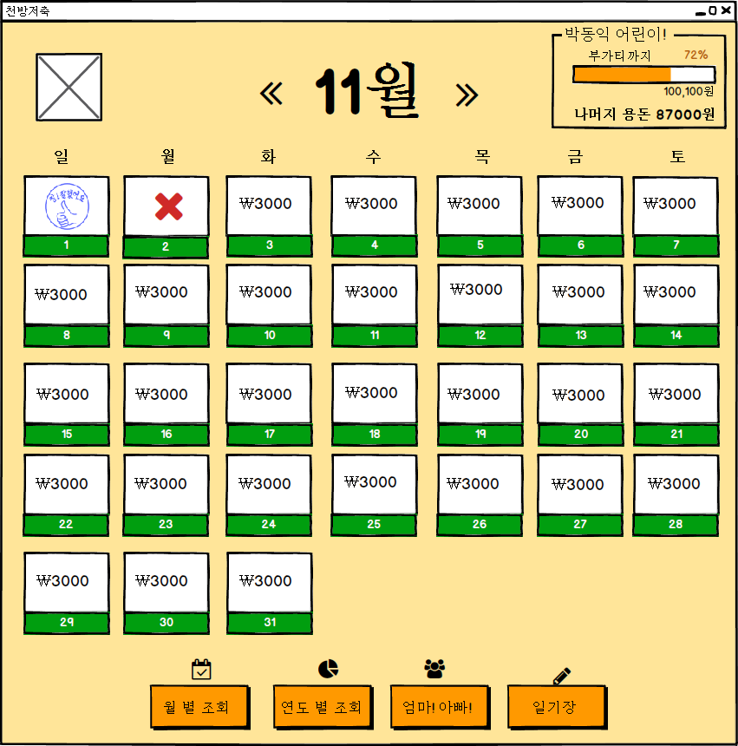
UIDiagram001
PreviousCalendarListener
+actionPerformed(ActionEvenet:e)
EventSource : ImageIcon
NextCalendarListener
+actionPerformed(ActionEvenet:e)
EventSource : ImageIcon
DayAccountLabelListener
+mouseClicked(MouseEvent:e)
EventSource : JLabel

Slide 2
UIDiagram002
MonthAccountBtnListener
+actionPerformed(ActionEvenet:e)
EventSource : JButton
YearAccountBtnListener
+actionPerformed(ActionEvenet:e)
EventSource : JButton

Slide 3
UIDiagram003
ToParentBtnListener
+actionPerformed(ActionEvenet:e)
EventSource : JButton
DiaryBtnListener
+actionPerformed(ActionEvenet:e)
EventSource : JButton

Slide 4
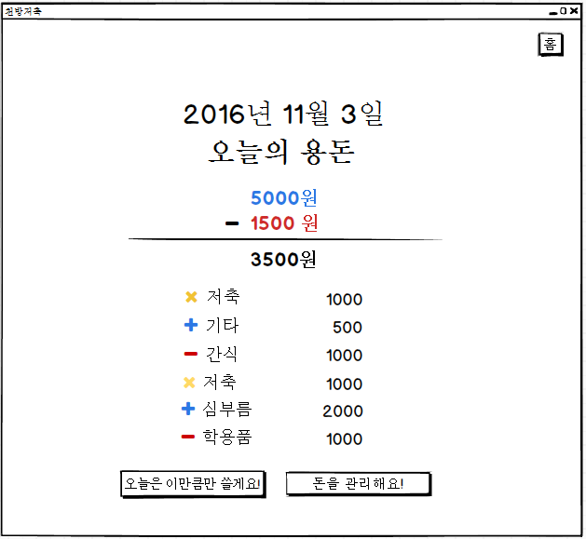
UIDiagram004
HomeBtnListener
+actionPerformed(ActionEvenet:e)
EventSource : JButton
OneHistoryMouseListener
+mouseClicked(MouseEvent:e)
EventSource : JLabel
TodayLimitListener
+actionPerformed(ActionEvenet:e)
EventSource : JButton
MoneyEditListener
+actionPerformed(ActionEvenet:e)
EventSource : JButton

Slide 5
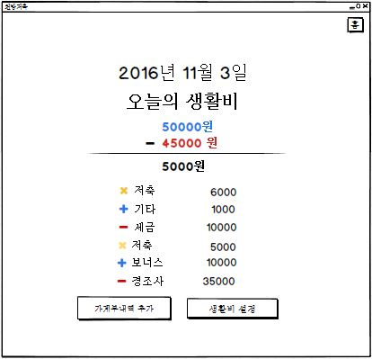
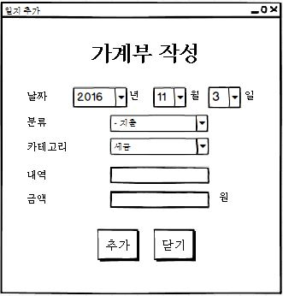
UIDiagram005
CategoryListener
+actionPerformed(ActionEvenet:e)
EditBtnListener
+actionPerformed(ActionEvenet:e)
EventSource : JButton
ㅕ
CloseBtnListener
+actionPerformed(ActionEvenet:e)
EventSource : JButton

Slide 6
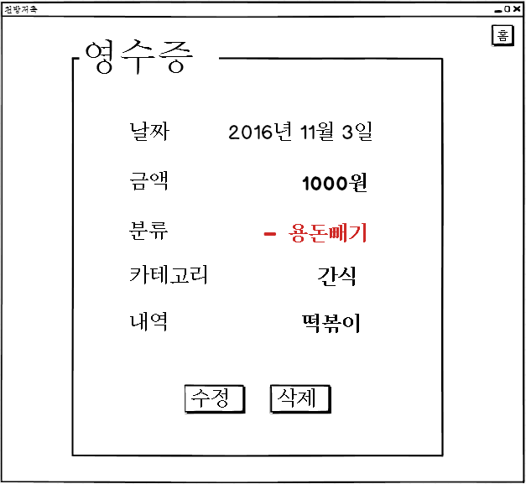
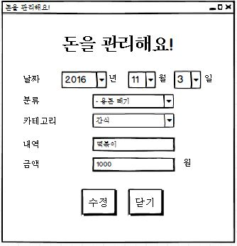
UIDiagram006
CategoryListener
+actionPerformed(ActionEvenet:e)
ModifyBtnListener
+actionPerformed(ActionEvenet:e)
EventSource : JButton
CloseBtnListener
+actionPerformed(ActionEvenet:e)
EventSource : JButton

Slide 7
UIDiagram007
HomeBtnListener
+actionPerformed(ActionEvenet:e)
EventSource : JButton
OneHistoryMouseListener
+mouseClicked(MouseEvent:e)
EventSource : JLabel
TodayLimitListener
+actionPerformed(ActionEvenet:e)
EventSource : JButton
MoneyEditListener
+actionPerformed(ActionEvenet:e)
EventSource : JButton

Slide 8
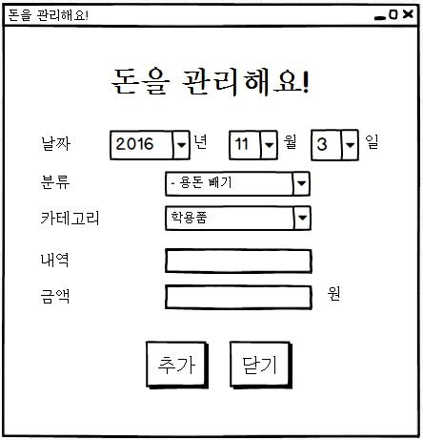
UIDiagram008
CategoryListener
+actionPerformed(ActionEvenet:e)
EditBtnListener
+actionPerformed(ActionEvenet:e)
EventSource : JButton
CloseBtnListener
+actionPerformed(ActionEvenet:e)
EventSource : JButton

Slide 9
UIDiagram009
HistoryViewCloseBtnListener
+actionPerformed(ActionEvenet:e)
EventSource : JButton
닫기
HistoryViewModifyBtnListener
+actionPerformed(ActionEvenet:e)
EventSource : JButton
HistroyViewDelBtnListener
+actionPerformed(ActionEvenet:e)
EventSource : JButton

Slide 10
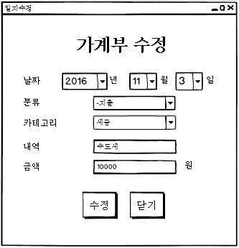
UIDiagram010
CategoryListener
+actionPerformed(ActionEvenet:e)
EventSource : JComboBox
ModifyBtnListener
+actionPerformed(ActionEvenet:e)
EventSource : JButton
CloseBtnListener
+actionPerformed(ActionEvenet:e)
EventSource : JButton

Slide 11
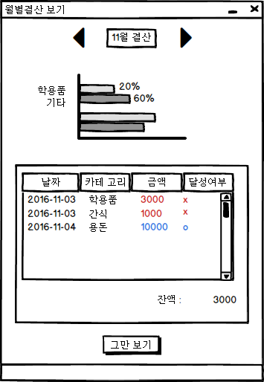
UIDiagram011
PreviousMonthListener
+actionPerformed(ActionEvenet:e)
EventSource : ImageIcon
NextMonthListener
+actionPerformed(ActionEvenet:e)
EventSource : ImageIcon
CloseBtnListener
+actionPerformed(ActionEvenet:e)
EventSource : JButton

Slide 12
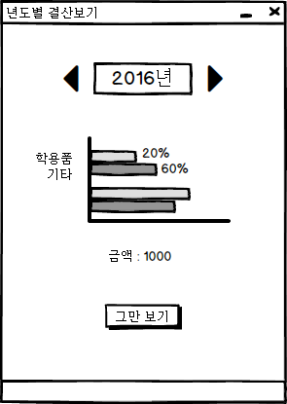
UIDiagram012
PreviousYearListener
+actionPerformed(ActionEvenet:e)
EventSource : ImageIcon
NextYearListener
+actionPerformed(ActionEvenet:e)
EventSource : ImageIcon
CloseBtnListener
+actionPerformed(ActionEvenet:e)
EventSource : JButton

Slide 13
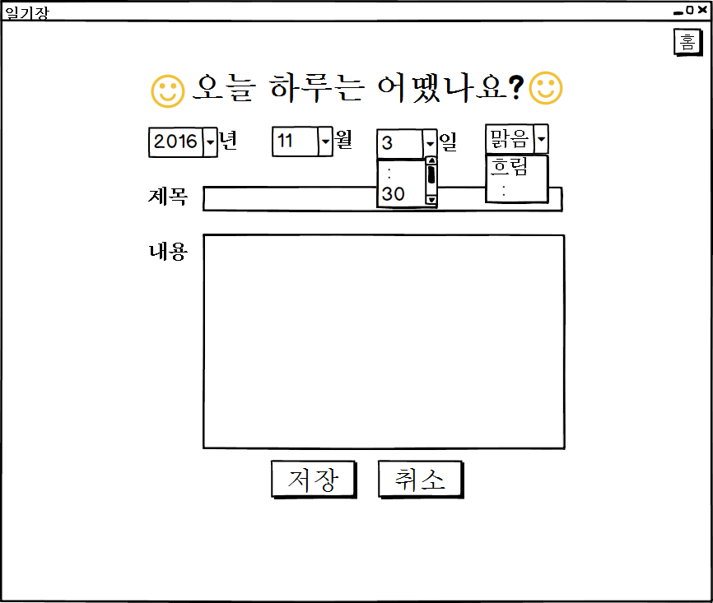
UIDiagram013
DateSelectListener
+actionPerformed(ActionEvenet:e)
EventSource : JDatePicker
SaveDiaryBtnListener
+actionPerformed(ActionEvenet:e)
EventSource : JButton
CloseBtnListener
+actionPerformed(ActionEvenet:e)
EventSource : JButton

Slide 14
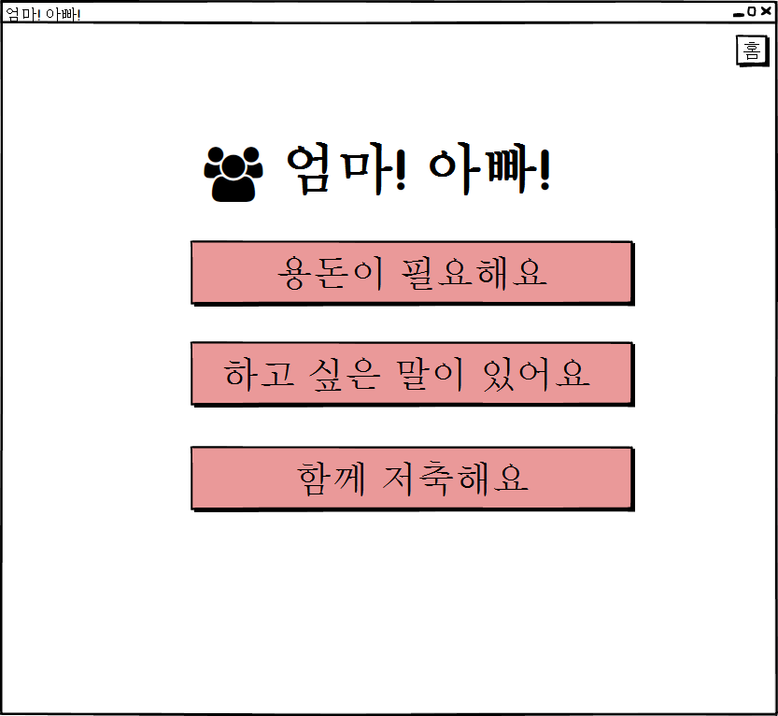
UIDiagram014
NeedAllowanceBtnListener
+actionPerformed(ActionEvenet:e)
EventSource : JButton
CommunicationBtnListener
+actionPerformed(ActionEvenet:e)
EventSource : JButton
SavingBtnListener
+actionPerformed(ActionEvenet:e)
EventSource : JButton

Slide 15
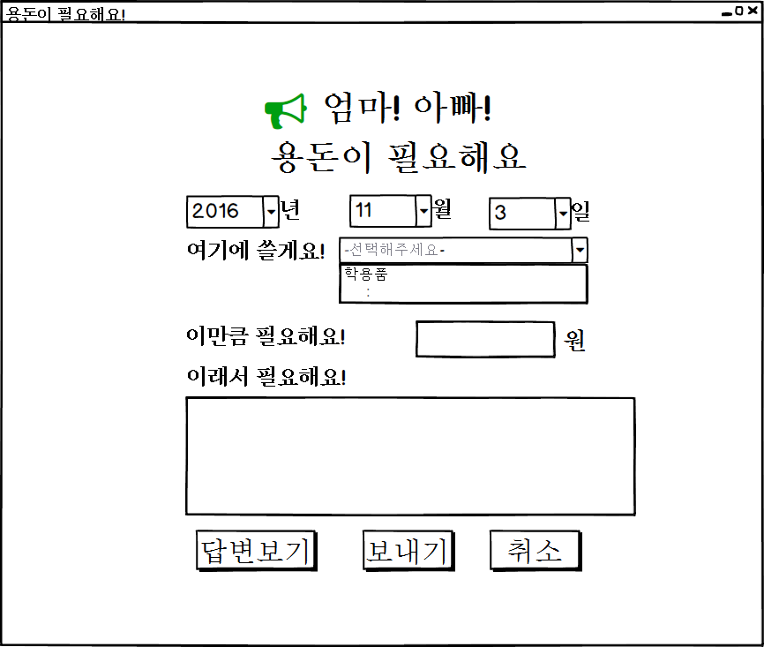
UIDiagram015
ShowResponseBtnListener
+actionPerformed(ActionEvenet:e)
EventSource : JButton
AskAllowanceBtnListener
+actionPerformed(ActionEvenet:e)
EventSource : JButton
CloseBtnListener
+actionPerformed(ActionEvenet:e)
EventSource : JButton

Slide 16
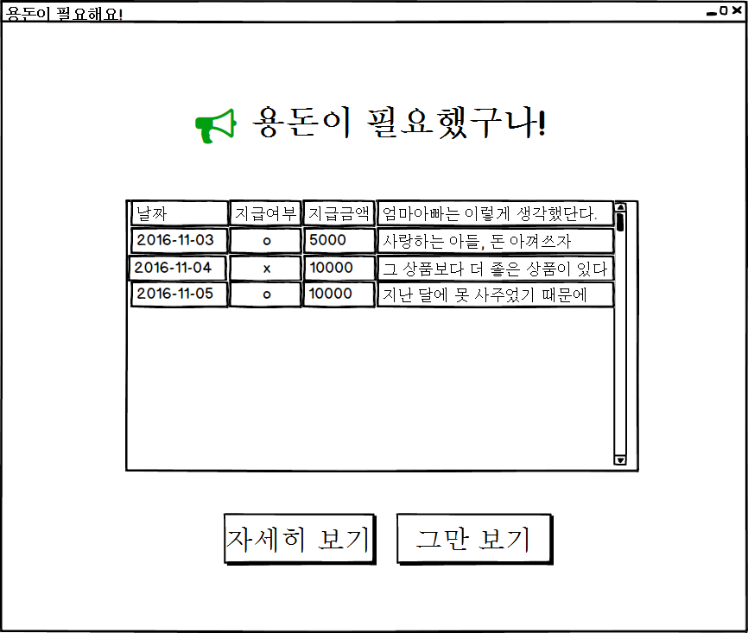
UIDiagram016
ShowDetailAllowanceBtn Listener
+actionPerformed(ActionEvenet:e)
EventSource : JButton
CloseBtnListener
+actionPerformed(ActionEvenet:e)
EventSource : JButton

Slide 17
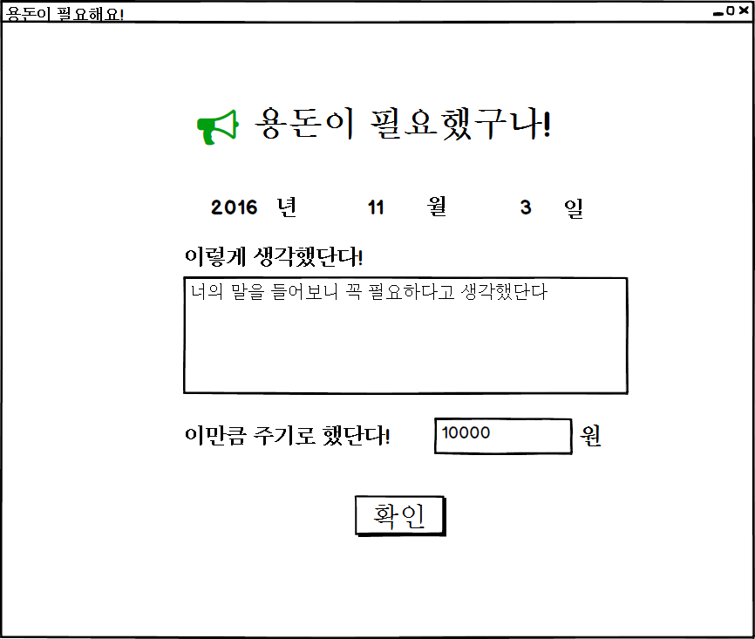
UIDiagram017
CloseBtnListener
+actionPerformed(ActionEvenet:e)
EventSource : JButton

Slide 18
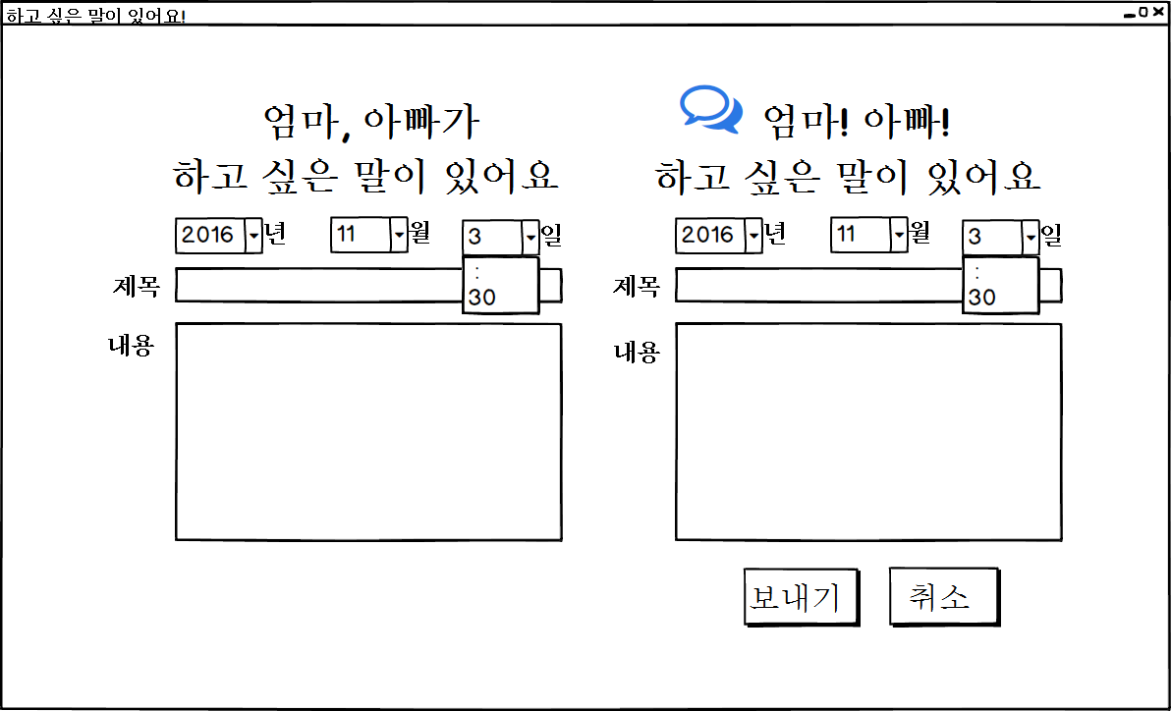
UIDiagram018
DateSelectListener
+actionPerformed(ActionEvenet:e)
EventSource : JComboBox

Slide 19
UIDiagram019
CloseBtnListener
+actionPerformed(ActionEvenet:e)
SaveMemoBtnListener
+actionPerformed(ActionEvenet:e)
EventSource : JButton
EventSource : JButton

Slide 20
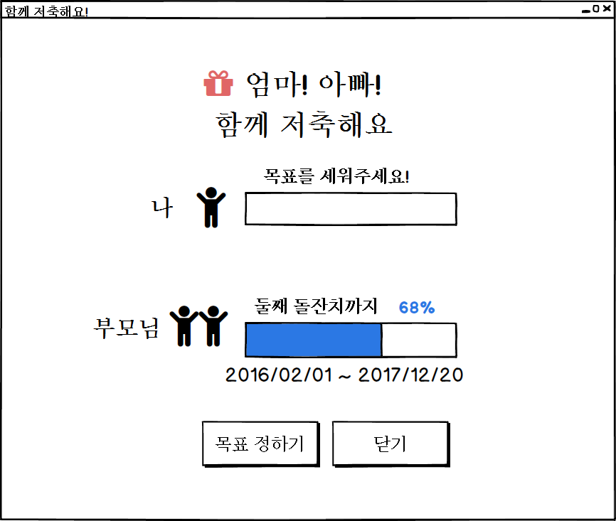
UIDiagram020
SetGoalStartBtnListener
+actionPerformed(ActionEvenet:e)
EventSource : JButton
CloseBtnListener
+actionPerformed(ActionEvenet:e)
EventSource : JButton

Slide 21
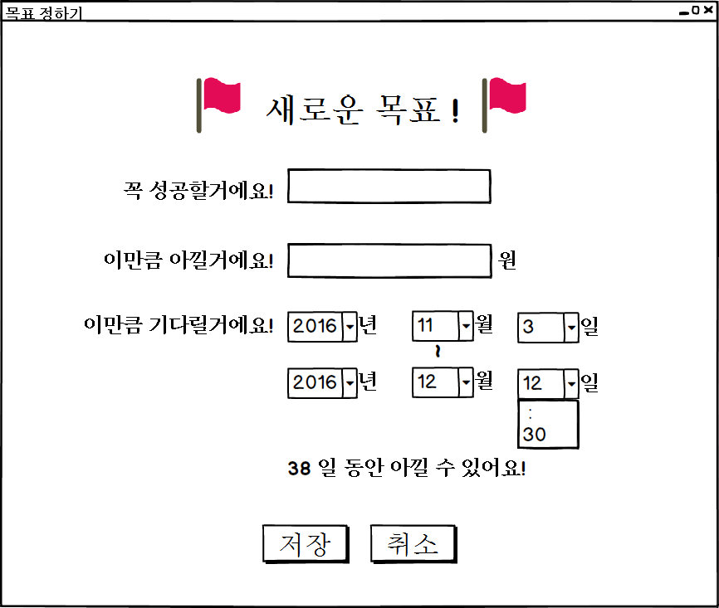
UIDiagram021
SetGoalBtnListener
+actionPerformed(ActionEvenet:e)
EventSource : JButton
CloseBtnListener
+actionPerformed(ActionEvenet:e)
EventSource : JButton

Slide 22
UIDiagram022
DiaryDayListener
+actionPerformed(ActionEvenet:e)
EventSource : JComboBox
SaveDiaryBtnListener
+actionPerformed(ActionEvenet:e)
EventSource : JButton
CloseBtnListener
+actionPerformed(ActionEvenet:e)
EventSource : JButton

Slide 23
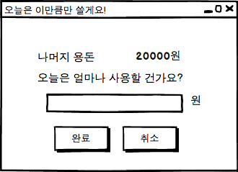
UIDiagram023
RegisterLimitListener
+actionPerformed(e:ActionEvent)
CloseBtnListener
+actionPerformed(ActionEvenet:e)
EventSource : JButton
EventSource : JButton

Slide 24
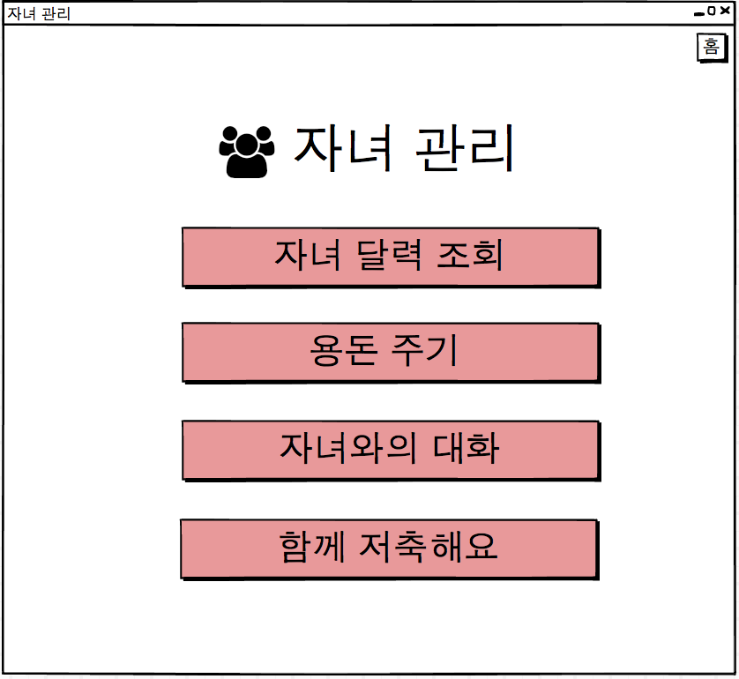
UIDiagram024
CloseCommunicationListener
+actionPerformed(e:ActionEvent)
EventSource : JButton
CheckChildMainBtnListener
+actionPerformed(e:ActionEvent)
EventSource : JButton
GiveMoneyBtnListener
+actionPerformed(e:ActionEvent)
SavingBtnListener
+actionPerformed(e:ActionEvent)
EventSource : JButton
CommunicationBtnListener
+actionPerformed(e:ActionEvent)
EventSource : JButton
EventSource : JButton

Slide 25
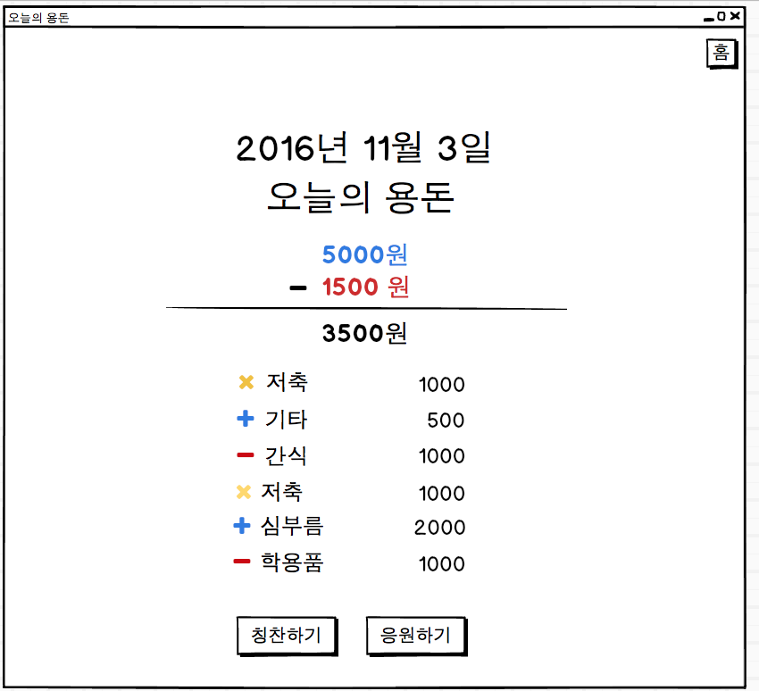
UIDiagram025
ReturnToChildMainBtnListener
+actionPerformed(e:ActionEvent)
ComplimentBtnListener
+actionPerformed(e:ActionEvent)
SupportBtnListener
+actionPerformed(e:ActionEvent)
EventSource : JButton
EventSource : JButton

Slide 26
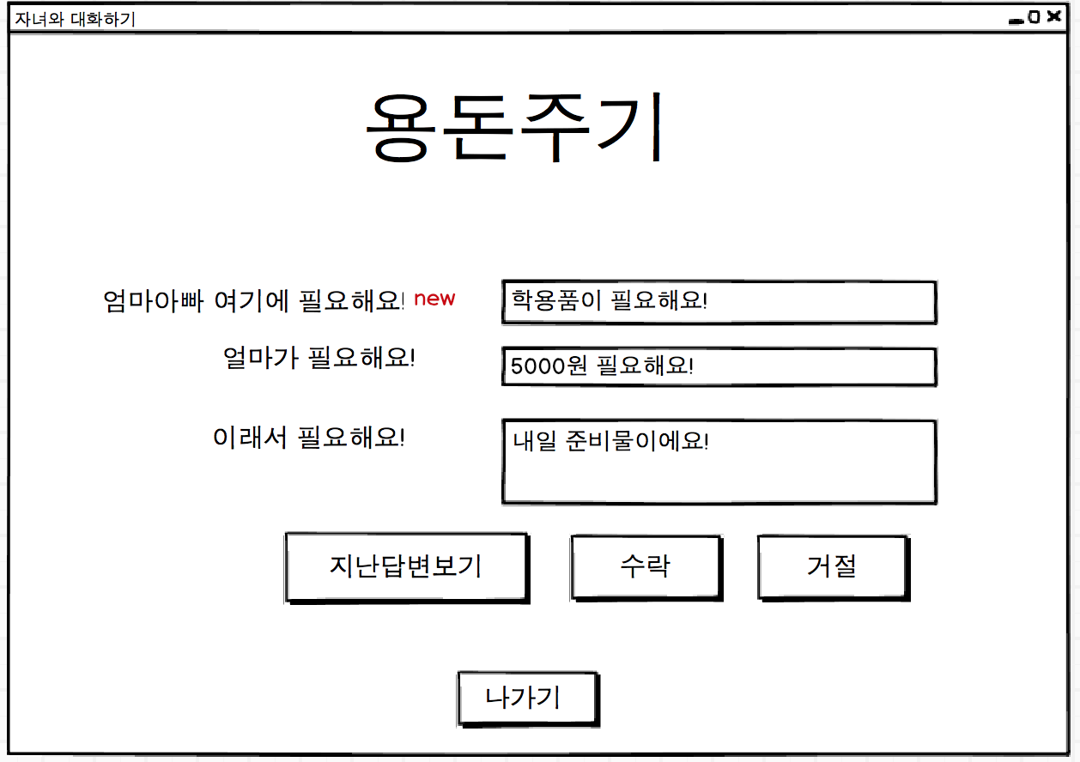
UIDiagram026
AcceptBtnListener
+actionPerformed(e:ActionEvent)
EventSource : JButton
RefuseBtnListener
+actionPerformed(e:ActionEvent)
EventSource : JButton
CloseBtnListener
+actionPerformed(ActionEvenet:e)
ShowResponseBtnListener
+actionPerformed(e:ActionEvent)
EventSource : JButton
EventSource : JButton

Slide 27
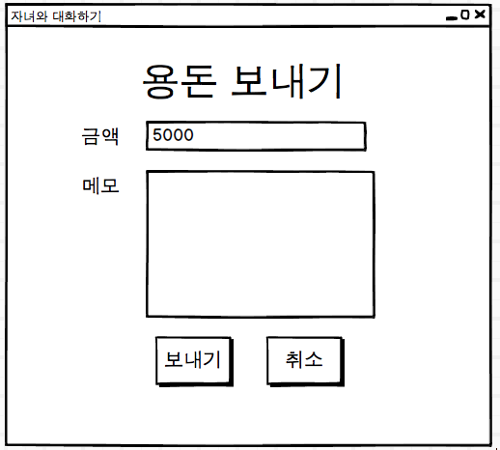
UIDiagram027
SendMoneyListener
+actionPerformed(e:ActionEvent)
CloseBtnListener
+actionPerformed(ActionEvenet:e)
EventSource : JButton
EventSource : JButton

Slide 28
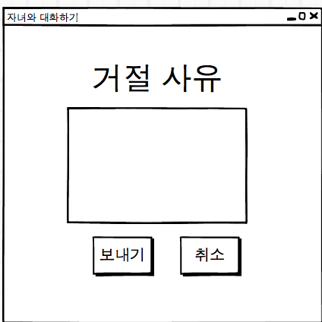
UIDiagram028
SendRefuseMsgListener
+actionPerformed(e:ActionEvent)
CloseBtnListener
+actionPerformed(ActionEvenet:e)
EventSource : JButton
EventSource : JButton

Slide 29
UIDiagram029
ShowDetailAllowanceBtn Listener
+actionPerformed(ActionEvenet:e)
EventSource : JButton
CloseBtnListener
+actionPerformed(ActionEvenet:e)
EventSource : JButton

Slide 30
UIDiagram030
CloseBtnListener
+actionPerformed(ActionEvenet:e)
EventSource : JButton

Slide 31
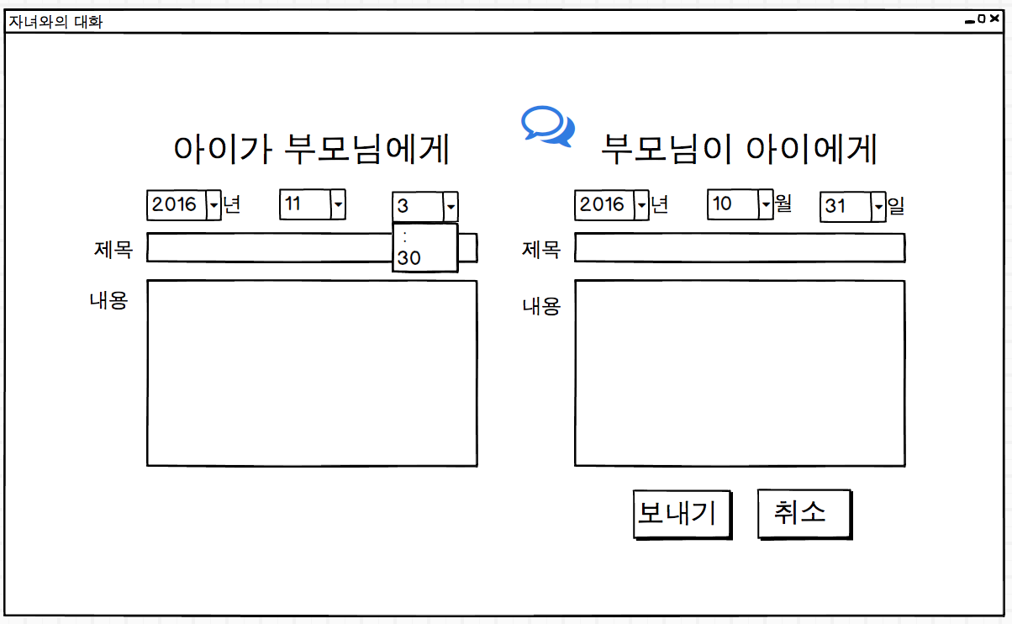
UIDiagram031
SaveMemoBtnListener
+actionPerformed(ActionEvenet:e)
CloseBtnListener
+actionPerformed(ActionEvenet:e)
EventSource : JButton
EventSource : JButton

Slide 32
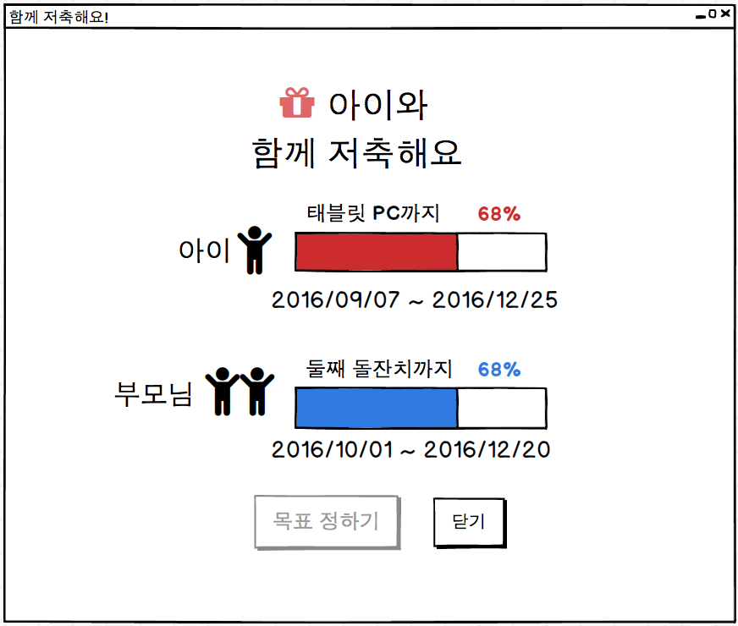
UIDiagram032
SetGoalStartBtnListener
+actionPerformed(ActionEvenet:e)
EventSource : JButton
CloseBtnListener
+actionPerformed(ActionEvenet:e)
EventSource : JButton

Slide 33
UIDiagram033
SetGoalBtnListener
+actionPerformed(ActionEvenet:e)
EventSource : JButton
CloseBtnListener
+actionPerformed(ActionEvenet:e)
EventSource : JButton

Slide 34
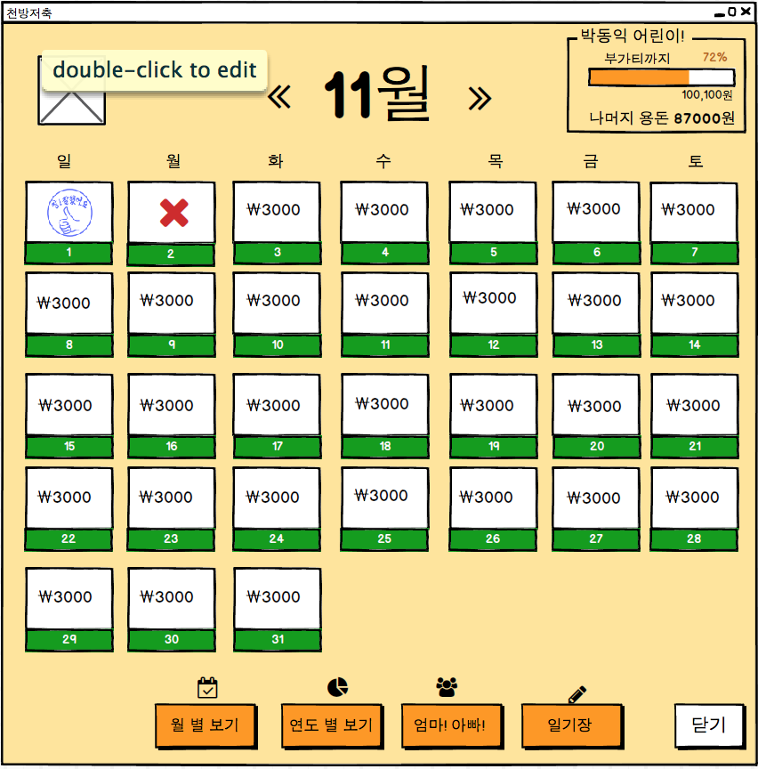
UIDiagram034
ChildManagementListener
+actionPerformed(e:ActionEvent)
EventSource : JButton
CloseBtnListener
+actionPerformed(ActionEvenet:e)
EventSource : JButton

Slide 35
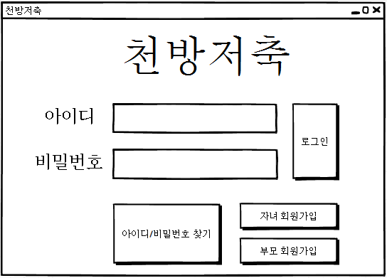
UIDiagram035
LoginBtnListener
+actionPerformed(ActionEvenet:e)
EventSource : ImageIcon
ChildSignUpBtnListener
+actionPerformed(ActionEvenet:e)
EventSource : ImageIcon
ParentSignUpBtnListener
+actionPerformed(ActionEvenet:e)
FindInfoBtnListener
+actionPerformed(ActionEvenet:e)
EventSource : JButton

Slide 36
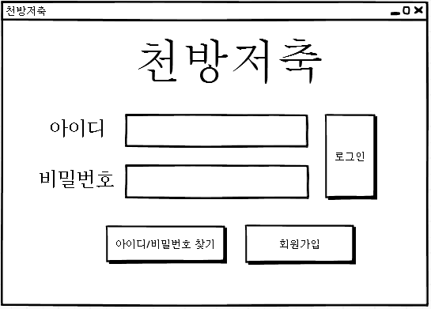
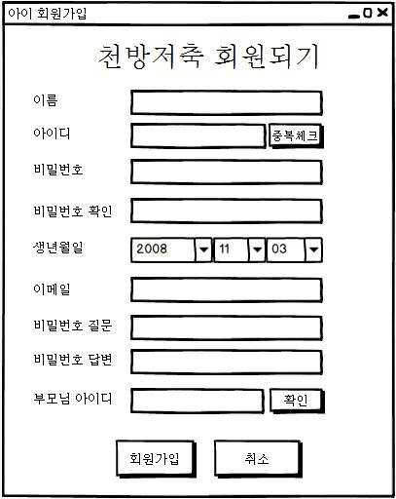
ChildMemberCheckBtnListener
+actionPerformed(ActionEvenet:e)
UIDiagram036
EventSource : JButton
ChildJoinBtnListener
+actionPerformed(ActionEvenet:e)
EventSource : JButton
ParentAcceptBtnListener
+actionPerformed(ActionEvenet:e)
EventSource : JButton
CloseBtnListener
+actionPerformed(ActionEvenet:e)
EventSource : JButton

Slide 37
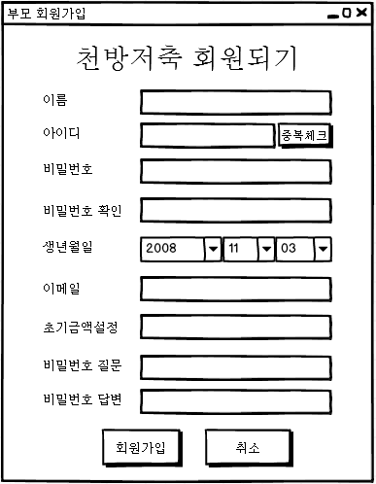
UIDiagram037
ParentMemberCheckBtnListener
+actionPerformed(ActionEvenet:e)
EventSource : JButton
ParentJoinBtnListener
+actionPerformed(ActionEvenet:e)
EventSource : JButton
CloseBtnListener
+actionPerformed(ActionEvenet:e)
EventSource : JButton

Slide 38
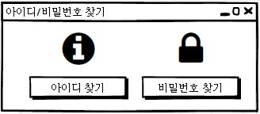
UIDiagram038
PasswordFindBtnListener
+actionPerformed(ActionEvenet:e)
EventSource : JButton
IDFindBtnListener
+actionPerformed(ActionEvenet:e)
EventSource : JButton

Slide 39
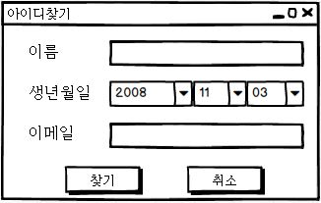
UIDiagram039
StartFindBtnListener
+actionPerformed(ActionEvenet:e)
EventSource : JButton
CloseBtnListener
+actionPerformed(ActionEvenet:e)
EventSource : JButton

Slide 40
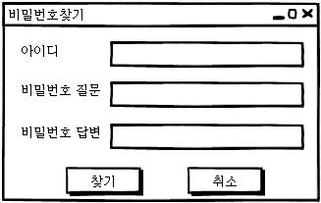
UIDiagram040
StartFindPasswordBtnListener
+actionPerformed(ActionEvenet:e)
EventSource : JButton
CloseBtnListener
+actionPerformed(ActionEvenet:e)
EventSource : JButton

Slide 41
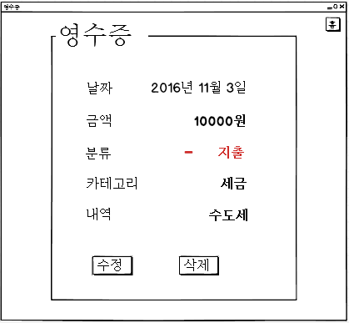
UIDiagram041
HistoryViewCloseBtnListener
+actionPerformed(ActionEvenet:e)
EventSource : JButton
닫기
HistoryViewModifyBtnListener
+actionPerformed(ActionEvenet:e)
EventSource : JButton
HistroyViewDelBtnListener
+actionPerformed(ActionEvenet:e)
EventSource : JButton

Slide 42
UIDiagram042
RegisterLimitBtnListener
+actionPerformed(ActionEvenet:e)
CancelBtnListener
+actionPerformed(ActionEvenet:e)

Slide 43
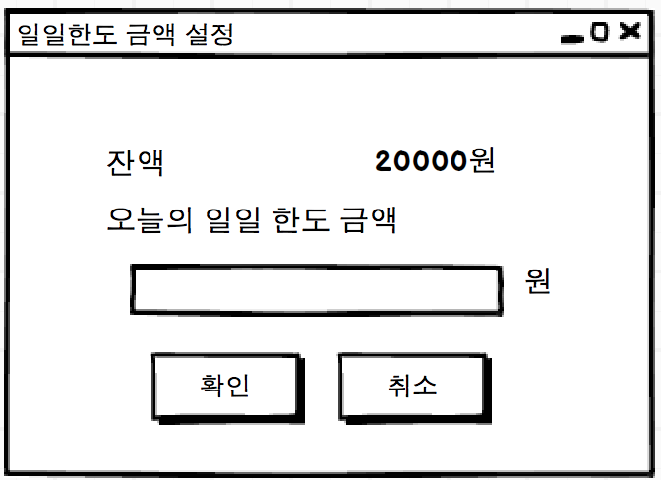
UIDiagram043
RegisterLimitBtnListener
+actionPerformed(ActionEvenet:e)
CancelBtnListener
+actionPerformed(ActionEvenet:e)

