Slide 1
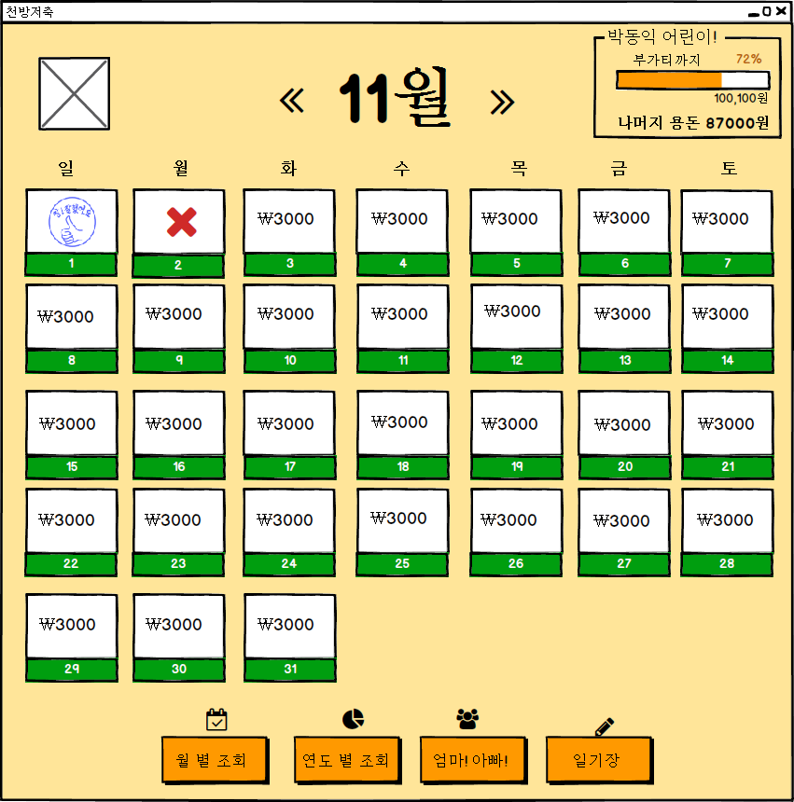
UIDiagram001
PreviousCalendarListener
actionPerformed(ActionEvenet:e)
EventSource : ImageIcon
NextCalendarListener
actionPerformed(ActionEvenet:e)
EventSource : ImageIcon
DayAccountLabelListener
actionPerformed(ActionEvenet:e)
EventSource : JLabel

Slide 2
UIDiagram001
MonthAccountBtnListener
actionPerformed(ActionEvenet:e)
EventSource : JButton
YearAccountBtnListener
actionPerformed(ActionEvenet:e)
EventSource : JButton

Slide 3
UIDiagram001
CommunicationBtnListener
actionPerformed(ActionEvenet:e)
EventSource : JButton
DiaryBtnListener
actionPerformed(ActionEvenet:e)
EventSource : JButton

Slide 4
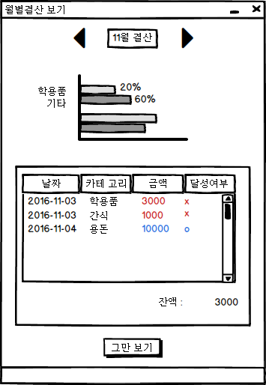
UIDiagram001
PreviousMonthListener
actionPerformed(ActionEvenet:e)
EventSource : ImageIcon
NextMonthListener
actionPerformed(ActionEvenet:e)
EventSource : ImageIcon
StopShowingListener
actionPerformed(ActionEvenet:e)
EventSource : JButton

Slide 5
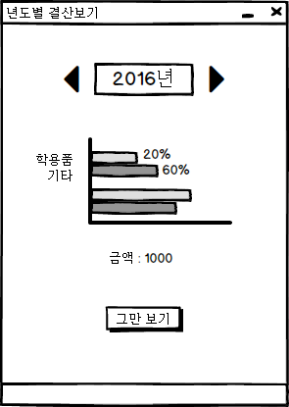
UIDiagram001
PreviousYearListener
actionPerformed(ActionEvenet:e)
EventSource : ImageIcon
NextYearListener
actionPerformed(ActionEvenet:e)
EventSource : ImageIcon
StopShowingListener
actionPerformed(ActionEvenet:e)
EventSource : JButton

Slide 6
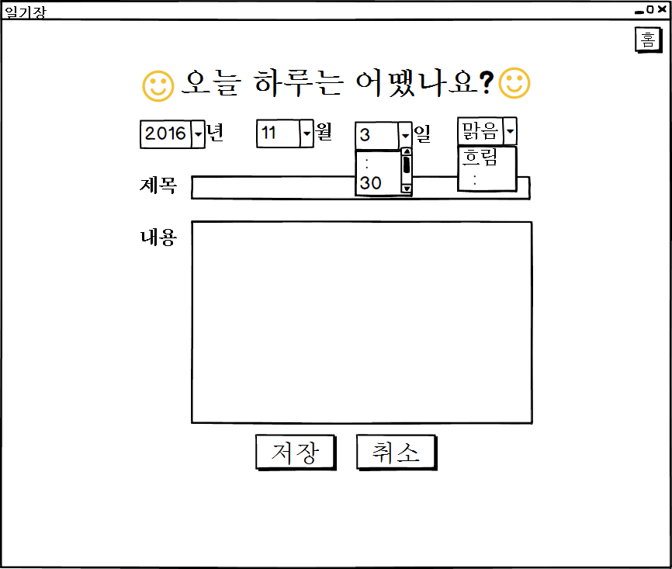
UIDiagram001
DiaryDayListener
+actionPerformed(ActionEvenet:e)
EventSource : JComboBox
SaveDiaryBtnListener
+actionPerformed(ActionEvenet:e)
EventSource : JButton
StopShowingDiaryBtn Listener
+actionPerformed(ActionEvenet:e)
EventSource : JButton

Slide 7
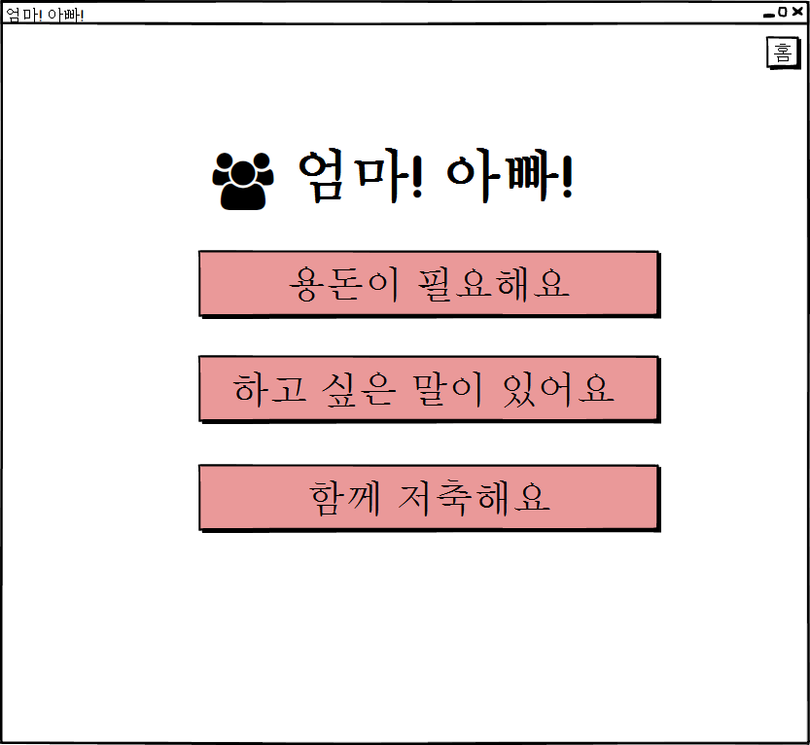
UIDiagram001
NeedAllowanceBtnListener
+actionPerformed(ActionEvenet:e)
EventSource : JButton
TalkToParentBtnListener
+actionPerformed(ActionEvenet:e)
EventSource : JButton
SavingWithParentBtnListener
+actionPerformed(ActionEvenet:e)
EventSource : JButton

Slide 8
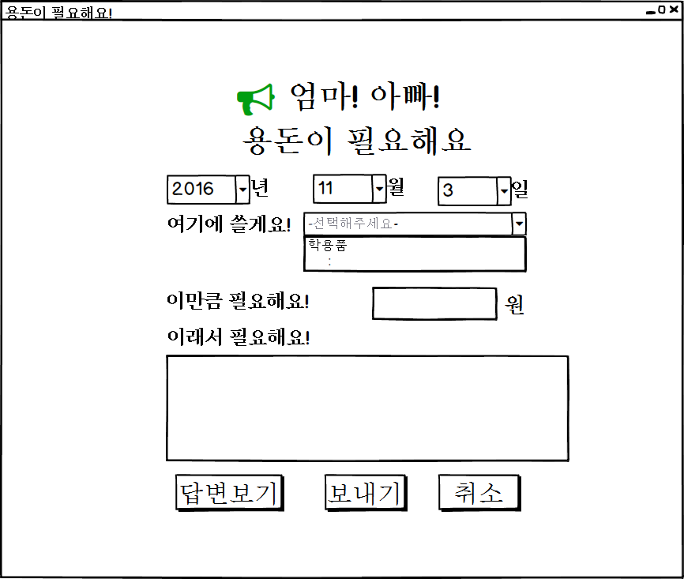
UIDiagram001
ShowResponseBtnListener
+actionPerformed(ActionEvenet:e)
EventSource : JButton
AskAllowanceBtnListener
+actionPerformed(ActionEvenet:e)
EventSource : JButton
CancelAllowanceBtnListener
+actionPerformed(ActionEvenet:e)
EventSource : JButton

Slide 9
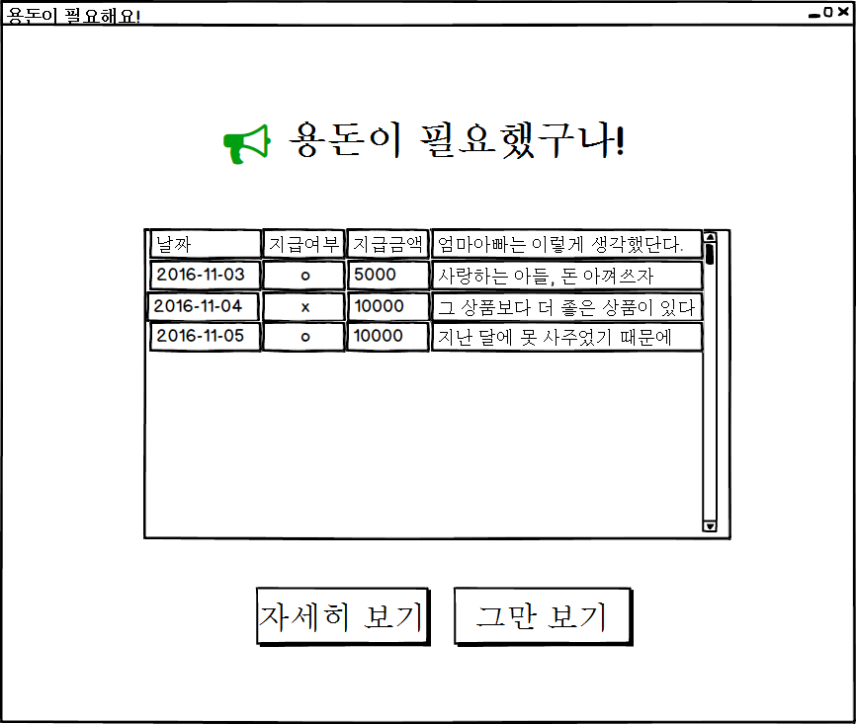
UIDiagram001
ShowDetailAllowanceBtn Listener
+actionPerformed(ActionEvenet:e)
EventSource : JButton
CancelDetailAllowanceBtn Listener
+actionPerformed(ActionEvenet:e)
EventSource : JButton

Slide 10
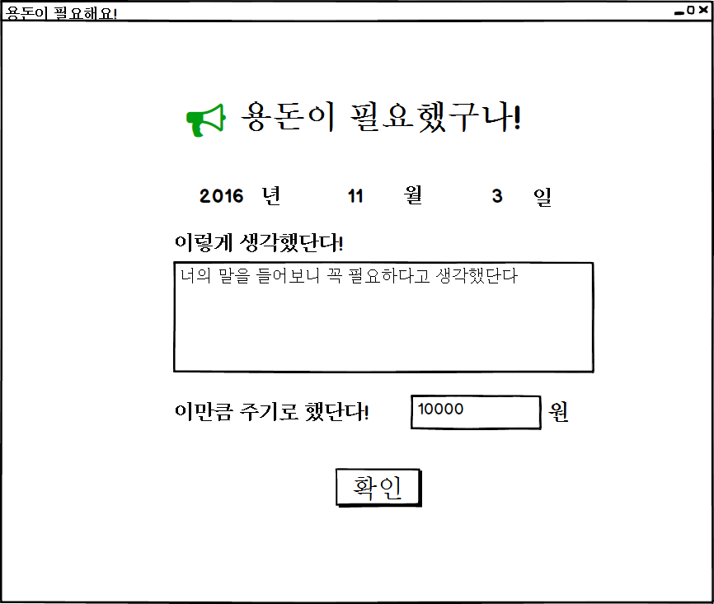
UIDiagram001
ConfirmDetailAllowanceBtnListener
+actionPerformed(ActionEvenet:e)
EventSource : JButton

Slide 11
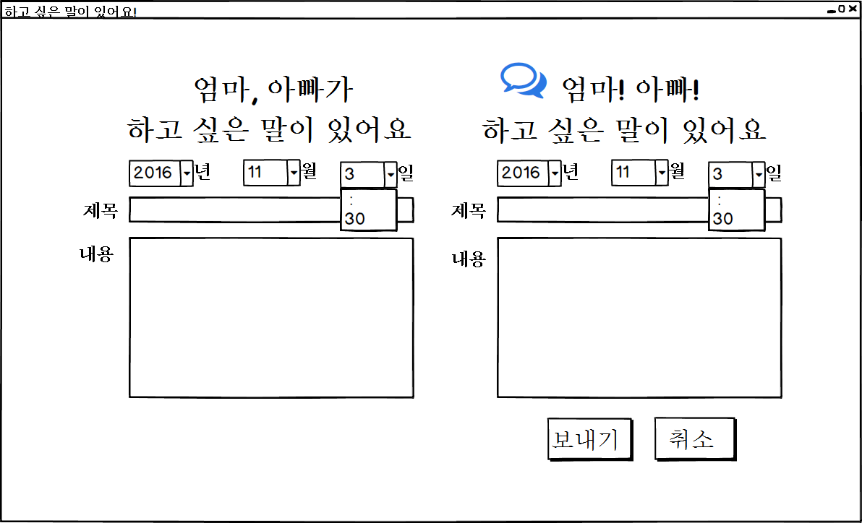
UIDiagram001
MemoDayListener
+actionPerformed(ActionEvenet:e)
EventSource : JComboBox

Slide 12
UIDiagram001
SaveMemoBtnListener
+actionPerformed(ActionEvenet:e)
SaveMemoBtnListener
+actionPerformed(ActionEvenet:e)
EventSource : JButton
EventSource : JButton

Slide 13
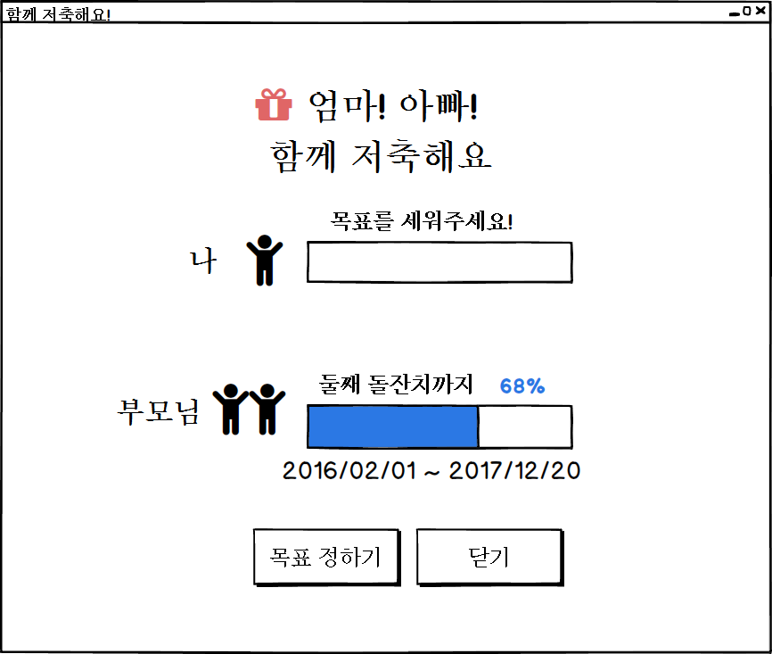
UIDiagram001
SetGoalStartBtnListener
+actionPerformed(ActionEvenet:e)
EventSource : JButton
CancelGoalBtnListener
+actionPerformed(ActionEvenet:e)
EventSource : JButton

Slide 14
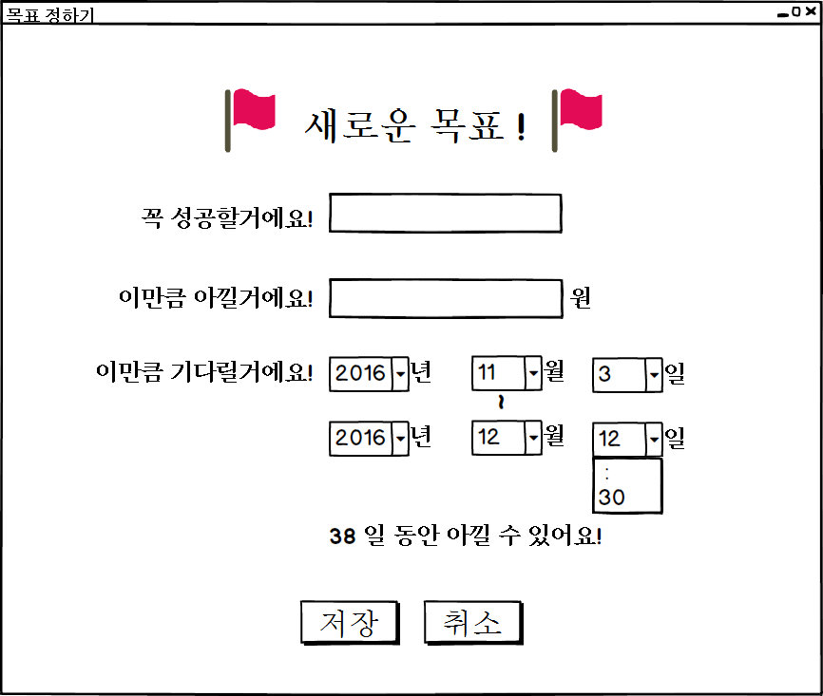
UIDiagram001
SetGoalBtnListener
+actionPerformed(ActionEvenet:e)
EventSource : JButton
CancelSetGoalBtnListener
+actionPerformed(ActionEvenet:e)
EventSource : JButton

