Slide 1
Front Panel Design
Systems Product Division
Agilent Restricted
Month, DD 2007

Slide 2
Challenges for Front panel design
Assuming No mouse and key board is attached with Box
All the events/user activity will originate/informed through Front panel driver
Every action/intention is triggered through Front panel
Requirement /Use case is not very clear, so design should have extra flexibility, may be required to absorb some unseen features or use case.
Undo functionality, Up to What level?

Slide 3
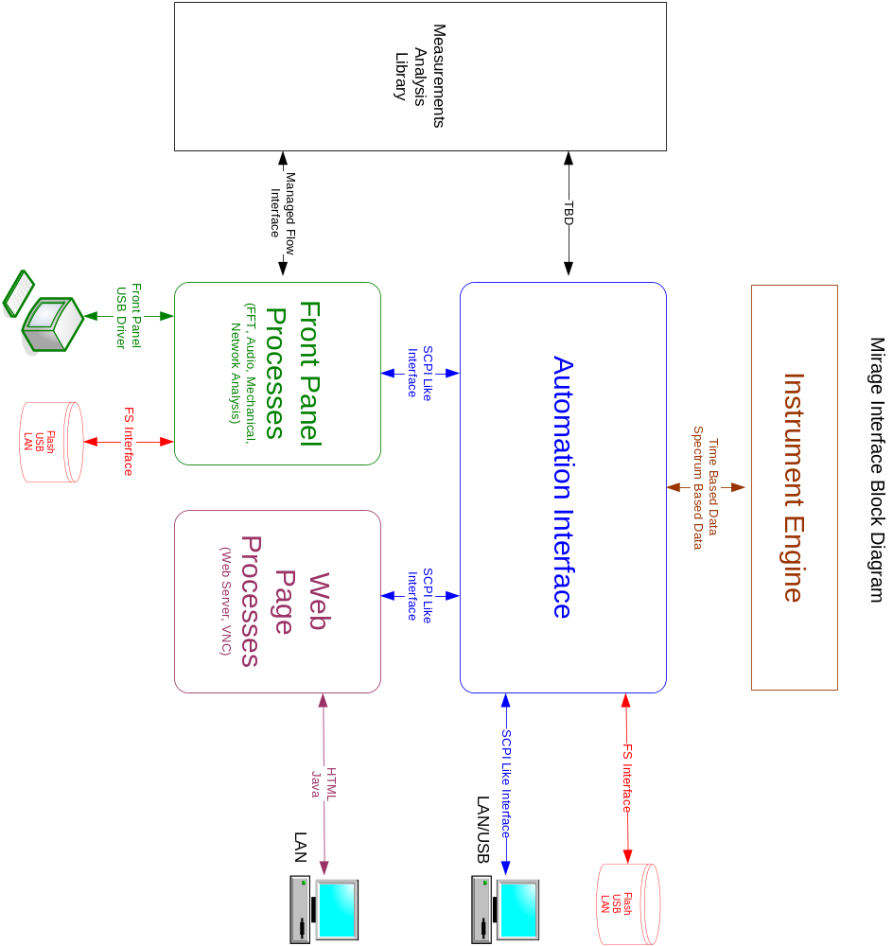
Mirage Interface Diagram

Slide 4
Soft Key Menu Event Flow
Keyboard
key pressed
VNCServerListener
KeyboardListner
FPEventListener
Key Strokes
Remote client requests
Front panel key pressed
EventInterpreter
eFPEvents
CommandFactory
oCommand
oCommand
Business logic for
front panel events
implemented here
CommandExecuter
Do( )
MenuCommand
Action corresponding to front panel event
MenuController
OnFocusSoftKeyChangedEvent( ) OnSoftKeysChangedEvent( )
SoftKeyPadCtrl
contd…

Slide 5
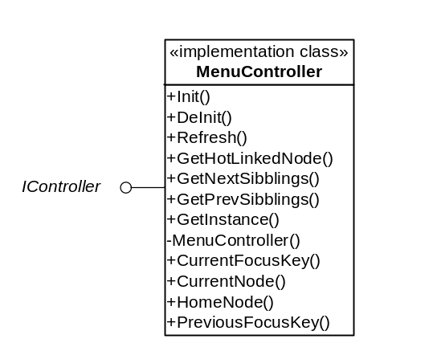
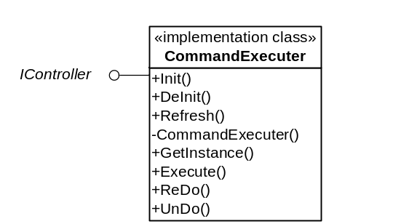
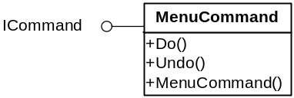
contd…
public enum eFPEvents
{
  eKnobLeft, eKnobRight, eNavigatorUp, eNavigatorDown, eNavigatorLeft, eNavigatorRight, eMode, eFrequency, eProperties, eDisplay, eMeasurement, eTroubleShoot, eAnalysis, eUndo, eSoftKey1, eSoftKey2, eSoftKey3, eSoftKey4, eSoftKey5, eSoftKey6, eSoftKey7, eMenuHome, eMenuBack, eMarkerAdd, eMarkerNext, eMarkerDel, eMarkerFunc, eMarkerKnob1Right, eMarkerKnob1Left, eMarkerKnob2Right, eMarkerKnob2Left, eRun, eSingle, eStrat_Stop, ePreset, eAutoScaleOnce, eMoreKey, eLessKey
}
public interface ICommand
{
int Do();
int Undo();
}
public interface IController
{
int Init();
int DeInit();
int Refresh();
}
contd…

Slide 6
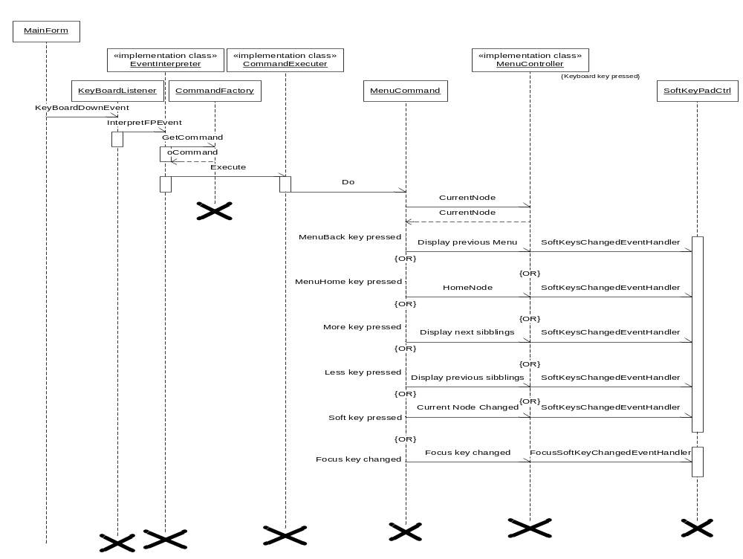
Sequence Diagram
contd…

Slide 7
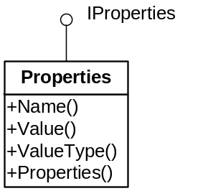
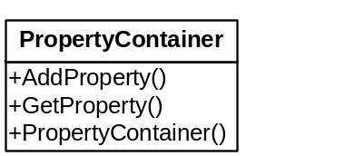
Channel / Mode / View
public interface IProperties
{
string Name
{
get;
set;
}
object Value
{
get;
set;
}
Type ValueType
{
get;
set;
}
}
public interface IChannel
{
string ChannelID
{
get;
set;
}
void AddProperty(IProperties oProperties);
IProperties GetProperty(string strName);
}
public interface IMode
{
int ModeID
{
get;
set;
}
string ModeType
{
get;
set;
}
}
public interface IView
{
int ViewID
{
get;
set;
}
string ViewType
{
get;
set;
}
}
Each object, Channel / Mode / View, has its own specific property.
These properties are contained in another object, PropertyContainer
contd…

Slide 8
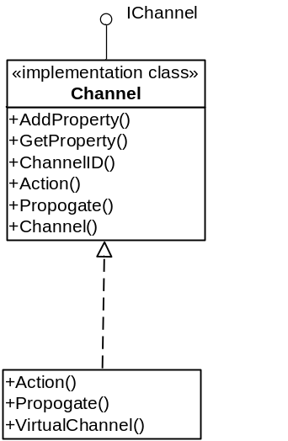
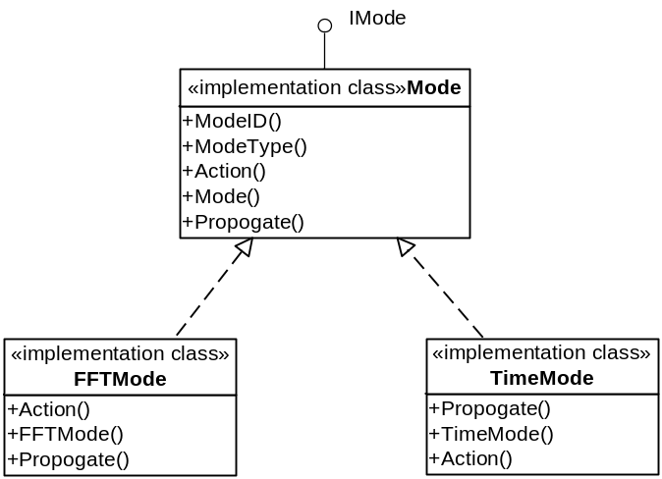
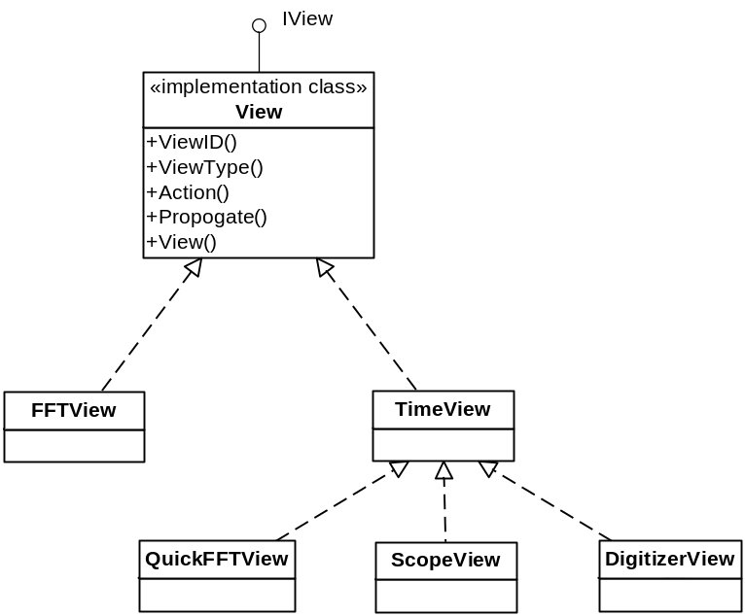
contd…
The class for implementing “Source” will also be derived from the interface IChannel.
Channel class contains an object of PropertyContainer which further contains Channel specific properties.
Similarly, Mode and View classes also contains an object of PropertyContainer which further contains Mode and View specific properties respectively.

Slide 9
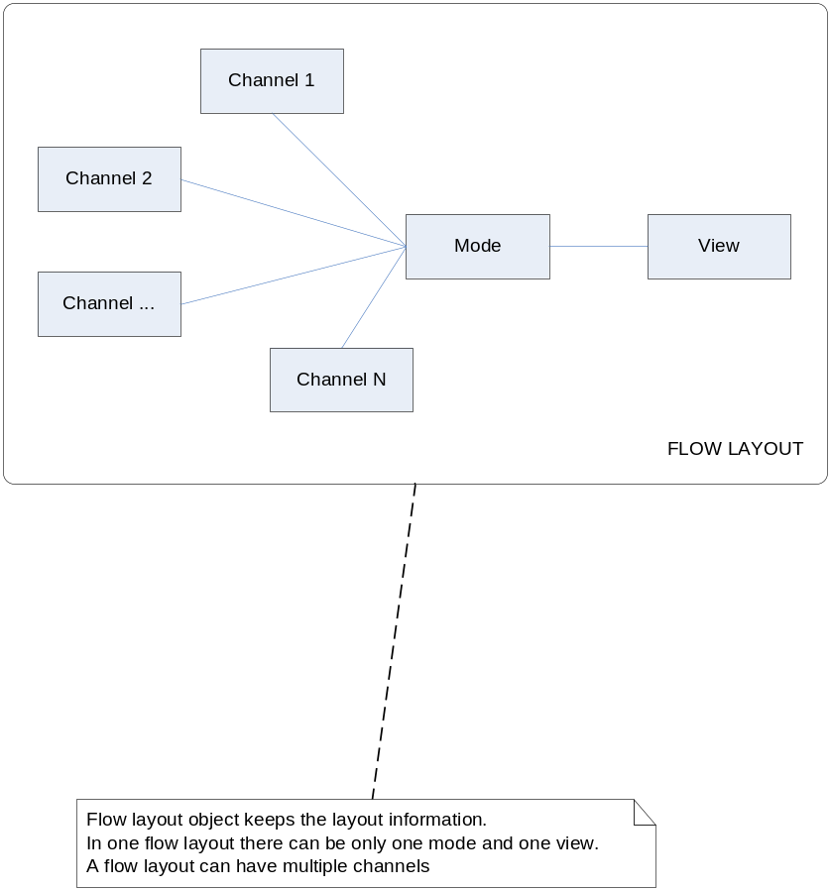
FlowLayout
public interface IFlowLayout
{
void AttachChannel(IChannel oChannel);
void AttachChannel(IChannel[] oChannel);
void DetachChannel(IChannel oChannel);
void DetachChannel(IChannel[] oChannel);
ArrayList GetChannels
{
get;
set;
}
void AttachMode(IMode oMode);
IMode GetMode
{
get;
set;
}
void AttachView(IView oView);
IView GetView
{
get;
set;
}
}
contd…

Slide 10
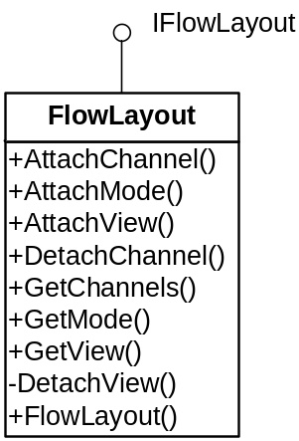
contd…
Each FlowLayout object is Mode specific
Denotes Channel-Mode-View relationship
Only single Mode and single View
Can contain multiple Channels
Existing Mode can be replaced with a new Mode in a FlowLayout object
Similarly, existing View can also be replaced with a new View in a FlowLayout object
Channel-Mode-View relationship is kept Mode specific using FlowLayout object, while data flow is channel specific using Signal Flow Framework for each FlowLayout.

Slide 11
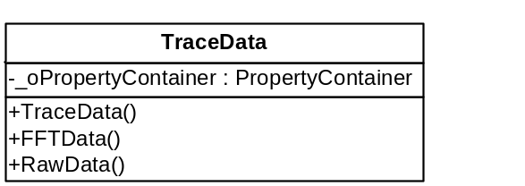
TraceData
Input signal from each channel flows further down in form of TraceData
TraceData object is separate for each channel
TraceData contains the object of PropertyContainer
This PropertyContainer object contains various properties as:
  RawData : Represents actual data from the channel
  FFTData : Represents the spectrum data
Thus, TraceData object contains the intermediate results for each channel

Slide 12
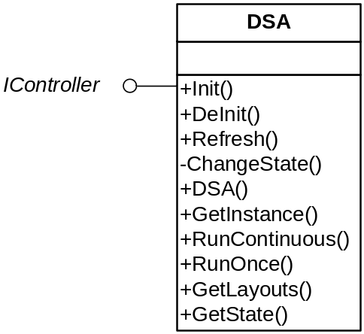
DSA
DSA class is of type singleton
Derived from IController interface
Contains a collection of FlowLayout objects
Initially starts with 4 default channels in FFT mode with linear view
Used by Simulator to get the FlowLayout info, for data flow through every channel in each FlowLayout

Slide 13
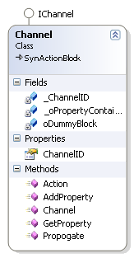
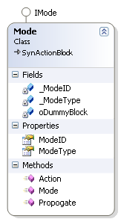
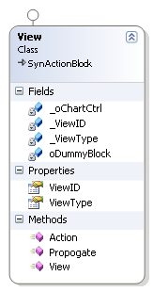
Use of Signal Flow Framework
*
*
*
*
The classes representing Channel, Mode and View are also derived from the SynActionBlock class in the Signal Flow Framework
Each of them behave like as ActionBlocks of Signal Flow Framework
Supports following methods:
  Action()
  Propogate()
  Connect()
  DisConnect()
contd…

Slide 14
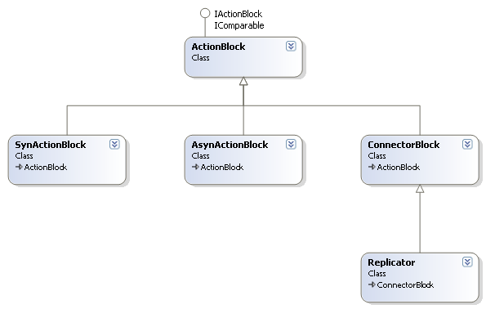
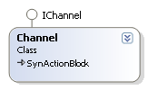
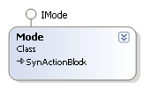

contd…
Signal Flow FrameWork Library / DLL
FrontPanelProto Application
Data flows in form of TraceData
TraceData will actually flow from channel to mode and mode to view
Actual measurement will be done in mode, results will be added to TraceData object
Intermediate results are thus available at any time via TraceData object
contd…

Slide 15
contd…
TraceData
TraceData
ActionBlock
ActionBlock
ActionBlock
Channel
Mode
View
Channel.Propogate()
Mode.Propogate()
TraceData (containing raw data)
TraceData (containing mmt result as well)
TraceData Changes At Each Step
<RawData>, < ArrayList >
+
<WidowedData>, < ArrayList >
+
<FFTData>, < ArrayList >
+
<HarmonicValue>, < int >
Info from used added to TraceData
<HarmonicFreq>, < double/float >
<HarmonicNo>, < int >
Windowing
Windowed data added to TraceData
Mode
FFT
FFT data added to TraceData
Derived from
Harmonic
Calculation
Function call
Harmonic value added to TraceData
Data Flow

Slide 16
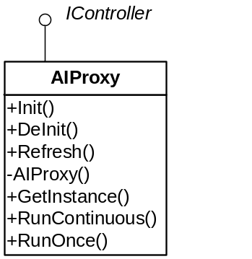
Data Flow
Functions exposed:
  RunOnce()
  RunContinuous()
  Stop()
Calls these functions for performing front panel action
Front Panel
Front Panel Layers
*
AI Proxy
AI Proxy
SCPI like Interface
Automation Interface
(AI)
Real Proxy
Simulated Proxy
*
Corresponding function calls in front panel design
Converts function into SCPI like interface
Simulates the function behavior using random numbers
AI Proxy calls the function in DSA to perform the required action
DSA further calls the Simulator for simulating the data and performing the required measurement
This uses the TraceData and Signal Flow Framework discussed earlier

Slide 17
Front Panel Messaging system
MessageFP
MessageType
FPEvent
Source
MsgTarget
  …
  ….
All the user interaction (FPEvents) will be transformed into MessageFP object.
MessageFP will encapsulate the type of message, source of origin, target destination and additional information required to process that message.
contd…

Slide 18
Message Processor
Keyboard
key pressed
VNCServerListener
KeyboardListner
FPEventListener
Key Strokes
Remote client requests
eFPEvents
Front panel key pressed
MsgGenerator
MessageFP
MsgProcessor
Message Processor will keep a history of Message ( History queue length will be configurable)
Translate Message : Translate softkeys FPEvents into respective MessageFP. Mobile Pad key press FPevent will be translated here into a number or character press Message.
Dispatch message to Message dispatching system.
Undo functionality can be simulated using Message Queue.
contd…

Slide 19
Message Target
This can be any object, may be chart, grid, simple business object etc
Message target will act as a sink to message, who will take an appropriate action on that message.
Each message target will have a target priority.
MessageFP will be connected in ordered/priority list of message target objects.
Once a message handled by any object in MsgTarget order list, it will stop flowing further.
MsgTarget Priority will be
  1 : Highest priority ( Always assigned to Modal Message box , If a priority one target exist in MessageFlow path, then it will not flow through out the ordered MSgTarget list. If this is not handled by priority one object, then it will be ignored.
  2 : Focused View will falls in this category
  3: Non Focused View
  4 : DisplayFrame
  5: DSA
contd…

Slide 20
Message Dispatcher
MsgTarget (Focused View)
2
Role:
Singleton object, single instance per application
Maintained a priority queue of MsgTargets.
Once a priorty of an view get changed, MsgDispatcher will again order his priority queue.
MsgTarget(Non Focus)
3
MsgTarget (Non Focus)
3
MsgTarget (Non Focus)
3
MsgTarget ( Display Frm)
4
MsgTarget (DSA)
5
contd…

Slide 21
Messaging enabled Objects footprint
Class ChartView
{
private MsgTarget _MsgTarget;
public ChartView()
{
_MsgTarget = new MsgTarget( enumTargetPriority);
MsgMap oMap = new (MsgType.KNOB_Right, MsgKnobHandler);
MsgTarget .AddMsgMap(oMap );
oMap = new (MsgType.KNOB_LEFT, MsgKnobHandler);
MsgTarget .AddMsgMap(oMap );
oMap = new (MsgType.NUmbert, MsgNumberHandler);
MsgTarget .AddMsgMap(oMap );
oMap = new (MsgType.OK, MsgOKButtonHandler);
MsgTarget .AddMsgMap(oMap );
}
Public int MsgKnobHandler(MessageFp) {};
}
contd…

Slide 22
Message Target Footprint
MsgTarget
Class MsgTarget
{
private enumMsgTargetPriority _ Pririty;
Private SortedLIst _MsgMaps;
public MsgTarget (enumMsgTargetPriority oMsgTargetPriority )
{
_ MsgMaps = new SortedLIst() ;
  }
Public void AddMsgMap( MsgMap oMap)
{
// Add the MsgMap into MsgMap structure
}
Public bool DispatchMsg( MessageFP oMsg)
{
// Look the Sortedlist for respected Message type , if it exist then call the handler otherwise return unhandled message.
}
}
contd…

Slide 23
Display Management
Menu Bar (View) Priority 3
Chart 1( Focused View) Priority 2
Soft Keys
(View)
Priority 3
DisplayFrame
MessageBox( Highest Priority 1 Modal View)
Chart 2 ( Non Focused View) Priority 3
OK
Cancel
Status Bar (View) Priority 3
contd…

Slide 24
Msg Flow between View and FlowLayout
Time Chart (Focused View)
IVth Priority
FlowLayout
IIIrd Priority
Channel
First Priority
Mode
IInd Priority
contd…

Slide 25
Display Frame
DisplayFrame
Role:
Singleton object, single instance per application
Responsible for managing the screen/view size/space.
Responsible for providing the focus/active view
Cascading of multiple chart in screen area will be the responsibility of this object
All the popup message box, informative dialog will be display through Display Frame object. This will allocate the screen area.
contd…

Slide 26
DISCUSSION
Q & A

