Slide 1
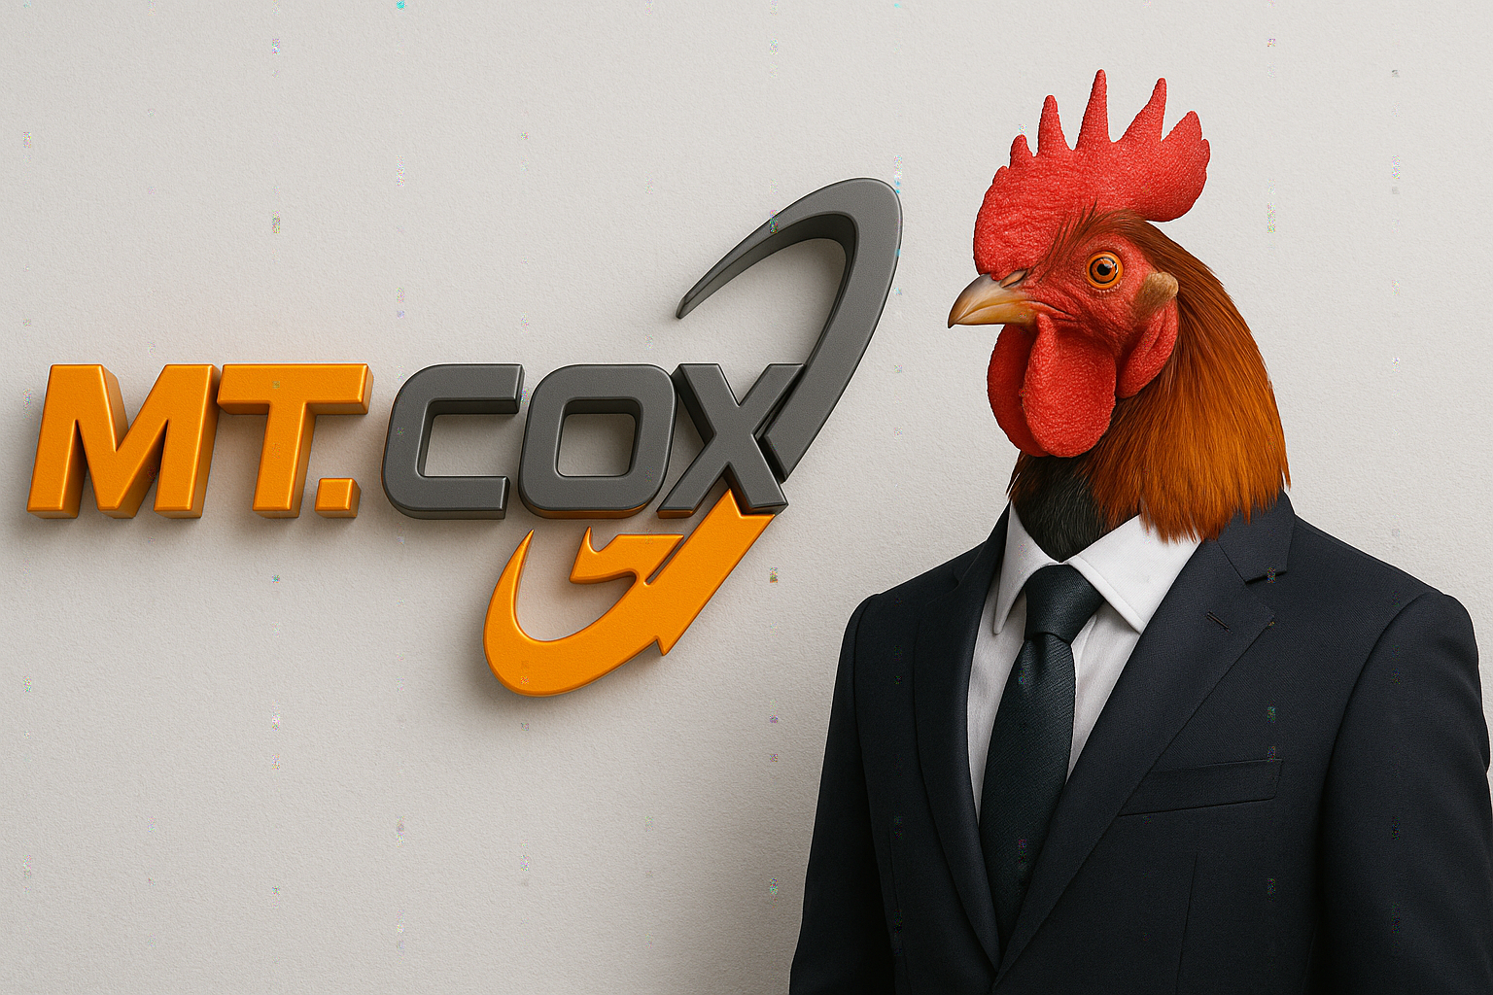
MT.COX LLC
the exchange of culture — mathematics of the trenches

Slide 2
the problem
- insiders farm 90% before launch
- cexes skim 2–5% while dumping
- bagholders = exit liquidity
graph: retail portfolio goes straight down

Slide 3
the pain (math)
$100 * (1 - 0.90) = $10 → 90% drawdown
no memes, no culture, no hope

Slide 4
the solution: mt.cox math
- redistribution: 30% → bagholders
- buy & boost: 20% → cock energy
- chaos incentives: 10% → trenches
total = 60% back to trenches

Slide 5
cock with suit theorem
Trench Utility (TU) = Memes² + Cock Energy ÷ Rug Risk
- memes² → viral posts amplify value quadratically
- cock energy → reserves of chaos funding
- rug risk → minimized (we promise nothing)
thus, TU → ∞ as memes → ∞

Slide 6
tokenomics
ticker: $mtcox
supply: infinite (like cope)
meme tax: 1%
cock tax: 1%
EV = (100 * 50) - 2 = 4,998
mathematically funnier than dog wif hat

Slide 7
roadmap
Q1 2025 — launch broken site → 10k meme posts
Q2 2025 — competitions → $1m redistributed
Q3 2025 — buy & boost events → 20% supply shock
Q4 2025 — cockposting engine v2.0 → 69,420 memes/min

Slide 8
call to action
“the trenches needed a runner. here you go.”
#mtcoxllc #forthetrenches

