Slide 2
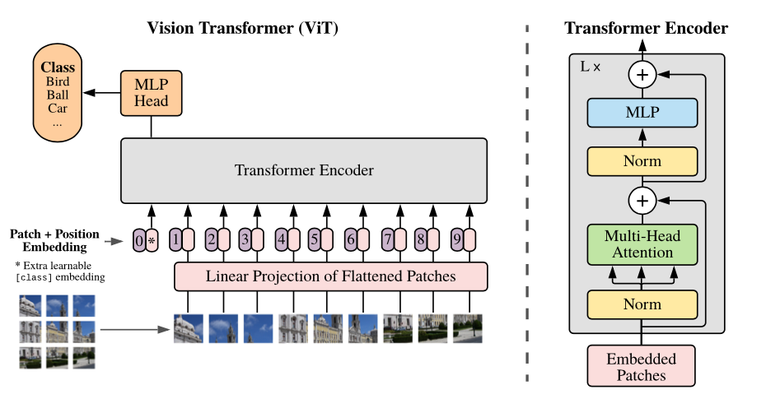
Vision Transformer
https://github.com/google-research/vision_transformer

Slide 3
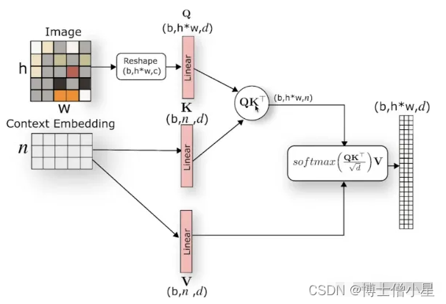
Cross Attention Mechanism

Slide 4
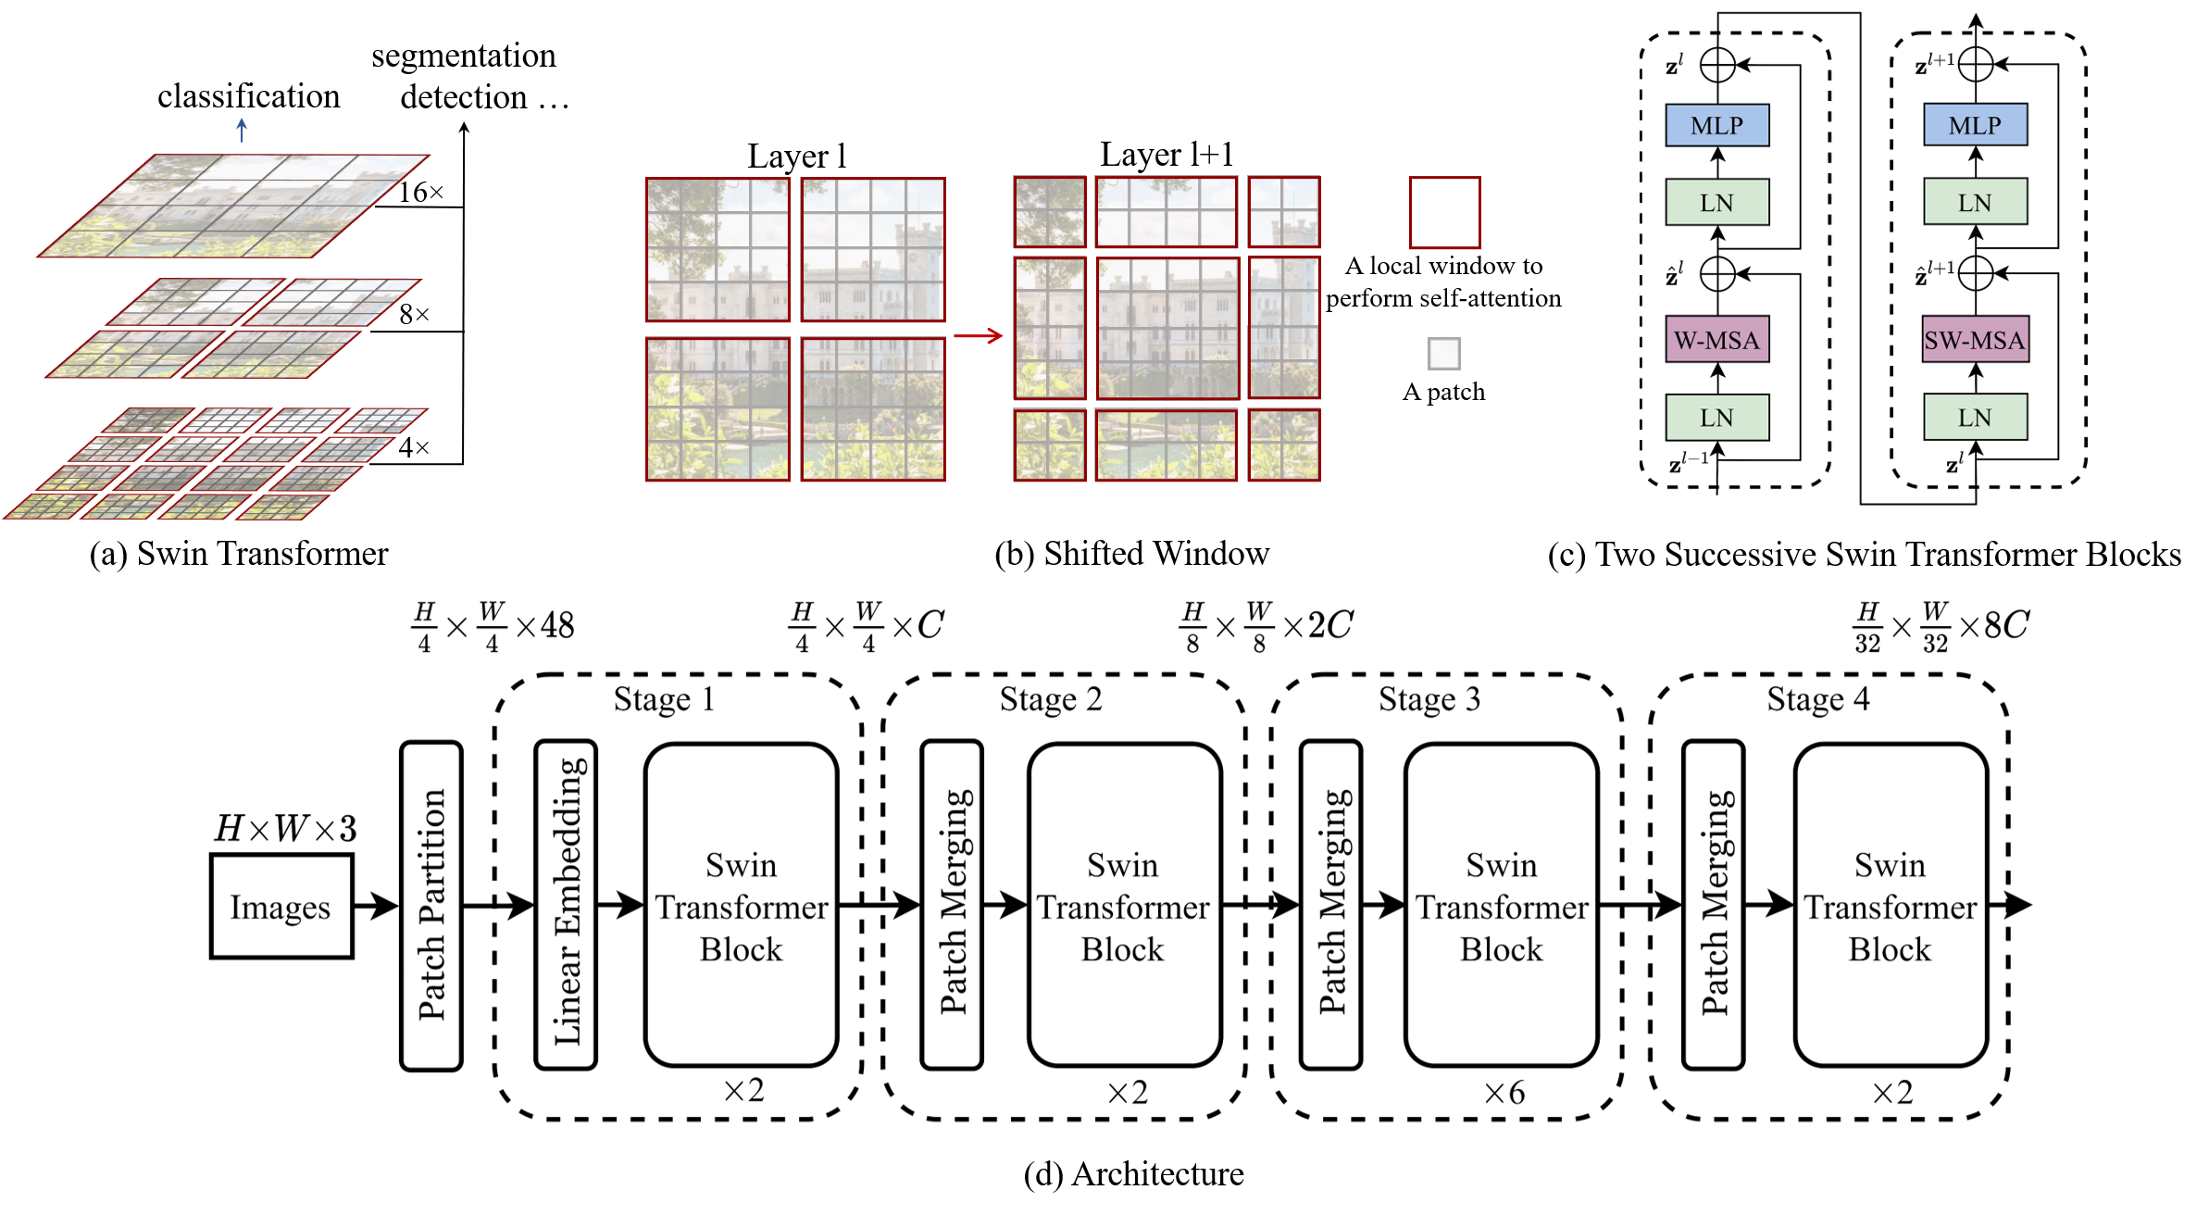
Swin Transformer
图解Swin Transformer - zzk again的文章 - 知乎https://zhuanlan.zhihu.com/p/367111046
Swin Transformer: Hierarchical Vision Transformer using Shifted Windows. https://arxiv.org/abs/2103.14030

Slide 5
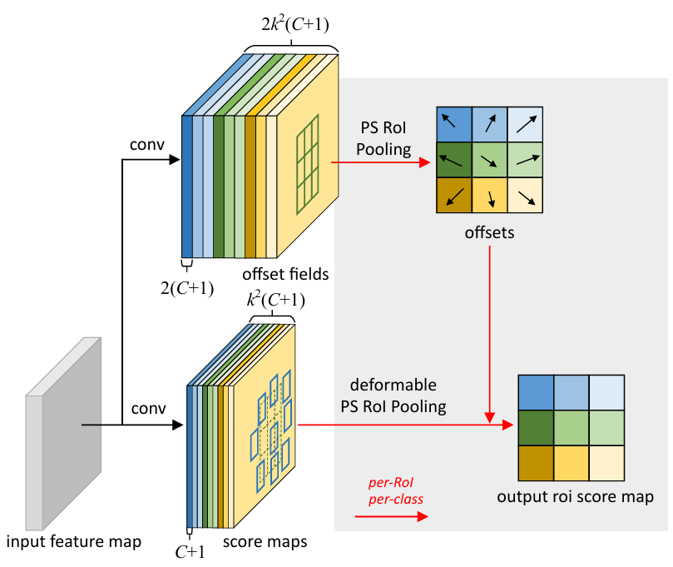
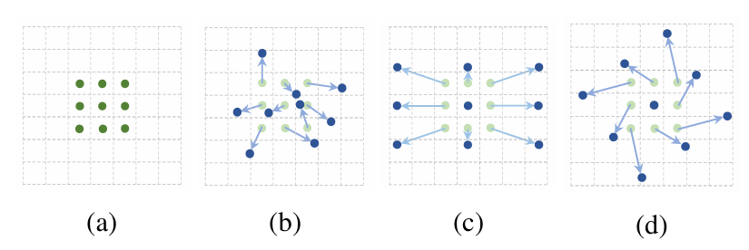
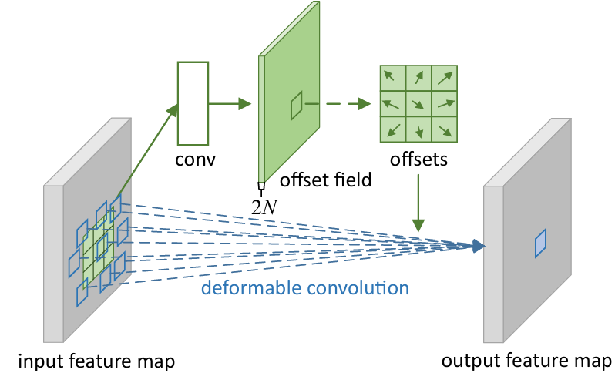
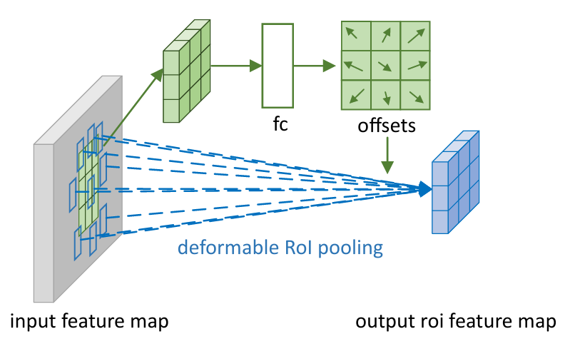
Deformable Convolution Networks
deformable convolution
deformable RoI Pooling
class

Slide 6
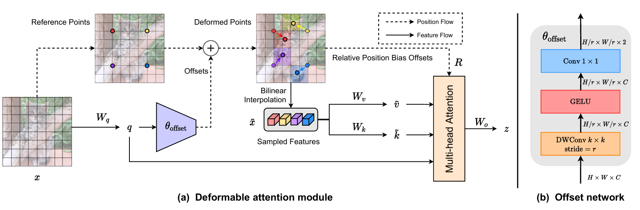
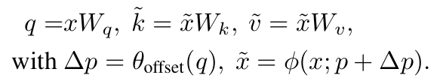
Vision Transformer with Deformable Attention
bilinear interpolation
https://arxiv.org/abs/2201.00520

Slide 8
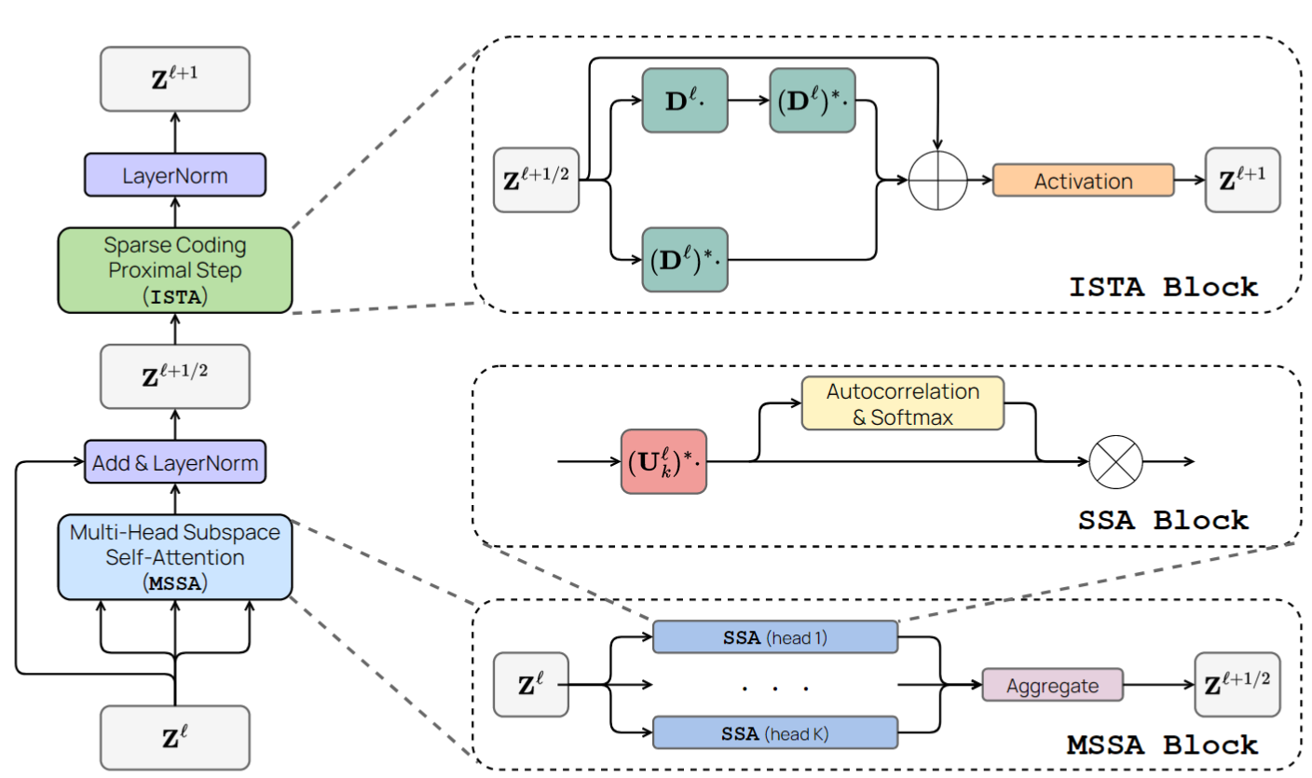
CRATE

