Slide 1



EduConnect
By DerekGPT, DerekAI, etc...
Notes:
Hello, we are EduConnect and our names are …..

Slide 2

Agenda
Background & Significance
Solution Overview
Business Model
Ethical Considerations
Demo & Future Steps
2
Notes:
We will be going over the background of our solution, followed by how our solution works overall, how we plan to implement our business model, the ethical considerations we took when developing our solution, and finally our demo and future plan with EduConnect

Slide 3
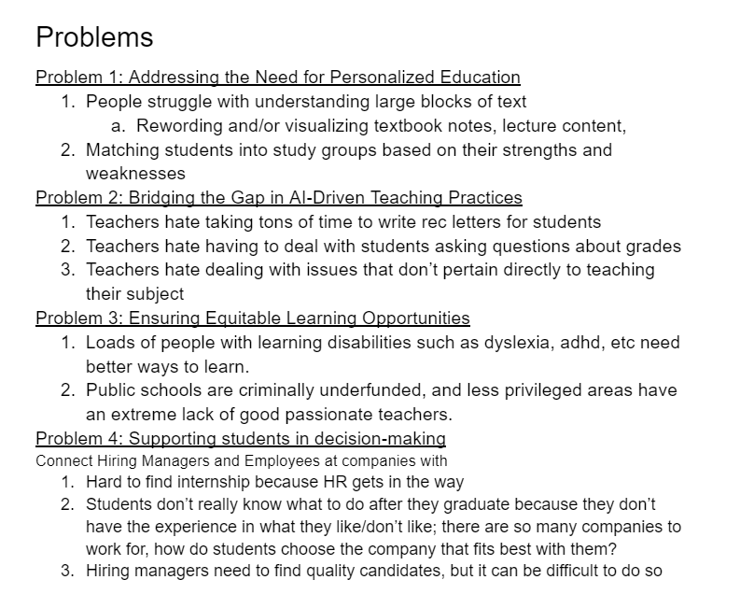

Background
Is it a real problem?
Is it solvable?
Can AI help?
Students enter advising appts. Without a clear sense of goals and options
Academic advisors often focus on logistics rather than learning outcomes
Students often end up with professors that don't match their learning styles
3
This Photo by Unknown author is licensed under CC BY-NC-ND.
Notes:
Feeling Unprepared: Students often enter advisor appointments without a clear sense of their goals or a good understanding of their options.
Difficulty Articulating Needs: Even with goals, students might struggle to explain their preferences for professors or courses that cater to their learning style.
Advisor sessions have time constraints, and discussions often focus on logistics (course availability, fulfilling requirements) rather than optimal learning matches.

Slide 4

The Goal
Reducing Uncertainty: Increasing students' confidence early in their college career...
Improved Retention:
Feeling supported → thriving in learning environment
→ more likely to persist through educational
challenges and complete degree program
Ultimately narrowing the gap between college students with prior coaching and experience and those who may have received less support and exposure before university
4
Notes:
Reducing Uncertainty: Helping students feel confident they'll have an optimal learning experience early in their college career
Improved Retention: Students who feel supported and thrive in their learning environment might be more likely to persist through challenging courses and complete their degrees.
Narrowing the gap between college students with prior coaching and experience and relevant fields and those who may have received less support and exposure before university

Slide 5

Our solution focuses on saving time and resources in academic planning and student management.
Stakeholder Centric Approach – How it Works
Incorporates student preferences
Manages student schedule while recommending most compatible professors
Saves administrative time to focus on helping students with major problems
5
Notes:
Students take a short survey to identify their learning style preferences.
Our system analyzes professor review data to understand teaching styles.
Students receive recommendations for professors whose styles align with their learning preferences.

Slide 6
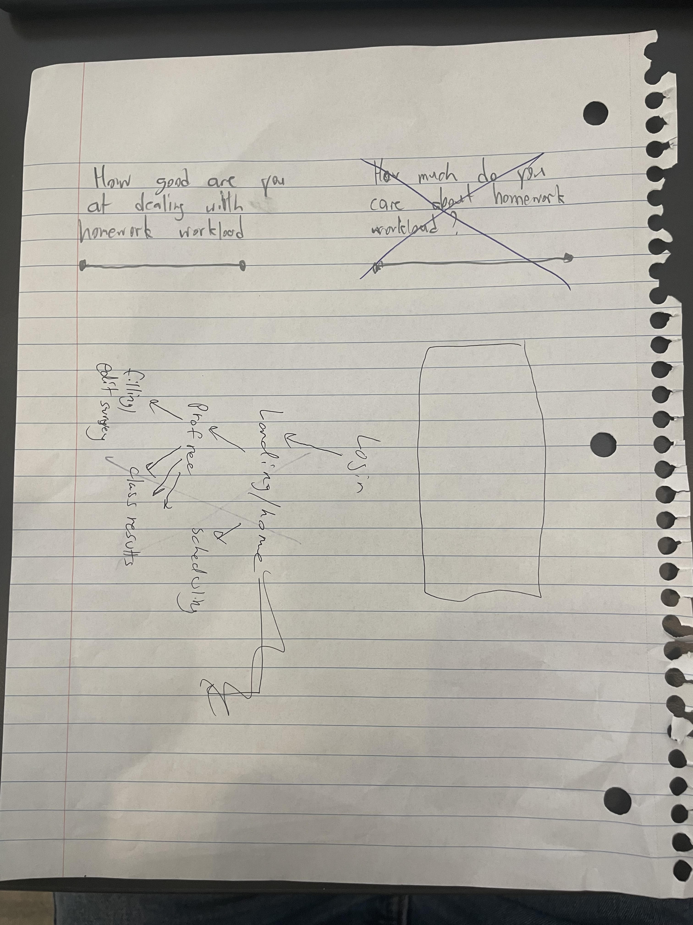

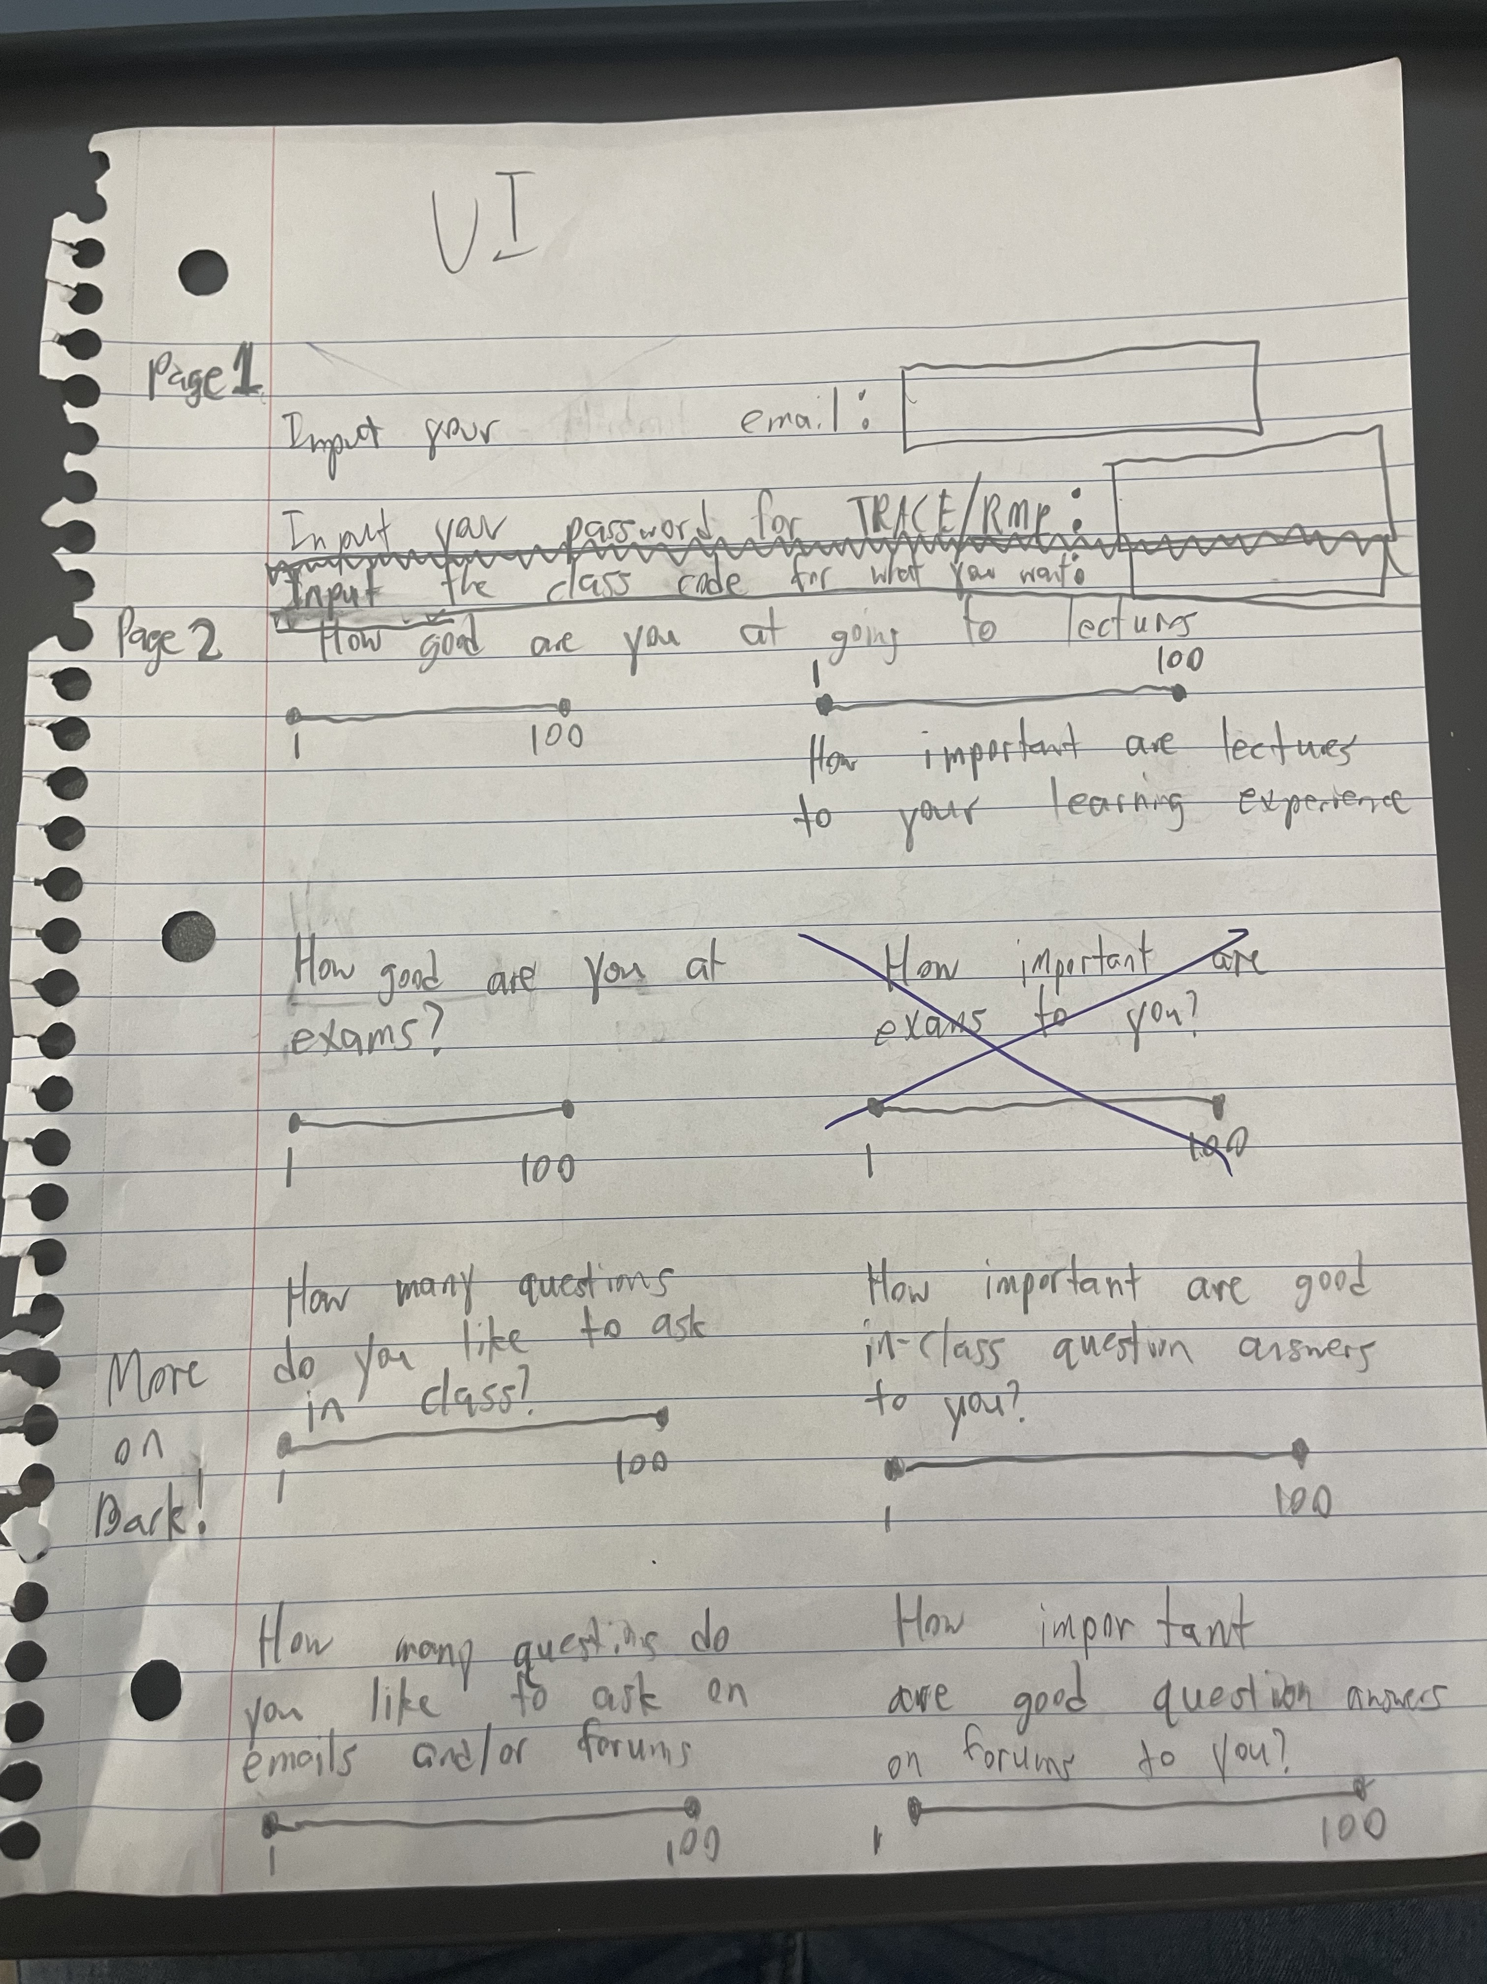
Proof of concept
Notes:
This is our proof of concept on paper, where we decided how the UI would work and how it to implement the UI with our solution pipeline.

Slide 7
Utilizing LLMs and webscraped data to determine compatibility
Incorporation of AI
Utilizes a large language model to process each review for each professor
Determines a compatibility rank based off predetermined parameters, weighted with an algorithm
Analyzes students schedule and optimizes compatible professors with the student’s schedule
7
Notes:
We utilized a LLM and web scraped data to determine compatibility between a student user and professors of the course. Using data from rateMyProfessor we detemined rank for specific parameters and weighted the compatibility between professor and student with a custom algorithm. And we show the result of a potential student schedule based off of the results.

Slide 8
Our business plan
Working with universities to incorporate our product w/ their own reviews and systems
Implement for free at Northeastern
Launch
Scale application to handle more universities
Market to implement at other universities
Implement a price per student pricing
Make web application available to everyone with a Northeastern student email.
Integrate other planned functionality.
Deploy application with free plans for every university who wants to use it.
Update the application to be able to handle mass amounts of users on the platform at once.
Market the product to other universities to maximize users.
Allows us to understand proper pricing at a university level.
8
Notes:
We will first implement a free version of our application at northeastern to understand how the users interact with the application and reiterate based off of feedback. Once we integrate the user feedback and planned functionality, we will launch the product for other universities to use and test as well, while scaling the application to handle more users at once. Finally we will implement a price per student pricing to gain revenue.
WILL FOCUS ON WORKING WITH UNIVERSITIES TO INCORPORATE THE IDEA WITH THEIR OWN STUDENT REVIEWS

Slide 9

Potential Areas of growth
Personalized 4-year plan generator based on individual student interests (+ schedule/workflow optimization!)
Extend language capabilities for international students
Allows the model to converse in the user's native language
Expanded capabilities for undeclared students
Explore features, recommendations for electives, degree major/minor paths, courses outside of chosen major, etc.
Tools for academic advisors
Export functions, sharing, user data persistence for meeting prep
Fine-tuning
Training specialized LLMs for each institution
Implementing user feedback
9

Slide 10




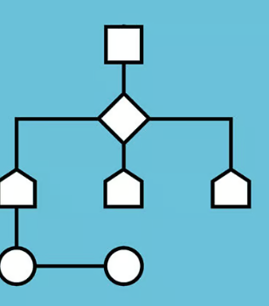
DEMO AND FUNCtIONALITY
Front End
Backend
Webscraping
LLM
Algorithm
https://drive.google.com/file/d/10tJZQnsdmeDIvAELg3rxxLBIIc24N3R_/view?usp=sharing
10

Slide 12

OUTCOMES
Data-Driven Discussions
Recommendations generated by Educonnect will give students tangible starting points for a discussion
Streamlining advisor meetings
Advisors can dedicate more time to nuanced guidance and personalized planning
Teaching Self-Advocacy
Advocating for oneself based on understanding learning needs --> improved confidence and proactivity
12
Notes:
We've all had to deal with 15 min drop-in meetings which feel like they've accomplished nothing
Since the initial self-reflection and compatibility matching has already been done, advisors can dedicate more time to nuanced guidance or helping students build a plan that matches their individual strengths.
Self-Advocacy: The tool teaches students to advocate for themselves based on their learning needs. This is a valuable skill beyond the advisor relationship.
Confidence Boost: Students arriving at advisor meetings feeling informed and prepared are likely to be more confident and proactive during their sessions.

Slide 13
Ethical Considerations
+ what we've learned this weekend
Accessibility​
Unbiased Data​
"Give a student a course recommendation and they might have a good semester.
Help them understand their learning style, and they gain a tool for lifelong success"
“Give a man fish he eats for a day, teach a man how to fish and he eats for a lifetime” - Prof. Riccio
13
Notes:
Transition to the importance of self-awareness: Real power comes from a student understanding how they learn best.
Emphasize that your tool facilitates this self-discovery process by matching individual students with professors whose teaching styles are compatible.
Reiterate that this knowledge transcends individual courses, empowering students to make informed decisions about their educational journey for ongoing success.
"...they unlock a powerful tool that can guide them throughout their academic career and beyond."
"...they're equipped to navigate any learning environment and maximize their potential."

Slide 14




Questions?
14

