Slide 1
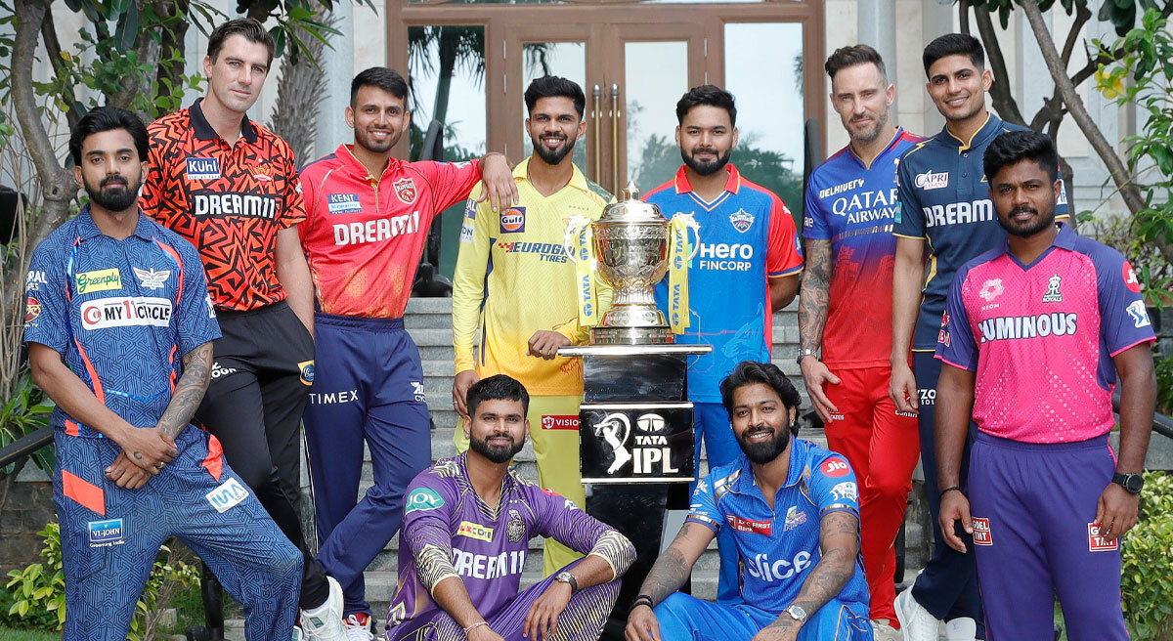
Indian Premier League(ipl)

Slide 2
Context:
The evolution of ipl
Media rights and revenue streams
Impact on team franchise and their growth
Economic benefits for players and support staff
Challenges and criticisms of the IPL Model
Social and Culture Impact on INDIAN Cricket

Slide 3
INTRODUCTION

Slide 4
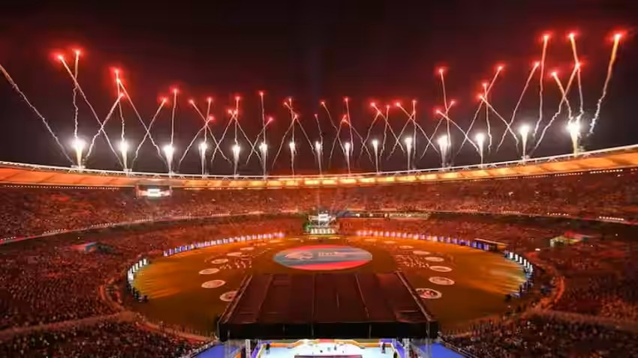
The Evolution of IPL: From 2007 to Present Day
Early Years
The IPL was launched in 2007, aiming to create a commercially driven T20 cricket league.
Rapid Growth
In just a few years, it became one of the most popular sporting events globally, with a huge fan base.
Digital Age
The league has embraced technology, using social media and streaming platforms to reach wider audiences.

Slide 5
Media Rights and Revenue Streams
TV Broadcasting
Live broadcasts generate massive viewership and advertising revenue.
Digital Streaming
Streaming platforms like Hotstar and others have expanded the league's global reach.
Sponsorships
Partnerships with brands generate significant income for the league and individual teams.

Slide 6
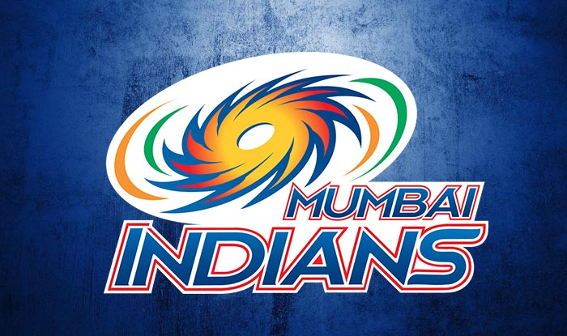
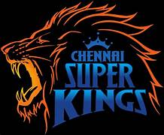

Impact on Team Franchises and Their Growth
Mumbai Indians
The most successful team with five IPL titles, highlighting their consistent performance.
Chennai Super Kings
Known for their loyal fan base and strong performance, consistently ranking among the top teams.
Kolkata Knight Riders
A team with a significant fan following and a history of success, showcasing their strong brand identity.

Slide 7
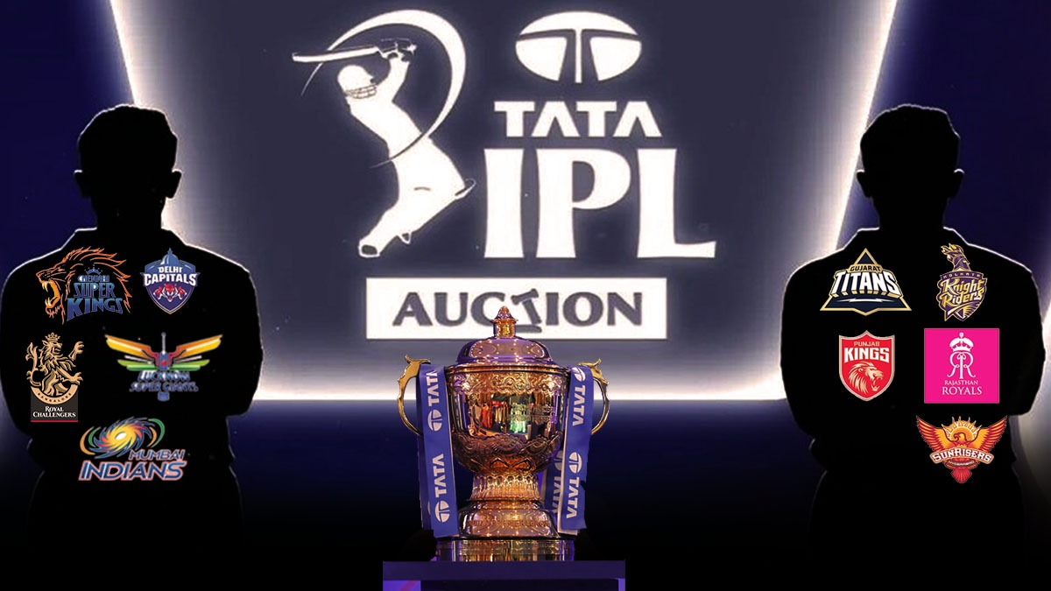
Economic Benefits for Players and Support Staff
Player Salaries
IPL contracts offer lucrative salaries for top players, providing a stable income and recognition.
Support Staff
Coaches, trainers, and other staff also benefit from the league's growth and investment.
Auction System
The annual player auction system ensures competition and fair compensation for players.

Slide 8
Challenges and Criticisms of the IPL Model
Player Workload
The IPL's intense schedule can put a strain on players, potentially leading to burnout.
Tournament Length
The two-month duration of the tournament can impact international cricket schedules and player availability.
Financial Imbalance
The IPL's popularity has led to a significant financial imbalance between teams, creating a competitive disparity.

Slide 9
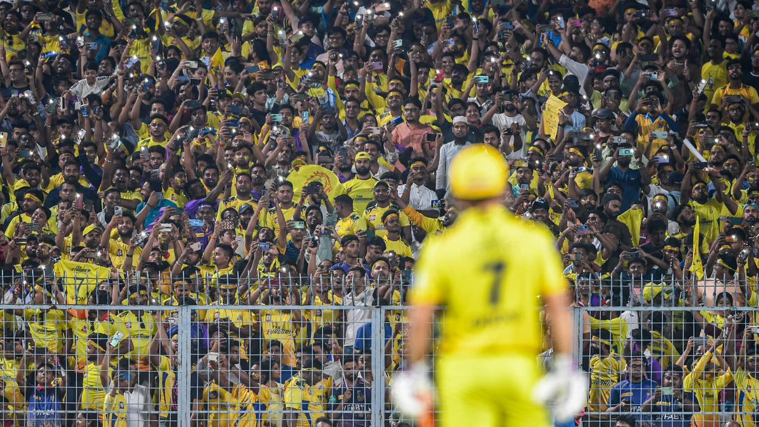
Social and Cultural Impact on Indian Cricket
Fan Culture
The IPL has fostered a vibrant fan culture, uniting people across regions and social classes.
National Pride
The IPL's success reflects India's growing influence in the world of cricket.
Talent Development
The league provides opportunities for young Indian players to gain valuable experience and exposure.

Slide 10
THANK YOU

