Slide 1
第一章相关内容

Slide 2
大致介绍
single-stream logging schemes
performance bottleneck
Taurus
a vector of log sequence numbers (LSNs)
dependencies

Slide 3
性能对比
VS single-streamed data logging 9.9×
command logging 2.9×
recover up to 22.9×
75.6× faster
2.8× better on NVMe
9.2× on HDDs

Slide 4
WAL(writeahead-logging)
在数据写入到数据库之前，先写入到日志.再将日志记录变更到存储器中

Slide 5
瓶颈
increasing parallelism
high-throughput in-memory DBMSs
scalability bottleneck

Slide 6
难点
ensure the correct recovery order of transactions
not easy to efficiently recover transactions
distributed across multiple logs without central LSNs
parallel logging across multiple logs

Slide 7
Taurus
performs both logging and recovery in parallel
both data and command logging
concurrency control schemes
Tracking the inter-transaction dependencies
LSN Vector (LV)
compresses the vector
no dependencies

Slide 8
第二章

Slide 9
Serial Logging
a single log stream
if T2 depends on T1, then the DBMS writes T2 to disk after T1.

Slide 10
Data logging VS command logging
data logging
contain the physical modifications
Command logging
recording the high-level commands

Slide 11
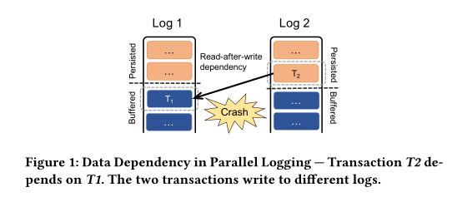
Challenges
When to Commit a Transaction
Whether to Recover a Transaction
Determine the Recovery Order

Slide 12
Taurus
LSN Vector
strict two-phase locking (S2PL)

Slide 13
LSN Vector
a transaction to track its dependency information
a data item to capture the dependencies between transactions accessing it
dimension of an LV is the same as the number of logs
Each element of LV indicates that a transactionTmay depend on transactions before a certain position in the corresponding log.

Slide 14
Property
Transaction T does not depend on any transaction T′ that maps to the T’-th log with LSN>LV[i].

Slide 15
A transaction T can commit if it is persistent and each log has flushed to the point specified byT.LV, indicating that all transactions thatTdepends on are persistent.
(2) During recovery, the DBMS determines that a transactionThas committed before the crash if each log has flushed to the point ofT.LV.
(3) The recovery order follows the partial order specified by LVs

Slide 16
Data Structures
T.LV
Tuple.readLV/writeLV
L.logLSN
L.allocatedLSN
L.filledLSN
Global.PLV

Slide 17
Logging Operations
Worker threads
log manager

Slide 18
Worker threads
Worker threads track dependencies by enforcing partial orders on the LSN Vectors.

