Slide 1
Reading Group
StripeMerge: Efficient Wide-Stripe Generation for
Large-Scale Erasure-Coded Storage
2021/10/18
Presenter: Tianyang Niu

Slide 2
Outline
1
Background
2
Motivation
3
Design
4
Evaluation
3
5
Conclusion

Slide 3
Outline
1
Background
2
Motivation
3
Design
4
Evaluation
3
5
Conclusion

Slide 4
Background
wide stripes
stripes that have a very largek
（k+m）/k approaches one
Assume
used for cold data
backup and archival data
binary large objects (BLOBs)
access frequency drops as they age
Challenge
high repair penalty
repair bandwidth

Slide 5
Background
Wide-stripe
Be parameterized differently via a tiered approach with respect to the data age
encoded into the stripes with a smallk, narrow stripes
later re-encoded into wide stripes

Slide 6
Outline
1
Background
2
Motivation
3
Design
4
Evaluation
3
5
Conclusion

Slide 7
Motivation
Wide-stripe generation problem
substantial bandwidth overhead
Re-distributing the 2k data chunks
Migrating some of the data and parity chunks
K->2k

Slide 8
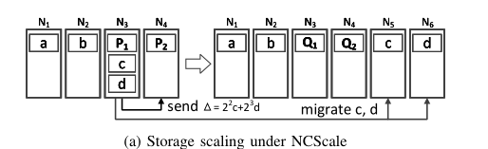
Motivation
Storage Scaling
Adding s new nodes
Convert (k,m) stripes into (k+s,m) stripes
NCScale

Slide 9
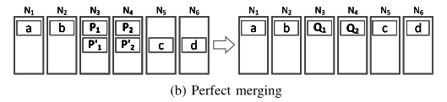

Motivation
Perfect merging
(does not assume the addition of new nodes)
select two suitable (k,m) narrow stripes
data chunks reside in different nodes
parity chunks have identical encoding coefficients and reside in the same nodes

Slide 10
Motivation
Perfect merging Challenges
apply perfect merging to generate multiple wide stripes
all narrow stripes are currently placed
search of all narrow stripes is time-consuming procedure

Slide 11
Outline
1
Background
2
Motivation
3
Design
4
Evaluation
3
5
Conclusion

Slide 12
Design
StripeMerge
each chunk placement has the same number of narrow stripes(?)
Hopcroft-Karp algorithm O(n2.5)

Slide 13
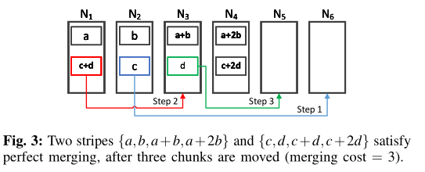
Design
StripeMerge-G
apply the perfect merging of existing narrow stripes to generate as many wide stripes as possible
remaining narrow stripes
Transfer a number of chunks
make them satisfy perfect merging

Slide 14
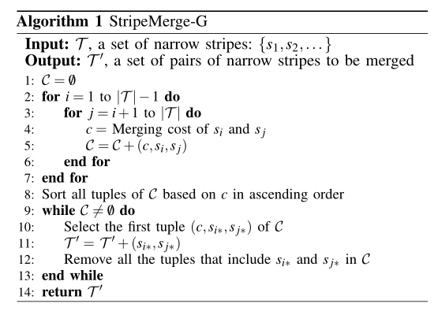
Design
StripeMerge-G
O((k+m)n²)

Slide 15
Design
StripeMerge-P
fully parity-aligned
parity chunks have identical encoding coefficients
reside in identical nodes

Slide 16
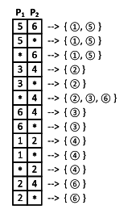
Design
StripeMerge-P
hash table
metadata of parity chunk placements
key
certain placement of anyiparity chunks
Value
a list of indices of the stripes

Slide 17
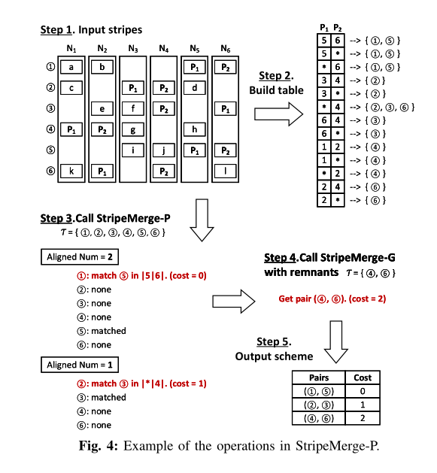
Design
StripeMerge-P

Slide 18
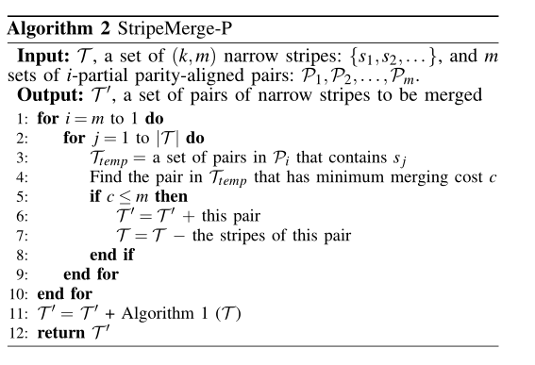
Design
StripeMerge-P
O((k+m)mn)

Slide 19
Design
StripeMerge-P
fully or partially parity-aligned
data chunks may happen to reside in the same nodes

Slide 20
Outline
1
Background
2
Motivation
3
Design & Implementation
4
Evaluation
3
5
Conclusion

Slide 21
Evaluation
Simulations
Amazon EC2 Experiments
wide-stripe generation bandwidth
running time

Slide 22
Evaluation
Simulations
2.10 GHz CPU
256 GiB RAM
1 TiB SA TA hard disk
N as a multiple of2k+m
10,000 narrow stripes
NCScale vs StripeMerge-P StripeMerge-G

Slide 23
Evaluation
Experiment A.1 (Wide-stripe generation bandwidth)

Slide 24
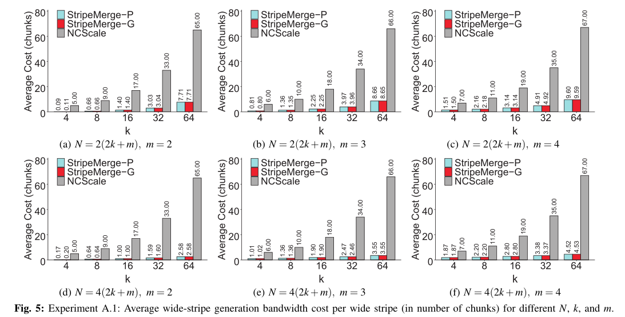
Evaluation
Experiment A.1 (Wide-stripe generation bandwidth)
4≤k≤64,2≤m≤4 N=2(2k+m) and N=4(2k+m)

Slide 25
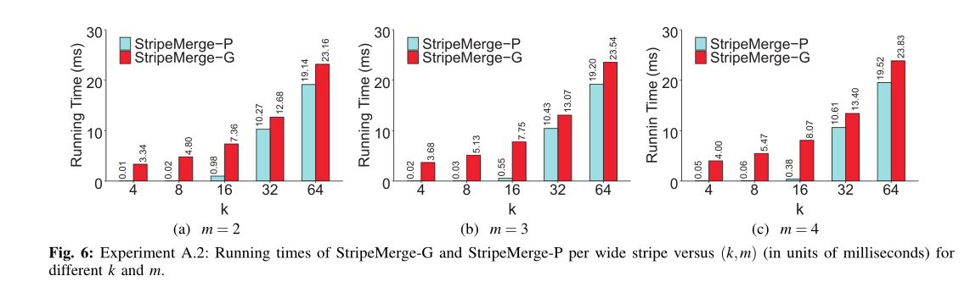
Evaluation
Experiment A.2 (Running time versus(k,m))

Slide 26
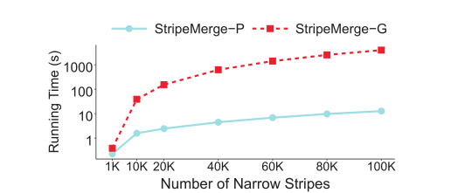
Evaluation
Experiment A.3 (Running time versus the number of nar-row stripes

Slide 27
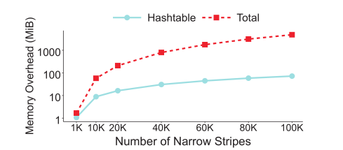
Evaluation
Experiment A.4 (Memory consumption of StripeMerge-P)

Slide 28
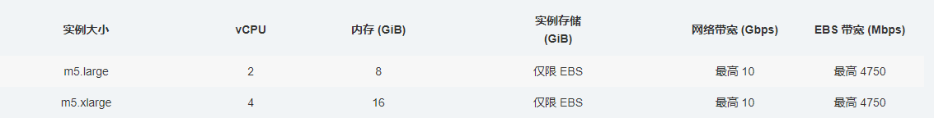
Evaluation
Amazon EC2 Experiments
ISA-L
m5.xlarge
bandwidth from 1 Gb/s to 8 Gb/s
10,000 narrow stripes

Slide 29

Evaluation
Experiment B.1 (Time breakdown)
(k,m) = (16,4),N=2(2k+m) =72
chunk size of 64MiB
gateway bandwidth of 8Gb/s
Time
running time of the algorithm
transfer time
compute time

Slide 30
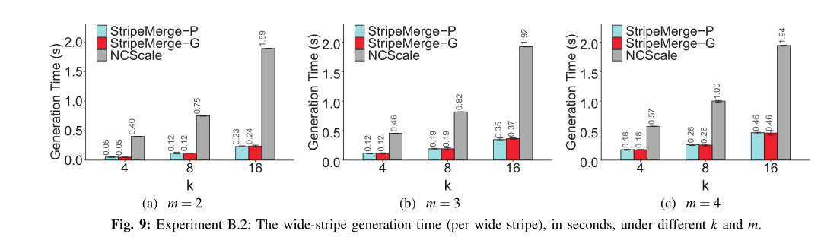
Evaluation
Experiment B.2 (Wide-stripe generation time versus)

Slide 31
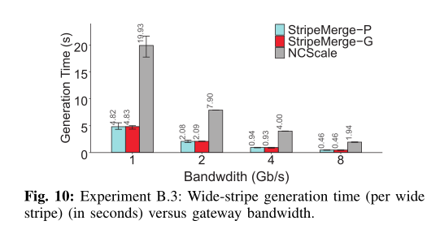
Evaluation
Experiment B.3 (Impact of gateway bandwidth)
(k,m) = (16,4),N=2(2k+m) =72
gateway bandwidth, from 1 Gb/s to 8 Gb/s

Slide 32
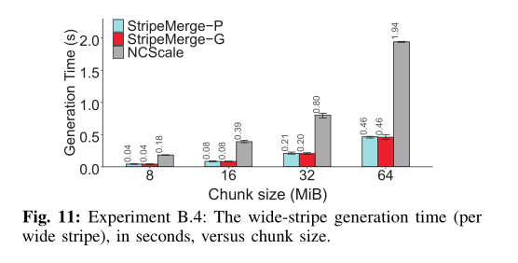
Evaluation
Experiment B.4 (Impact of chunk size)
chunk sizes, from 8 MiB to 64 MiB
(k,m) = (16,4),N=2(2k+m) =72
gateway bandwidth of 8 Gb/s

Slide 33
Outline
1
Background
2
Motivation
3
Design
4
Evaluation
3
5
Conclusion

Slide 34
Conclution
StripeMerge
existence of an optimal scheme for wide-stripe generation
StripeMerge-P and StripeMerge-G

Slide 35
Conclution
如果分很多层，来处理，k值逐渐增大。初始k值怎么决定，合并的标准。

Slide 36
THANK YOU

