Slide 1
Operating system and system programming (25CS2104E)
Linux File Descriptor and File I/O Management System
Review-I
Under the Esteemed Guidance of
Raghupathi M
CSE Department
Team Members:
Yegna Sai Reddy – 2520080055
Suresh Babu – 2520090036
P. Sonu - 2520090204

Slide 2
Contents
Abstract
Introduction
Hardware and Software requirements
System Architecture
Conclusion

Slide 3
Abstract
The Linux File Descriptor and File I/O Management System is a Linux-based system programming project designed to demonstrate how files are created, opened, read, written, and closed using Linux system calls. The project provides a simple interface for performing basic file operations and understanding how file descriptors are used by the operating system to manage open files. It uses system calls such as open(), read(), write(), lseek(), and close() to perform file input and output operations. The system will allow users to create or open a file, display its contents, add new data, overwrite existing data, and close the file safely. It will also display important information such as the file descriptor returned by the operating system. The project demonstrates important Operating Systems and System Programming concepts, including file descriptors, file handling, system calls, kernel-level file management, and standard input/output. The expected outcome is a simple and user-friendly Linux application that clearly demonstrates how Linux manages files and file descriptors.

Slide 4
Introduction
Linux provides system calls that allow applications to communicate with the operating system for file and I/O operations.
A file descriptor is a non-negative integer assigned by Linux when a process opens a file or another I/O resource.
Common file descriptors:
• 0 – Standard Input (stdin)
• 1 – Standard Output (stdout)
• 2 – Standard Error (stderr)
Major operations: creating/opening files, reading, writing, changing file offset with lseek(), closing files, and handling errors.

Slide 5
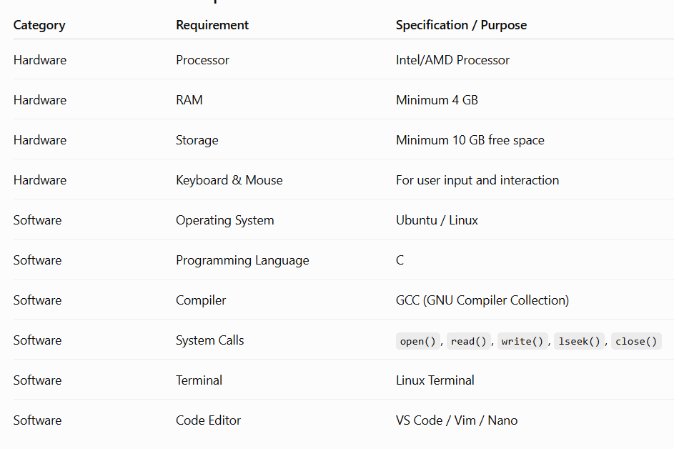
Hardware and Software requirements
List the Requirements in table format

Slide 6
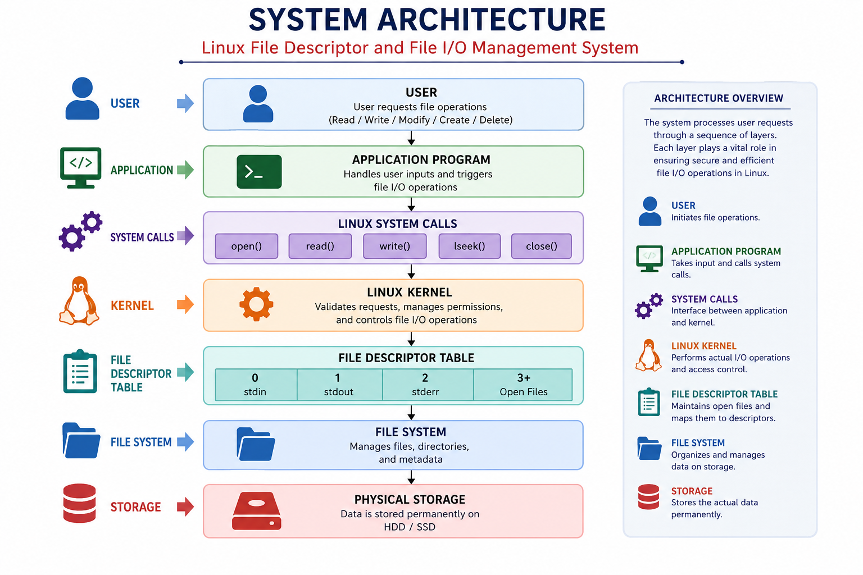
System Architecture

Slide 7
Thank you

