Slide 1
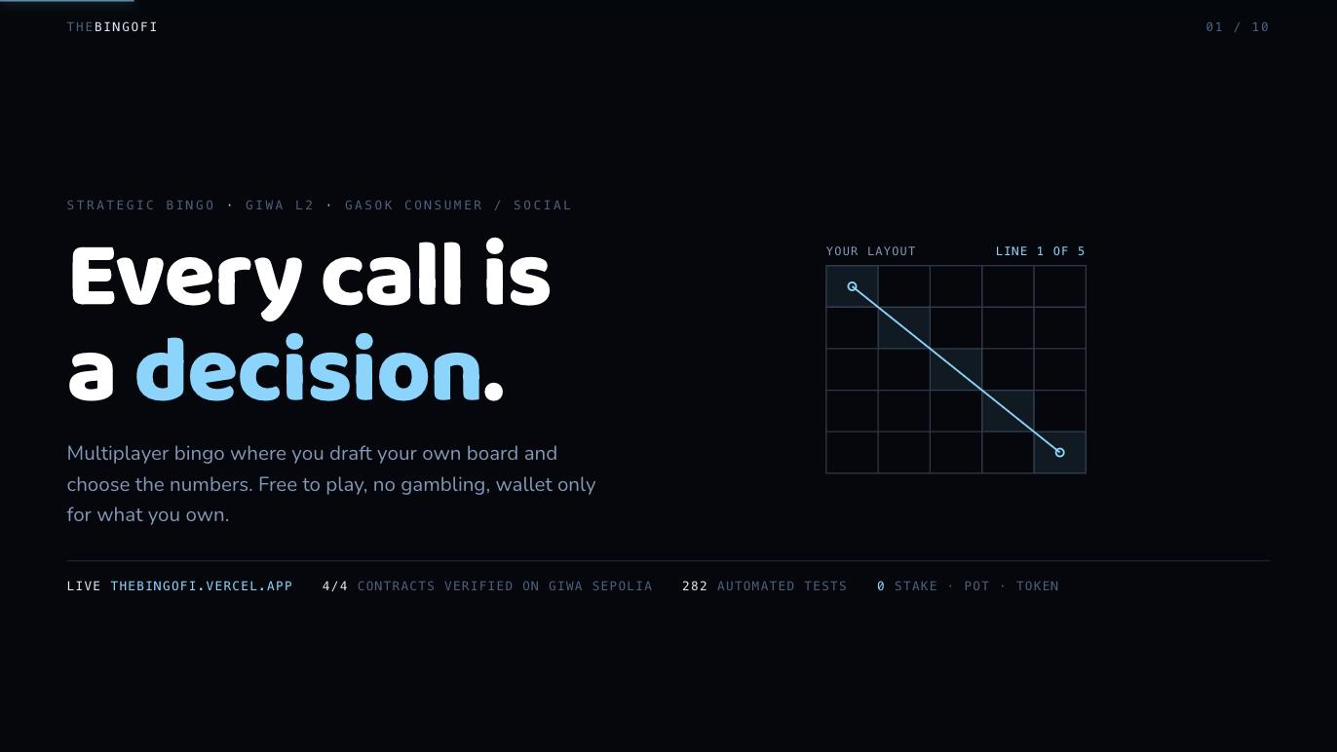
Notes:
Strategic bingo on GIWA L2. You draft your own board and choose the numbers. Free to play, non gambling, live today.

Slide 2
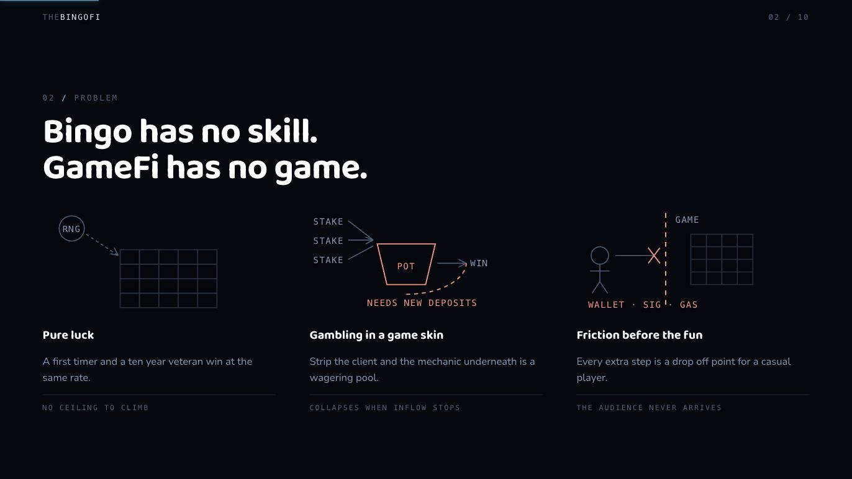
Notes:
Three compounding problems: bingo is pure luck, GameFi is a wagering pool with a game client, and web3 UX gates casual players behind a wallet.

Slide 3
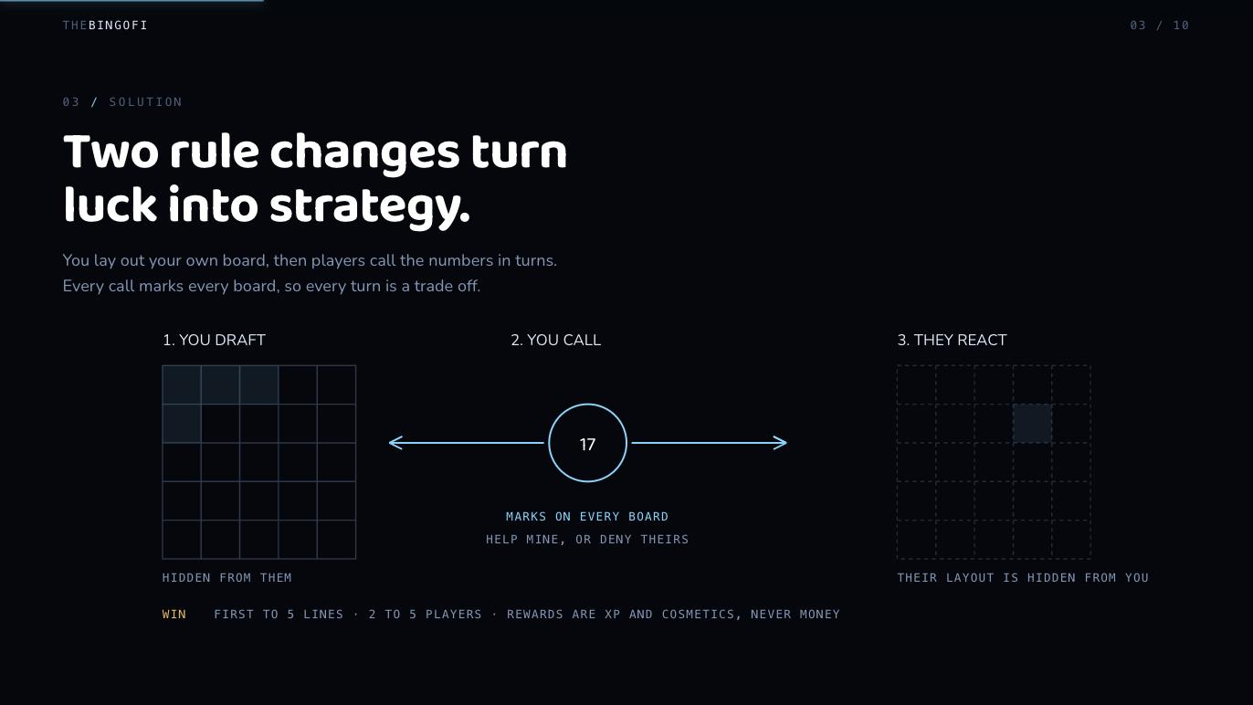
Notes:
Two rule changes: you draft your own board, and players call numbers in turns. Every call marks every board, so each turn trades your progress against theirs.

Slide 4
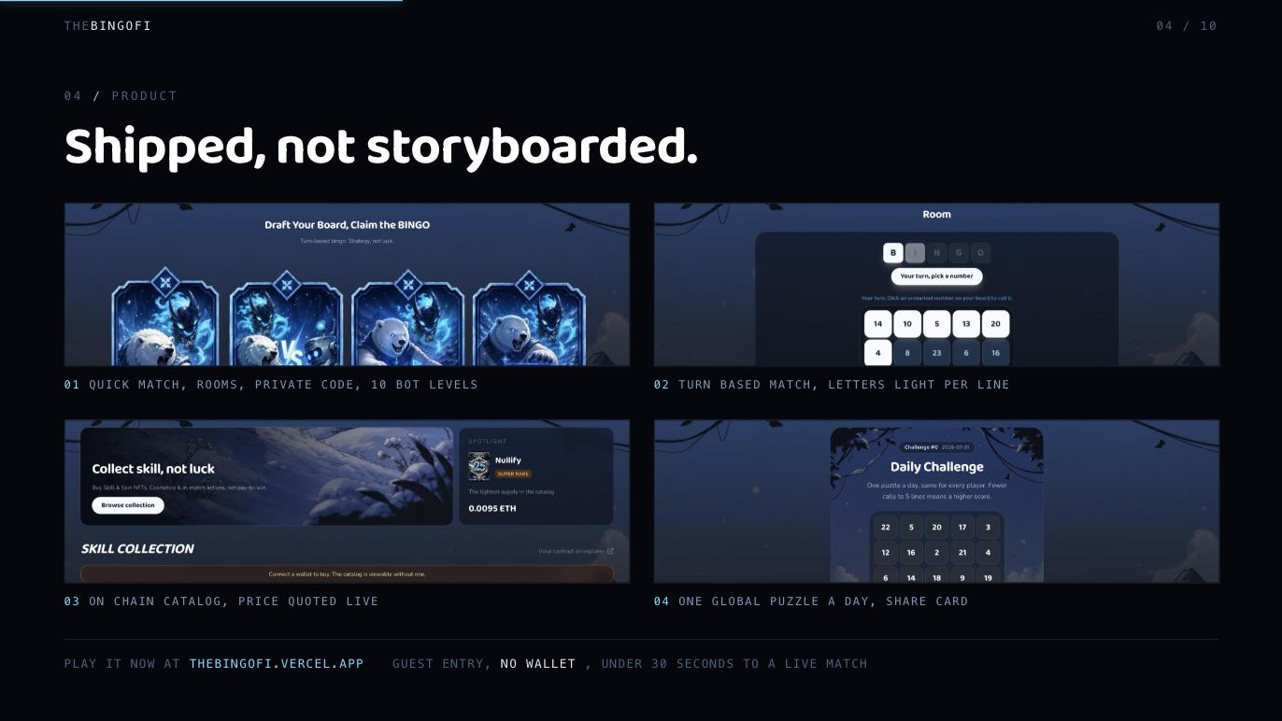
Notes:
Everything on these screens is live at thebingofi.vercel.app. Guest can finish a match in under 30 seconds without a wallet.

Slide 5
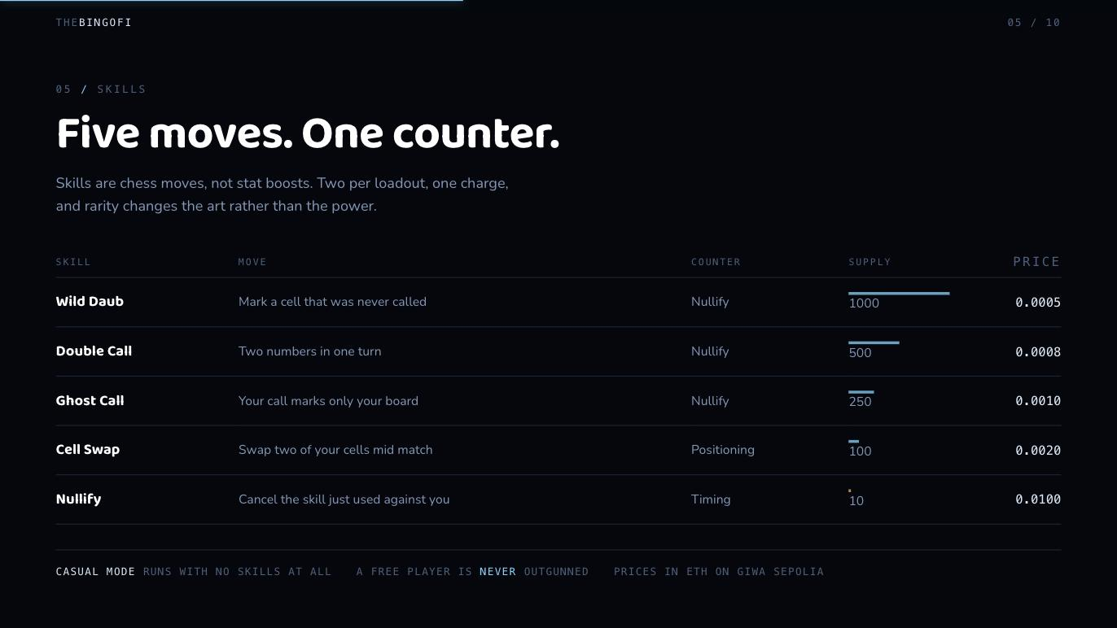
Notes:
Skills are chess moves, not stat boosts: two per loadout, one charge, all counterable by Nullify. Rarity sells art, not power. Casual mode has no skills at all.

Slide 6
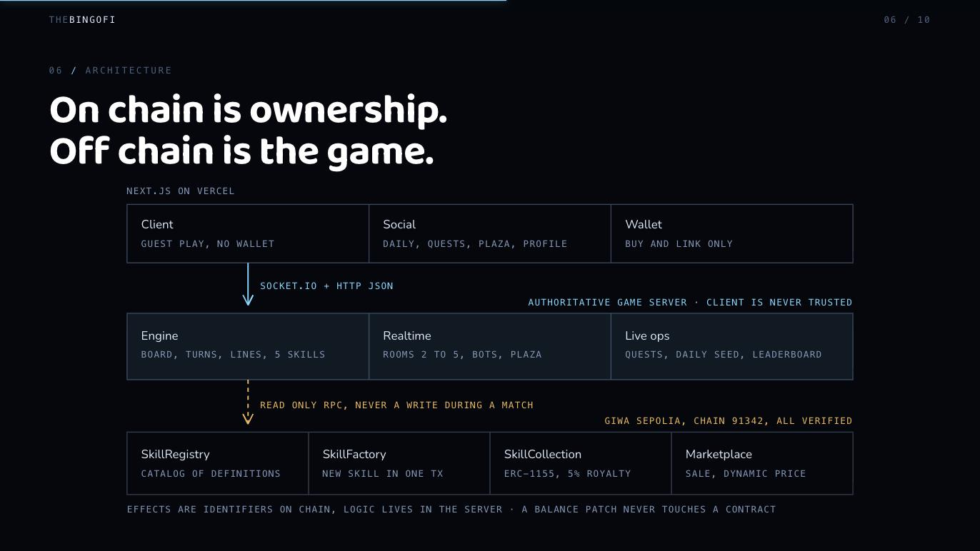
Notes:
On chain is only ownership and catalog. Every rule runs on the authoritative server, zero transactions during a match, and the server only reads the chain.

Slide 7
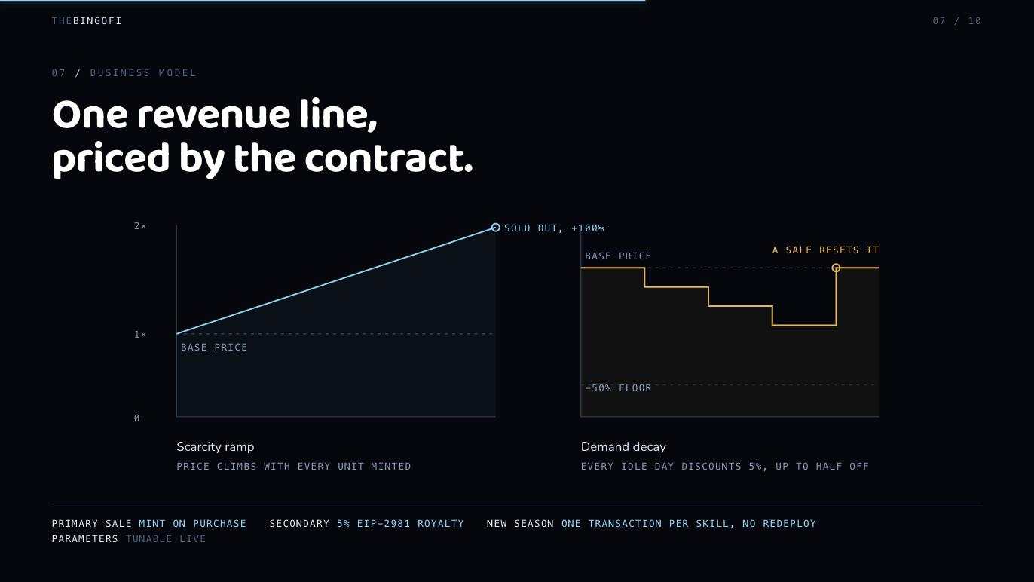
Notes:
One revenue line: primary sale plus 5 percent royalty. Price is computed on chain per call, rising with scarcity and decaying while idle. New season is one transaction per skill.

Slide 8
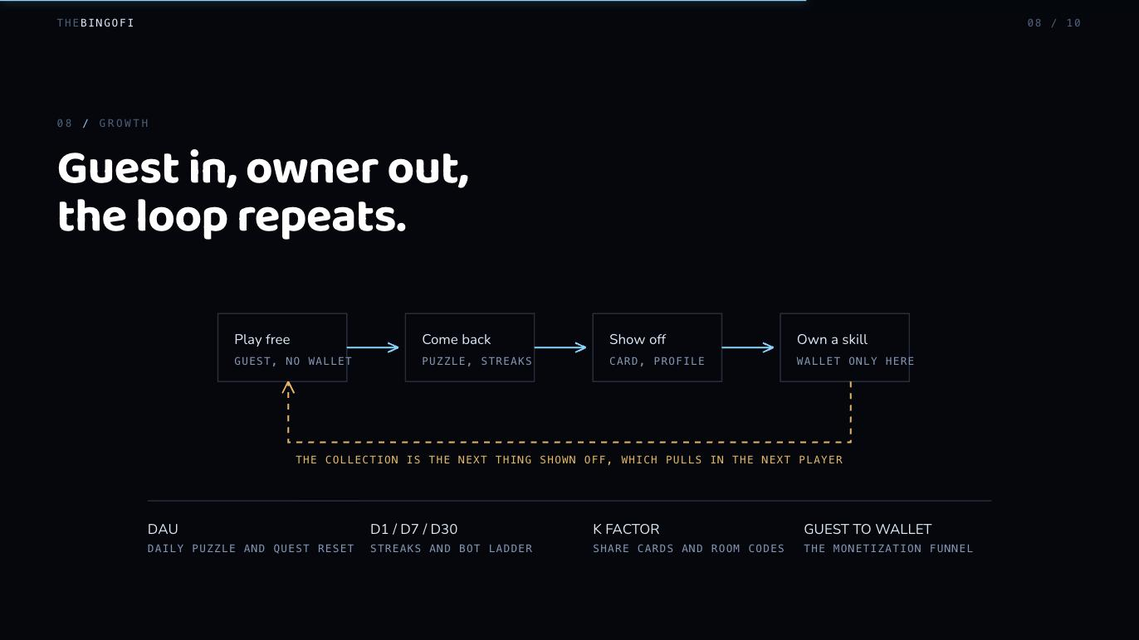
Notes:
Free play brings players in, daily puzzle and quests bring them back, share cards and profiles bring their friends, ownership is the exit. KPIs: DAU, retention, K factor, guest to wallet.

Slide 9
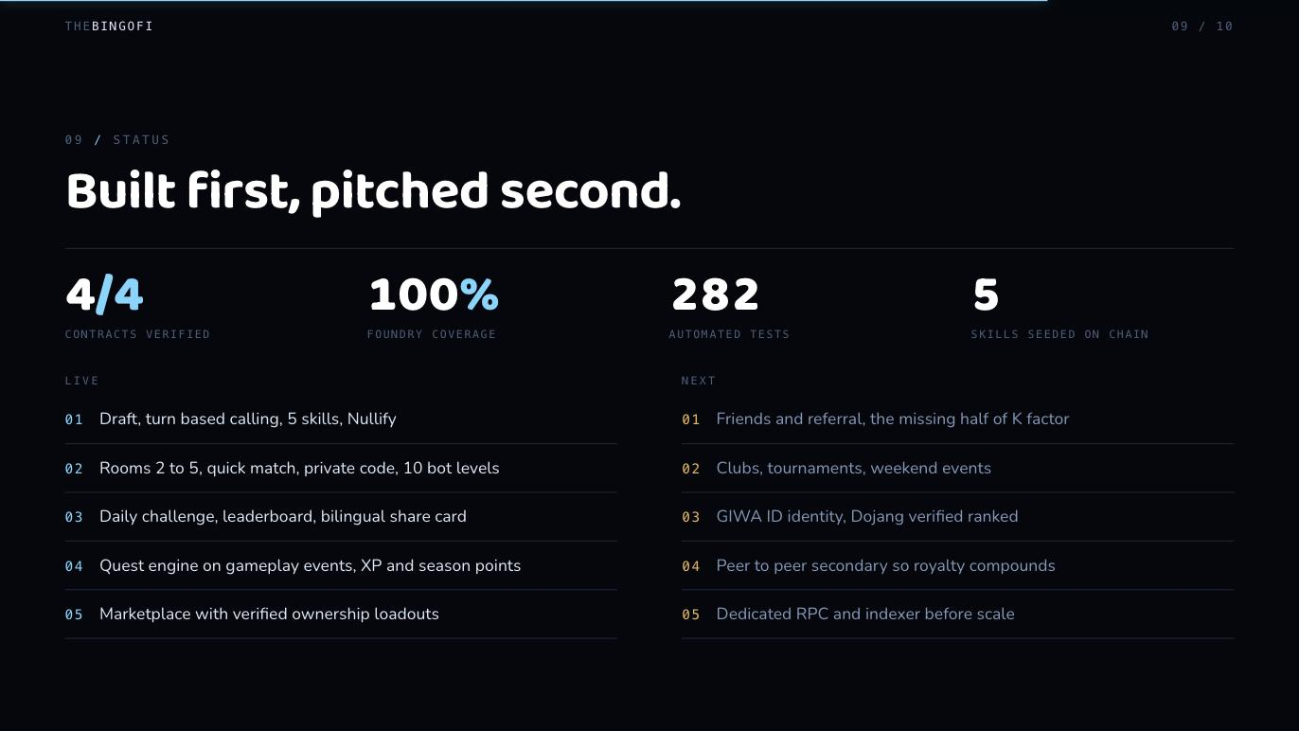
Notes:
Contracts verified on GIWA Sepolia with full Foundry coverage, 282 automated tests, five skills seeded. Next: referral, clubs, GIWA ID and Dojang, peer to peer secondary.

Slide 10
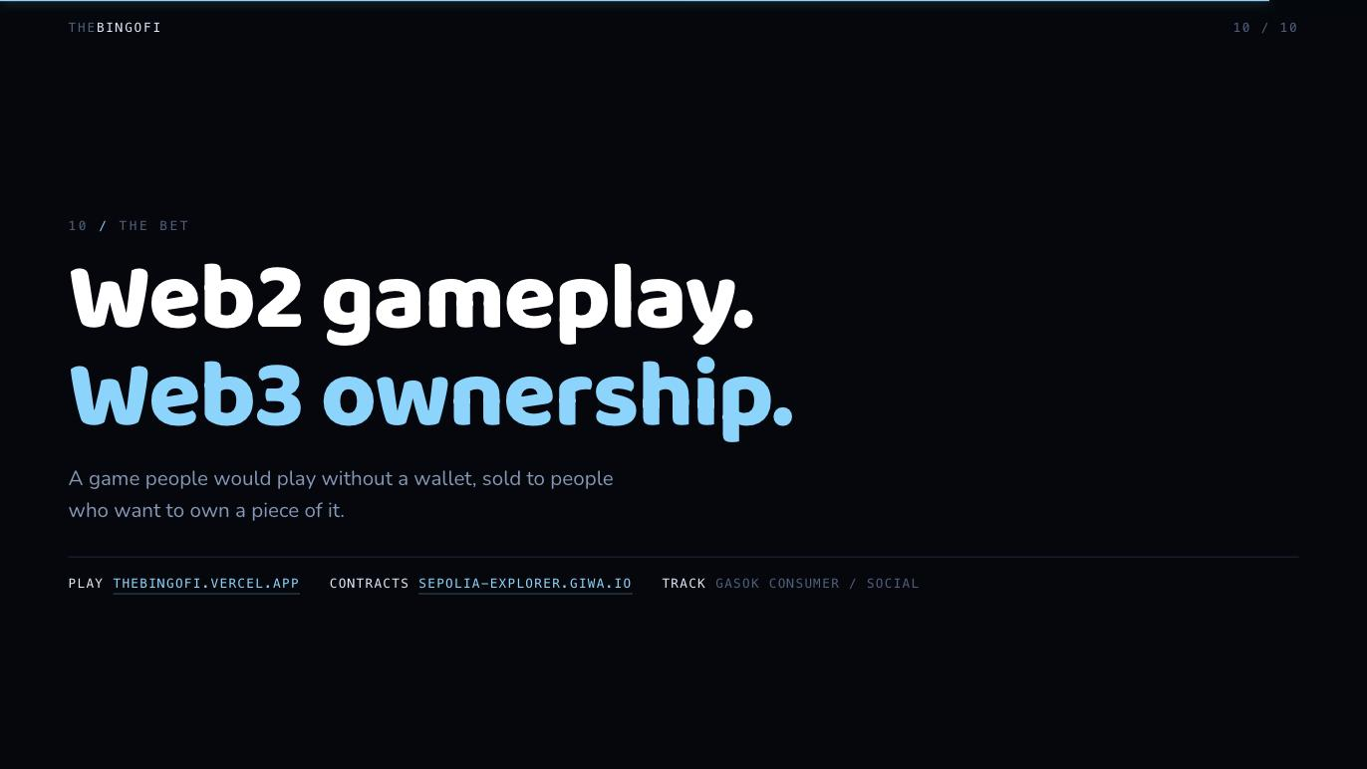
Notes:
Web2 gameplay, web3 ownership. Play it, then look at the contracts.

