Slide 1
The Risk of a person getting a Heart Attack
Yehia ahmed el-masry

Slide 2

Introduction
Heart attacks, or myocardial infarctions, remain one of the leading causes of mortality worldwide, profoundly impacting both individuals and healthcare systems. Characterized by the obstruction of blood flow to the heart muscle, heart attacks can result in severe cardiac damage, disability, or death. Despite advancements in medical technology and preventive measures, the prevalence of heart attacks persists, underscoring the critical need for ongoing research and improved intervention strategies.

Slide 3
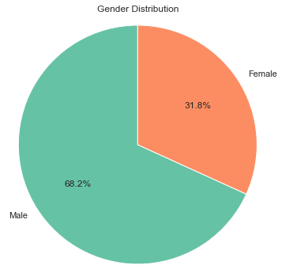
the gender Feature
One of the critical aspects of understanding heart attacks is recognizing the demographic disparities in their occurrence. Notably, men are disproportionately affected by heart attacks, accounting for 68% of cases, while women represent 32% of the affected population. This gender disparity underscores the necessity of tailored approaches in both prevention and treatment. Analyzing these differences and the underlying risk factors is essential for developing more effective, gender-sensitive healthcare strategies.

Slide 4
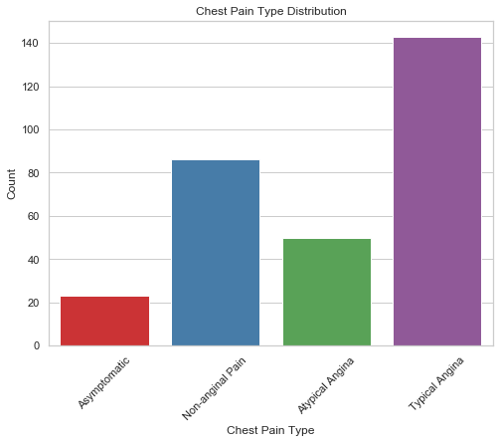
Chest Pain
X-axis: Chest pain type.
Y-axis: The number of patients
Typical Angina: Chest pain with a predictable pattern, often triggered by exertion. (> 140 & < 145)
Atypical Angina: Chest pain with an unpredictable pattern or atypical characteristics.( > 40 & < 48 )
Non-anginal Pain: Chest pain unrelated to heart disease, often caused by other conditions.( > 80 & < 88 )
Asymptomatic: Presence of underlying heart disease without noticeable symptoms.( > 20 & < 25)

Slide 5
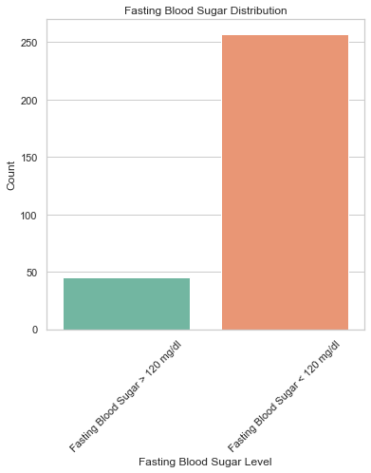
Fasting Blood Sugar
X-axis: Fasting blood sugar level
Y-axis: Number of Patients
Fasting Blood Sugar < 120 mg/dl ( > 50 )
Fasting Blood Sugar > 120 mg/dl ( < 250 )

Slide 6
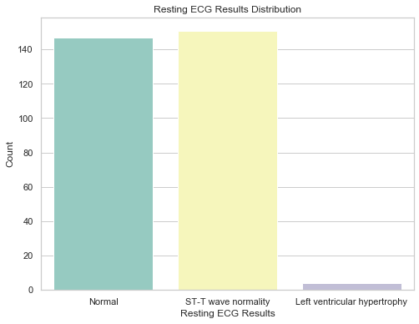
Resting ECG Results
ECG: a test to record the electrical signals in the heart.
X-axis: Resting ECG Results.
Y-axis: Number of Patients
Normal :140+
ST-T: 140+
Left vertical hypertrophy: >5

Slide 7
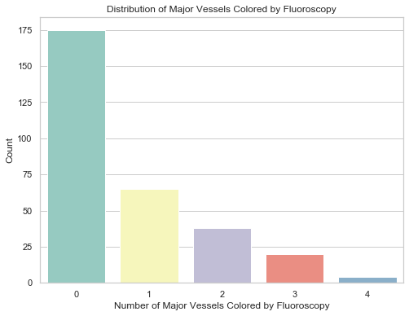
NO of Major Vessels
X-axis: Number of Major Vessels Colored by Fluoroscopy.
Y-axis: Number of Patients
0 major vessels : 175
1 Major vessels : >60
2 Major vessels :>35
3 Major vessels :>20
4 Major vessels : >5

Slide 8
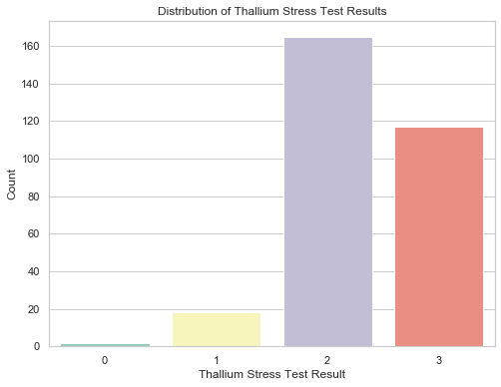
Thallium Stress
X-axis : Major cells
Y-axis : Number of patients
1=no blood flow in the heart(<20)
2: normal blood flow(>160 & < 170)
3: reversible defect (a blood flow is observed but it is not normal) ( < 120 & > 110 )

Slide 9
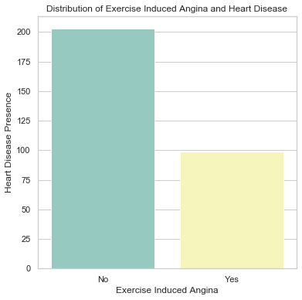
Distribution of Exercise Induced Angina and Heart Disease
Time series graphs
X-axis: Exercise Induced Angina
Y-axis: Heart Disease Presence
- Patients don’t have Angina because of exercise approximately 200
- Patients get Angina because of exercise approximately 100

Slide 10
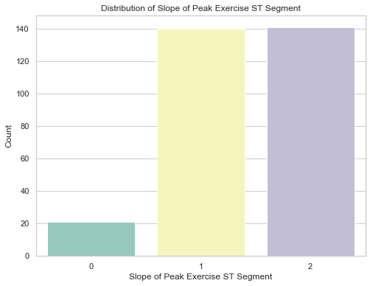
Slope of Peak Exercise ST Segment
X-axis: Slope of peak exercise ST segment (values in mV/s)
Y-axis: Number of patients
0: Downsloping approximately 20
1: flat approximately 120
2: upsloping approximately 120

Slide 11
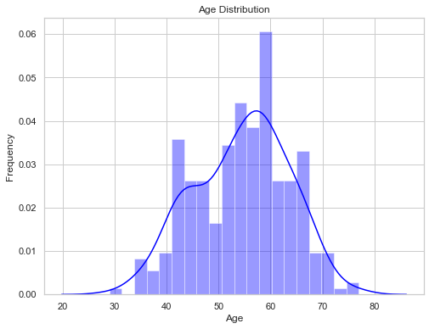
Age Distribution
X-axis: Age groups, like 0-20, 21-40, and so on.
Y-axis: Number of people in each age group.

Slide 12
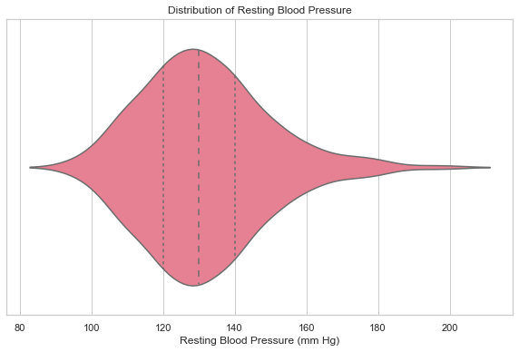
Distribution of Resting Blood Pressure
X-axis: Resting blood pressure in mmHg.
In this Graph:
The most high pressure is between 120 & 140

Slide 13
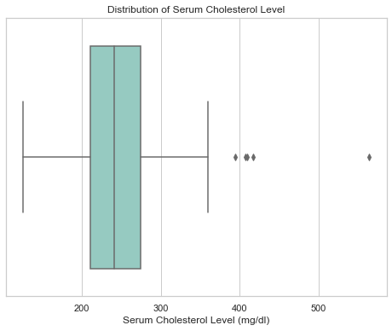
Distribution of Serum Cholesterol Level
The x-axis represents cholesterol levels in mg/dL.
The highest level is between 200 & 300

Slide 14
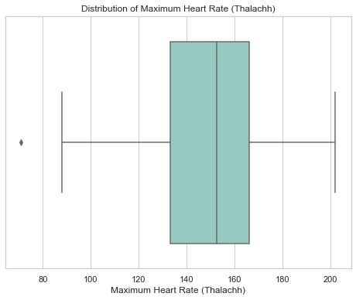
Distribution of Maximum Heart Rate (Thalachh)
Histograms help visualize heart rate distribution. The x-axis shows heart rate ranges.
The highest level is between 130 & 170

Slide 15
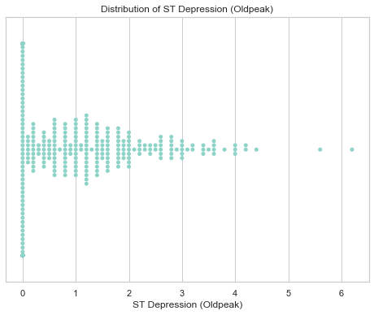
Distribution of ST Depression (Oldpeak)
The graph shows the distribution of ST depression (Oldpeak) over six
weeks.
It seems week zero had the most cases.

Slide 16
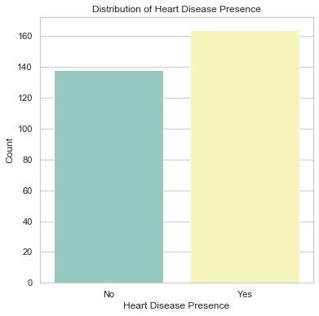
Distribution of Heart Disease Presence
X-axis: heart disease presence
Y-axis: Number of Patients
Number of patients that have heart disease is approximately 162
Number of patients that do not have heart disease is approximately 138

Slide 17
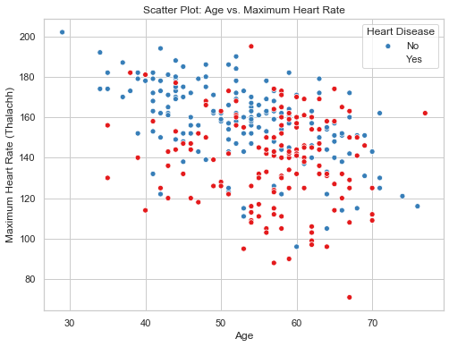
Scatter Plot: Age vs. Maximum Heart Rate
The scatter plot shows a negative correlation between age and maximum heart rate. In simpler terms, as people get older, their maximum heart rate tends to decrease. This is likely due to the heart's reduced efficiency with age. While there's a general trend, the data also shows variations, meaning individuals might deviate from this pattern.

Slide 18
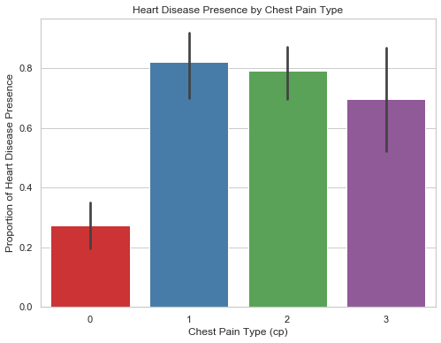
Heart Disease Presence by Chest Pain Type
X-axis : Resting Electrocardiographic Results
Y-axis: Proportion of Heart Disease Presence
Typical Angina:0.24
Atypical Angina:0.81
Non-anginal Pain:0.78
Asymptomatic:0.7

Slide 19
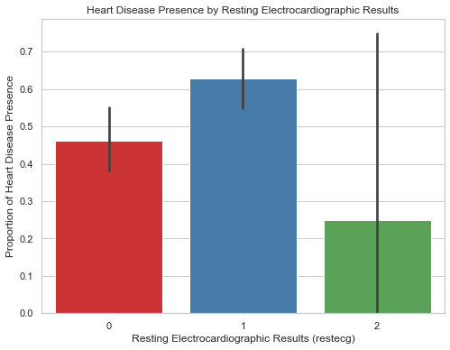
Heart Disease Presence by Chest Pain Type
0 = normal-0.45
1 = ST-T wave abnormality 0.63
2 = left ventricular hypertrophy by 0.25

Slide 20
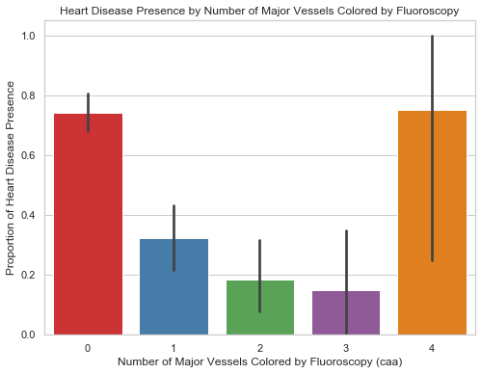
Heart Disease Presence by Number of Major Vessels Colored by Fluoroscopy
X-axis : Number of Major Vessels Colored by Fluoroscopy (caa)
Y-axis: Proportion of Heart Disease Presence
0 vessels are colored :0.77
1 vessels are colored :0.3
2 vessels are colored :0.18
3 vessels are colored :0.16
4 vessels are colored :0.76

Slide 21
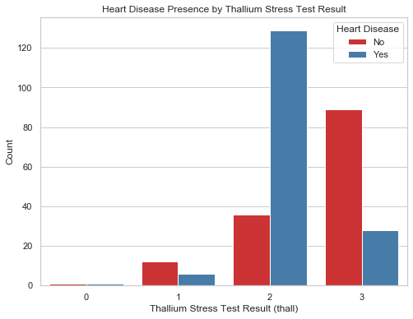
Heart Disease Presence by Thallium Stress Test Result
X-axis :Thallium Stress Test Result (thall)
Y-axis: number of patients
1=no blood flow in the heart
2: normal blood flow
3: reversible defect (a blood flow is observed but it is not normal)

Slide 22
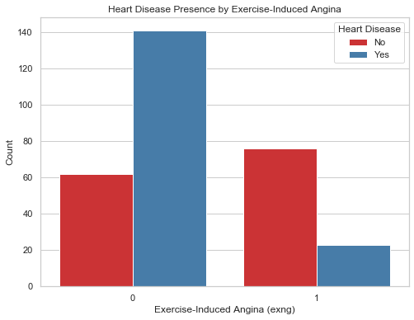
Heart Disease Presence by Exercise-Induced Angina
X-axis : Exercise-Induced Angina
Y-axis: number of patients
1=yes
0=no

Slide 23
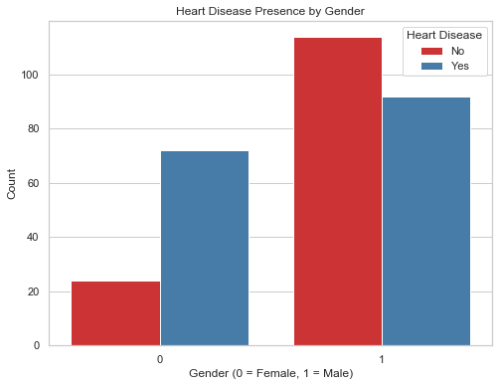
Heart Disease Presence by Gender
X-axis :Gender (0 = Female, 1 = Male) Results
Y-axis: number of patients

Slide 24
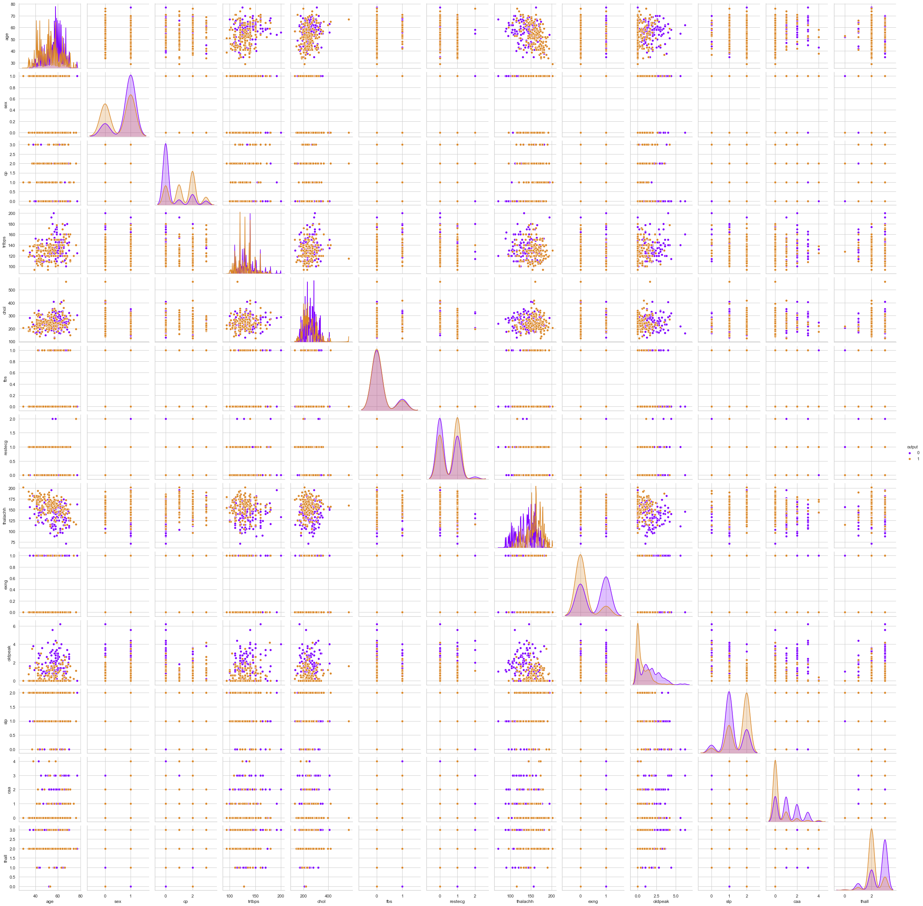
Pairplot

Slide 25
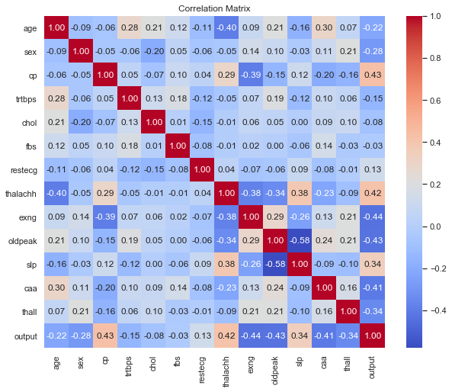
Correlation Matrix

Slide 26

Thank you
Yehia ahmed el-masry
Yehia.elmasry306@gmail.com

