Slide 1
EE557 Computer Systems Architecture
Spring 2026
Discussion Week 3
Jonghyun Lee

Slide 2
Simulation Assignment 1

Slide 3
Branch Predictors
A branch predictor tries to guess the next instruction for a branch before the branch is resolved. The purpose of the branch predictor is to improve the flow in the pipeline.
In the project, you are going to implement various branch predictors. One static branch predictor and three dynamic branch predictors are shown below
  a) Always Taken
  b) 2-bit Global (00, 01 = untaken, 10,11 = taken; one SBP for all, Figure 1)
  c) 2-bit Bimodal
  d) 2-bit Correlated

Slide 4
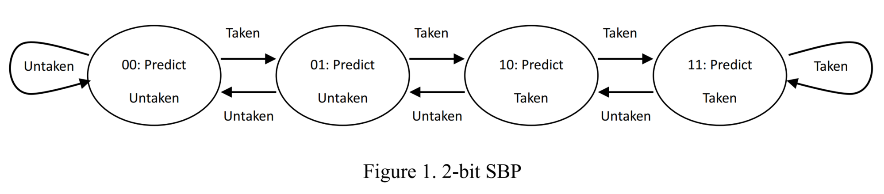
Branch Predictors
2-bit Saturating Branch Predictor (SBP)
  If taken, increment
  If not taken, decrement
  Until saturation
  00, 01: predicted untaken
  10, 11: predicted taken
(a) always taken predictor, all branches are always predicted taken statically.
(b) 2-bit global predictor, one 2-bit SBP is used to predict all branch instructions without separate branch history buffers.

Slide 5
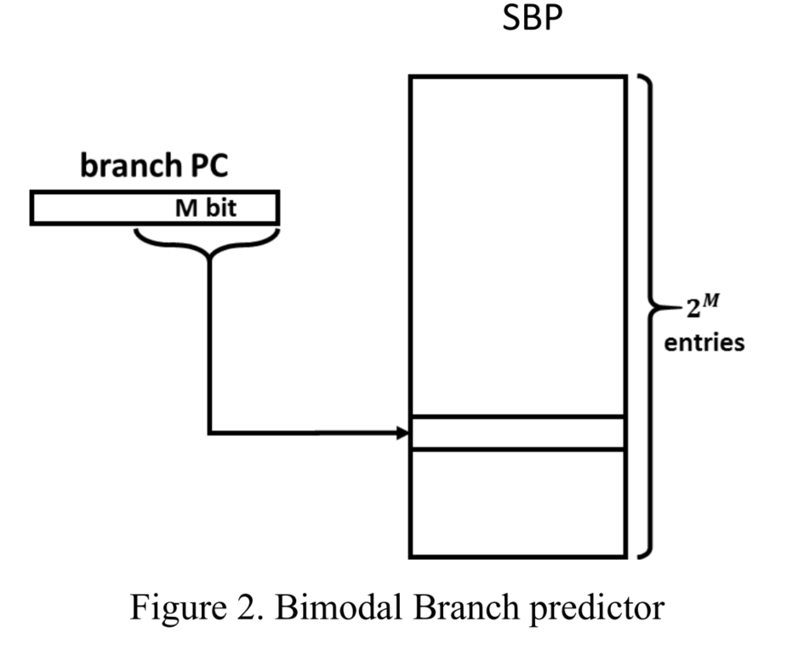
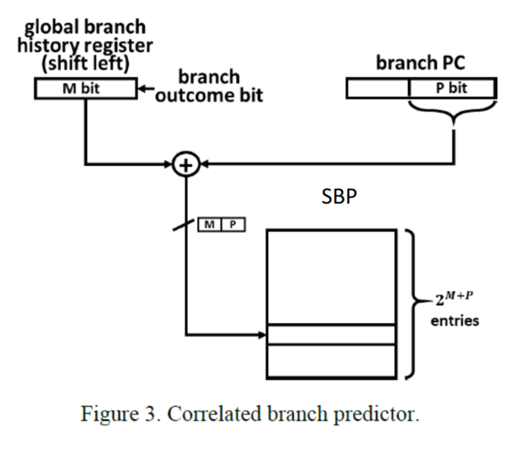
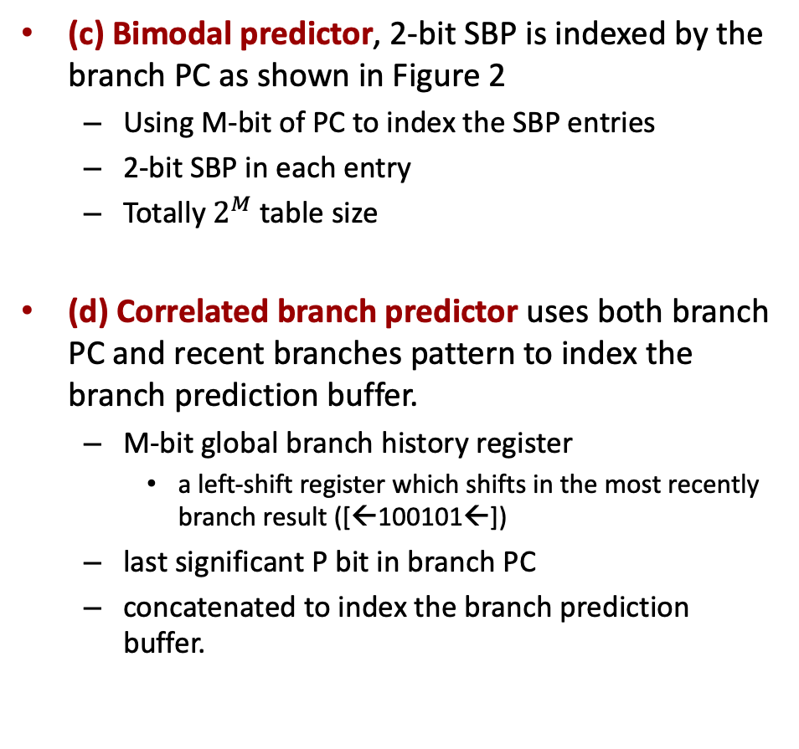
Branch Predictors
(c) Bimodal predictor, 2-bit SBP is indexed by the branch PC as shown in Figure 2
  Using M-bit of PC to index the SBP entries
  2-bit SBP in each entry
  Totally $2^{M}$ table size
(d) Correlated branch predictor uses both branch PC and recent branches pattern to index the branch prediction buffer.
  M-bit global branch history register
    a left-shift register which shifts in the most recently branch result ([←100101←])
  last significant P bit in branch PC
  concatenated to index the branch prediction buffer.

Slide 6
Implementation
P1 folder:
  bimodal.H bpred.cpp makefile makefile.rules
  Sample code for a bimodal predictor is provided
  make bpred.test
benchmarking the branch predictors using the “tar” program:
  pin -t bpred.so -- tar -czPf /home/ee557/Desktop/P0/pin.tar.gz /home/ee557/Desktop/P0/pin-3.17-98314-g0c048d619-gcc-linux

Slide 7
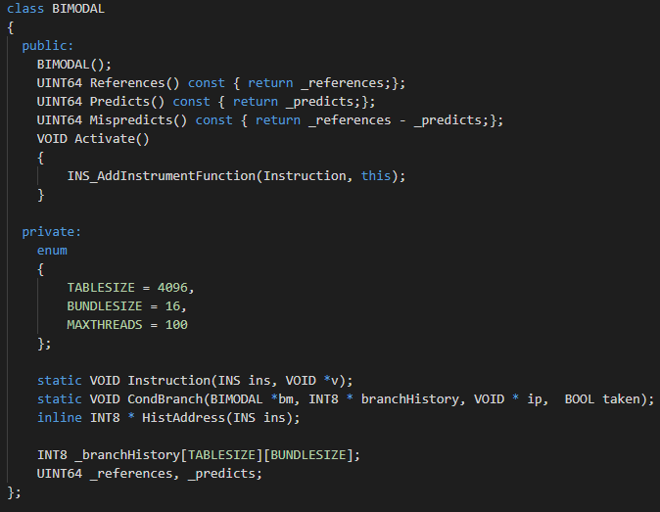
Sample Code
Bimodal.H
Not a solution to this project, just a sample for you to learn.
You need to modify this code to fit the design requirement of bimodal predictor.

Slide 8
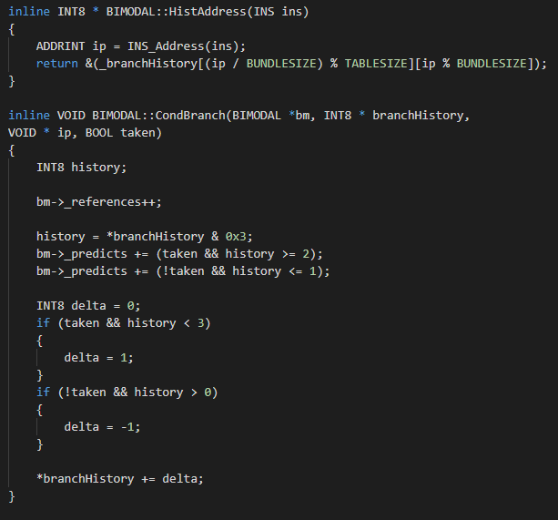
Implementation
Bimodal
If correct prediction,
Predicts+1
SBP updates

Slide 9
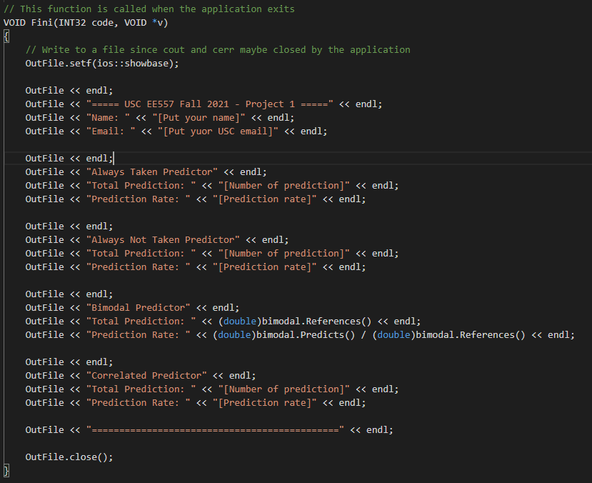
Implementation
Bpred.cpp
  You need to modify this file to generate the final report with all results

Slide 10
Submission
Report with screenshot
Codes: the colored files require your modification/implementation
  makefile.rules
  makefile
  bpred.cpp
  bimodal.H
  .H files that has your implementation of other branch predictors
Submit in one tar file to DEN

Slide 11
Thank you!

