Slide 1
新人自介
NTAP
葉紓彣

Slide 2
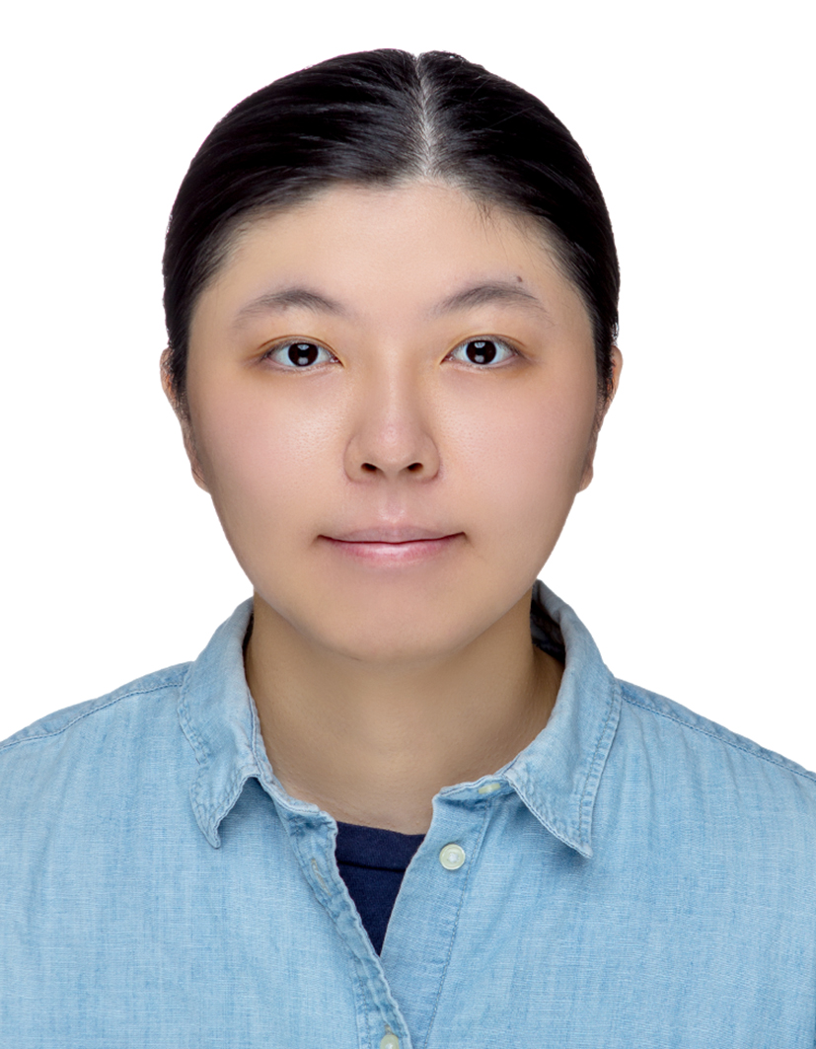



About me
Education
NCKU - Department of Statistics
NYMU- Institute of Biomedical Informatics
Experience
Cathay Life Insurance - Software Engineer (Java/Python)
Hobbies
Netflix

