Slide 1
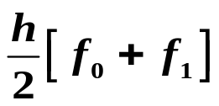
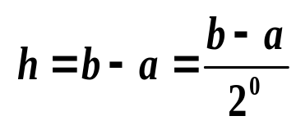

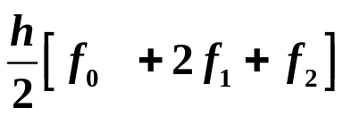
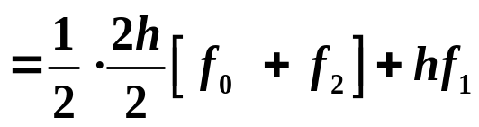
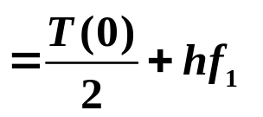
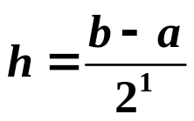

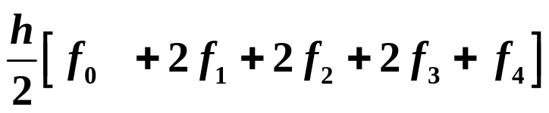

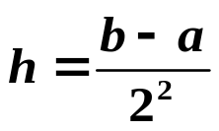
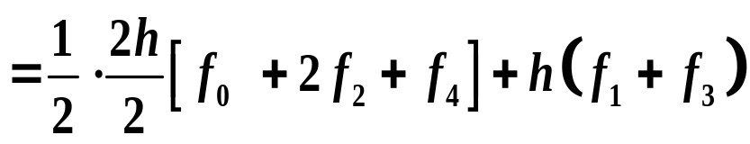
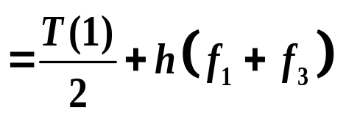

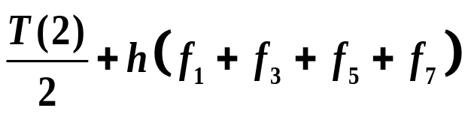

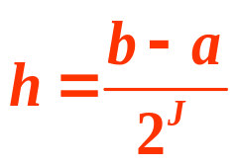
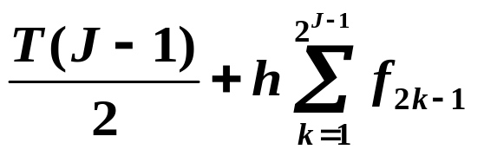

6.5 Romberg Integration
Recursive Trapezoidal Rules

Slide 2
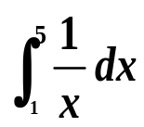

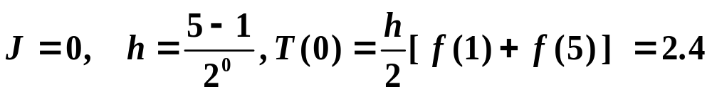
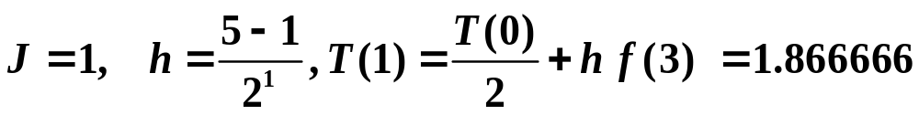
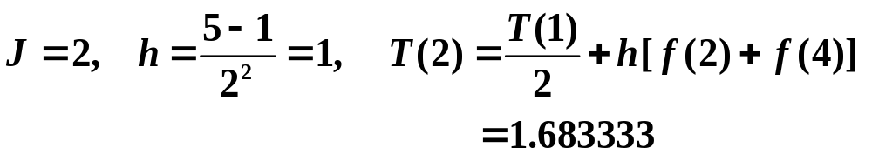
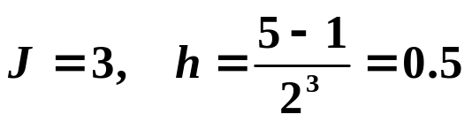
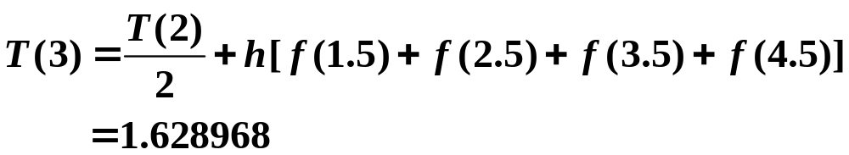
Example Approximate using
ln 5≈1.6094379124
J | T(J)
0 | 2.4
1 | 1.866666
2 | 1.683333
3 | 1.628968

Slide 3

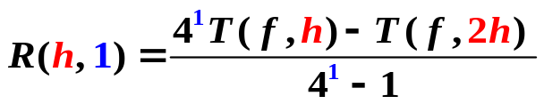

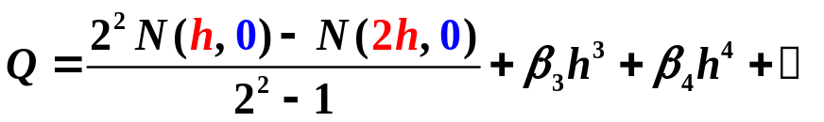
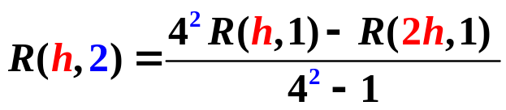


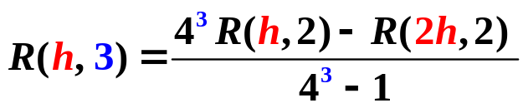

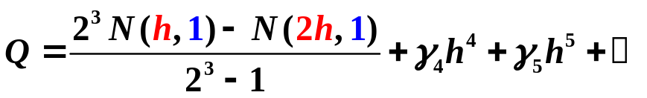
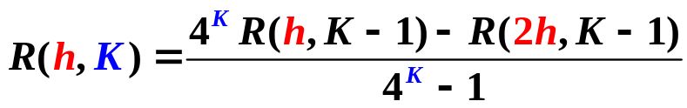


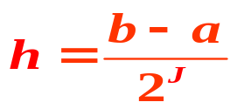
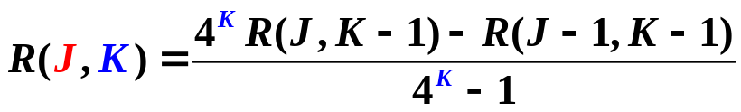
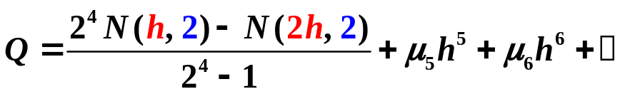

Richardson’s Extrapolation
2²×(1) – (2)
2³×(3) – (4)
2⁴×(5) – (6)
Romberg Integration

Slide 4
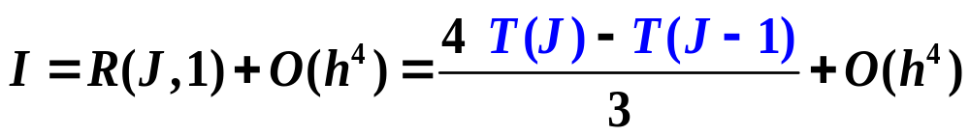


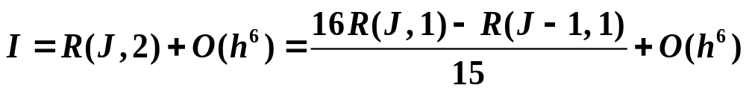

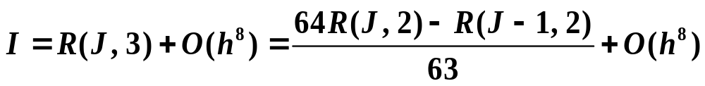
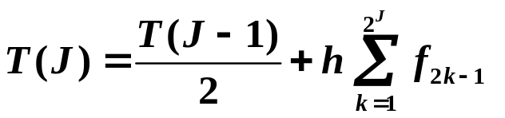
Romberg Integration
J
0 | T(0)
1 | T(1)
2 | T(2)
3 | T(3)
4 | T(4)
. . . | . . . | . . .
R(J,0)
R(J,1) | R(J,2) | R(J,3) | R(J,4)
R(1,1)
R(2,1)
R(3,1)
R(4,1)
R(2,2)
R(3,2)
R(4,2)
. . .
R(3,3)
R(4,3)
. . .
R(4,4)
. . .

Slide 5
Example Approximate using
using Romberg integration R(3, 3)
ln 5≈1.6094379124
J | T(J)
0 | 2.4
1 | 1.866666
2 | 1.683333
3 | 1.628968
=R(J,0)
R(J,1)
R(J,2)
R(J,3)
1.688888
1.622222
1.610846
1.617778
1.610088
1.609966

Slide 6
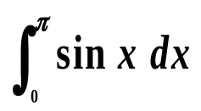
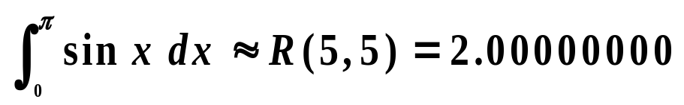
Example Approximate using R(5,5).
Solution Compute R(J, K).
J | R(J,0) | R(J,1) | R(J,2) | R(J,3) | R(J,4) | R(J,5)
0
1.57079633
1.89611890
1.97423160
1.99357034
1.99839336
0
1
2
3
4
5
2.09439511
2.00455976
2.00026917
2.00001659
2.00000103
1.99857073
1.99998313
1.99999975
2.00000000
2.00000555
2.00000001
2.00000000
1.99999999
2.00000000
2.00000000
Therefore,

Slide 7

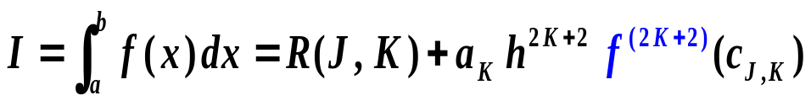


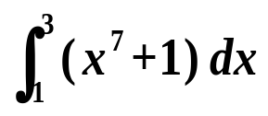
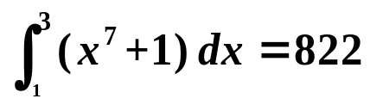
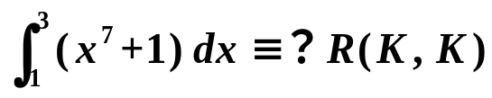
Precision of Romberg Integration
Example Approximate using R(3,3).
J | R(J, 0) | R(J, 1) | R(J, 2) | R(J, 3)
0
1
2
3
R(J, 4)
2190
1224
926.72
848.45
902
827.613
822.363
822.654
822.014
822.003
4
822.000
828.63 | 822.023 | 822.001 | 822.000

Slide 8
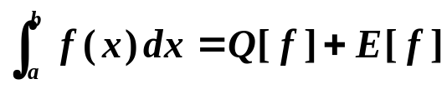
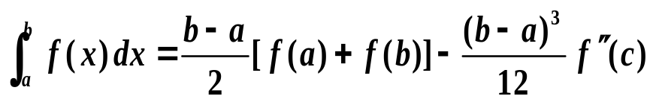
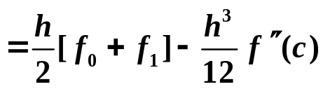

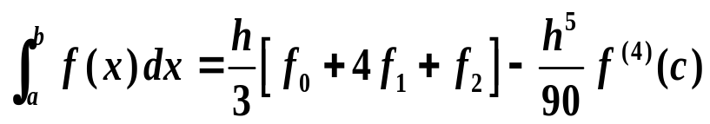
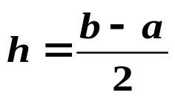
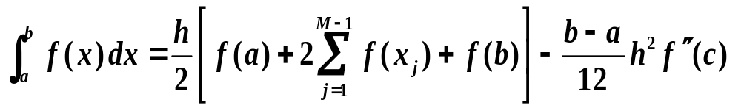
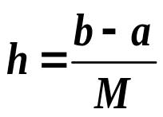

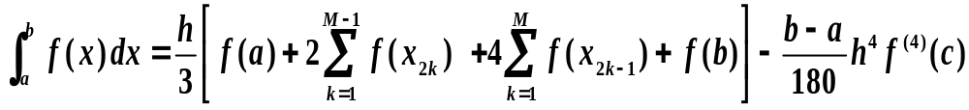
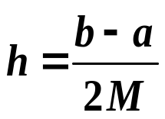

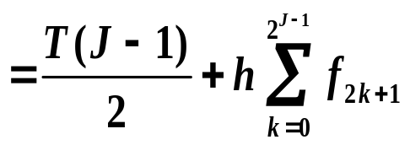
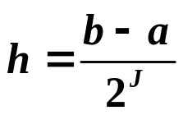

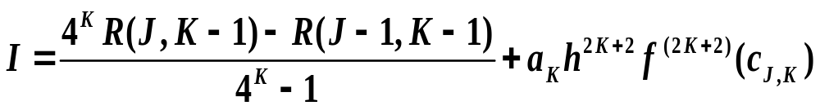
Trapezoidal Rule
Simpson’s rule
Composite Trapezoidal Rule
Composite Simpson’s Rule
Romberg Integration

