Slide 1

CHAPTER 7

Slide 2
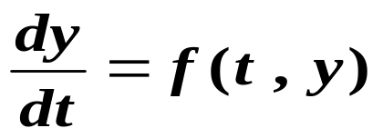





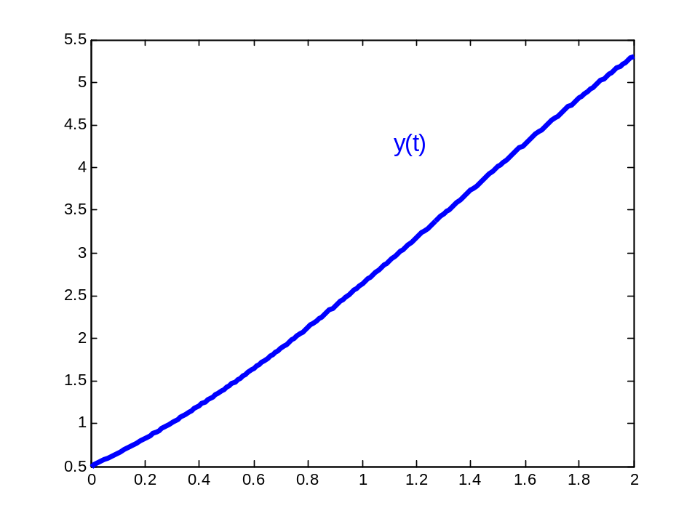
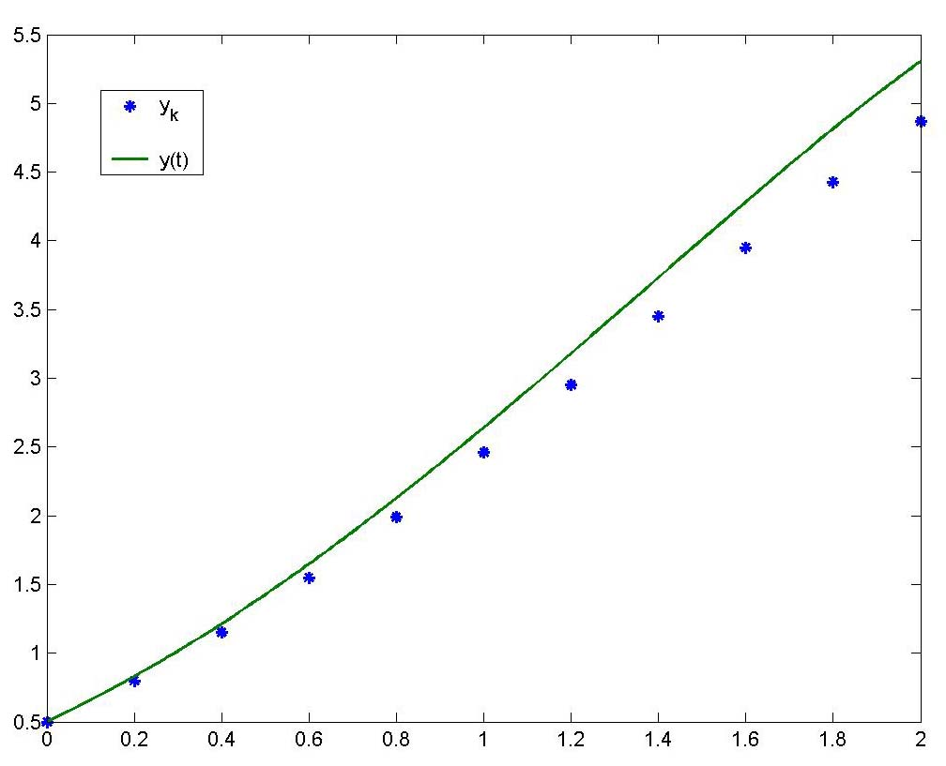
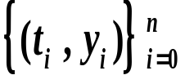
Chapter 7 focuses on how to find the numerical solutions of the given Initial-Value Problems :
The approximations to will be generated at various abscissas .
The set is called
the Numerical Solution.
Analytical Solution

Slide 3
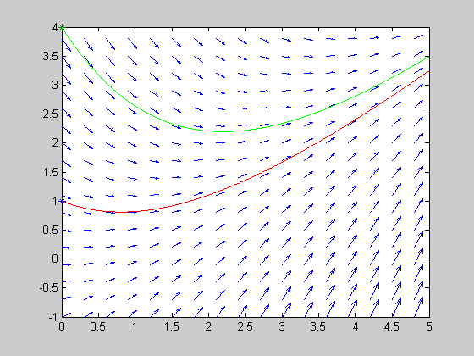
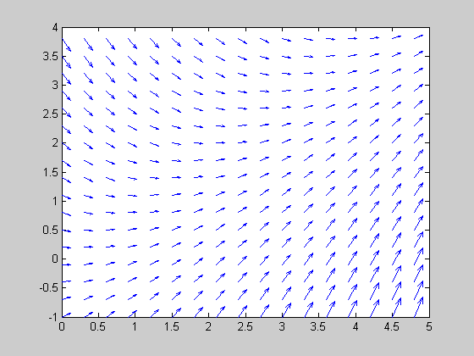
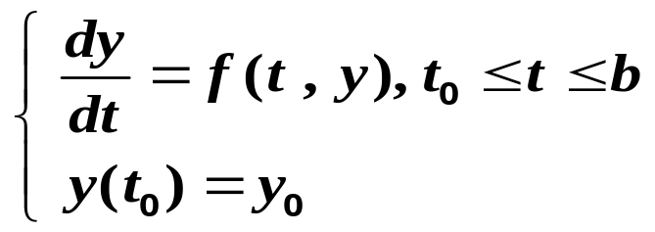
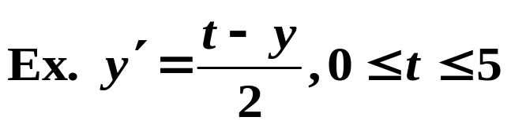


7.1 Introduction to Differential Equations
I. V. P.
hold on
x=0.:.01:5;
z1=3*exp(-x/2)-2+x;
z2=6*exp(-x/2)-2+x;
x0=0;y1=1;y2=4;
plot(x0,y1,'*',x0,y2,'*')
hold on
plot(x,z1,'r')
hold on
plot(x,z2,'g')
clear all
[t,y]=meshgrid(0:.3:5,-1:.3:4);
n=length(t);
dt=ones(n);
dy=(t-y)/2;
quiver(t,y,dt,dy);

Slide 4











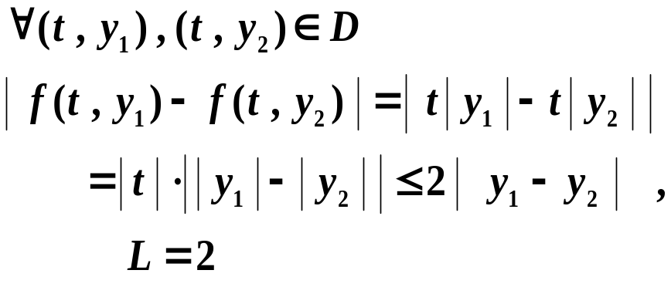





Definition A function is said to satisfy a Lipschitz condition in the variable on a set if a constant exists with whenever . The constant is called a Lipschitz constant for .
Example Show that satisfy a Lipschitz condition in the variable on

Slide 5

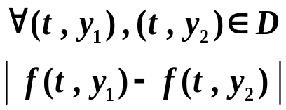


Theorem Suppose that is defined on a region
. If a constant exists with
then satisfies a Lipschitz condition on
in the variable with Lipschitz constant .
Example Consider the initial-value problem

Slide 6







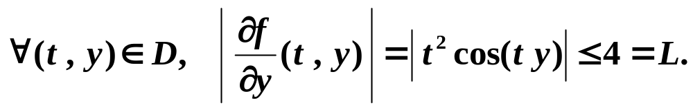
Theorem Suppose that and is continuous on D . If satisfies a Lipschitz condition in the variable , then the initial-value problem has a unique solution for .
Example Show that the initial-value problem
has a unique solution .
Solution
Let
That is, f(t, y) is continuous and satisfies a Lipschitz condition in
the variable y . This initial-value problem has a unique solution.

Slide 7










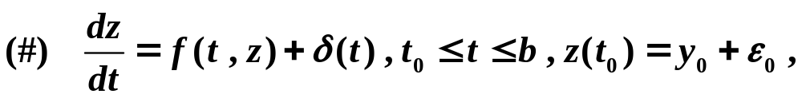


A well-posed problem The initial-value problem
is said to be a well-posed problem if :
1. A unique solution , , to the problem exists ;
2. For any , there exists a positive constant , such that
whenever and is continuous with on [a , b] ,
a unique solution , , to
exists with for all .
perturbed problem

Slide 8
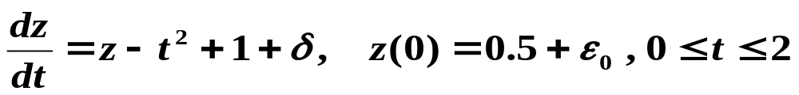
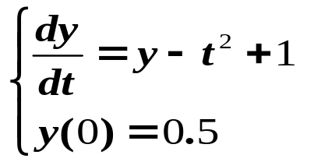









Example Consider the perturbed problem:
is well posed

Slide 9





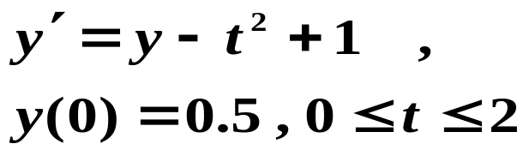
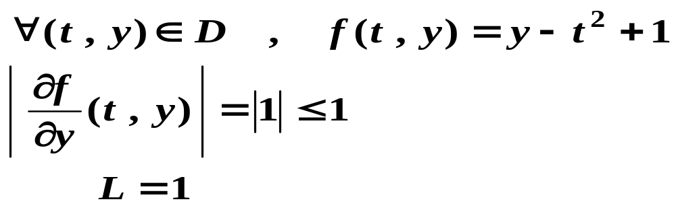

Theorem Suppose . If is continuous and satisfies a Lipschitz condition in the variable on the set , then the initial-value problem is well-posed .
Example Consider
It is well-posed on

Slide 10
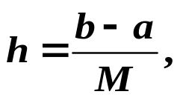


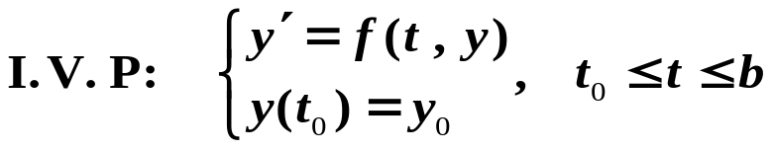





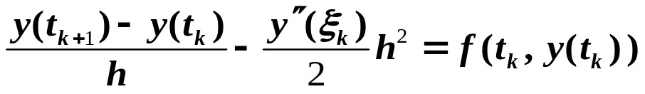


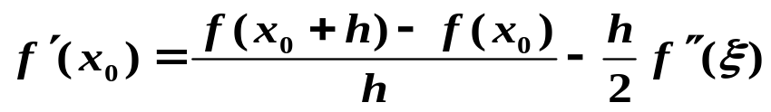
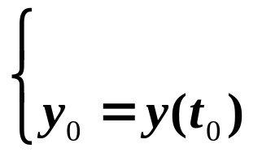

Euler’s Method
Stipulation:
Euler’s method

Slide 11


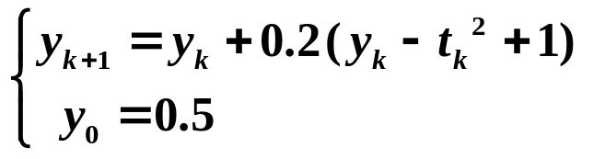
























Example Use Euler method to approximate the solution of the initial-value problem with .
0.0
0.2
0.4
0.6
0.8
1.0
1.2
1.4
1.6
1.8
2.0

Slide 13


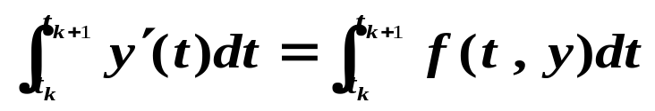
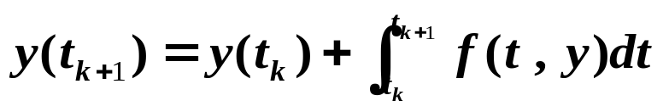
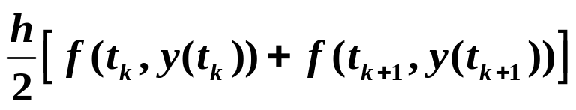

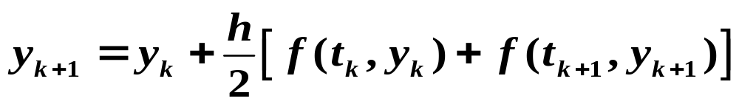


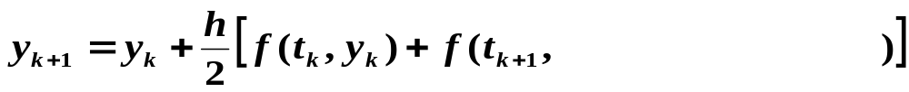

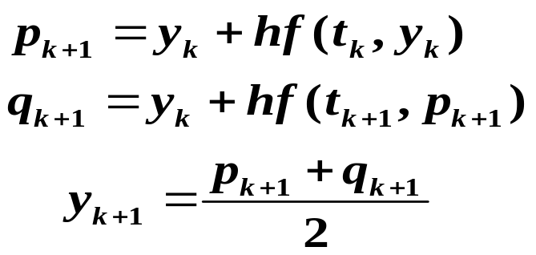
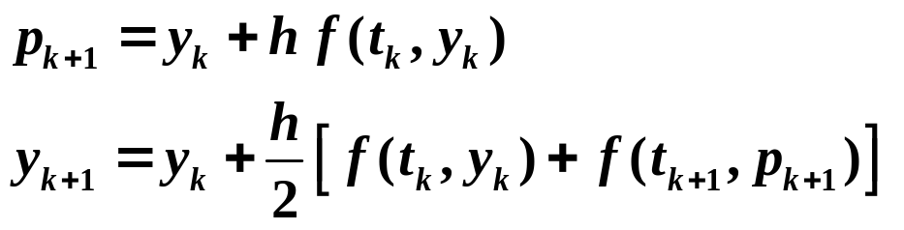
Modified Euler Method
Predictor-corrector method

Slide 14
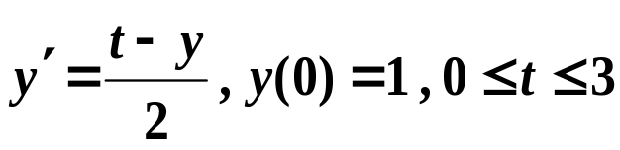



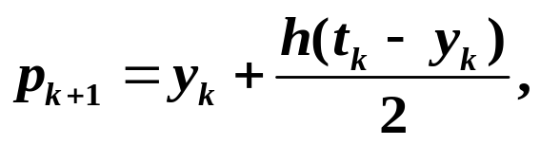
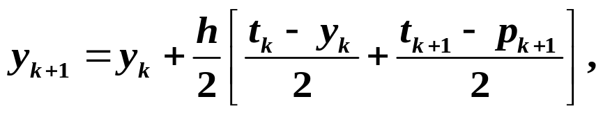

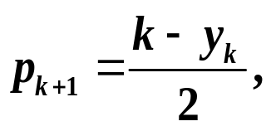
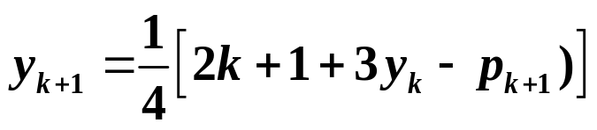


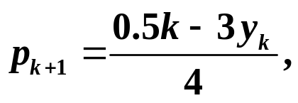
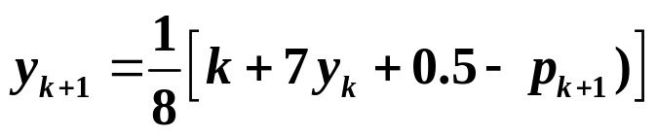
Example Use modified Euler method to approximate the solution
of I.V.P with and .
Solution
Modified Euler formula
h=1
t_{k} | y_{k} |  | Exact values y(t)
 | h=1 | h=0.5
0 | 1 | 1 | 1
0.5 |  | 0.84375 | 0.836402
1 | 0.875 | 0.831055 | 0.819592
1.5 |  | 0.930511 | 0.917100
2 | 1.171875 | 1.117587 | 1.103638
2.5 |  | 1.373115 | 1.359514
3 | 1.732422 | 1.682121 | 1.669390
h=0.5

Slide 15
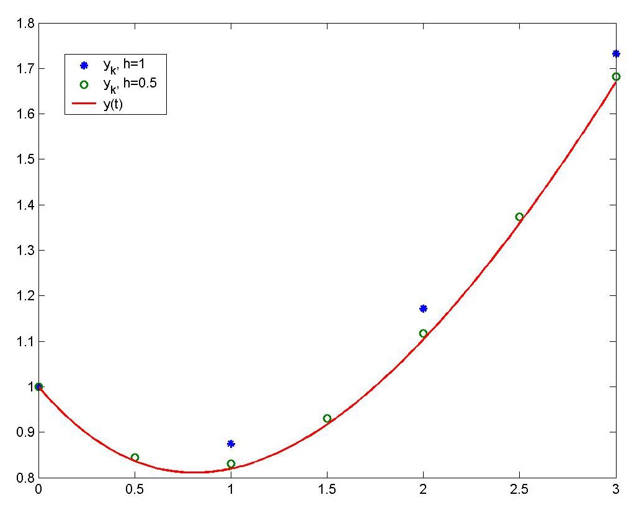

Slide 16

One-step difference-equation Method
Euler’s Method
Modified Euler Method

Slide 17


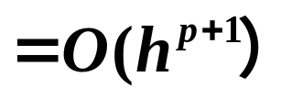

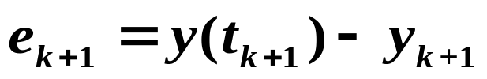
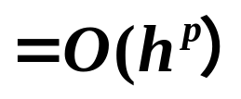
Local/ Global Discretization Error
Definition
has local discretization error
and global discretization error
p is called the order of the accuracy
Local error measures the accuracy of the method at a specific step assuming that the method was exact at the previous step .
Global error measures the accumulated error at the some step from the beginning.

Slide 18
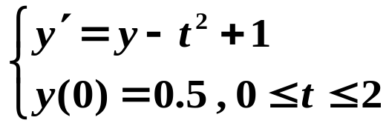



























=0.0109
=3.169031
0.0
0.2
0.4
0.6
0.8
1.0
1.2
1.4
1.6
1.8
2.0

Slide 19
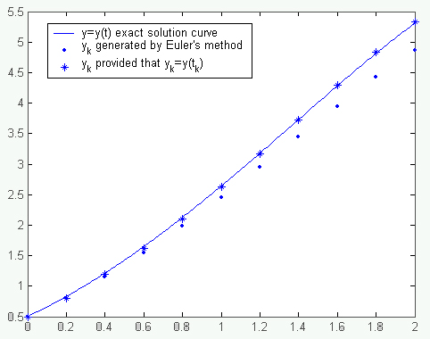

Slide 20
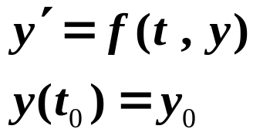
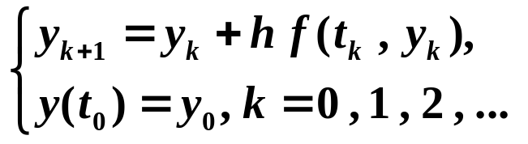
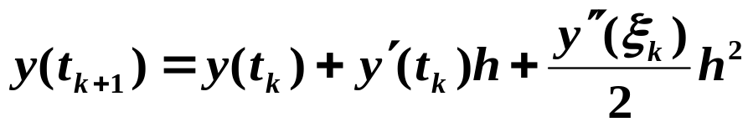
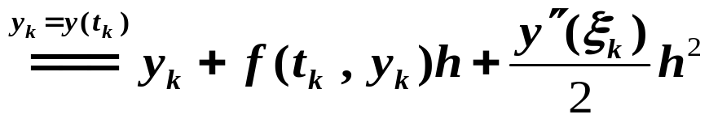

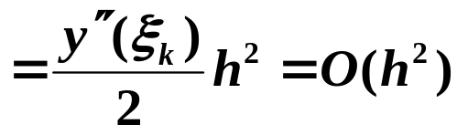
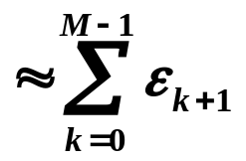
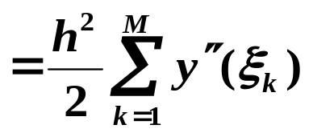
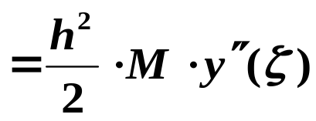



Precision of Euler’s Method
Euler’s formula
Local Discretization Error
Global Discretization error at the last step (F. G. E. )

Slide 21





Theorem Suppose that and all its partial derivatives of order less than or equal to n+1 are continuous on
For every , there exists
where
and
Taylor’s theorem in two variables

Slide 22








Slide 23











Precision of modified Euler method

Slide 24





7.4 Runge-Kutta Methods
Runge-Kutta methods have the high-order local truncation error. The main computational effort in applying Runge-Kutta methods is the evaluation of the function f.
1) The ideas of Runge-Kutta methods

Slide 25














Slide 26





2) The derivation of Runge-Kutta methods
In general, mth-order Runge-Kutta method has the form
Runge-Kutta order Three
Runge-Kutta order two
Runge-Kutta order four

Slide 27











Derivation of Runge-Kutta order two

Slide 28












Slide 29






Runge-Kutta order four
Runge-Kutta order two
Example Use Runge-Kutta order two and order four respectively to approximate the solution of
with

Slide 30





Runge-Kutta order four:
Runge-Kutta order two:
k | 0 | 1 | 2 | 3 | 4 | 5 | 6 | 7 | 8 | 9 | 10
t_{k} | 0 | 0.2 | 0.4 | 0.6 | 0.8 | 1.0 | 1.2 | 1.4 | 1.6 | 1.8 | 2.0
y2_{k}
y4_{k}
y
0.5000000 | 0.8000000 | 1.1520000 | 1.5504000 | 1.9884800 | 2.4581760 | 2.9498112 | 3.4517734 | 3.9501281 | 4.4281538 | 4.8657845
0.5000000 | 0.8292933 | 1.2140762 | 1.6489220 | 2.1272027 | 2.6408227 | 3.1798942 | 3.7323401 | 4.2834095 | 4.8150857 | 5.3053630
0.5000000 | 0.8292986 | 1.2140877 | 1.6489406 | 2.1272295 | 2.6408591 | 3.1799451 | 3.7324000 | 4.2834838 | 4.8151763 | 5.3054720

Slide 31


Slide 32








Solutions of ODEs
Single-step methods
Difference methods
Euler’s method
Modified Euler method
Runge-Kutta methods

