Slide 1






3. 3 Iteration Methods
Iterative techniques are seldom used for solving linear systems of small dimension since the time required for sufficient accuracy exceeds that required for direct techniques . For large systems with a high percentage of 0 entries , these techniques are efficient in terms of both computer storage and computation .
An iterative technique to solve the linear system AX=B starts with an initial approximation and generates a sequence of vectors which will converge to the solution X .

Slide 2
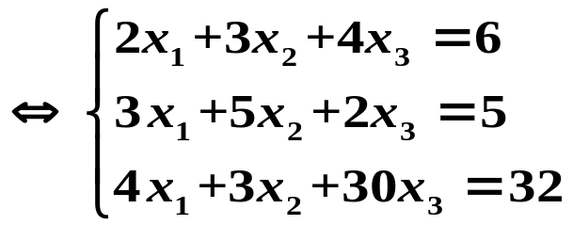

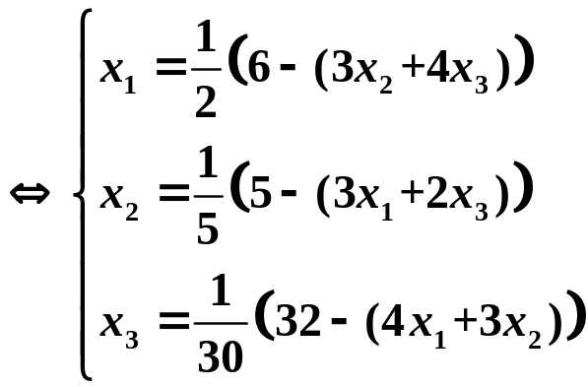
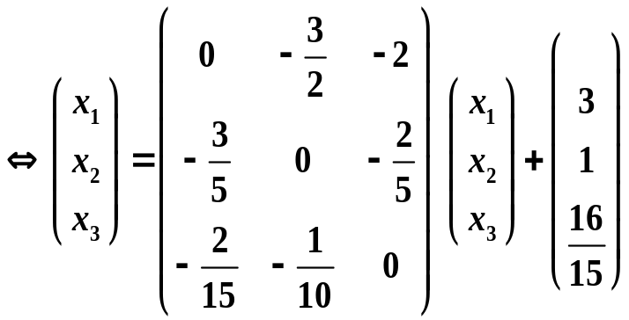



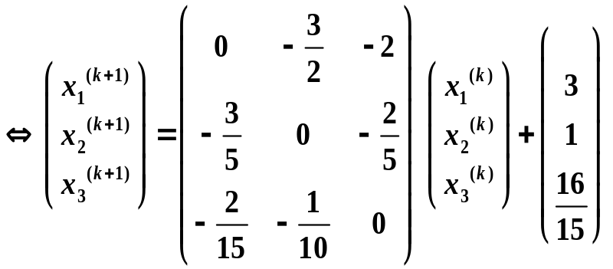
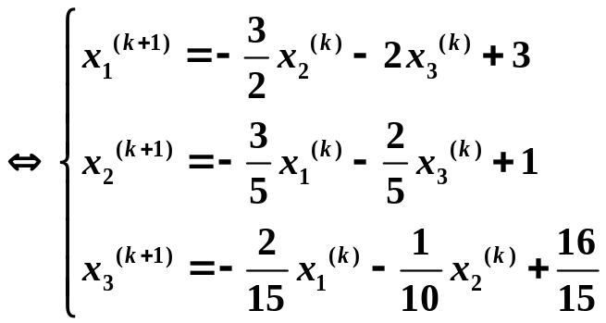

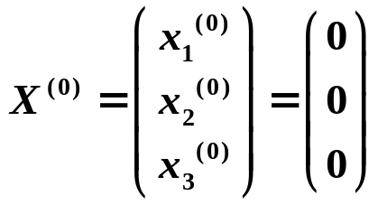
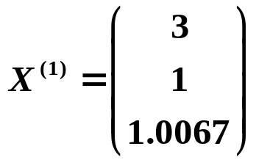
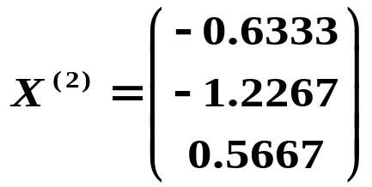
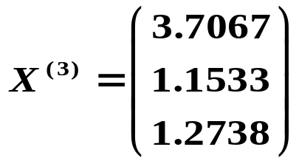


Slide 3




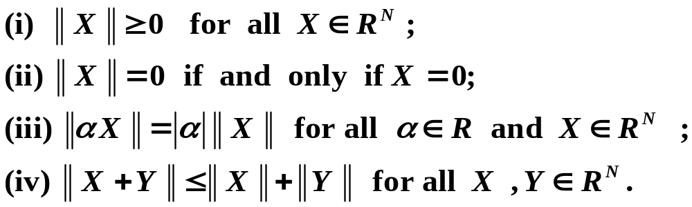

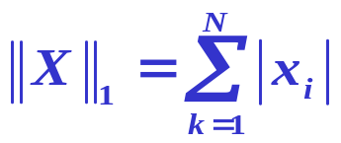
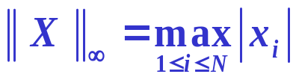


Norms of Vectors on
Definition A vector norm on is a function , , from into with the following properties :
Some useful norms on

Slide 4
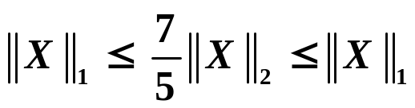
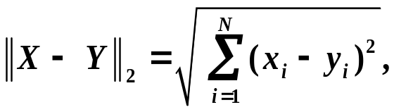
Equivalence of Norms (TH 3.8)
Example
Distance between two vectors

Slide 5
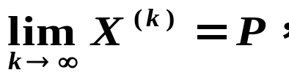
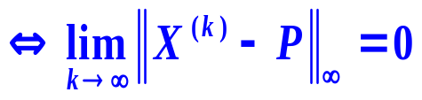
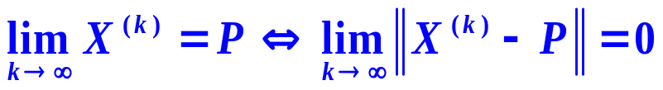
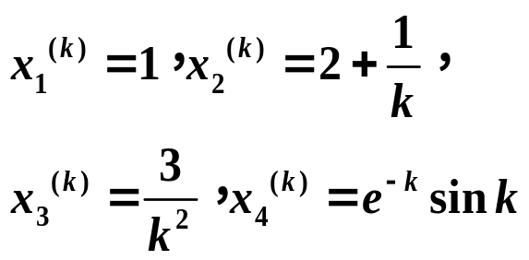
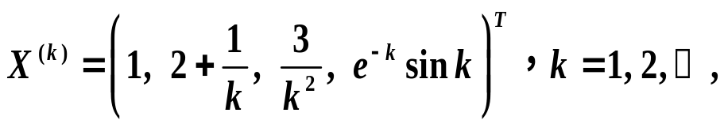
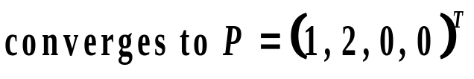
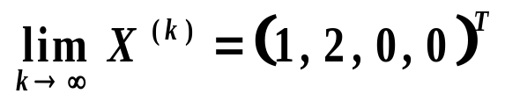
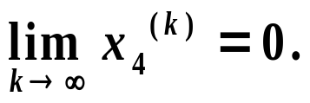
Definition 3.7
Example

Slide 6






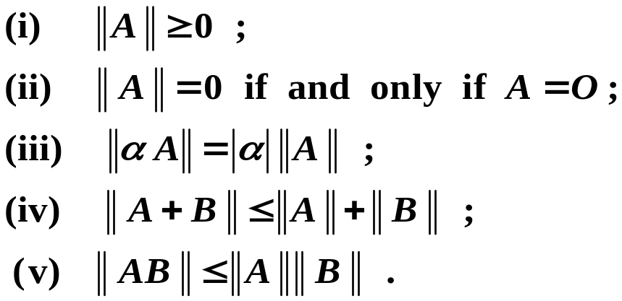
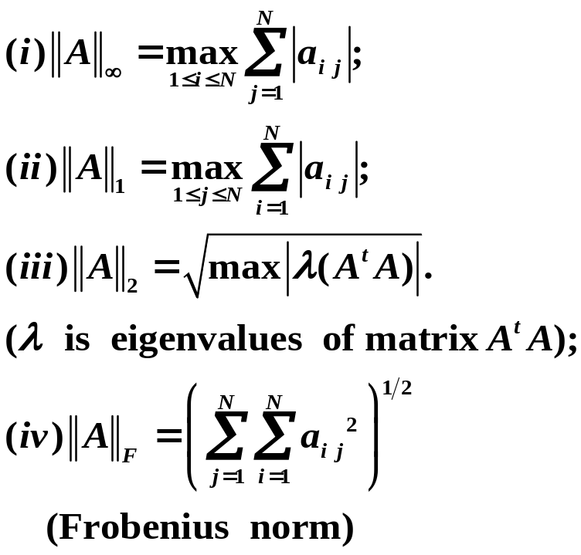
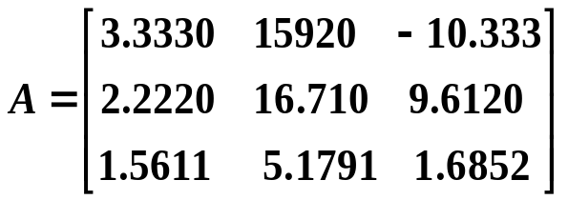




Norm of the matrix
Definition A matrix norm on the set of all matrices is a real function , , defined on this set , satisfying for all matrices and and all real numbers :

Slide 7
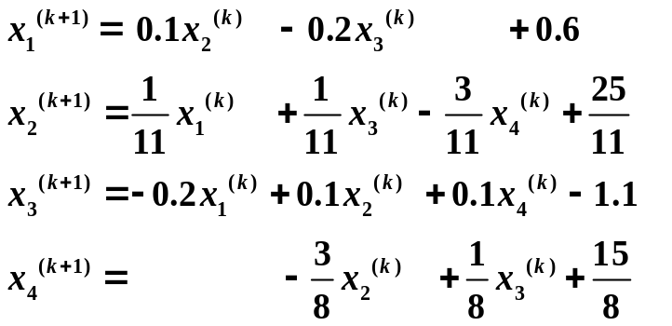

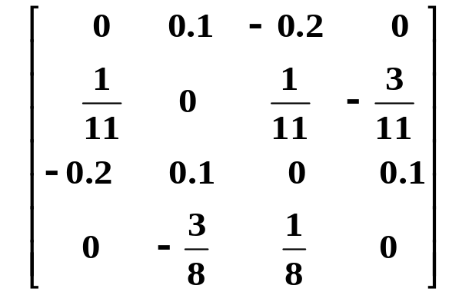

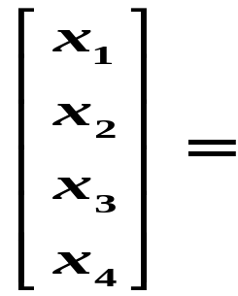
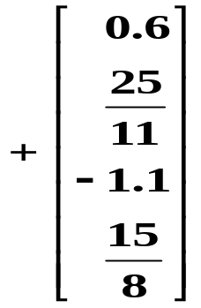

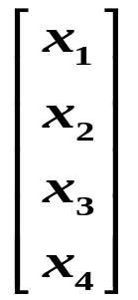


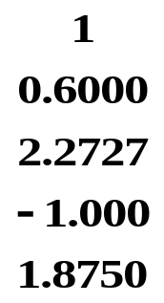
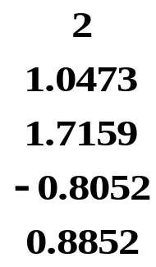
Example Solve the linear system
Jacobi
Iteration

Slide 8
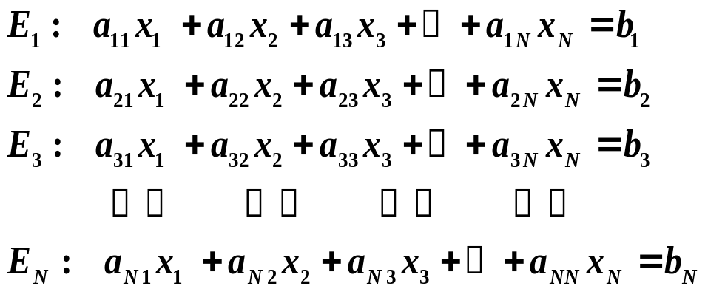
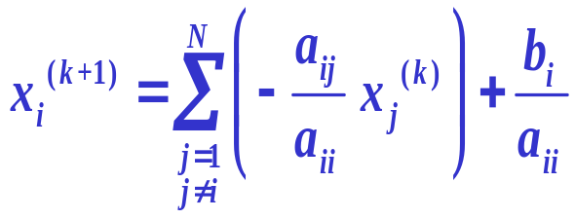

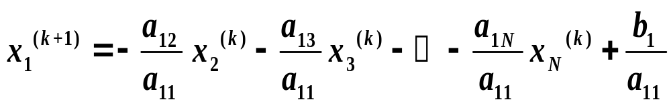
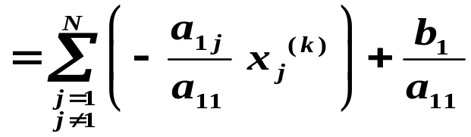
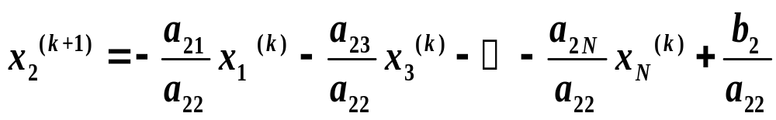

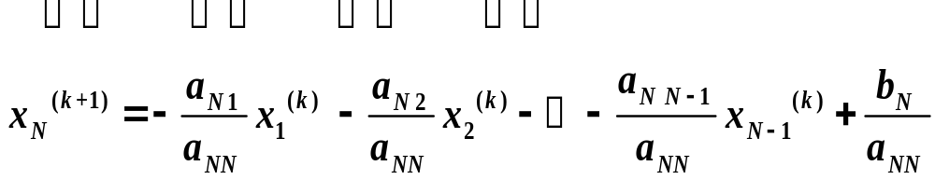
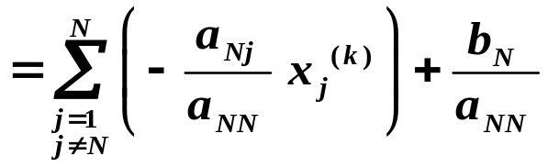
Jacobi Iteration

Slide 9
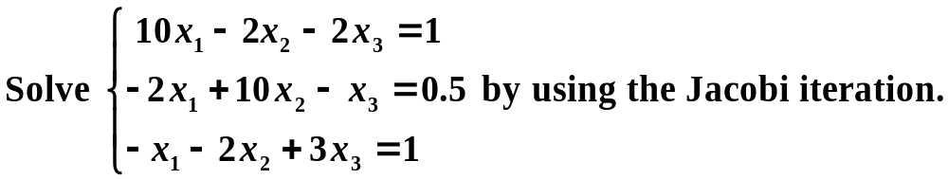

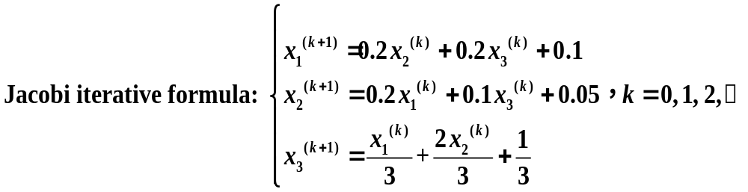






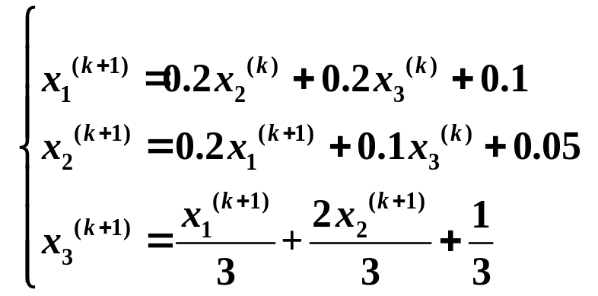
Exercise
Solution

Slide 10
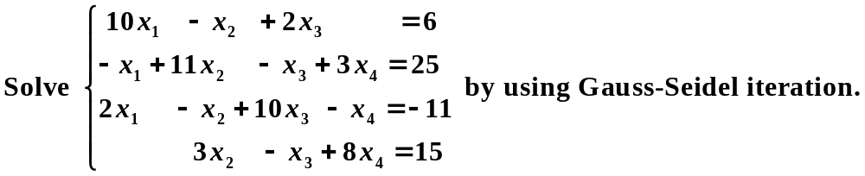
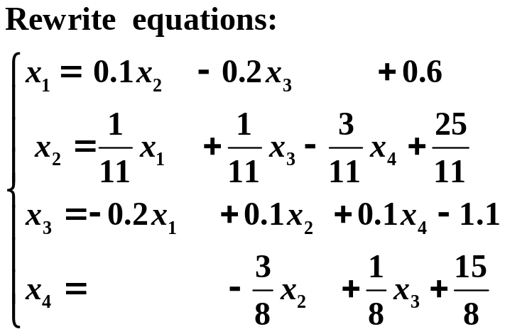
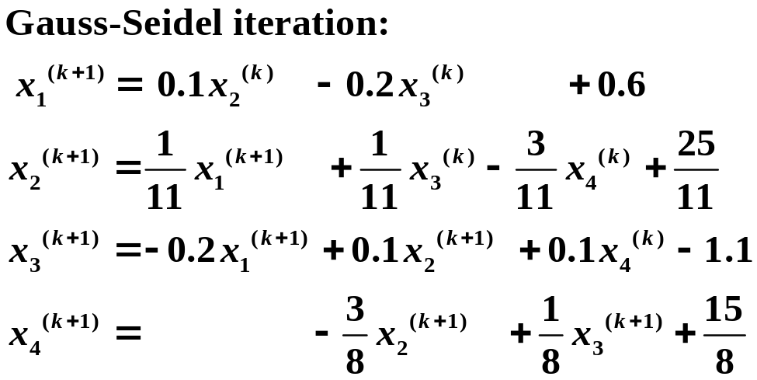
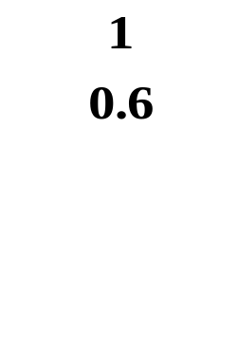
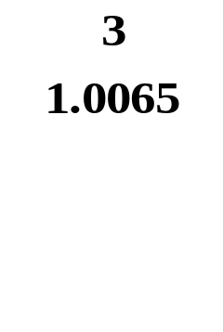


Example
Solution

Slide 11
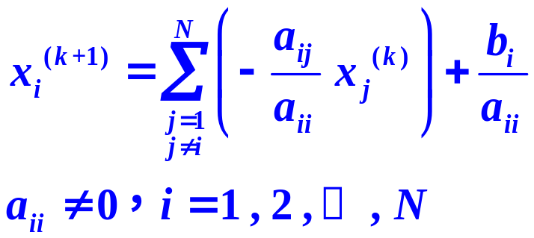

Gauss-Seidel Iteration
Jacobi Iteration

Slide 12
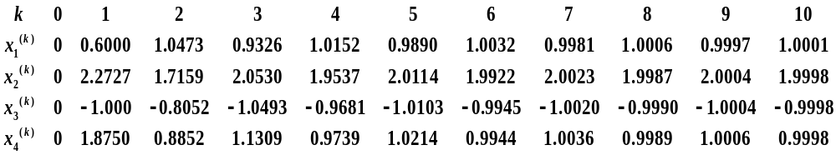
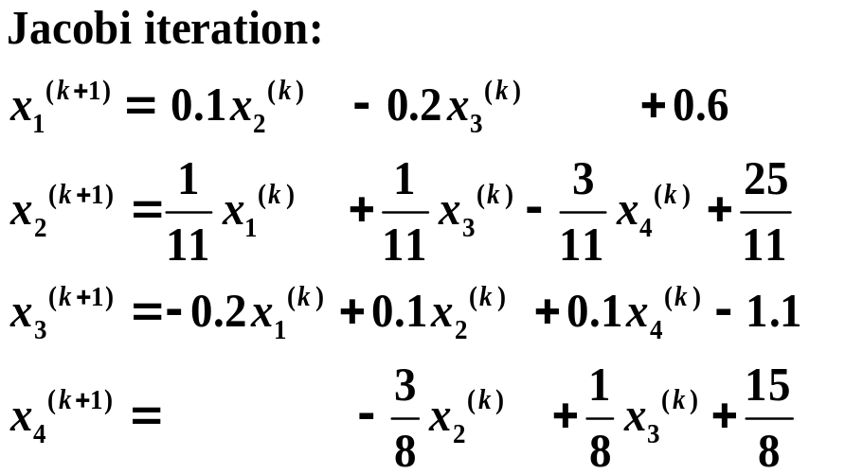













Slide 13


%Jacobi
clear
x=zeros(3);
for k=1:5
x1=0.2*x(k,2)+0.2*x(k,3)+0.1;
x2=0.2*x(k,1)+0.1*x(k,3)+0.05;
x3=1/3*x(k,1)+2/3*x(k,2)+1/3;
x(k+1,:)=[x1,x2,x3];
end
%Gauss-Seidal
clear
x=zeros(3);
for k=1:5
x1=0.2*x(k,2)+0.2*x(k,3)+0.1;
x2=0.2*x1+0.1*x(k,3)+0.05;
x3=1/3*x1+2/3*x2+1/3;
x(k+1,:)=[x1,x2,x3];
end
0 0 0
0.1000 0.0500 0.3333
0.1767 0.1033 0.4000
0.2007 0.1253 0.4611
0.2173 0.1362 0.4838
0.2240 0.1418 0.4966
0 0 0
0.1000 0.0700 0.4133
0.1967 0.1307 0.4860
0.2233 0.1433 0.5033
0.2293 0.1462 0.5072
0.2307 0.1469 0.5081

Slide 14









Example Find the iterative matrices of both Jacobi and
Gauss-Seidel iteration for solving the system
Jacobi iterative formula：
Gauss-Seidel iterative formula：

Slide 15


















Jacobi iterative formula

Slide 16







Jacobi
Iteration

Slide 17













Gauss-Seidel iterative formula：

Slide 18










Gauss-Seidel Iteration

Slide 19






Example
Calculate the iterative matrices.
Solution:
Split A into 3 parts.

Slide 20










Example

Slide 21






Convergence of Jacobi and Gauss-Seidel iterative
Theorem
Definition The spectral radius of a matrix A is defined by

Slide 22














Example Consider the convergences of Jacobi and Gauss-Seidel iteration for solving the system

Slide 23















Example Consider the convergences of Jacobi and Gauss-Seidel iteration for solving the system

Slide 24













Iterative methods

Slide 25






Stabiliy of Numerical methods for solving linear systems
Example Solve the linear system

Slide 26



































Slide 27











Example Ex. 18, page 63.
Hilbert Matrix :
where
for

Slide 28





Hilbert matrix
is ill conditioned.
(Ex. 19, page 63)

