Slide 1
CHAPTER 4
Interpolation and Polynomial
Approximation

Slide 2






4. 1 Interpolation Problem
Find a simple function to pass through the given data
Find a function P(x) such that
One class of simple functions is the set of polynomials
Bolzano-Weierstrass Theorem
Suppose that . For each , there exists a polynomial with the property that

Slide 3
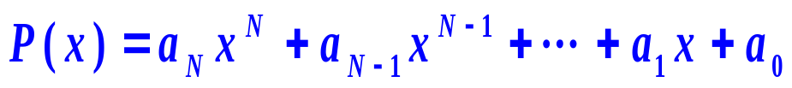
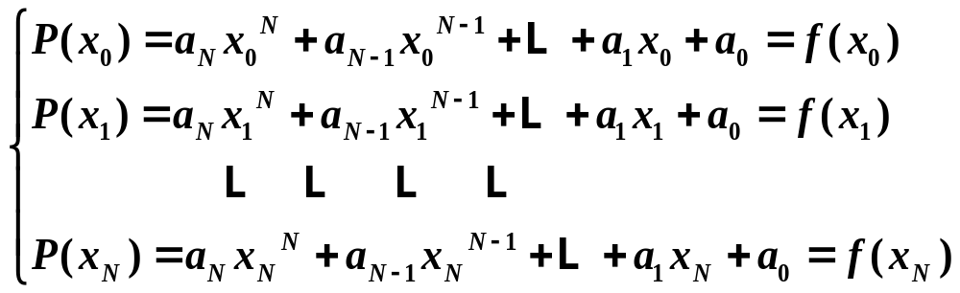
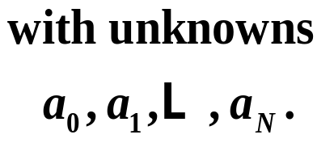
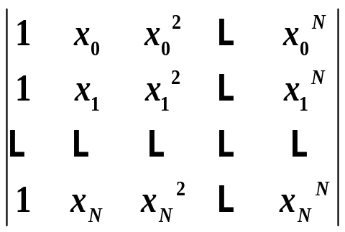

Existence and Uniqueness
produce a linear system
The coefficient determinant
Vandemonde determinant

Slide 4



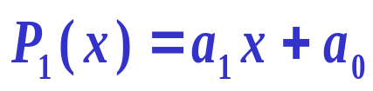
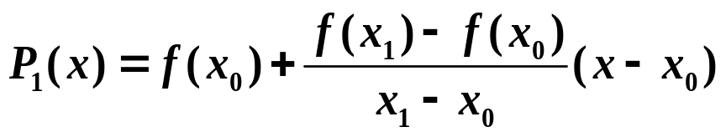


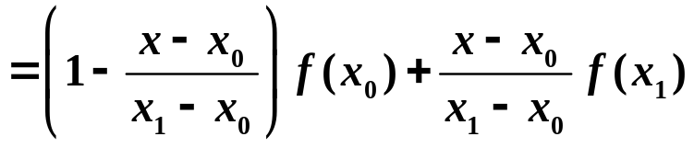
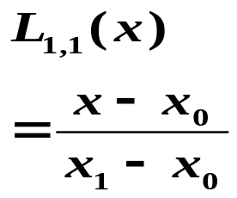
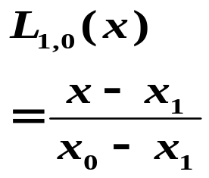
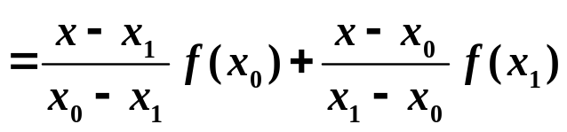


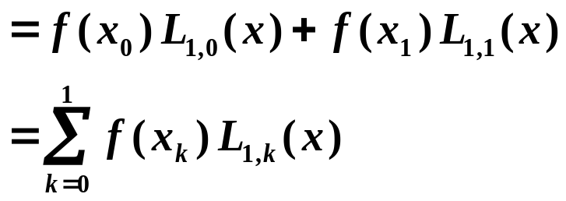
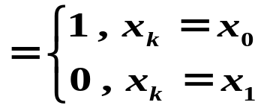
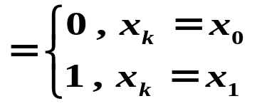
4 .2 Lagrange Interpolation
(1) Linear interpolation (N=1)
*
*

Slide 5


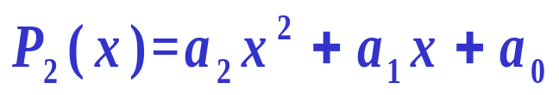
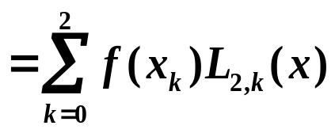
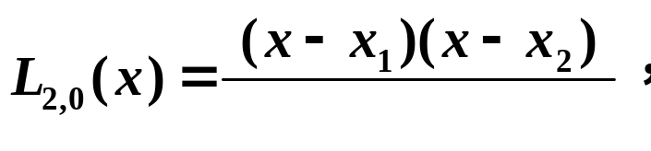
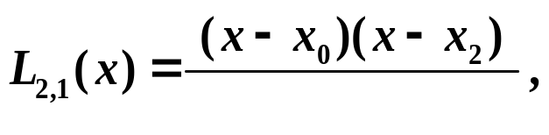


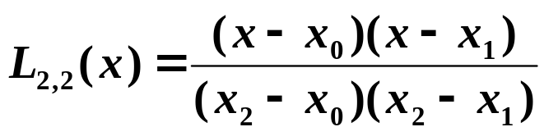
(2) Quadratic interpolation N=2
*
*
*

Slide 6
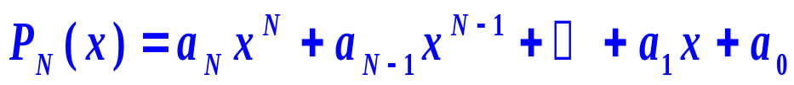
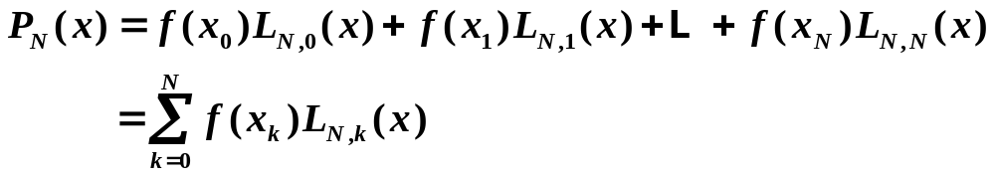
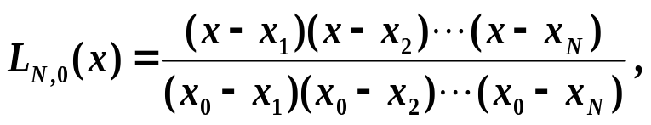
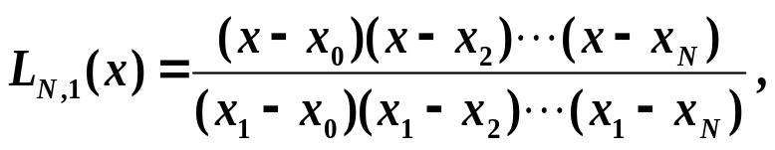
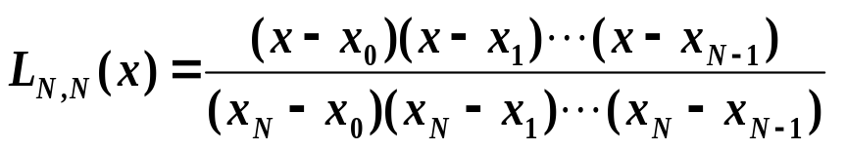
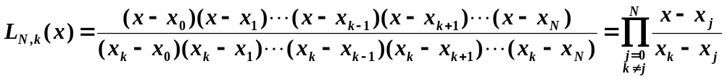
(3) The Nth-degree Lagrange interpolation
… … …,

Slide 7

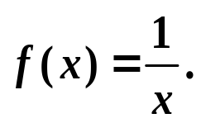

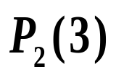
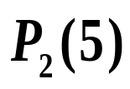
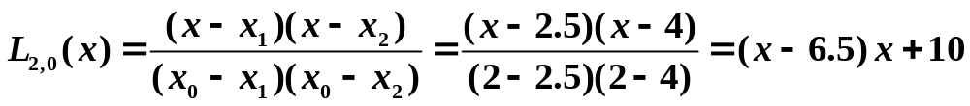
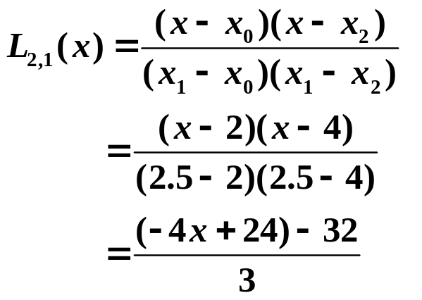
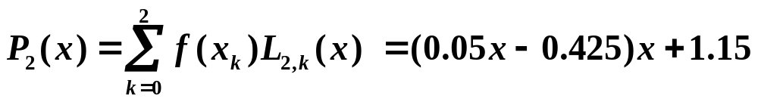
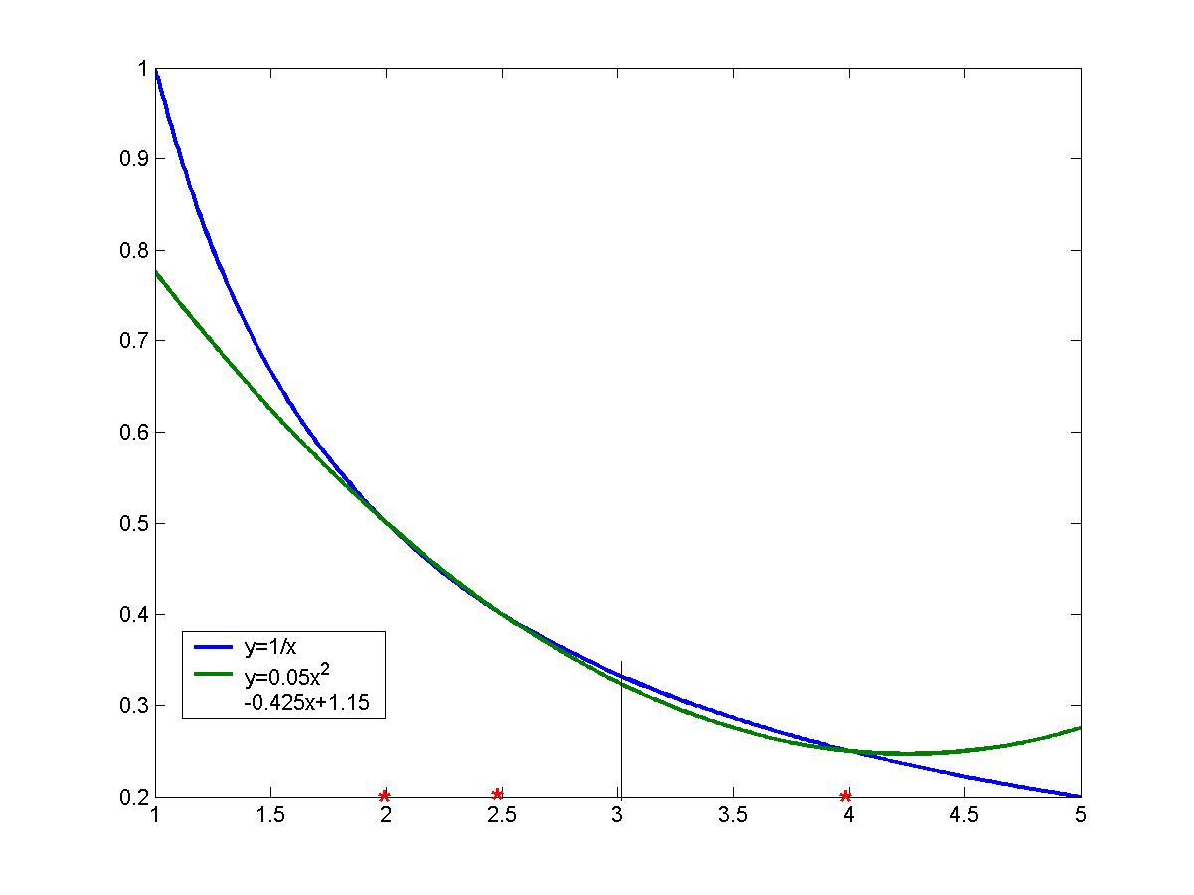


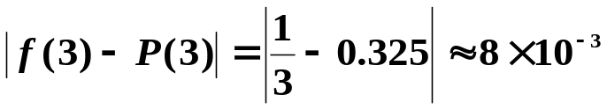
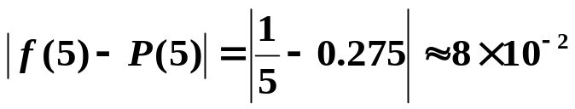
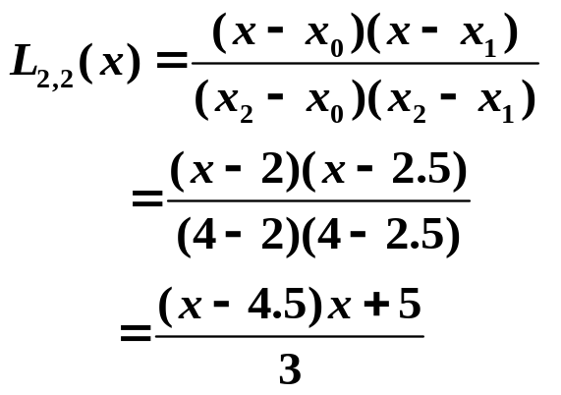
Example Find the 2nd-order interpolating polynomial
using the nodes to approximate
And evaluate and .

Slide 8








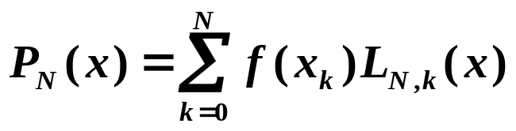
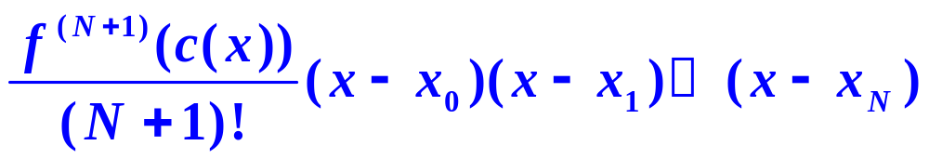
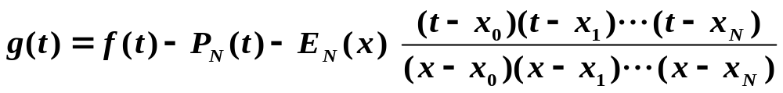
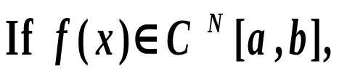
Truncation Error
Theorem 4. 2 Suppose that are distinct numbers in the
interval and . Then , for each in ,
there is in such that
where
and

Slide 9


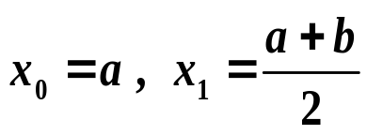

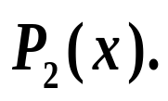

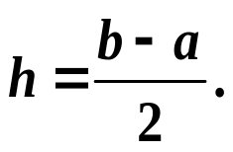



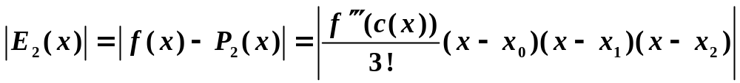
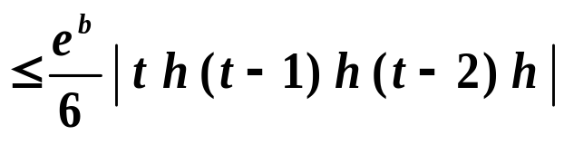
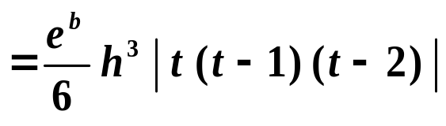
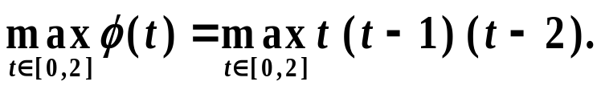
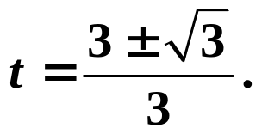


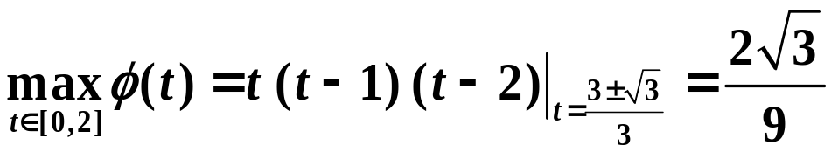
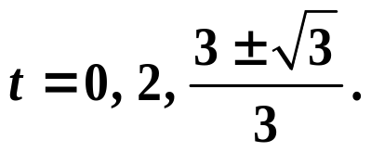

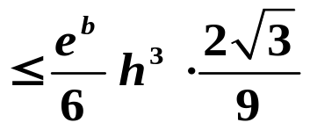
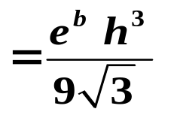
Example Consider Using nodes
and
can interpolate a 2-degree
polynomial
Find the bound of error
Let
Then
and
Now we try to find
Let
Then
Evaluate at
Then
Thus

Slide 10



























Slide 11














4. 3 Newton Interpolation
均差
1) Definitions of divided differences
(1) The zeroth divided difference of with respect to
(2) The first divided difference of with respect to and
(3) The second divided difference of with respect to
(4) The kth divided difference of with respect to

Slide 12
































2) Divided-Difference Table
0 | 0
1 | 1
2 | 4
1
3
1

Slide 13



Example Suppose . Find
Solution
Construct the divided-difference table for f (x)
x_{k} | f [ ] | f [ , ] | f [ , , ] | f [ , , , ] | f [ , , , ]
1
2
4
8
16
-3
71
2973
97913
3144177
74
1451
23735
380783
459
3714
29754
465
1860
93

Slide 14












3) Some properties of divided difference
(1)
is independent of the order of

Slide 15














Assume that and are distinct in ,
then a number exists in with
(Theorem 4.3 )
Example Suppose .
Find and .

Slide 16












3) Newton Interpolation
Suppose
with

Slide 17





Example Let
Solution
Construct the divided-difference table for f (x)
x_{k} | f [ ] | f [ , ] | f [ , , ] | f [ , , , ] | f [ , , , ]
1
2
4
8
16
-3
71
2973
97913
3144177
74
1451
23735
380783
459
3714
29754
465
1860
93

Slide 18




















Example Approximate to using Newton divided-difference method and the given data shown in the table .
x_{k} | f [ ] | f [ , ] | f [ , , ] | f [ , , , ] | f [ , , , , ]
1.0 | 0.7651977
1.3 | 0.6200860
1.6 | 0.4554022
1.9 | 0.2818186
2.2 | 0.1103623
1.0
0.7651977
1.3
0.6200860
1.6
0.4554022
1.9
0.2818186
2.2
0.1103623

Slide 19











Theorem 4.4 Truncation Error of Newton’s interpolation

Slide 20














Assume that and are distinct in ,
then a number exists in with
Proof
(Theorem 4.3 )
The nth-degree polynomial，based on nodes ，is
Let
Then
0
A number exists in with
That is

Slide 21















Problem of Interpolation
Determine a polynomial of degree at most N that passes through the given N+1 points .
Lagrange Approximation
Newton Approximation

Slide 22

Population Forecast
Year | 1953 | 1964 | 1982 | 1990 | 2000 | 2010
Population (in ten millions) | 60.19 | 72.31 | 103.19 | 116 | 129.53 | 137.05
year | x | y=f[]
1953 | 0 | 60.9
1964 | 11 | 72.31
1982 | 29 | 103.19
1990 | 37 | 116
2000 | 47 | 129.53
2010 | 57 | 137.05
f[,] | f[,,] | f[,,,] | f[,,,,] | f[,,,,,]
1.0373
1.7156 | 0.0234
1.6013 | -0.0044 | 1.0e-003 *-0.7510
1.3530 | -0.0138 | 1.0e-003 *-0.2610 | 1.0e-004 *0.1043
0.7520 | -0.0300 | 1.0e-003 *-0.5807 | 1.0e-004 *-0.0695 | -3.0482e-007
2020 | 67 | 129.60
2030 | 77 | 88.94

Slide 23



Question: Assume that f(x) is approximated by the interpolation P_{N}(x) over [a, b] based on equally spaced nodes. Does E_{N}(x)=f(x)-P_{N}(x) tend to zero as N increases?
Runge Phenomenon
Piece wise-linear interpolation

