Slide 1
CHAPTER 5
Curve Fitting

Slide 2
N+1 points are given.
Find a function to fit the points.
(I) Each point has high precision. That is,
where f is unknown or complexity.
We can use a simple function, such as, a polynomial P(x) to
approximate f (x).
It is rational to let
(II) The points have poor precision.
It is rational to minimize the errors
The goal of Chapter 5 is to find a function in a certain class to represent the given data best relative to some measure .

Slide 3


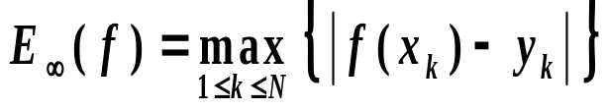
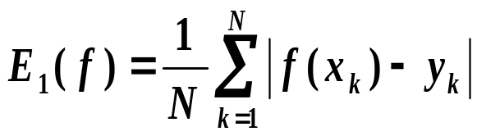
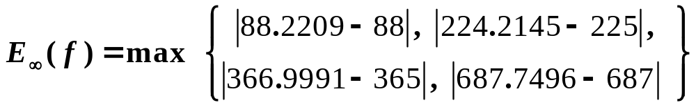

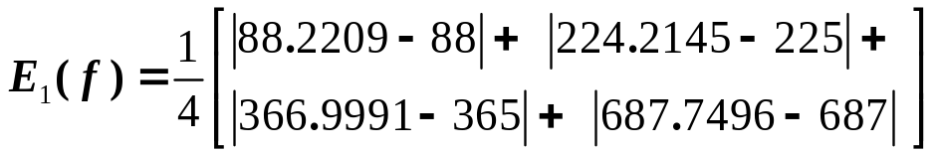
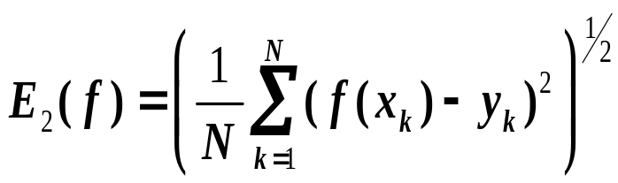

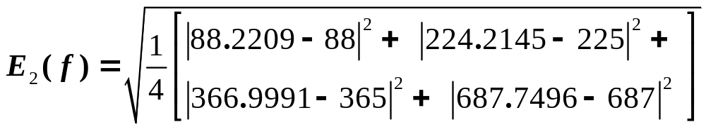

Problem
Given , where the abscissas are distinct.
Find a function
to minimize the errors in some sense
Maximum error
x_{i} | 58 | 108 | 150 | 228
y_{i} | 88 | 225 | 365 | 687
f (x_{i}) | 88.2209 | 224.2145 | 366.9991 | 687.7496
Everage error
Root-mean-square error

Slide 4
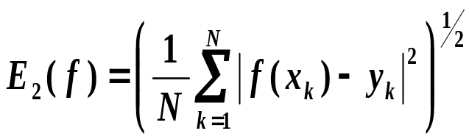
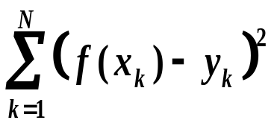
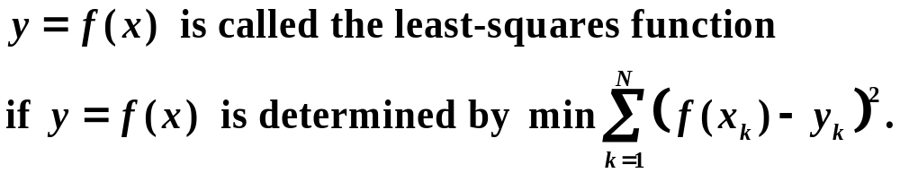




To minimize
is equivalent to minimize
Functions used for fitting curves
Straight line
Polynomial
Power curve
Exponential curve

Slide 5


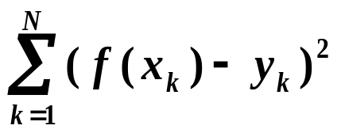
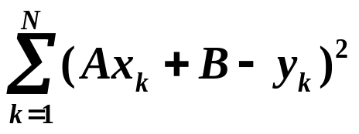





5.2 Polynomial Fitting
5.2.1 Least-Squares Line
Determine a line approximation using the given
data with
minimum
To minimize
·
·
*
*
·
*
·
*

Slide 6
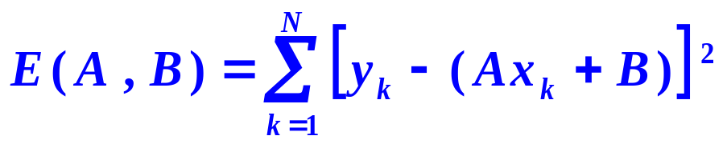

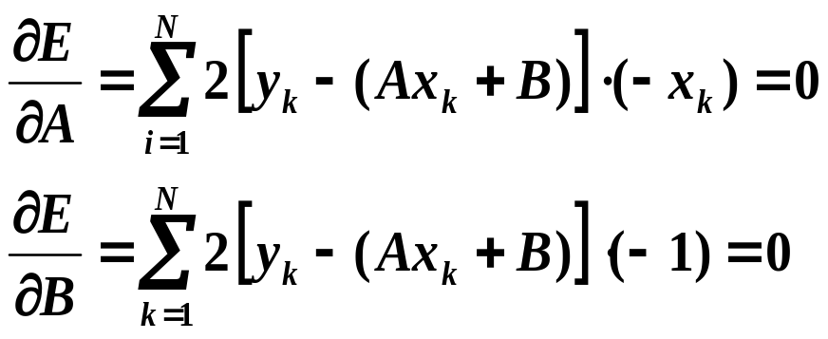
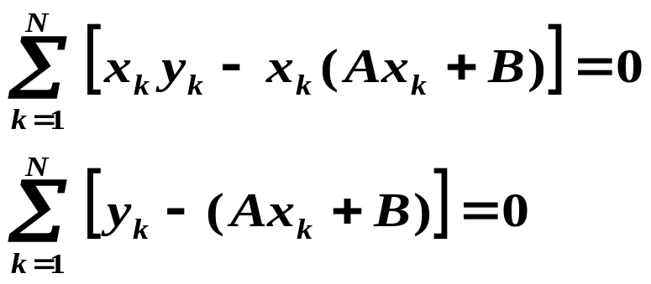
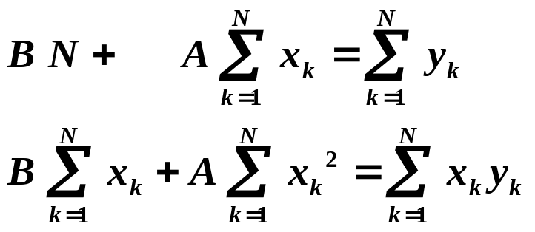









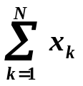
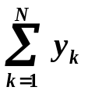
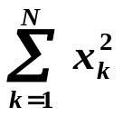
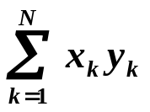
To minimize
The normal equations
See Eq. (5.5) (P90-91)

Slide 7
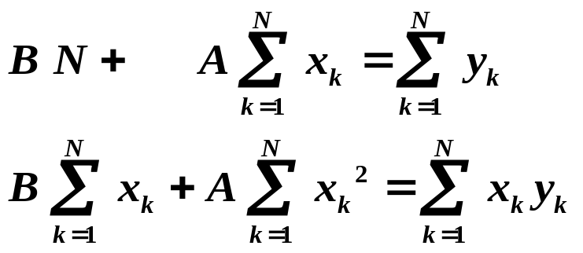
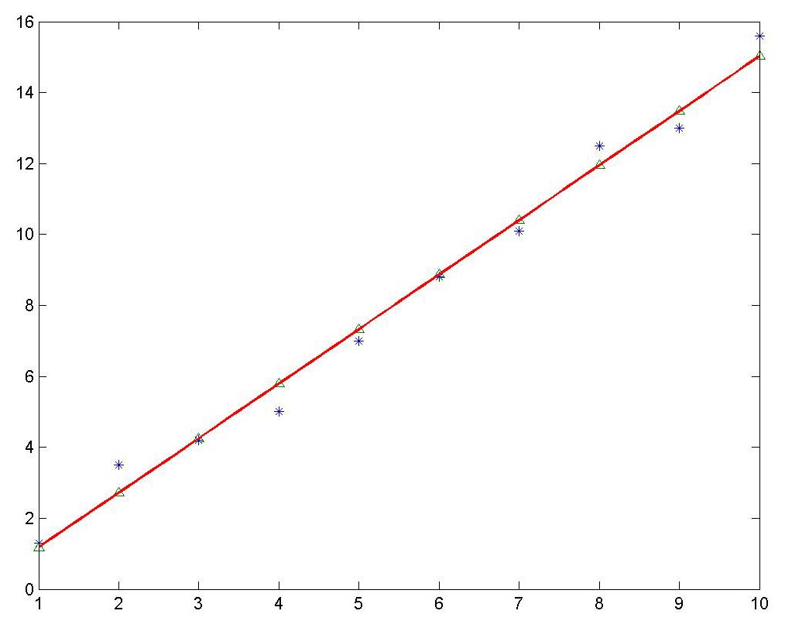
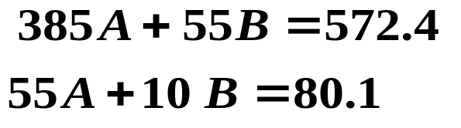

Example Find the least squares line to approximate the data given in the given table.
k | 1 | 2 | 3 | 4 | 5 | 6 | 7 | 8 | 9 | 10
x_{k} | 1 | 2 | 3 | 4 | 5 | 6 | 7 | 8 | 9 | 10
y_{k} | 1.3 | 3.5 | 4.2 | 5.0 | 7.0 | 8.8 | 10.1 | 12.5 | 13.0 | 15.6
Find the normal equations
Solving the equations gives
So,

Slide 8


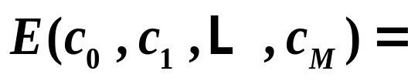
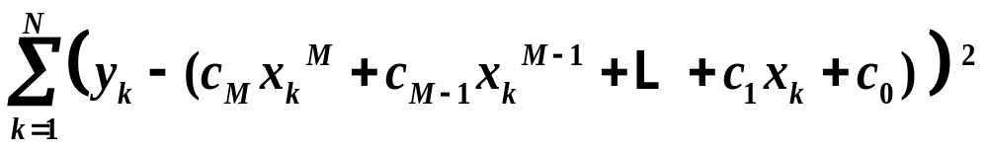



5.2.2 Polynomial Fitting
Determine a best approximation
using the given data
such that
is minimal .
*
·
*
*

Slide 9



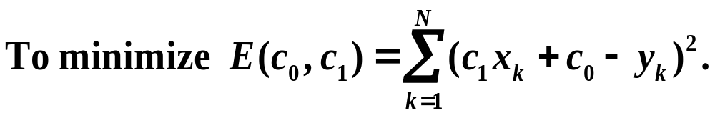
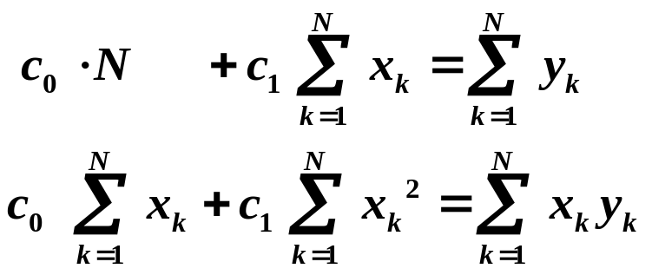


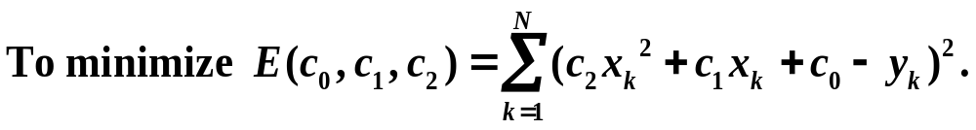
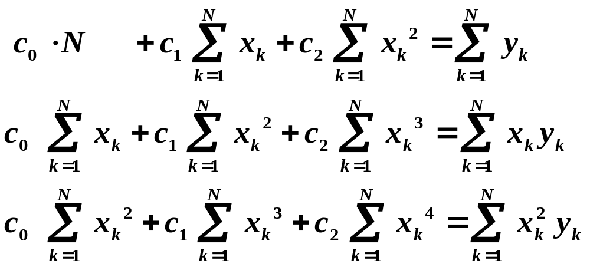
Normal equations:
Normal equations:

Slide 10
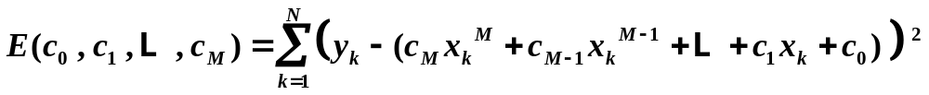
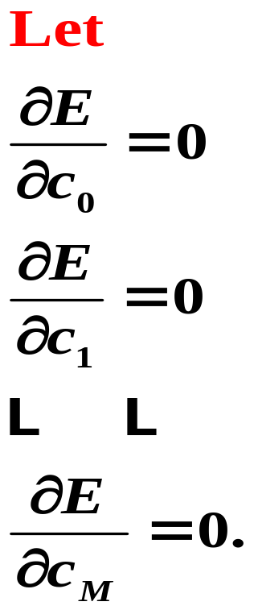
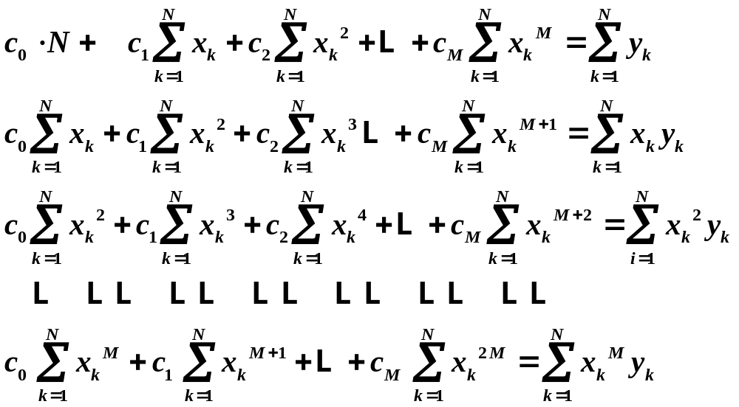


Slide 11

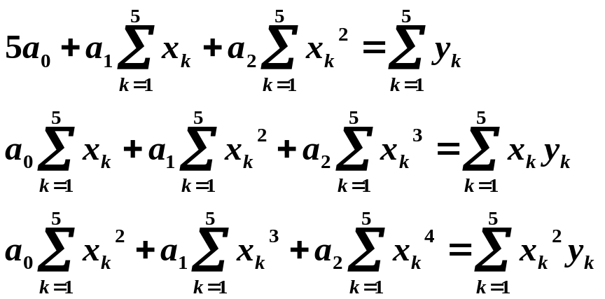
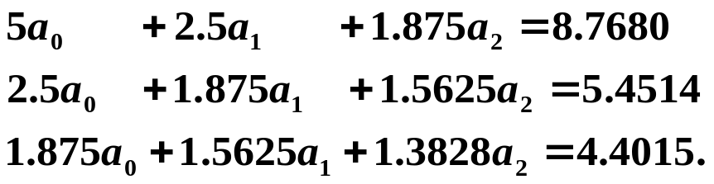
Example Fit the data in the table with the discrete least-squares polynomial of degree 2 .
k | 1 | 2 | 3 | 4 | 5
x_{k} | 0 | 0.25 | 0.5 | 0.75 | 1.00
y_{k} | 1.0000 | 1.2840 | 1.6487 | 2.1170 | 2.7183
Using normal equations
produces
Solving the system gives
Hence

Slide 12
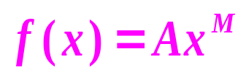


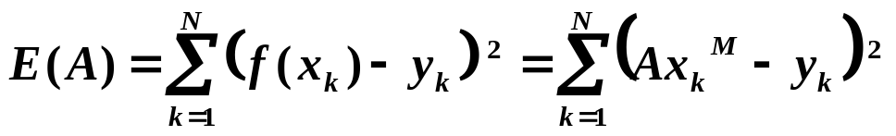
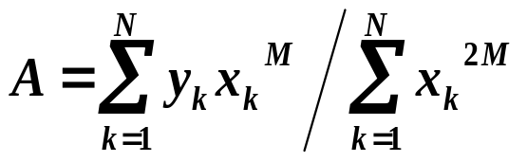
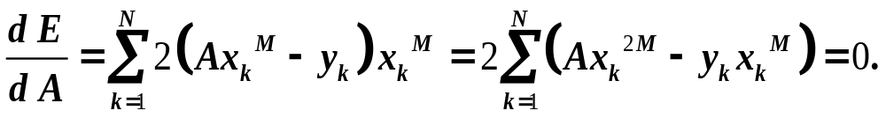
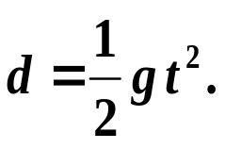
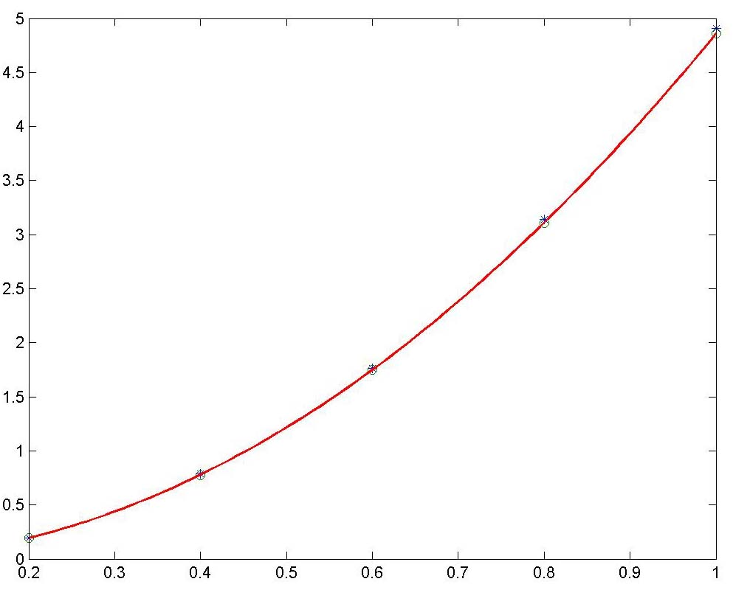

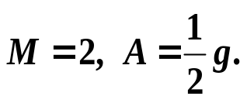
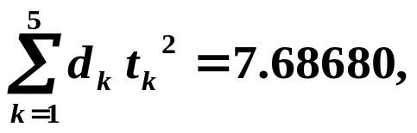
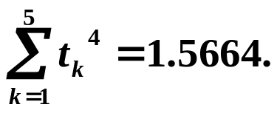
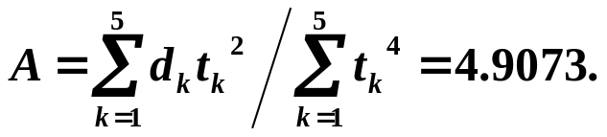

Power fit
Determine an linear-squares power function
using the given data
Minimize
Then
Let
Example The relation is Find the gravitation constant using the given data.
k | 1 | 2 | 3 | 4 | 5
t_{k} | 0.2 | 0.4 | 0.6 | 0.8 | 1.0
d_{k} | 0.1960 | 0.7850 | 1.7665 | 3.1405 | 4.9075

Slide 13

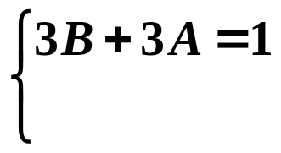
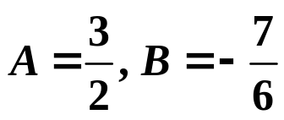
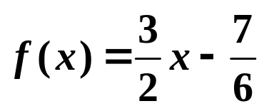

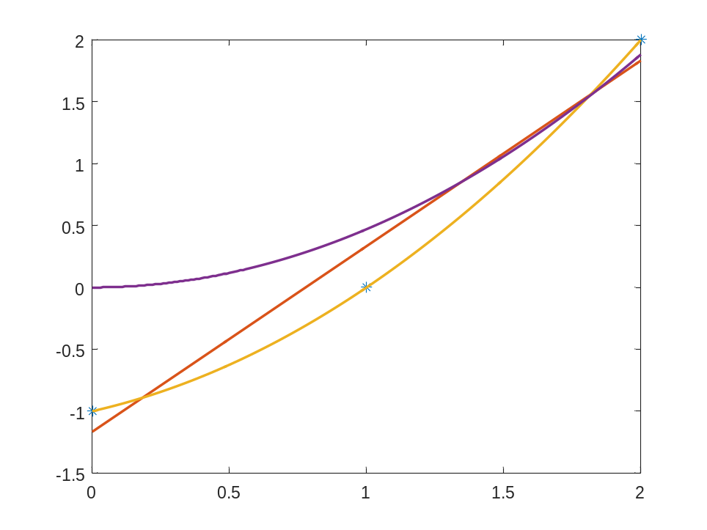
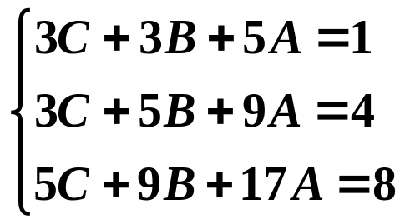


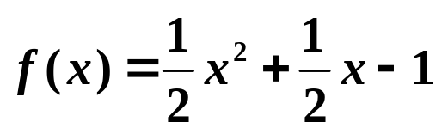
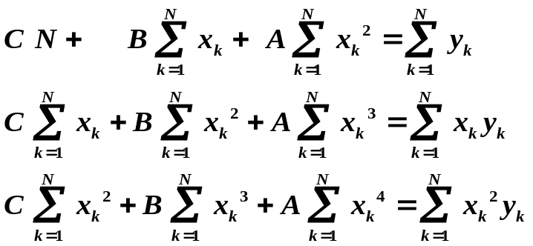






Example Fit the data in the table with the least-squares polynomials of degree 1 and degree 2, respectively .
x_{k} | 0 | 1 | 2
y_{k} | -1 | 0 | 2

Slide 14





5.3 Data Linearization
Determine a least-squares exponential function
using the given data
Method I Find directly using the least-squares technique.
Minimize
Let
We have
This is a nonlinear system with unknowns A and C.
Method II Transformations for data linearization

Slide 15










Transformations for data linearization
Determine a least-squares exponential function
using the given data
Notice that
Change of variables:
To find
is to find the least-squares line
1. Transform
into
denoted as
2. Find the normal equations with unkowns
3. Solve the equations for A and B, then
4. Write down

Slide 16












Example Use the data linearization method to find the exponential fit for the given dada.
k | 1 | 2 | 3 | 4 | 5
x_{k} | 0.0 | 1.0 | 2.0 | 3.0 | 4.0
y_{k} | 1.5 | 2.5 | 3.5 | 5.0 | 7.5
Change of variables
Data linearization:
X_{k} | 0.0 | 1.0 | 2.0 | 3.0 | 4.0
Y_{k}=ln(y_{k}) | 0.4055 | 0.9163 | 1.2528 | 1.6094 | 2.0149
Sum data needed:
Solve the normal equations
for A and B.
Thus,

Slide 17








Review of Chapter 5
To fit the least-squares curve y=f(x) using given data {(x_{k}, y_{k})} ₁^{N}
Data linearization:

