Slide 1
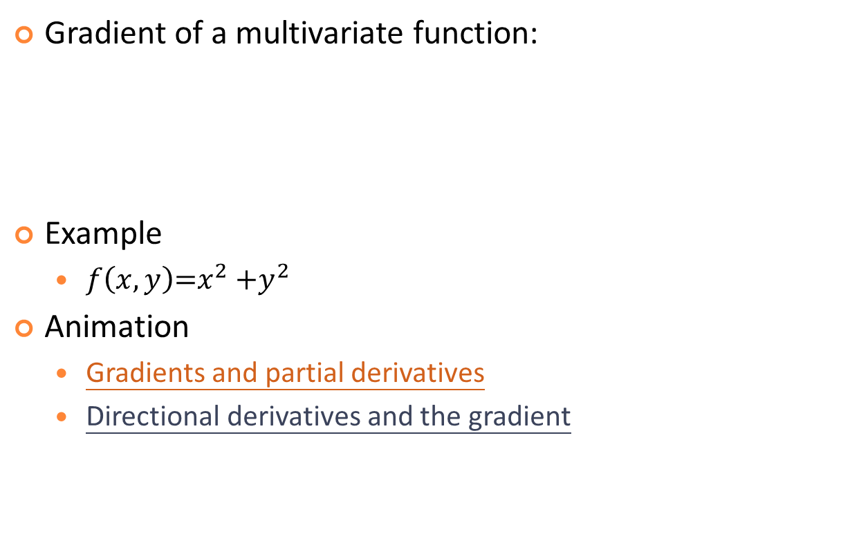
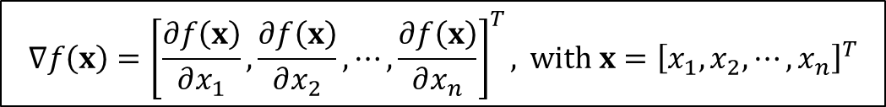
Gradient

Slide 2
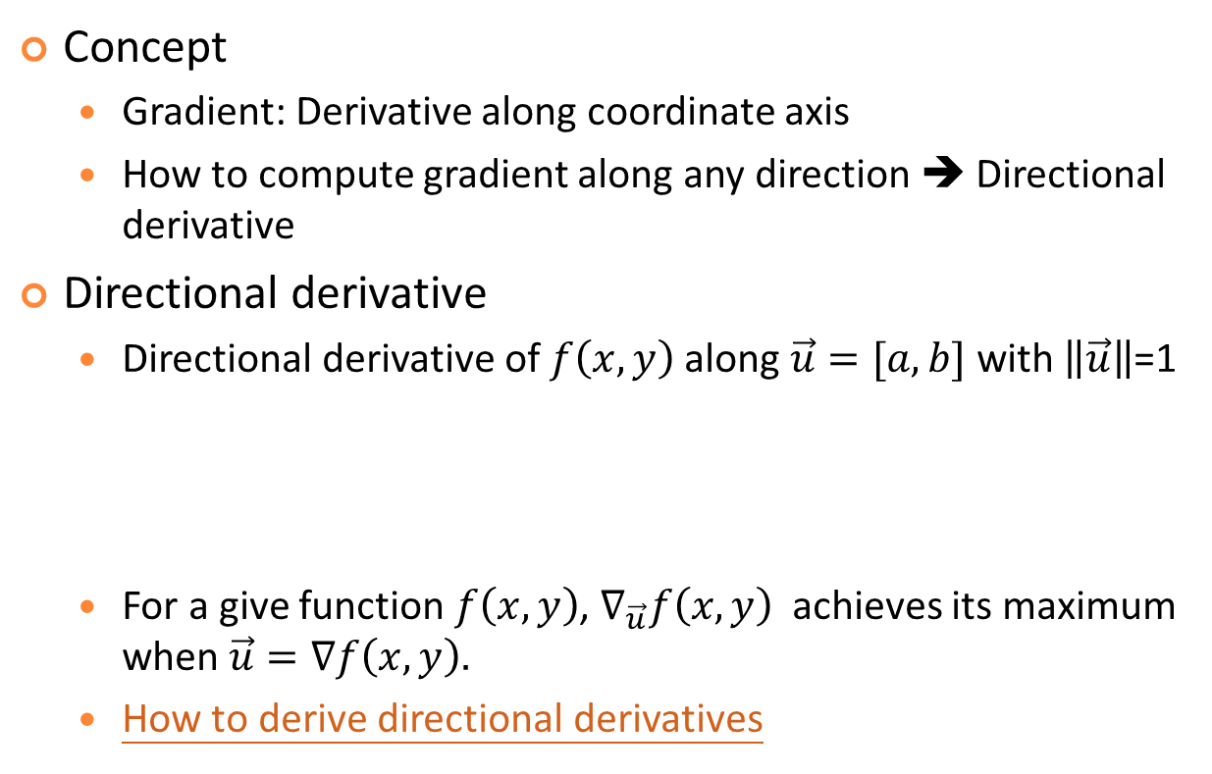
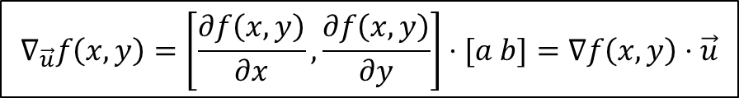
Directional Derivatives

Slide 3


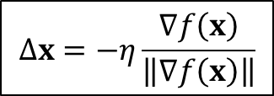

Gradient Descent (GD)
Gradient descent (GD): AKA steepest descent (SD)
Goal: Minimize a function iteratively based on gradient
Formula for GD:
Normalized version
With momentum
Step size or learning rate

Slide 4
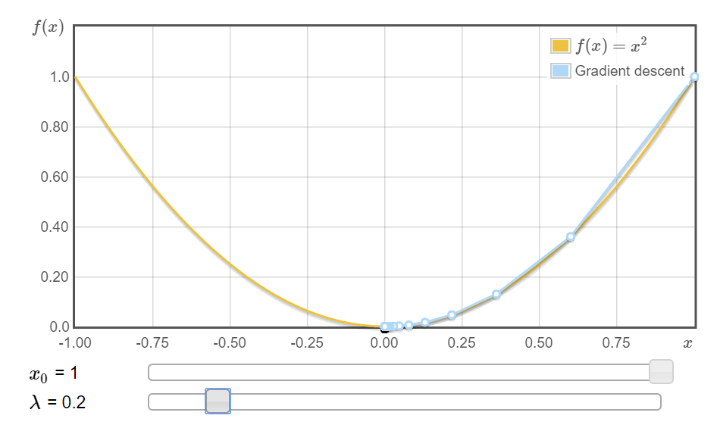
Example of Single-Input Functions
If n=1, GD reduces to the problem of going left or right.
Example
Animation:
http://www.onmyphd.com/?p=gradient.descent

Slide 5
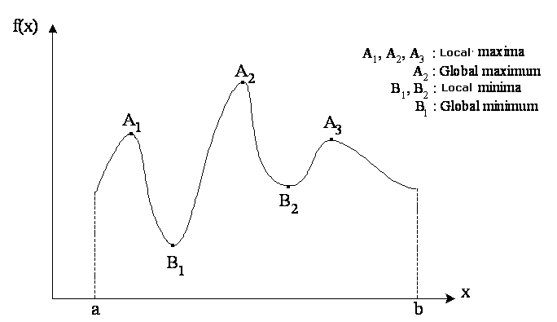
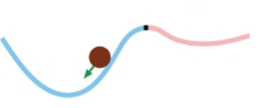
Basin of Attraction in 1D
Each point/region with zero gradient has a basin of attraction

Slide 6
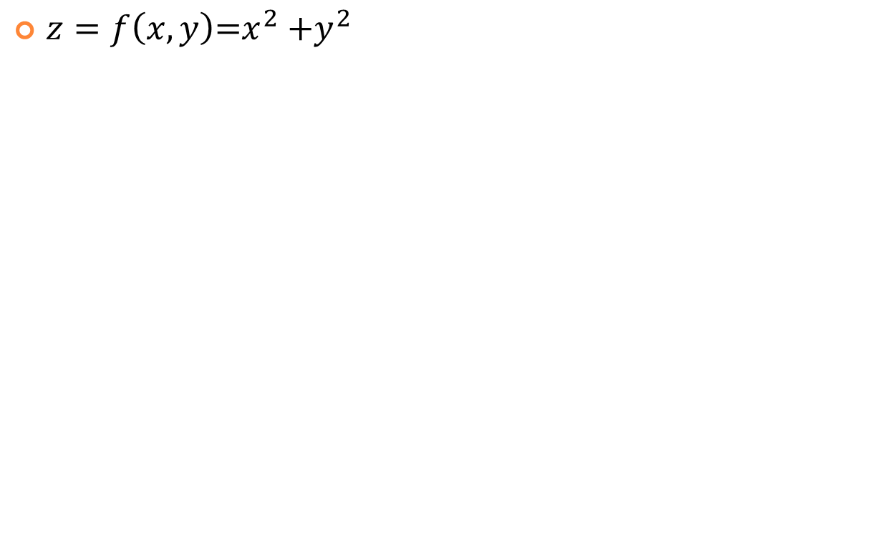
Example of Two-input Functions

Slide 7
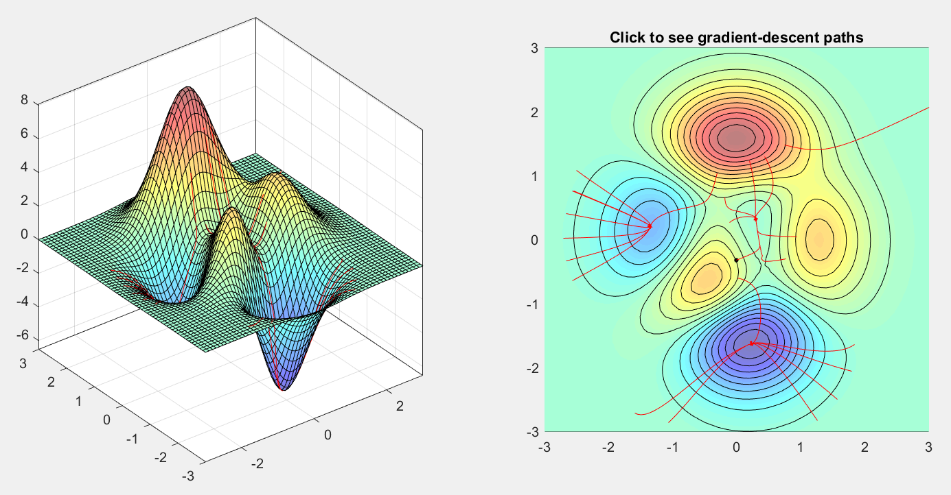
“Peaks” Functions (1/2)
If n=2, GD needs to find a direction in 2D plane.
Example: “Peaks” function in MATLAB
Animation: gradientDescentDemo.m
Gradients is
perpendicular
to contours, why?
3 local maxima
3 local minima

Slide 8
“Peaks” Functions (2/2)
Gradient of the “peaks” function
dz/dx = -6*(1-x)*exp(-x^2-(y+1)^2) - 6*(1-x)^2*x*exp(-x^2-(y+1)^2) - 10*(1/5-3*x^2)*exp(-x^2-y^2) + 20*(1/5*x-x^3-y^5)*x*exp(-x^2-y^2) - 1/3*(-2*x-2)*exp(-(x+1)^2-y^2)
dz/dy = 3*(1-x)^2*(-2*y-2)*exp(-x^2-(y+1)^2) + 50*y^4*exp(-x^2-y^2) + 20*(1/5*x-x^3-y^5)*y*exp(-x^2-y^2) + 2/3*y*exp(-(x+1)^2-y^2)
d(dz/dx)/dx = 36*x*exp(-x^2-(y+1)^2) - 18*x^2*exp(-x^2-(y+1)^2) - 24*x^3*exp(-x^2-(y+1)^2) + 12*x^4*exp(-x^2-(y+1)^2) + 72*x*exp(-x^2-y^2) - 148*x^3*exp(-x^2-y^2) - 20*y^5*exp(-x^2-y^2) + 40*x^5*exp(-x^2-y^2) + 40*x^2*exp(-x^2-y^2)*y^5 -2/3*exp(-(x+1)^2-y^2) - 4/3*exp(-(x+1)^2-y^2)*x^2 -8/3*exp(-(x+1)^2-y^2)*x

Slide 9
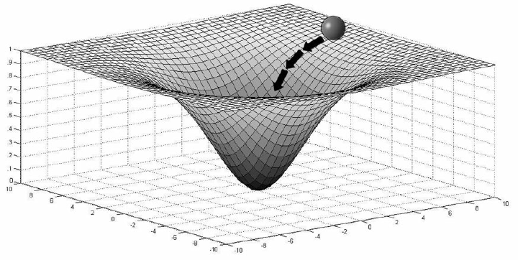
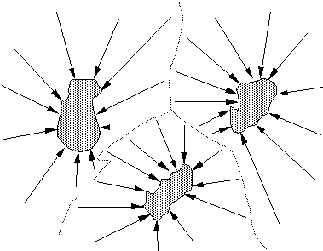
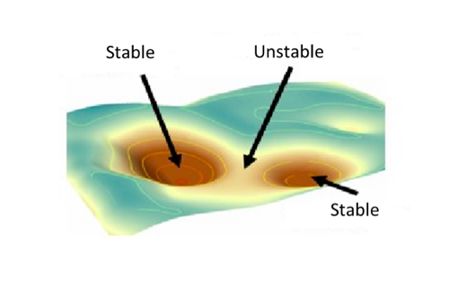
Basin of Attraction in 2D
Each point/region with zero gradient has a basin of attraction

Slide 10
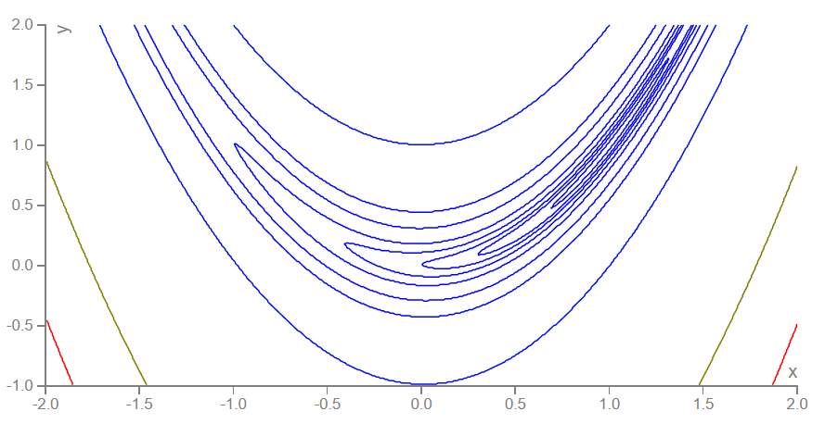
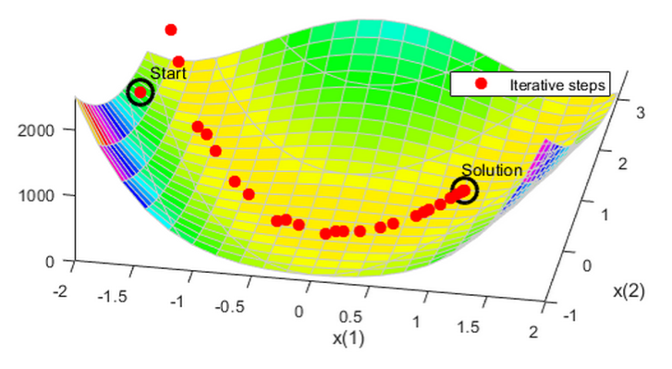
Rosenbrock Function
Rosenbrock function
More about this function
Animation: http://www.onmyphd.com/?p=gradient.descent
Document on how to optimize this function
Justification for using momentum terms

Slide 11
Properties of Gradient Descent
Properties
No guarantee for reaching global optimum
Feasible for differentiable objective functions (which can have finite number of non-differential points)
Performance heavily dependent on starting point and step size
Variants
Use adaptive step sizes
Normalize the gradient by its length
Use the momentum term to reduce zig-zag paths
Use line minimization at each iteration
Quiz!

Slide 12
Comparisons of Gradient-based Optimization
Gradient descent (GD)
Treat all parameters as nonlinear
Hybrid learning of GD+LSE
Distinguish between linear and nonlinear
Conjugate gradient descent
Try to reach the minimizing point by assume the objective function is quadratic
Gauss-Newton (GN) method
Linearize the objective function to treat all parameters as linear
Levenberg-Marquardt (LM) method
Switch smoothly between SD and GN

Slide 13
Gauss-Newton Method
Synonyms
Linearization method
Extended Kalman filter method
Concept:
General nonlinear model: y = f(x, θ)
linearization at θ = θnow:
y = f(x, θnow)+a1(θ1 - θ1,now)+a2(θ2 - θ2,now) + ...
LSE solution:
θnext = θnow + η(A^{T}A)⁻¹A^{T}B

Slide 14
Levenberg-Marquardt Method
Formula
θnext = θnow + η(A^{T}A+λI)⁻¹A^{T}B
Effects of λ
λ small ➔ Gauss-Newton method
λ big ➔ Gradient descent
How to update λ
Greedy policy ➔ Make λ small
Cautious policy ➔ Make λ big

Slide 15
Exercises
Can we use GD to find the minimum of f(x)=|x|?
What is the gradient of the sigmoid function? Can you express the gradient using the original function?
What are the basins of attraction of the following curve?
Quiz: The gradient of a function of e^{ax}
can be expressed as the function itself. Why?

