Slide 1
Numerical Analysis
(数值分析）
北京理工大学出版社

Slide 2
Bilingual course
Numerical Analysis is one of the bilingual courses in your study. The purpose of the course focuses on understanding numerical analysis in English.We do hope you can read and write the mathematical materials in English as smoothly as possible after finishing the course.

Slide 3
Syllubus(课程大纲）
Numerical Analysis（数值分析）, 9 周
Machine Learning (机器学习）,7周
Soft ware: Python, Matlab, Octave

Slide 4
本课程成绩评定构成
平时成绩(45%)：homework+project and presentation,
考勤：5%
期末考试：50%

Slide 5
Numerical Analysis
* Solutions of Nonlinear Equations
* Solution of linear Systems
* Interpolation and Polynomial Approximation
* Curve Fitting
* Numerical Differentiation and Numerical Integration
* Solutions of Ordinary Differential Equations

Slide 6
Machine Learning
* linear classification and linear regression
* decision tree
* naive Bayes classification
* K-means cluster
* Nerual Net Work
* Convolutional Nerual Net Work

Slide 7
The following tools are needed
python， MATLAB， Octave
问题（problem)-- 算法(algorithm)---方案（solution）

Slide 8
How to install Python
STEP 1: log in to the website:
http: //www.python.org
STEP 2: click on downloads
python-3.9.6 for windows
STEP 3: install python on your laptop by follwing the defaut options

Slide 9
numerical analysis is important
real world problems
simplify
abstract
mathematical models
interpret
analyze
conclusions
numerical methods
simulate
program
computer models
Algorithm

Slide 10
Purpose of numerical annalysis
★ To give an introduction to modern approximating techniques;
★ To explain how, why, and when algorithm can be expected to work;
★ To provide a firm basis for future study of numerical analysis and computing science .

Slide 11

References
《数值分析》 李庆扬，王能超等，华中科技大学出版社
《数值计算引论》白峰杉，高等教育出版社
《计算方法》王能超，高等教育出版社
《数值分析》 孙志忠，袁慰平等，东南大学出版社
《数值分析与实验学习指导》蔡大用，清华大学出版社
《数值分析及其MATLAB实验》姜建飞等，科学出版社
《Numeical Analysis》Richard L. Bursen高等教育出版社
《Numerical Methods Using MATLAB》 (英文版)
（美) John H. Mathews, 黄仿伦

Slide 12

Reference

Slide 13
Chapter 1
Some Basics for Calculus

Slide 14
Theorem1.1 (Lagrange mean value Theorem)
let f(x) be a function on [a,b], and satisfies
(i) f(x) is continuous on [a, b]
(ii) f(x) is differentiable on (a, b)
Then there exists such that

Slide 15
Theorem1.2 (Rolle Theorem)
let f(x) be a function on [a,b], and satisfies
(i) f(x) is continuous on [a, b] and f(a)=f(b)
(ii) f(x) is differentiable on (a, b)
Then there exists such that

Slide 16
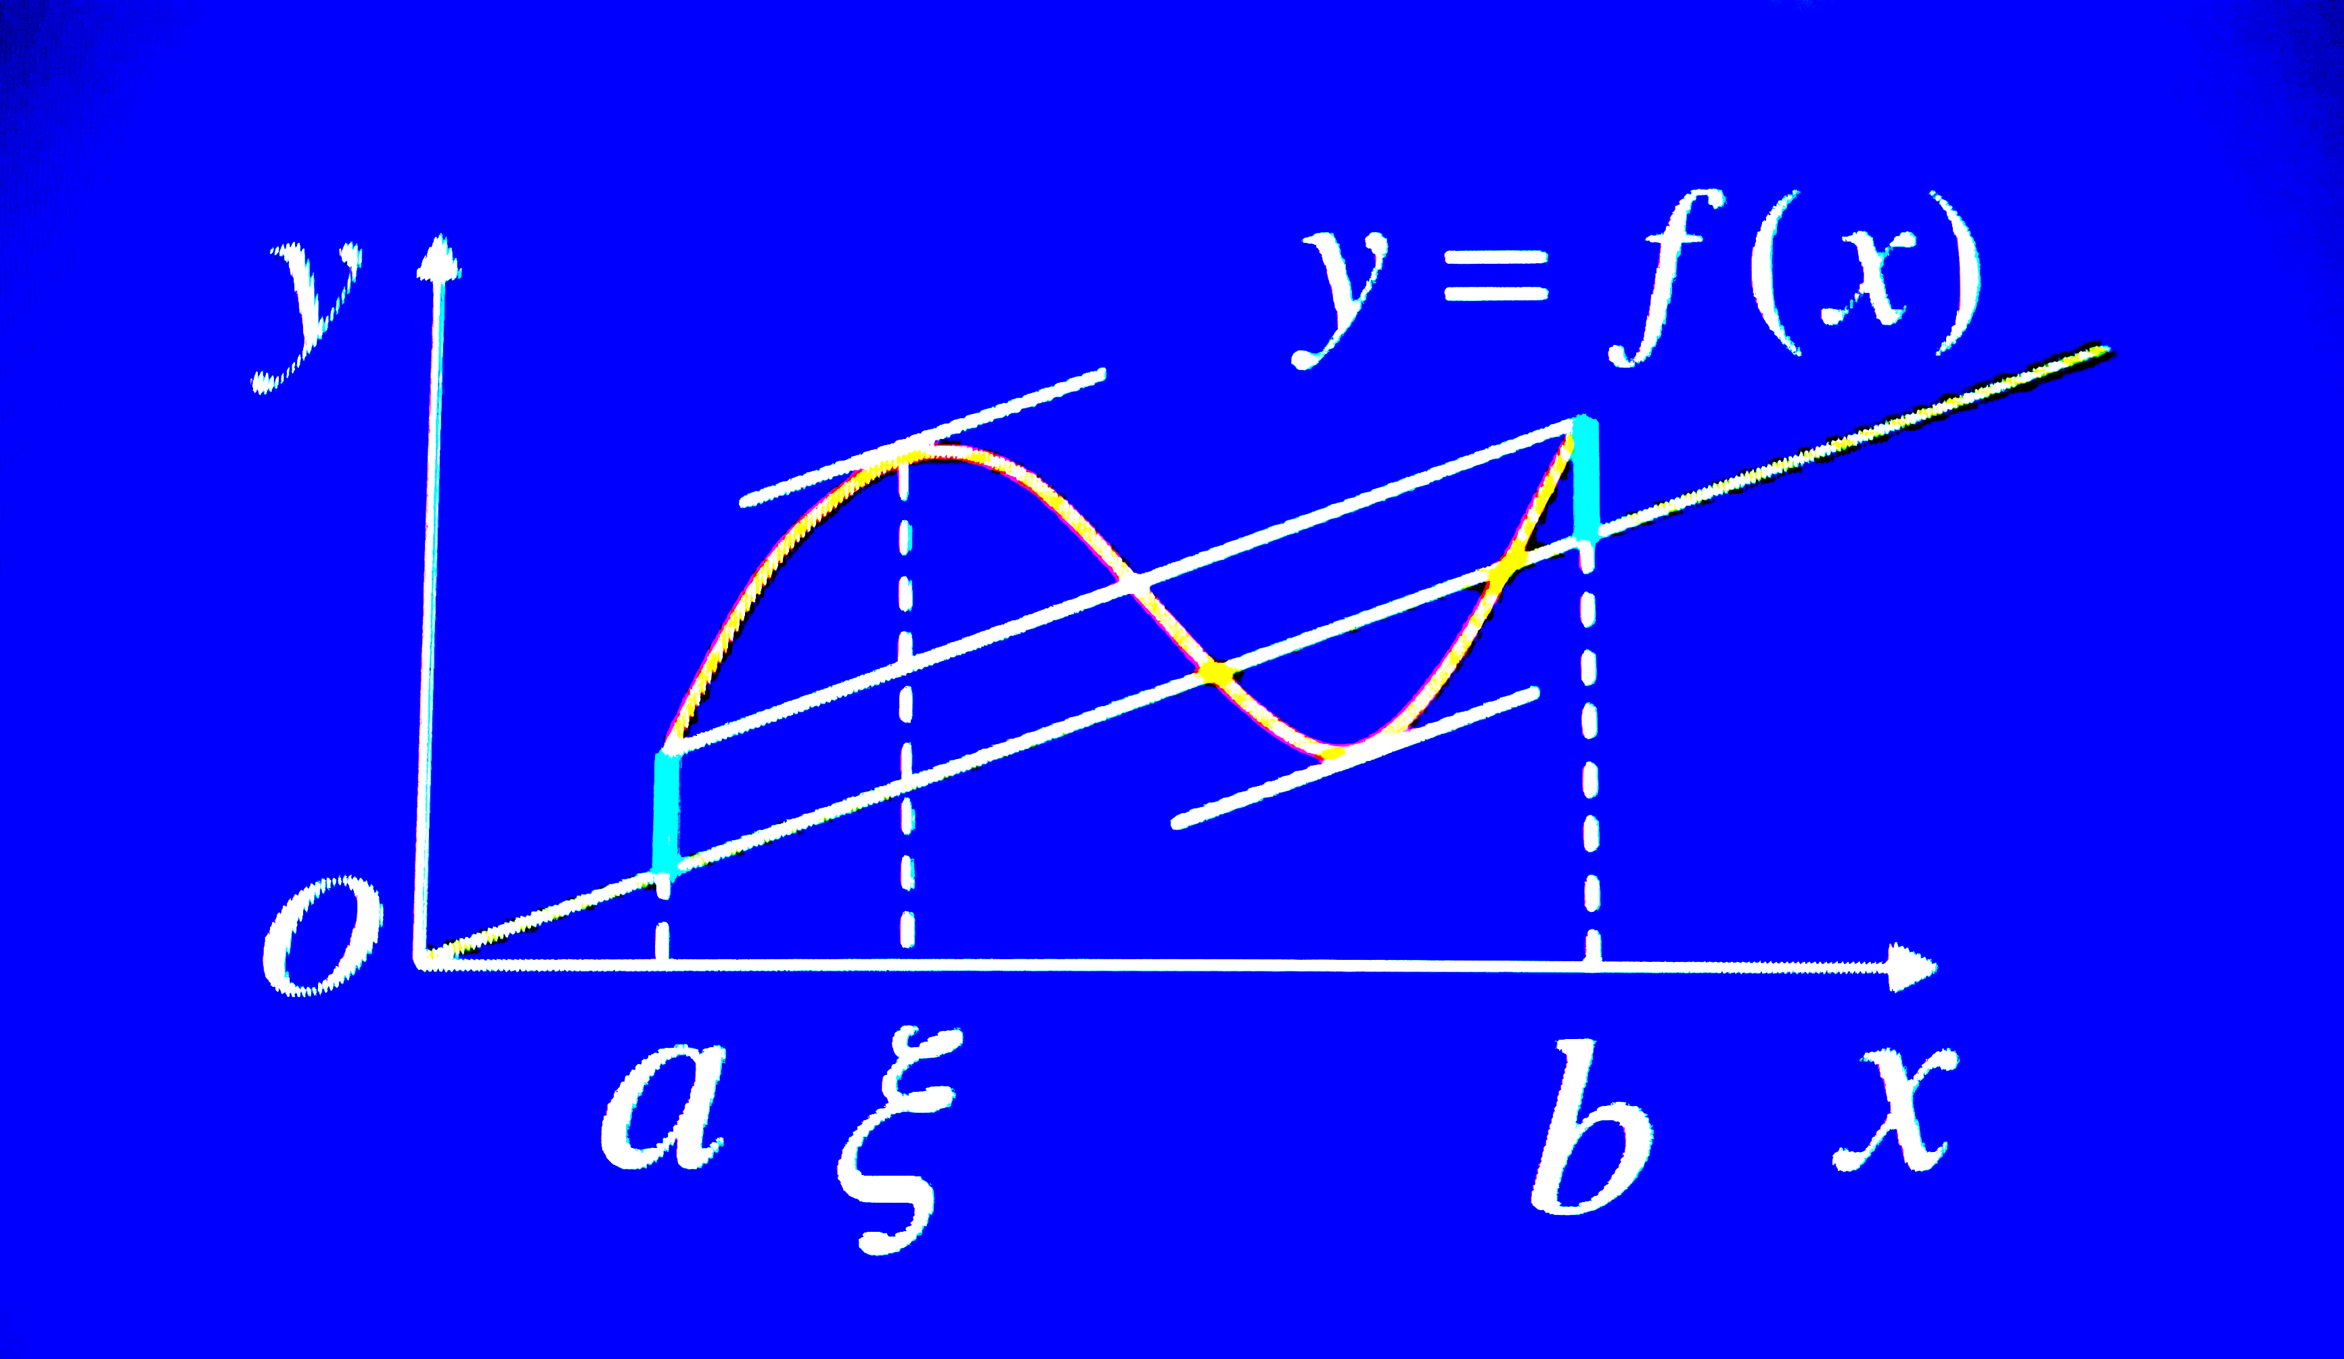
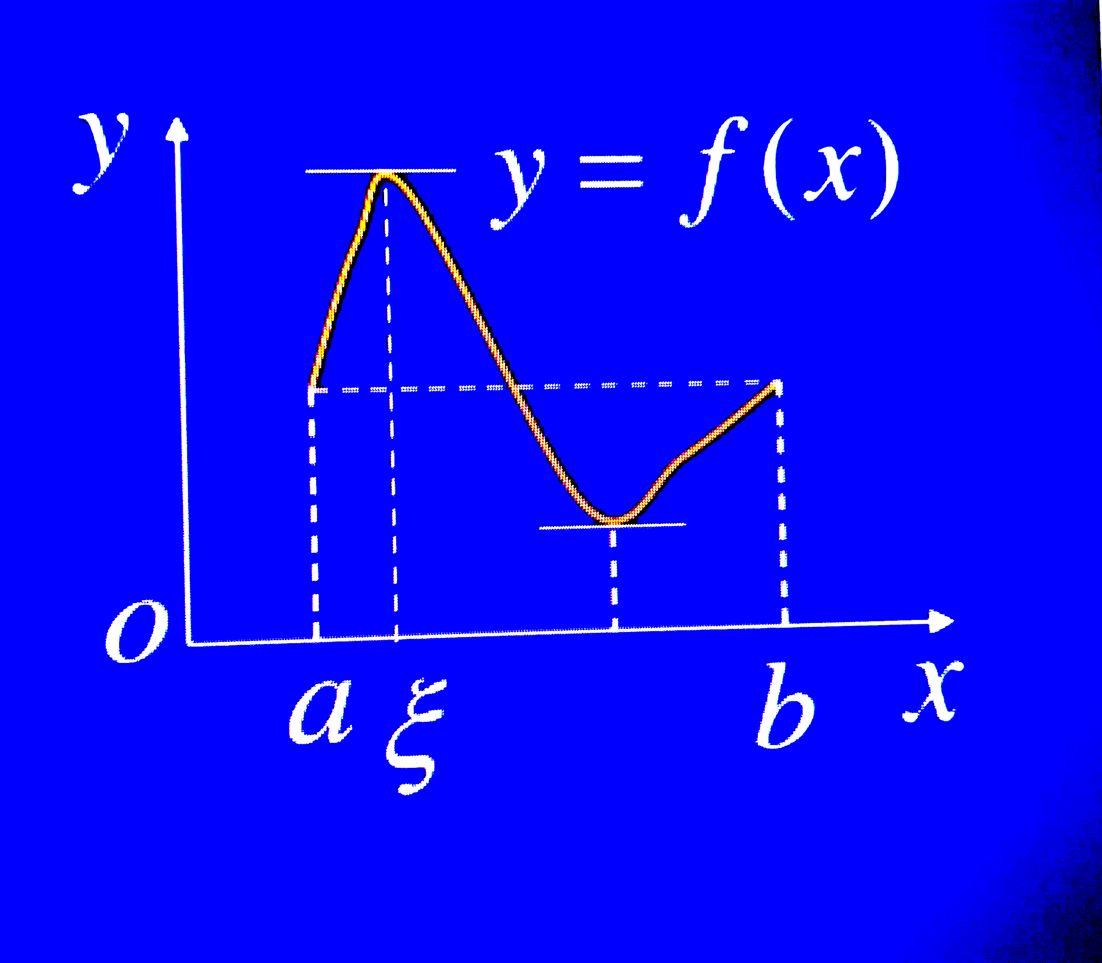
Th 1.1
Th 1.2

Slide 17
Th 1.3
Genaralized Rolle Theroem

Slide 18
Th 1.7

Slide 19
Truncation Error
Error Analysis
Round-Off Error
Normalized Decimal Real Number
chopping
rounding

Slide 20
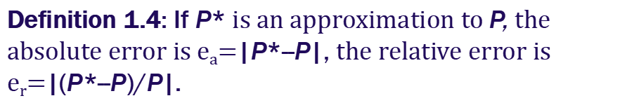
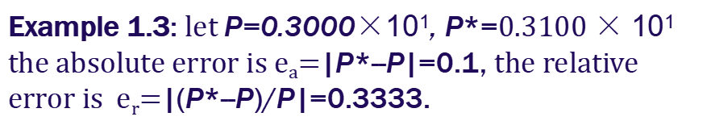
Absolute Error and Relative Error
Notice: Some times the relative error is more accurate and meaningful than absolute error !

Slide 21
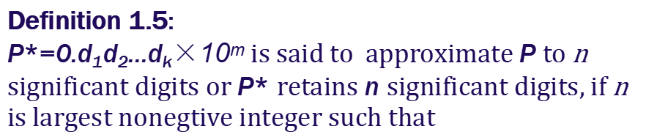
|P*--P|≦0.5×10^{m-n}, or
|(P*--P)/p|≦0.5×10^{-n},

Slide 22
|P*--P|≦0.5×10^{m-n}, or
|(P*--P)/p|≦0.5×10^{-n},

Slide 23
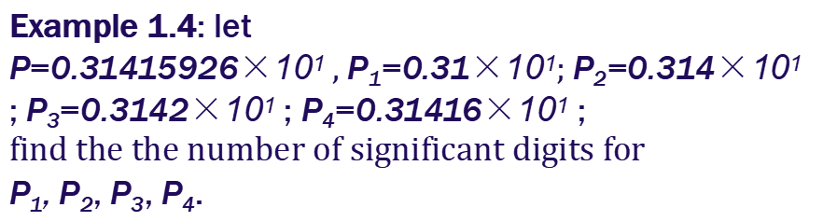
Solution: It is easy to varify
|P--P₁|≦0.5×10⁻², |P--P₂|≦0.5×10⁻³
|P--P₃|≦0.5×10⁻⁴, |P--P₄|≦0.5×10⁻⁵
So the number of significant digits for
P₁, P₂, P₃, P₄ are 2,3,4,5 respectively.

Slide 24
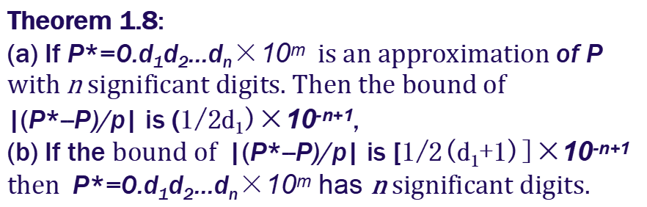
Proof: (a) since P has n significant digits.
Thererfore,
|(P*--P)/p|≦ [(1/2)×10^{-n+m}]/(d₁×10^{m-1})
≦ [(1/2d₁)]/10^{-n+1}.

Slide 25
(b) since P has n significant digits.
Thererfore,
|(P*--P)/p|≦|(P*--P)/p|*|p|
≦ [(1/2(d₁+1)]×10^{-n+1} × (d₁+1)×10^{m-1})
≦ 1/2× 10^{-n+m}
Therefore, P* has n significant digits.

Slide 26
Th 1.8
Proof

Slide 27
Conclusion:
The number of significant digits can be used to evaluate the ralative error and vice versa.
结论:
有效数字位数可用来估计相对误差反过来也对。

Slide 28
Ex. 1.5
Let P* be an approximation to , determine the least number of siginificant digits of P* such that the relative error bound is
Note: |(P*--P)/p|≦ [(1/2d₁)]X10^{-n+1}.

Slide 29
Ex. 1.5
Solution
......

Slide 30
4 rules must followed when caculations are performed
(1) Aviod subtraction of nearly equal numbers.
(2) Aviod division by numbers with small magnitude.
(3) Aviod big number “swallowing” small numbers.
(4)Reduce the number of calculations

