Slide 1
CHAPTER 2
Solutions of
Nonlinear Equations

Slide 2
2.1 Bisection Method

Slide 3
Theorem 2. 1 ( Bisection Theorem)
Ex. 2. 1

Slide 4
Example Use the Bisection method to find the solution
accurate to for on .
Solution
Let
It is clear that
and
for
So,
there exists a unique root of in .
Solving the inequality
gives
Therefore, n=9 steps are needed to guarantee that
the solution is accurate to .

Slide 5
Table: Results of the first ten iterations
n | a_{n} | b_{n} | c_{n}
0 | 1.0 | 2.0 | 1.5
1 | 1.0 | 1.5 | 1.25
2 | 1.25 | 1.5 | 1.375
3 | 1.25 | 1.375 | 1.3125
4 | 1.3125 | 1.375 | 1.34375
5 | 1.34375 | 1.3745 | 1.359375
6 | 1.359375 | 1.375 | 1.3671875
7 | 1.359375 | 1.3671875 | 1.36328125
8 | 1.3628125 | 1.3671875 | 1.365234375
9 | 1.36328125 | 1.365234375 | 1.364257813 (9.77*10⁻⁴<10⁻³)

Slide 7
2.2 Fixed-Point Iteration method
if
finding the root of the equation
is equivalent to finding the solution to the equation
p is said to be the fixed point of g(x) if

Slide 8
2.2 Fixed-Point Iteration
Example
is equivalent to

Slide 9
2.2 Fixed-Point Iteration
Example

Slide 10
Theorem 2. 2 Suppose that
Proof

Slide 11
on [3, 4].
Example Consider

Slide 12
Theorem 2. 3（Fixed-Point Theorem） Assume that
Proof
All hypotheses guarantee that there exists a unique
fixed point
Then,
since
That is,

Slide 13
Example Show that

Slide 14
Example
 | 0 | 1 | 2 | 3 | 4 | 5 | 6
 | 1.5 | 1.34840 | 1.36738 | 1.36496 | 1.36526 | 1.36523 | 1.36523

Slide 15
Consider the convergence of the iterative rule on . Where the function g(x) is as follows:

Slide 17
n | (1) | (2) | (3) | (4) | (5)
0 | 1.5 | 1.5 | 1.5 | 1.5 | 1.5
1 | -0.875 | 0.8165 | 1.28695 | 1.34840 | 1.37333
2 | 6.732 | 2.9969 | 1.40254 | 1.36738 | 1.36526
3 | -469.7 | (-8.65)^{1/2} | 1.34546 | 1.36496 | 1.36526
4 | 1.03×10⁸ |  | 1.37717 | 1.36526
5 |  |  | 1.36009 | 1.36523
6 |  |  | 1.36785 | 1.36523
7 |  |  | 1.36592
8 |  |  | 1.36487
9 |  |  | 1.36541
10 |  |  | 1.36522

Slide 18
Graphical Interpratation of Fixed-Point Iteration
y
y=g(x)
x

Slide 19
Fixed-Point Theorem Assume that
2.3 Newton-Raphson Method
simple root / multiple root
Theorem 2.4

Slide 20
Newton-Raphson Theorem
Proof

Slide 21
Example Find the solution of equation
in
using Newton-Raphson iteration with .
Solution
Newton-Raphson iterative formula:
The results are listed in the following table with
 | 0 | 1 | 2 | 3
 | 1.5
1.37333 | 1.36526 | 1.36526
 | 1
1.45455 | 1.36890 | 1.36524
1.5 | 1.37333 | 1.36526
 | 2
 | -0.25
-5.637931 | -4.402963 | -3.626323

Slide 22
Newton-Raphson Theorem
Example Find the solution of on
using Newton-Raphson iteration .
Solution

Slide 23
Example Approximate using Newton-Raphson method.
Solution
0 0.05
1 50.0249999999999
2 2.33333333333333
25.0624750124938
12.6309882291405
6.51342003728092
3.64053295431645
7 2.50697911823893
8 2.25070568342295
9 2.23611557644537
10 2.23606797800639
11 2.23606797749979
12 2.23606797749979
0 2.00000000000000
1 2.25000000000000
2 2.236111111111111
3 2.23606797791580
4 2.23606797749979
5 2.23606797749979

Slide 24
Geometrical Explanation for Newton’s Method

Slide 25
Newton’s Method from Taylor polynomial
Consider the first Taylor polynomial for expended about

Slide 26
2.4 Secant Method

Slide 28
n | 0 | 1 | 2 | 3 | 4 | 5
p_{n} | 0.5
0.785398 | 0.736384 | 0.739058 | 0.730951 | 0.730951

Slide 29
n
n
n
0
0.7853981635
0
0.7853981635
0
0.5
1
0.7071067810
1
0.7395361337
1
0.7853981635
2
0.7602445972
3
0.7246674808
2
0.7390851781
2
0.7363841388
4
0.7487198858
3
0.7390851332
3
0.7390581392
5
0.7345608446
4
0.7390851332
4
0.7390851493
6
0.7434642113
5
0.7390851332
7
0.7361282565
⁞ ⁞
20 0.7391025006

Slide 30
2.5 Rate of Convergence
n | p_{n} | |e_{n}| | |e_{n+1}|/|e_{n}|
0 | 1.2
1 | 1.103030
2 | 1.052356
3 | 1.026401
4 | 1.013258
5 | 1.006643
0.2
0.103030
0.052356
0.026401
0.013258
0.006643
0.515152
0.508165
0.504252
0.502171
0.501098
n | p_{n} | |e_{n}| | |e_{n+1}|/|e_{n}|²
0 | -2.4 | 0.4
1 | -2.076190 | 0.076190 | 0.47619
2 | -2.003596 | 0.003596 | 0.619469
3 4 | -2.000009 -2.000000 | 0.000009 0.000000 | 0.664277 0.666655
n | 0 | 1 | 2 | 3 | 4 | 5 | … | 10
p_{n} | -2.400000 | -2.076190 | -2.003596 | -2.000009 | -2.000000
 | 1.200000 | 1.103030 | 1.052356 | 1.026401 | 1.013258 | 1.006643 |  | 1.000208

Slide 31
Rate of fixed-point iteration

Slide 32
Theorem 2.7
Rate of Newton-Raphson method

Slide 33
Conclusions
Theorem
Theorem
If is a simple root, convergence is quadratic and
for n sufficiently large.
If is a root of multiplicity M, convergence is linear and
for n sufficiently large.

Slide 34
Example Use Newton-Raphson method to find the root of
started with
and
respectively.
Solution
Newton-Raphson iterative formula:
n | 0 | 1 | 2 | 3 | 4 | 5 | … | 10
p_{n} | -2.400000 | -2.076190 | -2.003596 | -2.000009 | -2.000000
 | 1.200000 | 1.103030 | 1.052356 | 1.026401 | 1.013258 | 1.006643 |  | 1.000208

Slide 35
Example Use Newton-Raphson method to find the root of
started with
and
respectively.
n | p_{n} | |e_{n}| | |e_{n+1}|/|e_{n}|²
0 | -2.4 | 0.4
1 | -2.076190 | 0.076190 | 0.47619
2 | -2.003596 | 0.003596 | 0.619469
3 4 | -2.000009 -2.000000 | 0.000009 0.000000 | 0.664277 0.666655
n | p_{n} | |e_{n}| | |e_{n+1}|/|e_{n}|
0 | 1.2
1 | 1.103030
2 | 1.052356
3 | 1.026401
4 | 1.013258
5 | 1.006643
0.2
0.103030
0.052356
0.026401
0.013258
0.006643
0.515152
0.508165
0.504252
0.502171
0.501098
n | 0 | 1 | 2 | 3 | 4 | 5 | … | 10
p_{n} | -2.400000 | -2.076190 | -2.003596 | -2.000009 | -2.000000
 | 1.200000 | 1.103030 | 1.052356 | 1.026401 | 1.013258 | 1.006643 |  | 1.000208

Slide 36
Convergence of the Secand Method
Theorem

Slide 37
n
n
n
0
0.7853981635
0
0.7853981635
0
0.5
1
0.7071067810
1
0.7395361337
1
0.7853981635
2
0.7602445972
2
0.7390851781
2
0.7363841388
3
0.7246674808
3
0.7390851332
3
0.7390581392
4
0.7487198858
5
0.7345608446
4
0.7390851332
4
0.7390851493
6
0.7434642113
5
0.7390851332
7
0.7361282565
⁞ ⁞
20 0.7391025006

Slide 38
Improvements on Newton-Raphson method
Simple Newton method
n | p_{n}
0 | 0.7853981635
1 | 0.7395361335
2 | 0.7390939381
3 | 0.7390853060
4 | 0.7390851366
5 | 0.7390851333
6 | 0.7390851332
7 | 0.7390851332
n
0
0.7853981633
1
0.7395361337
2
0.7390851781
3
0.7390851332
4
0.7390851332

Slide 39
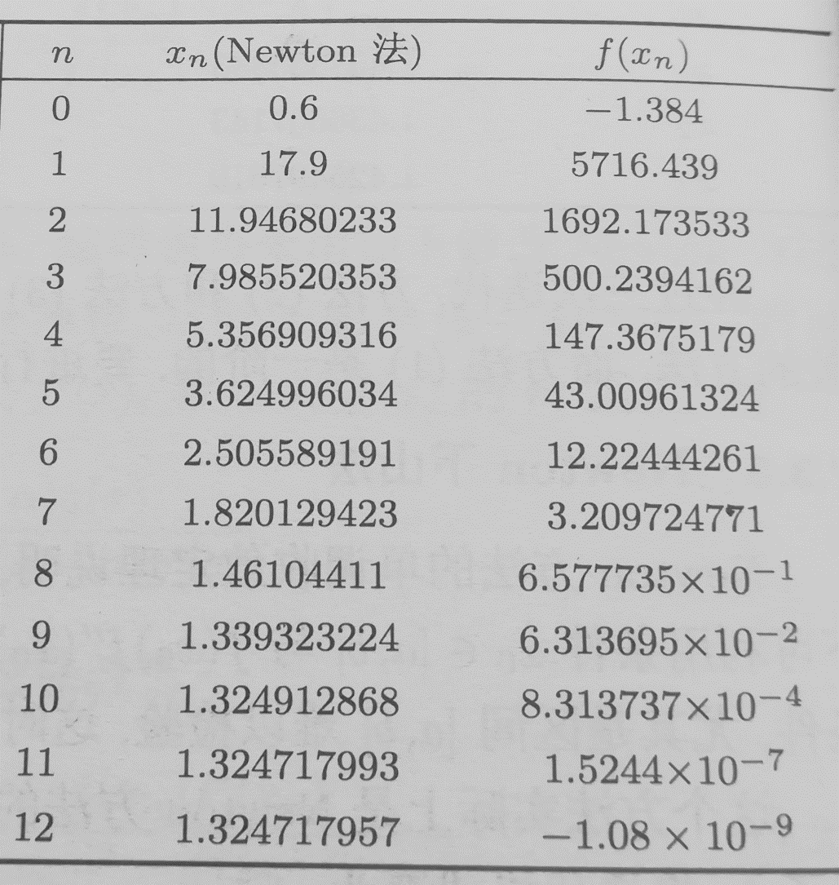
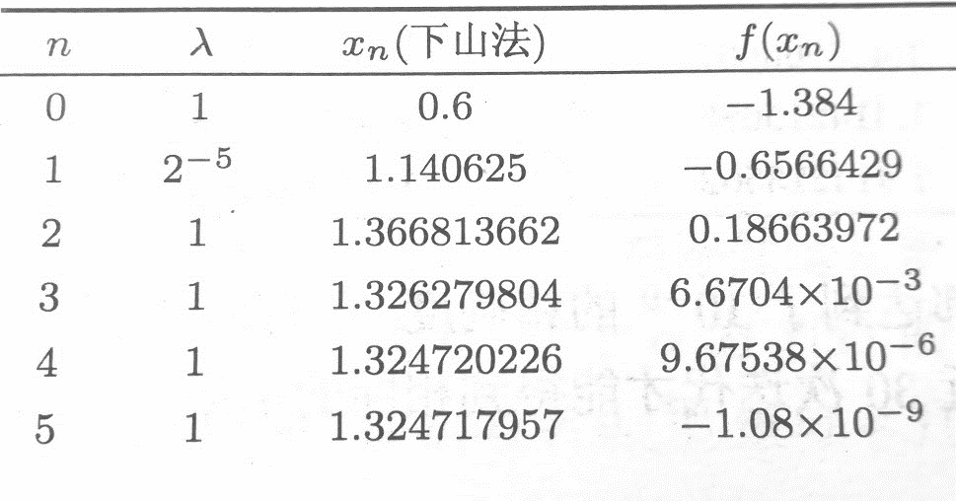
Newton downhill method
Example Use Newton downhill method to find the root of

Slide 40
Cases of Multiple Roots
a) The multiplicity of the root is known
b) The multiplicity of the root is unknown

Slide 41
Example Use Newton-Raphson method to find the root of
started with
and
respectively.
Solution
x =1 is a multiple root of order 2.
n | p_{n}
0 | 1.2
1 | 1.103030
2 | 1.052356
3 | 1.026401
4 | 1.013258
5 | 1.006643
⁞ ⁞
10 1.000208

