Slide 1
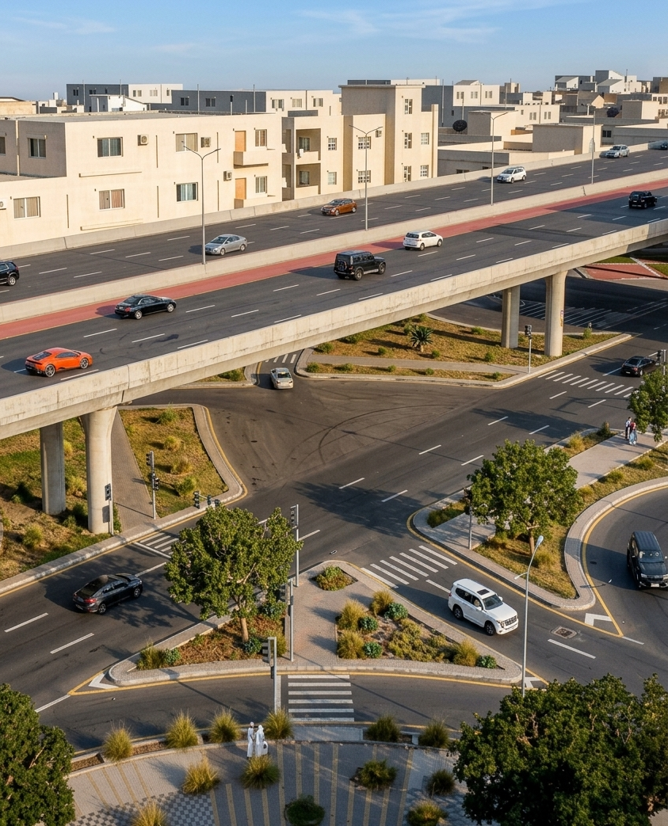
Taif Road Development — Junctions Daily Dashboard
Prepared for the Royal Commission for Riyadh City
STATUS 10 NOV 2026
39.72%
20.9%
OVERALL JUNCTIONS PLAN
OVERALL JUNCTIONS ACTUAL
LEFT LANE — P1 to P8 + A1/A2

Slide 2
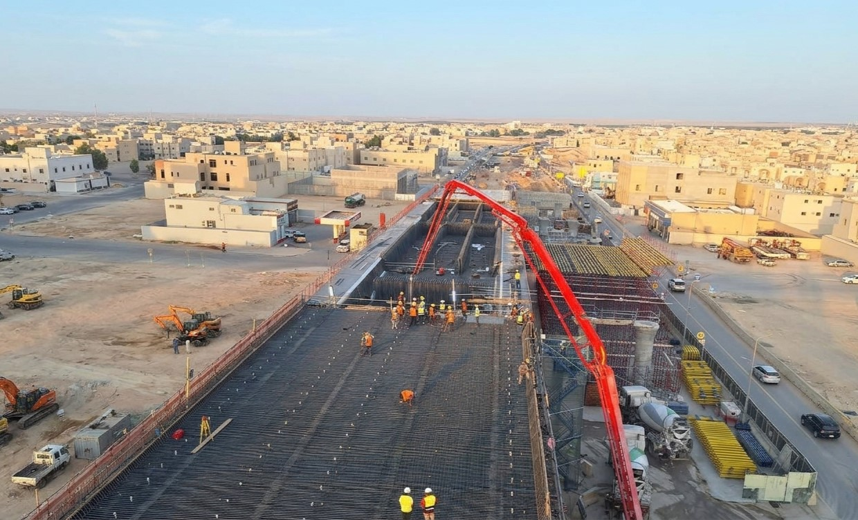
Taif Road Development — Daily Dashboard
Prepared for the Royal Commission for Riyadh City
STATUS 10 NOV 2026
Junction-07 (4+050) · ASEER STREET · Work Follow-Up Status
64.01%
38.58%
10
PLANNED
PIERS / ABUTMENTS
LEFT LANE — P1 to P8 + A1/A2
ACTUAL
-
-
-
P1–P8 + A1–A2
WORK SEQUENCE — LEFT LANE
S1
S2
S3
S4
S5
S6
S7
S8
S9
Progress Picture
A1
P1
P2
P3
P4
P5
P6
P7
P8
A2
Junction 07· Concrete· Work Follow-Up Status
S1
S2
S3
S4
S5
S6
S7
S8
S9
Description | Planned Progress | Actual Progress | Actual This Week | Budgeted (Qty) | Actual Progress (Qty)
OVERALL CONCRETE | 95% | 43.7% | 0.4% | 15472.1 | 7277.6
Piers Work | 100% | 87.7% | 1.6% | 3655.8 | 3262.6
Edge Walls | 100% | 66.4% | 0.2% | 2254.1 | 1579.4
Post Tension Deck Slab/Diaphragm | 93% | 28.9% | 0.1% | 9562.3 | 2435.6
A1
P1
P2
P3
P4
P5
P6
P7
P8
A2
WORK SEQUENCE — RIGHT LANE
Legends
Legends
Concrete Completed
Rebar In Progress
WORKS ABOVE LIVE TRAFFIC
Formwork In Progress
Excavation
Traffic flow is maintained safely during construction, with temporary barriers and traffic management measures in place to ensure safe movement of road users.
Not Started
Traffic management maintained throughout.

Slide 3
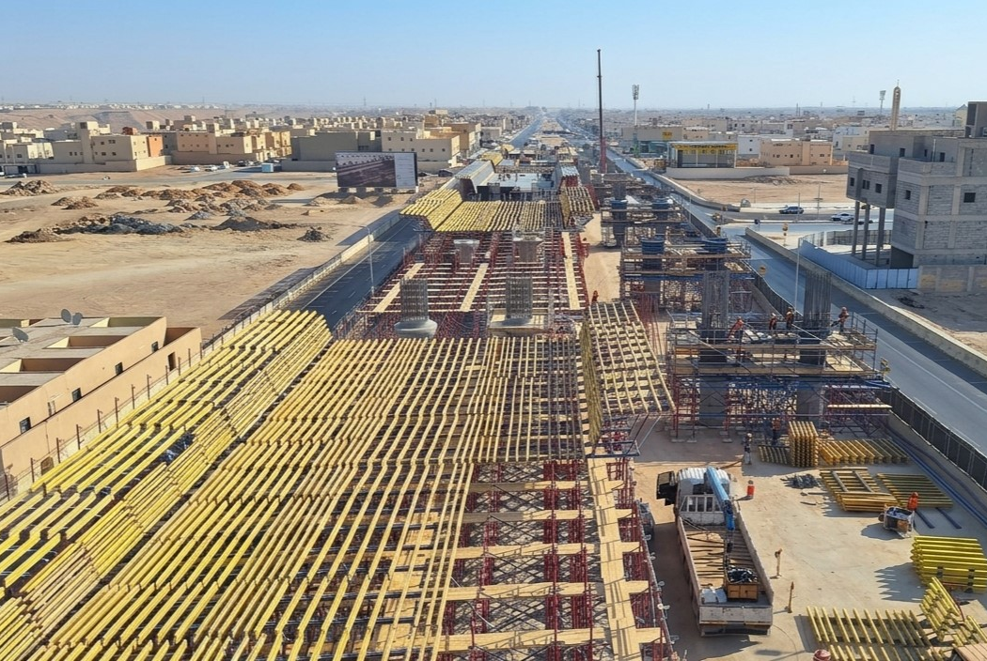
Taif Road Development — Daily Dashboard
Prepared for the Royal Commission for Riyadh City
STATUS 10 NOV 2026
Junction-05 (7+300) · AL SHIFA STREET · Work Follow-Up Status
33.26%
8.98%
10
16.99%
PLANNED
PIERS / ABUTMENTS
LEFT LANE — P1 to P8 + A1/A2
Actual
ACTUAL
-
-
-
P1–P8 + A1–A2
WORK SEQUENCE — LEFT LANE
S1
S2
S3
S4
S5
S6
S7
S8
S9
Progress Picture
A1
P1
P2
P3
P4
P5
P6
P7
P8
A2
Junction 05· Concrete· Work Follow-Up Status
S1
S2
S3
S4
S5
S6
S7
S8
S9
Description | Planned Progress | Actual Progress | Actual This Week | Budgeted (Qty) | Actual Progress (Qty)
OVERALL CONCRETE | 27% | 18.5% | 1.3% | 13374.9 | 3357.3
Piers Work | 98% | 100% | 0% | 3205.1 | 3166.6
Edge Walls | 87% | 0% | 0% | 1050 | 0.0
Post Tension Deck Slab/Diaphragm | 3% | 3.4% | 1.8% | 9119.7 | 190.7
A1
P1
P2
P3
P4
P5
P6
P7
P8
A2
Legends
WORK SEQUENCE — RIGHT LANE
Legends
Concrete Completed
Rebar In Progress
WORKS ABOVE LIVE TRAFFIC
Formwork In Progress
Excavation
Traffic flow is maintained safely during construction, with temporary barriers and traffic management measures in place to ensure safe movement of road users.
Not Started
Traffic management maintained throughout.

Slide 4
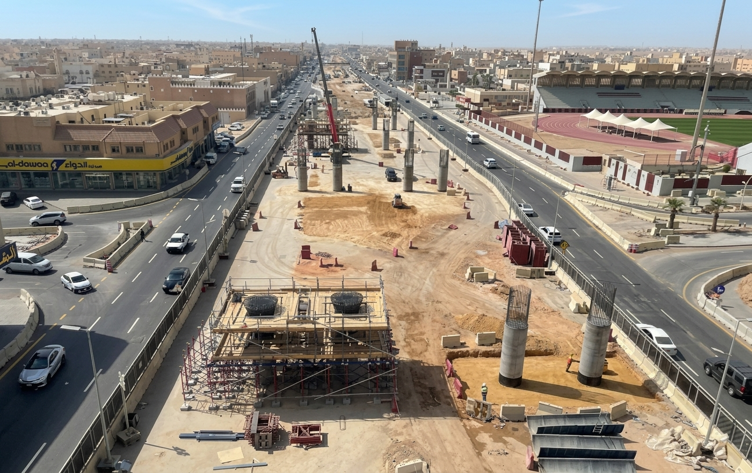
Taif Road Development — Daily Dashboard
Prepared for the Royal Commission for Riyadh City
STATUS 10 NOV 2026
Junction-03 (10+500) · TAIBA STREET · Work Follow-Up Status
30.12%
12.65%
8
PLANNED
ACTUAL
PIERS / ABUTMENTS
LEFT LANE — P1 to P8 + A1/A2
-
-
P1–P6 + A1–A2
WORK SEQUENCE —LEFT LANE
S1
S2
S3
S4
S5
S6
S7
Progress Picture
A1
P1
P2
P3
P4
P5
P6
A2
Junction 03· Concrete· Work Follow-Up Status
S1
S2
S3
S4
S5
S6
S7
Description | Planned Progress | Actual Progress | Actual This Week | Budgeted (Qty) | Actual Progress (Qty)
OVERALL CONCRETE | 17% | 15.1% | 0.1% | 21615.6 | 2459.4
Piers Work | 83% | 100% | 0% | 2509.3 | 2351.3
Edge Walls | 38% | 6.8% | 0.4% | 1210.9 | 108.1
Post Tension Deck Slab/Diaphragm | 0% | 0% | 0% | 17894.4 | 0.0
A1
P1
P2
P3
P4
P5
P6
A2
WORK SEQUENCE — RIGHT LANE
Legends
Legends
Concrete Completed
Rebar In Progress
WORKS ABOVE LIVE TRAFFIC
Formwork In Progress
Excavation
Traffic flow is maintained safely during construction, with temporary barriers and traffic management measures in place to ensure safe movement of road users.
Not Started
Traffic management maintained throughout.

Slide 5
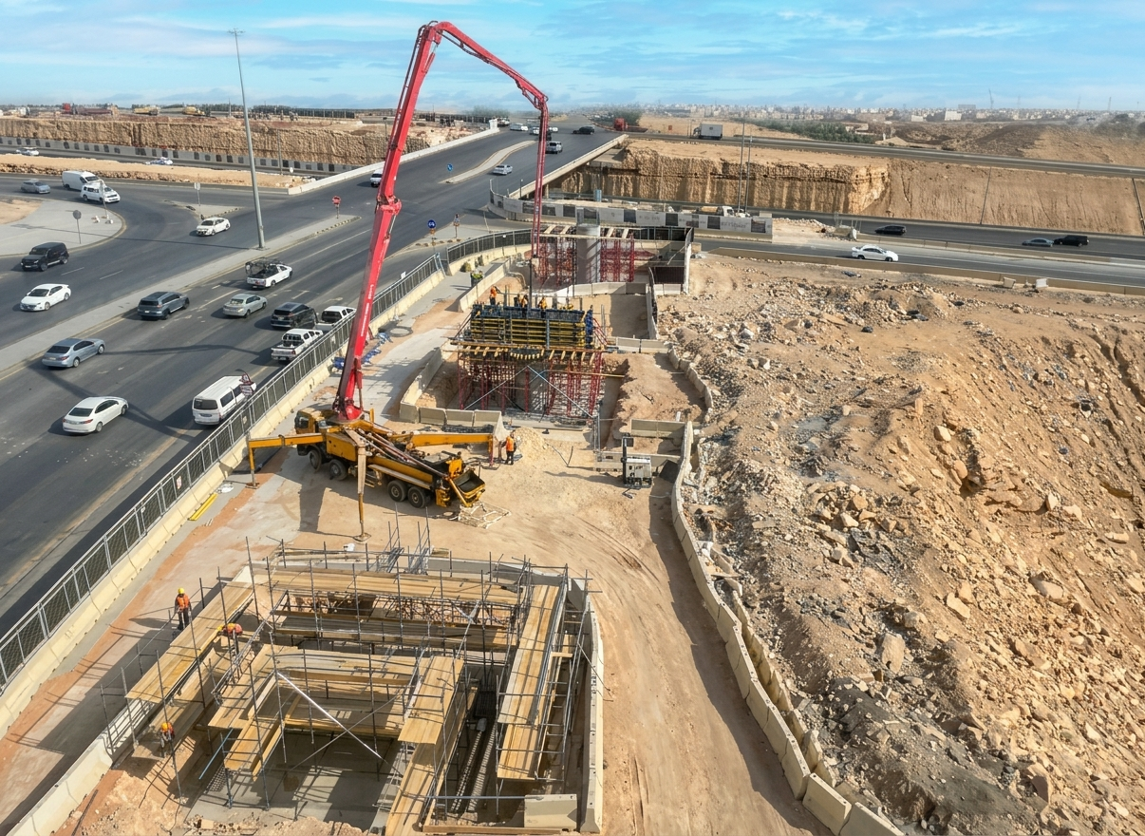
Taif Road Development — Daily Dashboard
Prepared for the Royal Commission for Riyadh City
STATUS 10 NOV 2026
Junction-01 (15+400) · JEDDAH JUNCTON · Work Follow-Up Status
18.36%
6.07%
10
PLANNED
ACTUAL
PIERS / ABUTMENTS
LEFT LANE — P1 to P8 + A1/A2
-
-
P1–P8 + A1–A2
WORK SEQUENCE
S1
S2
S3
S4
S5
S6
S7
S8
S9
A1
P1
P2
P3
P4
P5
P6
P7
P8
WORKS ABOVE LIVE TRAFFIC
A2
Traffic flow is maintained safely during construction, with temporary barriers and traffic management measures in place to ensure safe movement of road users.
Legends
Legends
Traffic management maintained throughout.
Concrete Completed
Rebar In Progress
Formwork In Progress
Excavation
Not Started

