Slide 1
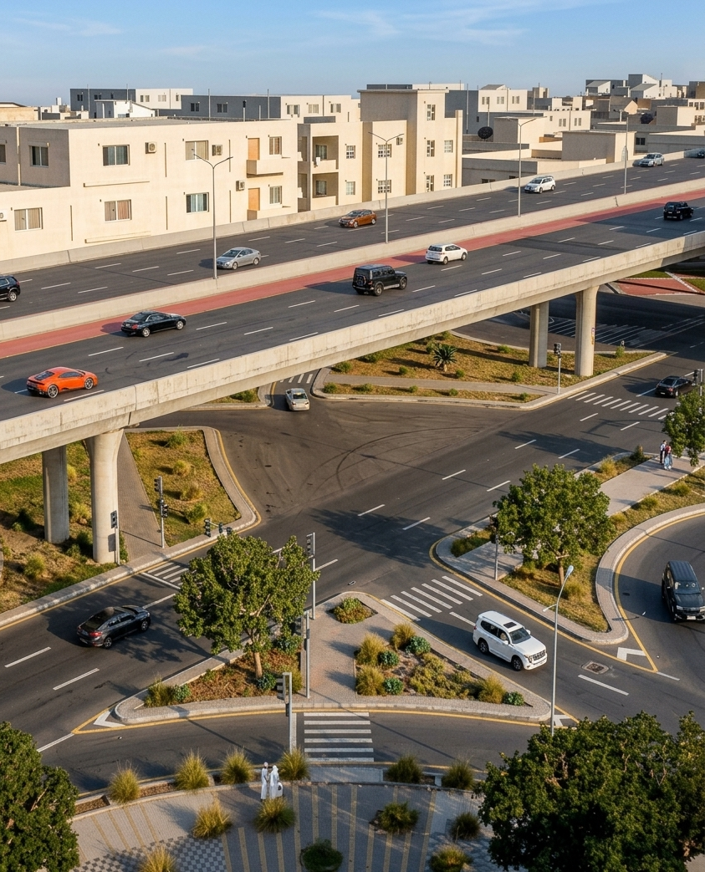
Taif Road Development — Junctions Daily Dashboard
Prepared for the Royal Commission for Riyadh City
STATUS 17 Oct 2026
32.3%
18.51%
OVERALL JUNCTIONS PLAN
OVERALL JUNCTIONS ACTUAL
LEFT LANE — P1 to P8 + A1/A2

Slide 2
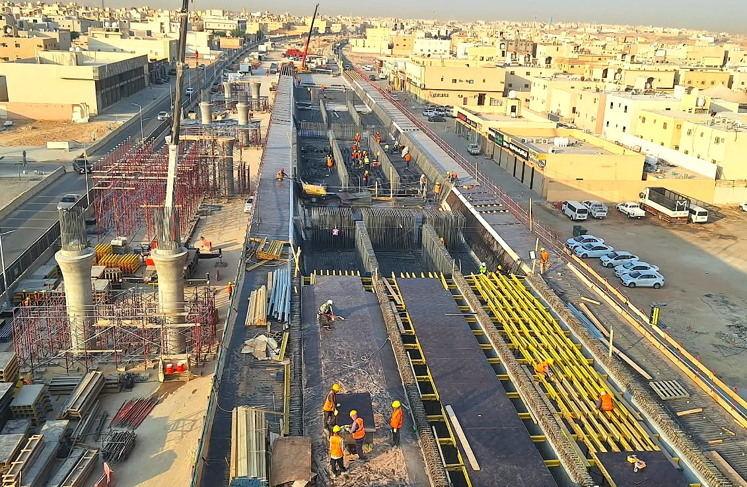
Taif Road Development — Daily Dashboard
Prepared for the Royal Commission for Riyadh City
STATUS 17 Oct 2026
Junction-07 (4+050) · ASEER STREET · Work Follow-Up Status
57.50%
34.86%
10
PLANNED
PIERS / ABUTMENTS
LEFT LANE — P1 to P8 + A1/A2
ACTUAL
-
-
-
P1–P8 + A1–A2
WORK SEQUENCE — LEFT LANE
S1
S2
S3
S4
S5
S6
S7
S8
S9
Progress Picture :
P1
P2
P3
P4
P5
P6
P7
P8
S1
S2
S3
S4
S5
S6
S7
S8
S9
WORKS ABOVE LIVE TRAFFIC
Traffic flow is maintained safely during construction, with temporary barriers and traffic management measures in place to ensure safe movement of road users.
P1
P2
P3
P4
P5
P6
P7
P8
Traffic management maintained throughout.
WORK SEQUENCE — RIGHT LANE
Legends
Legends
Concrete Completed
Rebar In Progress
Formwork In Progress
Excavation
Not Started

Slide 3
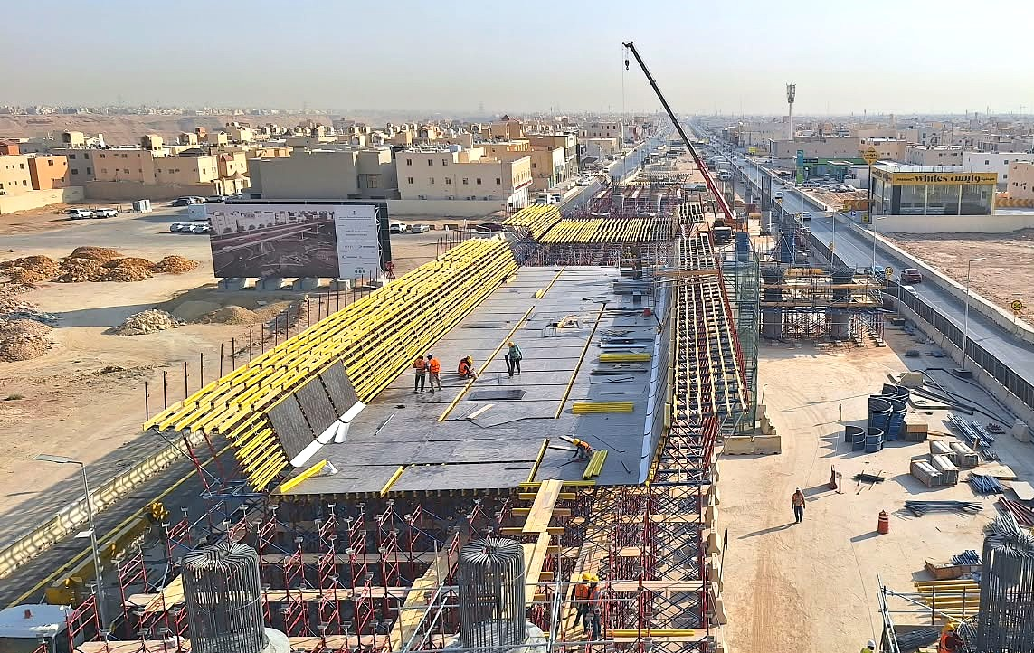
Taif Road Development — Daily Dashboard
Prepared for the Royal Commission for Riyadh City
STATUS 17 Oct 2026
Junction-05 (7+300) · AL SHIFA STREET · Work Follow-Up Status
24.17%
8.98%
10
15.64%
PLANNED
PIERS / ABUTMENTS
LEFT LANE — P1 to P8 + A1/A2
Actual
ACTUAL
-
-
-
P1–P8 + A1–A2
WORK SEQUENCE — LEFT LANE
S1
S2
S3
S4
S5
S6
S7
S8
S9
Progress Picture :
A1
P1
P2
P3
P4
P5
P6
P7
P8
A2
S1
S2
S3
S4
S5
S6
S7
S8
S9
WORKS ABOVE LIVE TRAFFIC
Traffic flow is maintained safely during construction, with temporary barriers and traffic management measures in place to ensure safe movement of road users.
A1
P1
P2
P3
P4
P5
P6
P7
P8
A2
Traffic management maintained throughout.
Legends
WORK SEQUENCE — RIGHT LANE
Legends
Concrete Completed
Rebar In Progress
Formwork In Progress
Excavation
Not Started

Slide 4
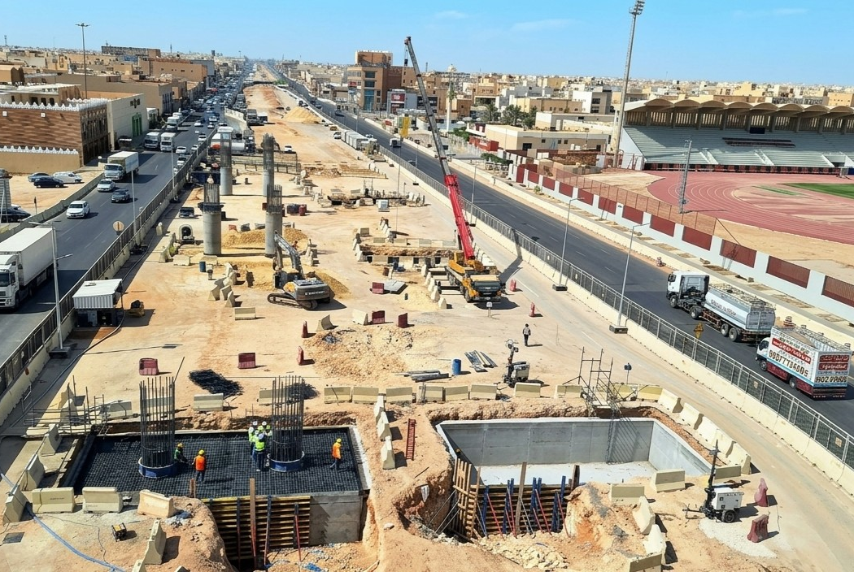
Taif Road Development — Daily Dashboard
Prepared for the Royal Commission for Riyadh City
STATUS 17 Oct 2026
Junction-03 (10+500) · TAIBA STREET · Work Follow-Up Status
20.90%
10.19%
8
PLANNED
ACTUAL
PIERS / ABUTMENTS
LEFT LANE — P1 to P8 + A1/A2
-
-
P1–P6 + A1–A2
WORK SEQUENCE —LEFT LANE
S1
S2
S3
S4
S5
S6
S7
Progress Picture :
A1
P1
P2
P3
P4
P5
P6
A2
S1
S2
S3
S4
S5
S6
S7
WORKS ABOVE LIVE TRAFFIC
Traffic flow is maintained safely during construction, with temporary barriers and traffic management measures in place to ensure safe movement of road users.
A1
P1
P2
P3
P4
P5
P6
A2
Traffic management maintained throughout.
WORK SEQUENCE — RIGHT LANE
Legends
Legends
Concrete Completed
Rebar In Progress
Formwork In Progress
Excavation
Not Started

Slide 5
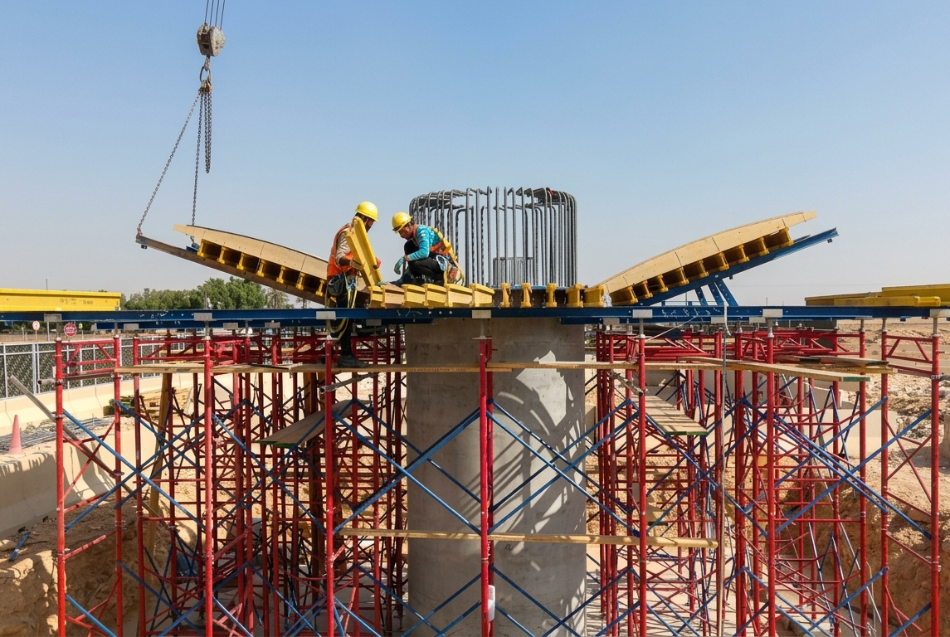
Taif Road Development — Daily Dashboard
Prepared for the Royal Commission for Riyadh City
STATUS 17 Oct 2026
Junction-01 (15+400) · JEDDAH JUNCTON · Work Follow-Up Status
16.10%
4.42%
10
PLANNED
ACTUAL
PIERS / ABUTMENTS
LEFT LANE — P1 to P8 + A1/A2
-
-
P1–P8 + A1–A2
WORK SEQUENCE
S1
S2
S3
S4
S5
S6
S7
S8
S9
Progress Picture :
P1
P2
P3
P4
P5
P6
P7
P8
WORKS ABOVE LIVE TRAFFIC
Traffic flow is maintained safely during construction, with temporary barriers and traffic management measures in place to ensure safe movement of road users.
Legends
Legends
Traffic management maintained throughout.
Concrete Completed
Rebar In Progress
Formwork In Progress
Excavation
Not Started

