Slide 1
NON-FUNCTIONAL REQUIREMENTS
21 measurable requirements (NF-01 to NF-21), each with its own acceptance test.
20 s
R/O
6
80 %
Performance
Security
Flexibility
Testability
NF-01 – NF-02
NF-03 – NF-06
NF-07 – NF-12
NF-13 – NF-21
Node state change on the map in ≤ 20 s
95 % of history queries ≤ 2 s with 50 concurrent users
Colbits telemetry and alarm tables are read-only
Salted bcrypt / Argon2 hashes
Lock 15 min after 5 failed logins
Token expires after 15 idle minutes
Configurable with no code change:
inactivity and low-energy thresholds
5-min grouping window, min. duration
severity criterion, SMAC tolerance
API + UI suites on generated data
Explicit scope-leak test
CI on every PR to main
≥ 80 % API coverage, clean-env setup
Notes:
[~60 s] Thank you, Javier. I'll take the second half: non-functional requirements, backlog, mockups, and then the architecture.
Besides what the system does, we have twenty-one non-functional requirements. Each one has a measurable acceptance test. They fall into four groups.
Performance: a state change in the database must reach the map within twenty seconds, and with fifty concurrent users, ninety-five percent of history queries must answer in under two seconds.
Security: Colbits' telemetry and alarm tables are read-only for us. We prove it with a test that tries to write and expects a permission error. Passwords are stored as Argon2 or bcrypt hashes, five failed logins lock the account for fifteen minutes, and fifteen idle minutes end the session.
Flexibility: every business threshold, like the inactivity times or the five-minute grouping window, lives in configuration, so changing it needs no code.
Testability: API and interface suites that run on generated data, including an explicit test that no user can see data outside their scope. They run in CI on every pull request, with at least eighty percent coverage.

Slide 2
INITIAL PRODUCT BACKLOG
29 user stories, all To Do — coding starts in Sprint 3.
29
user stories, each traced to F- / NF- requirements
131
estimated effort points
5
sprints planned (Sprint 3 to 7)
Priority 5
US1–US12 Generator, login, scope, map, inactivity, fuse and transformer colors · Sprints 3–4
Priority 4
US13–US26 Filters, faults and alarms, user management, history, indicators, export · Sprints 5–7
Priority 3–2
US27–US29 Alarm → map, momentary openings, Spanish chat (optional) · Sprint 7
Notes:
[~45 s] This is the initial state of the product backlog: twenty-nine user stories, each traced to its requirements, and all still To Do because coding starts in Sprint 3.
We ordered them by priority and spread them over Sprints 3 to 7.
Priority 5 is the foundation: the data generator, login, scope, the map and the node colors, in Sprints 3 and 4.
Priority 4 adds filters, faults and alarms, user management, history and export.
At the bottom are the extras, including the Spanish chat, which is optional and the first thing we would drop.
The chart shows the estimated effort per sprint, around twenty-five to thirty points each, with Sprint 5 a bit lighter.
Our Sprint 3 goal is concrete: a user logs in and sees the nodes in their scope on the map, colored by fuse state, using generated data.

Slide 3
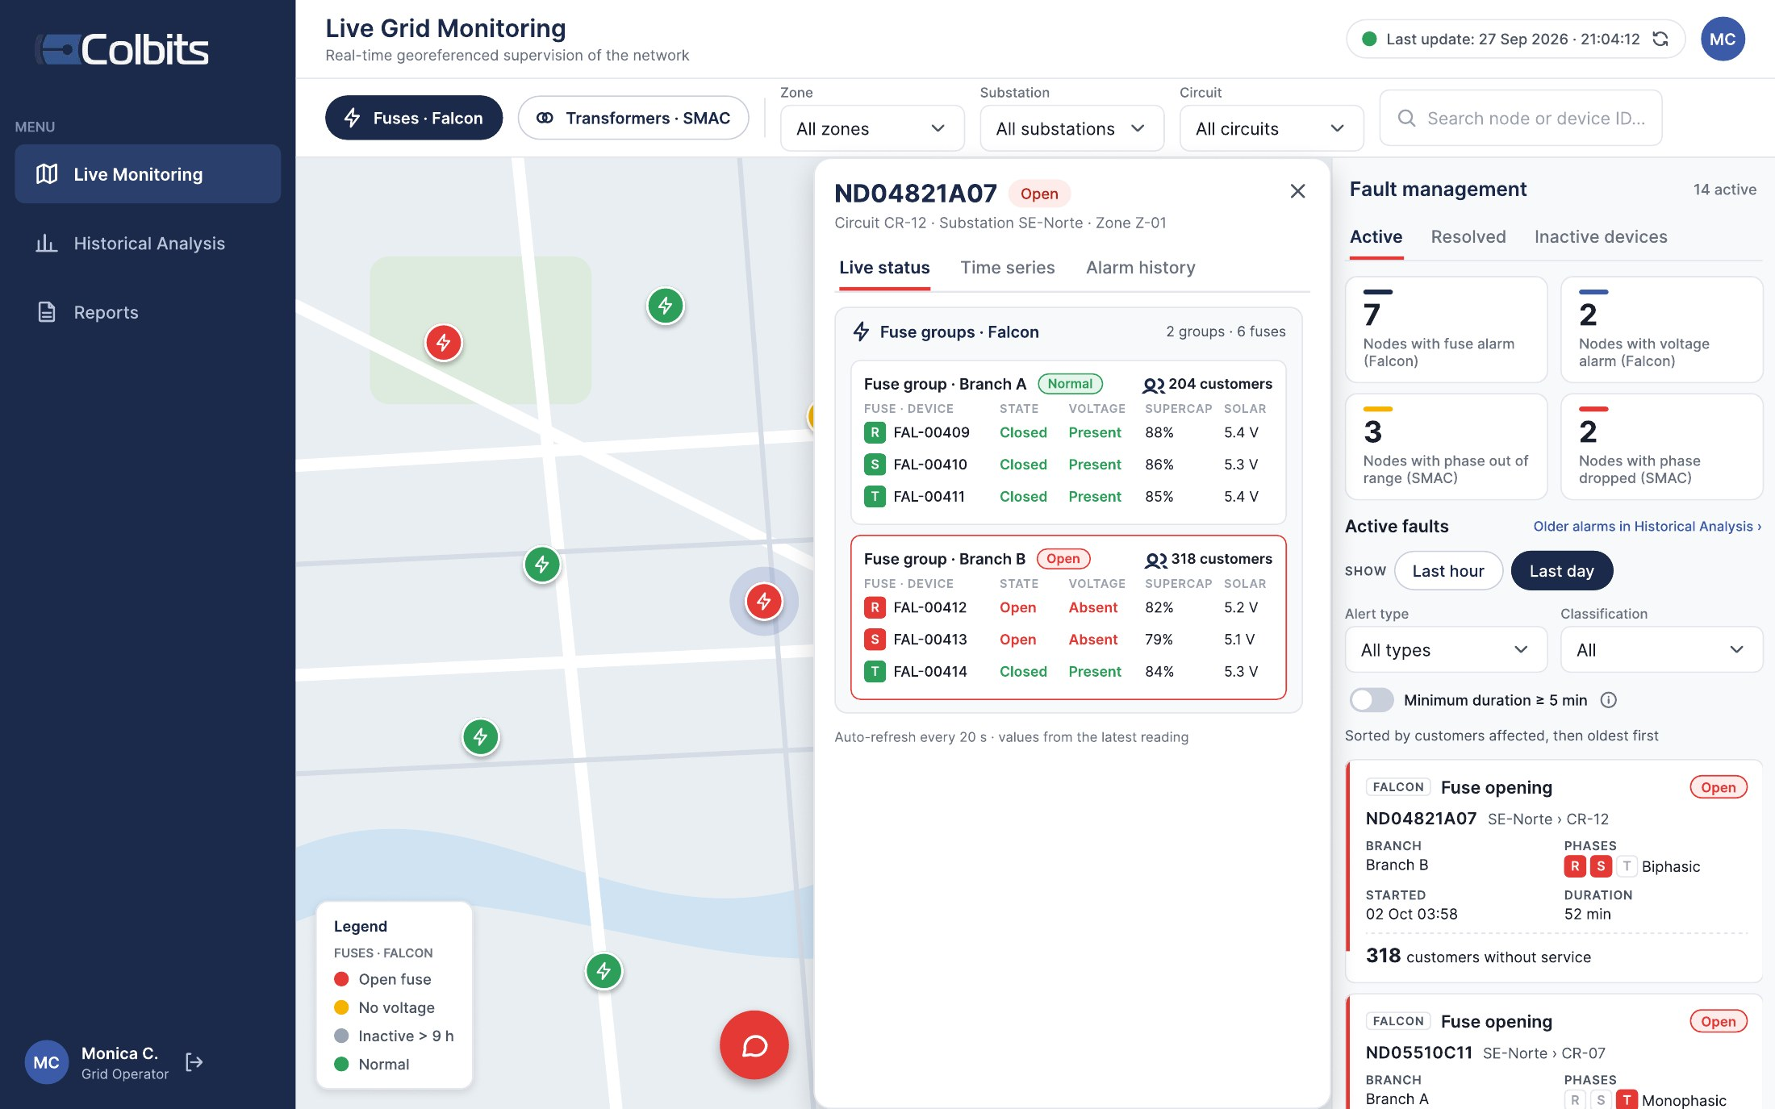
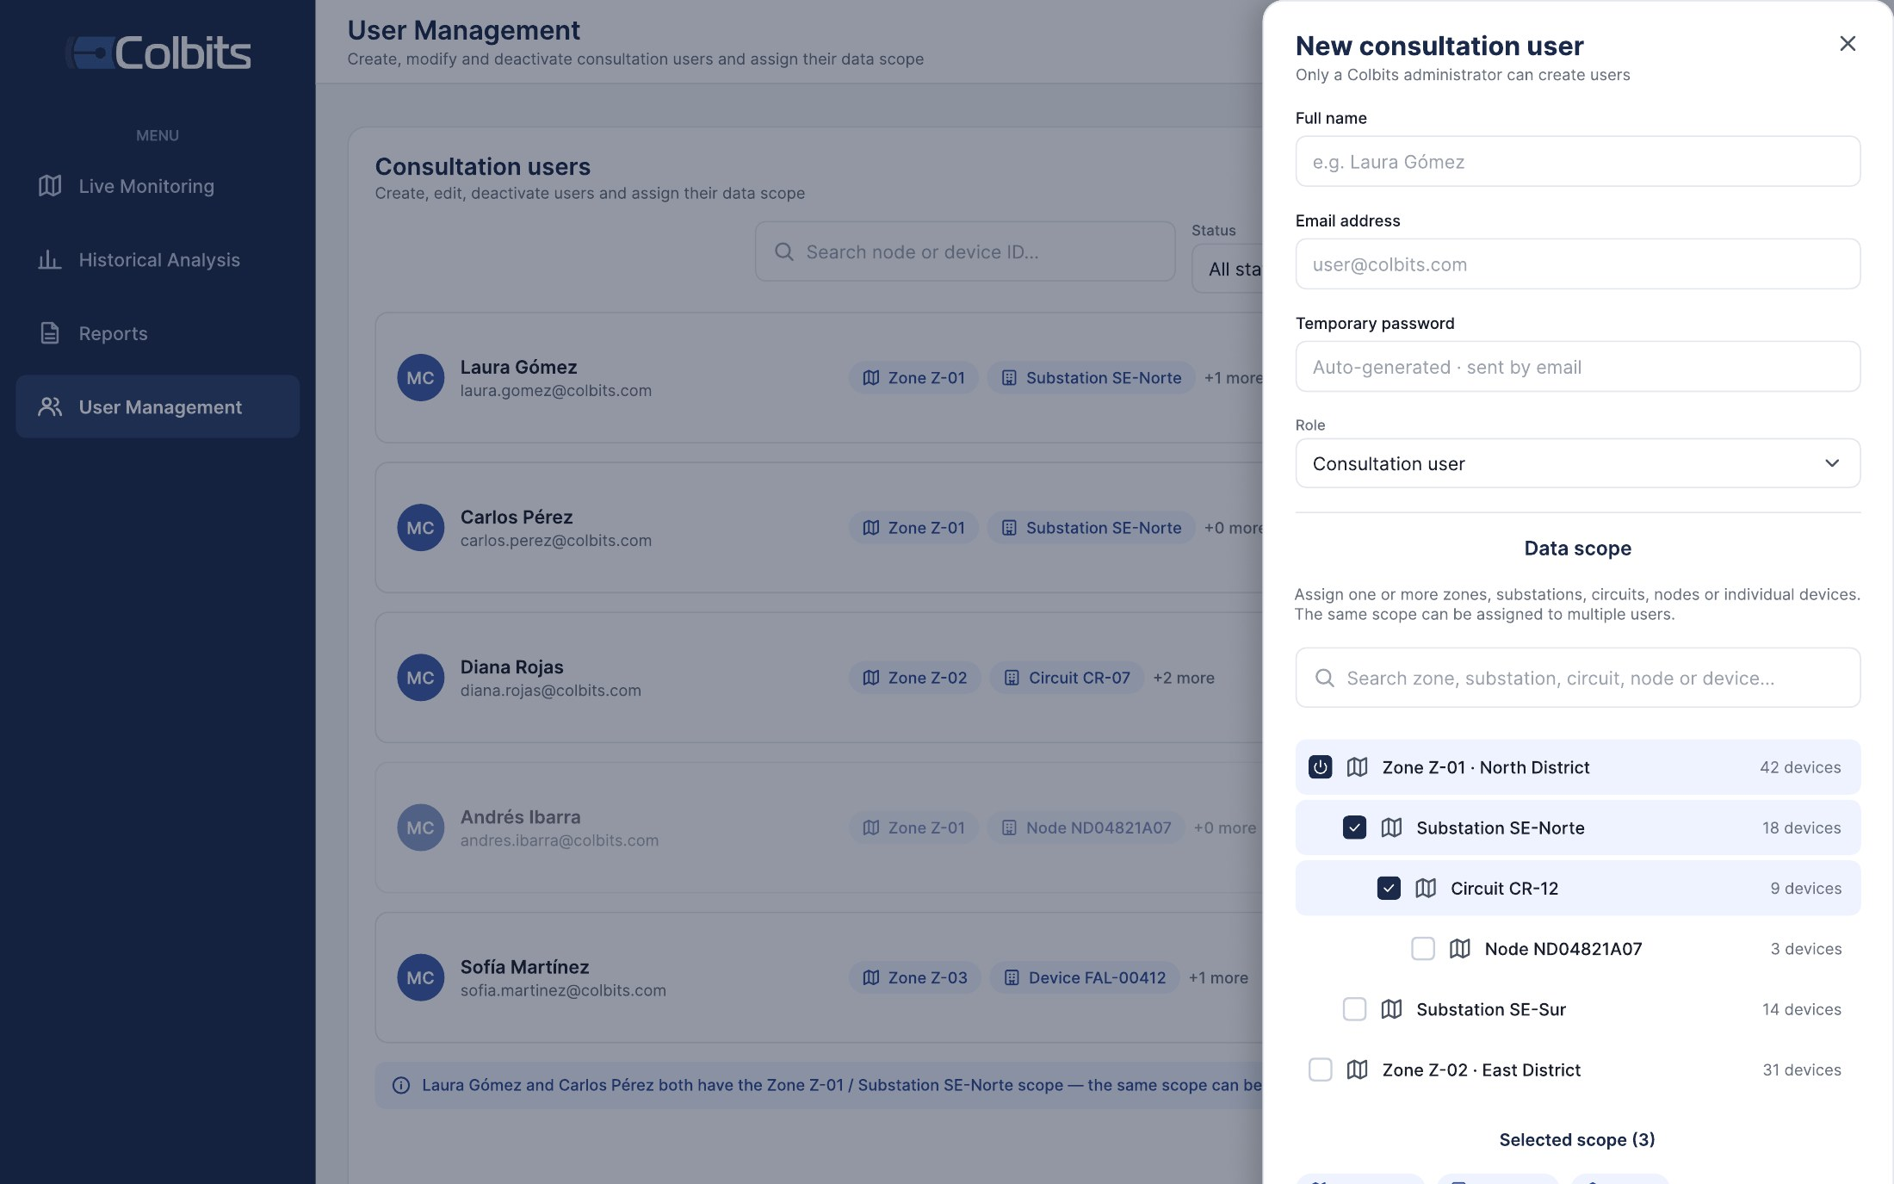
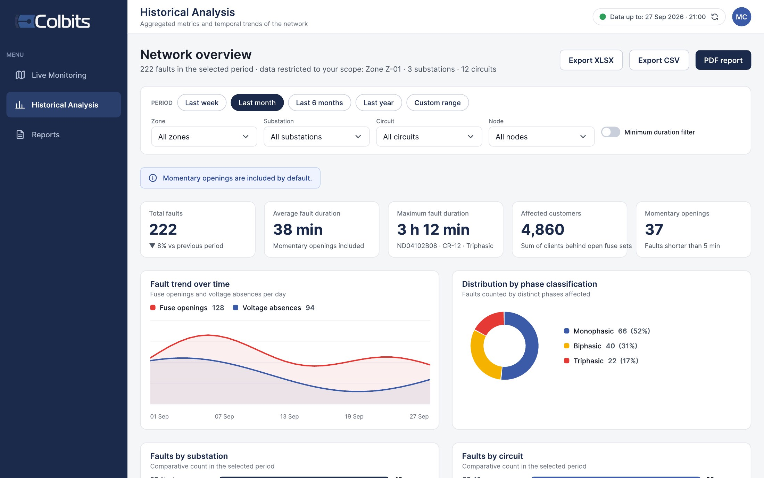
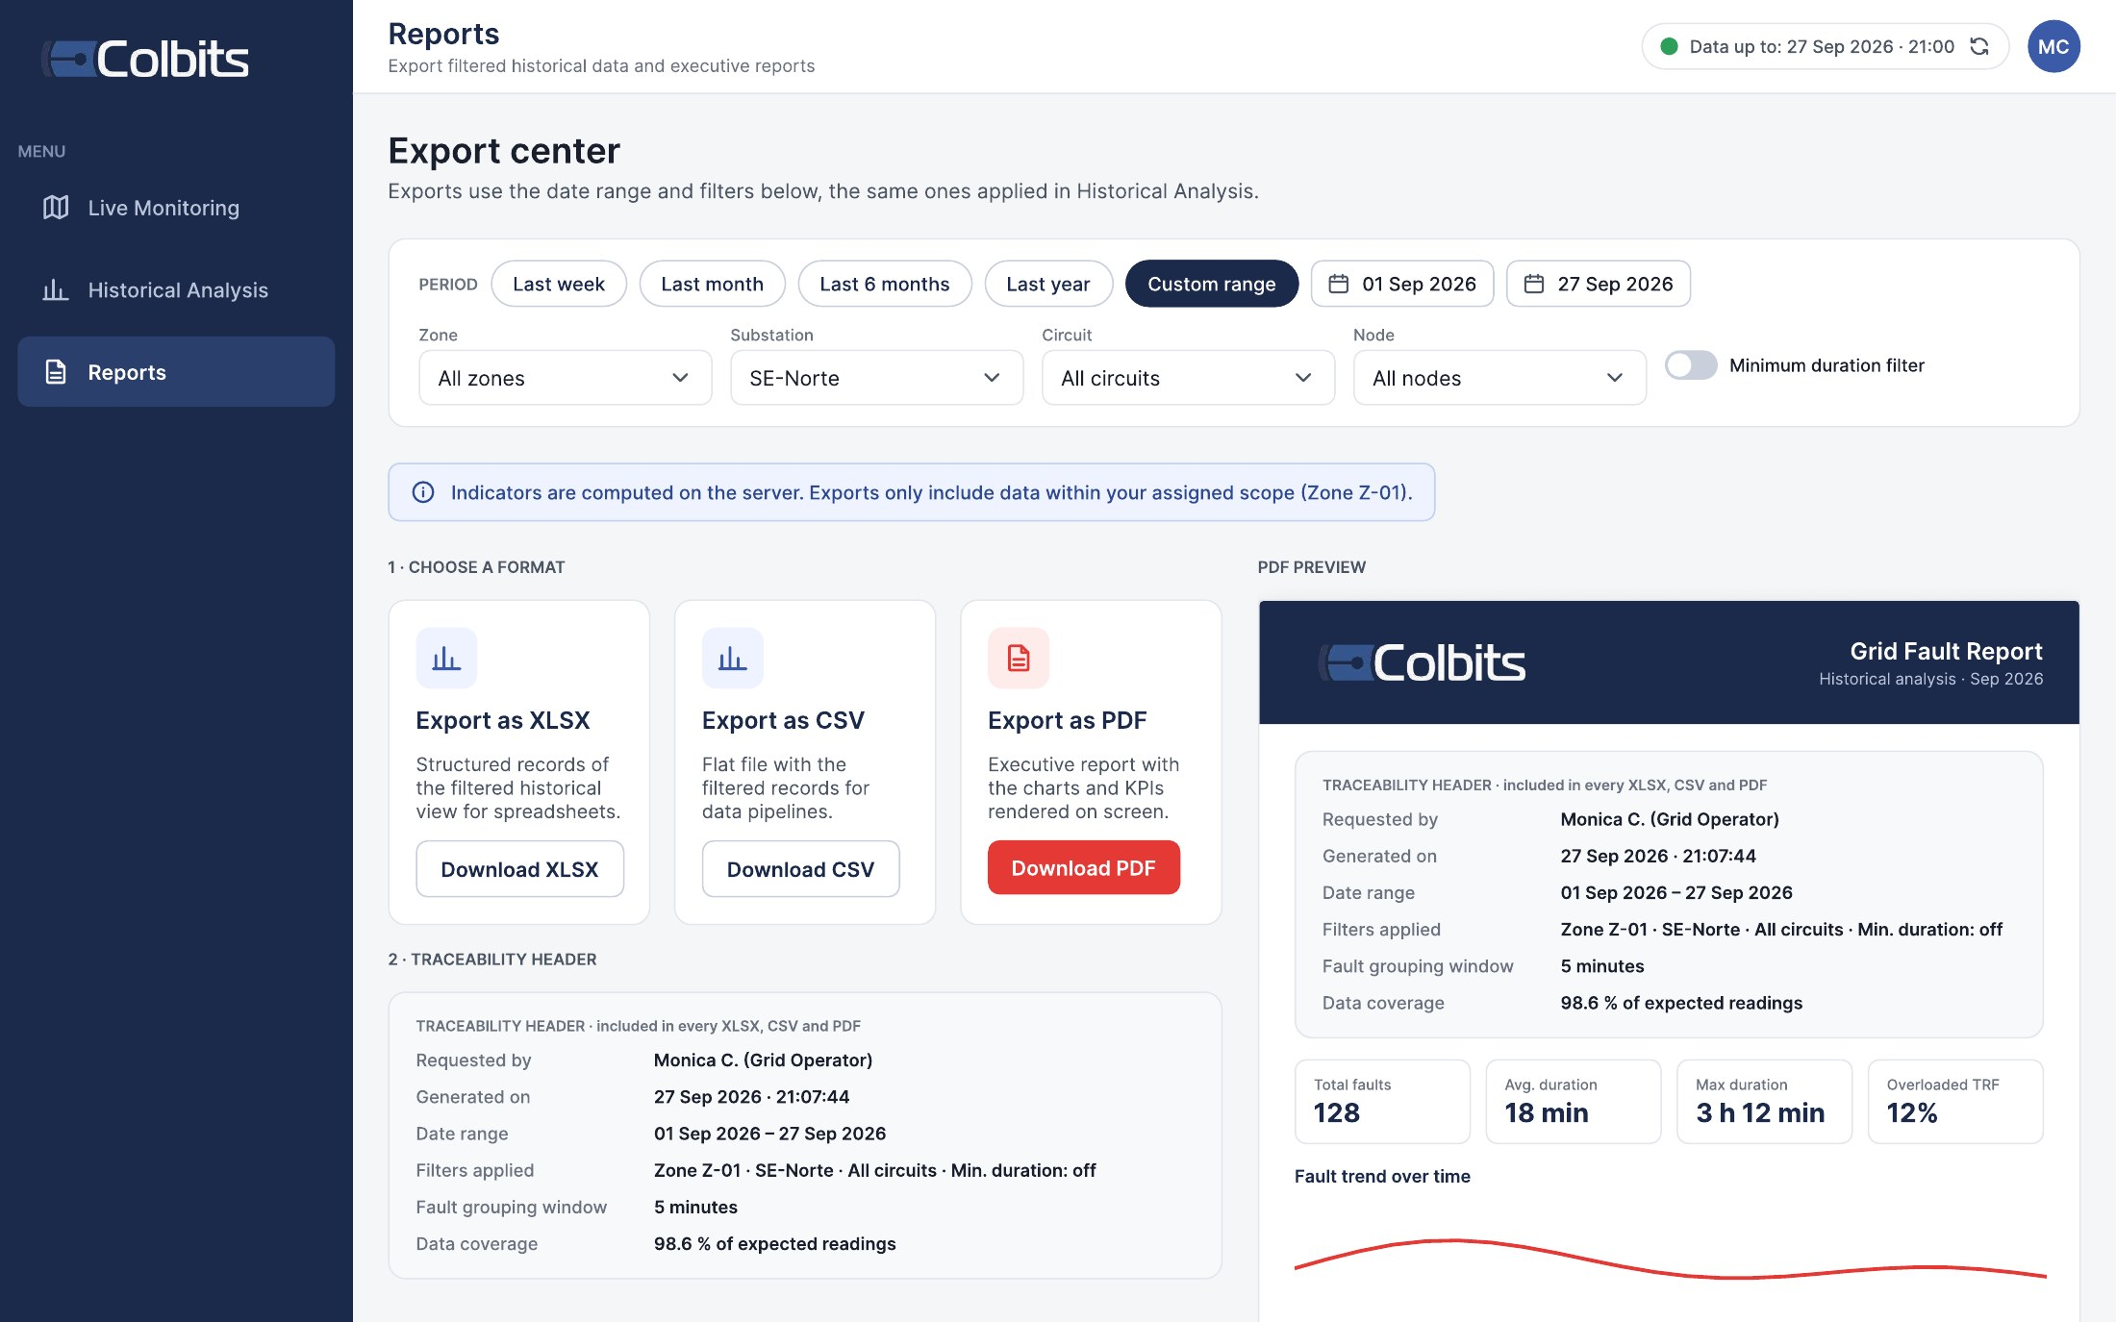
INITIAL MOCKUPS (FIGMA)
COLBITS Mockups v3 · built from Colbits' reference screens and reviewed with the client.
User management
The admin creates consultation users and assigns their data scope
Historical analysis
Date presets, filters, KPIs, trends and rankings
Export center
XLSX · CSV · PDF with the traceability header
Live grid monitoring fuse / transformer layers · node detail · faults by severity
Notes:
[~45 s] These are our mockups in Figma, version 3. We based them on Colbits' own reference screens and already reviewed them with the client. Their feedback is tracked as tasks in Jira.
The main screen is live grid monitoring: the map with the fuse and transformer layers, each node colored by state; the node detail with its fuse groups; and on the right, the active faults, ordered by the number of affected customers.
On the right side: user management, where the administrator creates consultation users and assigns their scope; historical analysis, with date presets, filters, KPIs and charts; and the export center, which shows the traceability header that goes into every XLSX, CSV and PDF file.
The optional assistant opens as a chat panel over these screens.

Slide 4
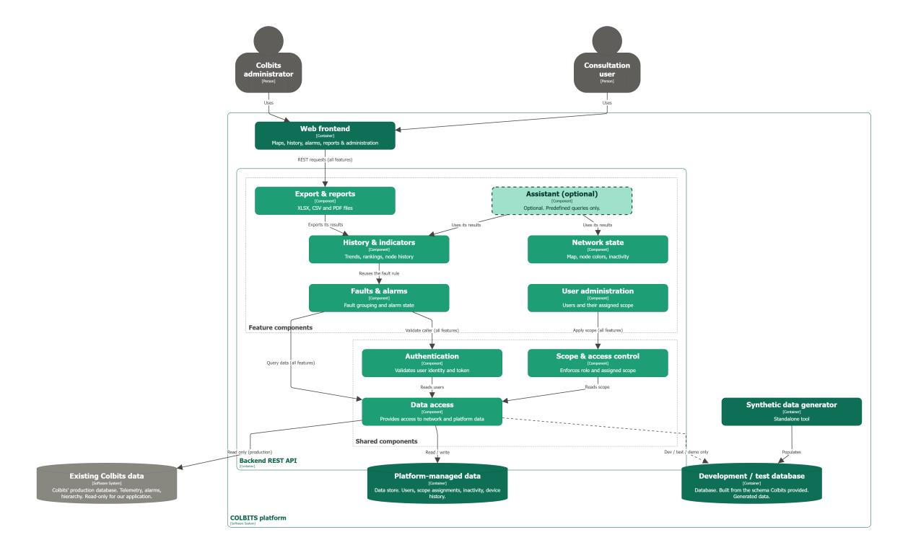
SYSTEM DECOMPOSITION
Legend
Colbits already has it
We build it
Optional (dashed)
Key points
Both roles use only the web frontend
6 feature components + 3 shared ones
Colbits data: read only
Our data: users, scope, faults, device history
Generator fills a separate dev / test DB
Notes:
[~60 s] Now the architecture. This is the inside of our backend.
A user, either the administrator or a consultation user, works only in the web frontend, and every action becomes a REST request to one of these six features: export, history, faults and alarms, network state, user administration, and the optional assistant.
Each feature relies on three shared parts: one checks who is calling, one limits what that user may see, and one reaches the data.
Features also reuse each other. History uses the same fault rule as the live alarms, so the numbers are identical on every screen.
The data comes from two places: Colbits' existing database, which we only read, shown in gray, and our own data, like users, their scope and device history.
For development and demos, our generator fills a separate database with the same structure, so we never touch Colbits' data.

Slide 5
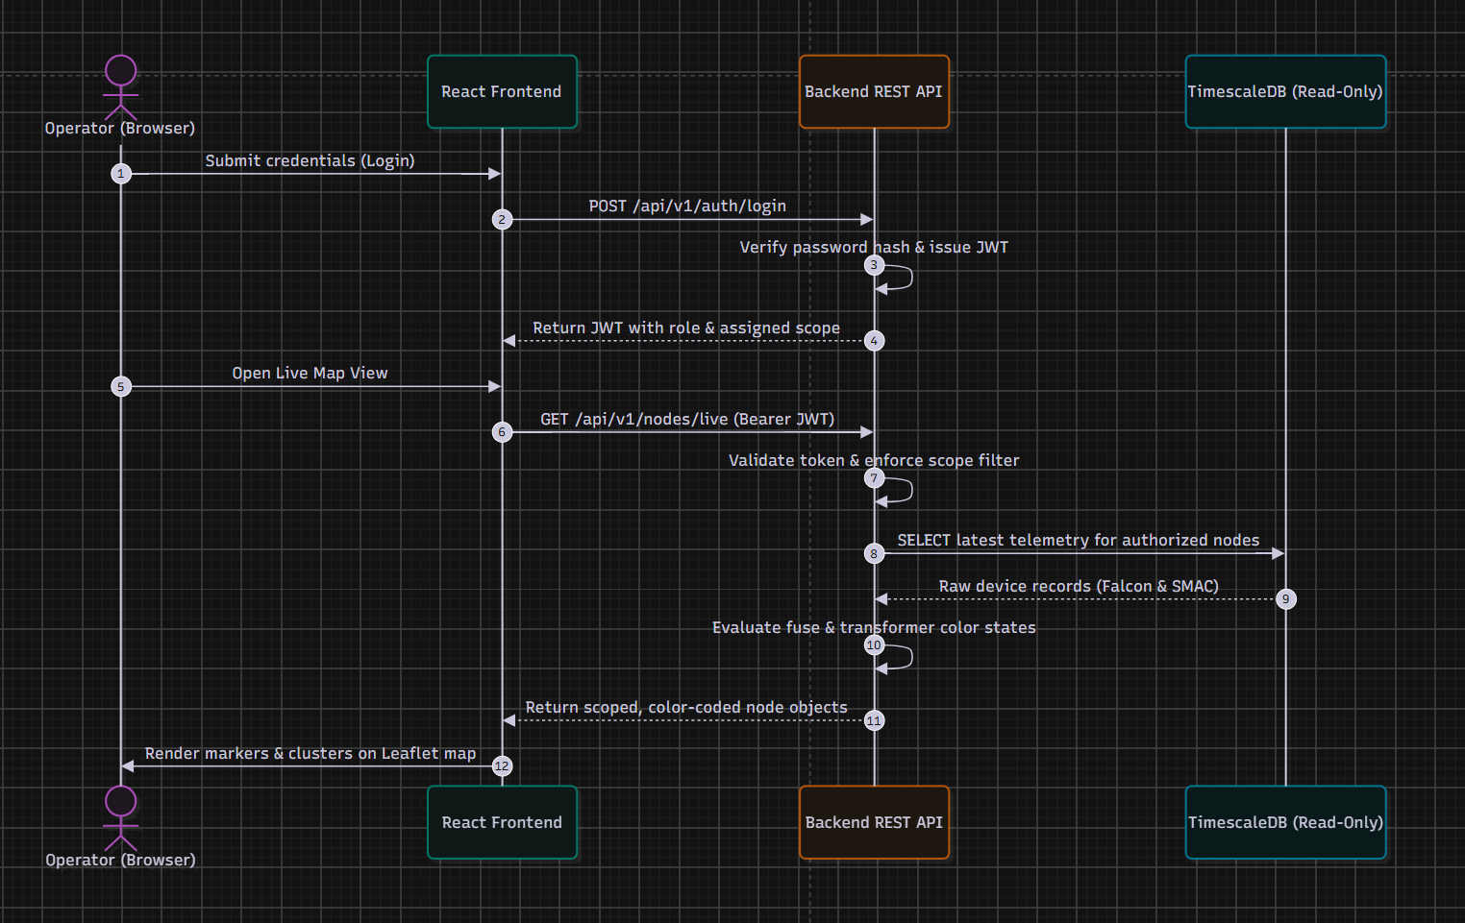
SEQUENCE 1 · SECURE LIVE MAP
1
Login
password hash checked; JWT with role and scope
2
Scoped request
every call carries the token
3
Scope filter
applied on the server, before any query
4
Read-only query
latest Falcon & SMAC telemetry
5
Node colors
computed in the API, drawn on the map
Notes:
[~35 s] The first sequence is the core flow: secure live monitoring.
The operator logs in, and the API checks the password hash and returns a token carrying the role and the scope.
When the map opens, every request carries that token. The API validates it and applies the scope filter on the server before any query runs.
Then it reads the latest Falcon and SMAC telemetry in read-only mode, computes the color of each node for the fuse and transformer layers, and returns only the nodes this user is allowed to see.

Slide 6
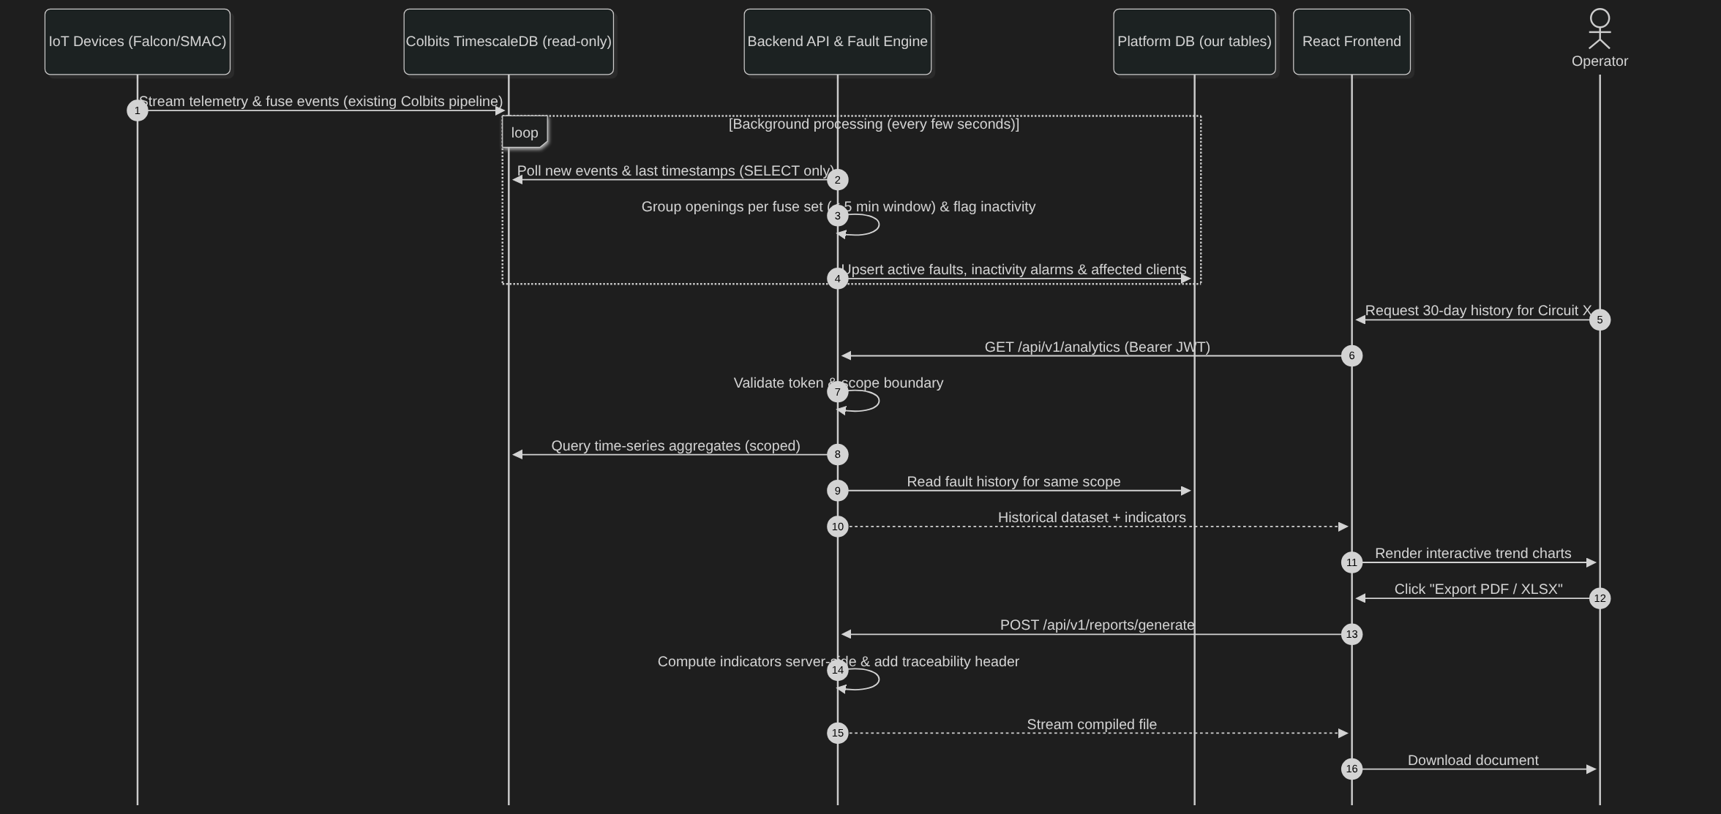
SEQUENCE 2 · FAULTS & REPORTS
Notes:
[~40 s] The second sequence shows how raw telemetry becomes alarms and reports.
In the background, a fault engine polls Colbits' database every few seconds. It groups fuse openings on the same fuse set within the five-minute window into single-, two- or three-phase faults, and flags devices that stopped reporting.
The results are written only to our own tables, never to Colbits' database.
When an operator asks for thirty days of history, the API checks the scope again, combines the time-series data with our fault history, and the frontend draws the charts.
For an export, the server computes the indicators itself and adds a traceability header, so two exports with the same filters always give the same numbers.

Slide 7
KEY ARCHITECTURAL DECISIONS
Decision | Why | Rejected alternative
Modular monolith: one REST API with feature modules | 6 part-time devs, 14 weeks: one deploy, one test suite; modules mirror the diagram | Microservices
Colbits data read-only; our state in a separate schema | Production stays untouched (NF-03); enforced by a SELECT-only DB role | New tables or columns in Colbits' schema
Scope enforced once, on the server, in the data-access layer | No leak through counts or totals (RF-SEG-08); one place to test (NF-14) | Filtering per endpoint or in the frontend
One fault rule, run by a background engine | Same numbers on map, list, history, export and chat; fast queries (NF-02) | Recomputing faults on every request
Live map by short polling (≤ 10 s) | Meets the 20 s target simply; easy "last refresh" warning (RF-MAP-11) | WebSockets / SSE (revisit if needed)
Seeded generator + Docker + CI from day one | Reproducible dev and tests without real data (NF-16, NF-18) | Testing on the shared DB copy
Notes:
[~50 s] These are our most important design decisions.
One: a modular monolith, a single API with feature modules, instead of microservices. With six part-time developers and fourteen weeks, one deployable and one test suite is the realistic choice.
Two: Colbits' data stays read-only, and our state lives in a separate schema, enforced by a database role that can only SELECT.
Three: scope is enforced in one place, the data-access layer on the server, so nothing can leak, not even through a count or a total.
Four: one fault rule, run by a background engine, so every screen shows the same numbers and queries stay fast.
Five: the live map uses short polling instead of WebSockets. It meets the twenty-second target and makes the last-refresh warning easy.
And six: the seeded generator, Docker and CI from day one, so all development and testing works without real data.

Slide 8
OPEN TECHNICAL CONCERNS
!
Performance on a database we cannot change
!
Real-data quirks
No new indexes or aggregates in Colbits' DB → pre-aggregate in our schema; load-test NF-02 early
SMAC readings split over 3 tables (time-tolerance join); legacy repetition fuse IDs the generator does not produce
!
End-to-end 20 s latency
!
Open points with Colbits
Poll interval + engine cycle + DB time must stay under 20 s → measured with the NF-01 test
Amber vs. yellow and the legend states in the mockups; DB copy with anonymised coordinates
Notes:
[~30 s] Some technical concerns remain open.
Performance: we cannot add indexes to Colbits' database, so we will pre-aggregate in our own schema and run the load test early.
Real-data quirks: SMAC readings are split across three tables and must be joined with a time tolerance, and old repetition fuse IDs exist in history that the generator does not produce.
The twenty-second end-to-end latency must be measured, not assumed.
And a few points are still to confirm with Colbits, such as the amber versus yellow color in the mockups.

Slide 9
TECHNOLOGIES BY COMPONENT
Web frontend
Backend REST API
Data, tooling & quality
Web frontend
React + TypeScript (Vite), Atomic Design
Feature components
Python 3.12 + FastAPI + Pydantic
Colbits data · dev / test DB
PostgreSQL + TimescaleDB
Map
Leaflet + react-leaflet + markercluster
Authentication
JWT + Argon2
Platform-managed data
PostgreSQL schema + Alembic
Charts
Recharts
Scope & data access
SQLAlchemy 2 + psycopg, SELECT-only role
Synthetic data generator
Python CLI (Typer + seeded NumPy)
Live refresh
TanStack Query, 10 s polling
Faults & alarms engine
APScheduler background job
Tests & CI
pytest + coverage · Playwright · GitHub Actions
Export & reports
openpyxl · csv · WeasyPrint
Packaging
Docker + Docker Compose
Notes:
[~45 s] Finally, the technologies, mapped to the components you saw in the diagram.
The web frontend is React with TypeScript, organized with Atomic Design. The map uses Leaflet with marker clustering, the charts use Recharts, and the live refresh is a ten-second polling query.
The backend is Python with FastAPI. It generates the API documentation automatically, which is one of our deliverables. Authentication uses JWT and Argon2. Data access uses SQLAlchemy with a read-only database role. The fault engine is a scheduled background job, and exports use openpyxl and WeasyPrint.
On the data side: PostgreSQL with TimescaleDB, the same engine as Colbits, plus our own schema with versioned migrations. The generator is a Python command-line tool with a fixed seed. Tests use pytest and Playwright, run in GitHub Actions, and everything is packaged with Docker.

