Slide 1
NON-FUNCTIONAL REQUIREMENTS
21 measurable requirements (NF-01 to NF-21), each with its own acceptance test.
20 s
R/O
6
80 %
Performance
Security
Flexibility
Testability
NF-01 – NF-02
NF-03 – NF-06
NF-07 – NF-12
NF-13 – NF-21
Node state change on the map in ≤ 20 s
95 % of history queries ≤ 2 s with 50 concurrent users
Colbits telemetry and alarm tables are read-only
Salted bcrypt / Argon2 hashes
Lock 15 min after 5 failed logins
Token expires after 15 idle minutes
Configurable with no code change:
inactivity and low-energy thresholds
5-min grouping window, min. duration
severity criterion, SMAC tolerance
API + UI suites on generated data
Explicit scope-leak test
CI on every PR to main
≥ 80 % API coverage, clean-env setup
Notes:
[~60 s] Thank you, Javier. Now I will present the second half: requirements, backlog, mockups and architecture.
Let's start with the non-functional requirements. They are not about what the system does, but how well it does it. We have twenty-one, in four groups, and each one has a test.
First, speed. When something changes in the field, the map must show it in less than twenty seconds. And with fifty people using the system at the same time, history queries must answer in under two seconds.
Second, security. We can only read Colbits' data, never change it. Passwords are never saved as plain text, only as secure hashes. After five wrong passwords, the account is locked for fifteen minutes, and after fifteen minutes without activity, you must log in again.
Third, flexibility. All the important numbers, like the inactivity time or the five-minute window for faults, are in a configuration file. They can change without touching the code.
And fourth, testing. Automatic tests run every time we change the code, and they must cover at least eighty percent of the backend.

Slide 2
INITIAL PRODUCT BACKLOG
29 user stories, all To Do — coding starts in Sprint 3.
29
user stories, each traced to F- / NF- requirements
131
estimated effort points
5
sprints planned (Sprint 3 to 7)
Priority 5
US1–US12 Generator, login, scope, map, inactivity, fuse and transformer colors · Sprints 3–4
Priority 4
US13–US26 Filters, faults and alarms, user management, history, indicators, export · Sprints 5–7
Priority 3–2
US27–US29 Alarm → map, momentary openings, Spanish chat (optional) · Sprint 7
Notes:
[~45 s] Here is our initial product backlog: twenty-nine user stories, each linked to the requirements. All are still "To Do", because coding starts now, in Sprint 3.
Priority five, in dark blue, is the base of the system: the data generator, login, the map and the colors of each node.
Priority four adds faults, history and export.
The last group has extras, like the chat in Spanish. It is optional, so if we run out of time, it is the first thing we drop.
On the chart you can see the effort is balanced: around twenty-five to thirty points per sprint.
And our goal for this sprint is simple: a user logs in and sees their part of the network on the map, with the right colors.

Slide 3
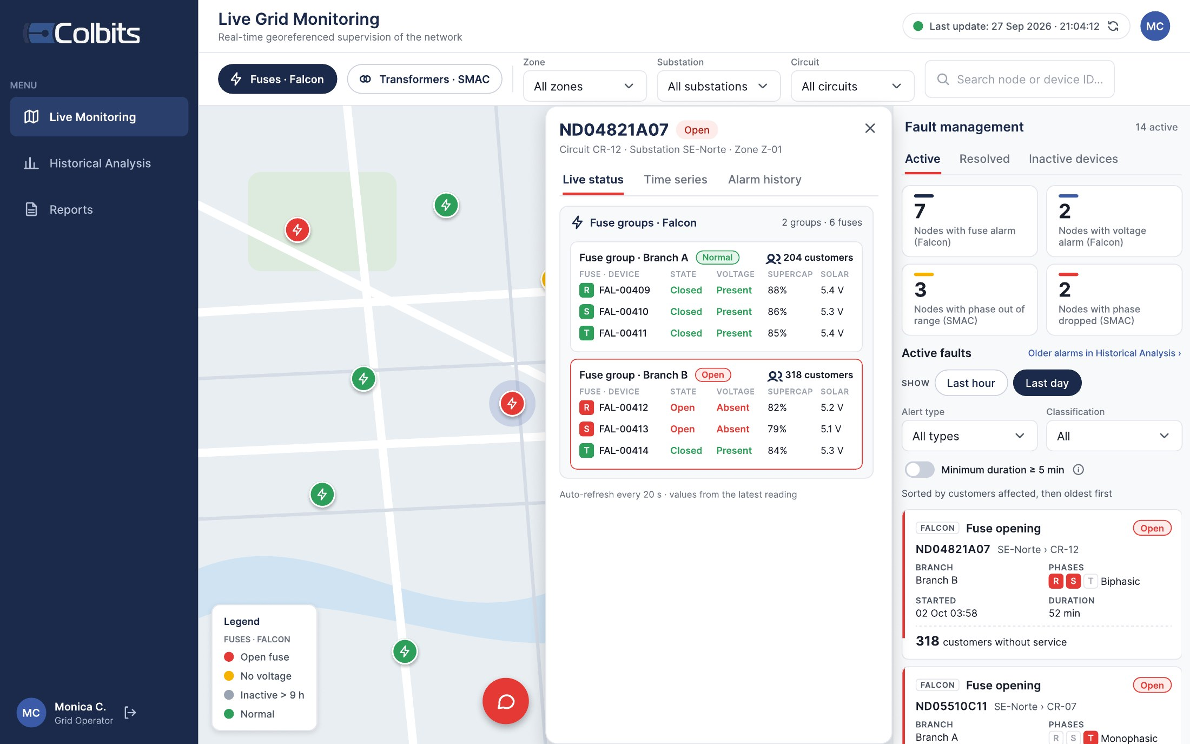
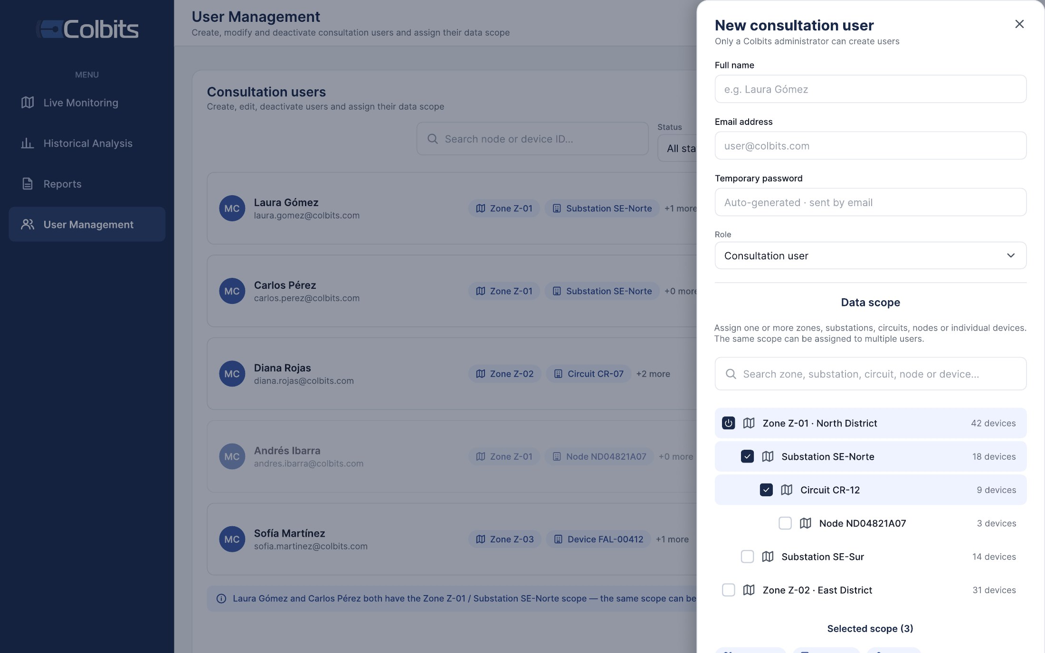
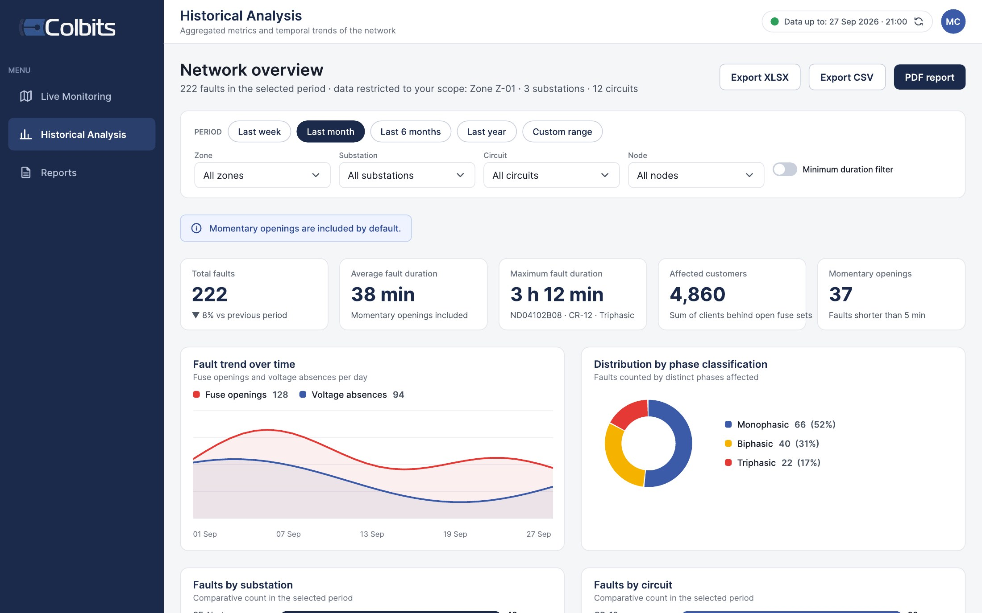
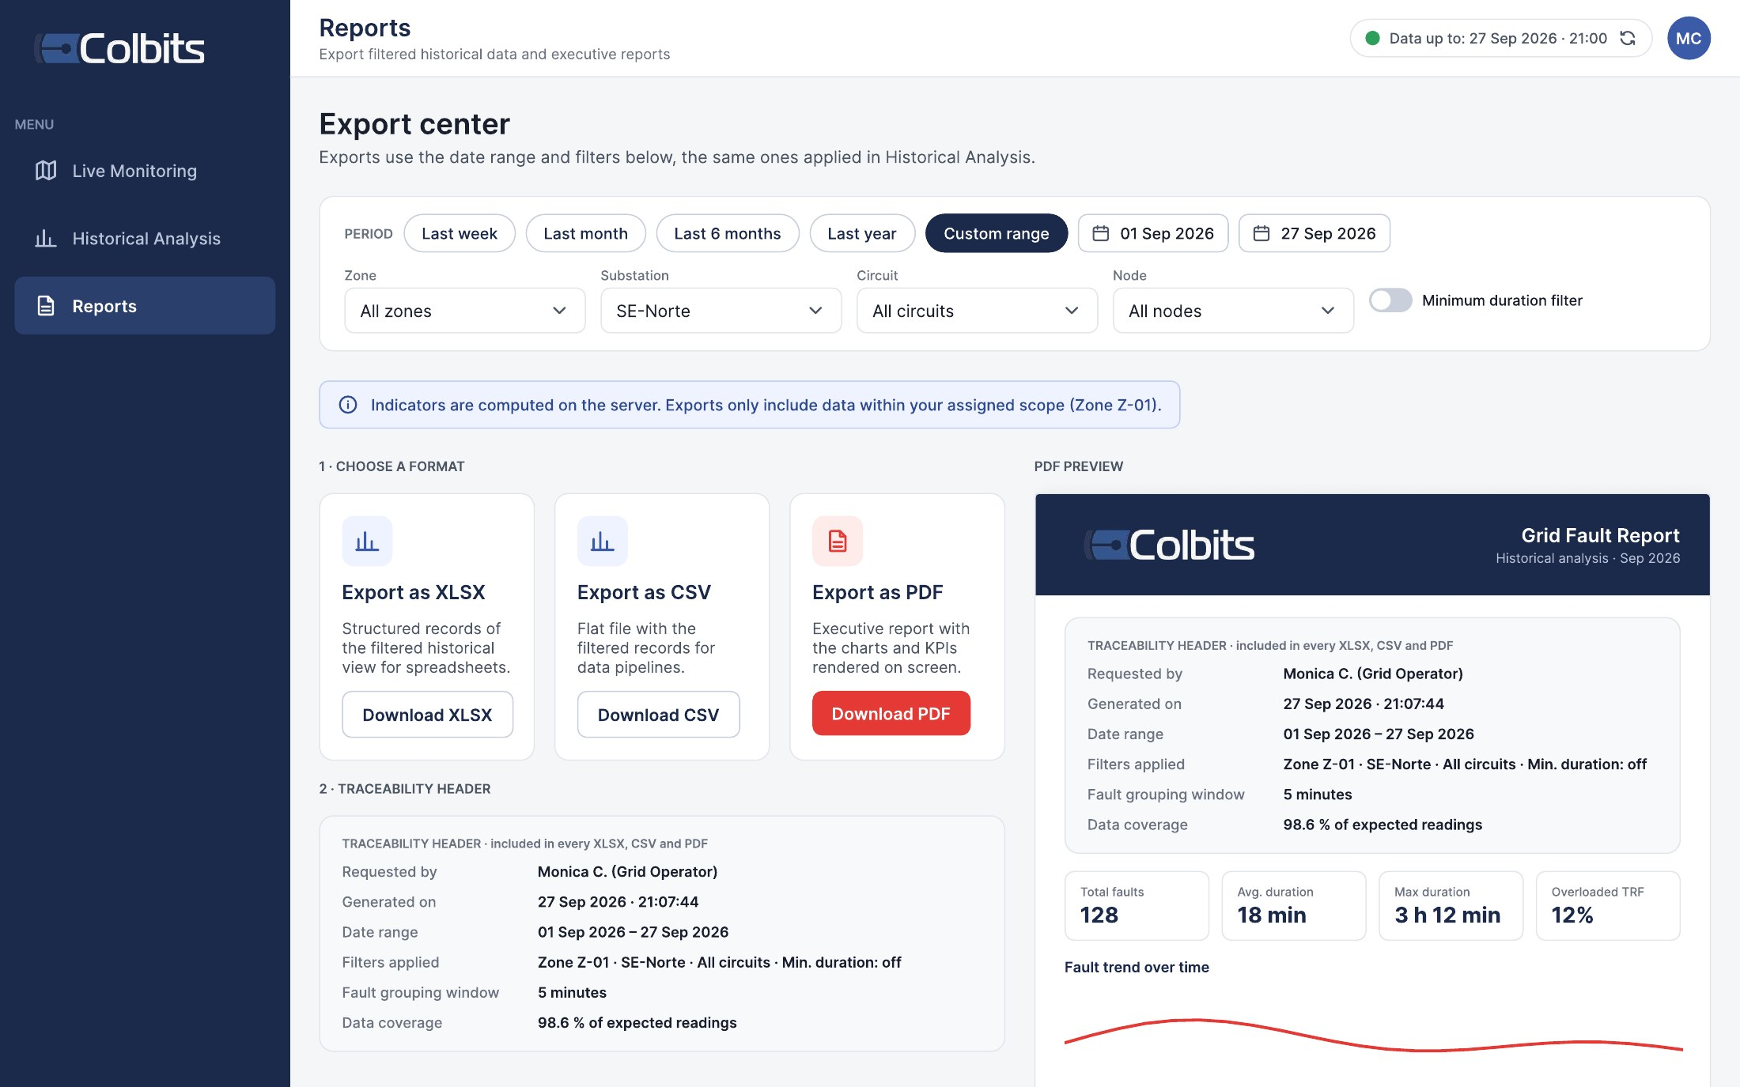
INITIAL MOCKUPS (FIGMA)
COLBITS Mockups v3 · built from Colbits' reference screens and reviewed with the client.
User management
The admin creates consultation users and assigns their data scope
Historical analysis
Date presets, filters, KPIs, trends and rankings
Export center
XLSX · CSV · PDF with the traceability header
Live grid monitoring fuse / transformer layers · node detail · faults by severity
Notes:
[~45 s] These are our mockups, made in Figma. We based them on Colbits' reference screens and already reviewed them with the client.
The big one is the main screen: live monitoring. You see the map with each pole as a colored point. Red means a fuse is open, yellow means no voltage, gray means the device stopped sending data, and green means everything is OK. When you click a node, you see its details. On the right, there is the list of active faults, with the most serious ones first.
On the right, three more screens: user management, where the administrator decides who sees what; historical analysis, with charts and indicators; and the export center, to download reports in Excel, CSV or PDF.

Slide 4
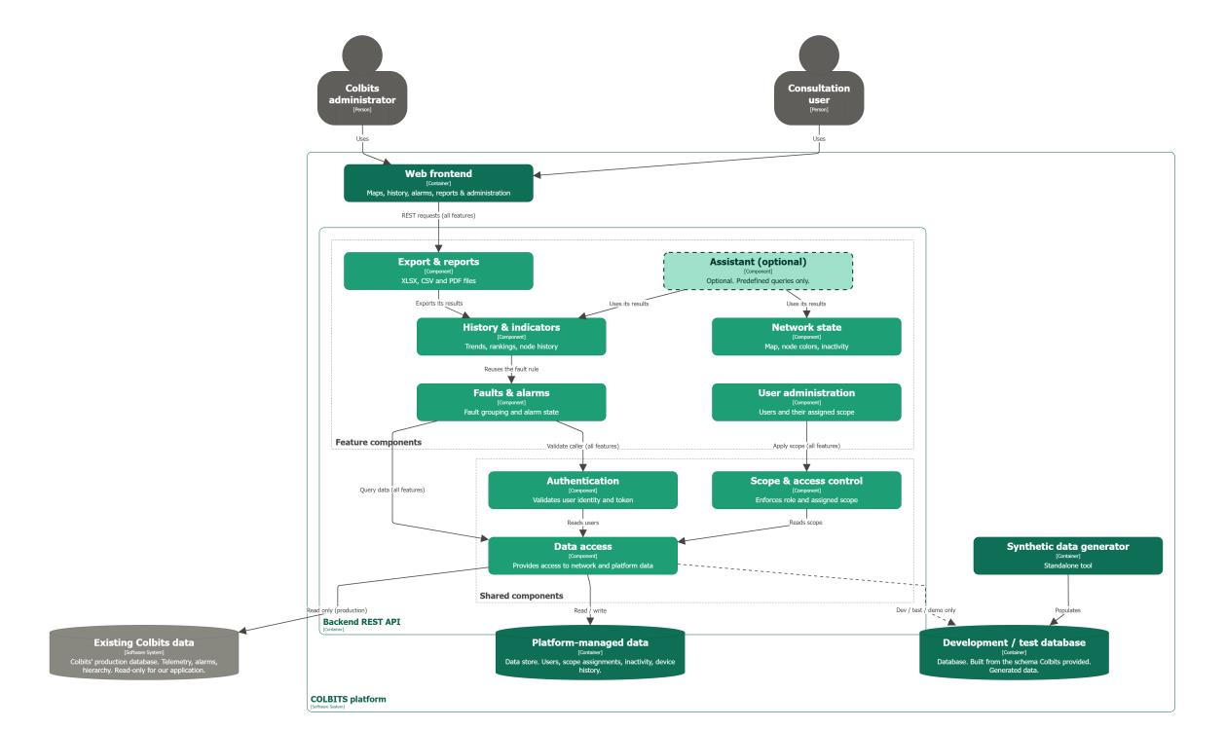
SYSTEM DECOMPOSITION
Legend
Colbits already has it
We build it
Optional (dashed)
Key points
Both roles use only the web frontend
6 feature components + 3 shared ones
Colbits data: read only
Our data: users, scope, faults, device history
Generator fills a separate dev / test DB
Notes:
[~60 s] Now, the architecture. This diagram shows how our system is built inside.
At the top are the two types of users. Both only use the web page, and every click sends a request to our backend. Inside the backend, we have six features: the map state, faults and alarms, history, export, user administration, and the optional assistant.
Below them, there are three shared parts that every feature uses. The first one checks who you are. The second one decides what you are allowed to see. And the third one is the only part that talks to the database.
At the bottom is the data. The gray one is Colbits' database: we only read it, never write to it. The green ones are ours: one for users and faults, and one with fake data for development and testing.
So, in short: Colbits' production data is always safe.

Slide 5
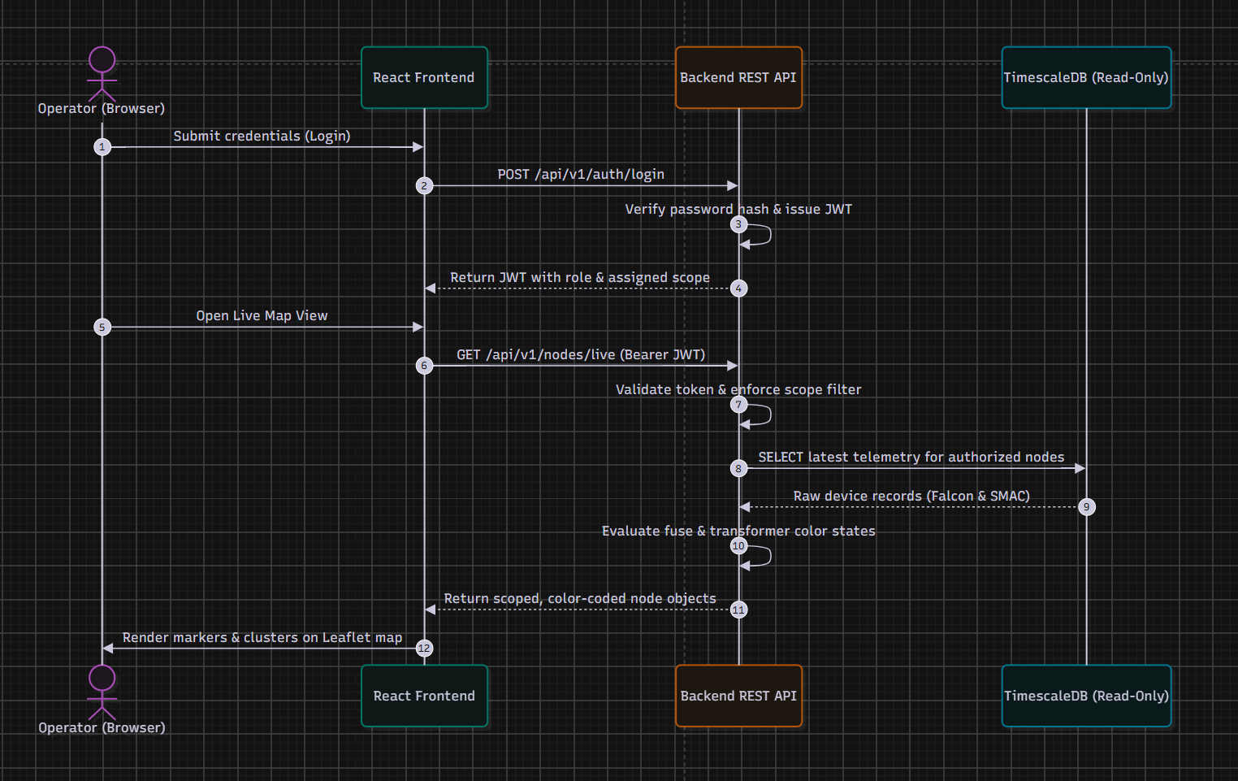
SEQUENCE 1 · SECURE LIVE MAP
1
Login
password hash checked; JWT with role and scope
2
Scoped request
every call carries the token
3
Scope filter
applied on the server, before any query
4
Read-only query
latest Falcon & SMAC telemetry
5
Node colors
computed in the API, drawn on the map
Notes:
[~35 s] This sequence shows the most important flow: opening the live map safely.
Step one: the user logs in, and the backend gives them a token. Think of it as a digital pass that says who they are and what they can see.
Step two: every request from the map carries that pass.
Step three: the backend checks the pass and applies the filter on the server, not in the browser. So a user can never see data from another zone.
Finally, the backend reads the latest data, calculates the color of each node, and sends back only the nodes that this user is allowed to see.

Slide 6
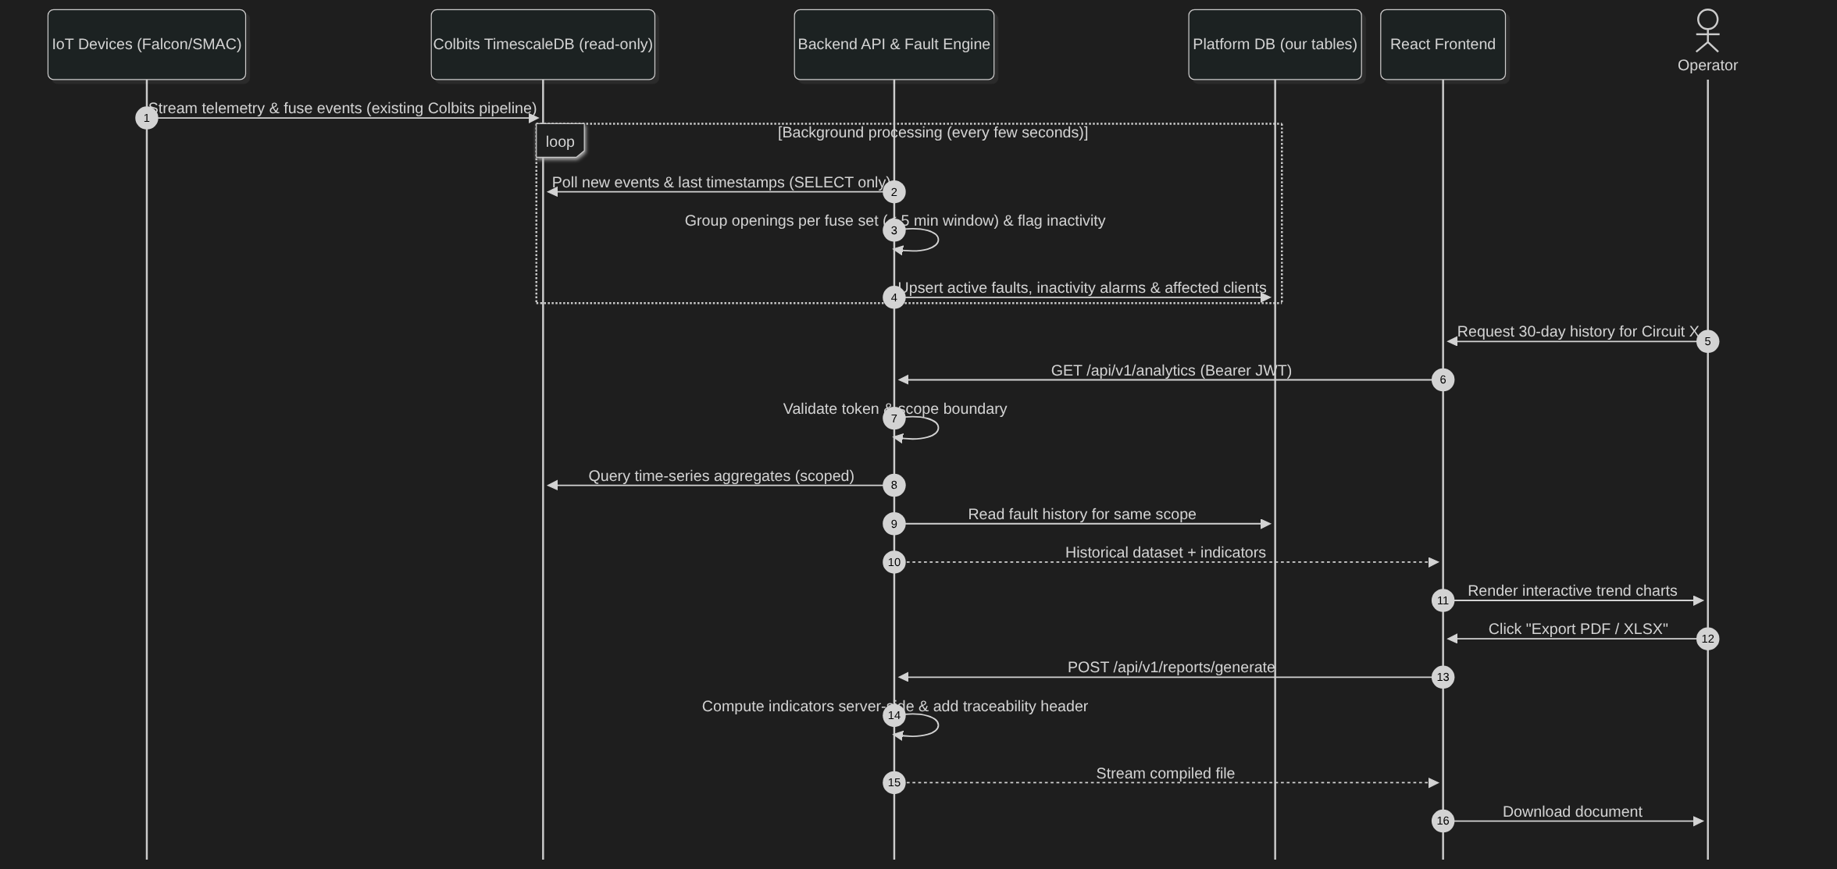
SEQUENCE 2 · FAULTS & REPORTS
Notes:
[~40 s] The second sequence shows how raw data becomes alarms and reports.
In the loop at the top, a background process runs every few seconds. It reads the new events from Colbits' database. Then it groups the fuses that opened within five minutes into one fault, and it decides if it is a single-, two- or three-phase fault. It also detects devices that stopped sending data.
The important detail: it saves the results in our own database, never in Colbits' database.
When a user asks for one month of history, the backend checks their permissions again and sends the data for the charts.
And when they export a report, the server calculates everything. So the same filters always give the same numbers.

Slide 7
KEY ARCHITECTURAL DECISIONS
Decision | Why | Rejected alternative
Modular monolith: one REST API with feature modules | 6 part-time devs, 14 weeks: one deploy, one test suite; modules mirror the diagram | Microservices
Colbits data read-only; our state in a separate schema | Production stays untouched (NF-03); enforced by a SELECT-only DB role | New tables or columns in Colbits' schema
Scope enforced once, on the server, in the data-access layer | No leak through counts or totals (RF-SEG-08); one place to test (NF-14) | Filtering per endpoint or in the frontend
One fault rule, run by a background engine | Same numbers on map, list, history, export and chat; fast queries (NF-02) | Recomputing faults on every request
Live map by short polling (≤ 10 s) | Meets the 20 s target simply; easy "last refresh" warning (RF-MAP-11) | WebSockets / SSE (revisit if needed)
Seeded generator + Docker + CI from day one | Reproducible dev and tests without real data (NF-16, NF-18) | Testing on the shared DB copy
Notes:
[~50 s] These are our six key decisions, and why we made them.
One: we build one single backend, divided into modules, and not microservices. We are six part-time students with fourteen weeks, so we need something simple to build and test.
Two: Colbits' data is read-only. Our own data lives in a separate space. The database itself blocks any writing, so it is not only a promise.
Three: the permission filter lives in one single place, on the server. One place is easier to protect, and easier to test.
Four: faults are calculated once, in the background. That way, every screen shows the same numbers, and the app stays fast.
Five: the map asks for new data every ten seconds. It is simpler than a live connection, and it is fast enough for the twenty-second goal.
And six: we use fake data, Docker and automatic tests from day one, so we never depend on the real database to work.

Slide 8
OPEN TECHNICAL CONCERNS
!
Performance on a database we cannot change
!
Real-data quirks
No new indexes or aggregates in Colbits' DB → pre-aggregate in our schema; load-test NF-02 early
SMAC readings split over 3 tables (time-tolerance join); legacy repetition fuse IDs the generator does not produce
!
End-to-end 20 s latency
!
Open points with Colbits
Poll interval + engine cycle + DB time must stay under 20 s → measured with the NF-01 test
Amber vs. yellow and the legend states in the mockups; DB copy with anonymised coordinates
Notes:
[~30 s] Of course, some risks are still open.
First, performance. We can't optimize Colbits' database, because we can't change it. So we will prepare the heavy calculations in our own database, and we will test the speed early.
Second, the real data has some unusual details. For example, one transformer reading is split across three tables.
Third, we must measure the twenty-second goal, not just assume it.
And finally, we still need to confirm a few small details with Colbits, like the exact colors in the mockups.

Slide 9
TECHNOLOGIES BY COMPONENT
Web frontend
Backend REST API
Data, tooling & quality
Web frontend
React + TypeScript (Vite), Atomic Design
Feature components
Python 3.12 + FastAPI + Pydantic
Colbits data · dev / test DB
PostgreSQL + TimescaleDB
Map
Leaflet + react-leaflet + markercluster
Authentication
JWT + Argon2
Platform-managed data
PostgreSQL schema + Alembic
Charts
Recharts
Scope & data access
SQLAlchemy 2 + psycopg, SELECT-only role
Synthetic data generator
Python CLI (Typer + seeded NumPy)
Live refresh
TanStack Query, 10 s polling
Faults & alarms engine
APScheduler background job
Tests & CI
pytest + coverage · Playwright · GitHub Actions
Export & reports
openpyxl · csv · WeasyPrint
Packaging
Docker + Docker Compose
Notes:
[~45 s] And finally, the technologies, one column per part of the diagram.
For the frontend, we use React with TypeScript. The map uses Leaflet, which is free and groups nearby points when you zoom out. Charts are made with Recharts.
For the backend, we use Python with FastAPI. One big advantage: it creates the API documentation automatically, and that is one of our deliverables. Login uses JWT tokens, and passwords are protected with Argon2. The fault engine is a background job, and reports are created with standard Python libraries.
For data, we use PostgreSQL with TimescaleDB, the same as Colbits. The fake data generator is also in Python. Tests run automatically on GitHub, and everything runs in Docker, so any team member can start the project with one command.
That's all from my side.

