Slide 1

Data Structures
South China University of Technology
School of Computer Science and Engineering
吕建明
Tel:13570397356
Email:jmlv@scut.edu.cn

Slide 2
Reading Material
数据结构与算法分析（C++版） （第二版）
Clifford A.Shaffer.
数据结构(C语言版) ，严蔚敏，吴伟民 ，清华大学出版社；
数据结构（用面向对象方法与c++描述），殷人昆等，清华大学出版社;
算法与数据结构，傅清祥，王晓东，电子工业出版社；

Slide 3

MOOCS
平时分数：
1）观看视频完成度
2）发帖回帖数
3）作业分数
4) OJ 分数
step 1. 注册学堂在线账号，并进入到下面网址学习MOOC
http://www.xuetangx.com/courses/course-v1:SCUT+145055+sp/about
step 2. 通过下面网址，访问在线表格，填入自己的学堂在线用户名https://docs.qq.com/sheet/DTlRUamF4Z05MdVVt?c=G5A0A0

Slide 4
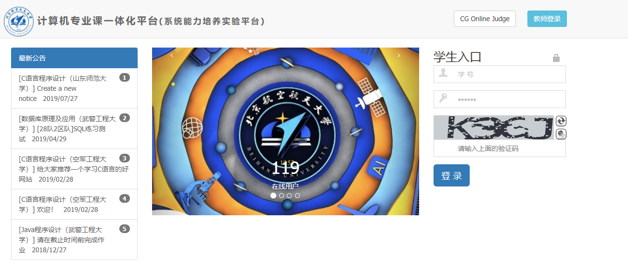
OJ平台
http://course.educg.net
用户名/密码：学号

Slide 5
上课要求
请每节课带好纸 (A4)和笔。
随堂作业 （助教批改或者同学们互相批改）
提前预习MOOC上课本章节的内容，并完成课后练习题目

Slide 6
Preliminaries
Chapter1
Data Structures and Algorithms
Chapter2
Mathematical Preliminaries
Chapter3
Algorithm Analysis

Slide 7
Chapter 1. Data Structures and Algorithms
1. What is Data structure?
2. How to present Data structures?
3. What is algorithm?
4. Data structure vs Algorithm.
5. How to select efficient Data structures and algorithms?

Slide 8
1. What is data structure?
A data structure is a particular way of storing and organizing data in a computer so that it can be used efficiently.
Different kinds of data structures are suited to different kinds of applications.

Slide 9
Some example (1)
Digital Library.
001 | 高等数学 | 樊映川 | 机械工业出版社 | …
002 | 理论力学 | 罗远祥 | 电子工业出版社 | …
003 | 高等数学 | 华罗庚 | 高等教育出版社 | …
004 | 线性代数 | 栾汝书 | 高等教育出版社 | …
… | … | … | … | …
Data structure:
List

Slide 10
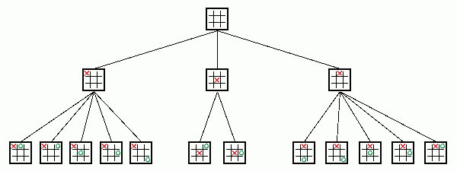
Some example (2)
Game: Gobang(五子棋), Chess, TicTacToe（井字棋）
Data structure:
Tree

Slide 11

Some example (3)
Social network
Data structure:
Graph

Slide 12
Chapter 1. Data Structures and Algorithms
1. What is Data structure?
2. How to present Data structures?
3. What is algorithm?
4. Data structure vs Algorithm.
5. How to select efficient Data structures and algorithms?

Slide 13
2.How to present Data structures?
In different Languages, there are different forms of implementation of the similar data structures.
Abstract Data Type (ADT): is a language independent model to describe data structures.
ADT is defined in terms of a set of values and a set of operations on the data.

Slide 14
Only about input and output.
No detail about implementation .
Example of ADT
template <class Elem>
class List {
public:
virtual void clear() = 0;
virtual bool insert(const Elem&) = 0;
virtual bool append(const Elem&) = 0;
virtual bool remove(Elem&) = 0;
virtual void setStart() = 0;
virtual void setEnd() = 0;
virtual void prev() = 0;
virtual void next() = 0;
}

Slide 15
Implementation of data structures
Implementation of a data structure:
  Decide how to store and organize the data.
  Decide how to implement the operations.
    Each operation can be implemented by one or more subroutines

Slide 16
Example of Data structure
template <class Elem> // Array-based list
class AList : public List<Elem> {
private:
  int maxSize; // Maximum size of list
  int listSize; // Actual elem count
  int fence; // Position of fence
  Elem* listArray; // Array holding list
public:
  … … … …
  void clear() {
  delete [] listArray;
  listSize = fence = 0;
  listArray = new Elem[maxSize];
  }
  void setStart() { fence = 0; }
  … … … …
Implementation
of data storage
Implementation
of operations

Slide 17
Chapter 1. Data Structures and Algorithms
1. What is Data structure?
2. How to present Data structures?
3. What is algorithm?
4. Data structure vs Algorithm.
5. How to select efficient Data structures and algorithms?

Slide 18
3. What is algorithm
Algorithm: a method or a process followed to solve a problem.
e.g. sort a set of integers:
An algorithm takes the input to a problem and transforms it to the output.
23 | 11 | 67 | 54 | 43 | 100 | 33
Sorting algorithm
11 | 23 | 33 | 43 | 54 | 67 | 100

Slide 19
Algorithm Properties
An algorithm possesses the following properties:
  It must be correct.
  It must be composed of a series of concrete steps.
  There can be no ambiguity as to which step will be performed next.
  It must be composed of a finite number of steps.
  It must terminate.

Slide 20
Chapter 1. Data Structures and Algorithms
1. What is Data structure?
2. How to present Data structures?
3. What is algorithm?
4. Data structure vs Algorithm.
5. How to select efficient Data structures and algorithms?

Slide 21
4. Data structure vs Algorithm
Data structures + algorithms = Programs !!
Data structures focus on the how to store and organize the application data
Algorithms focus on how to process the data to solve some problems
Data structures and algorithms have strong correlation.

Slide 22
Chapter 1. Data Structures and Algorithms
1. What is Data structure?
2. How to present Data structures?
3. What is algorithm?
4. Data structure vs Algorithm.
5. How to select efficient Data structures and algorithms?

Slide 23
5. How to select efficient Data structures and algorithms?
An algorithm is said to be efficient if it solves the problem within its resource constraints.
  Space
  Time
The choice of data structure and algorithm can make the difference between a program running in a few seconds or many days.

Slide 24
Selecting a Data Structure
Select a data structure as follows:
Analyze the problem to determine the resource constraints a solution must meet.
Determine the basic operations that must be supported. Quantify the resource constraints for each operation.
Select the data structure that best meets these requirements.

Slide 25
Some Questions to Ask when selecting
Are all data inserted into the data structure at the beginning, or are insertions interspersed with other operations?
Can data be deleted?
Are all data processed in some well-defined order, or is random access allowed?

Slide 26
Preliminaries
Chapter1
Data Structures and Algorithms
Chapter2
Mathematical Preliminaries
Chapter3
Algorithm Analysis

Slide 27
Chapter 2. Mathematical Preliminaries
Set (集合)concepts and notation.
Recursion (递归)
Induction Proofs （归纳证明）
Logarithms （对数公式）
Summations （求和公式）

Slide 28
Preliminaries
Chapter1
Data Structures and Algorithms
Chapter2
Mathematical Preliminaries
Chapter3
Algorithm Analysis

Slide 29
Chapter 3. Algorithm Analysis
Why we need algorithm analysis?
Growth rate Analysis
Asymptotic Algorithm Analysis
  3.1 Big-Oh
  3.2 Big-Omega
  3.3 Theta notation
  3.4 Simplifing rules
Problem analysis

Slide 30
1. Why we need Algorithm Analysis
Two (sometimes conflicting) goals of programming:
  To design an algorithm that is easy to understand, code, debug.
  2. To design an algorithm that makes efficient use of the computer’s resources.
Design pattern, Software engineering
Algorithm analysis
measurement of the algorithm efficiency

Slide 31
Chapter 3. Algorithm Analysis
Why we need algorithm analysis?
Growth rate Analysis
Asymptotic Algorithm Analysis
  3.1 Big-Oh
  3.2 Big-Omega
  3.3 Theta notation
  3.4 Simplifing rules
Problem analysis

Slide 32
2. Growth rate Analysis
Methods to measure the algorithm efficiency:
Empirical 以实验为根据的 comparison (run programs)
Growth rate Analysis
Analyze how the cost (Time, Space) grows when increasing the size of the input.
T(n) : The Running Time as a function on the input size n.
S(n): The used space as a function on the input size n.

Slide 33
Examples 1
// Find largest value
int largest(int array[], int n) {
int currlarge = 0; // Largest value seen
for (int i=1; i<=n; i++) // For each val
if (array[currlarge] < array[i])
currlarge = i; // Remember pos
return currlarge; // Return largest
}
T(n)=c₁n+c₂

Slide 34
Examples 2
sum = 0;
for (i=1; i<=n; i++)
for (j=1; j<=n; j++)
sum++;
}
T(n)= c₁n² + c₂

Slide 35
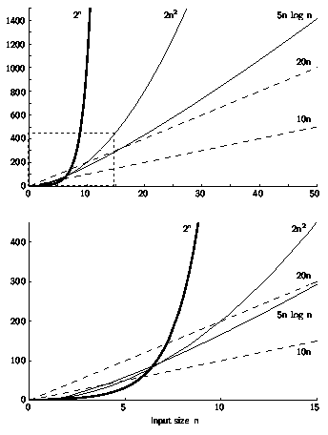
T(n) of different algorithms

Slide 36
Best, Worst, Average Cases
The running time for a algorithm to process different data set with the same size may be different.
Example: Sequential search for K in an array of n integers:
Best case:
Worst case:
Average case:
Find at first position: 1 compare
Find at last position: n compares
(n+1)/2 compares

Slide 37
Chapter 3. Algorithm Analysis
Why we need algorithm analysis?
Growth rate Analysis
Asymptotic Algorithm Analysis
  3.1 Big-Oh
  3.2 Big-Omega
  3.3 Theta notation
  3.4 Simplifing rules
Problem analysis

Slide 38
3. Asymptotic_{渐进} Analysis
T(n) usually has complex expression with multiple parameters.
  Ex: T(n) = c₁n²+ c₂logn + ….
Asymptotic analysis is used to simplify the measurement while capturing the asymptotic trend of T(n) .
  Big-Oh (Upper Bound)
  Big-Omega (Lower Bound)
  Theta

Slide 39
Chapter 3. Algorithm Analysis
Why we need algorithm analysis?
Growth rate Analysis
Asymptotic Algorithm Analysis
  3.1 Big-Oh
  3.2 Big-Omega
  3.3 Theta notation
  3.4 Simplifing rules
Problem analysis

Slide 40
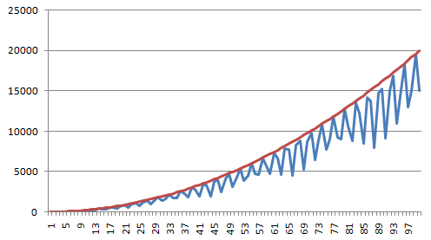
3.1 Big-Oh (1)
Definition: For T(n) a non-negatively valued function, T(n) is in the set O(f(n)) if there exist two positive constants c and n₀ such that T(n) ≤ cf(n) for all n > n₀.
f(n)=2n²
T(n)
n

Slide 41
3.1 Big-Oh (2)
Definition: For T(n) a non-negatively valued function, T(n) is in the set O(f(n)) if there exist two positive constants c and n₀ such that T(n) ≤ cf(n) for all n > n₀.
Note: ‘T(n) = O(f(n))’ in some books also means T(n) is in O(f(n)).
Big-oh notation indicates an upper bound.
Example: The running time of a algorithm is O(n²) in [best, average, worst] case.

Slide 42
Big-Oh (3)
Ex: If T(n) = 3n² then T(n) =O(n²).
Multiple upper bounds exist for a T(n).
  EX: T(n) = 3n² , we also have T(n) = O(n³).
Tightest upper bound is preferred to analyze the algorithm:
  O(n²) is preferred.

Slide 43
Big-Oh Examples (1)
Example 1: The average cost to find the value X in an array.
T(n) = c₀(n+1)/2.
For all values of n > 1, T(n) =c₀(n+1)/2 ≤ c₀n.
Therefore, by the definition, T(n)= O(n) for n₀ = 1 and c = c₀.

Slide 44
Big-Oh Examples (2)
Example 2: T(n) = c₁n² + c₂n in average case.
T(n ) =c₁n² + c₂n ≤ c₁n² + c₂n² ≤ (c₁ + c₂)n² for all n > 1.
Therefore, T(n) = O(n²) by the definition for c = c₁ + c₂ and n₀ = 1.
Example 3: T(n) = c. We say T(n) is
= O(1).

Slide 45
Chapter 3. Algorithm Analysis
Why we need algorithm analysis?
Growth rate Analysis
Asymptotic Algorithm Analysis
  3.1 Big-Oh
  3.2 Big-Omega
  3.3 Theta notation
  3.4 Simplifing rules
Problem analysis

Slide 46
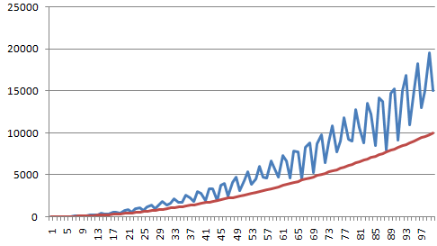
3.2 Big-Omega
Definition: For T(n) a non-negatively valued function, T(n) is in the set Ω(g(n)) if there exist two positive constants c and n₀ such that T(n) ≥ cg(n) for all n > n₀.
T(n)
g(n)=n²

Slide 47
3.2 Big-Omega
Definition: For T(n) a non-negatively valued function, T(n) is in the set Ω(g(n)) if there exist two positive constants c and n₀ such that T(n) ≥ cg(n) for all n > n₀.
Meaning: For all data sets big enough (i.e., n > n₀), the algorithm always executes in more than cg(n) steps.
Big-Omega notation indicates an Lower bound.
Note: ‘T(n) = Ω(f(n))’ in some books also means T(n) is in Ω(f(n)).

Slide 48
Big-Omega Example
Example: T(n) = c₁n² + c₂n.
T(n)= c₁n² + c₂n ≥ c₁n² for all n > 1.
Therefore, T(n) = Ω(n²) by the definition for c = c₁ and n₀ = 1.

Slide 49
Chapter 3. Algorithm Analysis
Why we need algorithm analysis?
Growth rate Analysis
Asymptotic Algorithm Analysis
  3.1 Big-Oh
  3.2 Big-Omega
  3.3 Theta notation
  3.4 Simplifing rules
Problem analysis

Slide 50
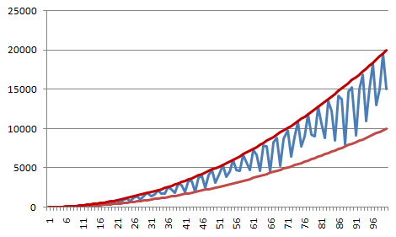
3.3 Theta Notation
Definition: For T(n) a non-negatively valued function,
T(n) = Θ(h(n)) if T(n) = O(h(n)) and T(n) = Ω(h(n)).
f(n)=2n²
T(n)
g(n)=n²
T(n) = O(n²), T(n) = Ω(n²). Thus T(n) = Θ(n²) .

Slide 51
Chapter 3. Algorithm Analysis
Why we need algorithm analysis?
Growth rate Analysis
Asymptotic Algorithm Analysis
  3.1 Big-Oh
  3.2 Big-Omega
  3.3 Theta notation
  3.4 Simplifing rules
Problem analysis

Slide 52
Constant Rule
If f(n) = O(kg(n)) for any constant k > 0, then f(n) = O(g(n)).
eg. 3n³ = O(3n³) = O(n³) .
These rules also hold true for Ω and Θ.

Slide 53
Add Rule
If f₁(n) = O(g₁(n)) and f₂(n) = O(g₂(n)), then f₁ (n) + f₂(n) = O(max(g₁(n), g₂(n))).
e.g. n² + n = O(n²).
e.g. 3n² + 2n + 4 = O(3n²) = O(n²).
These rules also hold true for Ω and Θ.

Slide 54
Examples (1)
sum1 = 0;
for(i=1;i<=n;i++)//first double loop
for(j=1;j<=n;j++)//do n times
sum1++;
T₁(n) = Θ(c₁n² + c₂) = Θ(n²).

Slide 55
Examples (2)
sum = 0;
for (i=1; i<=n; i++) //double loop
for (j=1; j<=i; j++)
sum++;
for (k=0; k<n; k++) //second loop
A[k] = k;
First statement is Θ(1).
First double loop is Θ(n²).
second loop is Θ(n).
Result: Θ(n²).

Slide 56
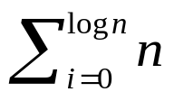
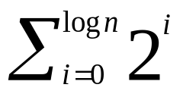
Examples (3)
sum1 = 0;
for (k=1; k<=n; k*=2)
for (j=1; j<=n; j++)
sum1++;
sum2 = 0;
for (k=1; k<=n; k*=2)
for (j=1; j<=k; j++)
sum2++;
First is = Θ(nlog n).
Second is = Θ(n).

Slide 57
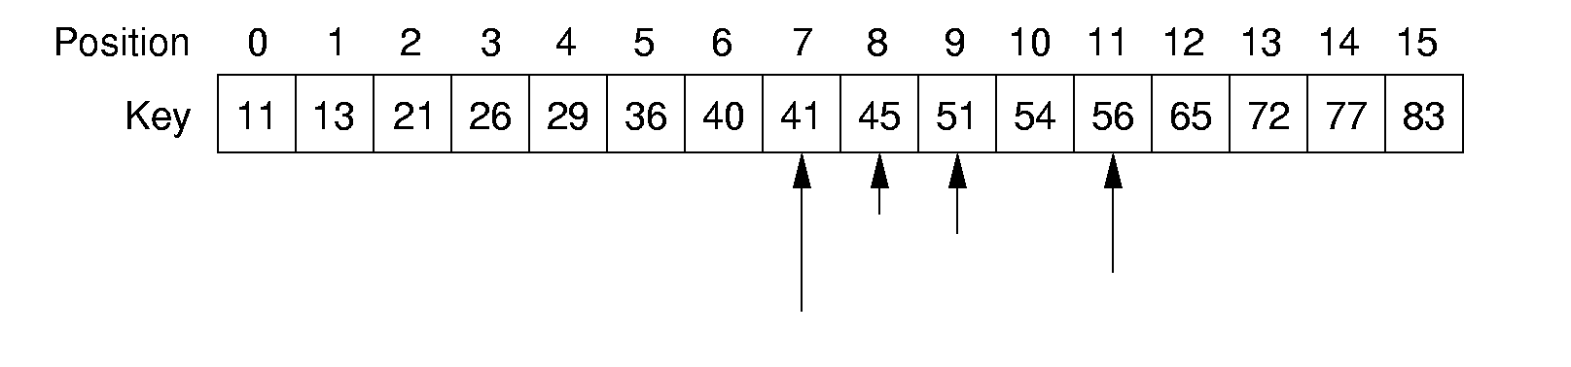
Examples (4) : Search
Search in unsorted array
0 1 2 3 4 5 6 7 8 9 10 11 12 13 14 15
40
83
11
51
13
36
54
26
41
77
45
21
65
56
29
72
search 45
Θ( )
n
Search in sorted array
search 45
O( ? )

Slide 58
Examples (4) : Binary Search (Cont.)
l
r
search 45
// Return position of element in sorted
// array of size n with value K.
int binary(int array[], int n, int K) {
int l = -1;
int r = n; // l, r are beyond array bounds
while (l+1 != r) { // Stop when l, r meet
int i = (l+r)/2; // Check middle
if (K < array[i]) r = i; // Left half
if (K == array[i]) return i; // Found it
if (K > array[i]) l = i; // Right half
}
return n; // Search value not in array
}

Slide 59
Examples (4) : Binary Search(cont.)
Analysis:
Spent time in the worst case?
T(1)= c (c > 0) (1)
T(n)=T(n/2)+c (n>1) (2)
From (1)(2), we have T(n)=c(logn+1) . T(n) is in Θ(logn) .
Comparison:
Sequential search
average case: T(n)= (n+1)/2 cost is Θ(n)
worst case: T(n)=n cost is Θ(n)

Slide 60
Other Rules
If f(n) = O(g(n)) and g(n) = O(h(n)), then f(n) = O(h(n)).
If f₁(n) = O(g₁(n)) and f₂(n) = O(g₂(n)) then f₁(n)f₂(n) = O(g₁(n)g₂(n)).
These rules also holds true for Ω and Θ.

Slide 61
Chapter 3. Algorithm Analysis
Why we need algorithm analysis?
Growth rate Analysis
Asymptotic Algorithm Analysis
  3.1 Big-Oh
  3.2 Big-Omega
  3.3 Theta notation
  3.4 Simplifing rules
Problem analysis

Slide 62
4. Problems Analysis
A problem can be solved in multiple algorithms with different efficiency.
Lower bound of a problem:
  Lower bound for every possible algorithm. Even algorithms that we have not thought of.
Upper bound of a problem:
  Upper bound of best known algorithm.

Slide 63
Example:
Example: Sorting Problem
1. Bubble or insertion sort: O(n²).
2. better sort (Quicksort, Mergesort, Heapsort, etc.): O(n log n).
3. Thus, sorting is O(n log n). (upper bound)
4. We can also prove later that sorting is Ω(n log n). (lower bound)

Slide 64
Goals of this Course
Learn the commonly used data structures.
Understand how to measure the cost of a data structure or program.
Reinforce the concept that costs and benefits exist for every data structure.

Slide 65
Thanks!
Questions?

